Slide 1
Optimization Methods for Maximum Likelihood Estimation of General Power Law Models
Index
Author: Abraham Martínez Cuesta
Advisor: Jordi Baró i Urbea

Slide 2
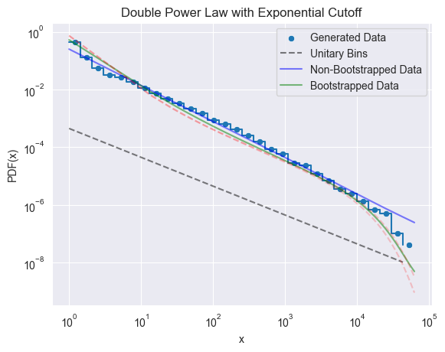
Introduction
Index
Introduction
Models Studied
Likelihood Function
Maximizing the Likelihood Function
Goodness of Fit
Results
Synthetic Data
Real Data
Summary
Conclusions
References

Slide 3
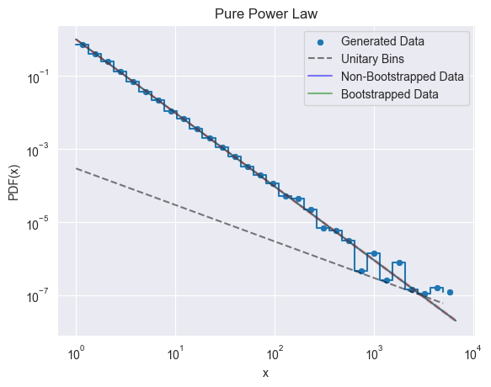
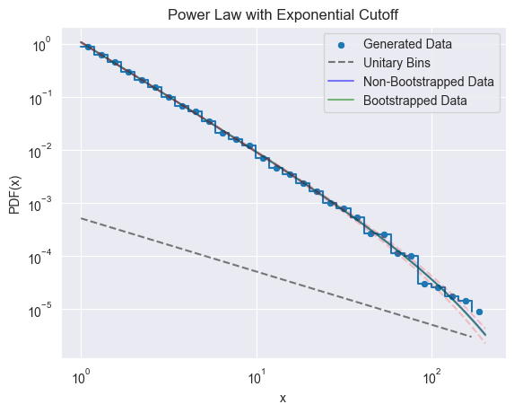
Introduction
Index
Models Studied
City Sizes
Earthquakes’ Magnitud
Percolation Sizes
…

Slide 4
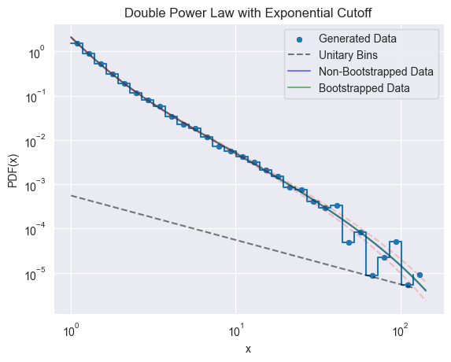
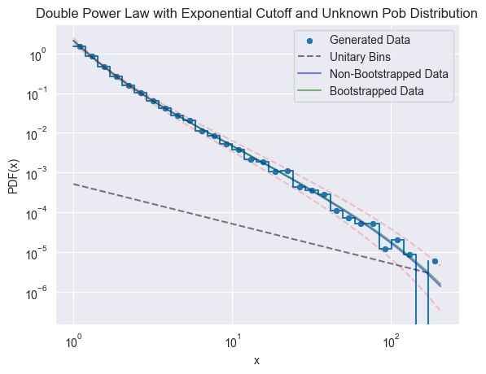


Introduction
Models Studied
$$p_{1}\left(x, α\right)=\frac{α−1}{x_{min}}{\left(\frac{x}{x_{min}}\right)}^{−α}$$
$$p_{2}\left(x, α, x_{c}\right)=\frac{x_{c}^{α−1}}{Γ^{+}\left(1−α,\frac{x_{min}}{x_{c}}\right)} {\left(\frac{x}{x_{min}}\right)}^{−α}e^{−\frac{x}{x_{c}}}$$

Slide 5



Likelihood Function
Models Studied
$$p_{1}\left(x, α\right)=\frac{α−1}{x_{min}}{\left(\frac{x}{x_{min}}\right)}^{−α}$$
$$p_{2}\left(x, α, x_{c}\right)=\frac{x_{c}^{α−1}}{Γ^{+}\left(1−α,\frac{x_{min}}{x_{c}}\right)} {\left(\frac{x}{x_{min}}\right)}^{−α}e^{−\frac{x}{x_{c}}}$$
$$p_{3}\left(x, α_{1}, α_{2},x_{C}\right)=βp_{1}\left(x, α_{1}\right)+\left(1−β\right)p_{2}\left(x, α_{2}, x_{c}\right)$$
$$β=Population distribution$$

Slide 6



Models Studied
Likelihood Function
$$ℒ\left(θ_{i}, x_{k}\right)=\prod_{k}{p\left(x_{k}|θ_{i}\right)}$$
$$′Given θ_{i} , how likely are$$
$$a set of x_{k} values$$
$$to be observed′$$
Objective: Maximize $ℒ{\left(θ_{i}, x_{k}\right)}^{∗}$

Slide 7




Goodness of Fit
Likelihood Function
Maximizing Likelihood Function
$$p_{1}\left(x, α\right)=\frac{α−1}{x_{min}}{\left(\frac{x}{x_{min}}\right)}^{−α}→\hat{α}=1+n{\left[\sum_{k=1}^{n}{\ln\left(\frac{x_{k}}{x_{min}}\right)}\right]}^{−1}$$
$$p_{2}\left(x, α, x_{c}\right)=\frac{x_{c}^{α−1}}{Γ^{+}\left(1−α,\frac{x_{min}}{x_{c}}\right)} {\left(\frac{x}{x_{min}}\right)}^{−α}e^{−\frac{x}{x_{c}}}→$$
$$→\begin{matrix}\frac{1}{Γ^{+}}\frac{∂Γ^{+}}{∂α}=\ln\left(\frac{x_{c}x_{min}}{x_{k}}\right) \\ \frac{\left(α−1\right)}{x_{c}}+\frac{x_{k}}{x_{c}^{2}}=\frac{1}{Γ^{+}}\frac{∂Γ^{+}}{∂x_{c}}\end{matrix}→\begin{matrix}Impossible \\ Inversion\end{matrix}→\begin{matrix}Numerical \\ Algorithms\end{matrix}$$
$$ℒ\left(θ_{i}, x_{k}\right)=\prod_{k}{p\left(x_{k}|θ_{i}\right)}$$
$$l\left(θ_{i}, x_{k}\right)=−\ln\left(ℒ\left(θ_{i}, x_{k}\right)\right)$$

Slide 8



Maximizing Likelihood Function
Goodness of Fit
Repeating and averaging the results
$$Bootstrapping→$$
$$Fischer Information Matrix$$
$$Std_{F}\left(\hat{θ}\right)=\sqrt{{\left[ℱ^{∗}\left(\hat{θ}\right)\right]}^{−1}}$$
$$ℒ\left(θ_{i}, x_{k}\right)=\prod_{k}{p\left(x_{k}|θ_{i}\right)}$$

Slide 9

Goodness of Fit
AICc / BIC → # Parameters vs Fit
$$Used to compare Models$$
$$ℒ\left(θ_{i}, x_{k}\right)=\prod_{k}{p\left(x_{k}|θ_{i}\right)}$$

Slide 10

Results over Synthetic and Real Data
Goodness of Fit
Results: Synthetic Fit
$$l\left(θ_{i}, x_{k}\right)=−\ln\left(ℒ\left(θ_{i}, x_{k}\right)\right)$$

Slide 11
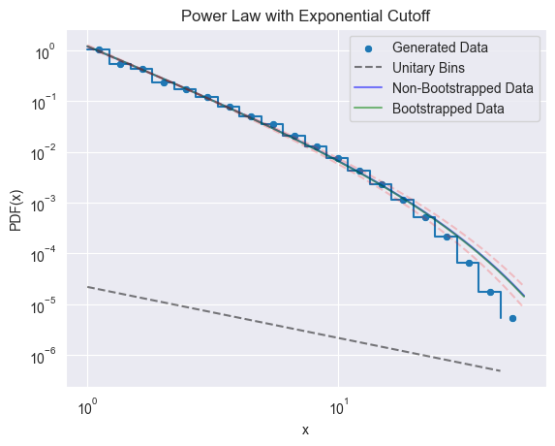
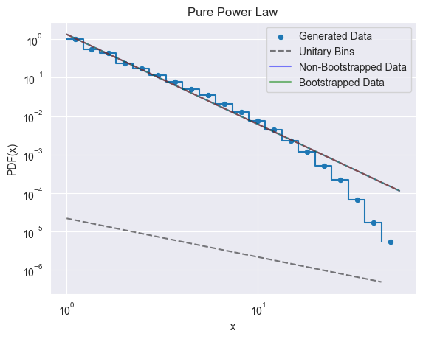
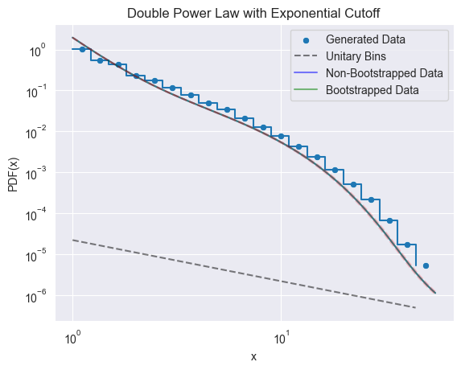
Results: Real Fit
Results: Synthetic Fit
AICc | 598723
BIC | 598724
AICc | 594388
BIC | 594408
AICc | 589629
BIC | 589659

Slide 12
Summary
Results: Real Fit
AICc | 598723
BIC | 598724
AICc | 594388
BIC | 594408
AICc | 589629
BIC | 589659

Slide 13
Conclusions
Summary
Data Generation / Recolection
Model Development
Likelihood Estimation
Standard Error
Model Selection

Slide 14
Summary
Conclusions
Good fits for Synthetic Data
Bootstrap vs Fischer Information Matrix
Complexity to fit some real data
Underlying Complex Model
Discretization of the data
The double power law model enhances the fit:
Model | AICc | BIC
Pure Power Law | 598723 | 598724
Power Law with Cutoff | 594388 | 594408
Double Power Law | 589629 | 589659

Slide 15
References
[1] | M.K. Sachs, M.R. Yoder, D.L. Turcotte, Black swans, power laws, and dragon-kings: Earthquakes, volcanic eruptions, landslides, wildfires, floods, and SOC models, Eur. Phys. J. Spec. Top. 205, 167–182, 2012. | [6] | Meurer, A. et al., SymPy: symbolic computing in Python. PeerJ Computer Science, 3, p.e103, 2017
[2] | A. Clauset, C.R. Shalizi, and M.E.J. Newman, Power-law distributions in empirical data, SIAM Review 51(4), 661-703, 2009 | [7] | A. Martínez, Optimization methods for maximum likelihood estimation in power laws, GitHub repository, 2024
[3] | J. Baró, E. Vives, Analysis of power-law exponents by maximum-likelihood maps, Phys. Rev. E 85 066121, 2012 | [8] | “Akaike information criterion” Wikipedia, The Free Encyclopedia, Wikimedia Foundation, 4th January 2024
[4] | J. A. Nelder and R. Mead. A simplex method for function minimization. The Computer Journal, 7(4):308–313, 1965 | [9] | “Bayesian information criterion” Wikipedia, The Free Encyclopedia, Wikimedia Foundation, 18th April 2023
[5] | E. Jones, P. Peterson, T. Oliphant and SciPy 1.0 Contributors. SciPy 1.0: Fundamental Algorithms for Scientific Computing in Python. Nature Methods, 17(3), 261-272, 2020 URL: https://rdcu.be/b08Wh | [10] | Cole Lord-May, Jordi Baró, David W. Eaton, Jörn Davidsen, Seismic hazard due to fluid injections, Phys. Rev. Research 2 043324, 2020

