Slide 1
Without mutate

Slide 2
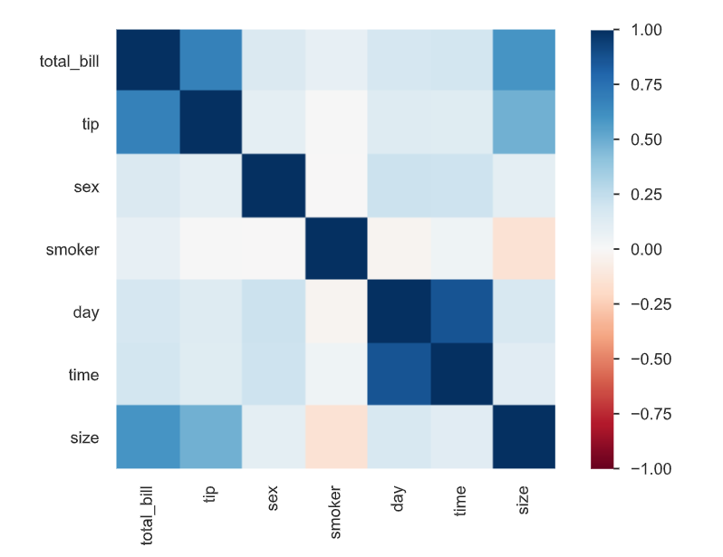
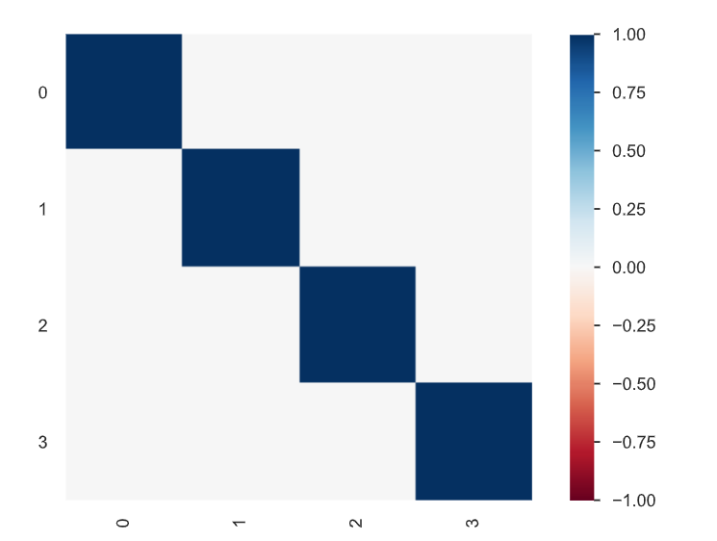
Target : Total Bill -> PCA without Mutate Variable
Before Featuring
After Featuring

Slide 3
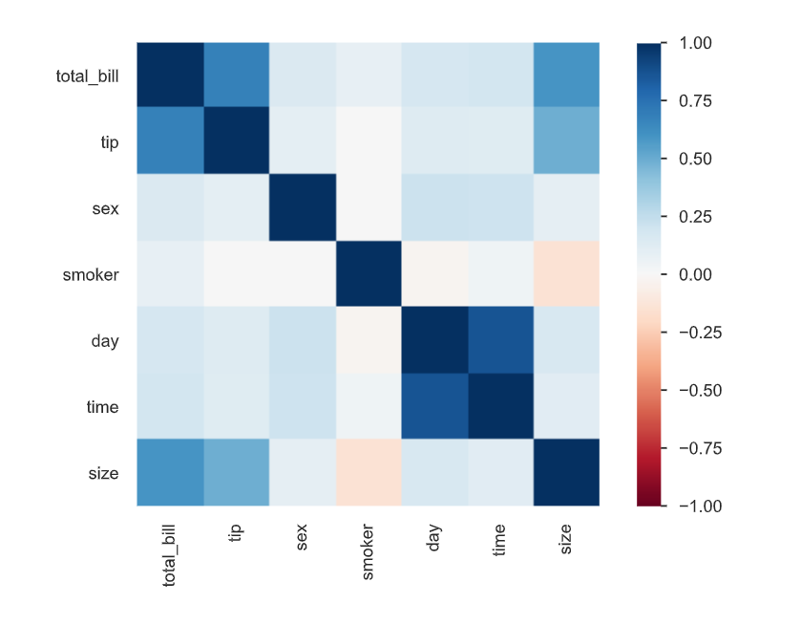
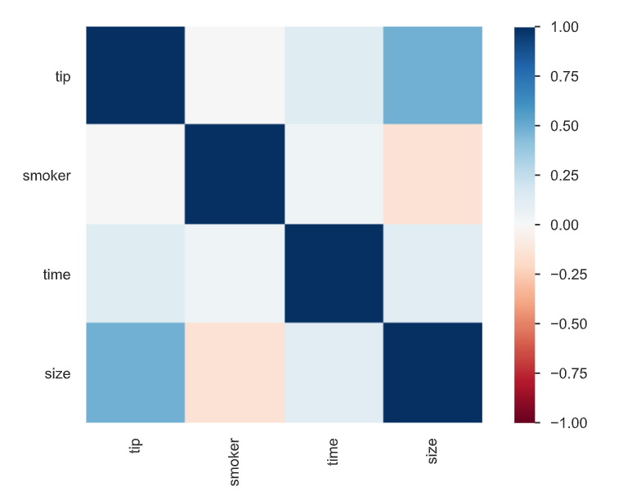
Target : Total Bill -> RFE(recursive feature elimination) without Mutate Variable
Before Featuring
After Featuring

Slide 4
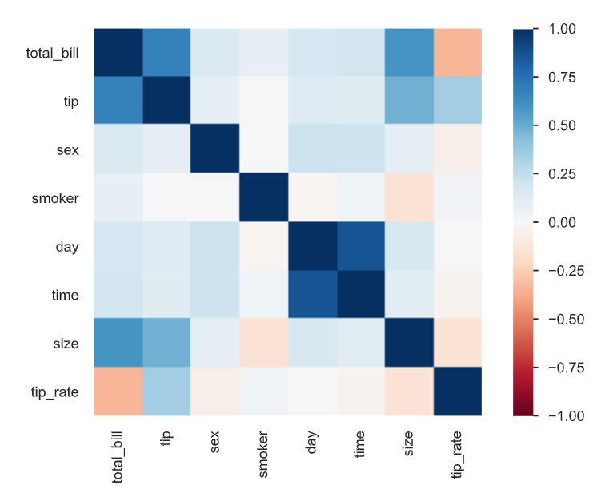
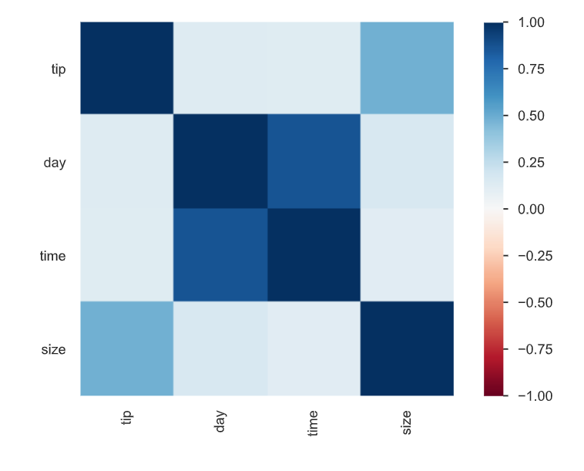
Target : Total Bill -> Regression Feature Selection without Mutate Variable
Before Featuring
After Featuring

Slide 5
With mutate

Slide 6
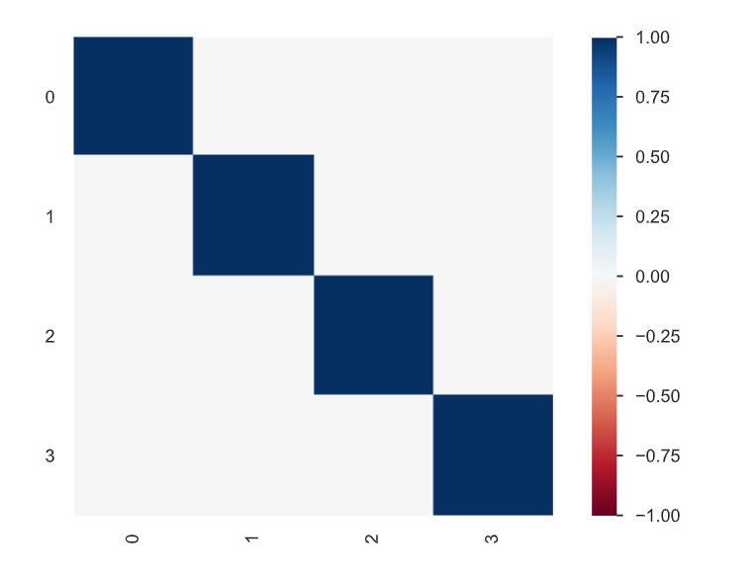
Target : Total Bill -> PCA with Mutate Variable : tip rate
Before Featuring
After Featuring

Slide 7
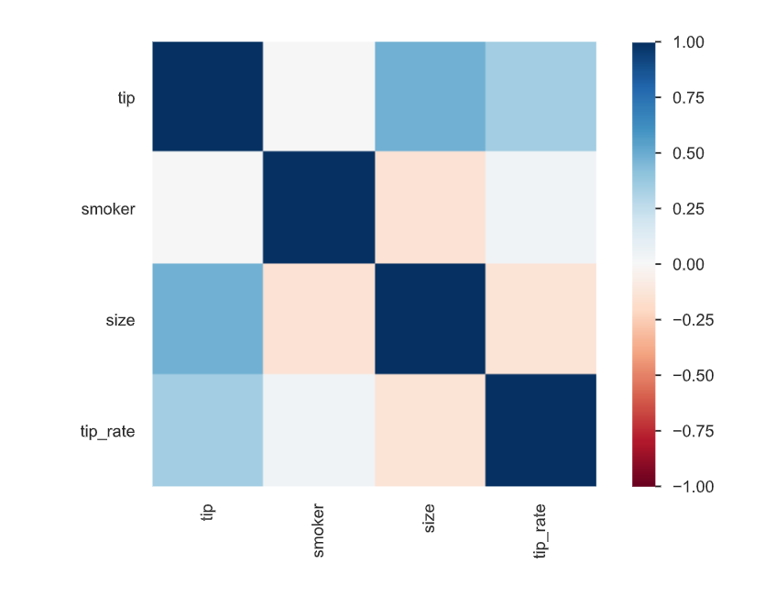
Target : Total Bill -> RFE(recursive feature elimination) with Mutate Variable : tip rate
Before Featuring
After Featuring

Slide 8
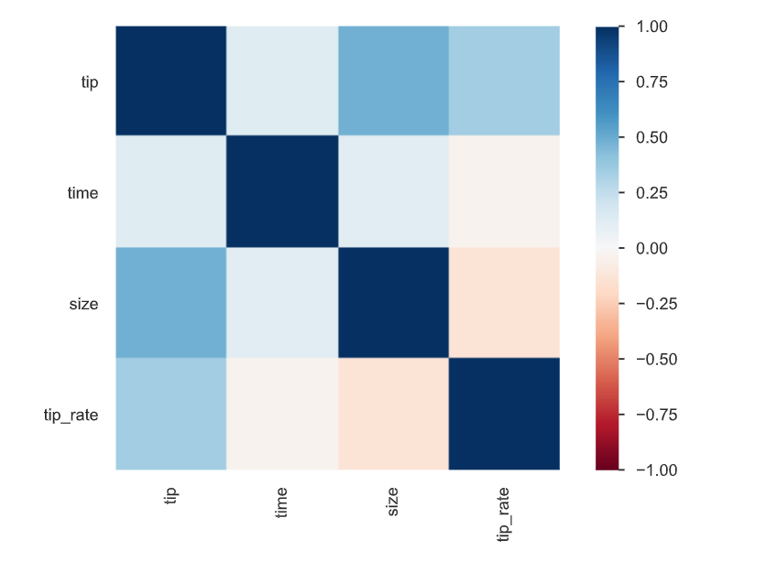
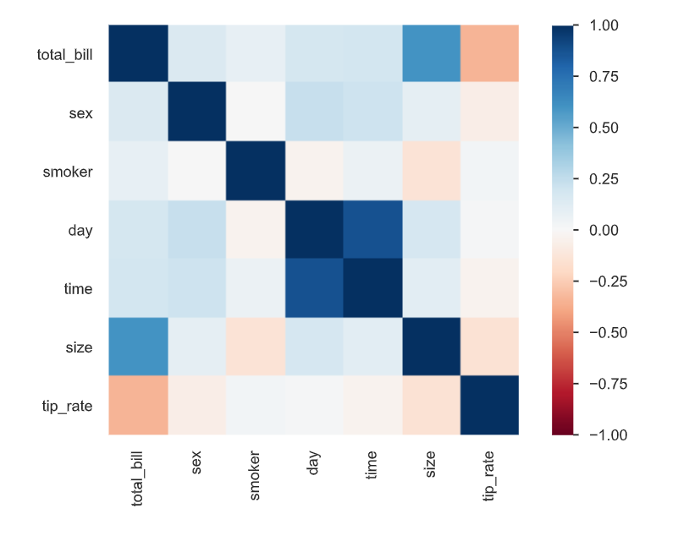
Target : Total Bill -> Regression Feature Selection with Mutate Variable : tip rate
Before Featuring
After Featuring

Slide 9
Normalize With mutate

Slide 10
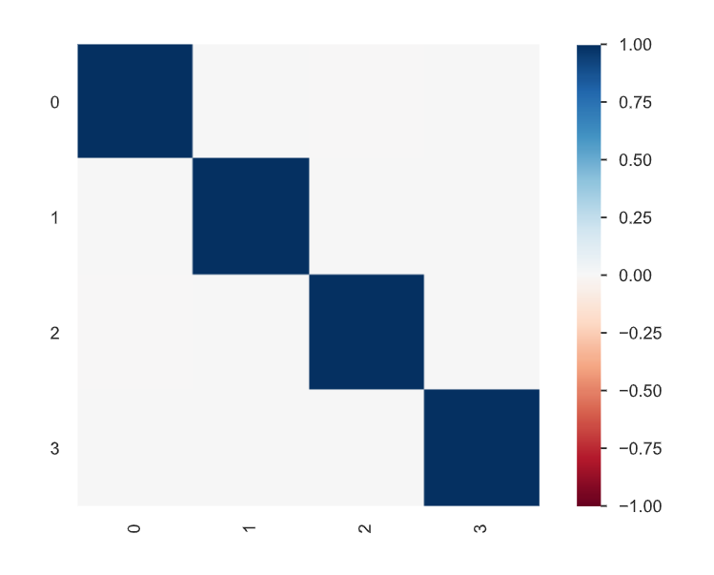
Target : Total Bill -> PCA with Mutate Variable : tip rate
Without Normalize
With Normalize

Slide 11
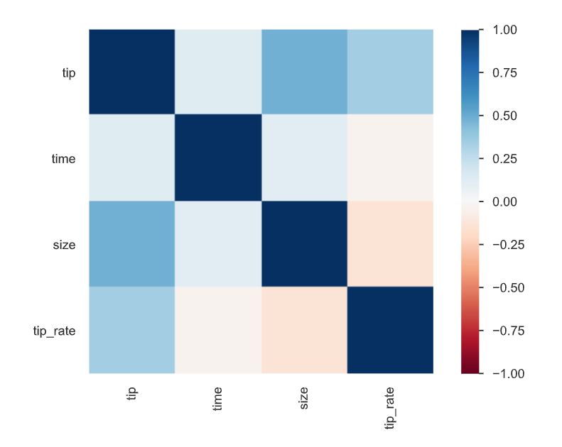
Target : Total Bill -> RFE(recursive feature elimination) with Mutate Variable : tip rate
Without Normalize
With Normalize

Slide 12
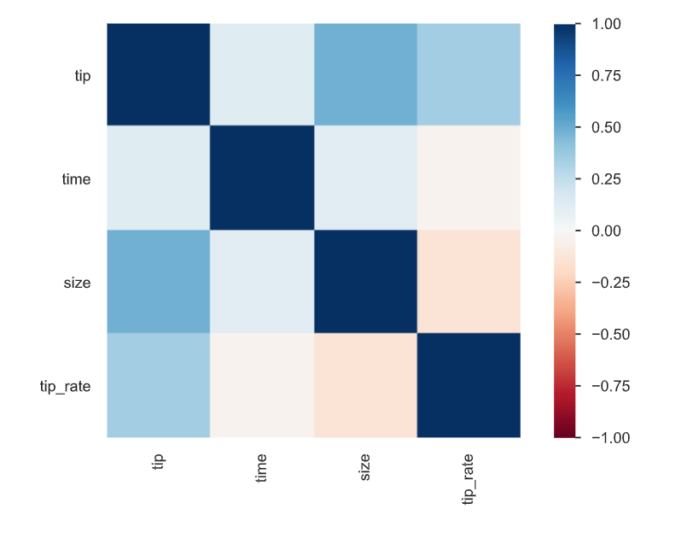
Target : Total Bill -> Regression Feature Selection with Mutate Variable : tip rate
Without Normalize
With Normalize

Slide 13
Stardardization With mutate

Slide 14
Target : Total Bill -> PCA with Mutate Variable : tip rate
Without sc
With sc

Slide 15
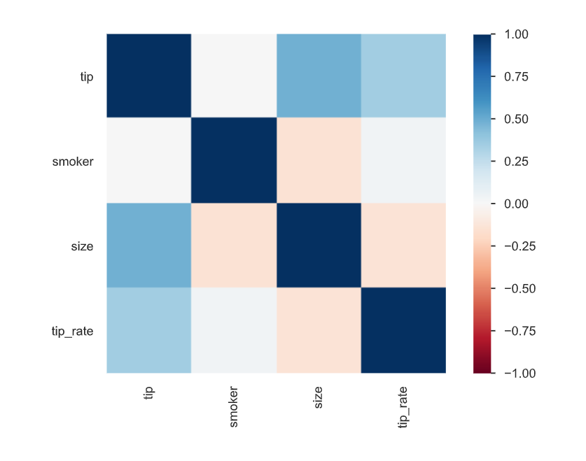
Target : Total Bill -> RFE(recursive feature elimination) with Mutate Variable : tip rate
Without sc
With sc

Slide 16
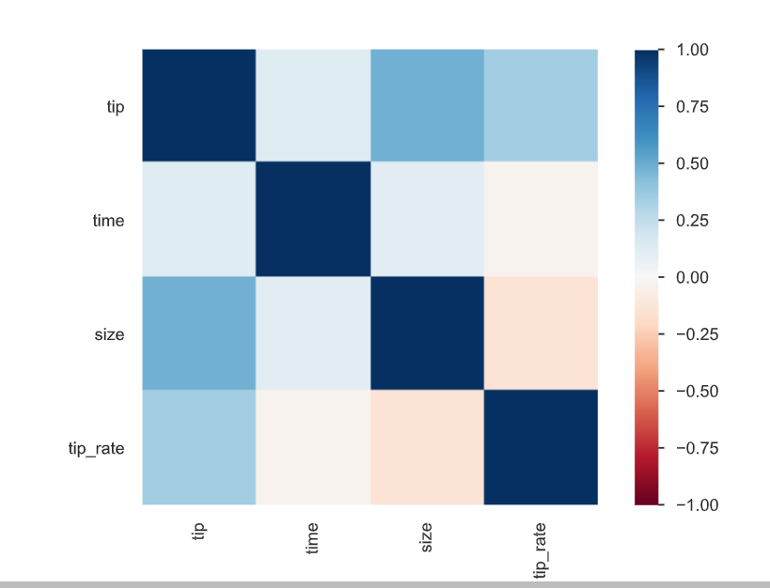
Target : Total Bill -> Regression Feature Selection with Mutate Variable : tip rate
Without sc
With sc

