Slide 1

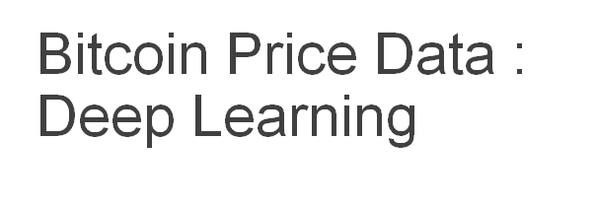


Slide 2


Slide 3
Bitcoin Price Data
Index | Timestamp | Open | High | Low | Close | Volume_(BTC) | Volume_ (Currency) | Weighted_ Price | date
4727772 | 1609372560 | 28801.47 | 28829.42 | 28785.64 | 28829.42 | 0.965221 | 27804.572129 | 28806.42 | 2020-12-30
4727773 | 1609372620 | 28829.42 | 28863.90 | 28829.42 | 28857.06 | 2.368831 | 68332.350629 | 28846.44 | 2020-12-30
4727774 | 1609372680 | 28850.49 | 28900.52 | 28850.49 | 28882.82 | 2.466590 | 71232.784464 | 28879.05 | 2020-12-30
4727775 | 1609372740 | 28910.54 | 28911.52 | 28867.60 | 28881.30 | 7.332773 | 211870.912660 | 28893.69 | 2020-12-30
4727776 | 1609372800 | 28893.21 | 28928.49 | 28893.21 | 28928.49 | 5.757679 | 166449.709320 | 28909.16 | 2020-12-31

Slide 4
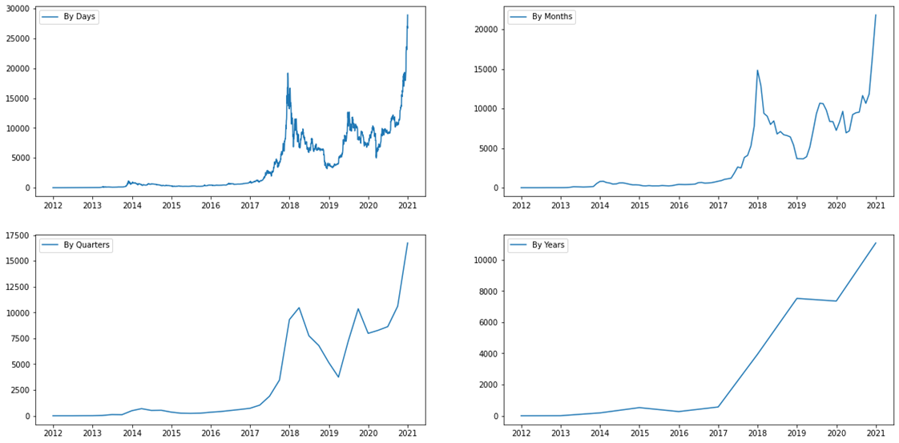
Bitcoin Price Charts

Slide 5
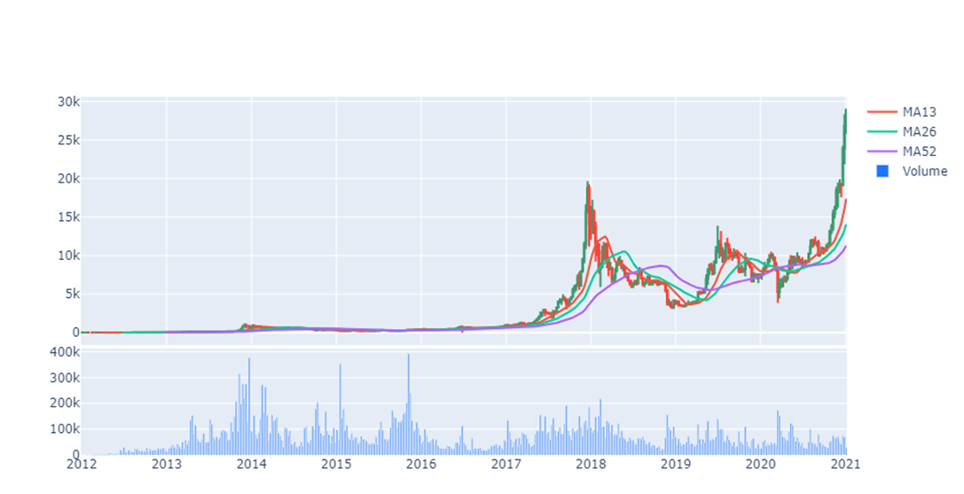
Moving Average with Transaction Volume

Slide 6
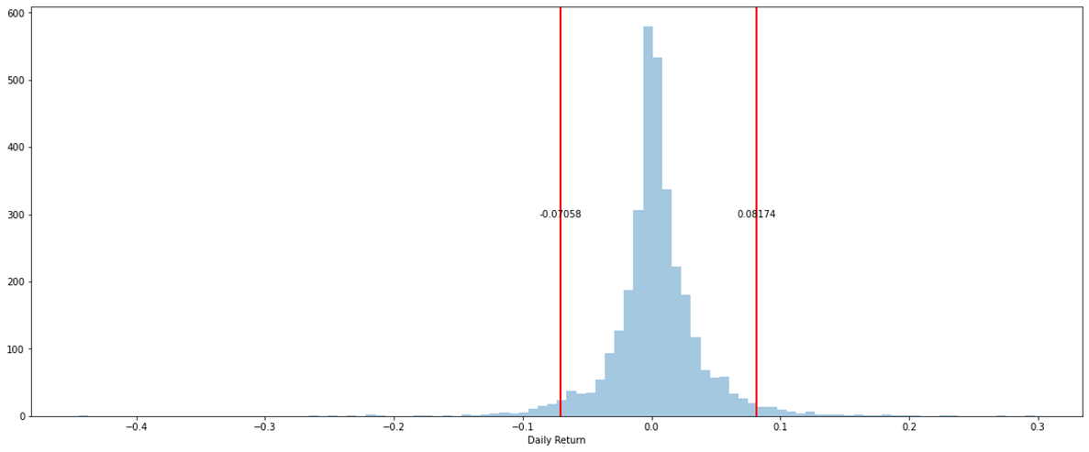
Daily Return Distribution

Slide 7
Forecasting bitcoin price for 50 days

Slide 8
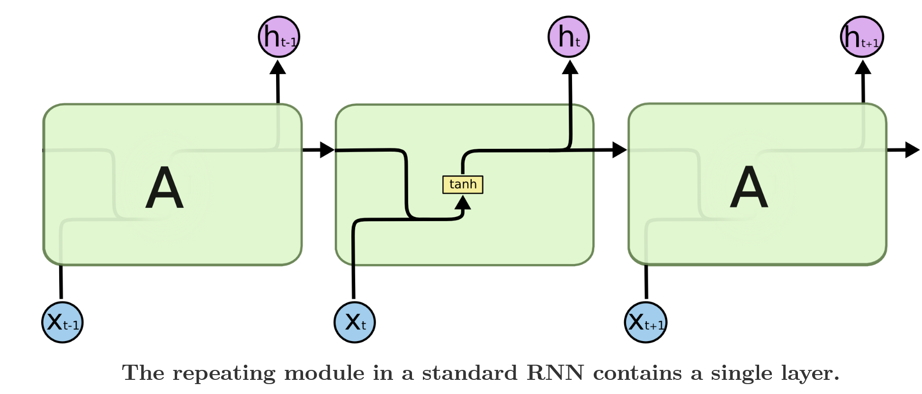
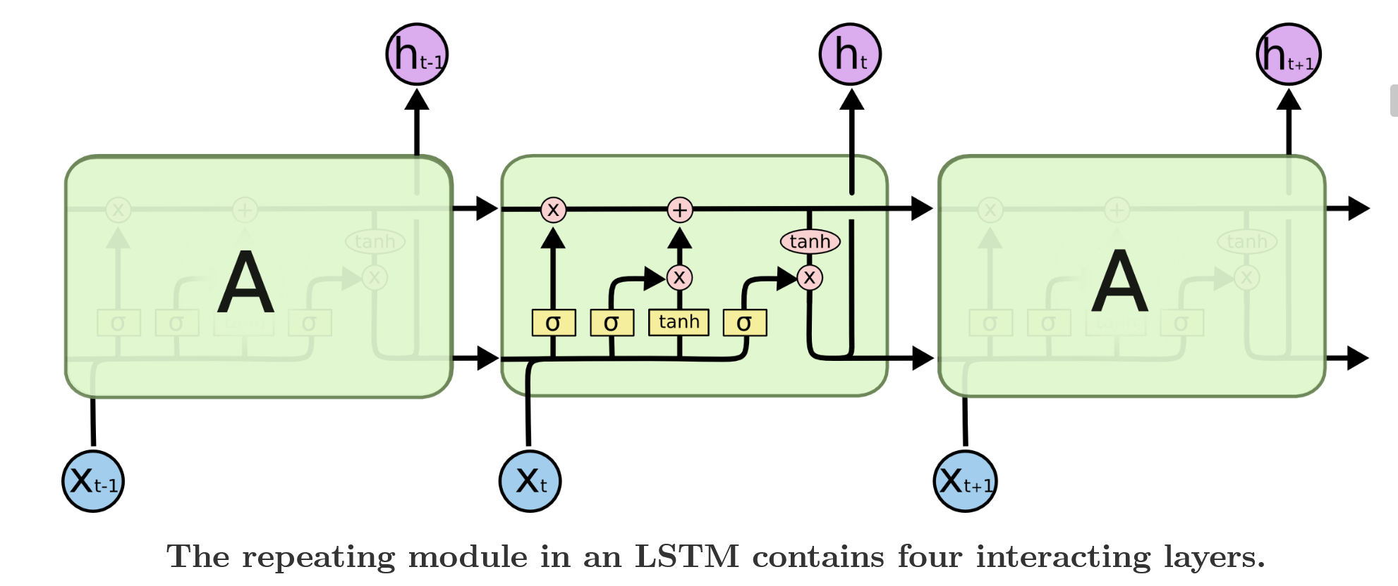

Slide 9
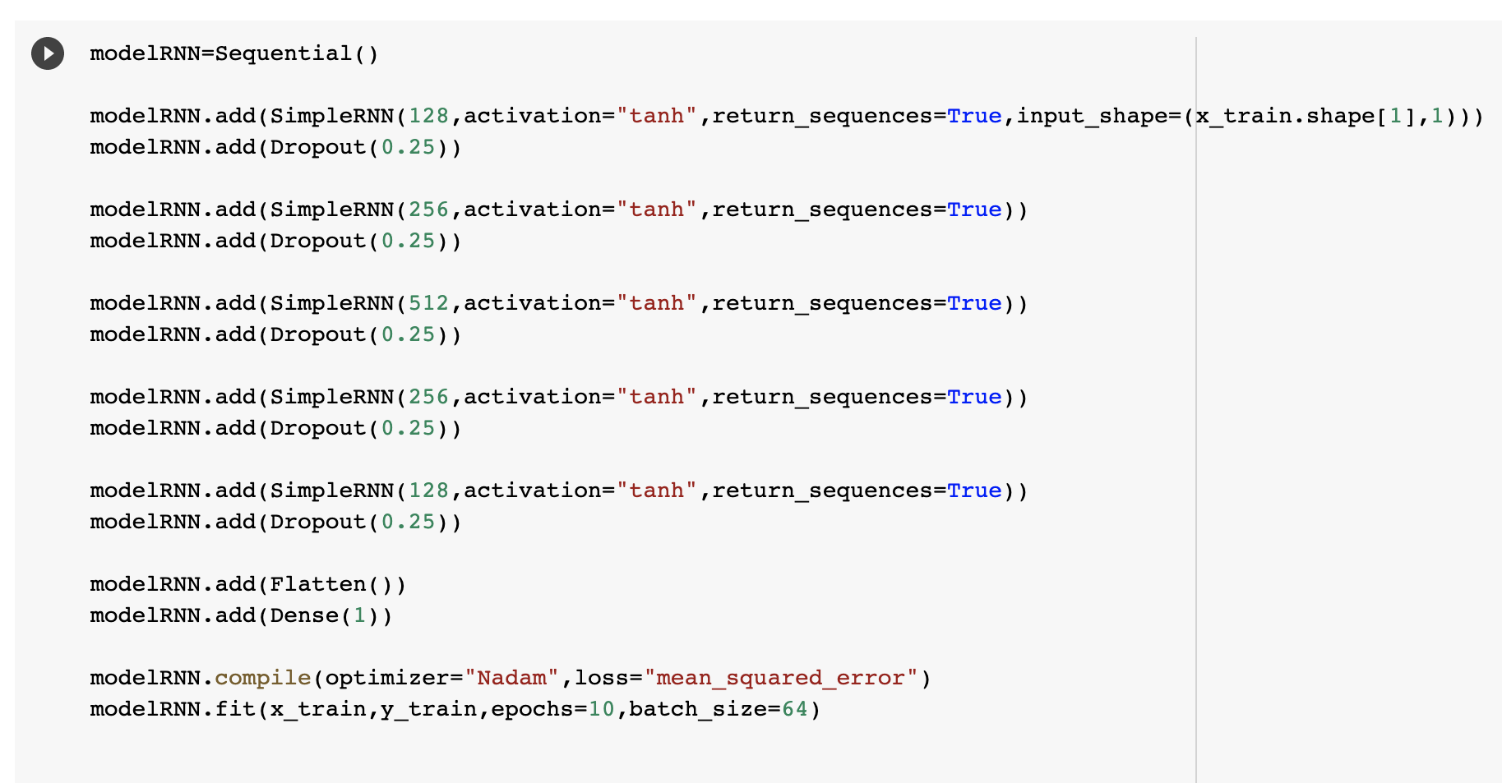
Forecasting bitcoin price using RNN model
Unstable gradient problems:
Tanh activation function
Dropout
Nadam optimizer
Notes:
- hyperbolic tangent is saturating activation function
-nonsaturating activation functions (e.g., ReLU) may not help as much here; in fact, they may actually lead the RNN to be even more unstable during training.
-Batch Normalization cannot be used as efficiently with RNNs as with deep feedforward nets.
-it is technically possible to add a BN layer to a memory cell (as we will see shortly) so that it will be applied at each time step (both on the inputs for that time step and on the hidden state from the previous step).
-However, the same BN
layer will be used at each time step, with the same parameters, regardless of the actual scale and offset of the inputs and hidden state. In practice, this does not yield good results
-dropout rate, is typically set between 20–30% in recurrent neural nets (chp 11)

Slide 10
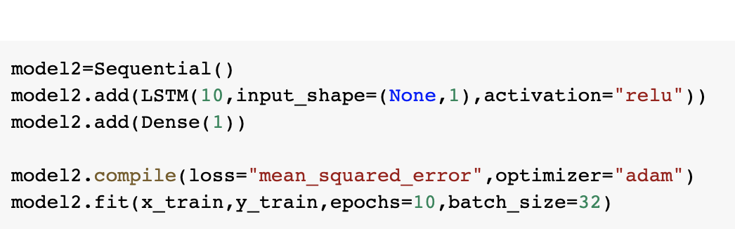
Forecasting bitcoin price using model with LSTM cell
LSTM cells will perform much better; training will converge faster, and it will detect long-term dependencies in the data.
Notes:
A LSTM cell is a type of RNN which stores important information about the past and forgets the unimportant pieces. In this way, when gradient back-propagates, it won’t be consumed by unnecessary information.

Slide 11
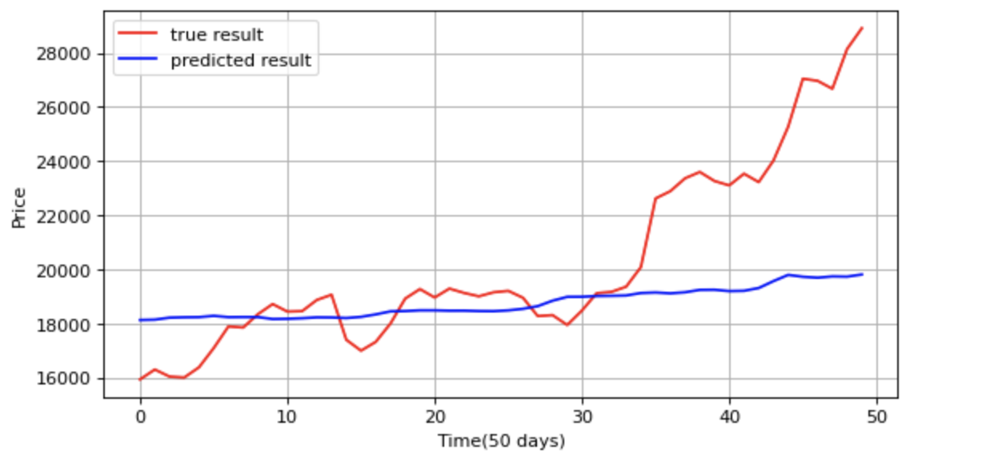
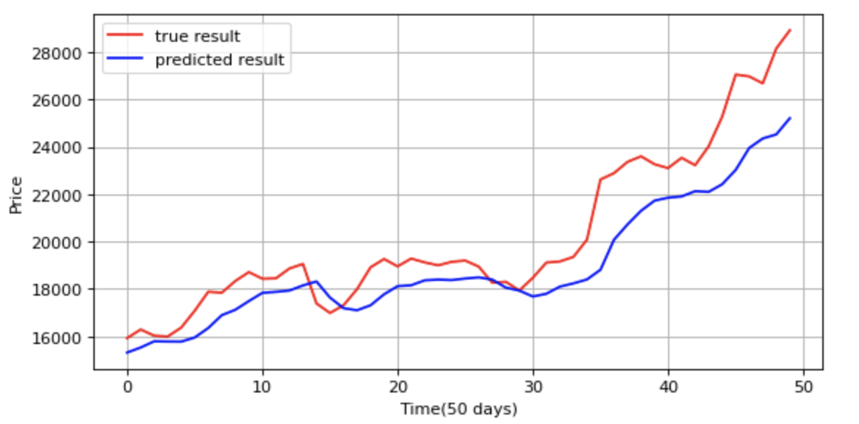
RNN model VS LSTM
We use the model to make it predict the next value, then add that value to the inputs (as if this predicted value occurred), and use the model again to predict the following value, and so on
RNN
LSTM

Slide 12
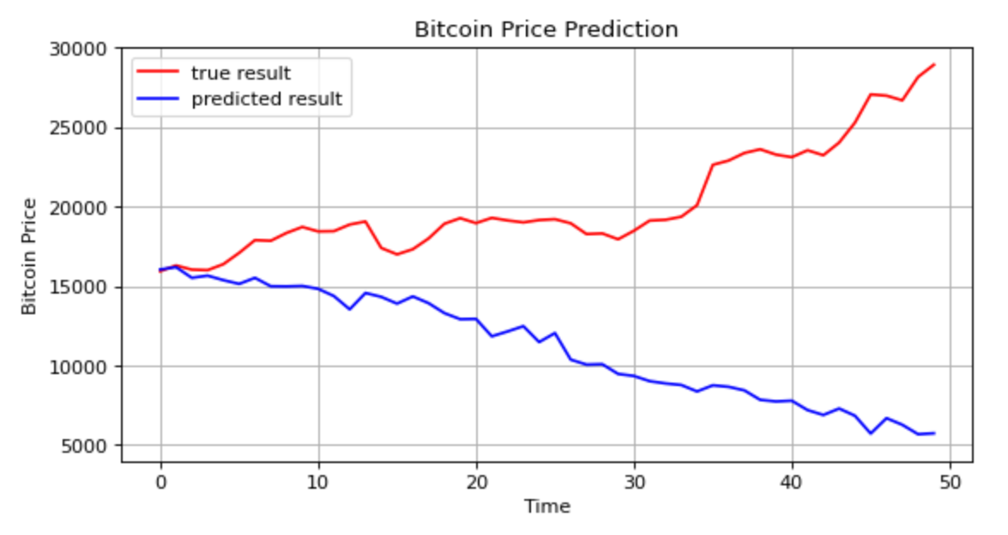
Predict all 50 Values at Once
Sequence-to-Vector
Change target to be vector containing next 50 values
4 LSTM layers with 50 units and 20% dropout after each.

Slide 13
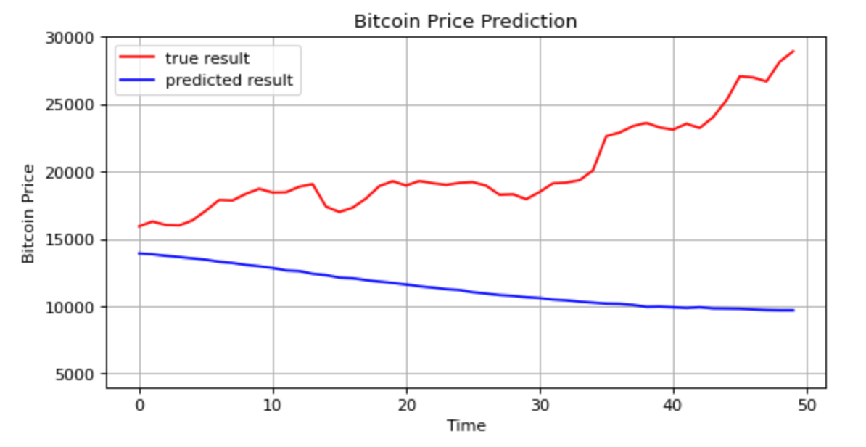
50 Predictions at Each and Every Time Step
Sequence-to-Sequence
At time step 0 the model will output a vector containing the forecasts for time steps 1 to 50, then at time step 1 the model will forecast time steps 2 to 51, and so on. ( [n,50,50] at each step)
4 LSTM layers with 50 units and 20% dropout after each.
Custom MSE at last time step

Slide 14
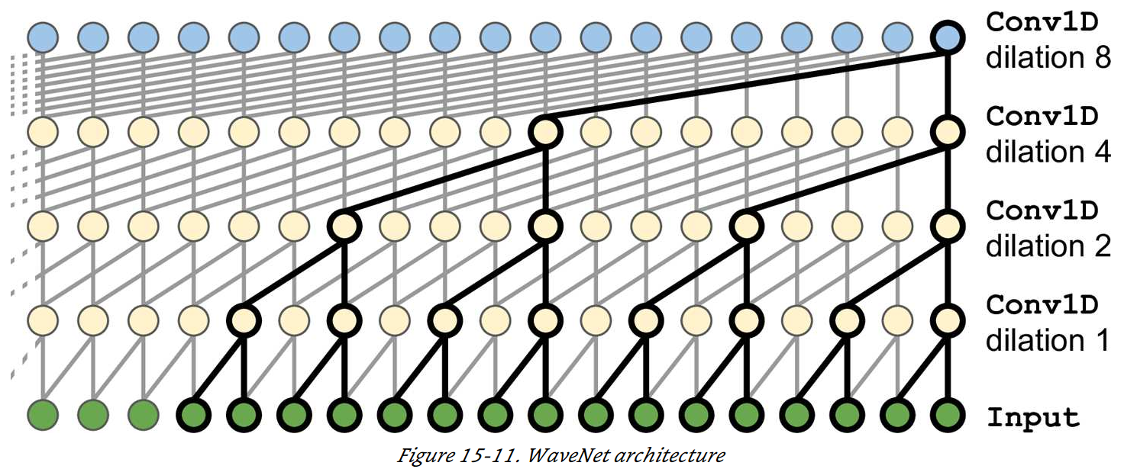
WaveNet
Stacked 1D Convolutional layers
Double the dilation rate at every layer
The first layers gets a glimpse of two time steps at a time, the next sees four, the next eight, and so on.
Lower layers learn short-term patterns, upper layers long-term patterns
No RNN or LSTM layers

Slide 15
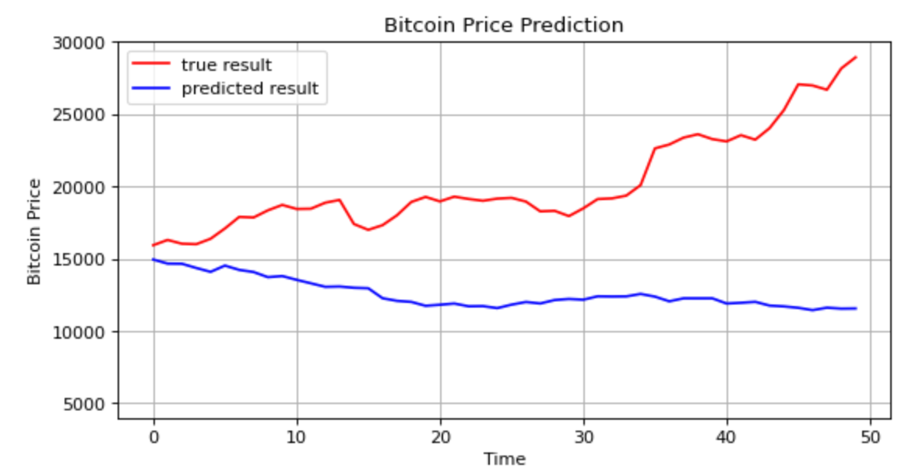
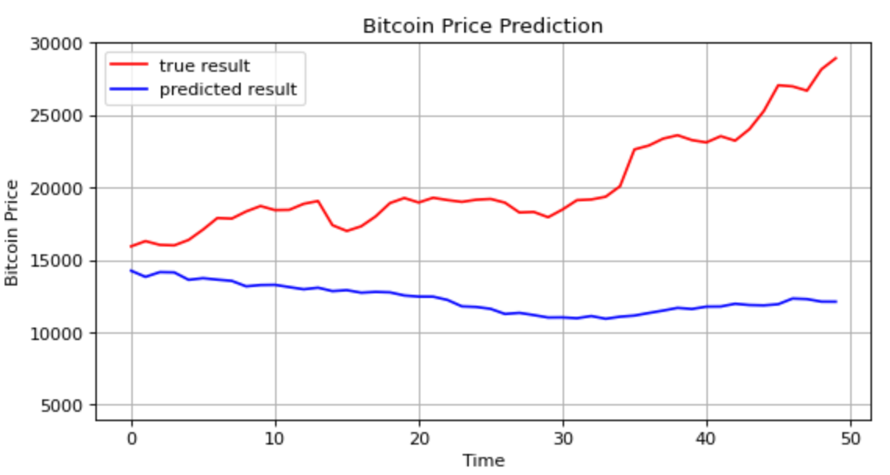
50 Predictions at Every Time Step Using WaveNet
6 stacked convolutional layers
Dilation rate: 1, 2, 4, 8, 16, 32
300 filters
Kernel size 2
Another group of 6 identical layers
Relu activation

Slide 16
Final Thoughts
More variables
Hyperparameter tuning (Bayesian Optimization, Hyperband, etc)
Different models
More data

