Slide 1
Intermediate Language for JavaScript
Aubrianna Zhu

Slide 2
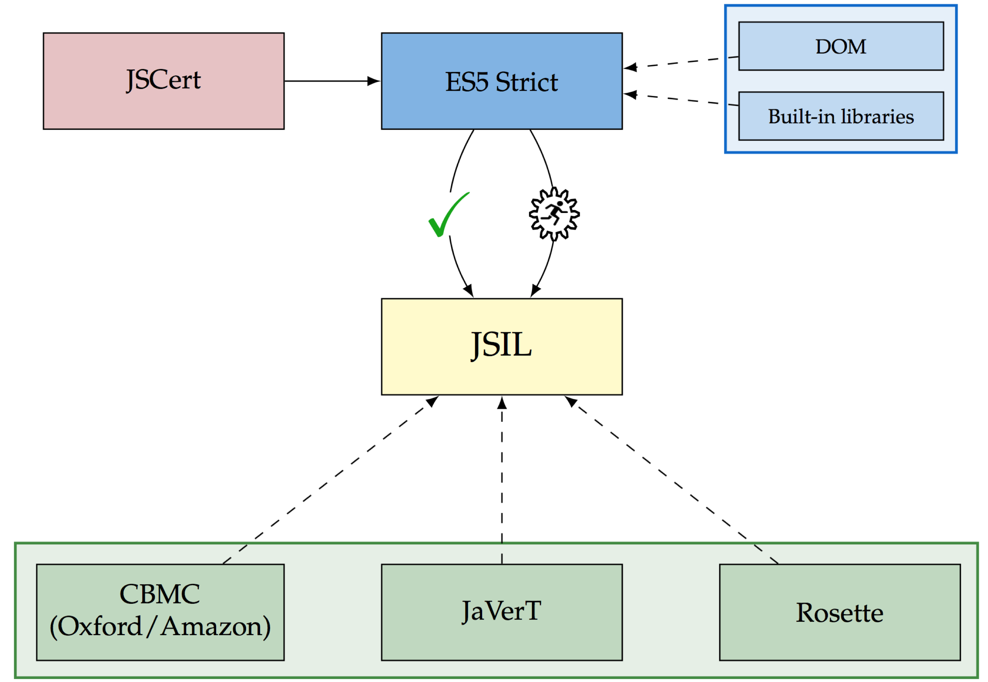
Context of the thesis
JS-2-JSIL
Notes:
JSCert – mech. spec. of JavaScript, the ES5 Standard, previous work on which this is based. We aim at ES5 Strict – mode of JavaScript with better behavioural properties. JavaScript too complicated for direct analysis –> we developed JSIL, simple intermediate goto language. JS-2-JSIL: compiler from ES5 Strict to JSIL. We establish trust in the correctness of JS-2-JSIL in two ways: hand-proof of correctness for a fragment (the tick) and extensively testing against the official Test262 Test suite (the running man). The intent is for JSIL to be used as a front end for a number of verification tools, such as CBMC (done by Daiva), Rosette (in progress with IBM), and JaVerT (our tool, currently in development.
CLICK
This thesis lives in this part of the project and mainly deals with extending the JS-2-JSIL compiler with support for some of the built-in libraries and the testing of this extension.

Slide 3
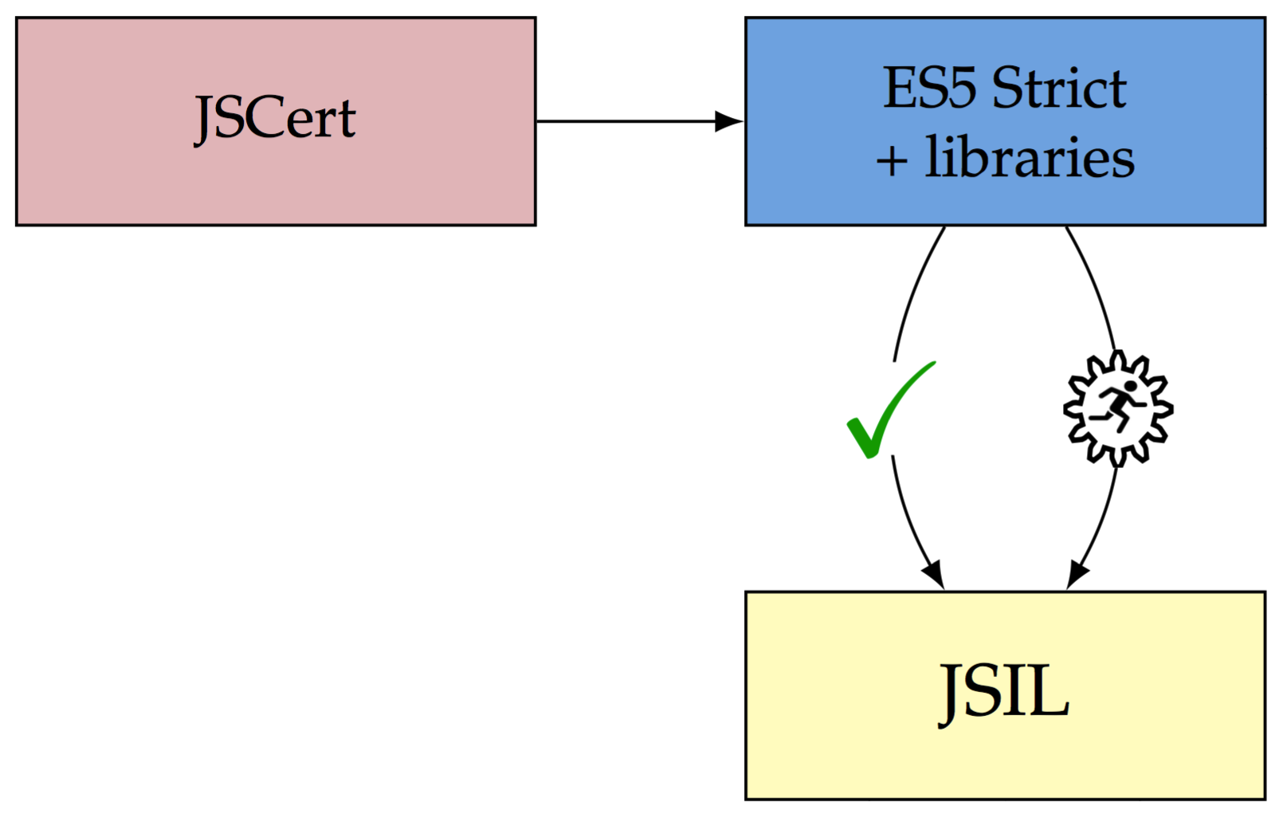
Contributions
Extending coverage of JS-2-JSIL
Language:
Arguments object
Built-in libraries:
Object.prototype
Array
String (partial)
Testing JSIL implementations
Comprehensive unit tests prior to deployment
Formal tests after deployment using the official Test262 Test Suite
JS-2-JSIL

Slide 4
Object.prototype.isPrototypeOf
Purpose:
To determine whether or not one object is in the prototype chain of another object.
Syntax:
O.isPrototypeOf(V)
Object.prototype.isPrototypeOf(O, V)
Return value:
true, if the object O is in the prototype chain of the object V;
false, otherwise.
ES5 Standard: O.isPrototypeOf(V)
If V is not an object, return false.
Let O be the result of calling ToObject passing the this value as the argument.
Repeat
Let V be the value of the [[Prototype]] internal property of V.
if V is null, return false.
If O and V refer to the same object, return true.
Notes:
As a running example for part of this presentation, we will take the Object.prototype.isPrototypeOf function. On the right is the English standard description of this function, through which we will go in detail later. Then explain from the left

Slide 5
JavaScript Objects
Objects: collections of properties
Extensible: properties can be added or deleted after object creation
var alice = {name: "Alice", age: 36};
alice
name | [V: “Alice”, W: true, E: true, C: true]
age | [V: 36, W: true, E: true, C: true]
@prototype | …
@getOwnProperty | …
@defineOwnProperty | …
… | …
alice
name | “Alice”
age | 36
@prototype | …
@getOwnProperty | …
@defineOwnProperty | …
… | …
alice
name | “Alice”
age | 36
Not so simple: two types of properties
Named properties: the usual
Internal properties: not available to the programmer, only used internally
More complicated: descriptors, not values
Descriptors are collections of attributes
Value: The actual value of the property (number, string, boolean, etc.)
Writable: Can the value be changed?
Enumerable: Will the property be enumerated in a for-in enumeration?
Configurable: Can the property be deleted? Can we change the values of W, E, and C?
Notes:
Our intuition from C++ and JavaObjects tells us to view objects as collections of properties. Alice and the first table. Note that JavaScript objects are extensible – yada yada…
However, it’s not all that simple – there are two types of properties – Alice and the second table; introduce and describe those in the table.
In fact, it is much more complicated than that. Attributes and the third table, examples of attributes – value, writable, enumerable, configurable – perhaps don’t mention getters and setters at all, but say that there are more.

Slide 6
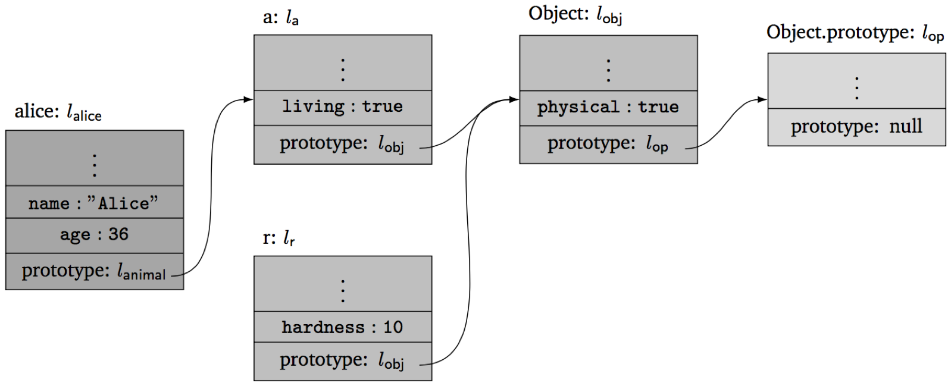
Prototype Inheritance
Object field lookup: o.x
Look for property x in the object o. If found, return its value.
Otherwise, look for property x in the prototype of the object o.
And so on, until the end of the prototype chain.
For example:
alice.name = “Alice”
r.physical = true
alice.living = true
alice.weight = undefined
All objects share the methods of Object.prototype (valueOf)

Slide 7
JSIL: An Intermediate Language for JS Verification
Verification tools, esp. separation logic ones, compile to goto languages
JS control flow constructs fully dismantled in JSIL – simpler analysis
✓ Simple goto language
Expressions (e):
v
x
- e, e + e
typeOf(e)
e._{v}e, e._{o}e
base(e)
field(e)
nth (e, e)
Basic commands (bc):
skip
x := e
x := new()
x := [e, e]
[e, e] := e
delete (e, e)
x := hasField(e, e)
x := getFields(e)
Commands (c):
bc
goto i
goto [e] i j
x := e (e, …, e) with j
x = PHI (x, …, x)
✓ Extensible objects
✓ Dynamic field access
✓ Dynamic procedure calls
✓ Top-level procedures
Procedures (proc):
proc m(x, …, x) {c, …, c}

Slide 8
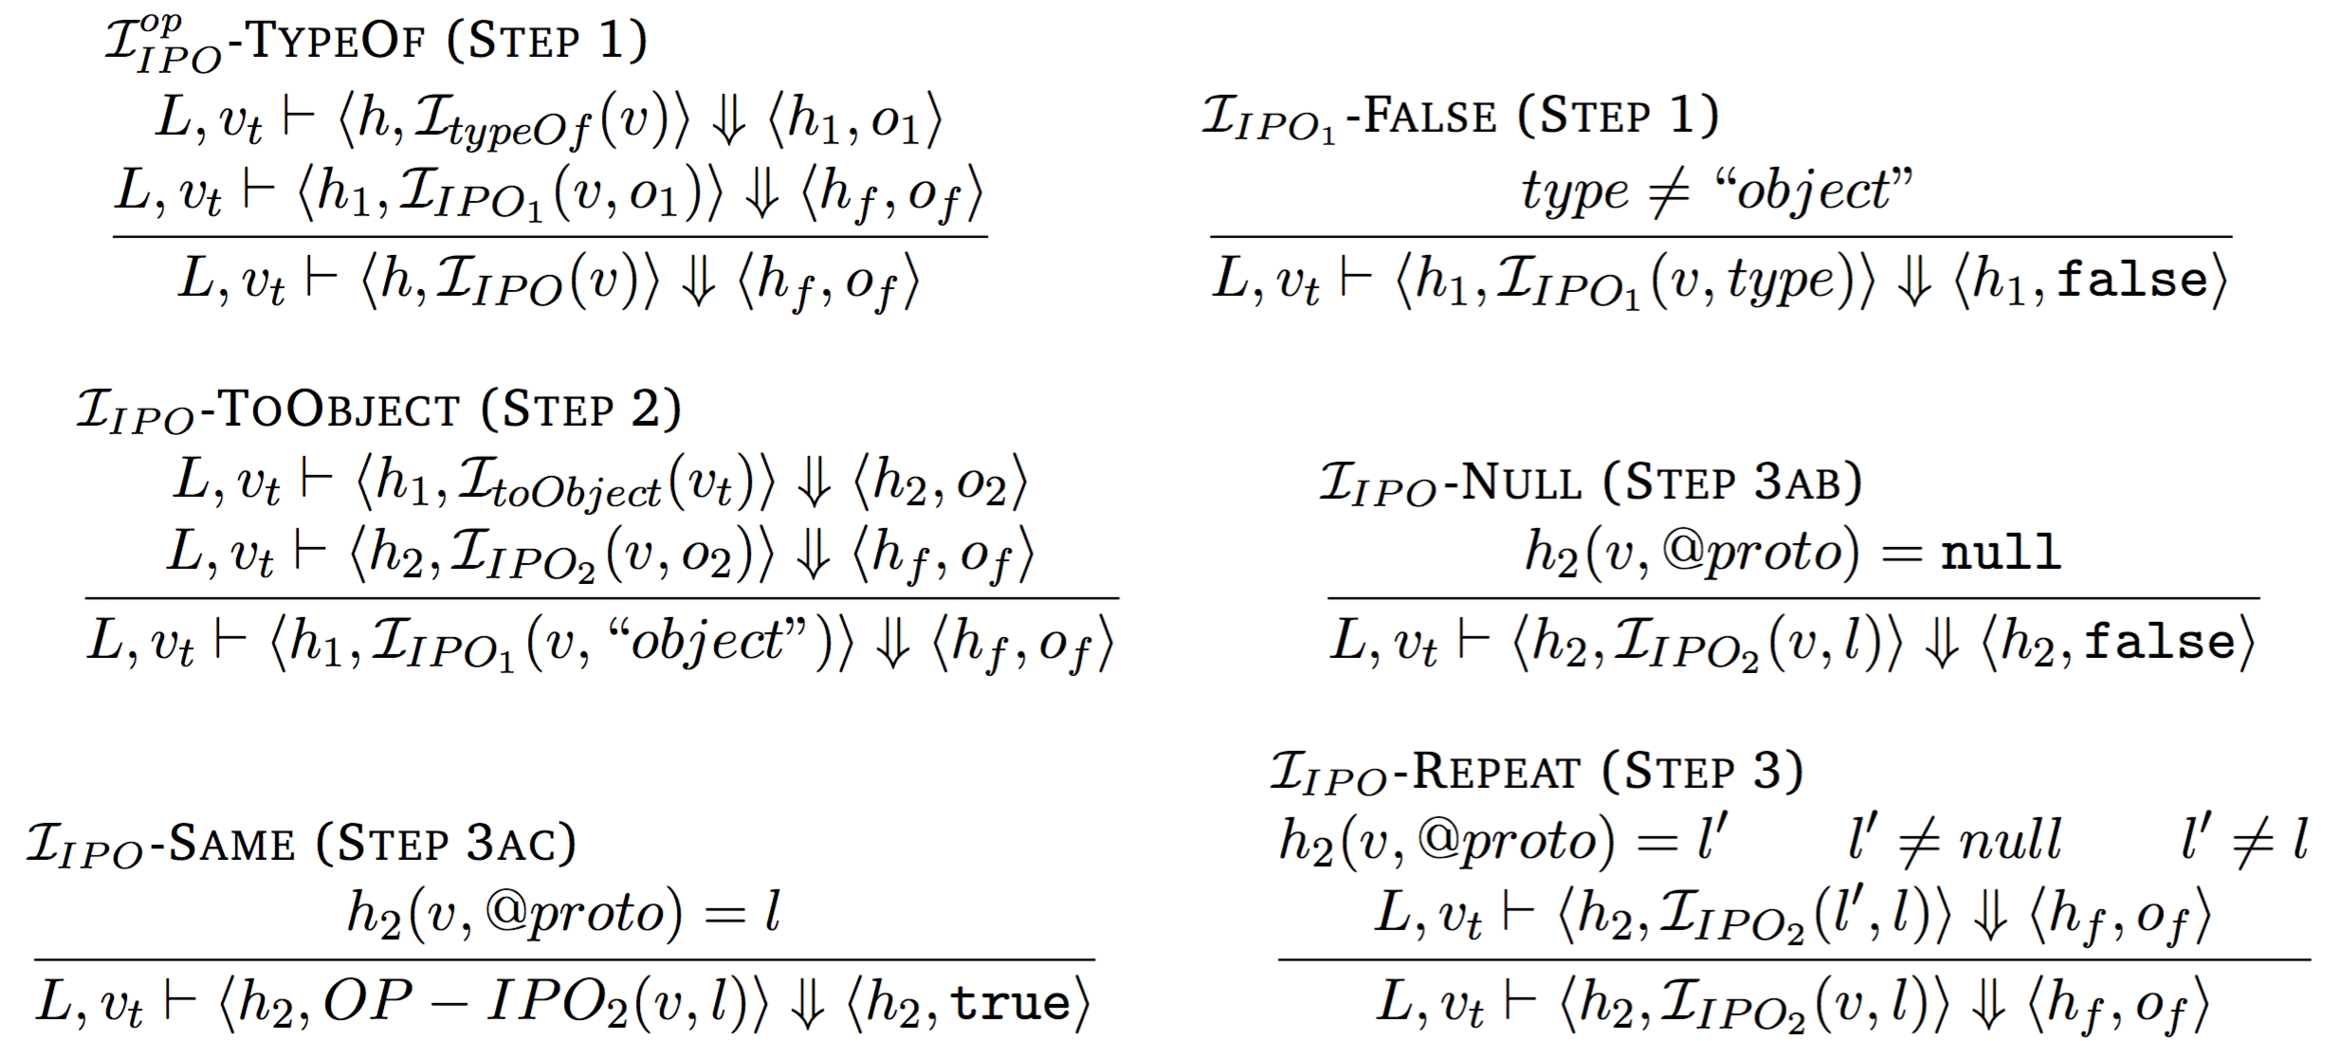
Object.prototype.isPrototypeOf
JSIL Implementation
proc OP_isPrototypeOf(xsc, vthis, v) {
goto [typeOf(v) = $$object_type] obj fret;
obj: xret := "i__toObject" (vthis) with elab;
rep: v := [v, "@proto"];
goto [v = $$null] fret nnull;
nnull: goto [v = xret] tret rep;
tret: xret := $$t;
goto rlab;
fret: xret := $$f;
rlab: skip;
elab: skip
}
with
{
ret: xret, rlab;
err: xret, elab;
};
Pretty-big-step Semantics
ES5 Standard
If V is not an object, return false.
Let O be the result of calling ToObject passing the this value as the argument.
Repeat
Let V be the value of the [[Prototype]] internal property of V.
if V is null, return false.
If O and V refer to the same object, return true.

Slide 9
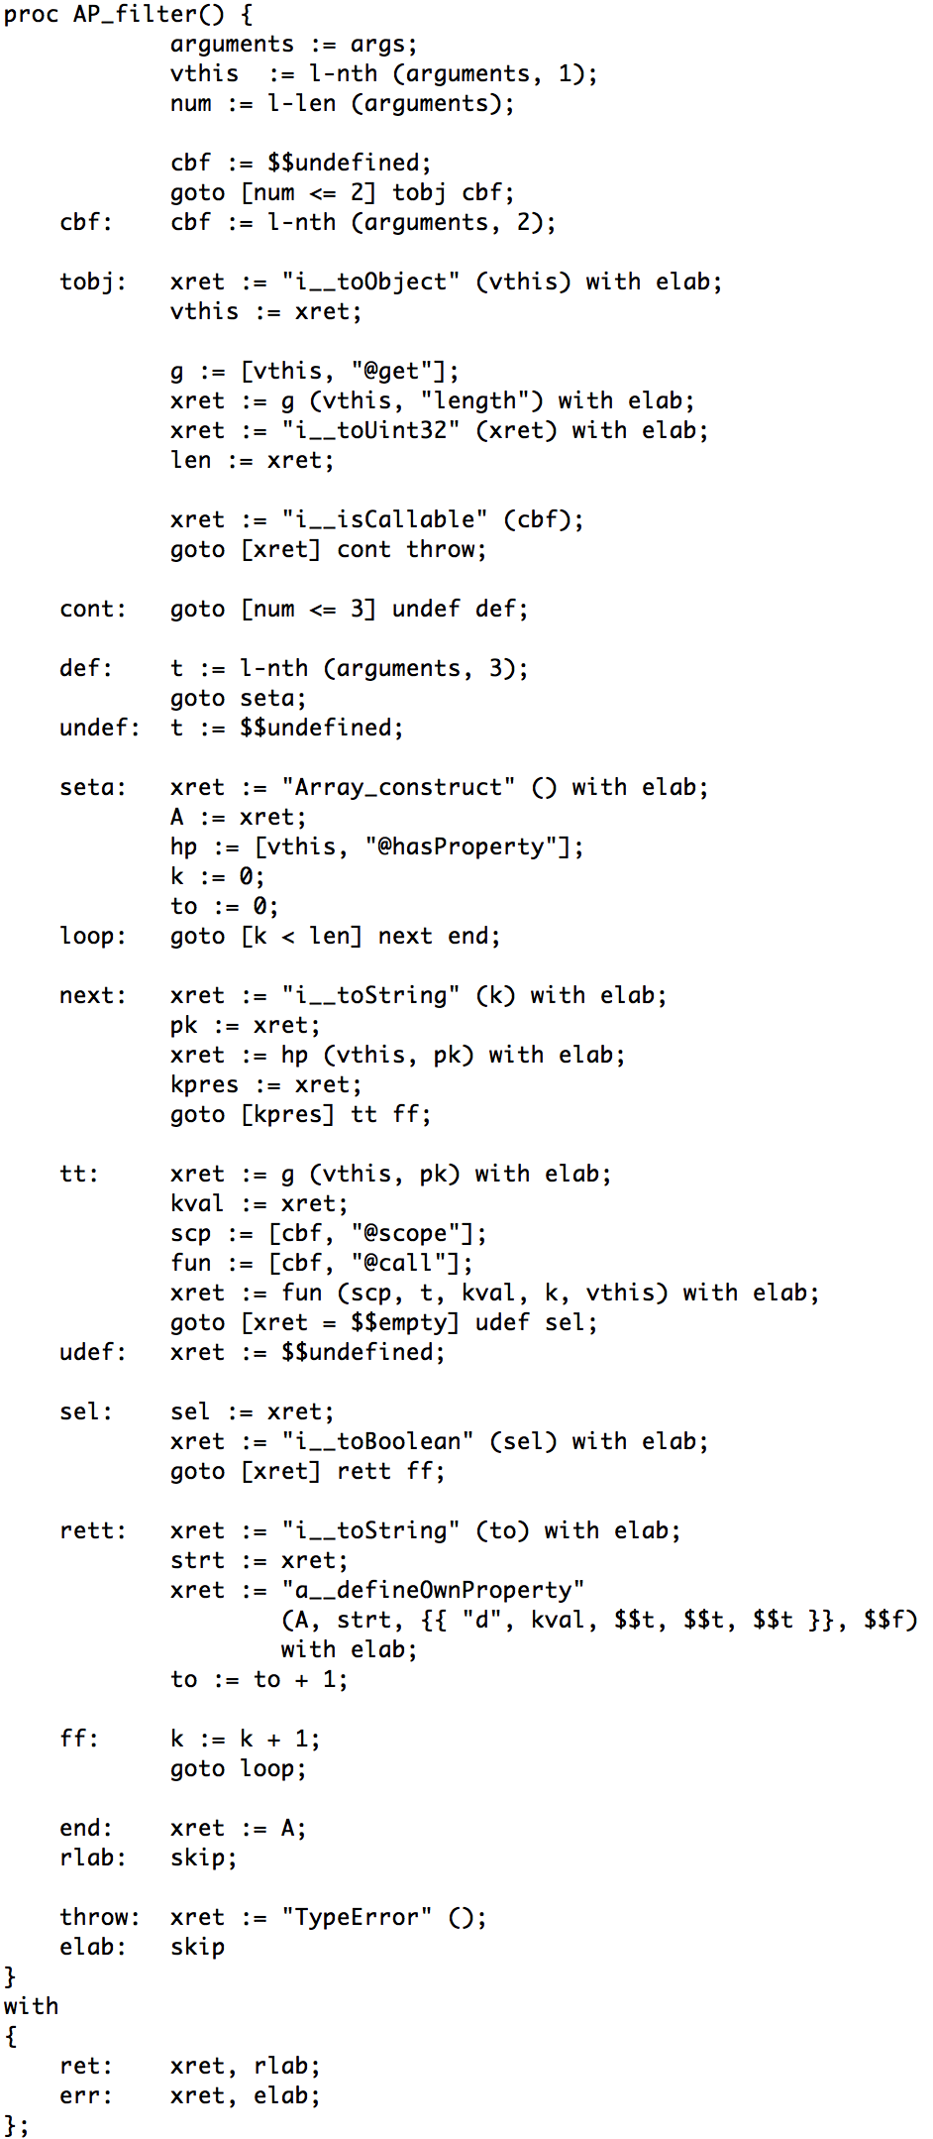
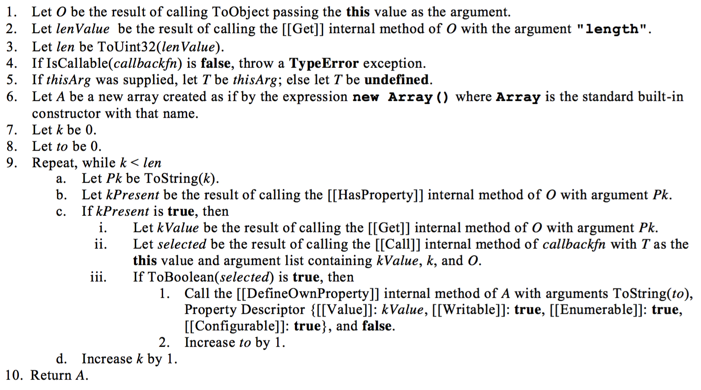
The Array Library
Example: Array.prototype.filter(filterFunction, [thisArg])
A comprehensive library of functions for manipulating JavaScript Array Objects:
toString, toLocaleString, concat, join, push, pop, reverse, shift, slice, sort, splice, unshift, indexOf, lastIndexOf, every, some, forEach, filter, map, reduce, reduceRight
20 pages of standard, around 1,500 lines of JSIL code
Specified operationally, some freedom left to programmer
Affecting around 1,800 tests
Substantial unit testing performed before pushing to repo
Notes:
Core of the project. Implementation following the standard. Mention quicksort. JSIL code illegible, but there to illustrate its size.

Slide 10
Extending the Coverage
What has been done?
Extending the language:
Arguments object
Extending the built-in libraries:
Object.prototype (entire)
Array (entire)
String (partial)
Quantity-wise:
Thirty-five methods implemented
Covering around forty pages of the standard
More than 2,000 lines of JSIL code
How has it been done?
Dominantly by relying on the ES5 English Standard
To a lesser extent, relying on the pre-existing and new pretty-big-step semantics
How has it been evaluated?
Pre-deployment unit testing
Tests created following the ES5 English standard
Post-deployment formal testing
Official Test262 Test Suite – much more complex than unit testing

Slide 11
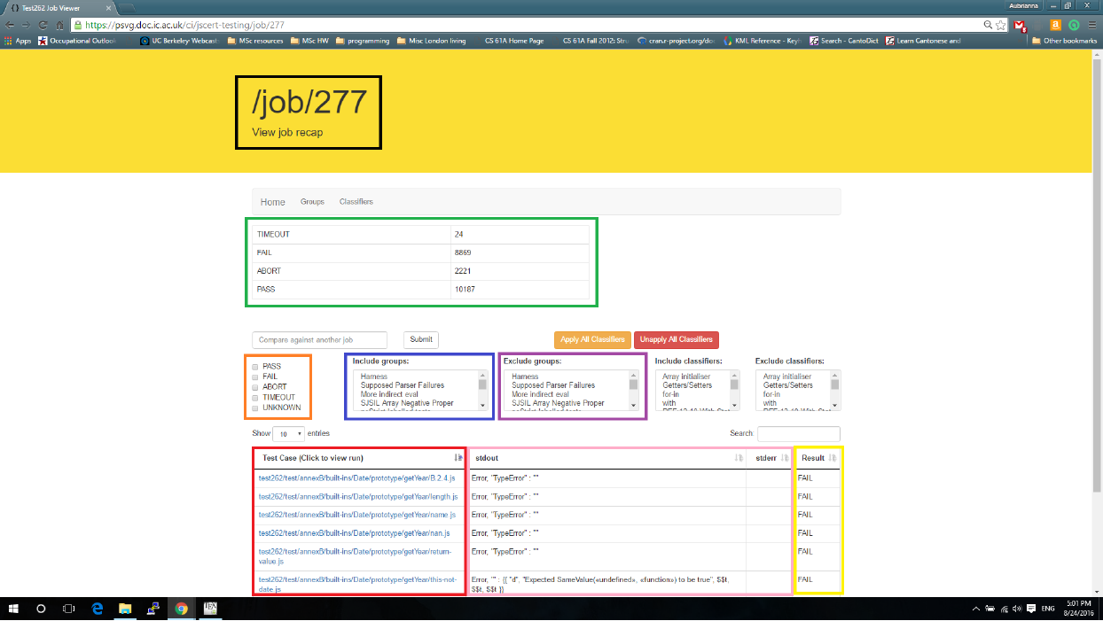
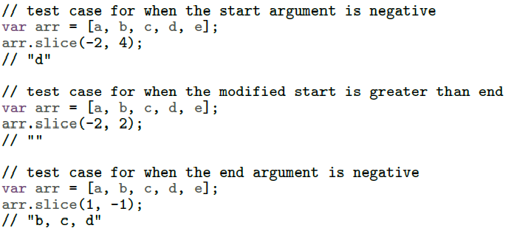
Testing
Official ECMAScript Test262 Test Suite
Tests much more complex than unit testing
Framework for continuous-integration tests at https://psvg.doc.ic.ac.uk/ci/jscert-testing/jobs
Demo of the testing framework
Unit testing
Based on the ES5 English standard: understanding all possible execution paths, then constructing and running tests that target those paths.
Written before JSIL implementation, with expected outcomes
Example: Array.prototype.slice(start, end)
Testing Results
Before: 5574 tests passing
Now: 2541 additional passes for 8025 total passing

Slide 12
Testing results for String
 | charAt |  | concat |  | indexOf |  | lastIndexOf |  | slice |  | substring |  | Total
 | Before | After | Before | After | Before | After | Before | After | Before | After | Before | After | Before | After
Pass | 5 | 23 | 5 | 18 | 6 | 27 | 6 | 20 | 5 | 31 | 5 | 39 | 32 | 158
Fail | 2 | 0 | 2 | 0 | 2 | 0 | 2 | 0 | 2 | 0 | 2 | 0 | 12 | 0
Abort | 18 | 0 | 13 | 0 | 28 | 7 | 14 | 0 | 27 | 1 | 35 | 1 | 135 | 9
Timeout | 0 | 0 | 0 | 0 | 0 | 0 | 0 | 0 | 0 | 0 | 0 | 0 | 0 | 0
Total | 25 | 23 | 20 | 18 | 36 | 34 | 22 | 20 | 34 | 32 | 42 | 40 | 179 | 167
Six methods from the String library implemented: charAt, concat, indexOf, lastIndexOf, slice, substring.
Why these? Independent of other unimplemented libraries, used in relevant tests.
Testing results breakdown:
126 additional test passes;
32 tests that were passing before implementation do not rely on actual implementation;
12 tests that were failing before implementation rely on ES6 semantics and are not applicable;
9 tests that still abort after implementation make use of unimplemented constructs.

Slide 13
Conclusions, Evaluation, Future Work
Summary
Extending the language:
Arguments object
Extending built-in libraries:
Object.prototype (entire)
Array (entire)
String (partial)
Testing:
Substantial unit tests
Testing using official test suite
2451 additional test passes
Evaluation
Understanding the ES5 Standard
Understanding operational semantics
Creating and running unit tests
Of great help with initial debugging
Coding in JSIL
Low-level goto language
Debugging difficult, language not fixed
The arguments object
Simpler than anticipated
Test262
Complex test cases, long running time
Unsuited for initial debugging
Using the testing infrastructure
Future Work
Extending built-in libraries:
Complete Number and String
Date, RegExp, JSON
Understand how to move to ES6
Verification tool:
Development of JaVerT
Notes:
Implementation – what was it based on (standard, opsem)
JSIL – programming not difficult, resembling assembly, but debugging + evolving language
Unit testing – greatly helped bug detection, reduced Test262 debugging time (shame we didn’t keep them)
Test262 experience – takes time, tests complex, unsuited for initial debugging
Experience with string in particular – how was the infrastructure?
Infrastructure - interface good, filtering, etc.
One important bit of possible future work is moving to the ES6 standard, but this still has to be investigate.

