Slide 1
Intermediate Language for JavaScript
Aubrianna Zhu

Slide 2
Context
DIAGRAM!

Slide 3
Contributions
DIAGRAM
ES5 Strict extensions
Arguments object
Libraries:
Array entire
Obj.proto entire
String partial
JSIL implementation
Unit tests
Formal tests (Test262) for the String bit

Slide 4
Object.prototype.isPrototypeOf
Purpose: to determine whether an object is in the prototype chain of another object
Syntax: prototypeObject.isPrototypeOf(object)
Return value: a Boolean indicating the result of prototype chain seach

Slide 5
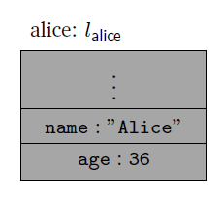
JavaScript Objects
var alice = {name: "Alice", age: 36};
Talk about properties/descriptors/attributes

Slide 6
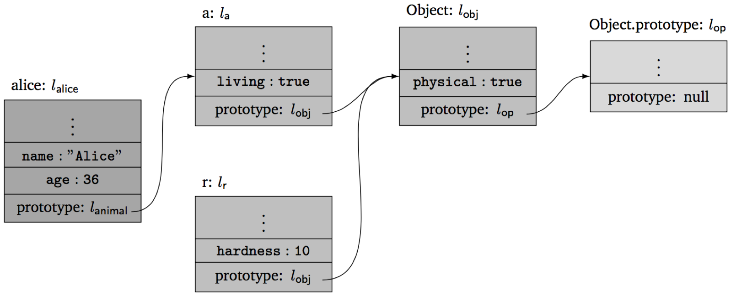
Prototype Inheritance
Object field lookup: o.x
Look for property x in the object o. If found, return its value.
Otherwise, look for property x in the prototype of object o.
And so on, until the end of the prototype chain.
For example:
alice.name = “Alice”
r.physical = true
alice.living = true
alice.weight = undefined
All objects share the methods of Object.prototype (valueOf)

Slide 7
JSIL: An Intermediate Language for JS Verification
Verification tools, esp. separation logic ones, compile to goto languages
JS control flow constructs fully dismantled in JSIL – simpler analysis
✓ Simple goto language
Expressions (e):
v
x
- e, e + e
typeOf(e)
e._{v}e, e._{o}e
base(e)
field(e)
nth (e, e)
Basic commands (bc):
skip
x := e
x := new()
x := [e, e]
[e, e] := e
delete (e, e)
x := hasField(e, e)
x := getFields(e)
Commands (c):
bc
goto i
goto [e] i j
x := e (e, …, e) with j
x = PHI (x, …, x)
✓ Extensible objects
✓ Dynamic field access
✓ Dynamic procedure calls
✓ Top-level procedures
Procedures (proc):
proc m(x, …, x) {c, …, c}

Slide 8
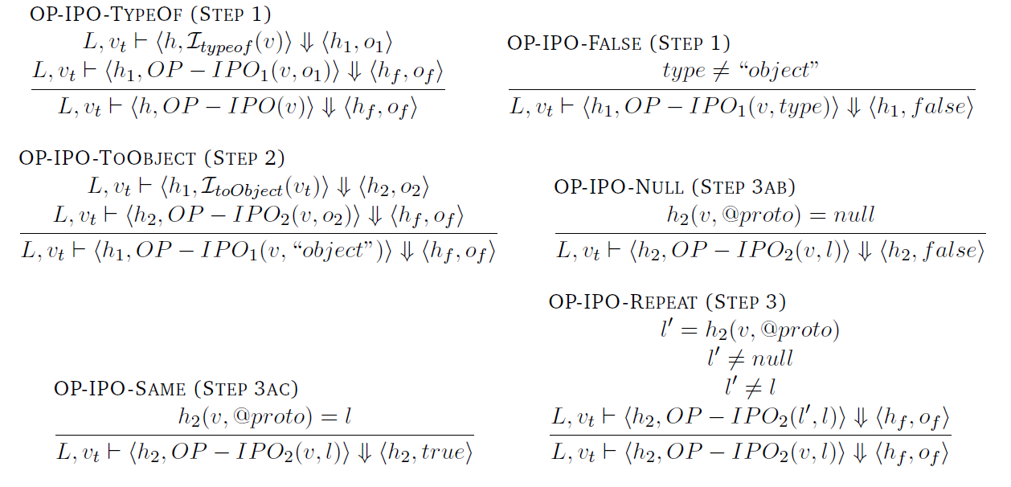
Object.prototype.isPrototypeOf
proc OP_isPrototypeOf(xsc, vthis, v) {
goto [typeOf(v) = $$object_type] obj fret;
obj: xret := "i__toObject" (vthis) with elab;
rep: v := [v, "@proto"];
goto [v = $$null] fret nnull;
nnull: goto [v = xret] tret rep;
tret: xret := $$t;
goto rlab;
fret: xret := $$f;
rlab: skip;
elab: skip
}
with
{
ret: xret, rlab;
err: xret, elab;
};
If V is not an object, return false.
Let O be the result of calling ToObject passing the this value as the argument.
Repeat
Let V be the value of the [[Prototype]] internal property of V .
if V is null, return false
If O and V refer to the same object, return true.

Slide 9
Coverage
What has been done
How? Standard, bit of opsem

Slide 10
Array Library
Unit tests before pushing to repo
Example (filter): standard, PBS, JSIL

Slide 11
Testing
Unit testing – how was it done?
Testing infrastructure – table
String stuff
Process (unit test + test suite)
Testing framework / interface

Slide 12
Testing results for String
List statistics for each method implemented

Slide 13
Conclusions and Evaluation
Implementation – what was it based on (standard, opsem)
JSIL – programming not difficult, resembling assembly, but debugging…
Unit testing – greatly helped bug detection, reduced Test262 debugging time (shame we didn’t keep them)
Test262 experience – takes time, tests complex, unsuited for intial debugging
Infrastructure - interface good, filtering, etc.

Slide 14
Future Work
Additional built-in libraries
Number
String
Date
RegExp
Other aspects of the verification tool
JSVerify
JaVerT

