Slide 1
Intermediate Language for JavaScript
Aubrianna Zhu

Slide 2
Context and Contributions
Provide infrastructure for the verification tool
Extend compilation tool for JSIL and test

Slide 3
JavaScript
Language of the web
Adds interactivity on web pages
Controls the Document Object Model
Security vulnerabilities such as cross-site scripting
Sample code snippet
(![]+[])[+!+[]]
Evaluates to “a”

Slide 4
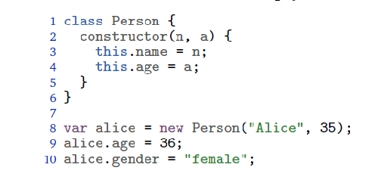
JavaScript Objects
An example:
Talk about properties/descriptors/attributes

Slide 5
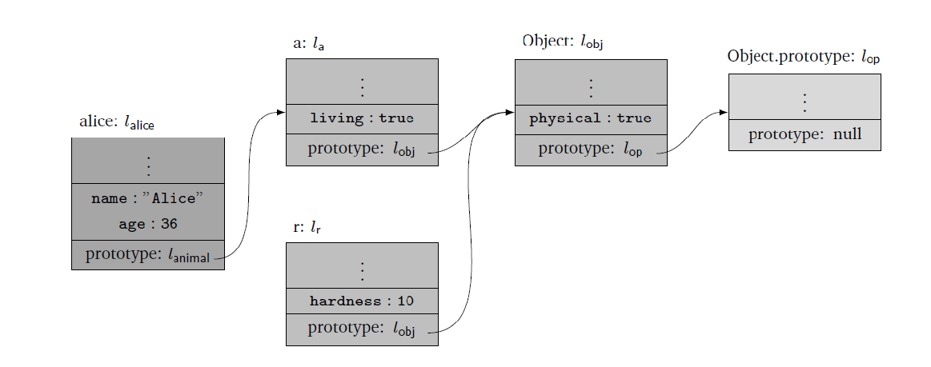
Prototype Inheritance
An example:

Slide 6
JSIL
Syntax + explain syntax

Slide 7
Object.prototype Library
Example (isPrototypeOf): standard, PBS, JSIL

Slide 8
JavaScript Arrays
Explain array properties
Example

Slide 9
Array Library
Unit tests before pushing to repo
Example (filter): standard, PBS, JSIL

Slide 10
Arguments Object
Explain
Show difference between strict and non strict (simpler)

Slide 11
Testing
Process (unit test + test suite)
Testing framework / interface

Slide 12
Testing results for String
List statistics for each method implemented

Slide 13
Future Work
Additional built-in libraries
Number
String
Date
RegExp
Other aspects of the verification tool
JSVerify
JaVerT

