Slide 1
Done by: Amrou Abas Budget: 10,000 €
Applied Genomics
Detection of genetic diversity and population structure in four Italian cattle breeds from different regions
1

Slide 2
Background Knowledge
❖ Before the beginning of the Second World War, the Italian government at that time neglected some cattle breeds due to their low production yield.
❖ However, this trend continued after the end of the second world war, which obliged the post war government to launch programs to repopulate these breeds.
❖ These breeds produced some types of cheese that are considered to be “authentic” and thus it had to be preserved.
❖ The Italian authorities classified them into 16 cattle breeds. In this project, four of these breeds will be analyzed in terms of genetic diversity and population structure.
2

Slide 3
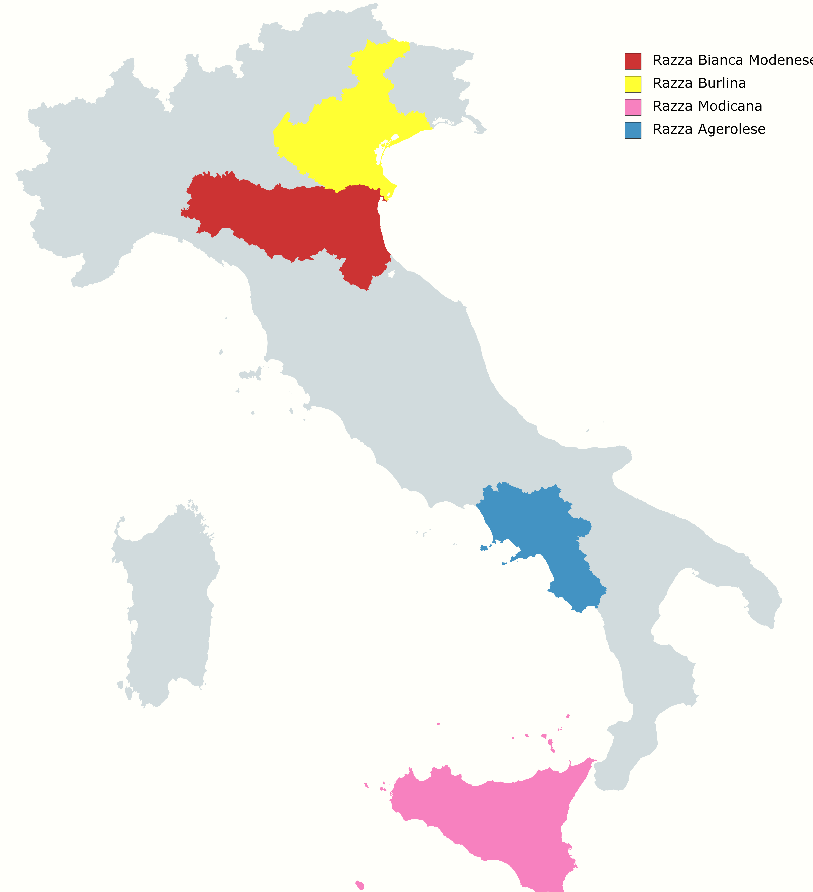
Overview of the breeds
❖ Burlina: Native to Veneto region, milk yield comparable to that of other Italian Alpine breeds, and about half that of a Friesian. The milk is traditionally used in the production of the regional Morlacco del Grappa cheese.
❖ Agerolese: Found in the region of Campania, famous for making Fior di Latte and Provolone del Monaco types of Cheese. Cows may give 20 L per day of milk with more than 3.5% fat.
❖ Modicana: Belongs to the Island of Sicily, its decline is linked to poor yield both in milk (3000 liters per year) and meat, famous for producing milk for Il Ragusano cheese.
❖ Bianca Modenese: Native to Emilia-Romagna, The Modenese is raised for milk and beef. Because of long selection for draught use. The milk is used to make the regional Parmigiano Reggiano type of cheese.
The regions in which each breed is spread.
❖❖ Additionally, a well-known comparative breed, Holstein, was included in the analysis as a reference.
3

Slide 4
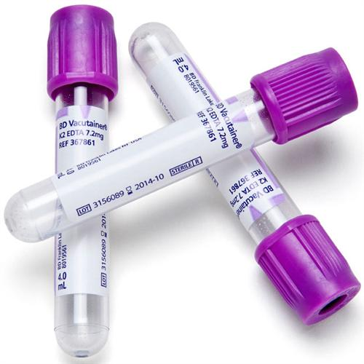
Conditions, sample collection and DNA extraction
❖ Total number of 24 cows (non-pregnant and unrelated) of each breed from various farms were selected. Pedigree information was taken from the respective farms, and cows were fed a Total Mixed Ration.
❖ All animals were kept under uniform management system with the same environment.
❖ Sample collection via EDTA VACUETTE® tubes and DNA extracted using DNeasy Blood and Tissue Kits and transported to the lab later in optimal conditions.
❖ The concentrations of dsDNA solutions were measured using a Qubit 3.0 fluorometer, The purity of DNA samples was checked by determining the OD260/280 ratio by using NanoDrop-2000. In addition, the DNA quality was checked using 1% agarose gel electrophoresis.
4

Slide 5
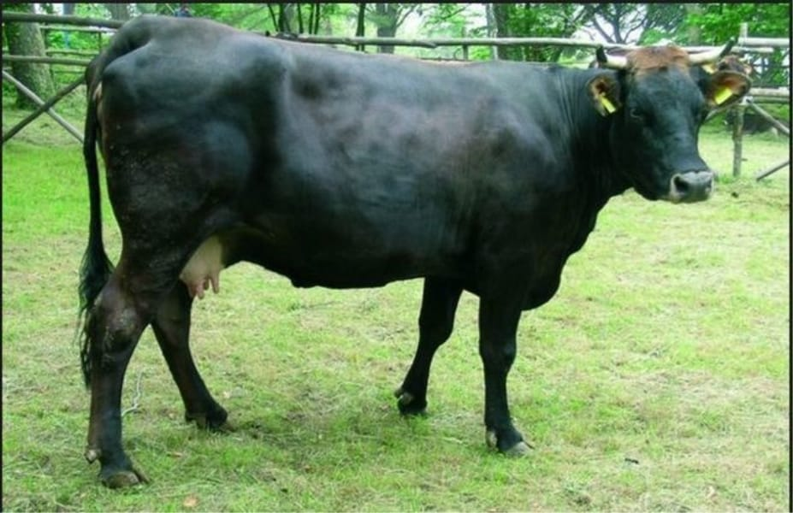
Genotyping and quality control
❖ The DNA samples were genotyped via the BovineHD BeadChip (777K) provided by Illumina according to their standard protocol, the same BeadChip used by Bahbahani et al for European Holsteins which we will take as a reference.
❖ PLINK was used to control the quality of the genotyping data.
❖ Only autosomal chromosomes were included, SNPs without known genomic position were excluded. Only SNPs with an individual call rate
of 90% were retained for further analysis.
❖ SNPs with a minor allele frequency (MAF) of less than 1% and with a significant deviation from Hardy-Weinberg equilibrium (HWE) were removed.
❖ The positions of SNPs were assigned according to
Bos Taurus genome assembly UMD 3.1.1.
Introduction to R
June 20, 2013
4 / 59
5

Slide 6
Measures placed to detect genetic diversity
❖ Within-population genetic diversity was evaluated using after LD-based pruning using PLINK.
❖ Five measures of genetic variability within populations were used to compare the level of heterogeneity: inbreeding coefficient, nucleotide diversity, effective number of alleles, heterozygosity, and allelic richness.
6

Slide 7
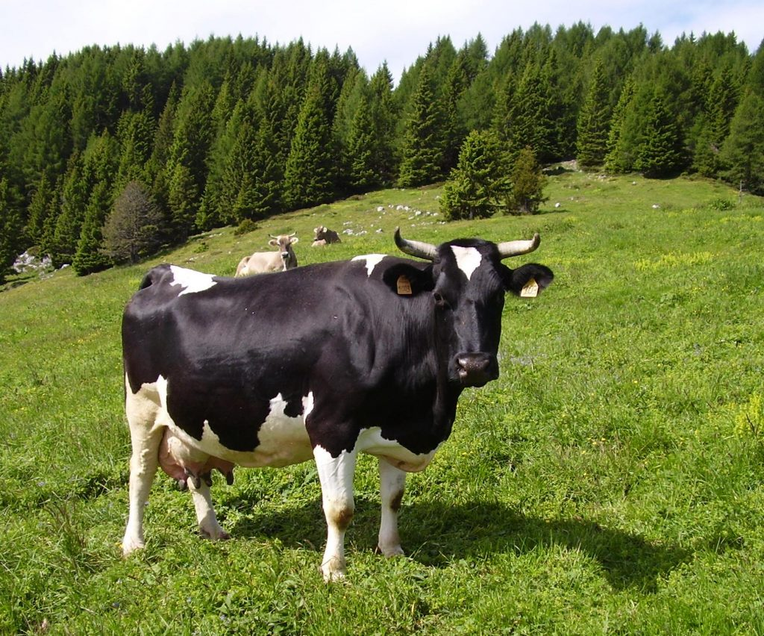
Runs of Homozigosity (ROH)
❖ The estimation of ROHs was done. One SNP with missing genotype was allowed and up to one possible heterozygous genotype in one run.
❖ To minimize false-positive results, we calculated the
minimum number of SNPs as well.
❖ The ROH number was estimated for each individual and then distributed between several ROH length classes.
❖ To estimate the proportion of genome
covered by different ROH segments, the sum of
ROHs for different minimum lengths was
calculated. The number and length of ROHs
were averaged per animal within each breed.
7

Slide 8
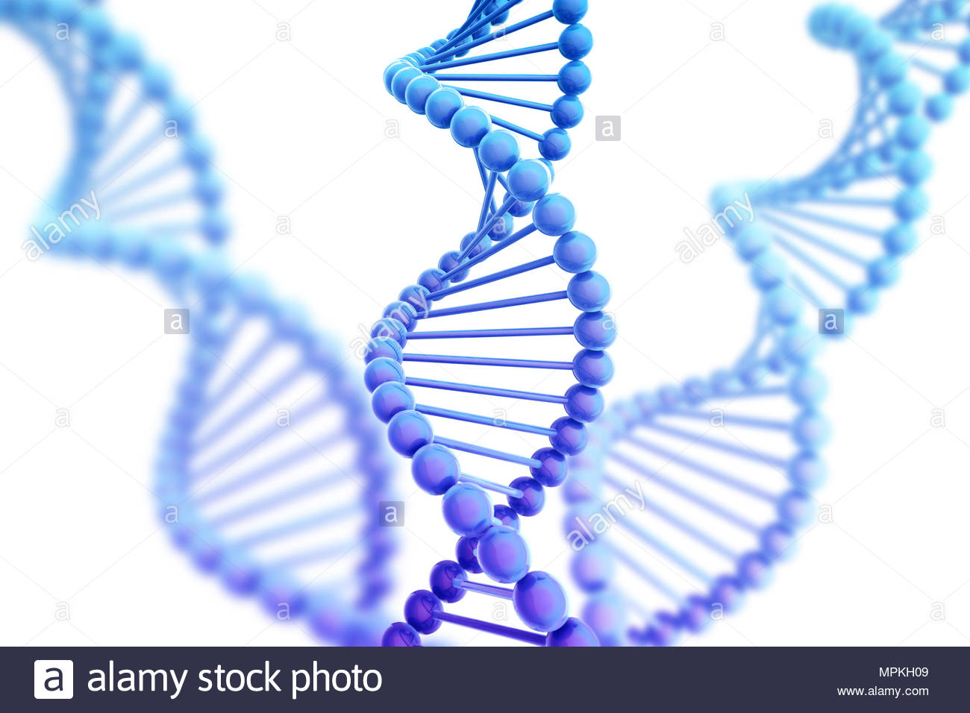
Population differentiation and genetic distance
❖ The pairwise identity-by-state (IBS) distances between all breeds were calculated using PLINK.
❖ A neighbor-joining relationship tree was constructed on the basis of Nei's genetic distance matrix.
❖ Fst was calculated (low MAF threshold), the top 0.1% Fst values will be used to represent the selection signature.
❖ Analysis of Molecular Variance
(AMOVA) was performed in three
different ways.
8

Slide 9
Further selection signature analyses
❖ We used hapFLK program to detect the signatures of selection through haplotype differentiation among the studied populations.
❖ We selected the overlapping ROH segments (with a minimal ROH length) shared by more than 50% of the samples as an indicator of possible ROH islands in the genome.
❖ The results obtained by the three different methods (Fst, hapFLK, and ROH) were compared, and genomic regions selected by at least two different methods were identified.
❖ Morever, we compared the identified genomic regions with the meta-assembly of selection signature in cattle.
9

Slide 10
Geographical distance, isolation by distance and population structure
❖ The geographical coordinates of the regions’ centers were taken as points of origin of the respective breeds. Thus, the geographical distances between the breeds’ geographical origins were calculated as the beeline distance. The geographical distances and the pairwise FST values were compared using Mantel's test.
❖ Population structure was analyzed to 5 hypothetical ancestral populations using ADMIXTURE and the cross-validation
error was used to estimate the most likely number of underlying ancestral populations of the present populations.
❖ Principal Component Analysis (PCA) was performed as well using PLINK.
10

Slide 11
Identification of genes and gene function within selected regions of the genome
❖ The FST statistic windows of the top 0.1% SNPs were investigated to select overlapping gene segments. For hapFLK and ROH analyses, the genes were selected if they were localized entirely or in part within the identified genomic regions. Gene identification was performed using Bos_taurus_UMD_3.1.1 genome assembly. The selected genes were considered as candidate genes.
❖ In addition, genes were compared with quantitative trait locus (QTL) regions included in the Cattle QTL database.
❖ Phenotypes that are known to be associated with the identified candidate genes were inferred from the most recent literature.
❖ The information for the annotation of some specific genes was sourced from Gene Cards.
11

Slide 12
Notable Expected Results
❖ It is anticipated that there is a positive correlation between genetic distance and Fst values. This will also be tested using Pearson’s correlation coefficient as well. A Venn diagram illustrating the distribution of the top 0.1% of SNPs by Fst value
between pairs of breeds will be realized as well.
❖ The hapFLK analysis will reveal any putative regions affected by selection, their sizes and on which autosomes they were distributed.
❖ As we mentioned earlier, the mean length of ROHs and the mean number of ROH will be calculated for all the four breeds and categorized as classes of ROH lengths.
12

Slide 13
Notable Expected Results
❖ AMOVA will reveal the percentage of genetic variability between and within breeds and it is expected that within breed genetic variance will account for the vast majority of the total variance, AMOVA will also determine if there is considerable variance among breeds.
❖ The cross-validation results generated from ADMIXTURE will give the optimal number of hypothetical ancestral population. To be compared with the neighbor-joining tree based on Nei's genetic distances and PCA’s results.
❖ Comparison of the genomic localisation of the region identified in our study by using FST, hapFLK, and ROH analyses will give a solid hypothesis about whether the genomic regions under putative selection are present or not in the studied breeds.
13

Slide 14
Notable Expected Results
❖ We will identify candidate genes within which the SNPs selected by FST analysis were localized, as well as the genes entirely or in part localized within the detected hapFLK regions and ROH islands.
14

Slide 15
A step further
❖ The study might indicate an alarming trend of reducing effective population size of those breeds.
❖ Native cattle breeds are usually known to carry specific signatures of selection reflecting their adaptation to the local environmental conditions and response to the breeding strategy used.
❖ The small number of animals per breed used in this study was a limitation, but it will not heavily affect the project since several distinct analyses were used.
❖ We deposited our Dataset files in the Dryad Digital Repository.
15

Slide 16
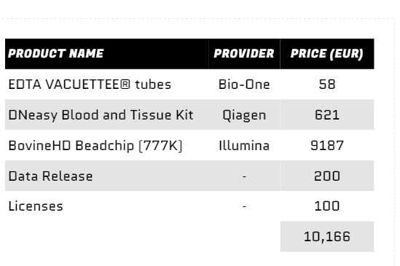
Costs:
16

