Slide 1
Cloud-Native Telecom
& Automation Revolution
مفهوم Cloud-Native في الاتصالات
Day 3 - Digital Transformation
PERFECT TRAINING CENTER

Slide 2
Our Digital Transformation Journey
What We've Built So Far:
📅 Day 1: Mastered Cloud Computing ☁️
📅 Day 2: Explored 5G & 6G Networks 📡
🎯 Today: Transform Telecom with Automation 🤖
💡 Connect Everything: Cloud + Networks + AI
🚀 Ready to revolutionize telecom operations!
PERFECT TRAINING CENTER
2

Slide 3
Today's Transformation Roadmap
Your Path to Telecom Automation:
1. Cloud-Native Fundamentals
  ➜ Why telecom is going cloud-native (15 min)
2. Orchestration & Automation
  ➜ MANO, Zero-touch, Intent-based (20 min)
3. Open RAN & AI Revolution
  ➜ Transforming network architecture (15 min)
4. DevOps for Telecom
PERFECT TRAINING CENTER
3

Slide 4
Quick Challenge: Spot the Difference!
Traditional Telecom 📟
🔧 Hardware-based
Dedicated physical appliances for each function
📦 Vendor lock-in
Proprietary systems creating single-vendor dependency
🐌 Slow deployment (months)
Months-long cycles for new service rollout
💰 High CAPEX
Significant upfront infrastructure investment
🔨 Manual operations
Labor-intensive, error-prone configuration
📊 Limited scalability
Constrained by physical capacity limits
Cloud-Native Telecom ☁️
💻 Software-defined
Network functions virtualized as cloud-native applications
🔓 Open standards
Multi-vendor interoperability through open interfaces
⚡ Rapid deployment (hours)
Services provisioned in hours, not months
💸 Pay-as-you-grow
OPEX-based consumption model, no upfront CAPEX
🤖 Automated everything
Zero-touch operations with self-healing capabilities
♾️ Infinite scalability
Elastic scaling that adapts to traffic demands instantly
PERFECT TRAINING CENTER
4

Slide 5
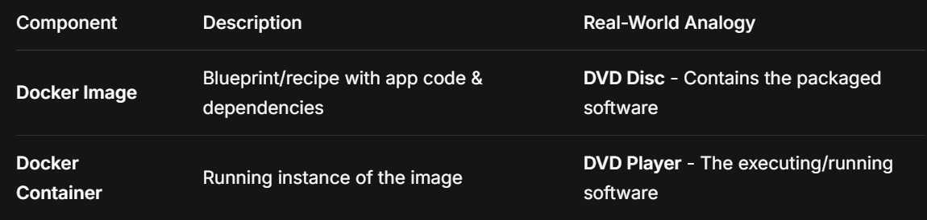
Cloud-Native: The New Telecom DNA
Core Principles of Cloud-Native Telecom:
Containerized: Everything runs in containers (Docker/K8s)
  "Package Your Application & Its Entire Environment"
  Each container includes: your code + runtime + libraries + system tools
  Creates a consistent, isolated environment that runs anywhere
Key Benefits
Consistency Across Environments
Instant Portability
  Run anywhere with Docker Engine:
    Your laptop
    Cloud providers (AWS, Azure, GCP)
    Edge devices
    On-premise servers
Lightning-Fast Scaling
  Start thousands of containers in seconds
  Perfect for handling traffic spikes
Isolation & Security
  Applications run in isolated environments
  Crash in one container doesn't affect others
PERFECT TRAINING CENTER
5

Slide 6
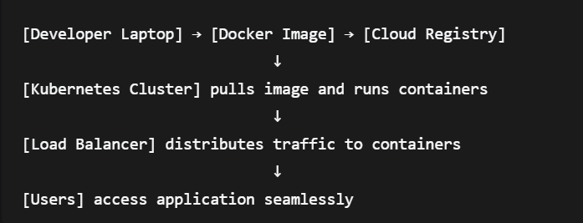
Cloud-Native: The New Telecom DNA
Core Principles of Cloud-Native Telecom:
Containerized: Everything runs in containers (Docker/K8s)
  Kubernetes: Container Orchestration
  🤔 Why We Need Orchestration?
    When you have hundreds of containers
    Need automatic management, scaling, and healing
    Require load balancing and service discovery
  What Kubernetes Does
  Deployment: "I want 10 copies of this container"
  Scaling: Automatically adds containers during traffic spikes
  Healing: Restarts failed containers automatically
  Load Balancing: Distributes traffic across containers
  Real-World Architecture
PERFECT TRAINING CENTER
5

Slide 7
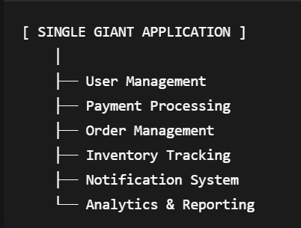
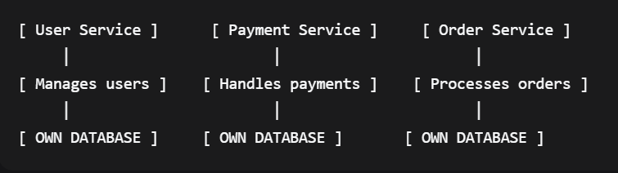
Cloud-Native: The New Telecom DNA
Core Principles of Cloud-Native Telecom:
Microservices: Break monoliths into small services
  Instead of one giant application, build many small, focused services
  Each service handles one business capability
  Services communicate through well-defined APIs
VS
PERFECT TRAINING CENTER
5

Slide 8
Cloud-Native: The New Telecom DNA
Core Principles of Cloud-Native Telecom:
CI/CD Pipeline: Continuous Integration/Deployment
  → Deploy updates multiple times per day
Observable: Monitor everything, everywhere
  → AI-powered insights and predictions
API-First: Everything talks through APIs
  → What is API-First?
  "Design APIs as the Foundation, Not an Afterthought"
  APIs become the contract between services
  Every component communicates through standardized interfaces
  ❌ Traditional (API-Last) ✅ API-First Approach
  [ Build Application ] → [ Add API ] → [ Hope It Works ] [ Design API Contract ] → [ Build Services ] → [ Seamless Integration ]
How Everything Communicates
[ Web App ] ────┐
│
[ Mobile App ] ─── ┼ ─── [ API GATEWAY ] ─── [ Microservices ]
│
[ Partner System ] ─┘
PERFECT TRAINING CENTER
5

Slide 9
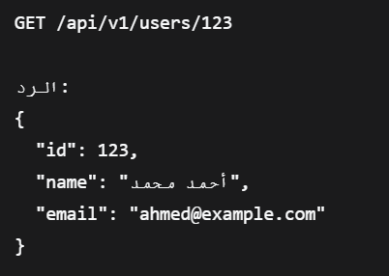
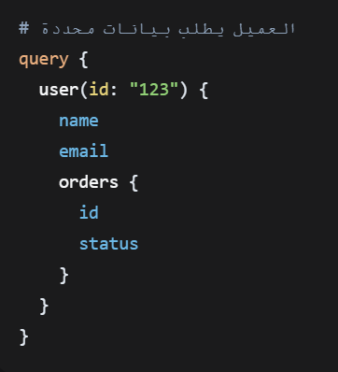
Cloud-Native: The New Telecom DNA
Core Principles of Cloud-Native Telecom:
Standardized Communication
RESTful APIs - HTTP/JSON for web services
  HTTP-based (GET/POST/PUT/DELETE)
  JSON/XML data format
  Stateless - each request independent
  Best for: CRUD operations
gRPC - High-performance internal communication
  gRPC = Google Remote Procedure Call
  gRPC = Google's Way of Calling Functions on Remote Computers
  result = employee_service.calculate_salary(employee_id) # ⬅️ الدالة شغالة على سيرفر تاني
  HTTP/2 protocol
  Bidirectional streaming
  7-10x faster than REST
  Best for: real-time apps
GraphQL - Flexible client-driven queries
  Client specifies exact data needed
  Strong typing system
  Best for: Complex apps
WebSocket - Real-time bidirectional communication
  Persistent connection
  Best for: Live chats, real-time dashboards
PERFECT TRAINING CENTER
5

Slide 10
The Telecom Transformation Imperative
Data Explosion: 1000x growth by 2030
  → 4K/8K video streaming
  VR/AR applications
  50 billion IoT devices
  Legacy systems can't handle this scale
  Cloud-native enables infinite scalability
Competition: OTT players eating revenue
  → Over-the-Top players eating revenue
  WhatsApp, Zoom, Netflix using your network for free
  Stealing voice and messaging revenue
  Must launch digital services faster to compete
5G Demands: Ultra-low latency, massive scale
  → Impossible without cloud-native
Customer Expectations: Netflix-like experience
  → Netflix-like digital experience
  Instant service activation
  Self-service management
  Seamless user experience
  Traditional telcos too slow
PERFECT TRAINING CENTER
6

Slide 11
Activity
Think and Try
PERFECT TRAINING CENTER
10

Slide 12
التحدي الاول: "أزمة الزحمة المفاجئة"
السيناريو:
خلال مباراة كأس العالم، انهارت شبكتك بسبب الزحمة:
٥٠٠٠٠ مستخدم في منطقة واحدة
خدمة الإنترنت انقطعت بالكامل
العملاء غاضبون
المطلوب منك:
كيف ستتعامل مع الأزمة فوراً؟
ما الحلول طويلة المدى لمنع تكرارها؟
كيف ستستخدم Cloud Native لحل المشكلة؟
PERFECT TRAINING CENTER
12

Slide 13
Orchestration: The Brain of Modern Telecom
Business Layer: Intent-Based Networking
What you want
Orchestration Layer: MANO / Service Orchestrator
How to achieve it
Control Layer: SDN Controllers / VIM
Network control
Infrastructure: Cloud / Edge / RAN
Physical resources
PERFECT TRAINING CENTER
7

Slide 14
Orchestration: The Brain of Modern Telecom
Business Layer
  Intent-Based Networking
  "What" not "How"
  Business objectives → Technical commands
  Example: "Improve gaming service quality by 30%"
Orchestration Layer
  MANO / Service Orchestrator
  The Strategic Planner
  Translates business intent into technical workflows
  Manages complete service lifecycle
Control Layer
  SDN Controllers / VIM
  The Tactical Commander
  Real-time network control
  Resource allocation and management
Infrastructure Layer
  Cloud / Edge / RAN
  Physical and virtual resources
  Where the actual work happens
PERFECT TRAINING CENTER
7

Slide 15
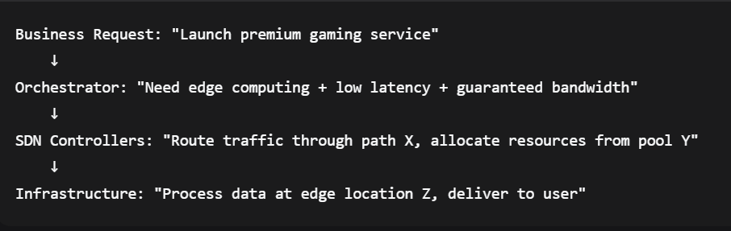
Orchestration: The Brain of Modern Telecom
How It Works: The 5G Gaming Example
Orchestration transforms telecom networks from static infrastructure into dynamic, intelligent business platforms that can adapt, scale, and innovate at digital speed.
"From manual operations to autonomous business engines"
PERFECT TRAINING CENTER
7

Slide 16
MANO: Management & Orchestration
NFVO
NFV Orchestrator
Orchestrates network services
VNFM
VNF Manager
Manages virtual functions
VIM
Virtual Infrastructure Manager
Controls compute/storage/network
PERFECT TRAINING CENTER
8

Slide 17
MANO: Management & Orchestration
How They Work Together
Customer Orders "5G Premium Service"
NFVO: "I need security + routing + optimization"
↓
VNFM: "I'll manage firewall, router, optimizer"
↓
VIM: "I'll provide servers and bandwidth"
↓
Service delivered seamlessly!
PERFECT TRAINING CENTER
8

Slide 18
Zero-Touch: Automation Levels
From Manual to Magical:
Level 0: Manual 🔨
  • Everything done by humans → Weeks to provision service
Level 1: Assisted 🤝
  • Tools help humans → Days to provision
Level 2: Partial Automation 🔄
  • Some tasks automated → Hours to provision
Level 3: Conditional Automation 🤖
  • Automated with human oversight → Minutes to provision
Level 4: High Automation 🚀
  • Fully automated operations → Seconds to provision
Level 5: Zero-Touch 🎯
  • Self-driving networks → Instant, predictive provisioning
PERFECT TRAINING CENTER
9

Slide 19
Zero-Touch: Automation Levels
مثال عملي: توصيل خدمة إنترنت جديد لعميل
المستوى 3: Conditional Automation
العميل يطلب الخدمة ↓
النظام بيجهز كل حاجة ↓
بيتفعل الخدمة ↓
المهندس بيشرف من بعيد ↓
مش بيحتاج يتدخل إلا لو في مشكلة
المستوى 4: High Automation
العميل يطلب الخدمة ↓
النظام بيتكلم مع كل الأجهزة ↓
بيجهز الخدمة ↓
بيتفعلها ↓
مفيش تدخل بشري خالص
المستوى 5: Zero-Touch
النظام بيحلل بيانات العميل ↓
بيتوقع إنه هيطلب الخدمة ↓
بيجهزها beforehand ↓
العميل مايلاقيش إلا "Activate" ↓
الخدمة شغالة على طول!
  المستوى 0: Manual
  العميل يروح الفرع ↓
  يوقع على أوراق ↓
  موظف يدخل البيانات يدوي ↓
  المهندس يروح للعميل ↓
  يضبط الراوتر يدوي ↓
  يختبر الخدمة ↓
  يطلع فاتورة يدوي
  المستوى 1: Assisted
  العميل يطلب أونلاين ↓
  النظام يساعده يملأ البيانات ↓
  بيظهر له الأخطاء ↓
  بيقترح أفضل باقة ↓
  لكن لسه محتاج تدخل بشري للتأكيد
  المستوى 2: Partial Automation
  العميل يطلب من التطبيق ↓
  النظام بيتعرف على العنوان ↓
  بيجهز الإعدادات ↓
  بيطلب من المهندس يضغط "موافق" ↓
  بيبدأ التوصيل
PERFECT TRAINING CENTER
9

Slide 20
Intent-Based Networking: Say What You Want
Business Intent
"I need 99.99% uptime
for video service"
AI Translation
Bandwidth: 10Gbps
Latency: <20ms
Redundancy: Active
Automated
Execution
✓ Done!
More Intent Examples:
"Reduce latency for gaming traffic by 50%" | "Block all suspicious traffic from region X" | "Optimize network for IoT devices in smart city"
PERFECT TRAINING CENTER
10

Slide 21
The Three Pillars of Intelligent Networks
[Intent-Based]
"عايزين خدمة بث حي latency منخفض جداً"
[MANO]
"هنسخدم edge computing + CDN + محتاج 3 VNFs"
[Zero-Touch]
"تم التنفيذ في 45 ثانية - الخدمة شغالة!"
PERFECT TRAINING CENTER
10

Slide 22
Open RAN (Radio Access Network )
The critical infrastructure that connects your mobile devices to the core network
Traditional RAN vs Open RAN:
🔒 Traditional RAN:
  • Single vendor lock-in
  • Proprietary interfaces
  • Slow innovation
🔓 Open RAN:
  • Multi-vendor ecosystem
  • Open interfaces (O-RAN Alliance)
  • Rapid innovation cycle
PERFECT TRAINING CENTER
11

Slide 23
Activity
Think and Try
PERFECT TRAINING CENTER
10

Slide 24
التحدي الثاني: "من مدير إلى مبرمج شبكات"
السيناريو:
أنت مدير شبكات في شركة اتصالات تقليدية، وطلب منك المدير:
"حول شبكتنا من نظام مغلق إلى نظام مفتوح خلال 6 أشهر"
المطلوب منك:
ما هي أول 3 خطوات ستبدأ بها؟
أي التقنيات ستختار ولماذا؟
كيف ستقنع فريقك المقاوم للتغيير؟
PERFECT TRAINING CENTER
12

Slide 25
AI: The Network's New Brain
👥 Customer Experience
Proactive issue resolution
50% less complaints
AI/ML
Engine
🛡️ Security & Fraud
Real-time threat detection
99% accuracy
🔮 Predictive Maintenance
Fix before it breaks
70% less downtime
🎯 Network Optimization
Self-optimizing parameters
25% better performance
PERFECT TRAINING CENTER
12

Slide 26
The Evolution of Network Engineers
👷 Traditional Network Engineer: (Yesterday)
  → CLI commands
  → Manual configuration
  → Hardware focused
  → Reactive troubleshooting
🦸 Cloud-Native Network Engineer: (Today)
  → Infrastructure as Code
  → API & Automation
  → Software-defined everything
  → Proactive optimization
🚀 Future Network Architect: (Tomorrow)
  → AI/ML specialist
  → Business translator
  → DevOps practitioner
  → Innovation driver
PERFECT TRAINING CENTER
13

Slide 27
Your Turn: Design an Automated Workflow
🎯 Challenge: Automate a Telecom Process
Choose a scenario:
📱 New customer onboarding
🔧 Network fault resolution
📈 Capacity expansion
🛡️ Security threat response
📝 Design: Current vs Automated process
⏱️ 5 minutes design → 3 minutes present
PERFECT TRAINING CENTER
14

Slide 28
Lab: Build Your First Orchestrated Workflow
🔬 What You'll Build Today
🎭 Create a service orchestration workflow
🔄 Automate VNF deployment
📊 Monitor service health
🚨 Implement auto-healing
📈 Scale based on demand
🎯 Result: Zero-touch service deployment!
PERFECT TRAINING CENTER
15

Slide 29
Lab Exercise: Service Orchestration
Step 1: Access Orchestrator
  → URL: orchestrator.perfect-tc.com
  → Login: student@perfect-tc
  → Select: Telecom Workspace
Step 2: Design Service
  → Choose: vIMS (Virtual IMS) template
  → Configure: 3 VNFs (P-CSCF, I-CSCF, S-CSCF)
  → Set: Auto-scaling policies
Step 3: Deploy & Monitor
  → Click: Deploy Service
  → Watch: Real-time provisioning
  → Check: Service health dashboard
Step 4: Test Automation
  → Simulate: Traffic spike
  → Observe: Auto-scaling in action
  → Verify: Self-healing works
PERFECT TRAINING CENTER
16

Slide 30
DevOps (Development and Opserations): How Telecom Develops Now
The DevOps Pipeline for Networks:
📝 Plan: Define network service requirements
💻 Code: Infrastructure as Code (IaC)
🔨 Build: Container images for VNFs
🧪 Test: Automated network testing
🚀 Deploy: CI/CD pipeline execution
📊 Monitor: Observability & AIOps
🔄 Feedback: Continuous improvement
  Tools: Analytics, ML
PERFECT TRAINING CENTER
17

Slide 31
GitOps: Git as Single Source of Truth
GitOps Workflow:
  1️⃣ Developer pushes network config to Git
  2️⃣ CI pipeline validates configuration
  3️⃣ Approved changes merged to main branch
  4️⃣ GitOps controller detects changes
  5️⃣ Automatically applies to production
  6️⃣ Monitors drift and auto-corrects
✨ Result: Version-controlled, auditable network!
PERFECT TRAINING CENTER
18

Slide 32
The Future is Already Here
🤖 Autonomous Networks: Level 5 automation by 2030
  → Networks that run themselves
🧬 Digital Twins: Virtual replica of entire network
  → Test changes before production
⚡ Quantum Networking: Ultra-secure communications
  → Teleportation of network state
🌐 Network as a Service: Complete abstraction
  → Business outcomes, not infrastructure
🎯 Intent-Everything: Natural language operations
  → Tell network what you want in plain English
♾️ Infinite Scalability: Serverless network functions
  → Scale to zero or millions instantly
PERFECT TRAINING CENTER
19

Slide 33
Your Future in Cloud-Native Telecom
High-Demand Roles & Skills:
☁️ Cloud Network Architect
  💰 $120K-200K | Design cloud-native networks
🤖 Network Automation Engineer
  💰 $100K-180K | Automate everything
🔧 DevOps Network Engineer
  💰 $95K-170K | CI/CD for networks
📊 AIOps Specialist
  💰 $110K-190K | AI-driven operations
🎯 Intent-Based Network Designer
  💰 $115K-195K | Business to tech translator
🛡️ Cloud Security Architect
  💰 $125K-210K | Secure the future
🚀 Start learning: Kubernetes, Python, Terraform, Ansible
PERFECT TRAINING CENTER
20

Slide 34
Success Stories: Cloud-Native Transformation
Rakuten 🇯🇵
100% cloud-native
70% cost reduction
Dish Network 🇺🇸
Greenfield 5G
First cloud-native in US
Telefonica 🇪🇸
UNICA platform
50% faster deployment
Vodafone 🇬🇧
Open RAN leader
40% CAPEX savings
PERFECT TRAINING CENTER
21

Slide 35
Today's Transformation Insights
1️⃣ Cloud-Native is the Future
  → Software-defined, automated, scalable
2️⃣ Automation is Essential
  → Zero-touch operations are possible today
3️⃣ Open Standards Win
  → Open RAN, O-RAN Alliance leading change
4️⃣ AI Drives Everything
  → From optimization to security
5️⃣ DevOps is the Way
  → CI/CD, GitOps, IaC for networks
PERFECT TRAINING CENTER
22

Slide 36
Your Cloud-Native Learning Path
📚 Essential Courses:
  • Kubernetes for Network Engineers
  • Network Automation with Python
  • CI/CD for Telecom (Jenkins/GitLab)
  • Open RAN Fundamentals
🛠️ Must-Learn Tools:
  • Kubernetes, Docker, Helm
  • Terraform, Ansible
  • Git, GitHub/GitLab
  • Prometheus, Grafana
📖 Key Certifications:
  • CKA (Certified Kubernetes Admin)
  • O-RAN Alliance Certification
  • DevOps Institute Certifications
  • Cloud Provider Network Certs
🌐 Communities:
  • CNCF Telecom User Group
  • Open RAN Community
  • Network Automation Forum
  • DevOps for Telecom Groups
PERFECT TRAINING CENTER
23

Slide 37
Your Mission: Design the Future
📋 Part 1: Research (45 min)
  → Find 3 cloud-native telecom deployments
  → Analyze their architecture
  → Identify automation strategies
🏗️ Part 2: Design (60 min)
  → Create automated workflow for Egyptian telco
  → Use orchestration concepts learned
  → Include AI/ML components
🚀 Part 3: Innovation (30 min)
  → Propose new telecom service
  → Must be cloud-native
  → Show business value
📧 Submit to: cloudnative@perfect-tc.com
PERFECT TRAINING CENTER
24

Slide 38
Let's Transform Together!
🎤 Your Questions Drive Innovation!
Frequent questions:
• How to start with cloud-native?
• Which tools to learn first?
• Open RAN opportunities in Egypt?
• Automation vs job security?
• Best path to DevOps?
PERFECT TRAINING CENTER
25

Slide 39
You Are the Transformation!
🌟 Your Journey Starts Now!
📚 3 days → 3 transformative technologies
☁️ Cloud + 5G + Automation = Future
🚀 You're ready for the revolution
💡 Egypt needs cloud-native leaders
🎯 Your skills are in high demand
Transform networks. Transform careers. Transform Egypt! 🇪🇬
PERFECT TRAINING CENTER
26

Slide 40
Thank You!
You're Ready to Lead the Cloud-Native Revolution!
Stay Connected:
📧 cloudnative@perfect-tc.com
🌐 www.perfect-tc.com
💬 WhatsApp: +20-XXX-XXX-XXXX
Perfect Training Center - Transforming Telecom Professionals

