Slide 1
🫁
VENTILATOR TRAINING ACADEMY
Ventilator Training Academy
AEMT & Paramedic Edition — nine modules from pulmonary physiology to transport of the mechanically ventilated patient, built around the Pulmonetic LTV 1200.
9 modules · 56 lessons · two-day course
Jordan Hunter Jones, NRP · Course Director
Notes:
Course cover. Welcome the cohort, cover objectives and device setup, then begin Module 1.

Slide 2
Course agenda
Day 1: Foundations (Modules 1–5). Day 2: Application (Modules 6–9), then the certification exam.
1
Pulmonary Anatomy & Physiology ~45 min · 7 lessons
6
LTV 1200 — The Platform Tour ~50 min · 6 lessons
2
Recognizing Respiratory Failure ~45 min · 7 lessons
7
Alarms & Troubleshooting ~55 min · 7 lessons
3
Indications for Ventilatory Support ~40 min · 6 lessons
8
Sedation & Analgesia ~40 min · 5 lessons
4
Vent Vocabulary & Initial Settings ~50 min · 6 lessons
9
Special Populations ~60 min · 6 lessons
5
Modes of Ventilation ~60 min · 6 lessons
■ Day 1 — Foundations (1–5) ■ Day 2 — Application (6–9)
Capstone: Final Certification Exam — 25 questions, 80% to pass. Lecture alone totals ~7 h 25 min, before interactives and breaks.
Notes:
Walk the cohort through the day. Keep everyone moving together — modules unlock in sequence.

Slide 3
1
VENTILATOR TRAINING ACADEMY
Module 1
Pulmonary Anatomy & Physiology
The foundational hour. Learn how a healthy breath works — then use that to read every vent for the rest of the course.
Foundations · 7 lessons
Jordan Hunter Jones, NRP · Course Director
Notes:
Module 1: Pulmonary Anatomy & Physiology. The foundational hour. Learn how a healthy breath works — then use that to read every vent for the rest of the course.

Slide 4
In this module
1.1
Anatomy The Path of a Breath
1.5
V/Q Matching Shunt vs Dead Space
1.2
Function Two Functional Zones
1.6
Compliance vs Resistance How the Lung Pushes Back
1.3
The Mental Model Ventilation vs Oxygenation — Two Knobs Each
1.7
The Bedside Test PIP vs Pplat
1.4
Dead Space Air That Doesn't Help You
Then:
Knowledge Check
Match
Scenario
Simulator
Notes:
Roadmap of the module. Teach the lessons in order, then run the four interactive components on learner devices.

Slide 5
1.1 · Anatomy
1.1
The Path of a Breath
A breath begins at the nose or mouth and travels through the pharynx, larynx, and trachea.
From the carina, air enters the right and left mainstem bronchi — but the fork is lopsided, like a highway splitting into two ramps.
Confirm ETT depth at the lip — approximately 21 cm in women, 23 cm in men — and verify with equal bilateral breath sounds and a normal capnography waveform.
Beyond the mainstem bronchi, the airway branches through approximately 23 generations to reach the alveoli.
CLINICAL PEARL
ETT depth at the lip
21 cm in women, 23 cm in men. Confirm with capnography and equal breath sounds after every patient transition — loading, lifting, elevator, gurney bump.
Notes:
A breath begins at the nose or mouth and travels through the pharynx, larynx, and trachea. The adult trachea is approximately 12 centimeters long and ends at the carina, the bifurcation roughly at the level of the fourth thoracic vertebra. From the carina, air enters the right and left mainstem bronchi — but the fork is lopsided, like a highway splitting into two ramps. The right ramp barely curves (about 25° from vertical), almost a straight continuation of the road; the left banks hard (about 45°). Push an ETT too deep and it takes the path of least resistance straight down the right ramp, leaving the left lung dark and silent. That asymmetry is exactly why an over-deep tube is almost always a right-mainstem tube — and why you listen over the LEFT chest first when breath sounds go one-sided. Confirm ETT depth at the lip — approximately 21 cm in women, 23 cm in men — and verify with equal bilateral breath sounds and a normal capnography waveform. Beyond the mainstem bronchi, the airway branches through approximately 23 generations to reach the alveoli. There are approximately 300 million alveoli per adult, with a combined surface area of roughly 70 square meters — about the size of a tennis court. PEARL — ETT depth at the lip: 21 cm in women, 23 cm in men. Confirm with capnography and equal breath sounds after every patient transition — loading, lifting, elevator, gurney bump.

Slide 6
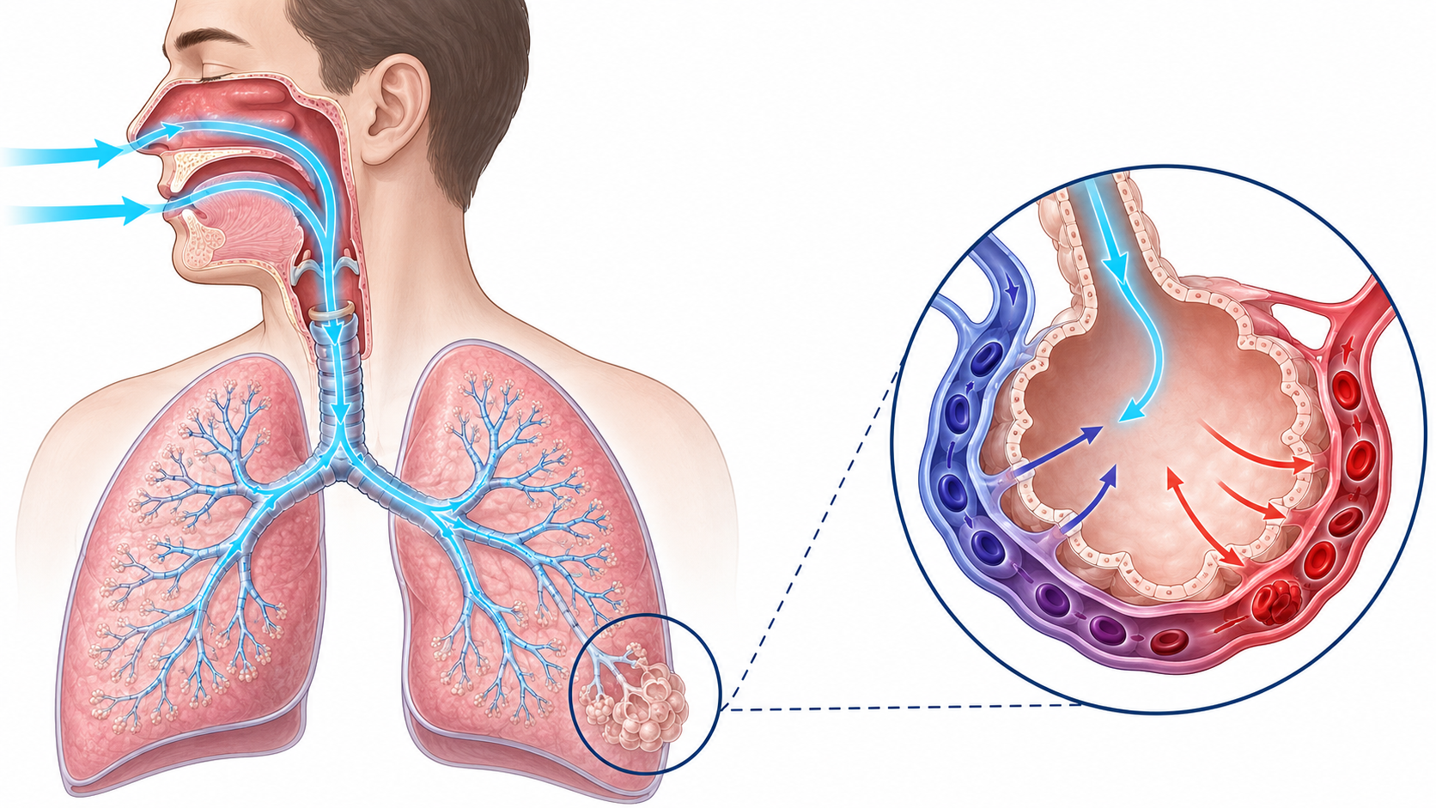
1.1 · Anatomy
1.1
The Path of a Breath
Notes:
Figure for 1.1. Trace the route with a finger: nose/mouth, pharynx, larynx, trachea, carina, then the lopsided fork. Stop on the fork and make them say out loud why an over-deep tube goes right. Then point at the lip mark: 21 cm women, 23 cm men, reconfirmed after every movement.

Slide 7
1.2 · Function
1.2
Two Functional Zones
The pulmonary system has two zones. The conducting zone is everything from the mouth to the terminal bronchioles. It moves air. No gas exchange occurs here.
The respiratory zone is where gas exchange happens. Type I pneumocytes form the thin alveolar wall (0.2–0.5 µm thick — about 1/100 the diameter of a red blood cell). Type II pneumocytes produce surfactant.
Picture two soap bubbles tied to the ends of a straw, one small and one large. By Laplace's law the small bubble has the higher pressure, so it empties itself into the big one and collapses.
When the soap is gone, PEEP is your bedside replacement: it is the doorstop you wedge under each alveolus, splinting it open mechanically until surfactant function returns.
EVIDENCE
Surfactant and PEEP
Conditions that damage Type II pneumocytes produce a stiff lung with refractory hypoxia. The bedside fix is PEEP — not more FiO₂.
Notes:
The pulmonary system has two zones. The conducting zone is everything from the mouth to the terminal bronchioles. It moves air. No gas exchange occurs here. The volume that fills it on each breath is anatomic dead space — approximately 2 mL per kilogram of body weight, or about 150 mL in a 70 kg adult. The respiratory zone is where gas exchange happens. Type I pneumocytes form the thin alveolar wall (0.2–0.5 µm thick — about 1/100 the diameter of a red blood cell). Type II pneumocytes produce surfactant. Picture two soap bubbles tied to the ends of a straw, one small and one large. By Laplace's law the small bubble has the higher pressure, so it empties itself into the big one and collapses. Alveoli would do the same to each other on every exhale — except for surfactant, the dish soap Type II cells make to lower that surface tension so the smallest alveoli survive instead of caving into their neighbors. ARDS, smoke inhalation, drowning, and gastric aspiration all damage Type II cells or wash the soap out. When the soap is gone, PEEP is your bedside replacement: it is the doorstop you wedge under each alveolus, splinting it open mechanically until surfactant function returns. EVIDENCE — Surfactant and PEEP: Conditions that damage Type II pneumocytes produce a stiff lung with refractory hypoxia. The bedside fix is PEEP — not more FiO₂.

Slide 8
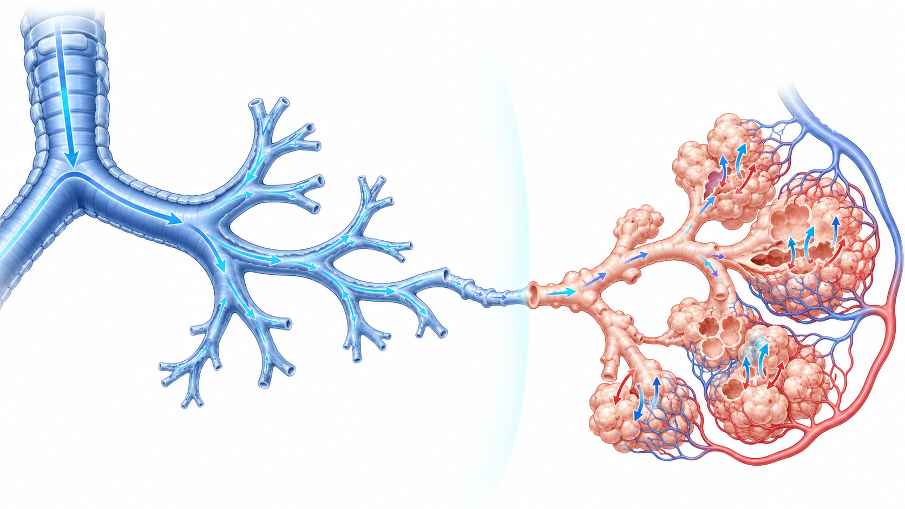
1.2 · Function
1.2
Two Functional Zones
Notes:
Figure for 1.2. Have the cohort draw the line between conducting and respiratory zone before you reveal it. Everything proximal to that line is dead space; everything distal is where gas exchange happens. Then connect to surfactant and PEEP as the bedside substitute.

Slide 9
1.3 · The Mental Model
1.3
Ventilation vs Oxygenation — Two Knobs Each
This is the single most useful mental model in mechanical ventilation — memorize it now. Picture the lung as a house with two completely separate chores, each with its own set of controls.
Ventilation is taking out the trash — clearing CO₂. You run it with two knobs: Respiratory Rate (RR) and Tidal Volume (Vt) — how often the trash goes out and how big each load is.
Oxygenation is bringing in the groceries — loading O₂ across the alveolar membrane into the blood.
Most ventilator errors are turning the wrong knob — bumping FiO₂ to fix a rising CO₂, or cranking the rate to fix a low saturation. Pair them in your head: RR + Vt for ventilation, FiO₂ + PEEP for oxygenation.
CLINICAL PEARL
Two knobs each
Ventilation = RR + Vt. Oxygenation = FiO₂ + PEEP. On the final exam. At every bedside for the rest of your career.
Notes:
This is the single most useful mental model in mechanical ventilation — memorize it now. Picture the lung as a house with two completely separate chores, each with its own set of controls. Confusing the two is the most common ventilator mistake there is. Ventilation is taking out the trash — clearing CO₂. You run it with two knobs: Respiratory Rate (RR) and Tidal Volume (Vt) — how often the trash goes out and how big each load is. Their product is Minute Ventilation. PaCO₂ too high? Turn one up. Too low? Turn one down. Oxygenation is bringing in the groceries — loading O₂ across the alveolar membrane into the blood. It runs on two different knobs: FiO₂ (how oxygen-rich the incoming air is) and PEEP (the pressure that holds alveoli open at end-expiration). SpO₂ too low? Raise FiO₂ first, then PEEP if you suspect shunt physiology. Running the trash out more often will never restock the fridge. Most ventilator errors are turning the wrong knob — bumping FiO₂ to fix a rising CO₂, or cranking the rate to fix a low saturation. Pair them in your head: RR + Vt for ventilation, FiO₂ + PEEP for oxygenation. Trash and groceries — two chores, two sets of knobs. PEARL — Two knobs each: Ventilation = RR + Vt. Oxygenation = FiO₂ + PEEP. On the final exam. At every bedside for the rest of your career.

Slide 10
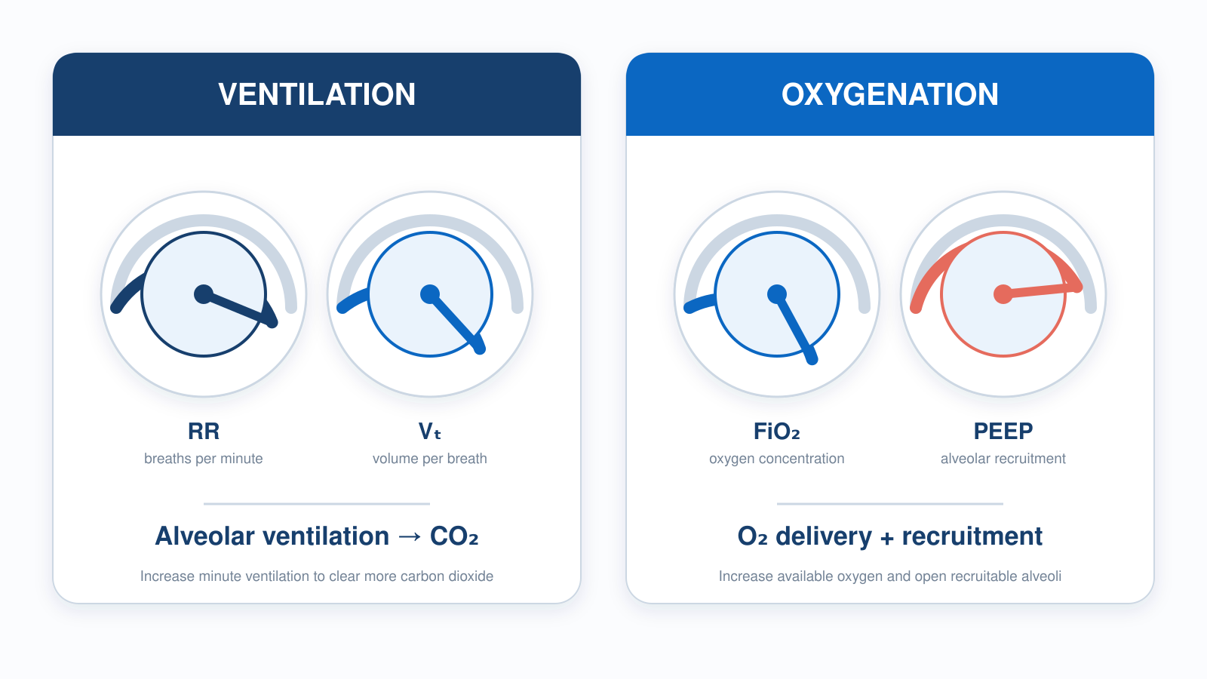
1.3 · The Mental Model
1.3
Ventilation vs Oxygenation — Two Knobs Each
Notes:
Figure for 1.3. This is the single most useful slide in the course. Cover the labels and quiz them cold: CO2 too high, which two knobs? Sat too low, which two? Do not move on until every learner pairs RR + Vt with ventilation and FiO2 + PEEP with oxygenation without hesitating.

Slide 11
1.4 · Dead Space
1.4
Air That Doesn't Help You
Every breath is like mailing a package down a long hallway to a room at the far end. The hallway holds air but does no gas exchange — anything that never reaches the room is wasted effort.
Anatomic dead space is the volume of the conducting airways: approximately 2 mL per kilogram of body weight.
Total physiologic dead space is normally about 30% of tidal volume in a healthy adult. A study by Nuckton and colleagues (NEJM 2002) showed that VD/VT greater than 0.6 in ARDS strongly predicts mortality.
The practical bedside implication: tidal volume must be large enough to overcome dead space. Set Vt too low and the whole breath gets stuck in the hallway — dead space eats it before any reaches the room.
Notes:
Every breath is like mailing a package down a long hallway to a room at the far end. The hallway holds air but does no gas exchange — anything that never reaches the room is wasted effort. That wasted volume is dead space: the part of every breath that does not participate in gas exchange. It comes in three kinds. Anatomic dead space is the volume of the conducting airways: approximately 2 mL per kilogram of body weight. Alveolar dead space is the volume of alveoli that are ventilated but not perfused — for example, downstream of a pulmonary embolism. Equipment dead space is the volume of the vent circuit between the ETT tip and the Y-piece — up to 80 to 90 mL on an adult circuit. Total physiologic dead space is normally about 30% of tidal volume in a healthy adult. A study by Nuckton and colleagues (NEJM 2002) showed that VD/VT greater than 0.6 in ARDS strongly predicts mortality. The practical bedside implication: tidal volume must be large enough to overcome dead space. Set Vt too low and the whole breath gets stuck in the hallway — dead space eats it before any reaches the room. Aim for 6–8 mL per kg of ideal body weight in most adults; 4–6 mL/kg IBW in ARDS.

Slide 12
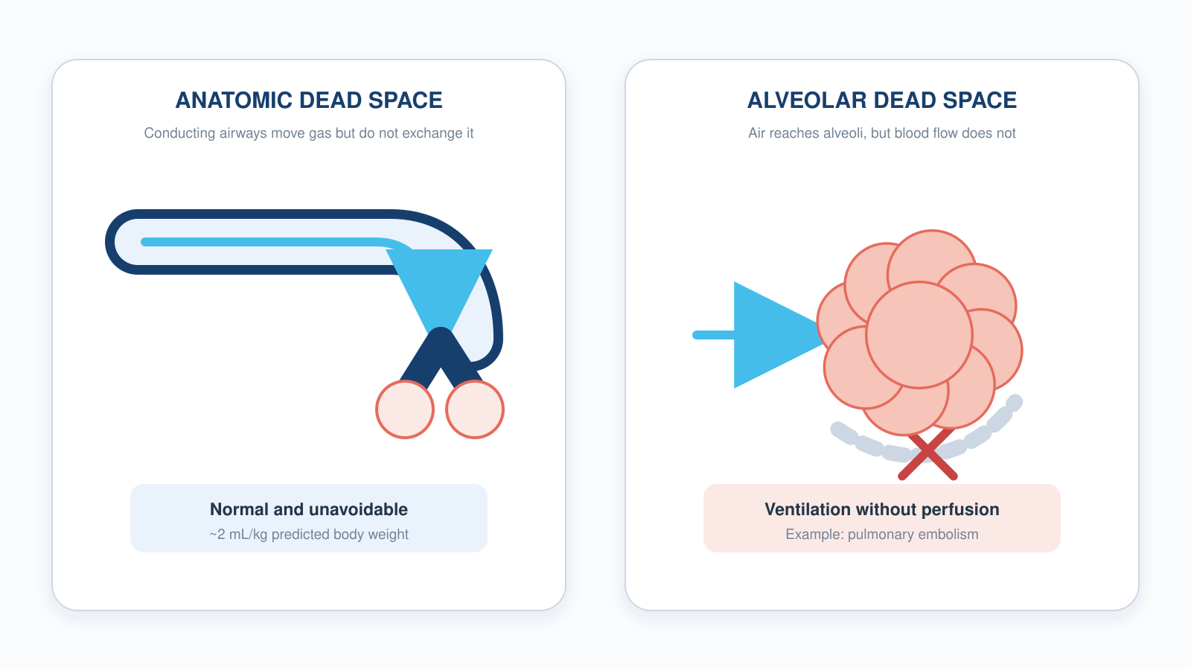
1.4 · Dead Space
1.4
Where the Breath Is Wasted
Notes:
Figure for 1.4. Walk the three compartments: anatomic (~2 mL/kg PBW), alveolar (ventilated but not perfused — think PE), and equipment (the circuit between the tube and the Y-piece, up to 80-90 mL on an adult set). The equipment column is the one that bites you in pediatrics.

Slide 13
1.5 · V/Q Matching
1.5
Shunt vs Dead Space
Picture a bus line where the buses are air and the passengers are blood. Gas exchange only happens where a bus and its passengers actually meet.
Shunt is passengers crowding a stop the bus skips entirely — perfusion with no ventilation, V/Q approaching zero. Pneumonia, pulmonary edema, ARDS, and atelectasis all produce shunt.
Dead space is the mirror image: a bus running its full route past empty stops — ventilation with no perfusion. Pulmonary embolism, low cardiac output, and severe hypovolemia produce dead-space physiology.
Hypoxic Pulmonary Vasoconstriction (HPV) is a partial auto-correction: the lung constricts arterioles in poorly ventilated regions, diverting blood toward better-ventilated alveoli.
CLINICAL PEARL
FiO₂ alone won't fix shunt
If a patient on a non-rebreather at flush rate is still hypoxic, suspect shunt. The bedside fix is PEEP, often via CPAP.
Notes:
Picture a bus line where the buses are air and the passengers are blood. Gas exchange only happens where a bus and its passengers actually meet. That match-up is V/Q, and disease breaks it in one of two opposite directions. Shunt is passengers crowding a stop the bus skips entirely — perfusion with no ventilation, V/Q approaching zero. Pneumonia, pulmonary edema, ARDS, and atelectasis all produce shunt. The hallmark is refractory hypoxia: you can send more buses (crank FiO₂ to 100%) but they keep driving past the skipped stop, so saturation barely moves. The bedside fix is PEEP, which re-opens the stop — recruiting collapsed alveoli so the bus can finally pick those passengers up. Dead space is the mirror image: a bus running its full route past empty stops — ventilation with no perfusion. Pulmonary embolism, low cardiac output, and severe hypovolemia produce dead-space physiology. The hallmark is a widening gap between PaCO₂ and EtCO₂: those empty-stop alveoli exhale air carrying almost no CO₂. The fix is getting passengers back to the stops — improving perfusion with fluids, pressors, or treating the embolism. Hypoxic Pulmonary Vasoconstriction (HPV) is a partial auto-correction: the lung constricts arterioles in poorly ventilated regions, diverting blood toward better-ventilated alveoli. HPV is incomplete; in significant disease, it is not enough. PEARL — FiO₂ alone won't fix shunt: If a patient on a non-rebreather at flush rate is still hypoxic, suspect shunt. The bedside fix is PEEP, often via CPAP.

Slide 14
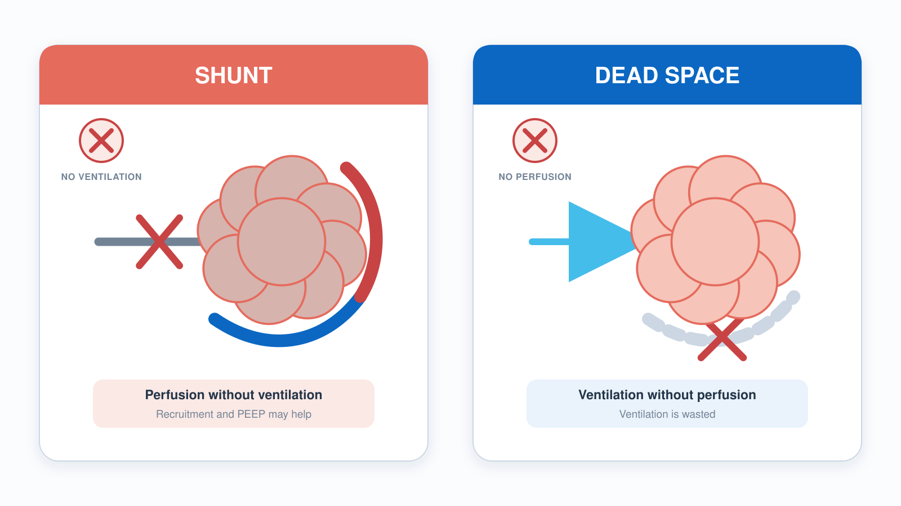
1.5 · V/Q Matching
1.5
Shunt vs Dead Space
Notes:
Figure for 1.5. Two failures, opposite directions. Shunt is perfusion without ventilation and the fix is PEEP, not FiO2. Dead space is ventilation without perfusion and the fix is restoring flow. Have them name the bedside signature of each before you show the captions: refractory hypoxia versus a widening PaCO2-EtCO2 gap.

Slide 15
1.6 · Compliance vs Resistance
1.6
How the Lung Pushes Back
Imagine blowing up a balloon through a straw — two completely separate things can make it hard. The first is the balloon's stiffness. That is compliance: how much volume the lung accepts for a given pressure.
The second is the straw's narrowness. That is resistance: how hard the airway pushes back against airflow.
Both can raise PIP on the ventilator — but only reduced compliance raises Pplat. That distinction is the foundation of bedside troubleshooting and the subject of the next lesson.
Notes:
Imagine blowing up a balloon through a straw — two completely separate things can make it hard. The first is the balloon's stiffness. That is compliance: how much volume the lung accepts for a given pressure. A brand-new, stiff balloon (the ARDS lung) fights every breath; a worn-in one gives easily. Normal adult static compliance is 60–100 mL per cmH₂O; ARDS can drop it to 20–30 — a very stiff balloon. The second is the straw's narrowness. That is resistance: how hard the airway pushes back against airflow. Pinch the straw — bronchospasm, a mucus plug, a kinked tube — and you must push far harder for the same airflow. Normal airway resistance is 1–2 cmH₂O per liter per second; severe asthma can push it to 15–20. Both can raise PIP on the ventilator — but only reduced compliance raises Pplat. That distinction is the foundation of bedside troubleshooting and the subject of the next lesson.

Slide 16
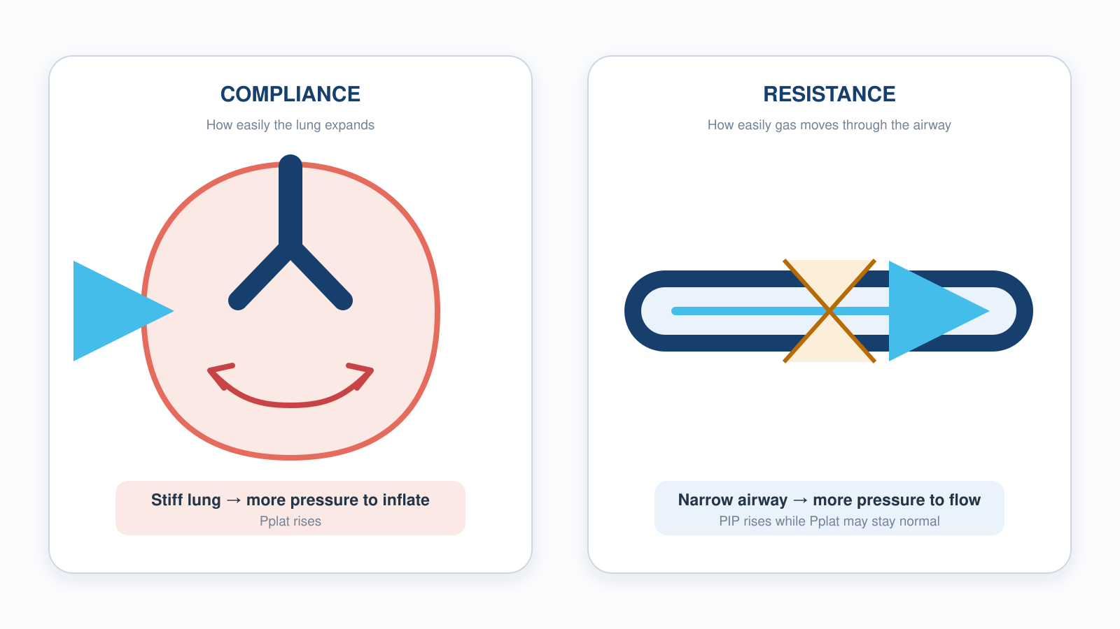
1.6 · Compliance vs Resistance
1.6
Two Ways the Lung Pushes Back
Notes:
Figure for 1.6. Note the right-hand caption carefully — it previews the next lesson. Reduced compliance raises Pplat. Increased resistance raises PIP while Pplat may stay normal. That single asymmetry is the whole basis of bedside troubleshooting.

Slide 17
1.7 · The Bedside Test
1.7
PIP vs Pplat
Picture pushing water through a hose that has a narrow nozzle (the airways) and a balloon on the end (the alveoli).
The relationship is mechanical: PIP is approximately Pplat plus (Resistance × Flow). Clog the nozzle and resistance rises — PIP climbs but Pplat does not. Stiffen the balloon and both rise together.
Bedside interpretation: High PIP + normal Pplat means an AIRWAY problem (resistance) — mucus plug, biting on the tube, bronchospasm, kinked tube.
Driving pressure (Pplat minus PEEP) is a strong mortality predictor in ARDS (Amato 2015, NEJM). The commonly taught target of ΔP under 14 cmH₂O is derived from that analysis, not a threshold any trial tested. Both Pplat and ΔP are only valid in a passive patient — if they are triggering, the numbers lie. More in Modules 4 and 9.
CLINICAL PEARL
PIP up, Pplat up?
Both up = lung problem. PIP up but Pplat normal = airway problem. The bedside test takes 3 seconds — press the inspiratory hold button.
Notes:
Picture pushing water through a hose that has a narrow nozzle (the airways) and a balloon on the end (the alveoli). Peak Inspiratory Pressure (PIP) is the pressure while water is still flowing — it includes the squeeze through the nozzle. Hit the inspiratory hold (about 0.5 seconds, no flow) and you feel only the balloon's stretch: that is Plateau Pressure (Pplat), which reflects alveolar pressure — a measure of compliance. The relationship is mechanical: PIP is approximately Pplat plus (Resistance × Flow). Clog the nozzle and resistance rises — PIP climbs but Pplat does not. Stiffen the balloon and both rise together. Bedside interpretation: High PIP + normal Pplat means an AIRWAY problem (resistance) — mucus plug, biting on the tube, bronchospasm, kinked tube. High PIP + high Pplat means a LUNG problem (compliance) — pneumothorax, mainstem migration, worsening ARDS, pulmonary edema. Driving pressure (Pplat minus PEEP) is a strong mortality predictor in ARDS (Amato 2015, NEJM). Note carefully what that study was and was not: it was a reanalysis of nine completed trials, not a trial of driving pressure itself. The number you hear quoted — keep ΔP under 14 — is derived from that analysis. No trial randomized patients to a ΔP target and showed benefit. Teach it as a useful target, not a proven cut point. One more limit that matters more in transport than in the ICU: Pplat, and therefore ΔP, is only valid in a passive patient. An inspiratory hold on someone who is triggering measures their effort as much as their lung. If your patient is breathing over the vent, treat both numbers as unreliable. You'll use this rule in Module 4 and again in Module 9. PEARL — PIP up, Pplat up?: Both up = lung problem. PIP up but Pplat normal = airway problem. The bedside test takes 3 seconds — press the inspiratory hold button.

Slide 18
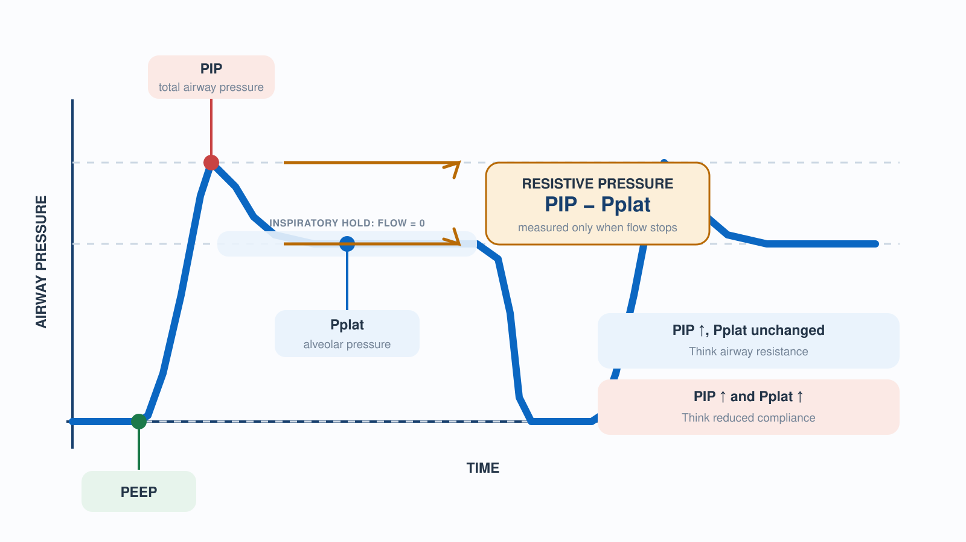
1.7 · The Bedside Test
1.7
PIP vs Plateau Pressure
Notes:
Figure for 1.7. Point to the moment flow reaches zero — that is the only point on the tracing where the number reflects the alveolus. Reinforce the caveat from the lesson: this reading is valid only in a passive patient. If they are triggering, the plateau you measure is partly their effort. Reuse this figure in 4.5.

Slide 19
Now put it to work
Hand off to learner devices — cues match your facilitator guide.
QUIZ
Knowledge Check
10 questions · pass 8/10 to unlock the next module
MATCH
Match the Knobs
4 items · Ventilation knobs · Oxygenation knobs · must be perfect
CASE
He's still breathing — but he's getting tired
4-decision branching scenario · 65-year-old male, 80 kg, long-standing COPD on home O₂
SIM
LTV 1200 Simulator
vent-ltv1200.html?level=1 — Meet the LTV 1200 hands-on — the Level 1 tutorial builds every control from scratch…
Notes:
Transition slide: send learners to the app for this module's quiz, match, scenario, then the simulator mission. Keep the cohort together; modules unlock in sequence.

Slide 20
Carry this out the door
✓
ETT depth at the lip 21 cm in women, 23 cm in men. Confirm with capnography and equal breath sounds after every patient transition — loading, lifting, elevator, gurney bump.
✓
Two knobs each Ventilation = RR + Vt. Oxygenation = FiO₂ + PEEP. On the final exam. At every bedside for the rest of your career.
✓
FiO₂ alone won't fix shunt If a patient on a non-rebreather at flush rate is still hypoxic, suspect shunt. The bedside fix is PEEP, often via CPAP.
✓
PIP up, Pplat up? Both up = lung problem. PIP up but Pplat normal = airway problem. The bedside test takes 3 seconds — press the inspiratory hold button.
Next: Module 2
Notes:
Recap the module pearls, then transition.

Slide 21
2
VENTILATOR TRAINING ACADEMY
Module 2
Recognizing Respiratory Failure
Call it before the patient calls it. Type I vs Type II, the SpO₂/PaO₂ cliff, capnography waveforms, and the pre-arrest signs everyone misses.
Foundations · 7 lessons
Jordan Hunter Jones, NRP · Course Director
Notes:
Module 2: Recognizing Respiratory Failure. Call it before the patient calls it. Type I vs Type II, the SpO₂/PaO₂ cliff, capnography waveforms, and the pre-arrest signs everyone misses.

Slide 22
In this module
2.1
Definitions What Respiratory Failure Means
2.5
Recognition Early Signs, Late Signs, and the False Calm
2.2
The Oxyhemoglobin Curve Why SpO₂ Lies — Until It Doesn't
2.6
Capnography EtCO₂ — The Earliest Number You Have
2.3
Type I Hypoxic Failure at the Bedside
2.7
Waveforms Four Capnography Patterns Every EMS Provider Must Recognize
2.4
Type II Hypercapnic Failure at the Bedside
Then:
Knowledge Check
Match
Scenario
Simulator
Notes:
Roadmap of the module. Teach the lessons in order, then run the four interactive components on learner devices.

Slide 23
2.1 · Definitions
2.1
What Respiratory Failure Means
Acute respiratory failure is defined by gas-exchange criteria. Type I, hypoxic respiratory failure, is PaO₂ less than 60 mmHg on room air.
Type II, hypercapnic respiratory failure, is PaCO₂ ≥ 45 mmHg with pH < 7.35. The acidemia is what makes it acute — a compensated chronic retainer can sit well above 45 with a near-normal pH and not be in acute failure.
Mixed failure (Type I + Type II) is common: pneumonia in a COPD patient, ARDS with respiratory fatigue. Treat what you see.
CLINICAL PEARL
ABGs in EMS
We rarely have an ABG prehospital. Clinical signs + EtCO₂ + SpO₂ let you recognize failure and act early — but they do NOT replace one. The PaCO₂–EtCO₂ gap widens with shock and V/Q mismatch, so EtCO₂ can under-read a rising PaCO₂. Treat the clinical picture; confirm with an ABG when available.
Notes:
Acute respiratory failure is defined by gas-exchange criteria. Type I, hypoxic respiratory failure, is PaO₂ less than 60 mmHg on room air. The CO₂ is typically normal or low because the patient is hyperventilating in compensation. Common causes: pneumonia, acute pulmonary edema, ARDS, pulmonary embolism, pulmonary contusion. Type II, hypercapnic respiratory failure, is PaCO₂ at or above 45 mmHg with a pH below 7.35. The pH requirement matters because chronic CO₂ retainers (stable COPD, for example) live with PaCO₂ in the 60s while their kidneys retain bicarbonate, keeping pH near normal. An acute rise in CO₂ has no time to compensate — pH crashes, and that acidosis defines the failure. Mixed failure (Type I + Type II) is common: pneumonia in a COPD patient, ARDS with respiratory fatigue. Treat what you see. PEARL — ABGs in EMS: We rarely have an arterial blood gas prehospital. Clinical signs + EtCO₂ + SpO₂ support recognition and let you act early — but they do NOT replace an ABG. The PaCO₂–EtCO₂ gap widens with shock and V/Q mismatch, so EtCO₂ can under-read a rising PaCO₂. Treat on the clinical picture; confirm gas exchange with an ABG when available.

Slide 24
2.2 · The Oxyhemoglobin Curve
2.2
Why SpO₂ Lies — Until It Doesn't
Pulse oximetry is not linear — the SpO₂/PaO₂ relationship is an S-shaped curve, and that shape is a flat tabletop that ends at a cliff.
SpO₂ 100% → PaO₂ ≥ 100 mmHg (the curve is flat on top — very different PaO₂ values produce the same saturation).
SpO₂ 95% → PaO₂ ≈ 80 mmHg. SpO₂ 90% → PaO₂ ≈ 60 mmHg — the edge of the cliff and the threshold for Type I respiratory failure.
SpO₂ 80% → PaO₂ ≈ 45 mmHg. SpO₂ 70% → PaO₂ ≈ 38 mmHg — minutes from arrest in most adults.
Practical implication: aim for SpO₂ 92–96%. High enough to be off the cliff, low enough to detect deterioration. Targeting 100% does the patient no good and wastes oxygen reserves.
EVIDENCE
Hyperoxia after ROSC
Observational data link severe hyperoxemia (PaO₂ above 250 mmHg) to worse outcomes. AHA 2025 targets SpO₂ 90–98% (PaO₂ 60–105 mmHg) post-ROSC — but only once SpO₂ reads reliably. Hold FiO₂ at 100% until then: EXACT found more hypoxic events when crews titrated down prehospital.
Notes:
Pulse oximetry is not linear — the SpO₂/PaO₂ relationship is an S-shaped curve, and that shape is a flat tabletop that ends at a cliff. Stroll along the top and big swings in PaO₂ barely move the saturation; step off the edge near 90% and you drop fast. SpO₂ 100% → PaO₂ ≥ 100 mmHg (the curve is flat on top — very different PaO₂ values produce the same saturation). SpO₂ 95% → PaO₂ ≈ 80 mmHg. SpO₂ 90% → PaO₂ ≈ 60 mmHg — the edge of the cliff and the threshold for Type I respiratory failure. SpO₂ 80% → PaO₂ ≈ 45 mmHg. SpO₂ 70% → PaO₂ ≈ 38 mmHg — minutes from arrest in most adults. Practical implication: aim for SpO₂ 92–96%. High enough to be off the cliff, low enough to detect deterioration. Targeting 100% does the patient no good and wastes oxygen reserves. EVIDENCE — Hyperoxia after ROSC: Observational data link severe hyperoxemia — PaO₂ above about 250 mmHg — to worse outcomes. AHA 2025 targets SpO₂ 90–98%, PaO₂ 60–105 mmHg, post-ROSC. The prehospital caveat matters for us: hold FiO₂ at 100% until SpO₂ reads reliably, because the EXACT trial found more hypoxic events when crews titrated down in the field. Avoiding hyperoxia is a stable-patient goal, not a first-five-minutes goal.

Slide 25
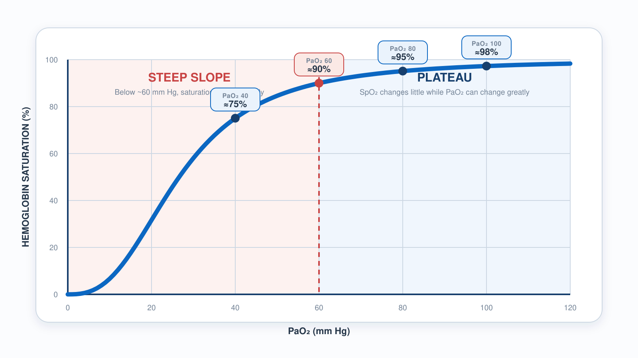
2.2 · The Oxyhemoglobin Curve
2.2
The Oxyhemoglobin Dissociation Curve
Notes:
Figure for 2.2. Walk the flat top, then the shoulder near 90%, then the cliff. The teaching point is that a falling sat on the tabletop is a slow problem and a falling sat past the shoulder is a fast one. Anchor the practical target of 92-96% to the shape, not to a memorized rule.

Slide 26
2.3 · Type I
2.3
Hypoxic Failure at the Bedside
Hypoxic failure presents first as work-of-breathing changes. Tachypnea. Accessory muscle use — sternocleidomastoid, retractions, nasal flaring, tripoding (sitting up with hands braced on knees).
Mental status is often well-preserved in early Type I failure. Hypoxia stimulates ventilation through peripheral chemoreceptors but produces less mental status change than rising CO₂.
Bedside test for shunt physiology: apply 100% FiO₂ via non-rebreather at flush rate and watch what happens to the saturation. A patient with diffusion-mediated hypoxia improves quickly.
Notes:
Hypoxic failure presents first as work-of-breathing changes. Tachypnea. Accessory muscle use — sternocleidomastoid, retractions, nasal flaring, tripoding (sitting up with hands braced on knees). Speech becomes broken into short phrases or single words. Skin: pale, mottled, or diaphoretic. Central cyanosis (blue lips and tongue) requires at least 5 g/dL of deoxygenated hemoglobin to be visible — a LATE sign. Mental status is often well-preserved in early Type I failure. Hypoxia stimulates ventilation through peripheral chemoreceptors but produces less mental status change than rising CO₂. A patient with a sat in the low 80s who is alert and oriented is not unusual in early pneumonia or pulmonary edema. Bedside test for shunt physiology: apply 100% FiO₂ via non-rebreather at flush rate and watch what happens to the saturation. A patient with diffusion-mediated hypoxia improves quickly. A patient with significant shunt does not — they need PEEP, not just more O₂. In an awake cooperative patient, that means CPAP.

Slide 27
2.4 · Type II
2.4
Hypercapnic Failure at the Bedside
Hypercapnic failure is more deceptive, because a tiring pump goes quiet, not loud. A patient retaining CO₂ may look comfortable while the partial pressure climbs — respiratory rate normal or even slowing.
Mental status correlates with the RATE of CO₂ rise rather than the absolute number. A chronic retainer at PaCO₂ 70 may be cognitively intact; an acute climb to the same value produces somnolence.
Common scenarios: the COPD patient who tires after a week of escalating bronchospasm; the severe asthmatic whose minute ventilation drops to a quiet chest; the opioid overdose with bradypnea and miosis; the neuromuscular patient whose muscles can no longer keep pace.
CLINICAL PEARL
Quiet chest in asthma
Wheeze means air is moving. A severe asthmatic who stops wheezing has stopped moving air. Silent chest in a previously wheezy patient is a pre-arrest sign. Bag immediately and prepare to intubate.
Notes:
Hypercapnic failure is more deceptive, because a tiring pump goes quiet, not loud. A patient retaining CO₂ may look comfortable while the partial pressure climbs — respiratory rate normal or even slowing. By the time CO₂ is high enough to affect mental status, the patient is already in trouble. Mental status correlates with the RATE of CO₂ rise rather than the absolute number. A chronic retainer at PaCO₂ 70 may be cognitively intact; an acute climb to the same value produces somnolence. As PaCO₂ rises into the 80s and 90s, the patient becomes increasingly difficult to arouse — CO₂ narcosis. Common scenarios: the COPD patient who tires after a week of escalating bronchospasm; the severe asthmatic whose minute ventilation drops to the point of quiet chest; the opioid-overdosed patient with bradypnea and miosis; the neuromuscular patient whose respiratory muscles can no longer keep pace. PEARL — Quiet chest in asthma: Wheeze means air is moving. A severe asthmatic who stops wheezing has stopped moving air. Silent chest in a previously wheezy patient is a pre-arrest sign. Bag immediately and prepare to intubate.

Slide 28
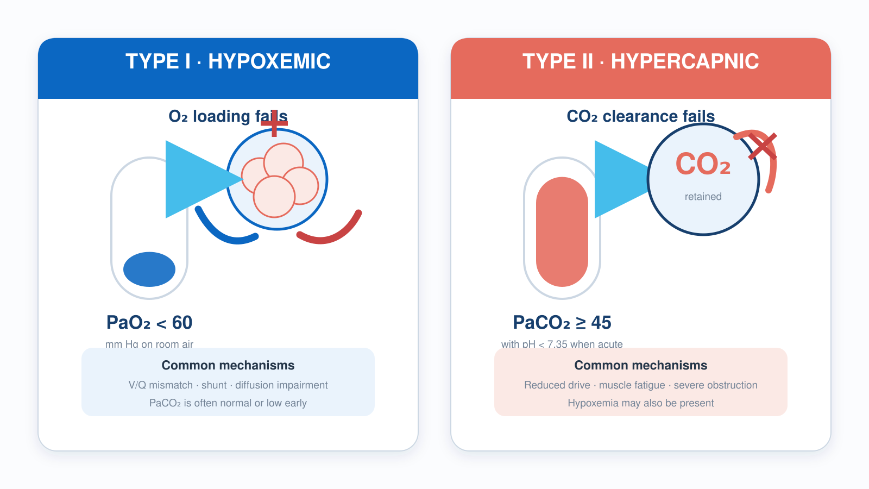
2.3–2.4 · Type I and Type II
2
Type I vs Type II Respiratory Failure
Notes:
Figure spanning 2.3 and 2.4. Use it as a side-by-side after teaching both. The course now uses a single threshold throughout: PaCO2 at or above 45 with pH under 7.35 defines ACUTE hypercapnic failure. Make the point that a compensated chronic retainer can sit well above 45 with a near-normal pH and is not in acute failure.

Slide 29
2.5 · Recognition
2.5
Early Signs, Late Signs, and the False Calm
Early signs of respiratory failure are predictable. Tachypnea is the earliest. Speech shortens. Patients tripod. Accessory muscles recruit. Skin becomes diaphoretic. The patient is often anxious or restless.
Late signs are subtle and dangerous. The previously tachypneic patient becomes quiet. RR drops. HR, which had been elevated, begins to fall.
Some call this the calm before the storm. It is pre-arrest. The patient has run out of compensatory reserve.
Notes:
Early signs of respiratory failure are predictable. Tachypnea is the earliest. Speech shortens. Patients tripod. Accessory muscles recruit. Skin becomes diaphoretic. The patient is often anxious or restless. Recognize these and you have time for non-invasive support. Late signs are subtle and dangerous. The previously tachypneic patient becomes quiet. RR drops. HR, which had been elevated, begins to fall. Accessory muscle use disappears — not because the patient is better but because they are exhausted. Cyanosis becomes obvious. Mental status declines. Some call this the calm before the storm. It is pre-arrest. The patient has run out of compensatory reserve. Capnography is your most reliable warning: a steadily climbing EtCO₂ over five minutes is a fatigue alarm. A waveform that suddenly disappears tells you the tube is out, the patient is in arrest, or perfusion has collapsed.

Slide 30
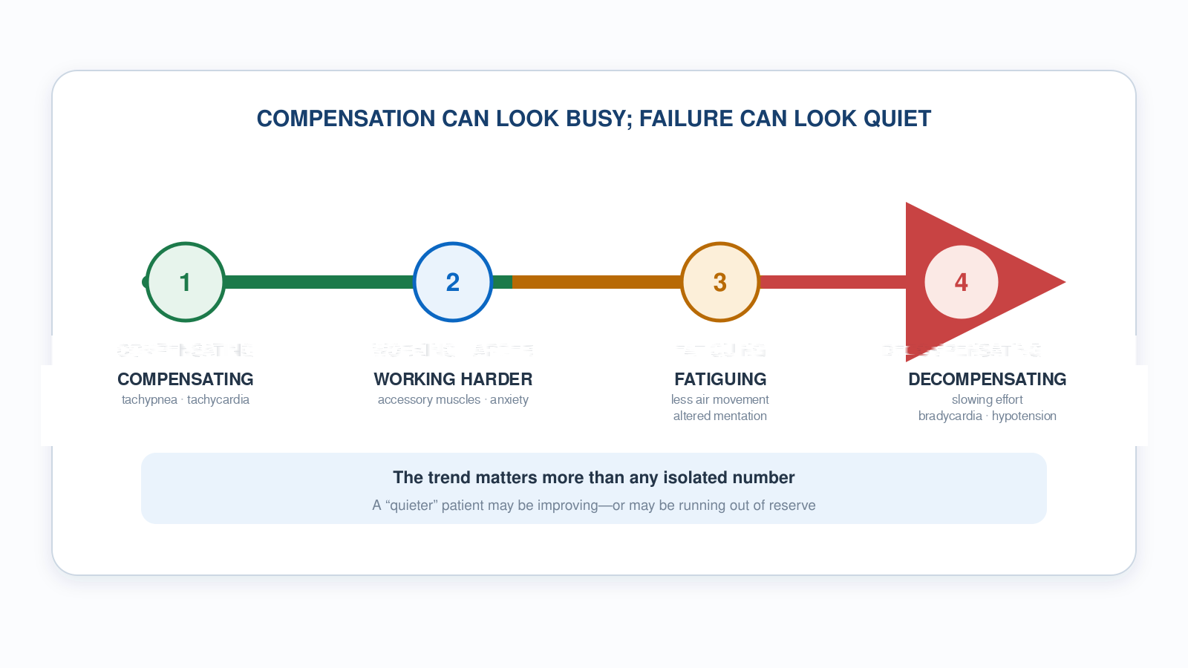
2.5 · Recognition
2.5
Respiratory Failure Progression
Notes:
Figure for 2.5. Walk left to right and make them name what they would see at each stage. Then walk it right to left and ask at which stage they still have time for non-invasive support. The stage that kills people is the quiet one — falling rate, falling heart rate, disappearing accessory muscle use.

Slide 31
2.6 · Capnography
2.6
EtCO₂ — The Earliest Number You Have
EtCO₂ is the partial pressure of CO₂ measured at the end of exhalation. In a healthy patient, EtCO₂ runs 2 to 5 mmHg lower than PaCO₂.
Normal adult EtCO₂ is 35 to 45 mmHg. A rising trend over several minutes in a non-intubated patient suggests fatigue.
Capnography has an underappreciated role in CPR. AHA recommends continuous waveform capnography during resuscitation.
Notes:
EtCO₂ is the partial pressure of CO₂ measured at the end of exhalation. In a healthy patient, EtCO₂ runs 2 to 5 mmHg lower than PaCO₂. The gradient widens whenever V/Q mismatch increases — for example, pulmonary embolism, low cardiac output, significant pulmonary disease. A widening EtCO₂–PaCO₂ gradient in a vented patient suggests rising physiologic dead space. Normal adult EtCO₂ is 35 to 45 mmHg. A rising trend over several minutes in a non-intubated patient suggests fatigue. A sudden drop to zero or near-zero in an intubated patient is one of four things: tube dislodgement, complete tube obstruction, cardiac arrest, or massive PE. All four require immediate action. Capnography has an underappreciated role in CPR. AHA recommends continuous waveform capnography during resuscitation. EtCO₂ persistently below 10 mmHg during compressions suggests inadequate compressions or that ROSC is unlikely. A sudden rise in EtCO₂ from 10 to 40+ during ongoing compressions is the most specific sign of ROSC — often before any palpable pulse change.

Slide 32
2.7 · Waveforms
2.7
Four Capnography Patterns Every EMS Provider Must Recognize
Normal: a box-like waveform. Sharp upstroke, flat plateau at the EtCO₂ value, sharp drop as the next inspiration begins.
Shark fin: the upstroke is sloped rather than sharp. This is the most specific bedside sign of bronchospasm — asthma, COPD exacerbation, anaphylaxis.
Rebreathing: the baseline is elevated rather than returning to zero between breaths. Common causes: a non-fitted NIV mask seal, an exhausted CO₂ absorber, or a kinked one-way valve.
Lost waveform: sudden drop to near zero. DOPE algorithm time — dislodgement, obstruction, pneumothorax, equipment. We cover this in Module 7.
CLINICAL PEARL
Shark fin = bronchospasm
If a vented patient's waveform turns shark-fin, treat the obstruction (bronchodilator, extended exhalation time). Don't chase the EtCO₂ number.
Notes:
Normal: a box-like waveform. Sharp upstroke, flat plateau at the EtCO₂ value, sharp drop as the next inspiration begins. Shark fin: the upstroke is sloped rather than sharp. This is the most specific bedside sign of bronchospasm — asthma, COPD exacerbation, anaphylaxis. The slope correlates with severity; the steeper the slope, the more obstruction. Rebreathing: the baseline is elevated rather than returning to zero between breaths. Common causes: a non-fitted NIV mask seal, an exhausted CO₂ absorber, or a kinked one-way valve. Patient is re-inhaling exhaled CO₂. Lost waveform: sudden drop to near zero. DOPE algorithm time — dislodgement, obstruction, pneumothorax, equipment. We cover this in Module 7. PEARL — Shark fin = bronchospasm: If a vented patient's waveform turns shark-fin, treat the obstruction (bronchodilator, extended exhalation time). Don't chase the EtCO₂ number.

Slide 33
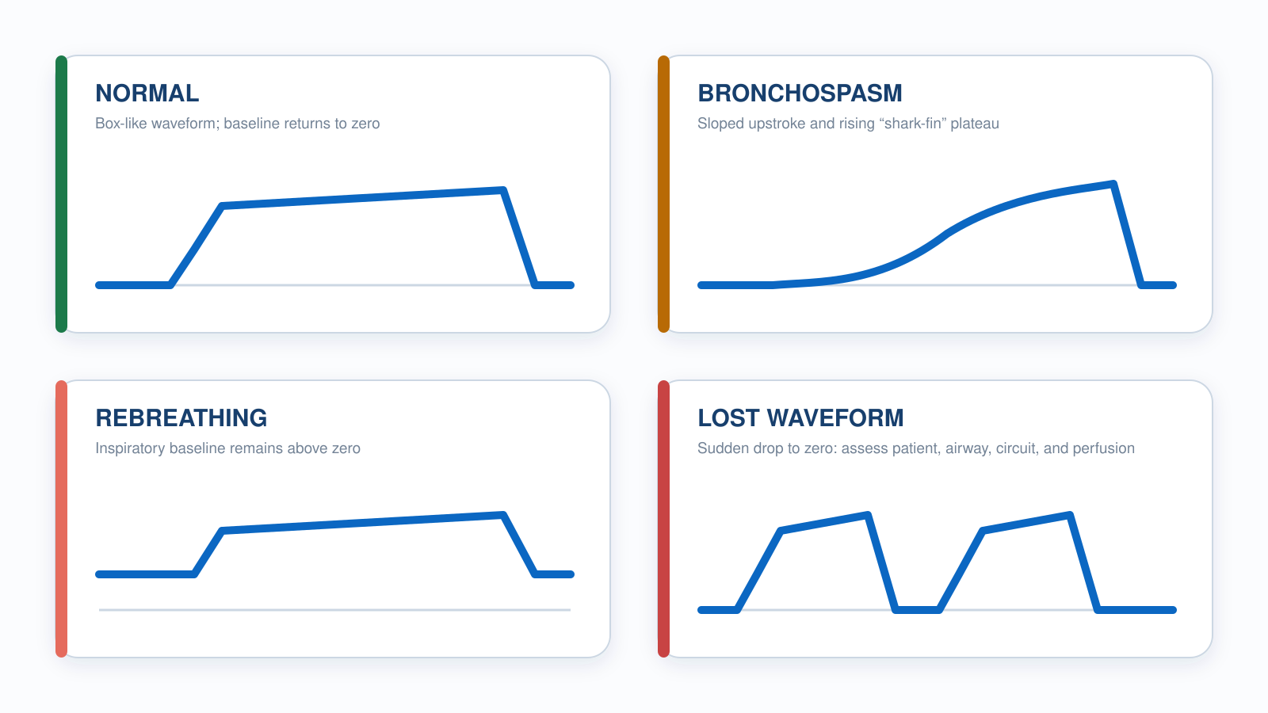
2.7 · Waveforms
2.7
Four Capnography Patterns
Notes:
Figure for 2.7. Cover the labels and run it as a four-item cold call. Shark fin is the highest-yield pattern in EMS — it is the most specific bedside sign of bronchospasm, and the slope tracks severity. Lost waveform hands off directly to DOPE in Module 7.

Slide 34
Now put it to work
Hand off to learner devices — cues match your facilitator guide.
QUIZ
Knowledge Check
10 questions · pass 8/10 to unlock the next module
MATCH
Type I or Type II?
6 items · Type I — Hypoxic · Type II — Hypercapnic · must be perfect
CASE
She was talking to me a minute ago
4-decision branching scenario · 42-year-old female, 70 kg, severe asthma, multiple prior intubations
SIM
LTV 1200 Simulator
vent-ltv1200.html?scenario=failure-type — Name the failure type from the monitor, then treat it — oxygenation vs ventilation.
Notes:
Transition slide: send learners to the app for this module's quiz, match, scenario, then the simulator mission. Keep the cohort together; modules unlock in sequence.

Slide 35
Carry this out the door
✓
ABGs in EMS We rarely have an ABG prehospital. Clinical signs + EtCO₂ + SpO₂ let you act early, but they do not replace one — EtCO₂ can under-read a rising PaCO₂.
✓
Quiet chest in asthma Wheeze means air is moving. A severe asthmatic who stops wheezing has stopped moving air. Silent chest in a previously wheezy patient is a pre-arrest sign.
✓
Shark fin = bronchospasm If a vented patient's waveform turns shark-fin, treat the obstruction (bronchodilator, extended exhalation time). Don't chase the EtCO₂ number.
Next: Module 3
Notes:
Recap the module pearls, then transition.

Slide 36
3
VENTILATOR TRAINING ACADEMY
Module 3
Indications for Ventilatory Support
Pick the right level of support — first time. CPAP for CHF. BiPAP for COPD. Invasive for failure. The evidence behind each and the contraindications that must not be missed.
Foundations · 6 lessons
Jordan Hunter Jones, NRP · Course Director
Notes:
Module 3: Indications for Ventilatory Support. Pick the right level of support — first time. CPAP for CHF. BiPAP for COPD. Invasive for failure. The evidence behind each and the contraindications that must not be missed.

Slide 37
In this module
3.1
NIV Indications When Non-Invasive Ventilation Is the Right Tool
3.4
Contraindications When NIV Is the WRONG Tool
3.2
The Two Flavors CPAP vs BiPAP
3.5
Invasive Indications for Endotracheal Intubation
3.3
Titration How to Make NIV Work — and Recognize When It Doesn't
3.6
Pre-Oxygenation Buying Yourself Eight Minutes
Then:
Knowledge Check
Match
Scenario
Simulator
Notes:
Roadmap of the module. Teach the lessons in order, then run the four interactive components on learner devices.

Slide 38
3.1 · NIV Indications
3.1
When Non-Invasive Ventilation Is the Right Tool
Non-invasive ventilation (NIV) delivers positive-pressure ventilation through a tightly-fitting mask rather than an endotracheal tube.
For acute pulmonary edema, the foundational evidence is Bersten et al. (NEJM 1991): 39 patients randomized to CPAP vs standard oxygen. Intubation rate dropped from 35% to 0% in the CPAP arm.
For COPD exacerbation with hypercapnia, Brochard et al. (NEJM 1995) randomized 85 patients to BiPAP vs standard care. Intubation: 26% vs 74%. Mortality: 9% vs 29%.
EVIDENCE
Strong evidence
CPAP for CHF and BiPAP for COPD-with-hypercapnia are among the most evidence-based EMS interventions. Level I evidence. If your service doesn't carry NIV, advocate for it.
Notes:
Non-invasive ventilation (NIV) delivers positive-pressure ventilation through a tightly-fitting mask rather than an endotracheal tube. In EMS, two indications dominate: acute cardiogenic pulmonary edema (treated with CPAP) and acute COPD exacerbation with hypercapnia (treated with BiPAP). For acute pulmonary edema, the foundational evidence is Bersten et al. (NEJM 1991): 39 patients randomized to CPAP vs standard oxygen. Intubation rate dropped from 35% to 0% in the CPAP arm. A 2013 Cochrane review pooling more than 30 trials confirmed NIV reduces hospital mortality and intubation in cardiogenic pulmonary edema, with NNT roughly 4 to 7 to prevent one intubation. For COPD exacerbation with hypercapnia, Brochard et al. (NEJM 1995) randomized 85 patients to BiPAP vs standard care. Intubation: 26% vs 74%. Mortality: 9% vs 29%. Cochrane meta-analyses confirm approximately a 50% relative reduction in both intubation and mortality. EVIDENCE — Strong evidence: CPAP for CHF and BiPAP for COPD-with-hypercapnia are among the most evidence-based EMS interventions. Level I evidence. If your service doesn't carry NIV, advocate for it.

Slide 39
3.2 · The Two Flavors
3.2
CPAP vs BiPAP
Continuous Positive Airway Pressure (CPAP) is one steady pressure the whole cycle long — a doorstop wedged under the airway, holding it open the same amount whether the patient breathes in or out.
Bilevel Positive Airway Pressure (BiPAP) adds a second, higher pressure on inspiration — like a spotter at the bench press who shoves the bar up each time you push and eases off as you lower it.
Typical starting settings: CPAP at 5 to 10 cmH₂O with FiO₂ 100% initially, weaned. BiPAP at IPAP 10 / EPAP 5, FiO₂ titrated. Both require a good mask seal. Sit the patient up.
Notes:
Continuous Positive Airway Pressure (CPAP) is one steady pressure the whole cycle long — a doorstop wedged under the airway, holding it open the same amount whether the patient breathes in or out. The patient does all the breathing work; the machine just holds the baseline. In CHF, that baseline pushes alveolar fluid back into the capillaries, drops preload (by raising intrathoracic pressure), and reduces LV afterload. The combined effect is often dramatic. Bilevel Positive Airway Pressure (BiPAP) adds a second, higher pressure on inspiration — like a spotter at the bench press who shoves the bar up each time you push and eases off as you lower it. The two pressures are IPAP (inspiratory) and EPAP (expiratory); their difference is the pressure support delivered with each breath. EPAP is the doorstop (it behaves like PEEP — holding alveoli open and overcoming auto-PEEP); IPAP is the spotter's shove, unloading the tired diaphragm. In COPD with hypercapnia, EPAP overcomes auto-PEEP while IPAP supports the diaphragm long enough for the patient to catch up. Typical starting settings: CPAP at 5 to 10 cmH₂O with FiO₂ 100% initially, weaned. BiPAP at IPAP 10 / EPAP 5, FiO₂ titrated. Both require a good mask seal. Sit the patient up. Coach them to breathe with the machine.

Slide 40
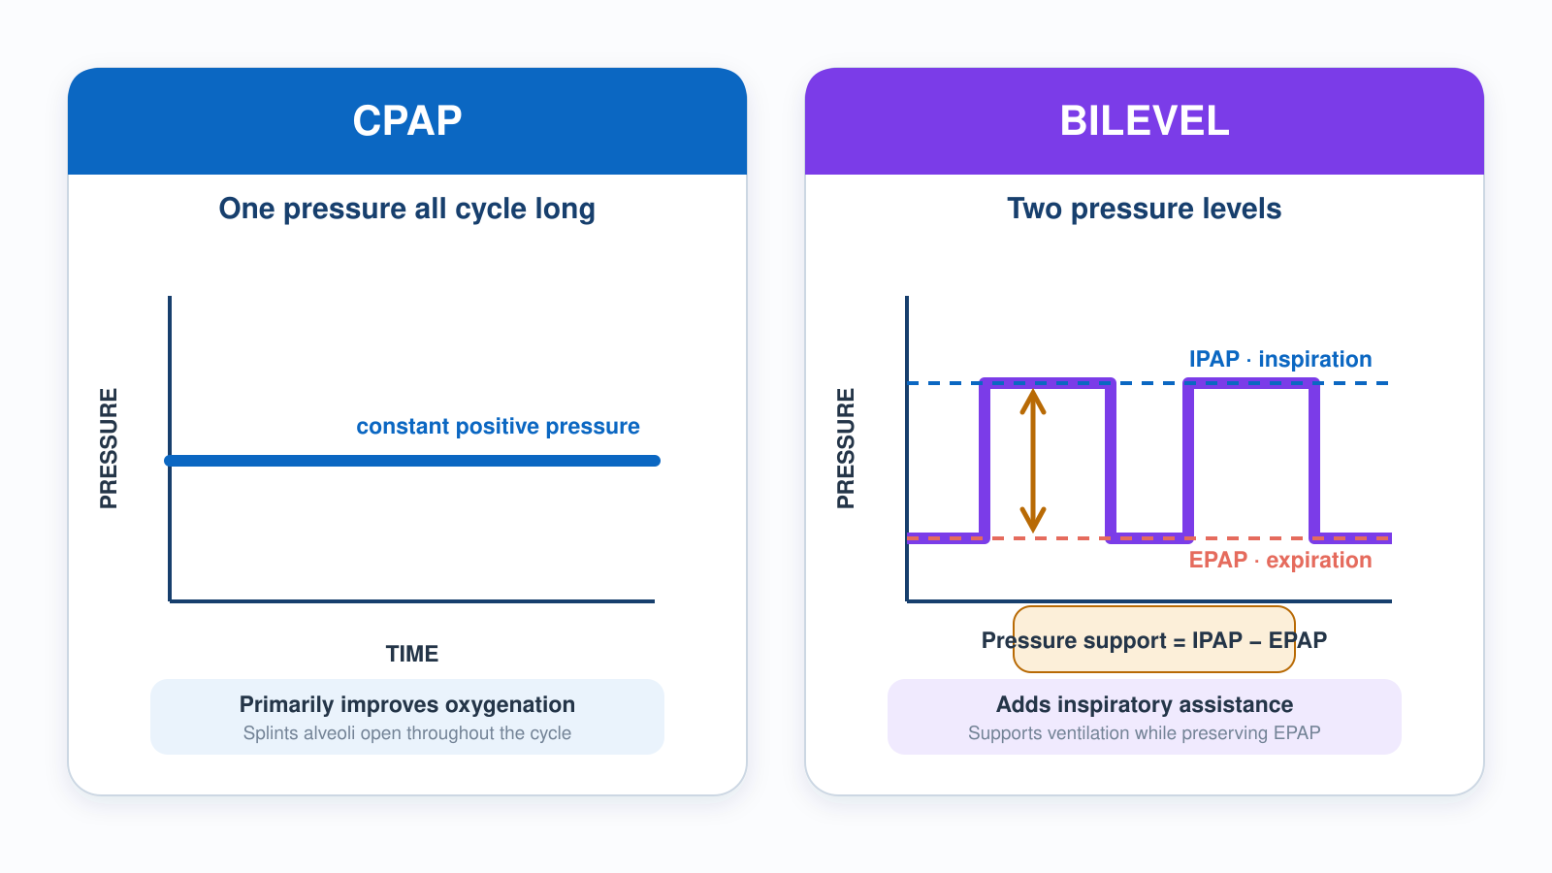
3.2 · The Two Flavors
3.2
CPAP vs Bilevel Pressure
Notes:
Figure for 3.2. Trace both tracings with a finger. CPAP is one flat line the whole cycle; bilevel steps up on inspiration and the height of that step is the pressure support. Tie it to indication: one pressure for an oxygenation problem, two pressures for a ventilation problem. Reuse this figure in 5.4.

Slide 41
3.3 · Titration
3.3
How to Make NIV Work — and Recognize When It Doesn't
NIV that is going to work shows signs of working within minutes. Improvement: falling respiratory rate, rising saturation, lengthening of speech, softening accessory muscle use, normalizing EtCO₂ trend.
NIV that is not going to work also declares itself early. Persistent or rising RR, no change in saturation, declining mental status, vomiting, inability to tolerate the mask are all signs of failure.
Reassess within minutes, not hours. Continue NIV only while objective improvement continues; intubate promptly for deterioration or for a trial that is not working. A fixed clock is not a substitute for serial reassessment.
CLINICAL PEARL
Sit them up
Upright posture (head of bed 30°+) improves functional residual capacity and reduces work of breathing. Always sit your NIV and your pre-RSI patients up.
Notes:
NIV that is going to work shows signs of working within minutes. Improvement: falling respiratory rate, rising saturation, lengthening of speech, softening accessory muscle use, normalizing EtCO₂ trend. Vital signs should improve in 5 to 15 minutes. Mental status improves in parallel. NIV that is not going to work also declares itself early. Persistent or rising RR, no change in saturation, declining mental status, vomiting, inability to tolerate the mask are all signs of failure. Apply the 1-hour rule. If the patient has been on NIV for 60 minutes without clear improvement, escalate to invasive ventilation. Continuing in a non-improving patient delays intubation under increasingly poor conditions — by the time the team gives up, the patient is often hypoxic, hypotensive, and exhausted. PEARL — Sit them up: Upright posture (head of bed 30°+) improves functional residual capacity and reduces work of breathing. Always sit your NIV and your pre-RSI patients up.

Slide 42
3.4 · Contraindications
3.4
When NIV Is the WRONG Tool
ABSOLUTE contraindications must be respected.
Inability to protect the airway or tolerate the mask — obtundation, active vomiting, copious secretions. Judge airway protection and cooperation, not a GCS number alone. NIV in such a patient is a comfortable way to deliver gastric contents into the lung.
Facial trauma or severe deformity preventing mask seal.
Hemodynamic instability or peri-arrest state. The time required to set up NIV is wasted on a patient who needs definitive airway control.
Pneumothorax (until decompressed). Positive pressure can tension a small PTX into a fatal one.
CLINICAL PEARL
Vomiting on NIV
If a patient on NIV begins to vomit, remove the mask immediately, suction aggressively, and prepare to secure the airway. Most protocols treat any vomiting episode as an absolute contraindication going forward.
Notes:
ABSOLUTE contraindications must be respected. 1. Inability to protect the airway — GCS ≤ 8, no gag, active vomiting, copious secretions. NIV in such a patient is a comfortable way to deliver gastric contents into the lung. 2. Facial trauma or severe deformity preventing mask seal. 3. Hemodynamic instability or peri-arrest state. The time required to set up NIV is wasted on a patient who needs definitive airway control. 4. Pneumothorax (until decompressed). Positive pressure can tension a small PTX into a fatal one. 5. Cardiac or respiratory arrest. Bag-mask ventilation and intubation are the only acceptable options. When in doubt: secure the airway. PEARL — Vomiting on NIV: If a patient on NIV begins to vomit, remove the mask immediately, suction aggressively, and prepare to secure the airway. Most protocols treat any vomiting episode as an absolute contraindication going forward.

Slide 43
3.5 · Invasive
3.5
Indications for Endotracheal Intubation
Move to invasive mechanical ventilation when:
NIV is not producing objective improvement on serial reassessment — escalate on the trend, not on a fixed clock.
Inability to protect or maintain the airway — assessed clinically, not by GCS alone.
Apnea or agonal respirations.
Refractory hypoxia despite high-FiO₂ NIV.
Hemodynamic instability requiring control of work of breathing.
Notes:
Move to invasive mechanical ventilation when: 1. NIV is failing after a fair trial (typically 30 to 60 minutes; maximum 2 hours). 2. GCS ≤ 8 or unable to protect airway. 3. Apnea or agonal respirations. 4. Refractory hypoxia despite high-FiO₂ NIV. 5. Hemodynamic instability requiring control of work of breathing. 6. Anticipated clinical course will deteriorate — severe burn with airway involvement, anaphylaxis with airway swelling. Prehospital RSI windows are short. Once you have paralyzed a patient, you are committed to managing the airway and the ventilator for the duration of the transport. Set up deliberately and pre-oxygenate aggressively.

Slide 44
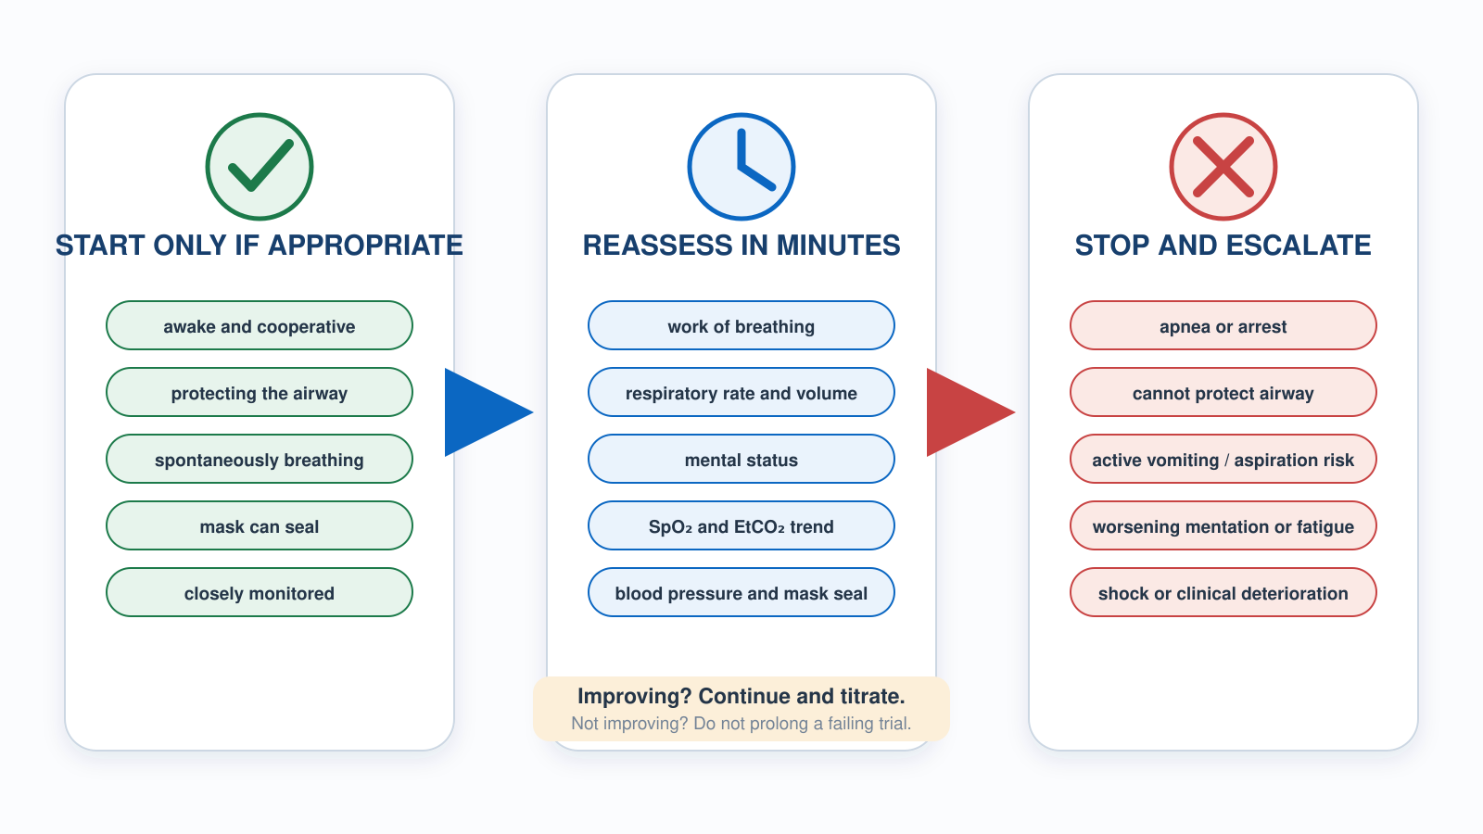
3.1–3.5 · NIV Decision Path
3
NIV Trial and Escalation
Notes:
Figure spanning 3.1 through 3.5. Use it as the module summary. The entry gate on the left is the contraindication check; the reassessment loop in the middle is the part crews skip. Emphasize that NIV which is going to work declares itself in minutes, and that a non-improving patient at 60 minutes is an escalation, not a wait.

Slide 45
3.6 · Pre-Oxygenation
3.6
Buying Yourself Eight Minutes
Pre-oxygenation before RSI is topping off the tank before a free-dive: you flush the nitrogen out of the lung's reservoir — the functional residual capacity (FRC) — and fill it with oxygen, so the patient can hold that breath through the apnea of intubation far longer before desaturating.
Standard technique: 3 minutes of tidal-volume breathing on a tight-sealed NRB at flush rate (15 L/min or higher). Alternative: 8 vital-capacity breaths.
Apneic oxygenation extends safe apnea further. A nasal cannula at 15 L/min applied during the laryngoscopy itself continues to deliver oxygen during the apneic interval.
CLINICAL PEARL
NoDESAT
Place a nasal cannula at 15 L/min on the patient during pre-oxygenation and leave it in place during laryngoscopy. The continued oxygen delivery extends safe apnea time. It is the cheapest and most effective single airway technique.
Notes:
Pre-oxygenation before RSI is topping off the tank before a free-dive: you flush the nitrogen out of the lung's reservoir — the functional residual capacity (FRC) — and fill it with oxygen, so the patient can hold that breath through the apnea of intubation far longer before desaturating. In a healthy adult with a good seal and high FiO₂, safe apnea time (before SpO₂ falls below 90%) stretches to approximately 8 minutes. With moderate disease, 3 to 5 minutes. With severe ARDS or obesity, sometimes less than 60 seconds. Standard technique: 3 minutes of tidal-volume breathing on a tight-sealed NRB at flush rate (15 L/min or higher). Alternative: 8 vital-capacity breaths. In a hypoxic patient who cannot achieve adequate pre-oxygenation by these methods, NIV (CPAP or BiPAP) for 3 to 5 minutes prior to the paralytic is the best option. Apneic oxygenation extends safe apnea further. A nasal cannula at 15 L/min applied during the laryngoscopy itself continues to deliver oxygen during the apneic interval. This technique — NoDESAT — adds several minutes of safe apnea time, particularly in obese and pediatric patients. Position the patient with the head elevated 20 to 30 degrees for both pre-oxygenation and laryngoscopy. PEARL — NoDESAT: Place a nasal cannula at 15 L/min on the patient during pre-oxygenation and leave it in place during laryngoscopy. The continued oxygen delivery extends safe apnea time. It is the cheapest and most effective single airway technique.

Slide 46
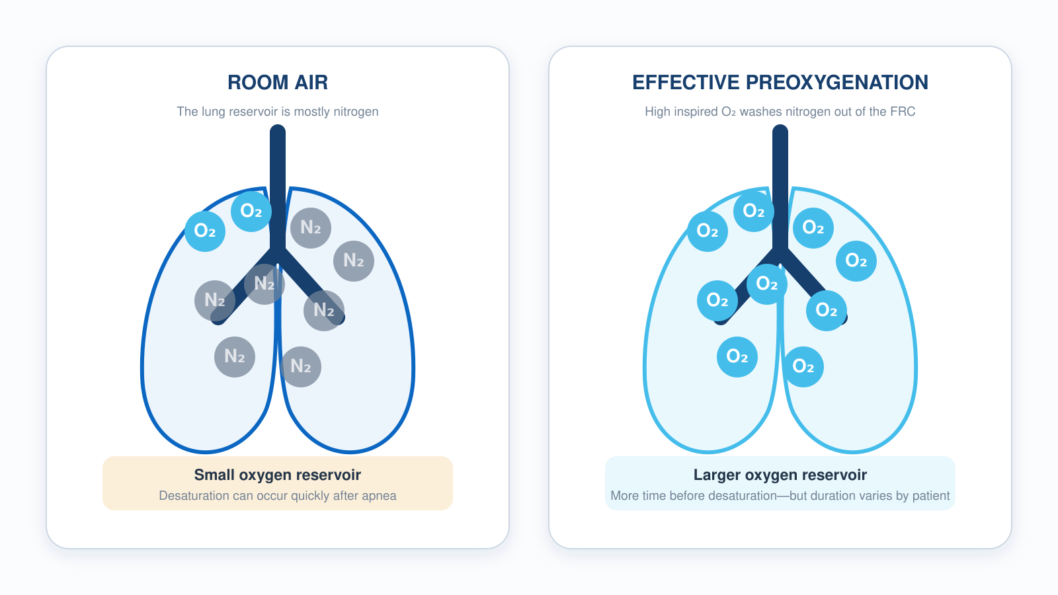
3.6 · Pre-Oxygenation
3.6
The Preoxygenation Reservoir
Notes:
Figure for 3.6. The left panel is the nitrogen-filled FRC; the right is that reservoir washed out and refilled with oxygen. That washout is the entire point of preoxygenation — you are not raising the saturation, you are filling a tank. Then add the nasal cannula at 15 L/min and leave it running through laryngoscopy.

Slide 47
Now put it to work
Hand off to learner devices — cues match your facilitator guide.
QUIZ
Knowledge Check
10 questions · pass 8/10 to unlock the next module
MATCH
Pick the Right Support
6 items · CPAP · BiPAP · Invasive Ventilation · must be perfect
CASE
Just put a non-rebreather on her
4-decision branching scenario · 68-year-old female, 80 kg, 5'4". HFrEF, atrial fibrillation, type 2…
SIM
LTV 1200 Simulator
vent-ltv1200.html?scenario=niv-vs-tube — Make the indication call on an awake COPD patient — BiPAP trial vs the tube — then set…
Notes:
Transition slide: send learners to the app for this module's quiz, match, scenario, then the simulator mission. Keep the cohort together; modules unlock in sequence.

Slide 48
Carry this out the door
✓
Sit them up Upright posture (head of bed 30°+) improves functional residual capacity and reduces work of breathing. Sit your NIV and pre-RSI patients up.
✓
Vomiting on NIV If a patient on NIV vomits, pull the mask, suction aggressively, and prepare to secure the airway. Most protocols treat it as an absolute contraindication.
✓
NoDESAT Nasal cannula at 15 L/min during pre-oxygenation, left in place through laryngoscopy. The continued flow extends safe apnea time. Cheapest airway win there is.
Next: Module 4
Notes:
Recap the module pearls, then transition.

Slide 49
4
VENTILATOR TRAINING ACADEMY
Module 4
Vent Vocabulary & Initial Settings
The eight numbers every vented patient has. IBW math, the ARDSNet history, and how to defend any setting you turn.
Foundations · 6 lessons
Jordan Hunter Jones, NRP · Course Director
Notes:
Module 4: Vent Vocabulary & Initial Settings. The eight numbers every vented patient has. IBW math, the ARDSNet history, and how to defend any setting you turn.

Slide 50
In this module
4.1
Tidal Volume Vt — How Much Air Per Breath
4.4
Timing I:E Ratio
4.2
Rate Respiratory Rate & Minute Ventilation
4.5
Pressures PIP, Pplat, and Driving Pressure
4.3
Oxygenation Knobs FiO₂ and PEEP
4.6
Defaults IBW Math and Safe Initial Settings
Then:
Knowledge Check
Match
Scenario
Simulator
Notes:
Roadmap of the module. Teach the lessons in order, then run the four interactive components on learner devices.

Slide 51
4.1 · Tidal Volume
4.1
Vt — How Much Air Per Breath
Tidal volume is the volume the ventilator delivers with each mandatory breath, measured in milliliters.
Modern adult target: 6 to 8 mL per kilogram of IDEAL body weight. Lower (4 to 6 mL/kg IBW) for ARDS. Pediatric: 6 to 8 mL/kg of ACTUAL body weight.
History matters. The 1990s standard was 10 to 12 mL/kg. ARDSNet ARMA (NEJM 2000) randomized 861 ARDS patients to 12 vs 6 mL/kg IBW. Mortality dropped from 39.8% to 31.0% (NNT 11).
Too low: dead space eats the breath; CO₂ rises despite normal-looking MV. Too high: alveolar over-distention, volutrauma. Always use IBW, not actual.
EVIDENCE
ARDSNet ARMA, NEJM 2000
Randomized 861 ARDS patients to 12 mL/kg vs 6 mL/kg IBW. Mortality 39.8% vs 31.0%. NNT 11. The trial also kept Pplat < 30 and paired PEEP with FiO₂.
Notes:
Tidal volume is the volume the ventilator delivers with each mandatory breath, measured in milliliters. Modern adult target: 6 to 8 mL per kilogram of IDEAL body weight. Lower (4 to 6 mL/kg IBW) for ARDS. Pediatric: 6 to 8 mL/kg of ACTUAL body weight. History matters. The 1990s standard was 10 to 12 mL/kg. ARDSNet ARMA (NEJM 2000) randomized 861 ARDS patients to 12 vs 6 mL/kg IBW. Mortality dropped from 39.8% to 31.0% (NNT 11). One of the most evidence-based interventions in critical care. Too low: dead space eats the breath; CO₂ rises despite normal-looking MV. Too high: alveolar over-distention, volutrauma. Always use IBW, not actual. EVIDENCE — ARDSNet ARMA, NEJM 2000: Randomized 861 ARDS patients to 12 mL/kg vs 6 mL/kg IBW. Mortality 39.8% vs 31.0%. NNT 11. The trial also kept Pplat < 30 and paired PEEP with FiO₂.

Slide 52
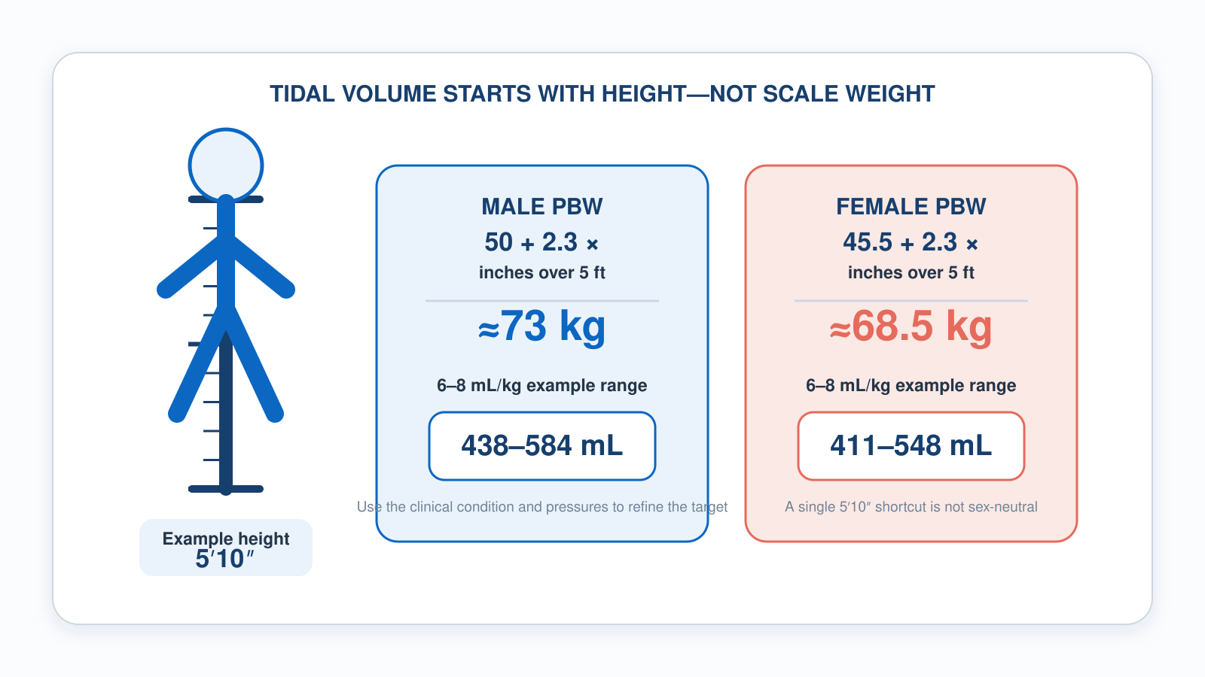
4.1 · Tidal Volume
4.1
Predicted Body Weight and Tidal Volume
Notes:
Figure for 4.1. The header says it: tidal volume starts with height, not scale weight. Work the 5 foot 10 example on the graphic for both sexes so the sex-specific difference is visible side by side. Reuse this figure in 4.6 alongside the safe-defaults list.

Slide 53
4.2 · Rate
4.2
Respiratory Rate & Minute Ventilation
Respiratory rate is the number of mandatory breaths per minute the vent delivers. Adult initial: 12 to 16, titrated to EtCO₂ 35 to 45.
Lower (8 to 10) for asthma/COPD — let them exhale. Higher (18 to 22) in ARDS where Vt is reduced.
Minute ventilation (MV) = RR × Vt. Adult target 6 to 8 L/min. For a 70 kg IBW adult: Vt 480 mL × RR 14 = 6.7 L/min, right in range.
Set the LOW MV alarm at ~70% of expected MV. The apnea alarm fires after 20 seconds of no breath — by then the patient has been failing for a while.
Notes:
Respiratory rate is the number of mandatory breaths per minute the vent delivers. Adult initial: 12 to 16, titrated to EtCO₂ 35 to 45. Lower (8 to 10) for asthma/COPD — let them exhale. Higher (18 to 22) in ARDS where Vt is reduced. Minute ventilation (MV) = RR × Vt. Adult target 6 to 8 L/min. For a 70 kg IBW adult: Vt 480 mL × RR 14 = 6.7 L/min, right in range. Set the LOW MV alarm at ~70% of expected MV. The apnea alarm fires after 20 seconds of no breath — by then the patient has been failing for a while.

Slide 54
4.3 · Oxygenation Knobs
4.3
FiO₂ and PEEP
FiO₂ is the fraction of oxygen in the inspired gas. Range 0.21 (room air) to 1.00 (100%). Start at 100% on every fresh intubation; wean.
Target SpO₂ 92–96% (adult), 88–92% (COPD per GOLD — the ceiling matters as much as the floor). TBI: BTF prehospital guidance is to avoid SpO₂ < 90%; a 94–98% target is a local-protocol choice, not BTF wording. Post-ROSC: AHA 2025 targets 90–98% (PaO₂ 60–105 mmHg), but hold FiO₂ at 100% until SpO₂ reads reliably — EXACT found more hypoxic events when crews titrated down in the field.
PEEP is the pressure remaining in airways at end-exhalation. Adult default 5 cmH₂O. In ARDS, titrate PEEP to oxygenation, severity and hemodynamics using the ARDSNet FiO₂/PEEP table — not a fixed 10–15.
PEEP recruits collapsed alveoli — the fix for shunt physiology. It also reduces preload, which can drop BP in volume-depleted patients. Pair PEEP with FiO₂ together, not separately.
CLINICAL PEARL
FiO₂ alone won't fix shunt
Patient on 100% FiO₂ and saturation barely moves? It's a shunt. The bedside fix is PEEP — usually via CPAP in awake patients.
Notes:
FiO₂ is the fraction of oxygen in the inspired gas. Range 0.21 (room air) to 1.00 (100%). Start at 100% on every fresh intubation; wean. Target SpO₂ 92–96% in the general adult, 88–92% in COPD per GOLD, 94–98% in TBI per BTF. Say the COPD number as a RANGE every time you teach it. The ceiling is the safety-relevant half — pushing a chronic retainer to 98% is a choice with consequences, and Austin's 2010 BMJ prehospital trial found titrated oxygen roughly halved mortality compared with high-flow in suspected COPD. Post-ROSC, AHA 2025 targets SpO₂ 90–98%, PaO₂ 60–105. But read the whole recommendation, because the prehospital half is the part that applies to you: keep FiO₂ at 100% until saturation can be measured reliably. The EXACT trial found MORE hypoxic events when crews titrated oxygen down in the field. Titrate in the back of a moving truck only when your number is trustworthy. Oxygen is a drug, not a vital sign — but so is hypoxia. PEEP is the pressure remaining in airways at end-exhalation. Adult default 5 cmH₂O. ARDS uses 10–15 cmH₂O paired with FiO₂ per the ARDSNet table. PEEP recruits collapsed alveoli — the fix for shunt physiology. It also reduces preload, which can drop BP in volume-depleted patients. Pair PEEP with FiO₂ together, not separately. PEARL — FiO₂ alone won't fix shunt: Patient on 100% FiO₂ and saturation barely moves? It's a shunt. The bedside fix is PEEP — usually via CPAP in awake patients.

Slide 55
4.4 · Timing
4.4
I:E Ratio
I:E is the ratio of inspiratory time to expiratory time. Adult default is 1:2 — inspiration takes half as long as exhalation.
In obstructive disease (asthma, COPD), set 1:4 or 1:5. Let the patient exhale. Forcing the rate up traps gas (auto-PEEP), drops blood pressure, and risks barotrauma.
On the LTV: you set inspiratory TIME in seconds (typically 1.0 to 1.2 in adults). The screen calculates the I:E.
Watch the expiratory flow waveform: if it doesn't return to zero before the next breath, suspect auto-PEEP — but the waveform is an insensitive screen. Confirm with an expiratory hold, then slow the rate and lengthen exhalation.
Notes:
I:E is the ratio of inspiratory time to expiratory time. Adult default is 1:2 — inspiration takes half as long as exhalation. In obstructive disease (asthma, COPD), set 1:4 or 1:5. Let the patient exhale. Forcing the rate up traps gas (auto-PEEP), drops blood pressure, and risks barotrauma. On the LTV: you set inspiratory TIME in seconds (typically 1.0 to 1.2 in adults). The screen calculates the I:E. Watch the expiratory flow waveform. If it doesn't return to zero before the next breath starts, suspect auto-PEEP. But treat that as a screen, not a diagnosis — it is an insensitive test and a normal-looking waveform does not rule trapping out. Confirm with an expiratory hold, then slow the rate and lengthen exhalation.

Slide 56
4.5 · Pressures
4.5
PIP, Pplat, and Driving Pressure
Peak Inspiratory Pressure (PIP): highest airway pressure during inspiration. Displayed continuously. Keep < 35 cmH₂O.
Plateau Pressure (Pplat): airway pressure during a 0.5-second inspiratory hold (no flow). Reflects alveolar pressure / compliance. Keep < 30 cmH₂O — ARDSNet protocol.
Math: PIP ≈ Pplat + (Resistance × Flow). High PIP + normal Pplat = AIRWAY problem (resistance). Both high = LUNG problem (compliance).
Driving pressure (ΔP) = Pplat − PEEP. Amato et al. (NEJM 2015) reanalyzed nine ARDS RCTs; ΔP tracked mortality better than Vt, Pplat, or PEEP alone. Each 7 cmH₂O rise raised mortality ~40%. Measure only in a passive patient — spontaneous effort invalidates Pplat.
EVIDENCE
Amato 2015 driving pressure
ΔP under 14 cmH₂O is the commonly taught ARDS target — derived from Amato's reanalysis, not validated as a cut point in a trial. Requires a passive patient.
Notes:
Peak Inspiratory Pressure (PIP): highest airway pressure during inspiration. Displayed continuously. Keep < 35 cmH₂O. Plateau Pressure (Pplat): airway pressure during a 0.5-second inspiratory hold (no flow). Reflects alveolar pressure / compliance. Keep < 30 cmH₂O — ARDSNet protocol. Press and hold the inspiratory hold button on the LTV to measure. Math: PIP ≈ Pplat + (Resistance × Flow). High PIP + normal Pplat = AIRWAY problem (resistance). Both high = LUNG problem (compliance). Driving pressure (ΔP) = Pplat − PEEP. Amato et al. (NEJM 2015) reanalyzed nine ARDS RCTs; ΔP tracked mortality better than Vt, Pplat, or PEEP considered alone. Each 7 cmH₂O rise was associated with roughly a 40% relative increase in mortality. The ΔP under 14 target in common use is derived from that analysis — it was not a randomized threshold. Both Pplat and ΔP require a passive patient. Spontaneous effort during the inspiratory hold corrupts the reading. Since our transport sedation target is RASS −1 to −2, many of your patients WILL be triggering — know that the plateau you just measured may not be a plateau at all. EVIDENCE — Amato 2015 driving pressure: Pplat − PEEP < 14 cmH₂O is the modern ARDS target. Stronger mortality predictor than Vt, Pplat, or PEEP individually.

Slide 57
4.6 · Defaults
4.6
IBW Math and Safe Initial Settings
Devine IBW formulas. Men: 50 + 2.3 × (inches over 60). Women: 45.5 + 2.3 × (inches over 60).
Examples. 5'6" man: 50 + 2.3 × 6 = 63.8 kg → safe Vt 380–510 mL. 5'10" woman: 45.5 + 2.3 × 10 = 68.5 kg → safe Vt 410–548 mL.
Safe adult defaults to defend: AC/VC mode; Vt 6–8 mL/kg IBW; RR 14, titrated to EtCO₂ 35–45; FiO₂ 100% then wean; PEEP 5; I:E 1:2; alarms PIP 35, low MV 4, low PEEP 3, apnea 20 sec.
When in doubt, return to defaults. Change ONE thing at a time, reassess in 30 seconds, and document with vitals before and after.
CLINICAL PEARL
5'10" rule of thumb
IBW is sex-specific — one number won't do. By the Devine formulas a 5'10" man ≈ 73 kg (Vt 440–580 mL) and a 5'10" woman ≈ 68.5 kg (Vt 410–548 mL). Anchor to the patient's sex and height, never actual weight.
Notes:
Devine IBW formulas. Men: 50 + 2.3 × (inches over 60). Women: 45.5 + 2.3 × (inches over 60). Examples. 5'6" man: 50 + 2.3 × 6 = 63.8 kg → safe Vt 380–510 mL. 5'10" woman: 45.5 + 2.3 × 10 = 68.5 kg → safe Vt 410–548 mL. Safe adult defaults to defend: AC/VC mode; Vt 6–8 mL/kg IBW; RR 14, titrated to EtCO₂ 35–45; FiO₂ 100% then wean; PEEP 5; I:E 1:2; alarms PIP 35, low MV 4, low PEEP 3, apnea 20 sec. When in doubt, return to defaults. Change ONE thing at a time, reassess in 30 seconds, and document with vitals before and after. PEARL — 5'10" rule of thumb: IBW is sex-specific — one number won't do. By the Devine formulas a 5'10" man ≈ 73 kg (Vt 440–580 mL) and a 5'10" woman ≈ 68.5 kg (Vt 410–548 mL). Anchor to the patient's sex and height, never actual weight.

Slide 58
Now put it to work
Hand off to learner devices — cues match your facilitator guide.
QUIZ
Knowledge Check
10 questions · pass 8/10 to unlock the next module
MATCH
Set or Monitored?
8 items · Operator-Set Settings · Monitored Values · must be perfect
CASE
Just took the vent. Settings look weird.
4-decision branching scenario · 5'6" male, 250 lb actual. Just intubated for hypoxic respiratory…
SIM
LTV 1200 Simulator
vent-ltv1200.html?scenario=initial-settings — Build safe initial settings on a freshly intubated patient — Vt by IBW, PEEP, and…
Notes:
Transition slide: send learners to the app for this module's quiz, match, scenario, then the simulator mission. Keep the cohort together; modules unlock in sequence.

Slide 59
Carry this out the door
✓
FiO₂ alone won't fix shunt Patient on 100% FiO₂ and saturation barely moves? It's a shunt. The bedside fix is PEEP — usually via CPAP in awake patients.
✓
5'10" rule of thumb IBW is sex-specific. By Devine, a 5'10" man ≈ 73 kg (Vt 440–580 mL) and a 5'10" woman ≈ 68.5 kg (Vt 410–548 mL). Anchor to sex and height, never actual weight.
✓
Pplat needs a passive patient Pplat and driving pressure only mean something when the patient isn't triggering. A spontaneously breathing patient makes both numbers unreliable.
✓
One change at a time Turn one knob, reassess in 30 seconds, document vitals before and after. Change two things at once and you'll never know which one worked.
Next: Module 5
Notes:
Recap the module pearls, then transition.

Slide 60
5
VENTILATOR TRAINING ACADEMY
Module 5
Modes of Ventilation
Volume targeted, pressure targeted, and the partnerships in between. Pick the mode the patient needs — not the mode you remember.
Foundations · 6 lessons
Jordan Hunter Jones, NRP · Course Director
Notes:
Module 5: Modes of Ventilation. Volume targeted, pressure targeted, and the partnerships in between. Pick the mode the patient needs — not the mode you remember.

Slide 61
In this module
5.1
Targeting Volume vs Pressure Targeting
5.4
NIV Modes CPAP vs BiPAP
5.2
Assist-Control What "Control" Really Means
5.5
PRVC PRVC and Newer Modes
5.3
SIMV & Pressure Support SIMV and Why It Fell Out of Favor
5.6
Synchrony Trigger Sensitivity & Inspiratory Rise Time
Then:
Knowledge Check
Match
Scenario
Simulator
Notes:
Roadmap of the module. Teach the lessons in order, then run the four interactive components on learner devices.

Slide 62
5.1 · Targeting
5.1
Volume vs Pressure Targeting
Every vent breath guarantees one thing and lets the other float — like inflating a tire: pump to a set volume of air and the pressure lands where it lands, or pump to a set pressure and the volume lands where it lands.
Volume-targeted (AC/VC): you set Vt — vent delivers it. PRESSURE varies with lung compliance. Most EMS default. Watch PIP / Pplat.
Pressure-targeted (AC/PC): you set inspiratory pressure — vent delivers it. VOLUME varies with compliance. Limiting pressure does not by itself make ventilation lung-protective. Watch delivered Vt and driving pressure.
Trade-off: AC/VC gives predictable minute ventilation but variable pressure. AC/PC limits pressure but volume floats with stiffness. Dual-control modes (PRVC) adapt pressure breath to breath toward a volume target — the LTV 1200 does not offer one.
Notes:
Every vent breath guarantees one thing and lets the other float — like inflating a tire: pump to a set volume of air and the pressure lands where it lands, or pump to a set pressure and the volume lands where it lands. You never get to fix both at once. Volume-targeted (AC/VC): you set Vt — vent delivers it. PRESSURE varies with lung compliance. Most EMS default. Watch PIP / Pplat. Pressure-targeted (AC/PC): you set inspiratory pressure — vent delivers it. VOLUME varies. Pressure capped, so barotrauma risk lower. Watch delivered Vt. Trade-off: AC/VC gives predictable minute ventilation but variable pressure. AC/PC caps pressure but volume floats with stiffness.

Slide 63
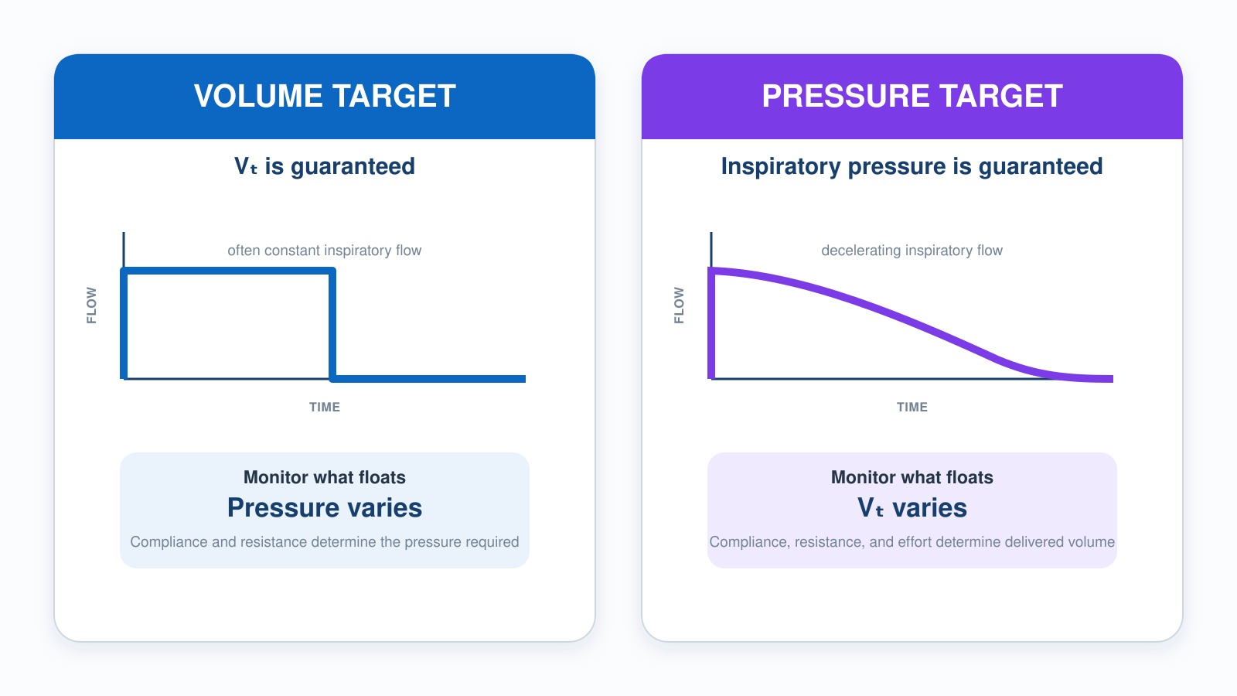
5.1 · Targeting
5.1
Volume vs Pressure Targeting
Notes:
Figure for 5.1. Whichever variable is guaranteed is the one you set; the other is the one you monitor. Point at the guaranteed side of each panel, then ask what the floating variable does when compliance worsens. That question is the whole lesson.

Slide 64
5.2 · Assist-Control
5.2
What "Control" Really Means
"Control" does NOT mean the patient is locked out. In AC mode, the patient can trigger their own breaths above the set rate.
AC guarantees a MINIMUM number of breaths per minute (set by RR). Patient-triggered breaths receive the full set Vt (or pressure) too. No "small supportive" breaths in pure AC.
Historical note: the original mode was CMV (Continuous Mandatory Ventilation) — patient locked out completely. AC came along to allow triggering, dramatically improving comfort.
Tachypneic patient on AC can stack breaths and develop auto-PEEP. Fix the cause of tachypnea (sedation, pain, hypoxia) — don't just lower the set rate.
CLINICAL PEARL
Pure AC = full breath every time
There are no small supportive breaths in AC. Every triggered breath gets the full set Vt.
Notes:
"Control" does NOT mean the patient is locked out. In AC mode, the patient can trigger their own breaths above the set rate. AC guarantees a MINIMUM number of breaths per minute (set by RR). Patient-triggered breaths receive the full set Vt (or pressure) too. No "small supportive" breaths in pure AC. Historical note: the original mode was CMV (Continuous Mandatory Ventilation) — patient locked out completely. AC came along to allow triggering, dramatically improving comfort. Tachypneic patient on AC can stack breaths and develop auto-PEEP. Fix the cause of tachypnea (sedation, pain, hypoxia) — don't just lower the set rate. PEARL — Pure AC = full breath every time: There are no small supportive breaths in AC. Every triggered breath gets the full set Vt.

Slide 65
5.3 · SIMV & Pressure Support
5.3
SIMV and Why It Fell Out of Favor
Synchronized Intermittent Mandatory Ventilation: vent delivers a SET rate of mandatory breaths. Between mandatory breaths, the patient breathes spontaneously at any volume.
Originally designed as a weaning mode — set rate decreased as the patient improved. Intuitive but not supported by evidence.
Esteban et al. (NEJM 1995) randomized weaning strategies. SIMV was the SLOWEST of four methods. Once-daily T-piece trials and PSV alone produced faster extubation. Most modern ICUs no longer use SIMV.
Pressure Support (PSV): vent senses spontaneous effort and adds a fixed pressure (5–15 cmH₂O). Compensates for ETT/circuit resistance (~5) or actively unloads the diaphragm (10–15).
EVIDENCE
Esteban 1995
T-piece and PSV both produced faster weaning than SIMV. Modern ICUs use spontaneous breathing trials, not SIMV gradual taper.
Notes:
Synchronized Intermittent Mandatory Ventilation: vent delivers a SET rate of mandatory breaths. Between mandatory breaths, the patient breathes spontaneously at any volume. Often paired with Pressure Support for the spontaneous breaths. Originally designed as a weaning mode — set rate decreased as the patient improved. Intuitive but not supported by evidence. Esteban et al. (NEJM 1995) randomized weaning strategies. SIMV was the SLOWEST of four methods. Once-daily T-piece trials and PSV alone produced faster extubation. Most modern ICUs no longer use SIMV. Pressure Support (PSV): vent senses spontaneous effort and adds a fixed pressure (5–15 cmH₂O). Compensates for ETT/circuit resistance (~5) or actively unloads the diaphragm (10–15). Inspiration cycles when flow drops to ~25% of peak. EVIDENCE — Esteban 1995: T-piece and PSV both produced faster weaning than SIMV. Modern ICUs use spontaneous breathing trials, not SIMV gradual taper.

Slide 66
5.4 · NIV Modes
5.4
CPAP vs BiPAP
CPAP: ONE pressure throughout the breath. Patient does all the work. Best for OXYGENATION problems (CHF, acute pulmonary edema).
Bersten et al. (NEJM 1991): in cardiogenic pulmonary edema, CPAP eliminated intubation in the treated arm. Cochrane: NNT 4–7 to prevent intubation.
BiPAP: TWO pressures (IPAP / EPAP). IPAP − EPAP = pressure support per breath. Best for VENTILATION problems (COPD with hypercapnia). Mechanism: EPAP overcomes auto-PEEP; IPAP unloads tired diaphragm.
Brochard et al. (NEJM 1995): in COPD exacerbation with hypercapnia, BiPAP reduced intubation from 74% to 26% and mortality from 29% to 9%.
Notes:
CPAP: ONE pressure throughout the breath. Patient does all the work. Best for OXYGENATION problems (CHF, acute pulmonary edema). Mechanism: pushes alveolar fluid into capillaries, reduces preload + LV afterload. Start 5–10 cmH₂O / FiO₂ 100%. Bersten et al. (NEJM 1991): in cardiogenic pulmonary edema, CPAP eliminated intubation in the treated arm. Cochrane: NNT 4–7 to prevent intubation. BiPAP: TWO pressures (IPAP / EPAP). IPAP − EPAP = pressure support per breath. Best for VENTILATION problems (COPD with hypercapnia). Mechanism: EPAP overcomes auto-PEEP; IPAP unloads tired diaphragm. Start IPAP 10 / EPAP 5. Brochard et al. (NEJM 1995): in COPD exacerbation with hypercapnia, BiPAP reduced intubation from 74% to 26% and mortality from 29% to 9%.

Slide 67
5.5 · PRVC
5.5
PRVC and Newer Modes
Pressure-Regulated Volume Control: a HYBRID. You set a Vt target; the vent delivers it using the LOWEST pressure required, measuring compliance breath-by-breath.
Vendor names differ: Drager AutoFlow, Servo PRVC, Hamilton ASV-like — all variations on the same idea.
The LTV 1200 does NOT natively offer PRVC. If you inherit a patient on PRVC from a sending facility, coordinate with the team, then switch to AC/VC (matching Vt and RR) or AC/PC.
APRV (Airway Pressure Release Ventilation) — used in refractory ARDS. NAVA (Neurally Adjusted Ventilatory Assist) — ICU-level synchrony. HFOV — once a rescue, OSCILLATE (NEJM 2013) showed harm.
Notes:
Pressure-Regulated Volume Control: a HYBRID. You set a Vt target; the vent delivers it using the LOWEST pressure required, measuring compliance breath-by-breath. Volume is targeted, not guaranteed: when the pressure ceiling is reached, tidal volume is what gets sacrificed. Watch delivered Vt, not just the target. Vendor names differ: Drager AutoFlow, Servo PRVC, Hamilton ASV-like — all variations on the same idea. The LTV 1200 does NOT natively offer PRVC. If you inherit a patient on PRVC from a sending facility, coordinate with the team, then switch to AC/VC (matching Vt and RR) or AC/PC. Watch PIP closely after the change. APRV (Airway Pressure Release Ventilation) — used in refractory ARDS. NAVA (Neurally Adjusted Ventilatory Assist) — ICU-level synchrony. HFOV — once a rescue, OSCILLATE (NEJM 2013) showed harm. All beyond EMS scope but worth recognizing.

Slide 68
5.6 · Synchrony
5.6
Trigger Sensitivity & Inspiratory Rise Time
Patient-vent dyssynchrony is the patient and the machine fighting over who leads the breath — pushing and pulling at different moments, like two people trying to row out of step.
Trigger sensitivity controls how easily the patient initiates a breath. Pressure trigger (−1 to −2 cmH₂O) is the common default. Flow trigger (1–3 L/min) is more responsive.
Inspiratory rise time: how fast the pressure ramps up at the start of inspiration (pressure-targeted modes). Faster rise (0.1–0.2 sec) feels powerful but can jolt awake patients.
Troubleshoot the cause first: patient, tube and circuit, pain, secretions, bronchospasm, auto-PEEP, then trigger, flow and timing. Add analgesia and sedation once a cause has been addressed and the patient still needs it.
Notes:
Patient-vent dyssynchrony is the patient and the machine fighting over who leads the breath — pushing and pulling at different moments, like two people trying to row out of step. It affects ~25% of vented patients (Blanch, Intensive Care Med 2015) and raises work of breathing, sedation needs, and mortality. Trigger sensitivity controls how easily the patient initiates a breath. Pressure trigger (−1 to −2 cmH₂O) is the common default. Flow trigger (1–3 L/min) is more responsive. Too sensitive → auto-cycling from circuit motion. Not sensitive enough → patient struggles. Inspiratory rise time: how fast the pressure ramps up at the start of inspiration (pressure-targeted modes). Faster rise (0.1–0.2 sec) feels powerful but can jolt awake patients. Slower (0.4–0.6 sec) is gentler but can feel like flow starvation in dyspneic patients. EMS bedside fix for most dyssynchrony: deepen sedation, ensure analgesia, check trigger settings.

Slide 69
Now put it to work
Hand off to learner devices — cues match your facilitator guide.
QUIZ
Knowledge Check
10 questions · pass 8/10 to unlock the next module
MATCH
Pick the Mode
6 items · CPAP · BiPAP · AC/VC · must be perfect
CASE
Inherited Patient on PRVC
4-decision branching scenario · 54-year-old female, 5'5" (IBW ~57 kg). ARDS day 1 from urosepsis. On…
SIM
LTV 1200 Simulator
vent-ltv1200.html?scenario=niv-setup — Pick and set the right mode for an awake CHF patient — non-invasive CPAP before the…
Notes:
Transition slide: send learners to the app for this module's quiz, match, scenario, then the simulator mission. Keep the cohort together; modules unlock in sequence.

Slide 70
Carry this out the door
✓
Pure AC = full breath every time There are no small supportive breaths in AC. Every triggered breath gets the full set Vt.
✓
Volume or pressure — know which one floats Conventional VC targets volume while pressure floats; conventional PC targets pressure while volume floats. Dual-control modes adapt pressure toward a volume target. Monitor whatever you did not set.
✓
SIMV is not a weaning mode Esteban 1995 found SIMV the slowest of four strategies. Wean with spontaneous breathing trials, not a gradual SIMV taper.
✓
The LTV has no PRVC Inherit a patient on PRVC and you must convert — match Vt and RR in AC/VC, coordinate with the sending team, then watch PIP closely.
Next: Module 6
Notes:
Recap the module pearls, then transition.

Slide 71
6
VENTILATOR TRAINING ACADEMY
Module 6
LTV 1200 — The Platform Tour
Every knob, every screen, every alarm — without a patient on it. POST every shift, every patient.
Application · 6 lessons
Jordan Hunter Jones, NRP · Course Director
Notes:
Module 6: LTV 1200 — The Platform Tour. Every knob, every screen, every alarm — without a patient on it. POST every shift, every patient.

Slide 72
In this module
6.1
Hardware Front Panel and Side Connections
6.4
Alarms The Core Alarms
6.2
Power Battery and Line Power
6.5
POST Power-On Self-Test
6.3
Display Reading the Screen
6.6
Workflow Safe Changes & Common Pitfalls
Then:
Knowledge Check
Match
Scenario
Simulator
Notes:
Roadmap of the module. Teach the lessons in order, then run the four interactive components on learner devices.

Slide 73
6.1 · Hardware
6.1
Front Panel and Side Connections
Front panel essentials: Power button (top corner, momentary press). Display (settings on left, monitored on right). Control knob (right of display — scrolls values).
Side panel: O₂ inlet at 50 PSI (DISS or quick-connect). Patient circuit ports including the easily-missed exhalation valve drive line.
Practice until you can locate every control by touch — then confirm on the display before you change anything. Touch makes you fast; visual confirmation is what prevents a wrong-control error.
The exhalation valve drive line is the most-missed connection. Connected incorrectly, exhalation, PEEP and exhaled-volume monitoring all become unreliable, and the manufacturer warns that a drive-line disconnection may go undetected if the critical alarms are not set. Verify it on every checkout.
CLINICAL PEARL
Find it by feel, confirm by eye
Spend ten minutes locating each control by touch, then confirm on the display before you act. Touch finds it fast; the display confirms you changed the right thing.
Notes:
Front panel essentials: Power button (top corner, momentary press). Display (settings on left, monitored on right). Control knob (right of display — scrolls values). Select button (moves cursor between parameters). Manual breath, Alarm Silence (60-sec mute), Alarm Reset. Side panel: O₂ inlet at 50 PSI (DISS or quick-connect). Patient circuit ports including the easily-missed exhalation valve drive line. Battery compartment, AC/DC power, bacterial/viral filter, USB (service only). Practice on the unit until you can find every control by feel. In a noisy ambulance bay or moving aircraft, you can't read labels. The exhalation valve drive line is the most-missed connection. Without it, the patient cannot exhale. Verify every POST. PEARL — Memorize by feel: Spend ten minutes with eyes closed, locating each control by touch. Pays off the first time you have to silence an alarm at 3 a.m. in a moving truck.

Slide 74
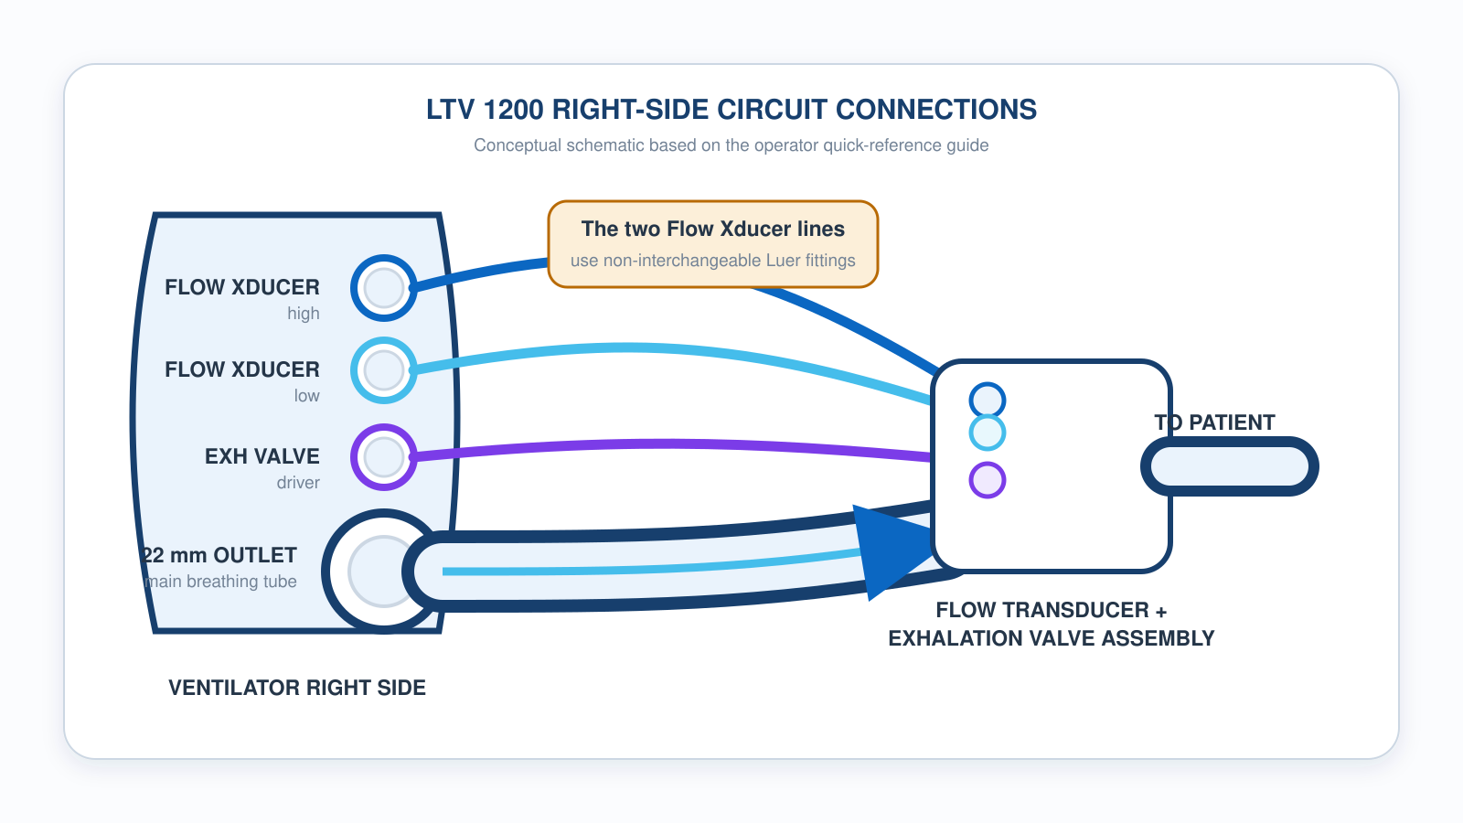
6.1 · Hardware
6.1
LTV 1200 Circuit Connections
Notes:
Figure for 6.1. Teaching schematic — verify port labels against the unit in service before you run this. Spend your time on the exhalation valve drive line: it is the most-missed connection on the LTV, and without it the patient cannot exhale. Have every learner point to it on a real unit before the module ends.

Slide 75
6.2 · Power
6.2
Battery and Line Power
Internal battery: sealed lead-acid, ~45 min at nominal settings (per the LTV operator manual). Drains FASTER at high FiO₂, high PEEP, rapid rates — plan far less for a sick lung.
Battery health degrades over service life. A unit in service > 3 years and never replaced will deliver less than spec. Document unexpected battery alarms.
On the truck: confirm "line power" on the display before loading the patient.
Pre-flight rule: 100% battery + line power confirmed = ready. Test external battery packs under load — a pack that holds static charge but fails under demand is a transport hazard.
Notes:
Internal battery: sealed lead-acid, ~45 min at nominal settings (per the LTV operator manual). Drains FASTER at high FiO₂, high PEEP, rapid rates — plan far less for a sick lung. Always confirm runtime against your unit's manual. Battery health degrades over service life. A unit in service > 3 years and never replaced will deliver less than spec. Document unexpected battery alarms. On the truck: confirm "line power" on the display before loading the patient. If external power is lost, the LTV annunciates a POWER LOST alarm and transfers to the internal battery — the switch is NOT silent; acknowledge the alarm and restore AC. Pre-flight rule: 100% battery + line power confirmed = ready. Test external battery packs under load — a pack that holds static charge but fails under demand is a transport hazard.

Slide 76
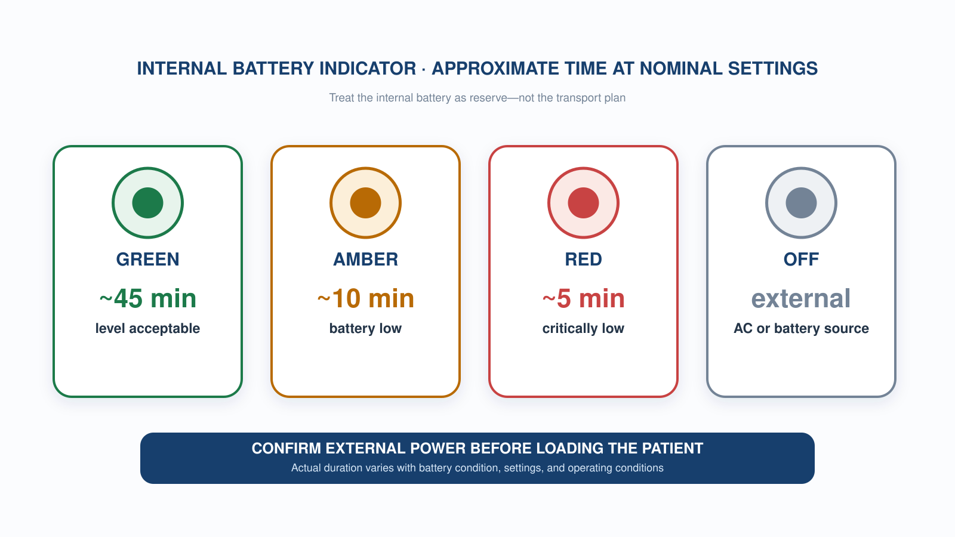
6.2 · Power
6.2
Internal Battery Indicator
Notes:
Figure for 6.2. The line under the header is the one to say out loud: the internal battery is reserve, not the transport plan. Note the runtimes are at nominal settings — high FiO2, high PEEP and rapid rates all shorten them, and a unit years into service will not make spec.

Slide 77
6.3 · Display
6.3
Reading the Screen
Display is organized left-to-right. SETTINGS on the left — what you programmed. MONITORED VALUES on the right — what the patient is actually receiving.
Settings half: Mode (top), Vt, RR, FiO₂, PEEP, I:E, trigger sensitivity. Scan top to bottom on every check.
Monitored half: PIP, exhaled Vt, total RR (set + spontaneous), exhaled MV, Pplat (when inspiratory hold is pressed), calculated I:E, FiO₂ delivered (if sensor present).
Divergence between SET Vt and EXHALED Vt is the earliest sign of a leak or compliance change. Don't silence — investigate.
CLINICAL PEARL
Set vs Exhaled
Exhaled Vt consistently < set Vt by > 10%? Check ETT cuff, walk the circuit, look at the exhalation valve drive line. Persistent leak = lost PEEP = lost oxygenation.
Notes:
Display is organized left-to-right. SETTINGS on the left — what you programmed. MONITORED VALUES on the right — what the patient is actually receiving. Settings half: Mode (top), Vt, RR, FiO₂, PEEP, I:E, trigger sensitivity. Scan top to bottom on every check. Monitored half: PIP, exhaled Vt, total RR (set + spontaneous), exhaled MV, Pplat (when inspiratory hold is pressed), calculated I:E, FiO₂ delivered (if sensor present). Divergence between SET Vt and EXHALED Vt is the earliest sign of a leak or compliance change. Don't silence — investigate. PEARL — Set vs Exhaled: Exhaled Vt consistently < set Vt by > 10%? Check ETT cuff, walk the circuit, look at the exhalation valve drive line. Persistent leak = lost PEEP = lost oxygenation.

Slide 78
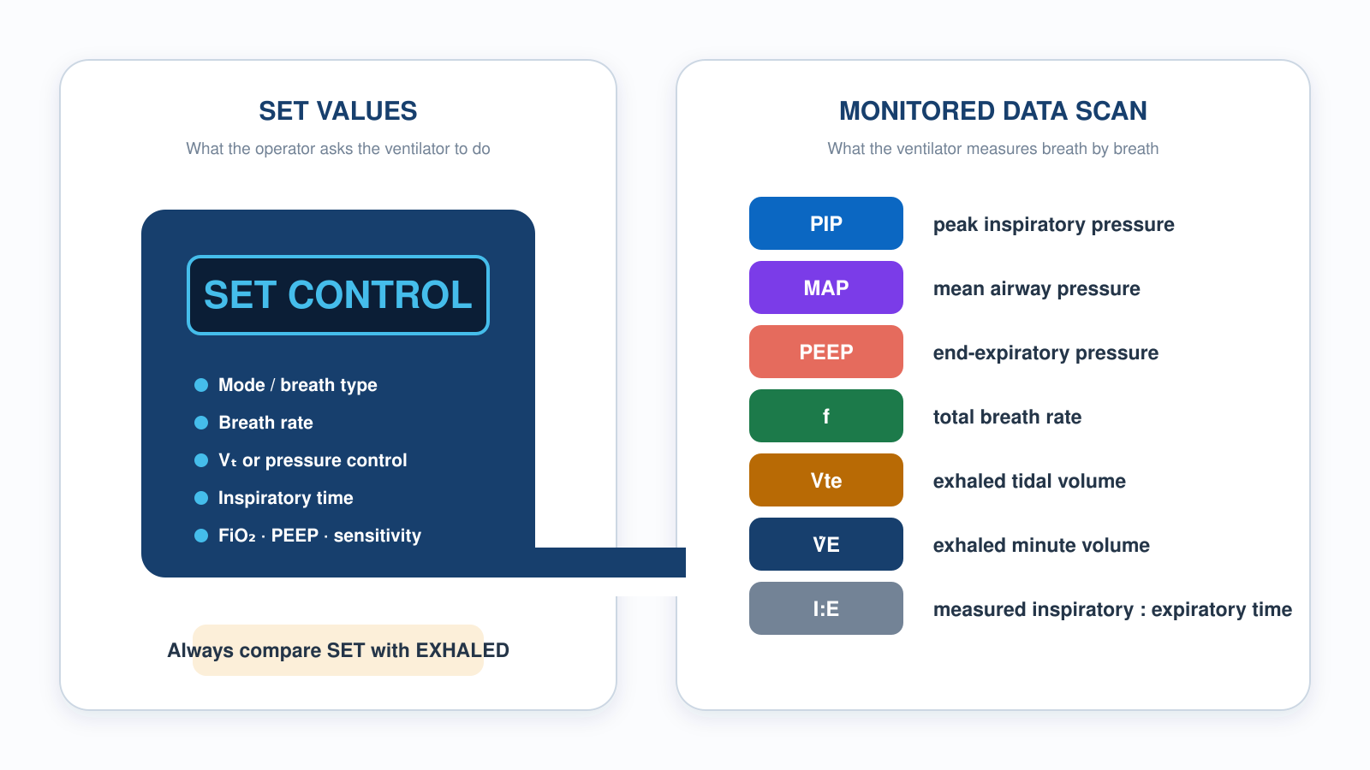
6.3 · Display
6.3
Reading Monitored Data
Notes:
Figure for 6.3. Left column is what you asked for, right column is what the patient is actually getting. Drill the scan order until it is automatic. The single most useful comparison on the screen is set Vt against exhaled Vt — a persistent gap over 10% is a leak, and a leak costs you PEEP.

Slide 79
6.4 · Alarms
6.4
The Core Alarms
HIGH PRESSURE — PIP exceeded threshold (default ~40 cmH₂O; set to 35 in lung-protective). Most common in EMS.
LOW PRESSURE / LOW PEEP — circuit leak, disconnect, ETT cuff leak. Low PEEP is set relative to set PEEP (manufacturer default: set PEEP minus 3 cmH₂O) in Extended Features. Confirm the value configured on your units.
LOW MINUTE VOLUME — exhaled MV below threshold. Default is often 0 — set this to ~70% of expected MV.
APNEA — no detected breath in apnea time (default 20 sec). Triggered by complete loss of effort or sensor failure.
POWER LOST / LOW BATTERY — external power lost (transfer to internal battery) or battery depleting. Restore AC promptly.
GAS SUPPLY — O₂ source pressure low; check tank, regulator, and hose.
Notes:
HIGH PRESSURE — PIP exceeded threshold (default ~40 cmH₂O; set to 35 in lung-protective). Most common in EMS. LOW PRESSURE / LOW PEEP — circuit leak, disconnect, ETT cuff leak. Default 4 cmH₂O below set PEEP. LOW MINUTE VOLUME — exhaled MV below threshold. Default is often 0 — set this to ~70% of expected MV. APNEA — no detected breath in apnea time (default 20 sec). Triggered by complete loss of effort or sensor failure. POWER LOST / LOW BATTERY — external power lost (transfer to internal battery) or battery depleting. Restore AC promptly. GAS SUPPLY — O₂ source pressure low; check tank, regulator, and hose. Triage: READ the alarm BEFORE silencing. Silencing without identifying the cause is a sentinel-level safety event. This is the core set — the operator manual lists additional device and self-test alarms. Know your unit's full alarm list before transport.

Slide 80
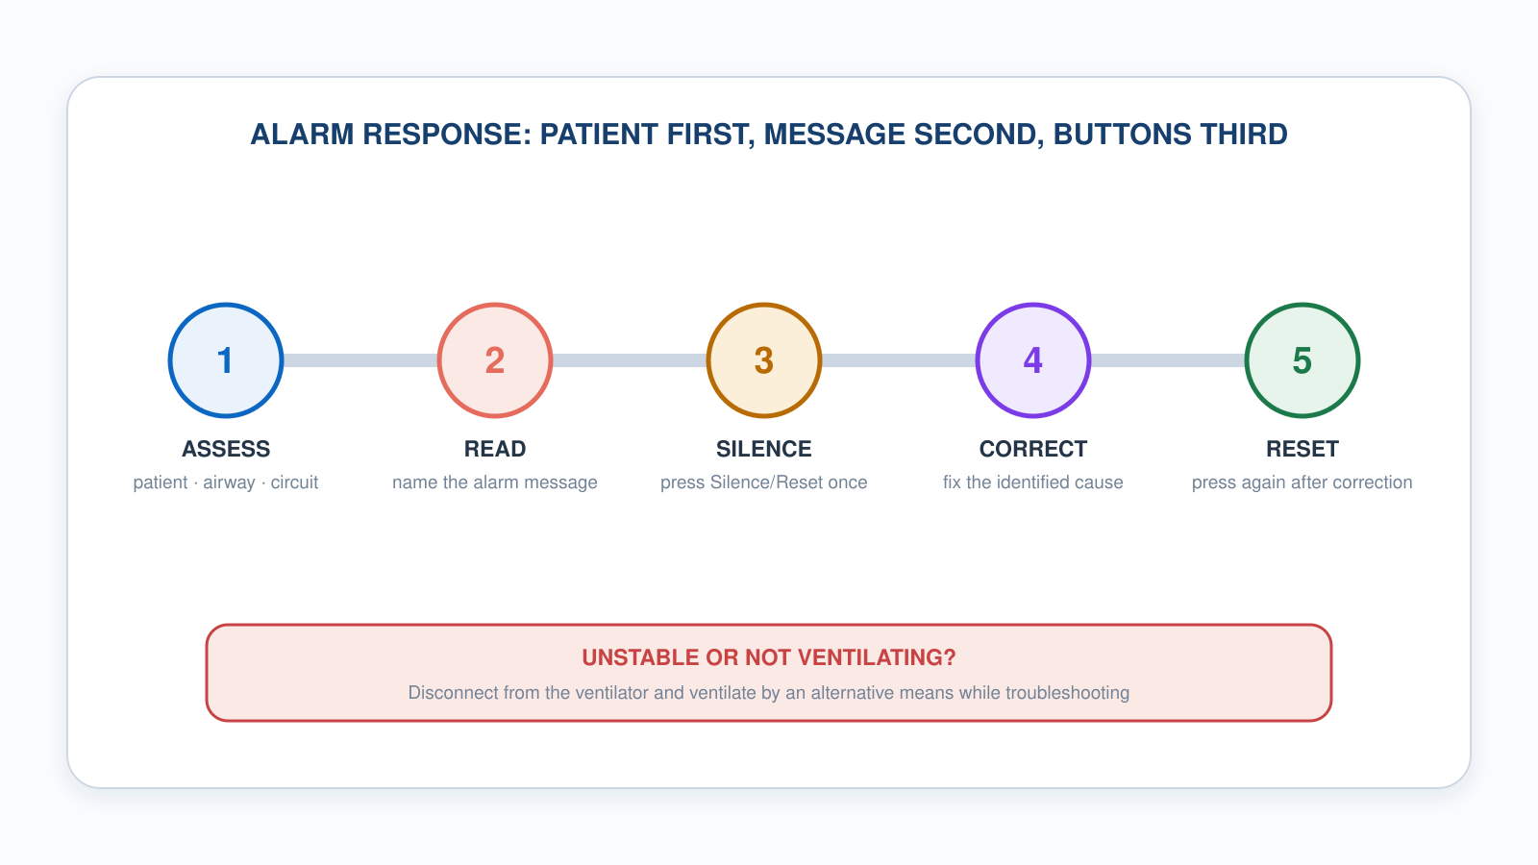
6.4 · Alarms
6.4
Alarm Response Sequence
Notes:
Figure for 6.4. Patient first, message second, buttons third — in that order, every time. Silencing before identifying is the single most common contributor to adverse vent events in transport review. Reuse this figure in 7.1 when you teach alarm philosophy.

Slide 81
6.5 · POST
6.5
Power-On Self-Test
Two different things: the ventilator’s automatic internal self-test at power-up, and YOUR pre-use checkout with a circuit and test lung. Do both — every shift change, every patient.
Connect the patient circuit and test lung before the pre-use checkout. The internal self-test tells you nothing about your circuit — the manufacturer requires a leak test of the circuit before connecting a patient.
Power on. The internal self-test runs automatically — let it finish and watch for any red indicator or fault message.
Verify alarms by triggering them: occlude circuit (high pressure should fire). Disconnect lung (low pressure should fire).
Verify Pplat: press inspiratory hold; confirm reading on display.
EVIDENCE
Why POST
A pre-use checkout catches circuit, leak and alarm faults the internal self-test cannot see. The worst time to find one is mid-transport.
Notes:
Every shift change, every patient. Five steps. 1. Connect circuit + test lung BEFORE powering on. POST without a circuit is meaningless. 2. Power on. Watch screen for any RED indicator. POST runs automatically — let it complete. 3. Verify alarms by triggering them: occlude circuit (high pressure should fire). Disconnect lung (low pressure should fire). 4. Verify Pplat: press inspiratory hold; confirm reading on display. 5. Document POST in service equipment log. Pull from service if POST fails. EVIDENCE — Why POST: Most field LTV failures are caught during POST. The worst time to find one is mid-transport.

Slide 82
6.6 · Workflow
6.6
Safe Changes & Common Pitfalls
Safe-change workflow: 1) Verbalize the change BEFORE you turn the dial. 2) Press SELECT to navigate. 3) Rotate CONTROL knob. 4) Press SELECT (or wait 5 sec) to commit. 5) Reassess in 30 sec.
Common pitfalls from incident reviews: forgetting to set the LOW MV alarm; setting PEEP at the dial but never attaching the PEEP valve; a pediatric patient on the adult circuit (dead space > Vt); missing the POWER LOST alarm when the AC plug bumps loose and the unit transfers to internal battery; POST skipped because "the next shift will do it."
Notes:
Safe-change workflow: 1) Verbalize the change BEFORE you turn the dial. 2) Press SELECT to navigate. 3) Rotate CONTROL knob. 4) Press SELECT (or wait 5 sec) to commit. 5) Reassess in 30 sec. 6) Document with vitals before AND after. Common pitfalls from incident reviews: forgetting to set the LOW MV alarm; setting PEEP at the dial but never attaching the PEEP valve; a pediatric patient on the adult circuit (dead space > Vt); missing the POWER LOST alarm when the AC plug bumps loose and the unit transfers to internal battery; POST skipped because "the next shift will do it."

Slide 83
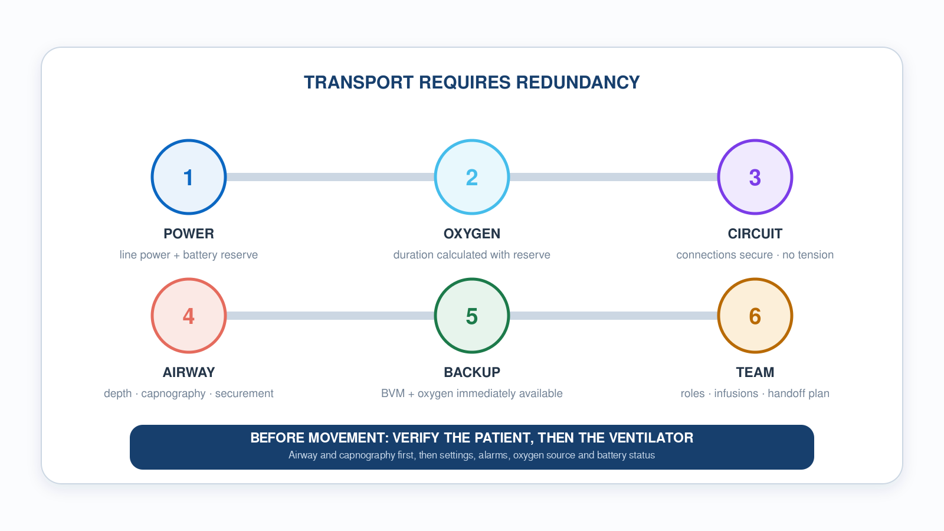
Module 6 · Transport Readiness
6
Ventilator Transport Readiness
Notes:
Provisional placement: this figure was authored for a transport module the deck does not yet have, so it sits at the end of Module 6 as an equipment-readiness capstone. Run it as a pre-departure checklist — power, oxygen, circuit, alarms, backup — and make the redundancy point explicit: every line on it needs a second answer before you move.

Slide 84
Now put it to work
Hand off to learner devices — cues match your facilitator guide.
QUIZ
Knowledge Check
10 questions · pass 8/10 to unlock the next module
MATCH
Front-Panel Controls
6 items · Navigates / Selects · Manages Alarms · Delivers a Breath / Measures · must be perfect
CASE
Pre-Shift Walkaround
4-decision branching scenario · Pre-shift unit check. No patient yet.
SIM
LTV 1200 Simulator
vent-ltv1200.html?level=1 — Learn the controls hands-on: work the LTV 1200 tutorial on the simulator.
Notes:
Transition slide: send learners to the app for this module's quiz, match, scenario, then the simulator mission. Keep the cohort together; modules unlock in sequence.

Slide 85
Carry this out the door
✓
Find it by feel, confirm by eye Locate controls by touch so you are fast in the dark — then confirm on the display before you change anything.
✓
Set vs Exhaled Exhaled Vt consistently more than 10% under set Vt? Check the ETT cuff, walk the circuit, check the exhalation valve drive line. A persistent leak costs you PEEP.
✓
The drive line is the one they forget The exhalation valve drive line is the most-missed connection on the LTV. Connected incorrectly, exhalation, PEEP and exhaled-volume readings all become unreliable. Verify it on every checkout.
✓
A self-test is not a checkout The automatic internal self-test does not check your circuit. Connect circuit and test lung, leak test, then trigger the alarms yourself to confirm they fire.
Next: Module 7
Notes:
Recap the module pearls, then transition.

Slide 86
7
VENTILATOR TRAINING ACADEMY
Module 7
Alarms & Troubleshooting
Every alarm is information. DOPE is the universal algorithm. The 10-second rule is non-negotiable.
Application · 7 lessons
Jordan Hunter Jones, NRP · Course Director
Notes:
Module 7: Alarms & Troubleshooting. Every alarm is information. DOPE is the universal algorithm. The 10-second rule is non-negotiable.

Slide 87
In this module
7.1
Philosophy What Alarms Are For
7.5
E Equipment Failure
7.2
D Dislodgement
7.6
The 10-Second Rule When to Disconnect and Bag
7.3
O Obstruction
7.7
Dyssynchrony When the Patient and Vent Argue
7.4
P Pneumothorax
Then:
Knowledge Check
Match
Scenario
Simulator
Notes:
Roadmap of the module. Teach the lessons in order, then run the four interactive components on learner devices.

Slide 88
7.1 · Philosophy
7.1
What Alarms Are For
Alarms are NOT nuisances. They are information about a deteriorating system. Two kinds: equipment alarms (machine problem) and patient alarms (patient problem). Some are both.
The cardinal rule: READ the alarm before you SILENCE it. Silencing an alarm without identifying the cause is a sentinel-level safety event, documented in nearly every transport-service incident review.
Silence gives you 60 seconds of quiet to fix. Not 60 seconds to ignore. After 60 sec, if the problem persists, the alarm re-fires.
Build the habit: read first, silence second, fix third, document fourth. Train it until it's automatic.
CLINICAL PEARL
Sentinel error
Silencing without investigating is the #1 contributor to adverse vent events in transport. Don't let muscle memory take over.
Notes:
Alarms are NOT nuisances. They are information about a deteriorating system. Two kinds: equipment alarms (machine problem) and patient alarms (patient problem). Some are both. The cardinal rule: READ the alarm before you SILENCE it. Silencing an alarm without identifying the cause is a sentinel-level safety event, documented in nearly every transport-service incident review. Silence gives you 60 seconds of quiet to fix. Not 60 seconds to ignore. After 60 sec, if the problem persists, the alarm re-fires. Build the habit: read first, silence second, fix third, document fourth. Train it until it's automatic. PEARL — Sentinel error: Silencing without investigating is the #1 contributor to adverse vent events in transport. Don't let muscle memory take over.

Slide 89
7.2 · D
7.2
Dislodgement
Most common cause of sudden vent crisis in transport. Movement during loading, lifting, transferring between gurney and aircraft, or a road bump can dislodge an ETT.
Confirm depth: marking at the lip should match what was secured (21 cm women, 23 cm men typically).
Capnography: sudden loss of waveform is a red flag, not a diagnosis. Consider dislodgement, disconnection, obstruction, apnea, sampling failure, arrest, or a sudden fall in perfusion.
Auscultate: equal bilateral breath sounds. Right-only = mainstem migration. Absent or epigastric = esophageal or completely out.
If the tube is out, bag with BVM + mask while preparing to re-intubate. Verify depth AGAIN after every transition.
Notes:
Most common cause of sudden vent crisis in transport. Movement during loading, lifting, transferring between gurney and aircraft, or a road bump can dislodge an ETT. Confirm depth: marking at the lip should match what was secured (21 cm women, 23 cm men typically). Confirm capnography: a sudden drop to zero is dislodgement until proven otherwise. Auscultate: equal bilateral breath sounds. Right-only = mainstem migration. Absent or epigastric = esophageal or completely out. If the tube is out, bag with BVM + mask while preparing to re-intubate. Verify depth AGAIN after every transition.

Slide 90
7.3 · O
7.3
Obstruction
Tube patent in position but blocked.
Pass a suction catheter. This is BOTH diagnostic AND therapeutic. If it passes easily and brings back secretions, you've solved the problem.
If suction passes but doesn't clear secretions, consider bronchodilator or repositioning.
If suction doesn't pass — you have a fixed obstruction or dislodgement. Disconnect and bag while investigating.
Notes:
Tube patent in position but blocked. Causes: mucus plug (most common in post-arrest, post-aspiration, COPD), biting on the tube, condensation pooled in dependent loop, kinked tube, over-inflated cuff herniating into lumen. Pass a suction catheter. This is BOTH diagnostic AND therapeutic. If it passes easily and brings back secretions, you've solved the problem. If suction passes but doesn't clear secretions, consider bronchodilator or repositioning. If suction doesn't pass — you have a fixed obstruction or dislodgement. Disconnect and bag while investigating.

Slide 91
7.4 · P
7.4
Pneumothorax
Sudden rise in PIP, often with falling SpO₂ and BP. Decreased or absent breath sounds on the affected side. Tracheal deviation away from the affected side (LATE).
Hyperresonance to percussion of the affected side. JVD + hemodynamic compromise = TENSION pneumothorax. Clinical diagnosis at the bedside, not waiting for imaging.
Decompress per protocol: needle thoracostomy at the 2nd ICS midclavicular OR 4th–5th ICS midaxillary. Then chest seal / tube as appropriate.
High-risk populations: asthma/COPD on positive pressure, trauma, recent central line placement. Suspect early.
Notes:
Sudden rise in PIP, often with falling SpO₂ and BP. Decreased or absent breath sounds on the affected side. Tracheal deviation away from the affected side (LATE). Hyperresonance to percussion of the affected side. JVD + hemodynamic compromise = TENSION pneumothorax. Clinical diagnosis at the bedside, not waiting for imaging. Decompress per protocol: needle thoracostomy at the 2nd ICS midclavicular OR 4th–5th ICS midaxillary. Then chest seal / tube as appropriate. High-risk populations: asthma/COPD on positive pressure, trauma, recent central line placement. Suspect early.

Slide 92
7.5 · E
7.5
Equipment Failure
Machine is the problem. Causes: disconnected circuit (most often exhalation valve drive line), failed sensor or transducer, silent battery switch, O₂ source disconnect, software hang, loose ETT cuff.
Universal answer: DISCONNECT FROM THE VENT AND BAG WITH 100% O₂. The bag tells you whether the problem is patient or machine.
Bag feel is a clue, not proof. Easy bag with a rising sat points to the machine; high resistance points to the patient (DOPE). Confirm ventilation with waveform capnography and oxygenation with SpO₂ and clinical response.
Bagging is rarely the wrong answer. It is diagnostic AND therapeutic at the same time.
Notes:
Machine is the problem. Causes: disconnected circuit (most often exhalation valve drive line), failed sensor or transducer, silent battery switch, O₂ source disconnect, software hang, loose ETT cuff. Universal answer: DISCONNECT FROM THE VENT AND BAG WITH 100% O₂. The bag tells you whether the problem is patient or machine. Easy bag + sat rises = vent problem. Troubleshoot vent off-patient. Hard bag = patient problem — apply DOPE (D, O, or P). Bagging is rarely the wrong answer. It is diagnostic AND therapeutic at the same time.

Slide 93
7.6 · The 10-Second Rule
7.6
When to Disconnect and Bag
If you cannot identify and fix an alarm in 10 seconds, disconnect from the ventilator and bag with 100% oxygen. Then troubleshoot.
Vented patients deteriorate fast — sats can drop 20 points in two minutes of failed ventilation. Bagging buys time.
The bag gives you direct feedback the vent cannot: resistance in your hand, chest rise in front of you. Confirm gas exchange with the capnography waveform — not with the feel of the bag alone.
Easy bag with a rising sat points to the machine; a hard bag points to the patient — run DOPE. Treat both as clues and confirm with waveform and SpO₂. Bagging is rarely the wrong answer.
CLINICAL PEARL
10 seconds, then bag
If you're hesitating past 10 seconds, you're losing time. Disconnect and bag. Troubleshoot with confidence that the patient is being ventilated.
Notes:
If you cannot identify and fix an alarm in 10 seconds, disconnect from the ventilator and bag with 100% oxygen. Then troubleshoot. Vented patients deteriorate fast — sats can drop 20 points in two minutes of failed ventilation. Bagging buys time. The bag gives you something the vent cannot: direct hands-on feedback. You feel resistance. You see chest rise. You CONFIRM gas exchange. If bagging is easy and sat comes up, the problem is the machine. If bagging is hard, the problem is the patient — DOPE. Bagging is rarely the wrong answer. PEARL — 10 seconds, then bag: If you're hesitating past 10 seconds, you're losing time. Disconnect and bag. Troubleshoot with confidence that the patient is being ventilated.

Slide 94
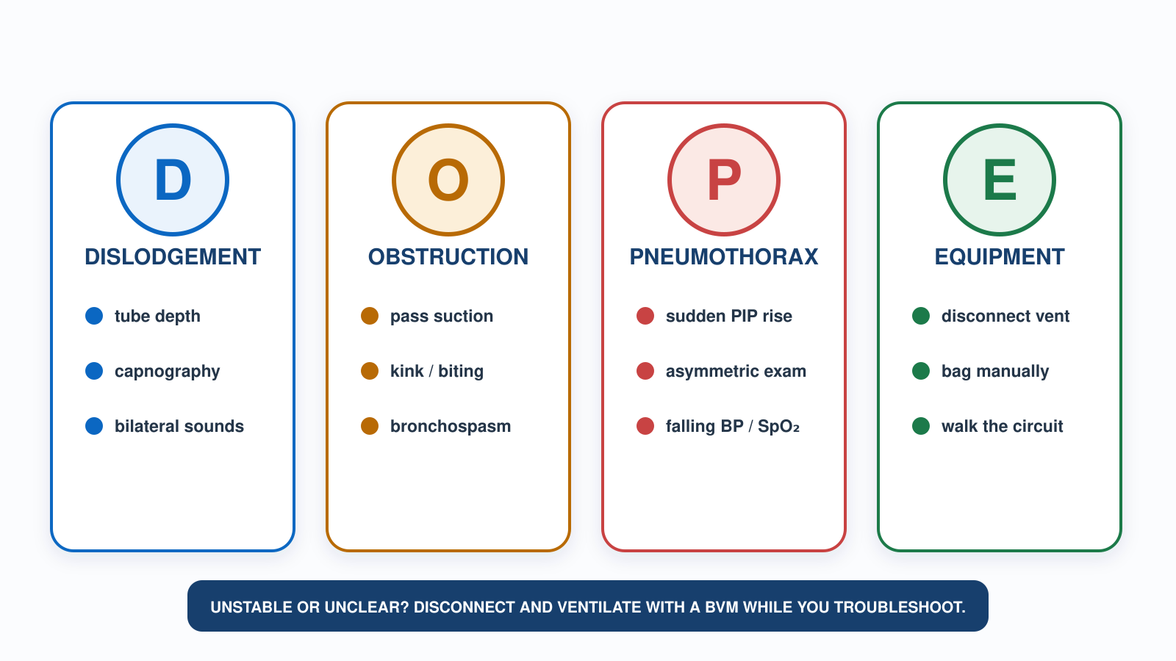
7.1–7.6 · DOPE
7
DOPE Troubleshooting
Notes:
Figure spanning 7.1 through 7.6. Use it as the module anchor and leave it up during the scenario. Four letters, four actions. Pair it with the ten-second rule: if you cannot name and fix the problem in ten seconds, disconnect and bag, then work the letters with the patient already being ventilated.

Slide 95
7.7 · Dyssynchrony
7.7
When the Patient and Vent Argue
Patient-vent dyssynchrony affects ~25% of vented patients (Blanch, ICM 2015). Four patterns:
Trigger asynchrony: patient effort doesn't initiate a breath. Fix: increase trigger sensitivity (flow trigger if available).
Flow asynchrony: vent flow doesn't match patient demand. Fix: increase peak flow or shorten inspiratory time.
Double triggering: patient effort outlasts inspiration; a second breath stacks immediately. Fix: lengthen inspiratory time and meet flow demand; treat air hunger and pain before adding sedative.
Work causes first: patient, tube and circuit, pain, secretions, bronchospasm, auto-PEEP, then trigger, flow and timing. Reach for analgesia and sedation once a cause has been addressed and the patient still needs it (SCCM PADIS).
Notes:
Patient-vent dyssynchrony affects ~25% of vented patients (Blanch, ICM 2015). Four patterns: Trigger asynchrony: patient effort doesn't initiate a breath. Fix: increase trigger sensitivity (flow trigger if available). Flow asynchrony: vent flow doesn't match patient demand. Fix: increase peak flow or shorten inspiratory time. Double triggering: patient effort outlasts inspiration; second breath stacks immediately. Fix: lengthen inspiratory time, deepen sedation, treat air hunger. EMS bedside fix for most dyssynchrony: deepen sedation, ensure adequate analgesia, check trigger settings.

Slide 96
Now put it to work
Hand off to learner devices — cues match your facilitator guide.
QUIZ
Knowledge Check
10 questions · pass 8/10 to unlock the next module
MATCH
Sort the Signs by DOPE Letter
8 items · D — Dislodgement · O — Obstruction · P — Pneumothorax · E — Equipment · must be perfect
CASE
Run DOPE in 60 Seconds
4-decision branching scenario · 27-year-old female, 65 kg IBW, status asthmaticus, intubated 30 min…
SIM
LTV 1200 Simulator
vent-ltv1200.html?level=2 — Test yourself on the simulator's clinical scenarios — set alarm limits and correct the…
Notes:
Transition slide: send learners to the app for this module's quiz, match, scenario, then the simulator mission. Keep the cohort together; modules unlock in sequence.

Slide 97
Carry this out the door
✓
Sentinel error Silencing without investigating is the #1 contributor to adverse vent events in transport. Don't let muscle memory take over.
✓
10 seconds, then bag If you're hesitating past 10 seconds, you're losing time. Disconnect and bag. Troubleshoot with confidence that the patient is being ventilated.
✓
Bagging is the diagnostic test Easy bag and the sat comes up = machine problem. Hard bag = patient problem, run DOPE. Diagnostic and therapeutic in the same motion.
✓
EtCO₂ to zero Sudden loss of waveform is a red flag, not a diagnosis — dislodgement, disconnect, obstruction, apnea, arrest, or collapsed perfusion. Check patient, tube and circuit, and confirm with waveform capnography.
Next: Module 8
Notes:
Recap the module pearls, then transition.

Slide 98
8
VENTILATOR TRAINING ACADEMY
Module 8
Sedation & Analgesia
If the patient can fight the vent, the vent will lose. Analgesia first. Push-dose pressors ready before you push the induction agent.
Application · 5 lessons
Jordan Hunter Jones, NRP · Course Director
Notes:
Module 8: Sedation & Analgesia. If the patient can fight the vent, the vent will lose. Analgesia first. Push-dose pressors ready before you push the induction agent.

Slide 99
In this module
8.1
Why Sedate Five Reasons
8.4
Push-Dose Pressors Ready BEFORE You Push Induction
8.2
RASS The Sedation Scale
8.5
Pitfalls What Goes Wrong
8.3
Agents EMS Sedation/Analgesia Toolbox
Then:
Knowledge Check
Match
Scenario
Simulator
Notes:
Roadmap of the module. Teach the lessons in order, then run the four interactive components on learner devices.

Slide 100
8.1 · Why Sedate
8.1
Five Reasons
Comfort: an ETT is uncomfortable; bucking the vent is exhausting.
Synchrony: a patient fighting the vent generates dangerously high airway pressures (barotrauma).
Safety: awake fighting patients pull tubes and lines — self-extubation is a sentinel event.
Oxygenation: lower work of breathing = lower O₂ demand = easier oxygenation.
Hemodynamics: well-sedated patients have less sympathetic drive and more predictable response to vasopressors.
CLINICAL PEARL
Iron rule
Paralyze ONLY a patient who is also analgesed AND sedated. Bolt-and-paralyze without sedation = awareness with paralysis. Sentinel safety event.
Notes:
Comfort: an ETT is uncomfortable; bucking the vent is exhausting. Synchrony: a patient fighting the vent generates dangerously high airway pressures (barotrauma). Safety: awake fighting patients pull tubes and lines — self-extubation is a sentinel event. Oxygenation: lower work of breathing = lower O₂ demand = easier oxygenation. Hemodynamics: well-sedated patients have less sympathetic drive and more predictable response to vasopressors. Modern ICU evidence (ABCDE bundle, SAT/SBT): LIGHTER sedation with daily wake-ups reduces vent days and mortality. EMS target: RASS −1 to −2 — calm but arousable. PEARL — Iron rule: Paralyze ONLY a patient who is also analgesed AND sedated. Bolt-and-paralyze without sedation = awareness with paralysis. Sentinel safety event.

Slide 101
8.2 · RASS
8.2
The Sedation Scale
Richmond Agitation-Sedation Scale runs +4 (combative) to −5 (unarousable).
+4 combative danger to staff. +3 very agitated, pulls at tubes. +2 agitated, fights vent. +1 restless but cooperative.
0 alert and calm.
−1 drowsy, sustained eye contact > 10 sec to voice. −2 light sedation, briefly opens eyes to voice. −3 moderate, movement to voice no eye contact. −4 deep, movement to physical stimulus only.
There is no universal transport target. RASS −1 to −2 suits many stable ventilated adults, but the right depth depends on indication, hemodynamics, neuromuscular blockade and local protocol — a paralyzed or severe-ARDS patient needs deeper.
Notes:
Richmond Agitation-Sedation Scale runs +4 (combative) to −5 (unarousable). +4 combative danger to staff. +3 very agitated, pulls at tubes. +2 agitated, fights vent. +1 restless but cooperative. 0 alert and calm. −1 drowsy, sustained eye contact > 10 sec to voice. −2 light sedation, briefly opens eyes to voice. −3 moderate, movement to voice no eye contact. −4 deep, movement to physical stimulus only. −5 unarousable. Transport target is RASS −1 to −2. Deeper than −2 makes handoff assessment hard. Lighter than −1 risks self-extubation.

Slide 102
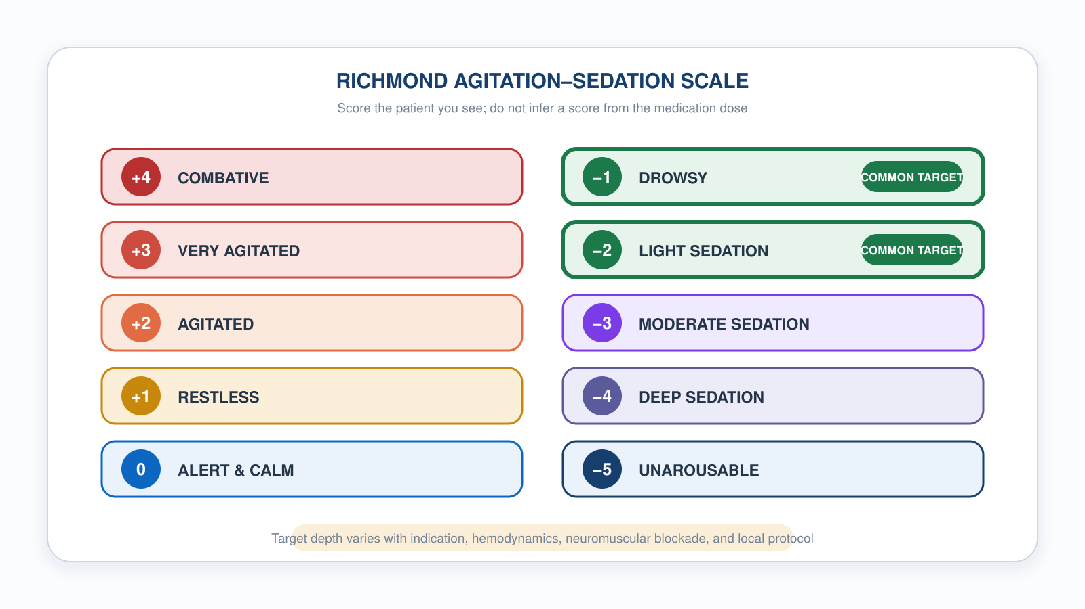
8.2 · RASS
8.2
The Richmond Agitation–Sedation Scale
Notes:
Figure for 8.2. The caption under the header is the teaching point: score the patient in front of you, do not infer a score from the dose you gave. Mark the transport target band of minus 1 to minus 2 on the graphic. Deeper than minus 2 complicates handoff; lighter than minus 1 risks self-extubation.

Slide 103
8.3 · Agents
8.3
EMS Sedation/Analgesia Toolbox
Fentanyl 1–2 mcg/kg IV, redose 0.5–1 mcg/kg q15–20 min. Analgesia first. Watch chest wall rigidity at high doses pushed rapidly.
Ketamine 1–2 mg/kg IV induction; 0.5–1 mg/kg redose. Long assumed to be the safer choice in shock, but current randomized evidence does not support that: the RSI trial (NEJM 2025, n=2,365) found no mortality difference and MORE cardiovascular collapse with ketamine. Acceptable in TBI. Follow your protocol.
Midazolam 0.05–0.1 mg/kg IV q5–10 min. Sedation + amnesia. Synergistic respiratory depression with opioids. Flumazenil reverses it but has no role in a tubed patient — seizure risk in chronic users and mixed ingestions.
Propofol 5–50 mcg/kg/min infusion (per service formulary). Drops BP. PRIS (propofol-related infusion syndrome): metabolic acidosis, rhabdomyolysis, cardiac arrhythmia at > 4 mg/kg/hr or > 48 hr infusions.
Etomidate 0.3 mg/kg IV induction. Transient adrenal suppression is real, but randomized data have not shown a mortality penalty against ketamine in emergency intubation. Not carried by every EMS service.
Notes:
Fentanyl 1–2 mcg/kg IV, redose 0.5–1 mcg/kg q15–20 min. Analgesia first. Watch chest wall rigidity at high doses pushed rapidly. Ketamine 1–2 mg/kg IV induction; 0.5–1 mg/kg redose. PREFERRED in shock — sympathetic effect supports BP. KETASED (Jabre 2009): equivalent to etomidate, safer in shock. Modern evidence: acceptable in TBI. Scope varies by service — some carry it only for ongoing sedation of already-intubated patients rather than as a field induction agent; know your local protocol. Midazolam 0.05–0.1 mg/kg IV q5–10 min. Sedation + amnesia. Synergistic respiratory depression with opioids — dose conservatively when you have already given fentanyl. Flumazenil reverses it pharmacologically, but do not carry that into practice here: it drops the seizure threshold in chronic benzodiazepine users and in mixed ingestions, and there is no scenario in which you reverse sedation in a patient who is intubated and on your vent. Propofol 5–50 mcg/kg/min infusion (per service formulary). Drops BP. PRIS (propofol-related infusion syndrome): metabolic acidosis, rhabdomyolysis, cardiac arrhythmia at > 4 mg/kg/hr or > 48 hr infusions. Often not carried on EMS units — typically a hospital-supplied infusion you may monitor, not initiate. Etomidate 0.3 mg/kg IV induction. Clean hemodynamics but causes adrenal suppression — many EMS prefer ketamine in shock RSI. Not carried by many EMS services.

Slide 104
8.4 · Push-Dose Pressors
8.4
Ready BEFORE You Push Induction
Post-intubation hypotension is common after emergency intubation — about 25% in Heffner's 2012 emergency-department cohort (an ED, not prehospital, study; anticipate it in the field too).
Push-dose epinephrine — prepare ONLY by your service’s approved method. Typical: epinephrine 0.1 mg/mL, 1 mL (100 mcg) diluted to a FINAL VOLUME of 10 mL with normal saline = 10 mcg/mL. Dose 5–20 mcg IV every 1–5 min.
Push-dose phenylephrine — alternative when avoiding tachycardia. Phenylephrine 10 mg diluted to a final volume of 100 mL with normal saline = 100 mcg/mL. Dose 50–200 mcg IV q1–5 min. Pure α-agonist; reflex bradycardia possible.
Label every syringe with drug and FINAL concentration in mcg/mL — never a ratio. Bedside dilution is a documented source of dosing error: use only a pharmacy-approved preparation. Document every push.
EVIDENCE
Post-intubation hypotension
Heffner 2012: ~25% incidence in an emergency-department intubation cohort (not a prehospital study). Higher in shock states. Always have push-dose pressors prepared before pushing the induction agent.
Notes:
Post-intubation hypotension is common after emergency intubation — about 25% in Heffner's 2012 emergency-department cohort (an ED, not prehospital, study; anticipate it in the field too). The fix is anticipation. Push-dose epinephrine — a rapid bridge for peri-intubation hypotension. Mix 1 mg (1:10,000) into 100 mL NS = 10 mcg/mL. Dose 5–20 mcg IV (typically 10 mcg) every 1–5 min. Onset 1 min, duration 5–10 min. Inotropy + vasoconstriction. It buys time until a continuous infusion is running — it is not the definitive pressor. Push-dose phenylephrine — alternative when avoiding tachycardia. Mix 10 mg into 100 mL NS = 100 mcg/mL. Dose 50–200 mcg IV q1–5 min. Pure α-agonist; reflex bradycardia possible. Label every syringe clearly. Document every push. Move to a continuous infusion as soon as practical — norepinephrine is the first-line infused vasopressor for most shock states (Surviving Sepsis 2021), started at 0.05–0.1 mcg/kg/min and titrated to MAP ≥ 65, and it can run peripherally through a good IV for transport. Push-dose pressors are a bridge to that infusion. EVIDENCE — Post-intubation hypotension: Heffner 2012: ~25% incidence in an emergency-department intubation cohort (not a prehospital study). Higher in shock states. Always have push-dose pressors prepared before pushing the induction agent.

Slide 105
8.5 · Pitfalls
8.5
What Goes Wrong
Under-sedation in the first 10 minutes after intubation. Long-acting paralytics outlast a single induction dose. Bolt → sedate → redose sedation BEFORE paralysis wears off.
Over-sedation pre-arrival. Deep sedation without an indication delays neurologic assessment and worsens hemodynamics. Titrate to the lightest depth that meets the patient’s indication and your protocol, and reassess.
Paralytic without analgesia/sedation. Awareness with paralysis — sentinel safety event. Always pair long-acting paralytics with BOTH.
Post-intubation hypotension. ~25% incidence. Push-dose pressors should be in your hand before induction.
Mixing too many agents. Stick with one analgesic + one sedative for transport.
Notes:
Under-sedation in the first 10 minutes after intubation. Long-acting paralytics outlast a single induction dose. Bolt → sedate → redose sedation BEFORE paralysis wears off. Over-sedation pre-arrival. RASS −5 patients can't help with hand-off and are at higher risk of hemodynamic instability. Target RASS −1 to −2 by handoff. Paralytic without analgesia/sedation. Awareness with paralysis — sentinel safety event. Always pair long-acting paralytics with BOTH. Post-intubation hypotension. ~25% incidence. Push-dose pressors should be in your hand before induction. Mixing too many agents. Stick with one analgesic + one sedative for transport.

Slide 106
Now put it to work
Hand off to learner devices — cues match your facilitator guide.
QUIZ
Knowledge Check
10 questions · pass 8/10 to unlock the next module
MATCH
Pick the Sedation/Pressor Agent
6 items · Ketamine · Fentanyl · Push-Dose Epi · must be perfect
CASE
Septic Shock RSI
4-decision branching scenario · 76-year-old female, 60 kg, urosepsis, on norepinephrine 8 mcg/min…
SIM
LTV 1200 Simulator
vent-ltv1200.html?scenario=agitation — A patient fighting the vent with normal mechanics — recognize when the fix is a drug,…
Notes:
Transition slide: send learners to the app for this module's quiz, match, scenario, then the simulator mission. Keep the cohort together; modules unlock in sequence.

Slide 107
Carry this out the door
✓
Iron rule Paralyze ONLY a patient who is also analgesed AND sedated. Bolt-and-paralyze without sedation = awareness with paralysis. Sentinel safety event.
✓
Analgesia first Pain is the most common reversible cause of a patient fighting the vent. Treat it before you reach for more sedative.
✓
Pressors in hand before induction Post-intubation hypotension runs about 25% in ED cohorts. Draw up push-dose epi before you push the induction agent, not after the BP drops.
✓
Sedate to indication, not to habit RASS −1 to −2 fits many stable ventilated adults; paralysis, severe ARDS and raised ICP need deeper. Deep sedation with no indication is not safety.
Next: Module 9
Notes:
Recap the module pearls, then transition.

Slide 108
9
VENTILATOR TRAINING ACADEMY
Module 9
Special Populations
Same vent. Different goals. Asthma/COPD, ARDS, TBI, pediatrics. Pick the goal first; the settings follow.
Application · 6 lessons
Jordan Hunter Jones, NRP · Course Director
Notes:
Module 9: Special Populations. Same vent. Different goals. Asthma/COPD, ARDS, TBI, pediatrics. Pick the goal first; the settings follow.

Slide 109
In this module
9.1
Asthma & COPD Let Them Exhale
9.4
ARDS Rescue When Lung-Protective Isn't Enough
9.2
Auto-PEEP When the Lung Doesn't Empty
9.5
TBI Strict Normocapnia
9.3
ARDS Lung-Protective Ventilation
9.6
Pediatrics Smaller Everything, Bigger Margins
Then:
Knowledge Check
Match
Scenario
Simulator
Notes:
Roadmap of the module. Teach the lessons in order, then run the four interactive components on learner devices.

Slide 110
9.1 · Asthma & COPD
9.1
Let Them Exhale
Obstructive disease is fundamentally an EXHALATION problem. Air goes in easily; getting it out takes time.
Strategy: low rate (RR 8–10), long expiratory time (I:E 1:4 or 1:5), Vt 6–8 mL/kg IBW, FiO₂ to SpO₂ 88–92% (COPD — don't overshoot) or 92–96% (asthma), PEEP 0–5 cmH₂O. Permissive hypercapnia is acceptable; pH ≥ 7.20 typical floor.
Don't chase a normal CO₂ at the cost of barotrauma. Forcing the rate up stacks breaths and drops BP via auto-PEEP.
Notes:
Obstructive disease is fundamentally an EXHALATION problem. Air goes in easily; getting it out takes time. Strategy: low rate (RR 8–10), long expiratory time (I:E 1:4 or 1:5), Vt 6–8 mL/kg IBW, FiO₂ titrated to SpO₂ 88–92% in COPD and 92–96% in asthma, PEEP 0–5 cmH₂O. Both oxygen targets are ranges, not floors — overshooting a COPD patient is not a safety margin. Permissive hypercapnia is acceptable; pH ≥ 7.20 is the typical floor. Don't chase a normal CO₂ at the cost of barotrauma. Forcing the rate up stacks breaths and drops BP via auto-PEEP.

Slide 111
9.2 · Auto-PEEP
9.2
When the Lung Doesn't Empty
Picture pouring into a glass that drains slowly: send the next splash before it empties and the level climbs until it overflows.
Clinical signs: BOTH PIP and Pplat climb breath to breath — trapped gas raises end-expiratory volume, so unlike pure bronchospasm the plateau rises too. Falling BP. Patient "fights" the vent. Expiratory flow doesn't return to zero before the next breath — a useful clue, but an insensitive one.
Confirm it with the EXPIRATORY hold — not the inspiratory hold. Pressure above set PEEP at the end of that hold is the auto-PEEP. Then manage: slow RR (often dramatically — to 8 or even 6) and lengthen expiratory time (I:E 1:4 or 1:5).
If hemodynamically compromised: BRIEFLY DISCONNECT FROM THE VENT for 5–10 seconds. Trapped gas releases. BP often improves immediately. Reconnect on slower settings.
CLINICAL PEARL
Brief disconnect
Hypotensive asthmatic on the vent? Disconnect for 5–10 sec and let the trapped gas out. BP often recovers in under a minute. A lower Pplat after you reconnect confirms trapping was the cause.
Notes:
Picture pouring into a glass that drains slowly: send the next splash before it empties and the level climbs until it overflows. Auto-PEEP is the same — in an obstructed lung that exhales slowly, the next breath starts before the last one finishes, so air stacks, the chest over-fills, intrathoracic pressure rises, venous return drops, and BP falls. Clinical signs — and this is where people get it wrong. Trapped gas raises the volume left in the chest at end-expiration, so the next breath starts from a higher baseline. That means BOTH PIP and Pplat climb, breath after breath. This is the exception to the Module 1 rule you just learned: in pure bronchospasm PIP rises alone, but once gas is actually trapping, the plateau rises with it. If you are waiting for a normal Pplat to tell you it's auto-PEEP, you will miss it. Other signs: falling BP, the patient appearing to fight the vent, and expiratory flow that never returns to zero before the next breath — that last one is a useful clue but an insensitive test, so a clean-looking waveform does not rule trapping out. Confirm it with the EXPIRATORY hold — not the inspiratory hold you use for Pplat. Occlude at end-expiration, let the pressure equilibrate, and read the number. Anything above your set PEEP is auto-PEEP. Then manage it: slow the rate, often dramatically, to 8 or even 6, and lengthen expiratory time to I:E 1:4 or 1:5. If hemodynamically compromised: BRIEFLY DISCONNECT FROM THE VENT for 5–10 seconds. Trapped gas releases. BP often improves immediately. Reconnect on slower settings. Vented status asthmaticus has ~30% incidence of post-intubation hypotension — anticipate it. PEARL — Brief disconnect: Hypotensive asthmatic on the vent? Disconnect for 5–10 sec and let the trapped gas out. BP often recovers in under a minute. A lower Pplat after you reconnect confirms trapping was the cause — that's your retrospective diagnosis.

Slide 112
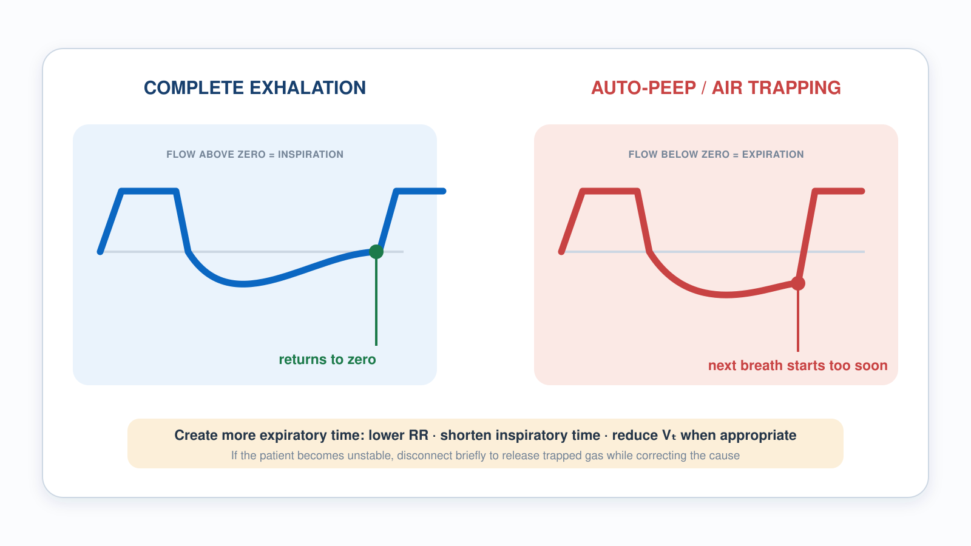
9.1–9.2 · Auto-PEEP
9.2
Auto-PEEP and Expiratory Flow
Notes:
Figure spanning 9.1 and 9.2. The two tracings show complete exhalation versus a next breath starting too soon. Use it to make the waveform recognizable — then repeat the lesson caveat: this waveform is an insensitive screen, and a clean-looking tracing does not rule trapping out. Confirm with an expiratory hold, and remember both PIP and Pplat rise when gas is genuinely trapping.

Slide 113
9.3 · ARDS
9.3
Lung-Protective Ventilation
ARDS: diffuse alveolar damage with refractory hypoxemia. Berlin definition — onset within 1 week of a known insult; bilateral opacities not explained by effusion, collapse or nodules; not fully explained by cardiac failure or fluid overload; PaO₂/FiO₂ ≤ 300 on PEEP or CPAP ≥ 5 cmH₂O.
Goal: protect the alveoli you have left. The mental model is the 'baby lung' — in ARDS so much lung is flooded or collapsed that only a small, child-sized portion is still open to ventilate.
Settings: AC/VC or AC/PC; START at 6 mL/kg PBW and adjust within 4–8 to keep Pplat < 30; RR 18–22 to hold minute ventilation; titrate PEEP by oxygenation, severity and hemodynamics using the ARDSNet table; driving pressure (Pplat − PEEP) < 14 cmH₂O.
ARDSNet ARMA (NEJM 2000): mortality 31% vs 40% comparing 6 vs 12 mL/kg IBW. NNT 11. The most evidence-based ARDS intervention.
EVIDENCE
ARDSNet PEEP/FiO₂ Lower-PEEP Table
FiO₂ 0.3 → PEEP 5. FiO₂ 0.5 → PEEP 8–10. FiO₂ 0.7 → PEEP 10–14. FiO₂ 1.0 → PEEP 18–24. Carry the card.
Notes:
Acute Respiratory Distress Syndrome: diffuse alveolar damage, refractory hypoxia. Berlin definition (2012): bilateral infiltrates, not cardiac, within 1 week. Severity by P/F ratio: mild 200–300, moderate 100–200, severe < 100. A 2023/2024 Global Definition of ARDS now also allows diagnosis by SpO₂/FiO₂ and includes patients on HFNO ≥ 30 L/min or CPAP/NIV ≥ 5 cmH₂O — but the Berlin P/F severity bands remain in everyday bedside use. Goal: protect the alveoli you have left. The mental model is the 'baby lung' — in ARDS so much lung is flooded or collapsed that only a small, child-sized portion is still open to ventilate. You are not filling an adult lung; you are filling what survives. So: small breaths, modest pressure, generous PEEP — a normal-sized Vt would over-stretch those few survivors and injure them. Settings: AC/VC or AC/PC; Vt 4–6 mL/kg IBW (LOWER than usual); RR 18–22 to maintain MV; PEEP 10–15 per ARDSNet table; Pplat < 30; driving pressure (Pplat − PEEP) < 14 cmH₂O. ARDSNet ARMA (NEJM 2000): mortality 31% vs 40% comparing 6 vs 12 mL/kg IBW. NNT 11. The most evidence-based ARDS intervention. EVIDENCE — ARDSNet PEEP/FiO₂ Lower-PEEP Table: FiO₂ 0.3 → PEEP 5. FiO₂ 0.5 → PEEP 8–10. FiO₂ 0.7 → PEEP 10–14. FiO₂ 1.0 → PEEP 18–24. Carry the card.

Slide 114
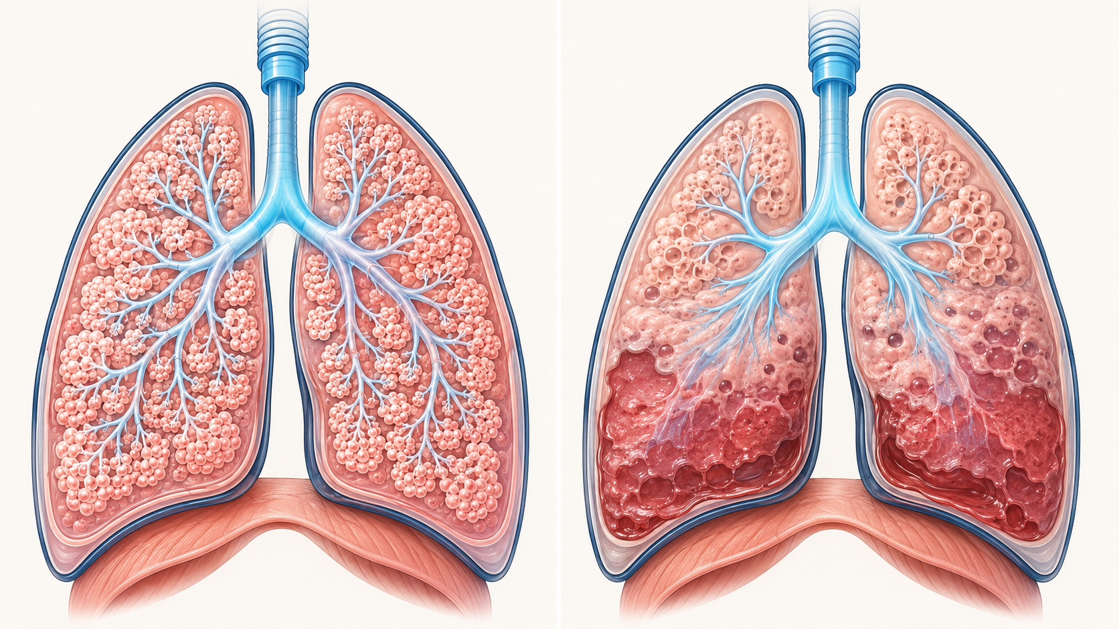
9.3 · ARDS
9.3
The ARDS "Baby Lung"
The functional "baby lung": in ARDS only a small fraction of the lung is still aerated — set Vt to PREDICTED body weight, but that breath lands in a far smaller lung.
Notes:
Figure for 9.3. The aerated portion is the whole argument for low tidal volumes. You are not filling an adult lung, you are filling what survives, and a normal-sized breath over-stretches those few open units. From there the numbers follow: 4-6 mL/kg IBW, Pplat under 30, driving pressure under 14, PEEP paired to FiO2 by the table.

Slide 115
9.4 · ARDS Rescue
9.4
When Lung-Protective Isn't Enough
When lung-protective settings (6 mL/kg, Pplat < 30, ΔP < 14) aren't enough, these are the rescue options — roughly in order of evidence:
Prone positioning — PROSEVA (Guérin, NEJM 2013): 16 hr/day in severe ARDS (P/F < 150). Mortality 33% → 16%, NNT 6. The strongest single rescue.
Neuromuscular blockade — ACURASYS (NEJM 2010) showed a mortality benefit with 48-hr cisatracurium; ROSE (NEJM 2019) did not replicate it. Now reserved for early severe ARDS with dyssynchrony or high plateau pressure, not routine.
HFOV — OSCILLATE / OSCAR (NEJM 2013): no benefit; OSCILLATE was stopped for harm. Not first-line.
ECMO — ICU-level. Transport teams may move ECMO patients but don't initiate. Notify the receiving facility early when standard care is failing.
Notes:
When lung-protective settings — 6 mL/kg, Pplat under 30, ΔP under 14 — aren't enough, these are the rescue options, roughly in order of the evidence behind them. You will not initiate most of these in the field. You need to recognize them, know what they cost, and know when to tell the receiving facility early. Prone positioning. PROSEVA (Guérin, NEJM 2013) enrolled severe ARDS with a P/F under 150 and proned them at least 16 hours a day. Twenty-eight-day mortality fell from about 33% to 16% — NNT of roughly 6. That is the strongest single rescue intervention in ARDS. Practical transport implication: if you are moving a patient who is already proned, plan the supination and the airway securement deliberately before you touch them, and know that the tube is the thing most likely to be lost during the turn. Neuromuscular blockade. ACURASYS (NEJM 2010) showed a mortality benefit from 48 hours of cisatracurium in early severe ARDS. ROSE (NEJM 2019) did not replicate it — though ROSE used lighter sedation in the control arm, which muddies a direct comparison. The current position is that paralysis is reserved for early severe ARDS with dyssynchrony or high plateau pressure, not given routinely. If you are transporting a paralyzed patient, the iron rule from Module 8 applies without exception: analgesia and sedation on board first, and redosed before the paralytic wears off. High-frequency oscillatory ventilation. OSCILLATE and OSCAR, both NEJM 2013, tested HFOV in moderate-to-severe ARDS. OSCAR was neutral; OSCILLATE was stopped early for harm. HFOV is not a first-line rescue and is not something you will see on a transport vent. ECMO. ICU-level therapy. Transport teams do move ECMO patients, but nobody initiates it in the field. The action item for you is timing: when standard care is failing on your patient, notify the receiving facility early, while the referral is still a phone call rather than an emergency.

Slide 116
9.5 · TBI
9.5
Strict Normocapnia
Two enemies of the injured brain: hypoxemia and hypotension. Avoid SpO₂ < 90%. BTF 4th ed. (2017) recommends maintaining SBP ≥ 100 mmHg for ages 50–69 and ≥ 110 mmHg for ages 15–49 or over 70.
Strict normocapnia: target EtCO₂ 35–40 mmHg. Avoid prophylactic hyperventilation (BTF Level IIB recommendation) — drops cerebral blood flow and worsens secondary injury.
Standard TBI settings: AC/VC, Vt 6–8 mL/kg PBW, RR 12–16 titrated to EtCO₂ 35–40, PEEP 5, FiO₂ titrated to avoid SpO₂ < 90% (many systems target 94–98% — follow local protocol), pressors ready.
Hyperventilation rescue (transient, for impending herniation only): increase RR to target EtCO₂ 30–35 mmHg (NEVER below 30). Return to normocapnia once the exam improves (typically 2–5 min).
CLINICAL PEARL
Hyperventilation past the rescue window is harmful
Use brief hyperventilation only for signs of impending herniation (Cushing's triad, blown pupil, posturing). Return EtCO₂ to 35–40 as soon as exam improves. EtCO₂ < 30 worsens ischemia.
Notes:
Two enemies of the injured brain: hypoxia and hypotension. A single SpO₂ < 90 or SBP < 90 doubles mortality in moderate-severe TBI (Brain Trauma Foundation 4th ed., 2017). Strict normocapnia: target EtCO₂ 35–40 mmHg. Avoid prophylactic hyperventilation (BTF Level IIB recommendation) — drops cerebral blood flow and worsens secondary injury. Standard TBI settings: AC/VC, Vt 6–8 mL/kg IBW, RR 12–16 titrated to EtCO₂ 35–40, PEEP 5, FiO₂ to SpO₂ ≥ 94%, pressors ready. BTF age-stratified BP target: SBP ≥ 100 (ages 50–69), SBP ≥ 110 (other ages); for simplicity, target SBP > 100 in all adult TBI. Hyperventilation rescue (transient, for impending herniation only): increase RR to target EtCO₂ 30–35 mmHg (NEVER below 30). Return to normocapnia once the exam improves (typically 2–5 min). PEARL — Hyperventilation past the rescue window is harmful: Use brief hyperventilation only for signs of impending herniation (Cushing's triad, blown pupil, posturing). Return EtCO₂ to 35–40 as soon as exam improves. EtCO₂ < 30 worsens ischemia.

Slide 117
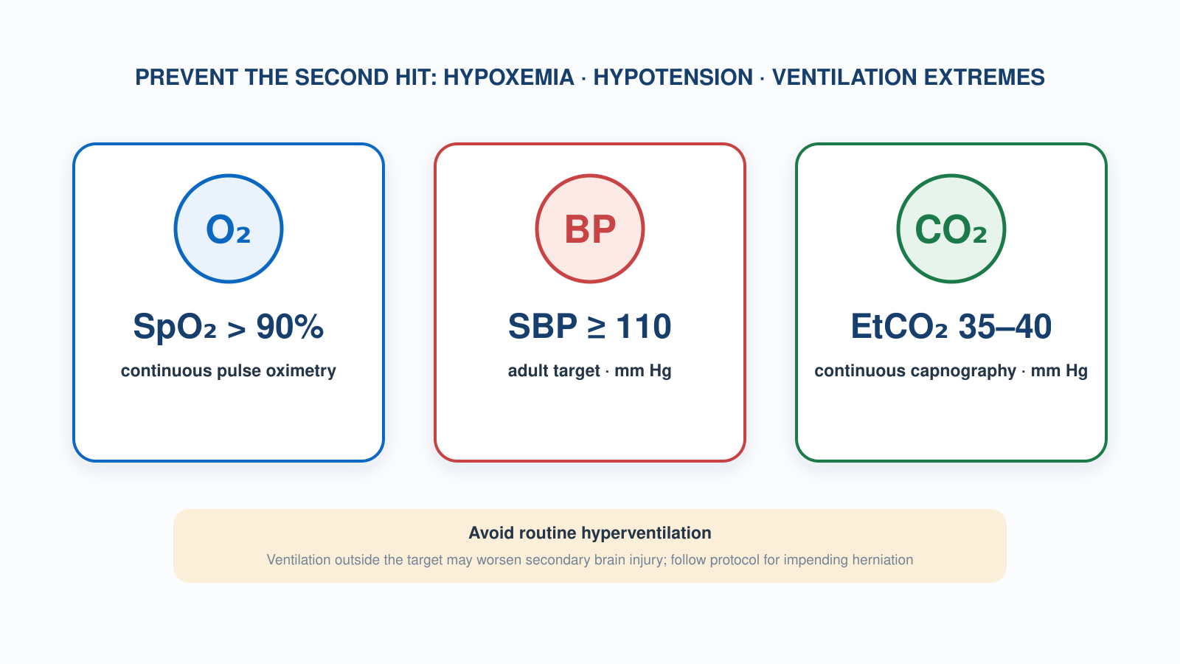
9.5 · TBI
9.5
Prehospital TBI Targets
Notes:
Figure for 9.5. Prevent the second hit: hypoxemia, hypotension, ventilation extremes. NOTE FOR THE FACILITATOR: the graphic shows SpO2 greater than 90% — that is the BTF prehospital hypoxia threshold to avoid, not the target. Slide 9.5 teaches a target of 94% or better. Say which number is the floor and which is the goal before you show this.

Slide 118
9.6 · Pediatrics
9.6
Smaller Everything, Bigger Margins
Use length-based weight (Broselow / Handtevy) — don’t guess. PALICC-2: interpret lung volumes using the LESSER of predicted or actual body weight, so use predicted weight whenever actual exceeds it. Start Vt 5–8 mL/kg and titrate to chest rise, EtCO₂ and plateau pressure.
Age-based RR: infant 25–30, child 15–20, adolescent 12–16. PEEP starts 5; can go higher in severe parenchymal disease. The LTV 1200 is indicated for patients weighing at least 5 kg (11 lb) — below that, use a device rated for the patient.
PALS 2020: cuffed endotracheal tubes are preferred in most pediatric patients, including infants. Pay attention to cuff pressure to avoid tracheal injury.
Most common pediatric error: adult circuit on a pediatric patient. Adult circuit dead space can exceed pediatric Vt — you're ventilating the circuit, not the lungs. Use the pediatric circuit.
Notes:
Use length-based weight (Broselow / Handtevy) — don't guess. Vt 6–8 mL/kg of ACTUAL body weight in peds, which is genuinely different from the adult rule. The exception is the obese child: dose to the length-based weight, not the number on the scale, or you will make the same over-distension error we spent Module 4 avoiding in adults. Age-based RR: infant 25–30, child 15–20, adolescent 12–16. PEEP starts 5; can go higher in severe parenchymal disease. PALS 2020: cuffed endotracheal tubes are preferred in most pediatric patients, including infants. Pay attention to cuff pressure to avoid tracheal injury. Most common pediatric error: adult circuit on a pediatric patient. Adult circuit dead space can exceed pediatric Vt — you're ventilating the circuit, not the lungs. Use the pediatric circuit. Verify visually.

Slide 119
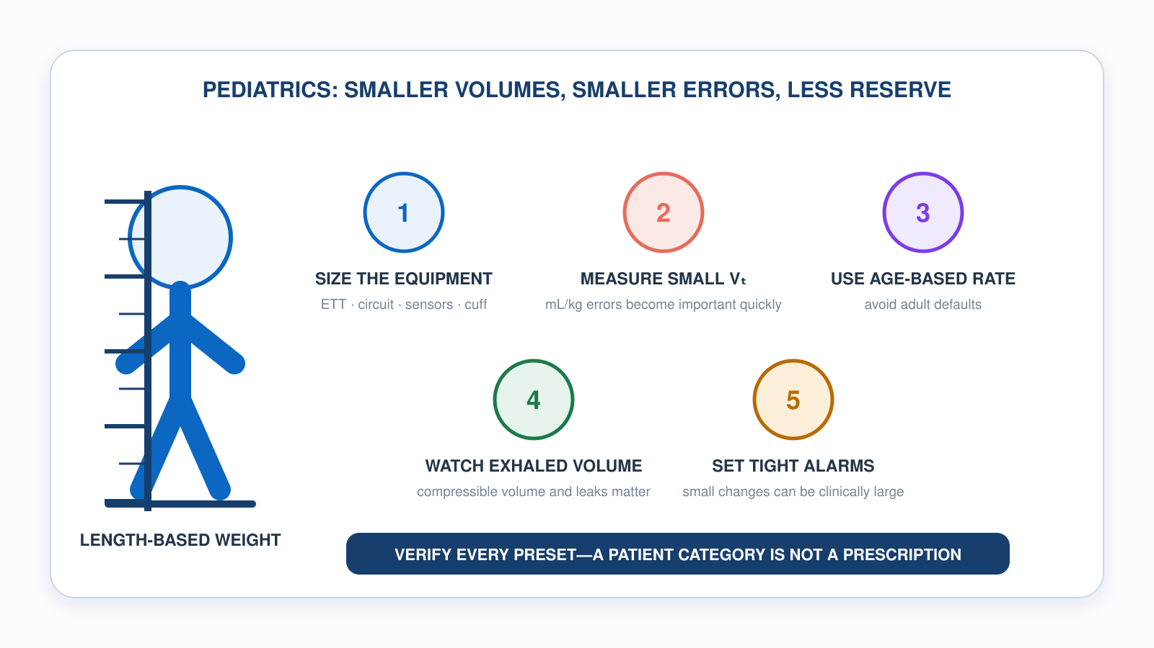
9.6 · Pediatrics
9.6
Pediatric Ventilation Guardrails
Notes:
Figure for 9.6. Length-based weight first, then size the equipment, then respect how quickly a milliliter-per-kilogram error matters at this size. Close on the circuit: adult circuit dead space can exceed a small child tidal volume, which means you would be ventilating tubing instead of lungs.

Slide 120
Now put it to work
Hand off to learner devices — cues match your facilitator guide.
QUIZ
Knowledge Check
10 questions · pass 8/10 to unlock the next module
MATCH
Population-Specific Strategy
6 items · Obstructive (low rate, long I:E) · Lung-Protective (low Vt) · Strict Normocapnia (EtCO₂ 35–40) · must be perfect
CASE
TBI with Impending Herniation
4-decision branching scenario · 22-year-old male, 80 kg, severe TBI from MVC. Intubated 30 min ago…
SIM
LTV 1200 Simulator
vent-ltv1200.html?level=3 — Take on the simulator's advanced cases — ARDS, COPD, TBI and more, no hand-holding.
Notes:
Transition slide: send learners to the app for this module's quiz, match, scenario, then the simulator mission. Keep the cohort together; modules unlock in sequence.

Slide 121
Carry this out the door
✓
Brief disconnect Hypotensive asthmatic on the vent? Disconnect for 5–10 sec and release the trapped gas. BP often recovers in under a minute. Reconnect on slower settings.
✓
Hyperventilation past the rescue window is harmful Hyperventilate only for impending herniation (Cushing's triad, blown pupil, posturing). Target EtCO₂ 30–35, never below 30, and return to 35–40 once the exam improves.
✓
Auto-PEEP raises Pplat too Trapped gas lifts both PIP and Pplat — not PIP alone. Confirm with an expiratory hold, then slow the rate and lengthen exhalation.
✓
Small lung, small breaths Vt 4–6 mL/kg IBW, Pplat under 30, ΔP under 14, PEEP paired to FiO₂ by the table. You're filling the baby lung, not an adult one.
Next: Final Certification Exam
Notes:
Recap the module pearls, then transition.

Slide 122
✓
VENTILATOR TRAINING ACADEMY
Capstone
Final Certification Exam
25 questions drawn from all nine modules. 80% to pass. Two attempts, then a facilitator debrief. Certificate issues on the learner device as soon as you pass.
All modules · 25 questions · 80% to pass
Jordan Hunter Jones, NRP · Course Director
Notes:
Capstone. Hand off to learner devices for the final certification exam: 25 questions drawn from all nine modules, 80% to pass. Remind the cohort that the pass threshold is per-attempt, not cumulative, and that a second failed attempt routes them to a facilitator debrief rather than a third try. Certificates issue automatically on the device. Before you release them, close the loop verbally on the four things that show up most often in transport incident reviews: read the alarm before you silence it, bag if you cannot fix it in ten seconds, confirm tube depth after every patient movement, and change one setting at a time.

Slide 123
Appendix · References
A
Sources — 1 of 2
Every figure and claim in this deck traces to one of the sources below. Where a source and your agency protocol differ, the protocol governs.
ARDS and lung-protective ventilation — ARDS Definition Task Force (Berlin). JAMA 2012;307:2526–33. · ARDSNet/ARMA. N Engl J Med 2000;342:1301–8. · Qadir N et al. ATS/ESICM/SCCM ARDS guideline. Am J Respir Crit Care Med 2024;209:24–36.
Dead space — Nuckton TJ et al. Pulmonary dead-space fraction as a risk factor for death in ARDS. N Engl J Med 2002;346:1281–6.
Non-invasive ventilation — Rochwerg B et al. ERS/ATS clinical practice guidelines: NIV for acute respiratory failure. Eur Respir J 2017;50:1602426.
Weaning — Esteban A et al. N Engl J Med 1995;332:345–50. · Dyssynchrony — Blanch L et al. Intensive Care Med 2015;41:633–41.
Traumatic brain injury — Brain Trauma Foundation. Guidelines for the Management of Severe TBI, 4th ed. Neurosurgery 2017;80:6–15.

Slide 124
Appendix · References
B
Sources — 2 of 2
Induction agents — Casey JD et al. Ketamine or etomidate for tracheal intubation of critically ill adults (RSI trial). N Engl J Med 2025; DOI 10.1056/NEJMoa2511420. · Greer A et al. Crit Care Med 2025;53:e374–83. · Jabre P et al. KETASED. Lancet 2009;374:293–300.
Sedation and analgesia — Devlin JW et al. PADIS guidelines. Crit Care Med 2018;46:e825–73.
Post-intubation hypotension — Heffner AC et al. J Crit Care 2012;27:417.e9–13.
Oxygen targets — GOLD. Global Strategy for the Diagnosis, Management and Prevention of COPD (current report). · Bernard SA et al. EXACT trial. JAMA 2022;328:1818–26. · American Heart Association, post-cardiac-arrest care guidance.
Pediatrics — Emeriaud G et al. PALICC-2 executive summary. Pediatr Crit Care Med 2023;24:143–68.
Device — CareFusion. LTV 1200 / 1150 Ventilator Operator’s Manual, P/N 19802-001 Rev. F (2013): indications for use, alarm behaviour, and checkout tests.

