Slide 1
1
VENTILATOR TRAINING ACADEMY
Module 1
Pulmonary Anatomy & Physiology
The foundational hour. Learn how a healthy breath works — then use that to read every vent for the rest of the course.
Foundations · 7 lessons
Jordan Hunter Jones, NRP · Course Director
Notes:
Module 1: Pulmonary Anatomy & Physiology. The foundational hour. Learn how a healthy breath works — then use that to read every vent for the rest of the course.

Slide 2
In this module
1.1
Anatomy The Path of a Breath
1.5
V/Q Matching Shunt vs Dead Space
1.2
Function Two Functional Zones
1.6
Compliance vs Resistance How the Lung Pushes Back
1.3
The Mental Model Ventilation vs Oxygenation — Two Knobs Each
1.7
The Bedside Test PIP vs Pplat
1.4
Dead Space Air That Doesn't Help You
Then:
Knowledge Check
Match
Scenario
Simulator
Notes:
Roadmap of the module. Teach the lessons in order, then run the four interactive components on learner devices.

Slide 3
1.1 · Anatomy
1.1
The Path of a Breath
A breath begins at the nose or mouth and travels through the pharynx, larynx, and trachea.
From the carina, air enters the right and left mainstem bronchi — but the fork is lopsided, like a highway splitting into two ramps.
Confirm ETT depth at the lip — approximately 21 cm in women, 23 cm in men — and verify with equal bilateral breath sounds and a normal capnography waveform.
Beyond the mainstem bronchi, the airway branches through approximately 23 generations to reach the alveoli.
CLINICAL PEARL
ETT depth at the lip
21 cm in women, 23 cm in men. Confirm with capnography and equal breath sounds after every patient transition — loading, lifting, elevator, gurney bump.
Notes:
A breath begins at the nose or mouth and travels through the pharynx, larynx, and trachea. The adult trachea is approximately 12 centimeters long and ends at the carina, the bifurcation roughly at the level of the fourth thoracic vertebra. From the carina, air enters the right and left mainstem bronchi — but the fork is lopsided, like a highway splitting into two ramps. The right ramp barely curves (about 25° from vertical), almost a straight continuation of the road; the left banks hard (about 45°). Push an ETT too deep and it takes the path of least resistance straight down the right ramp, leaving the left lung dark and silent. That asymmetry is exactly why an over-deep tube is almost always a right-mainstem tube — and why you listen over the LEFT chest first when breath sounds go one-sided. Confirm ETT depth at the lip — approximately 21 cm in women, 23 cm in men — and verify with equal bilateral breath sounds and a normal capnography waveform. Beyond the mainstem bronchi, the airway branches through approximately 23 generations to reach the alveoli. There are approximately 300 million alveoli per adult, with a combined surface area of roughly 70 square meters — about the size of a tennis court. PEARL — ETT depth at the lip: 21 cm in women, 23 cm in men. Confirm with capnography and equal breath sounds after every patient transition — loading, lifting, elevator, gurney bump.

Slide 4
1.2 · Function
1.2
Two Functional Zones
The pulmonary system has two zones. The conducting zone is everything from the mouth to the terminal bronchioles. It moves air. No gas exchange occurs here.
The respiratory zone is where gas exchange happens. Type I pneumocytes form the thin alveolar wall (0.2–0.5 µm thick — about 1/100 the diameter of a red blood cell). Type II pneumocytes produce surfactant.
Picture two soap bubbles tied to the ends of a straw, one small and one large. By Laplace's law the small bubble has the higher pressure, so it empties itself into the big one and collapses.
When the soap is gone, PEEP is NOT a substitute for surfactant — but it buys time: it is the doorstop you wedge under each alveolus, mechanically splinting it open until surfactant function returns.
EVIDENCE
Surfactant and PEEP
Conditions that damage Type II pneumocytes produce a stiff lung with refractory hypoxia. The bedside fix is PEEP — not more FiO₂.
Notes:
The pulmonary system has two zones. The conducting zone is everything from the mouth to the terminal bronchioles. It moves air. No gas exchange occurs here. The volume that fills it on each breath is anatomic dead space — approximately 2 mL per kilogram of body weight, or about 150 mL in a 70 kg adult. The respiratory zone is where gas exchange happens. Type I pneumocytes form the thin alveolar wall (0.2–0.5 µm thick — about 1/100 the diameter of a red blood cell). Type II pneumocytes produce surfactant. Picture two soap bubbles tied to the ends of a straw, one small and one large. By Laplace's law the small bubble has the higher pressure, so it empties itself into the big one and collapses. Alveoli would do the same to each other on every exhale — except for surfactant, the dish soap Type II cells make to lower that surface tension so the smallest alveoli survive instead of caving into their neighbors. ARDS, smoke inhalation, drowning, and gastric aspiration all damage Type II cells or wash the soap out. When the soap is gone, PEEP is NOT a substitute for surfactant — but it buys time: it is the doorstop you wedge under each alveolus, mechanically splinting it open until surfactant function returns. EVIDENCE — Surfactant and PEEP: Conditions that damage Type II pneumocytes produce a stiff lung with refractory hypoxia. The bedside fix is PEEP — not more FiO₂.

Slide 5
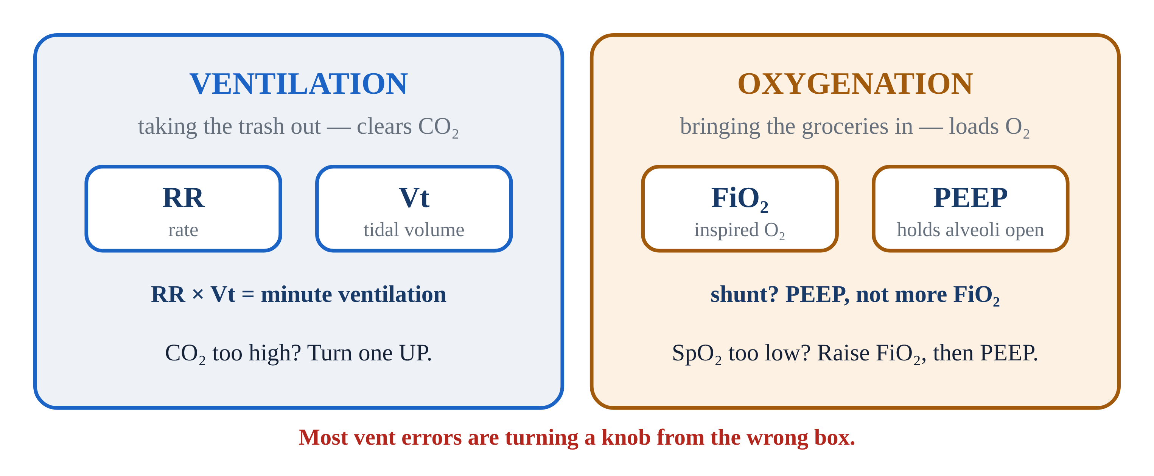
1.3 · The Mental Model
1.3
Ventilation vs Oxygenation — Two Knobs Each
This is the single most useful mental model in mechanical ventilation — memorize it now. Picture the lung as a house with two completely separate chores, each with its own set of controls.
Ventilation is taking out the trash — clearing CO₂. You run it with two knobs: Respiratory Rate (RR) and Tidal Volume (Vt) — how often the trash goes out and how big each load is.
Oxygenation is bringing in the groceries — loading O₂ across the alveolar membrane into the blood.
Most ventilator errors are turning the wrong knob — bumping FiO₂ to fix a rising CO₂, or cranking the rate to fix a low saturation. Pair them in your head: RR + Vt for ventilation, FiO₂ + PEEP for oxygenation.
Notes:
This is the single most useful mental model in mechanical ventilation — memorize it now. Picture the lung as a house with two completely separate chores, each with its own set of controls. Confusing the two is the most common ventilator mistake there is. Ventilation is taking out the trash — clearing CO₂. You run it with two knobs: Respiratory Rate (RR) and Tidal Volume (Vt) — how often the trash goes out and how big each load is. Their product is Minute Ventilation. PaCO₂ too high? Turn one up. Too low? Turn one down. Oxygenation is bringing in the groceries — loading O₂ across the alveolar membrane into the blood. It runs on two different knobs: FiO₂ (how oxygen-rich the incoming air is) and PEEP (the pressure that holds alveoli open at end-expiration). SpO₂ too low? Raise FiO₂ first, then PEEP if you suspect shunt physiology. Running the trash out more often will never restock the fridge. Most ventilator errors are turning the wrong knob — bumping FiO₂ to fix a rising CO₂, or cranking the rate to fix a low saturation. Pair them in your head: RR + Vt for ventilation, FiO₂ + PEEP for oxygenation. Trash and groceries — two chores, two sets of knobs. PEARL — Two knobs each: Ventilation = RR + Vt. Oxygenation = FiO₂ + PEEP. On the final exam. At every bedside for the rest of your career.

Slide 6
1.4 · Dead Space
1.4
Air That Doesn't Help You
Every breath is like mailing a package down a long hallway to a room at the far end. The hallway holds air but does no gas exchange — anything that never reaches the room is wasted effort.
Anatomic dead space is the volume of the conducting airways: approximately 2 mL per kilogram of body weight.
Total physiologic dead space is normally about 30% of tidal volume in a healthy adult. A study by Nuckton and colleagues (NEJM 2002) showed that VD/VT greater than 0.6 in ARDS strongly predicts mortality.
The practical bedside implication: tidal volume must be large enough to overcome dead space. Set Vt too low and the whole breath gets stuck in the hallway — dead space eats it before any reaches the room.
Notes:
Every breath is like mailing a package down a long hallway to a room at the far end. The hallway holds air but does no gas exchange — anything that never reaches the room is wasted effort. That wasted volume is dead space: the part of every breath that does not participate in gas exchange. It comes in three kinds. Anatomic dead space is the volume of the conducting airways: approximately 2 mL per kilogram of body weight. Alveolar dead space is the volume of alveoli that are ventilated but not perfused — for example, downstream of a pulmonary embolism. Equipment dead space is the volume of the vent circuit between the ETT tip and the Y-piece — up to 80 to 90 mL on an adult circuit. Total physiologic dead space is normally about 30% of tidal volume in a healthy adult. A study by Nuckton and colleagues (NEJM 2002) showed that VD/VT greater than 0.6 in ARDS strongly predicts mortality. The practical bedside implication: tidal volume must be large enough to overcome dead space. Set Vt too low and the whole breath gets stuck in the hallway — dead space eats it before any reaches the room. Aim for 6–8 mL per kg of ideal body weight in most adults; 4–6 mL/kg IBW in ARDS.

Slide 7
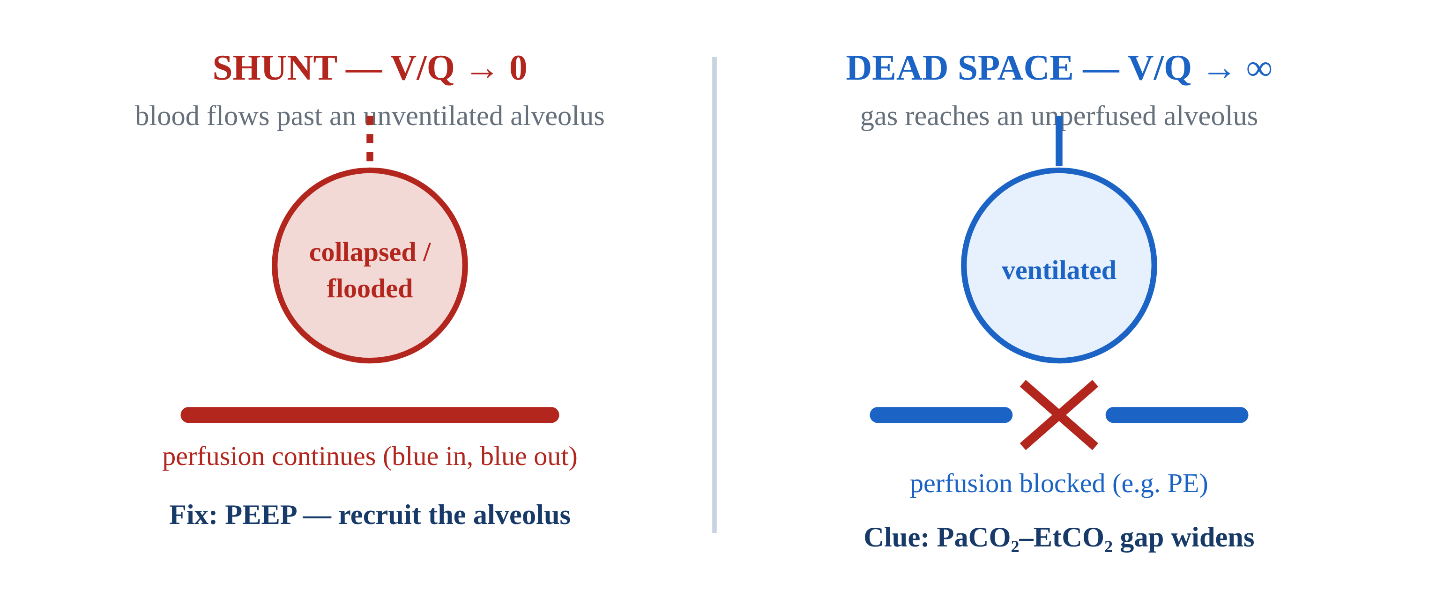
1.5 · V/Q Matching
1.5
Shunt vs Dead Space
Picture a bus line where the buses are air and the passengers are blood. Gas exchange only happens where a bus and its passengers actually meet.
Shunt is passengers crowding a stop the bus skips entirely — perfusion with no ventilation, V/Q approaching zero. Pneumonia, pulmonary edema, ARDS, and atelectasis all produce shunt.
Dead space is the mirror image: a bus running its full route past empty stops — ventilation with no perfusion. Pulmonary embolism, low cardiac output, and severe hypovolemia produce dead-space physiology.
Hypoxic Pulmonary Vasoconstriction (HPV) is a partial auto-correction: the lung constricts arterioles in poorly ventilated regions, diverting blood toward better-ventilated alveoli.
Notes:
Picture a bus line where the buses are air and the passengers are blood. Gas exchange only happens where a bus and its passengers actually meet. That match-up is V/Q, and disease breaks it in one of two opposite directions. Shunt is passengers crowding a stop the bus skips entirely — perfusion with no ventilation, V/Q approaching zero. Pneumonia, pulmonary edema, ARDS, and atelectasis all produce shunt. The hallmark is refractory hypoxia: you can send more buses (crank FiO₂ to 100%) but they keep driving past the skipped stop, so saturation barely moves. The bedside fix is PEEP, which re-opens the stop — recruiting collapsed alveoli so the bus can finally pick those passengers up. Dead space is the mirror image: a bus running its full route past empty stops — ventilation with no perfusion. Pulmonary embolism, low cardiac output, and severe hypovolemia produce dead-space physiology. The hallmark is a widening gap between PaCO₂ and EtCO₂: those empty-stop alveoli exhale air carrying almost no CO₂. The fix is getting passengers back to the stops — improving perfusion with fluids, pressors, or treating the embolism. Hypoxic Pulmonary Vasoconstriction (HPV) is a partial auto-correction: the lung constricts arterioles in poorly ventilated regions, diverting blood toward better-ventilated alveoli. HPV is incomplete; in significant disease, it is not enough. PEARL — FiO₂ alone won't fix shunt: If a patient on a non-rebreather at flush rate is still hypoxic, suspect shunt. The bedside fix is PEEP, often via CPAP.

Slide 8
1.6 · Compliance vs Resistance
1.6
How the Lung Pushes Back
Imagine blowing up a balloon through a straw — two completely separate things can make it hard. The first is the balloon's stiffness. That is compliance: how much volume the lung accepts for a given pressure.
The second is the straw's narrowness. That is resistance: how hard the airway pushes back against airflow.
Both can raise PIP on the ventilator — but only reduced compliance raises Pplat. That distinction is the foundation of bedside troubleshooting and the subject of the next lesson.
Notes:
Imagine blowing up a balloon through a straw — two completely separate things can make it hard. The first is the balloon's stiffness. That is compliance: how much volume the lung accepts for a given pressure. A brand-new, stiff balloon (the ARDS lung) fights every breath; a worn-in one gives easily. Normal adult static compliance is 60–100 mL per cmH₂O; ARDS can drop it to 20–30 — a very stiff balloon. The second is the straw's narrowness. That is resistance: how hard the airway pushes back against airflow. Pinch the straw — bronchospasm, a mucus plug, a kinked tube — and you must push far harder for the same airflow. Normal airway resistance is 1–2 cmH₂O per liter per second; severe asthma can push it to 15–20. Both can raise PIP on the ventilator — but only reduced compliance raises Pplat. That distinction is the foundation of bedside troubleshooting and the subject of the next lesson.

Slide 9
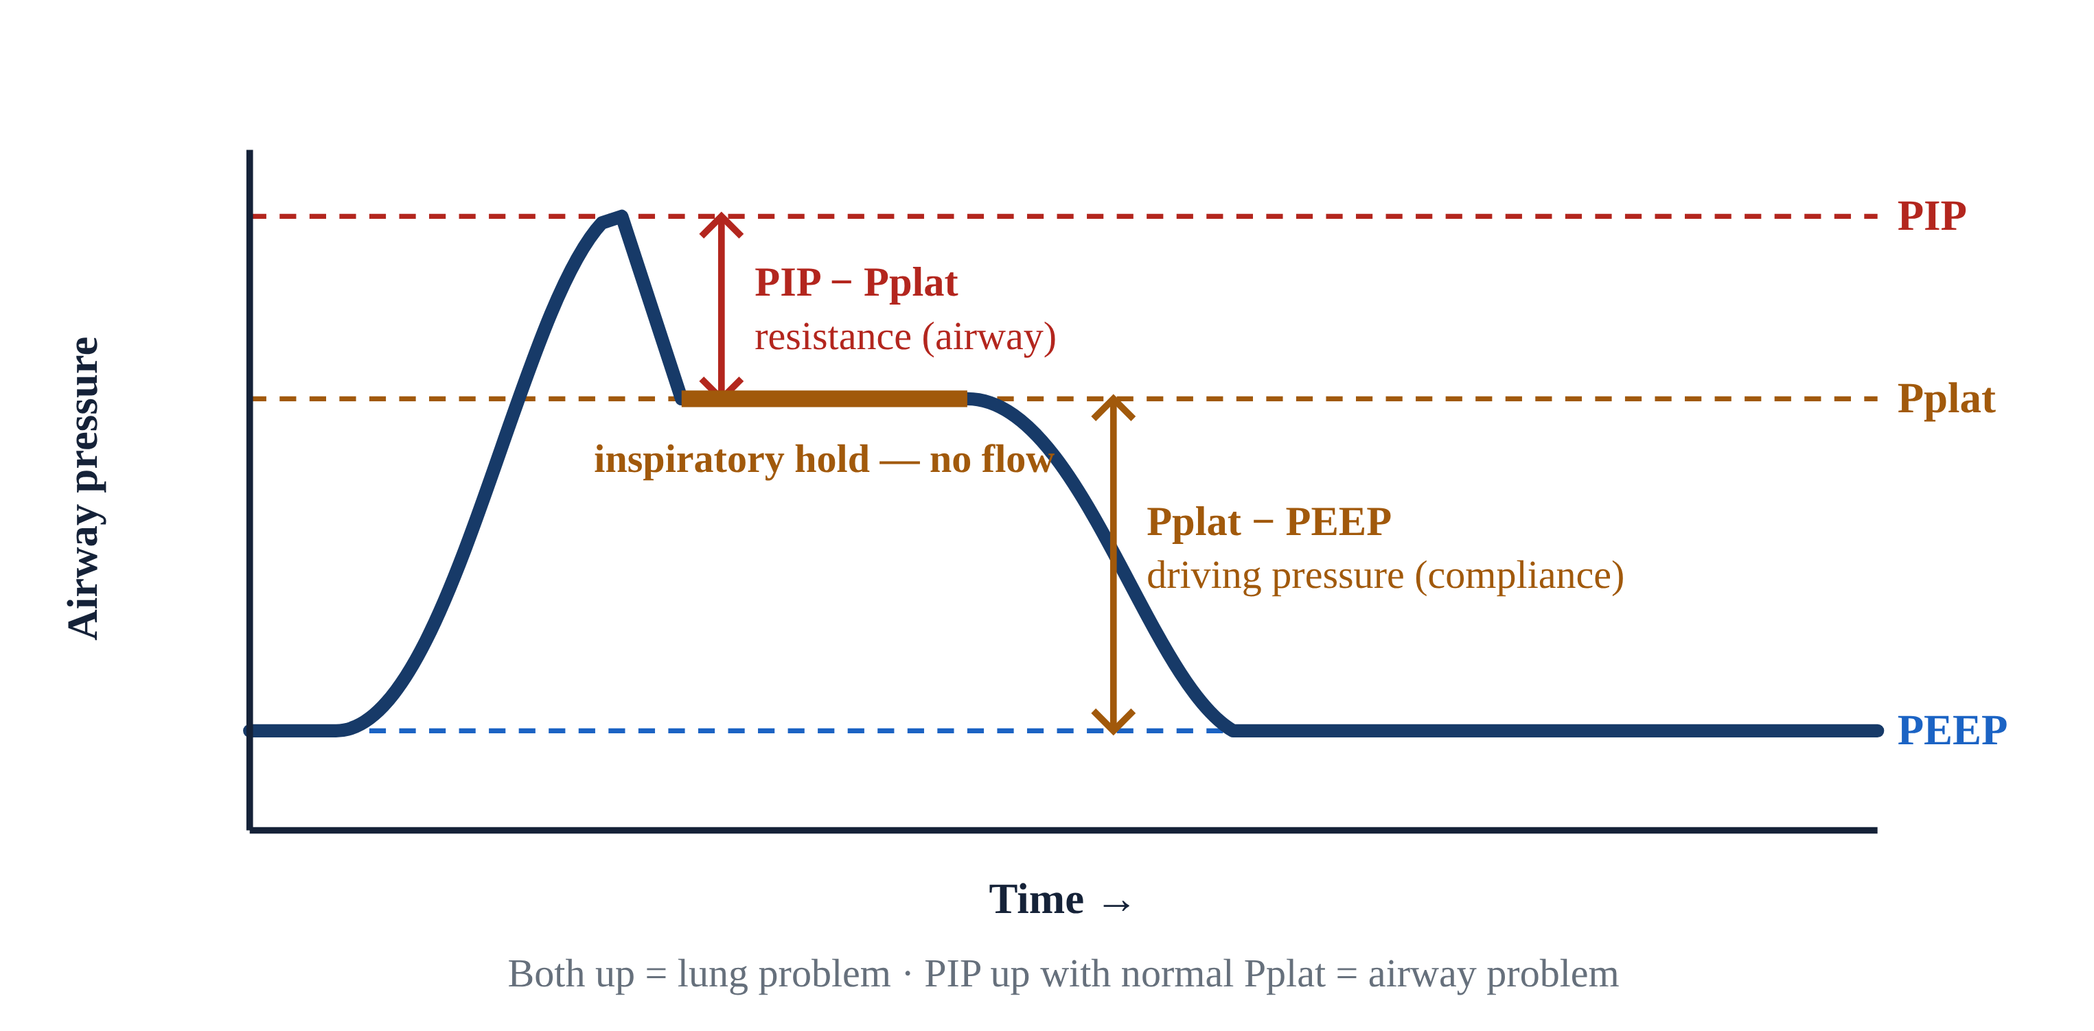
1.7 · The Bedside Test
1.7
PIP vs Pplat
Picture pushing water through a hose that has a narrow nozzle (the airways) and a balloon on the end (the alveoli).
The relationship is mechanical: PIP is approximately Pplat plus (Resistance × Flow). Clog the nozzle and resistance rises — PIP climbs but Pplat does not. Stiffen the balloon and both rise together.
Bedside interpretation: High PIP + normal Pplat means an AIRWAY problem (resistance) — mucus plug, biting on the tube, bronchospasm, kinked tube.
Driving pressure (Pplat minus PEEP) has emerged as a strong mortality predictor in ARDS (Amato 2015, NEJM). Aim for ΔP less than 14 cmH₂O. You'll use this rule in Module 4 and again in Module 9.
Notes:
Picture pushing water through a hose that has a narrow nozzle (the airways) and a balloon on the end (the alveoli). Peak Inspiratory Pressure (PIP) is the pressure while water is still flowing — it includes the squeeze through the nozzle. Hit the inspiratory hold (about 0.5 seconds, no flow) and you feel only the balloon's stretch: that is Plateau Pressure (Pplat), which reflects alveolar pressure — a measure of compliance. The relationship is mechanical: PIP is approximately Pplat plus (Resistance × Flow). Clog the nozzle and resistance rises — PIP climbs but Pplat does not. Stiffen the balloon and both rise together. Bedside interpretation: High PIP + normal Pplat means an AIRWAY problem (resistance) — mucus plug, biting on the tube, bronchospasm, kinked tube. High PIP + high Pplat means a LUNG problem (compliance) — pneumothorax, mainstem migration, worsening ARDS, pulmonary edema. Driving pressure (Pplat minus PEEP) has emerged as a strong mortality predictor in ARDS (Amato 2015, NEJM). Aim for ΔP less than 14 cmH₂O. You'll use this rule in Module 4 and again in Module 9. PEARL — PIP up, Pplat up?: Both up = lung problem. PIP up but Pplat normal = airway problem. The bedside test takes 3 seconds — press the inspiratory hold button.

Slide 10
Now put it to work
Hand off to learner devices — cues match your facilitator guide.
QUIZ
Knowledge Check
10 questions · pass 8/10 to unlock the next module
MATCH
Match the Knobs
4 items · Ventilation knobs · Oxygenation knobs · must be perfect
CASE
He's still breathing — but he's getting tired
4-decision branching scenario · 65-year-old male, 80 kg, long-standing COPD on home O₂
SIM
LTV 1200 Simulator
vent-ltv1200.html?level=1 — Meet the LTV 1200 hands-on — the Level 1 tutorial builds every control from scratch…
Notes:
Transition slide: send learners to the app for this module's quiz, match, scenario, then the simulator mission. Keep the cohort together; modules unlock in sequence.

Slide 11
Carry this out the door
✓
ETT depth at the lip 21 cm in women, 23 cm in men. Confirm with capnography and equal breath sounds after every patient transition — loading, lifting, elevator, gurney…
✓
Two knobs each Ventilation = RR + Vt. Oxygenation = FiO₂ + PEEP. On the final exam. At every bedside for the rest of your career.
✓
FiO₂ alone won't fix shunt If a patient on a non-rebreather at flush rate is still hypoxic, suspect shunt. The bedside fix is PEEP, often via CPAP.
✓
PIP up, Pplat up? Both up = lung problem. PIP up but Pplat normal = airway problem. The bedside test takes 3 seconds — press the inspiratory hold button.
Next: Module 2
Notes:
Recap the module pearls, then transition.

