Slide 1
2
VENTILATOR TRAINING ACADEMY
Module 2
Recognizing Respiratory Failure
Call it before the patient calls it. Type I vs Type II, the SpO₂/PaO₂ cliff, capnography waveforms, and the pre-arrest signs everyone misses.
Foundations · 7 lessons
Jordan Hunter Jones, NRP · Course Director
Notes:
Module 2: Recognizing Respiratory Failure. Call it before the patient calls it. Type I vs Type II, the SpO₂/PaO₂ cliff, capnography waveforms, and the pre-arrest signs everyone misses.

Slide 2
In this module
2.1
Definitions What Respiratory Failure Means
2.5
Recognition Early Signs, Late Signs, and the False Calm
2.2
The Oxyhemoglobin Curve Why SpO₂ Lies — Until It Doesn't
2.6
Capnography EtCO₂ — The Earliest Number You Have
2.3
Type I Hypoxic Failure at the Bedside
2.7
Waveforms Four Capnography Patterns Every EMS Provider Must Recognize
2.4
Type II Hypercapnic Failure at the Bedside
Then:
Knowledge Check
Match
Scenario
Simulator
Notes:
Roadmap of the module. Teach the lessons in order, then run the four interactive components on learner devices.

Slide 3
2.1 · Definitions
2.1
What Respiratory Failure Means
Acute respiratory failure is defined by gas-exchange criteria. Type I, hypoxic respiratory failure, is PaO₂ less than 60 mmHg on room air.
Type II, hypercapnic respiratory failure, is PaCO₂ greater than 50 mmHg accompanied by a pH less than 7.35.
Mixed failure (Type I + Type II) is common: pneumonia in a COPD patient, ARDS with respiratory fatigue. Treat what you see.
CLINICAL PEARL
ABGs in EMS
We rarely have an arterial blood gas prehospital. Clinical signs + EtCO₂ + SpO₂ support recognition and let you act early — but they do NOT replace an ABG. The PaCO₂–EtCO₂ gap widens with shock and V/Q mismatch, so EtCO₂ can under-read a rising PaCO₂. Treat on the clinical picture; confirm gas…
Notes:
Acute respiratory failure is defined by gas-exchange criteria. Type I, hypoxic respiratory failure, is PaO₂ less than 60 mmHg on room air. The CO₂ is typically normal or low because the patient is hyperventilating in compensation. Common causes: pneumonia, acute pulmonary edema, ARDS, pulmonary embolism, pulmonary contusion. Type II, hypercapnic respiratory failure, is PaCO₂ greater than 50 mmHg accompanied by a pH less than 7.35. The pH requirement matters because chronic CO₂ retainers (stable COPD, for example) live with PaCO₂ in the 60s while their kidneys retain bicarbonate, keeping pH near normal. An acute rise in CO₂ has no time to compensate — pH crashes, and that acidosis defines the failure. Mixed failure (Type I + Type II) is common: pneumonia in a COPD patient, ARDS with respiratory fatigue. Treat what you see. PEARL — ABGs in EMS: We rarely have an arterial blood gas prehospital. Clinical signs + EtCO₂ + SpO₂ support recognition and let you act early — but they do NOT replace an ABG. The PaCO₂–EtCO₂ gap widens with shock and V/Q mismatch, so EtCO₂ can under-read a rising PaCO₂. Treat on the clinical picture; confirm gas exchange with an ABG when available.

Slide 4
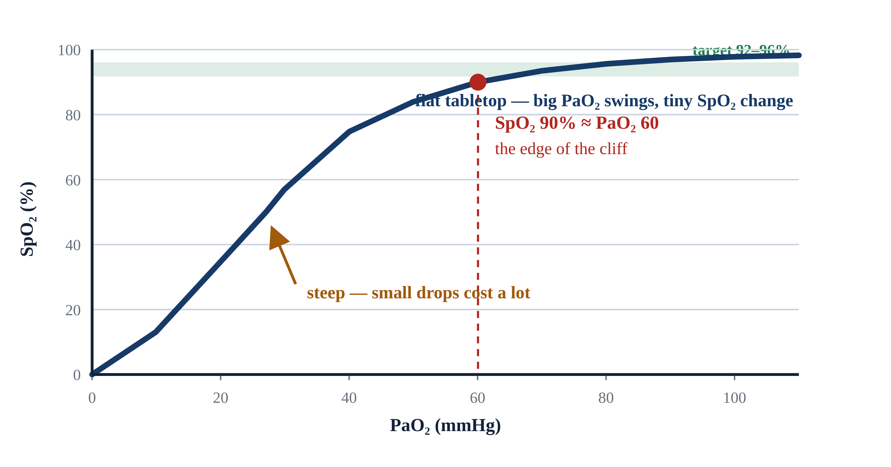
2.2 · The Oxyhemoglobin Curve
2.2
Why SpO₂ Lies — Until It Doesn't
Pulse oximetry is not linear — the SpO₂/PaO₂ relationship is an S-shaped curve, and that shape is a flat tabletop that ends at a cliff.
SpO₂ 100% → PaO₂ ≥ 100 mmHg (the curve is flat on top — very different PaO₂ values produce the same saturation).
SpO₂ 95% → PaO₂ ≈ 80 mmHg. SpO₂ 90% → PaO₂ ≈ 60 mmHg — the edge of the cliff and the threshold for Type I respiratory failure.
SpO₂ 80% → PaO₂ ≈ 45 mmHg. SpO₂ 70% → PaO₂ ≈ 38 mmHg — minutes from arrest in most adults.
Practical implication: aim for SpO₂ 92–96%. High enough to be off the cliff, low enough to detect deterioration. Targeting 100% does the patient no good and wastes oxygen reserves.
Notes:
Pulse oximetry is not linear — the SpO₂/PaO₂ relationship is an S-shaped curve, and that shape is a flat tabletop that ends at a cliff. Stroll along the top and big swings in PaO₂ barely move the saturation; step off the edge near 90% and you drop fast. SpO₂ 100% → PaO₂ ≥ 100 mmHg (the curve is flat on top — very different PaO₂ values produce the same saturation). SpO₂ 95% → PaO₂ ≈ 80 mmHg. SpO₂ 90% → PaO₂ ≈ 60 mmHg — the edge of the cliff and the threshold for Type I respiratory failure. SpO₂ 80% → PaO₂ ≈ 45 mmHg. SpO₂ 70% → PaO₂ ≈ 38 mmHg — minutes from arrest in most adults. Practical implication: aim for SpO₂ 92–96%. High enough to be off the cliff, low enough to detect deterioration. Targeting 100% does the patient no good and wastes oxygen reserves. EVIDENCE — Hyperoxia after ROSC: Multiple observational studies show worse neurologic outcomes in cardiac arrest survivors maintained at PaO₂ > 300 mmHg post-arrest. AHA recommends titrating FiO₂ to SpO₂ 90–98% post-ROSC (2025 AHA update; the prior target was 92–98%).

Slide 5
2.3 · Type I
2.3
Hypoxic Failure at the Bedside
Hypoxic failure presents first as work-of-breathing changes. Tachypnea. Accessory muscle use — sternocleidomastoid, retractions, nasal flaring, tripoding (sitting up with hands braced on knees).
Mental status is often well-preserved in early Type I failure. Hypoxia stimulates ventilation through peripheral chemoreceptors but produces less mental status change than rising CO₂.
Bedside test for shunt physiology: apply 100% FiO₂ via non-rebreather at flush rate and watch what happens to the saturation. A patient with diffusion-mediated hypoxia improves quickly.
Notes:
Hypoxic failure presents first as work-of-breathing changes. Tachypnea. Accessory muscle use — sternocleidomastoid, retractions, nasal flaring, tripoding (sitting up with hands braced on knees). Speech becomes broken into short phrases or single words. Skin: pale, mottled, or diaphoretic. Central cyanosis (blue lips and tongue) requires at least 5 g/dL of deoxygenated hemoglobin to be visible — a LATE sign. Mental status is often well-preserved in early Type I failure. Hypoxia stimulates ventilation through peripheral chemoreceptors but produces less mental status change than rising CO₂. A patient with a sat in the low 80s who is alert and oriented is not unusual in early pneumonia or pulmonary edema. Bedside test for shunt physiology: apply 100% FiO₂ via non-rebreather at flush rate and watch what happens to the saturation. A patient with diffusion-mediated hypoxia improves quickly. A patient with significant shunt does not — they need PEEP, not just more O₂. In an awake cooperative patient, that means CPAP.

Slide 6
2.4 · Type II
2.4
Hypercapnic Failure at the Bedside
Hypercapnic failure is more deceptive, because a tiring pump goes quiet, not loud. A patient retaining CO₂ may look comfortable while the partial pressure climbs — respiratory rate normal or even slowing.
Mental status correlates with the RATE of CO₂ rise rather than the absolute number. A chronic retainer at PaCO₂ 70 may be cognitively intact; an acute climb to the same value produces somnolence.
Common scenarios: the COPD patient who tires after a week of escalating bronchospasm; the severe asthmatic whose minute ventilation drops to the point of quiet chest; the opioid-overdosed patient with…
CLINICAL PEARL
Quiet chest in asthma
Wheeze means air is moving. A severe asthmatic who stops wheezing has stopped moving air. Silent chest in a previously wheezy patient is a pre-arrest sign. Bag immediately and prepare to intubate.
Notes:
Hypercapnic failure is more deceptive, because a tiring pump goes quiet, not loud. A patient retaining CO₂ may look comfortable while the partial pressure climbs — respiratory rate normal or even slowing. By the time CO₂ is high enough to affect mental status, the patient is already in trouble. Mental status correlates with the RATE of CO₂ rise rather than the absolute number. A chronic retainer at PaCO₂ 70 may be cognitively intact; an acute climb to the same value produces somnolence. As PaCO₂ rises into the 80s and 90s, the patient becomes increasingly difficult to arouse — CO₂ narcosis. Common scenarios: the COPD patient who tires after a week of escalating bronchospasm; the severe asthmatic whose minute ventilation drops to the point of quiet chest; the opioid-overdosed patient with bradypnea and miosis; the neuromuscular patient whose respiratory muscles can no longer keep pace. PEARL — Quiet chest in asthma: Wheeze means air is moving. A severe asthmatic who stops wheezing has stopped moving air. Silent chest in a previously wheezy patient is a pre-arrest sign. Bag immediately and prepare to intubate.

Slide 7
2.5 · Recognition
2.5
Early Signs, Late Signs, and the False Calm
Early signs of respiratory failure are predictable. Tachypnea is the earliest. Speech shortens. Patients tripod. Accessory muscles recruit. Skin becomes diaphoretic. The patient is often anxious or restless.
Late signs are subtle and dangerous. The previously tachypneic patient becomes quiet. RR drops. HR, which had been elevated, begins to fall.
Some call this the calm before the storm. It is pre-arrest. The patient has run out of compensatory reserve.
Notes:
Early signs of respiratory failure are predictable. Tachypnea is the earliest. Speech shortens. Patients tripod. Accessory muscles recruit. Skin becomes diaphoretic. The patient is often anxious or restless. Recognize these and you have time for non-invasive support. Late signs are subtle and dangerous. The previously tachypneic patient becomes quiet. RR drops. HR, which had been elevated, begins to fall. Accessory muscle use disappears — not because the patient is better but because they are exhausted. Cyanosis becomes obvious. Mental status declines. Some call this the calm before the storm. It is pre-arrest. The patient has run out of compensatory reserve. Capnography is your most reliable warning: a steadily climbing EtCO₂ over five minutes is a fatigue alarm. A waveform that suddenly disappears tells you the tube is out, the patient is in arrest, or perfusion has collapsed.

Slide 8
2.6 · Capnography
2.6
EtCO₂ — The Earliest Number You Have
EtCO₂ is the partial pressure of CO₂ measured at the end of exhalation. In a healthy patient, EtCO₂ runs 2 to 5 mmHg lower than PaCO₂.
Normal adult EtCO₂ is 35 to 45 mmHg. A rising trend over several minutes in a non-intubated patient suggests fatigue.
Capnography has an underappreciated role in CPR. AHA recommends continuous waveform capnography during resuscitation.
Notes:
EtCO₂ is the partial pressure of CO₂ measured at the end of exhalation. In a healthy patient, EtCO₂ runs 2 to 5 mmHg lower than PaCO₂. The gradient widens whenever V/Q mismatch increases — for example, pulmonary embolism, low cardiac output, significant pulmonary disease. A widening EtCO₂–PaCO₂ gradient in a vented patient suggests rising physiologic dead space. Normal adult EtCO₂ is 35 to 45 mmHg. A rising trend over several minutes in a non-intubated patient suggests fatigue. A sudden drop to zero or near-zero in an intubated patient is one of four things: tube dislodgement, complete tube obstruction, cardiac arrest, or massive PE. All four require immediate action. Capnography has an underappreciated role in CPR. AHA recommends continuous waveform capnography during resuscitation. EtCO₂ persistently below 10 mmHg during compressions suggests inadequate compressions or that ROSC is unlikely. A sudden rise in EtCO₂ from 10 to 40+ during ongoing compressions is the most specific sign of ROSC — often before any palpable pulse change.

Slide 9
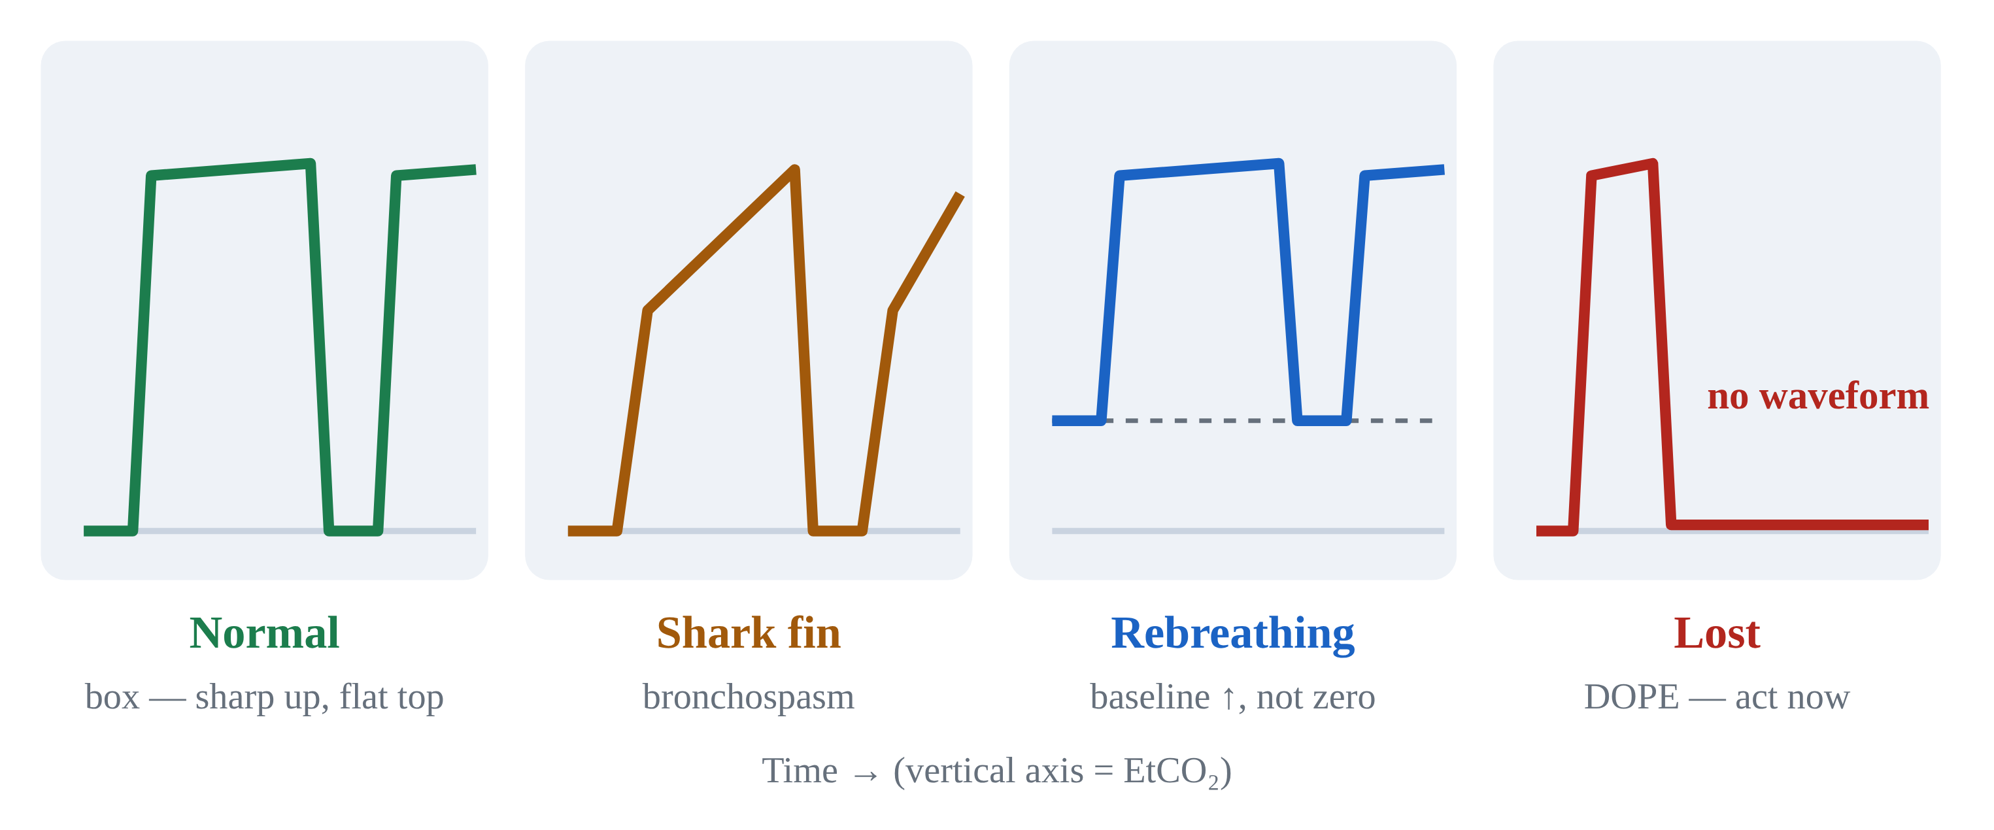
2.7 · Waveforms
2.7
Four Capnography Patterns Every EMS Provider Must Recognize
Normal: a box-like waveform. Sharp upstroke, flat plateau at the EtCO₂ value, sharp drop as the next inspiration begins.
Shark fin: the upstroke is sloped rather than sharp. This is the most specific bedside sign of bronchospasm — asthma, COPD exacerbation, anaphylaxis.
Rebreathing: the baseline is elevated rather than returning to zero between breaths. Common causes: a non-fitted NIV mask seal, an exhausted CO₂ absorber, or a kinked one-way valve.
Lost waveform: sudden drop to near zero. DOPE algorithm time — dislodgement, obstruction, pneumothorax, equipment. We cover this in Module 7.
Notes:
Normal: a box-like waveform. Sharp upstroke, flat plateau at the EtCO₂ value, sharp drop as the next inspiration begins. Shark fin: the upstroke is sloped rather than sharp. This is the most specific bedside sign of bronchospasm — asthma, COPD exacerbation, anaphylaxis. The slope correlates with severity; the steeper the slope, the more obstruction. Rebreathing: the baseline is elevated rather than returning to zero between breaths. Common causes: a non-fitted NIV mask seal, an exhausted CO₂ absorber, or a kinked one-way valve. Patient is re-inhaling exhaled CO₂. Lost waveform: sudden drop to near zero. DOPE algorithm time — dislodgement, obstruction, pneumothorax, equipment. We cover this in Module 7. PEARL — Shark fin = bronchospasm: If a vented patient's waveform turns shark-fin, treat the obstruction (bronchodilator, extended exhalation time). Don't chase the EtCO₂ number.

Slide 10
Now put it to work
Hand off to learner devices — cues match your facilitator guide.
QUIZ
Knowledge Check
10 questions · pass 8/10 to unlock the next module
MATCH
Type I or Type II?
6 items · Type I — Hypoxic · Type II — Hypercapnic · must be perfect
CASE
She was talking to me a minute ago
4-decision branching scenario · 42-year-old female, 70 kg, severe asthma, multiple prior intubations
SIM
LTV 1200 Simulator
vent-ltv1200.html?scenario=failure-type — Name the failure type from the monitor, then treat it — oxygenation vs ventilation.
Notes:
Transition slide: send learners to the app for this module's quiz, match, scenario, then the simulator mission. Keep the cohort together; modules unlock in sequence.

Slide 11
Carry this out the door
✓
ABGs in EMS We rarely have an arterial blood gas prehospital. Clinical signs + EtCO₂ + SpO₂ support recognition and let you act early — but they do NOT replace…
✓
Quiet chest in asthma Wheeze means air is moving. A severe asthmatic who stops wheezing has stopped moving air. Silent chest in a previously wheezy patient is a…
✓
Shark fin = bronchospasm If a vented patient's waveform turns shark-fin, treat the obstruction (bronchodilator, extended exhalation time). Don't chase the EtCO₂ number.
Next: Module 3
Notes:
Recap the module pearls, then transition.

