Slide 1
4
VENTILATOR TRAINING ACADEMY
Module 4
Vent Vocabulary & Initial Settings
The eight numbers every vented patient has. IBW math, the ARDSNet history, and how to defend any setting you turn.
Foundations · 6 lessons
Jordan Hunter Jones, NRP · Course Director
Notes:
Module 4: Vent Vocabulary & Initial Settings. The eight numbers every vented patient has. IBW math, the ARDSNet history, and how to defend any setting you turn.

Slide 2
In this module
4.1
Tidal Volume Vt — How Much Air Per Breath
4.4
Timing I:E Ratio
4.2
Rate Respiratory Rate & Minute Ventilation
4.5
Pressures PIP, Pplat, and Driving Pressure
4.3
Oxygenation Knobs FiO₂ and PEEP
4.6
Defaults IBW Math and Safe Initial Settings
Then:
Knowledge Check
Match
Scenario
Simulator
Notes:
Roadmap of the module. Teach the lessons in order, then run the four interactive components on learner devices.

Slide 3
4.1 · Tidal Volume
4.1
Vt — How Much Air Per Breath
Tidal volume is the volume the ventilator delivers with each mandatory breath, measured in milliliters.
Modern adult target: 6 to 8 mL per kilogram of IDEAL body weight. Lower (4 to 6 mL/kg IBW) for ARDS. Pediatric: 6 to 8 mL/kg of ACTUAL body weight.
History matters. The 1990s standard was 10 to 12 mL/kg. ARDSNet ARMA (NEJM 2000) randomized 861 ARDS patients to 12 vs 6 mL/kg IBW. Mortality dropped from 39.8% to 31.0% (NNT 11).
Too low: dead space eats the breath; CO₂ rises despite normal-looking MV. Too high: alveolar over-distention, volutrauma. Always use IBW, not actual.
EVIDENCE
ARDSNet ARMA, NEJM 2000
Randomized 861 ARDS patients to 12 mL/kg vs 6 mL/kg IBW. Mortality 39.8% vs 31.0%. NNT 11. The trial also kept Pplat < 30 and paired PEEP with FiO₂.
Notes:
Tidal volume is the volume the ventilator delivers with each mandatory breath, measured in milliliters. Modern adult target: 6 to 8 mL per kilogram of IDEAL body weight. Lower (4 to 6 mL/kg IBW) for ARDS. Pediatric: 6 to 8 mL/kg of ACTUAL body weight. History matters. The 1990s standard was 10 to 12 mL/kg. ARDSNet ARMA (NEJM 2000) randomized 861 ARDS patients to 12 vs 6 mL/kg IBW. Mortality dropped from 39.8% to 31.0% (NNT 11). One of the most evidence-based interventions in critical care. Too low: dead space eats the breath; CO₂ rises despite normal-looking MV. Too high: alveolar over-distention, volutrauma. Always use IBW, not actual. EVIDENCE — ARDSNet ARMA, NEJM 2000: Randomized 861 ARDS patients to 12 mL/kg vs 6 mL/kg IBW. Mortality 39.8% vs 31.0%. NNT 11. The trial also kept Pplat < 30 and paired PEEP with FiO₂.

Slide 4
4.2 · Rate
4.2
Respiratory Rate & Minute Ventilation
Respiratory rate is the number of mandatory breaths per minute the vent delivers. Adult initial: 12 to 16, titrated to EtCO₂ 35 to 45.
Lower (8 to 10) for asthma/COPD — let them exhale. Higher (18 to 22) in ARDS where Vt is reduced.
Minute ventilation (MV) = RR × Vt. Adult target 6 to 8 L/min. For a 70 kg IBW adult: Vt 480 mL × RR 14 = 6.7 L/min, right in range.
Set the LOW MV alarm at ~70% of expected MV. The apnea alarm fires after 20 seconds of no breath — by then the patient has been failing for a while.
Notes:
Respiratory rate is the number of mandatory breaths per minute the vent delivers. Adult initial: 12 to 16, titrated to EtCO₂ 35 to 45. Lower (8 to 10) for asthma/COPD — let them exhale. Higher (18 to 22) in ARDS where Vt is reduced. Minute ventilation (MV) = RR × Vt. Adult target 6 to 8 L/min. For a 70 kg IBW adult: Vt 480 mL × RR 14 = 6.7 L/min, right in range. Set the LOW MV alarm at ~70% of expected MV. The apnea alarm fires after 20 seconds of no breath — by then the patient has been failing for a while.

Slide 5
4.3 · Oxygenation Knobs
4.3
FiO₂ and PEEP
FiO₂ is the fraction of oxygen in the inspired gas. Range 0.21 (room air) to 1.00 (100%). Start at 100% on every fresh intubation; wean.
Target SpO₂ ≥ 92% (adult), ≥ 88% (COPD per GOLD), ≥ 94% (TBI per BTF). Hyperoxia post-ROSC worsens neurologic outcome — AHA recommends SpO₂ 90–98% after cardiac arrest (2025 update; previously 92–98%).
PEEP is the pressure remaining in airways at end-exhalation. Adult default 5 cmH₂O. ARDS uses 10–15 cmH₂O paired with FiO₂ per the ARDSNet table.
PEEP recruits collapsed alveoli — the fix for shunt physiology. It also reduces preload, which can drop BP in volume-depleted patients. Pair PEEP with FiO₂ together, not separately.
CLINICAL PEARL
FiO₂ alone won't fix shunt
Patient on 100% FiO₂ and saturation barely moves? It's a shunt. The bedside fix is PEEP — usually via CPAP in awake patients.
Notes:
FiO₂ is the fraction of oxygen in the inspired gas. Range 0.21 (room air) to 1.00 (100%). Start at 100% on every fresh intubation; wean. Target SpO₂ ≥ 92% (adult), ≥ 88% (COPD per GOLD), ≥ 94% (TBI per BTF). Hyperoxia post-ROSC worsens neurologic outcome — AHA recommends SpO₂ 90–98% after cardiac arrest (2025 update; previously 92–98%). Oxygen is a drug, not a vital sign. PEEP is the pressure remaining in airways at end-exhalation. Adult default 5 cmH₂O. ARDS uses 10–15 cmH₂O paired with FiO₂ per the ARDSNet table. PEEP recruits collapsed alveoli — the fix for shunt physiology. It also reduces preload, which can drop BP in volume-depleted patients. Pair PEEP with FiO₂ together, not separately. PEARL — FiO₂ alone won't fix shunt: Patient on 100% FiO₂ and saturation barely moves? It's a shunt. The bedside fix is PEEP — usually via CPAP in awake patients.

Slide 6
4.4 · Timing
4.4
I:E Ratio
I:E is the ratio of inspiratory time to expiratory time. Adult default is 1:2 — inspiration takes half as long as exhalation.
In obstructive disease (asthma, COPD), set 1:4 or 1:5. Let the patient exhale. Forcing the rate up traps gas (auto-PEEP), drops blood pressure, and risks barotrauma.
On the LTV: you set inspiratory TIME in seconds (typically 1.0 to 1.2 in adults). The screen calculates the I:E.
Watch the expiratory flow waveform. If it doesn't return to zero before the next breath starts, you have auto-PEEP. Slow the rate and lengthen exhalation.
Notes:
I:E is the ratio of inspiratory time to expiratory time. Adult default is 1:2 — inspiration takes half as long as exhalation. In obstructive disease (asthma, COPD), set 1:4 or 1:5. Let the patient exhale. Forcing the rate up traps gas (auto-PEEP), drops blood pressure, and risks barotrauma. On the LTV: you set inspiratory TIME in seconds (typically 1.0 to 1.2 in adults). The screen calculates the I:E. Watch the expiratory flow waveform. If it doesn't return to zero before the next breath starts, you have auto-PEEP. Slow the rate and lengthen exhalation.

Slide 7
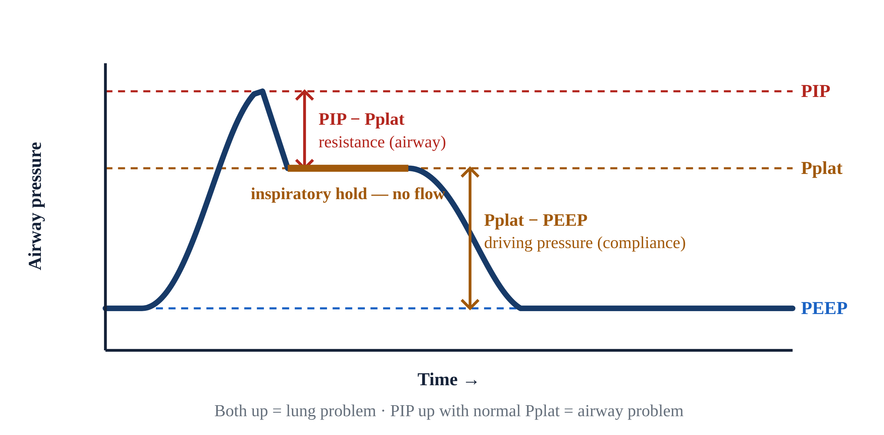
4.5 · Pressures
4.5
PIP, Pplat, and Driving Pressure
Peak Inspiratory Pressure (PIP): highest airway pressure during inspiration. Displayed continuously. Keep < 35 cmH₂O.
Plateau Pressure (Pplat): airway pressure during a 0.5-second inspiratory hold (no flow). Reflects alveolar pressure / compliance. Keep < 30 cmH₂O — ARDSNet protocol.
Math: PIP ≈ Pplat + (Resistance × Flow). High PIP + normal Pplat = AIRWAY problem (resistance). Both high = LUNG problem (compliance).
Driving pressure (ΔP) = Pplat − PEEP. Amato et al. (NEJM 2015) reanalyzed nine ARDS RCTs and showed ΔP was the strongest mortality predictor. Each 7 cmH₂O rise increased mortality ~40%.
Notes:
Peak Inspiratory Pressure (PIP): highest airway pressure during inspiration. Displayed continuously. Keep < 35 cmH₂O. Plateau Pressure (Pplat): airway pressure during a 0.5-second inspiratory hold (no flow). Reflects alveolar pressure / compliance. Keep < 30 cmH₂O — ARDSNet protocol. Press and hold the inspiratory hold button on the LTV to measure. Math: PIP ≈ Pplat + (Resistance × Flow). High PIP + normal Pplat = AIRWAY problem (resistance). Both high = LUNG problem (compliance). Driving pressure (ΔP) = Pplat − PEEP. Amato et al. (NEJM 2015) reanalyzed nine ARDS RCTs and showed ΔP was the strongest mortality predictor. Each 7 cmH₂O rise increased mortality ~40%. Target ΔP < 14 cmH₂O in ARDS. EVIDENCE — Amato 2015 driving pressure: Pplat − PEEP < 14 cmH₂O is the modern ARDS target. Stronger mortality predictor than Vt, Pplat, or PEEP individually.

Slide 8
4.6 · Defaults
4.6
IBW Math and Safe Initial Settings
Devine IBW formulas. Men: 50 + 2.3 × (inches over 60). Women: 45.5 + 2.3 × (inches over 60).
Examples. 5'6" man: 50 + 2.3 × 6 = 63.8 kg → safe Vt 380–510 mL. 5'10" woman: 45.5 + 2.3 × 10 = 68.5 kg → safe Vt 410–548 mL.
Safe adult defaults to defend: AC/VC mode; Vt 6–8 mL/kg IBW; RR 14, titrated to EtCO₂ 35–45; FiO₂ 100% then wean; PEEP 5; I:E 1:2; alarms PIP 35, low MV 4, low PEEP 3, apnea 20 sec.
When in doubt, return to defaults. Change ONE thing at a time, reassess in 30 seconds, and document with vitals before and after.
CLINICAL PEARL
5'10" rule of thumb
IBW is sex-specific — one number won't do. By the Devine formulas a 5'10" man ≈ 73 kg (Vt 440–580 mL) and a 5'10" woman ≈ 68.5 kg (Vt 410–548 mL). Anchor to the patient's sex and height, never actual weight.
Notes:
Devine IBW formulas. Men: 50 + 2.3 × (inches over 60). Women: 45.5 + 2.3 × (inches over 60). Examples. 5'6" man: 50 + 2.3 × 6 = 63.8 kg → safe Vt 380–510 mL. 5'10" woman: 45.5 + 2.3 × 10 = 68.5 kg → safe Vt 410–548 mL. Safe adult defaults to defend: AC/VC mode; Vt 6–8 mL/kg IBW; RR 14, titrated to EtCO₂ 35–45; FiO₂ 100% then wean; PEEP 5; I:E 1:2; alarms PIP 35, low MV 4, low PEEP 3, apnea 20 sec. When in doubt, return to defaults. Change ONE thing at a time, reassess in 30 seconds, and document with vitals before and after. PEARL — 5'10" rule of thumb: IBW is sex-specific — one number won't do. By the Devine formulas a 5'10" man ≈ 73 kg (Vt 440–580 mL) and a 5'10" woman ≈ 68.5 kg (Vt 410–548 mL). Anchor to the patient's sex and height, never actual weight.

Slide 9
Now put it to work
Hand off to learner devices — cues match your facilitator guide.
QUIZ
Knowledge Check
10 questions · pass 8/10 to unlock the next module
MATCH
Set or Monitored?
8 items · Operator-Set Settings · Monitored Values · must be perfect
CASE
Just took the vent. Settings look weird.
4-decision branching scenario · 5'6" male, 250 lb actual. Just intubated for hypoxic respiratory…
SIM
LTV 1200 Simulator
vent-ltv1200.html?scenario=initial-settings — Build safe initial settings on a freshly intubated patient — Vt by IBW, PEEP, and…
Notes:
Transition slide: send learners to the app for this module's quiz, match, scenario, then the simulator mission. Keep the cohort together; modules unlock in sequence.

Slide 10
Carry this out the door
✓
FiO₂ alone won't fix shunt Patient on 100% FiO₂ and saturation barely moves? It's a shunt. The bedside fix is PEEP — usually via CPAP in awake patients.
✓
5'10" rule of thumb IBW is sex-specific — one number won't do. By the Devine formulas a 5'10" man ≈ 73 kg (Vt 440–580 mL) and a 5'10" woman ≈ 68.5 kg (Vt 410–548 mL).…
✓
Tidal Volume Vt — How Much Air Per Breath
✓
Rate Respiratory Rate & Minute Ventilation
Next: Module 5
Notes:
Recap the module pearls, then transition.

