Slide 1
5
VENTILATOR TRAINING ACADEMY
Module 5
Modes of Ventilation
Volume targeted, pressure targeted, and the partnerships in between. Pick the mode the patient needs — not the mode you remember.
Foundations · 6 lessons
Jordan Hunter Jones, NRP · Course Director
Notes:
Module 5: Modes of Ventilation. Volume targeted, pressure targeted, and the partnerships in between. Pick the mode the patient needs — not the mode you remember.

Slide 2
In this module
5.1
Targeting Volume vs Pressure Targeting
5.4
NIV Modes CPAP vs BiPAP
5.2
Assist-Control What "Control" Really Means
5.5
PRVC PRVC and Newer Modes
5.3
SIMV & Pressure Support SIMV and Why It Fell Out of Favor
5.6
Synchrony Trigger Sensitivity & Inspiratory Rise Time
Then:
Knowledge Check
Match
Scenario
Simulator
Notes:
Roadmap of the module. Teach the lessons in order, then run the four interactive components on learner devices.

Slide 3
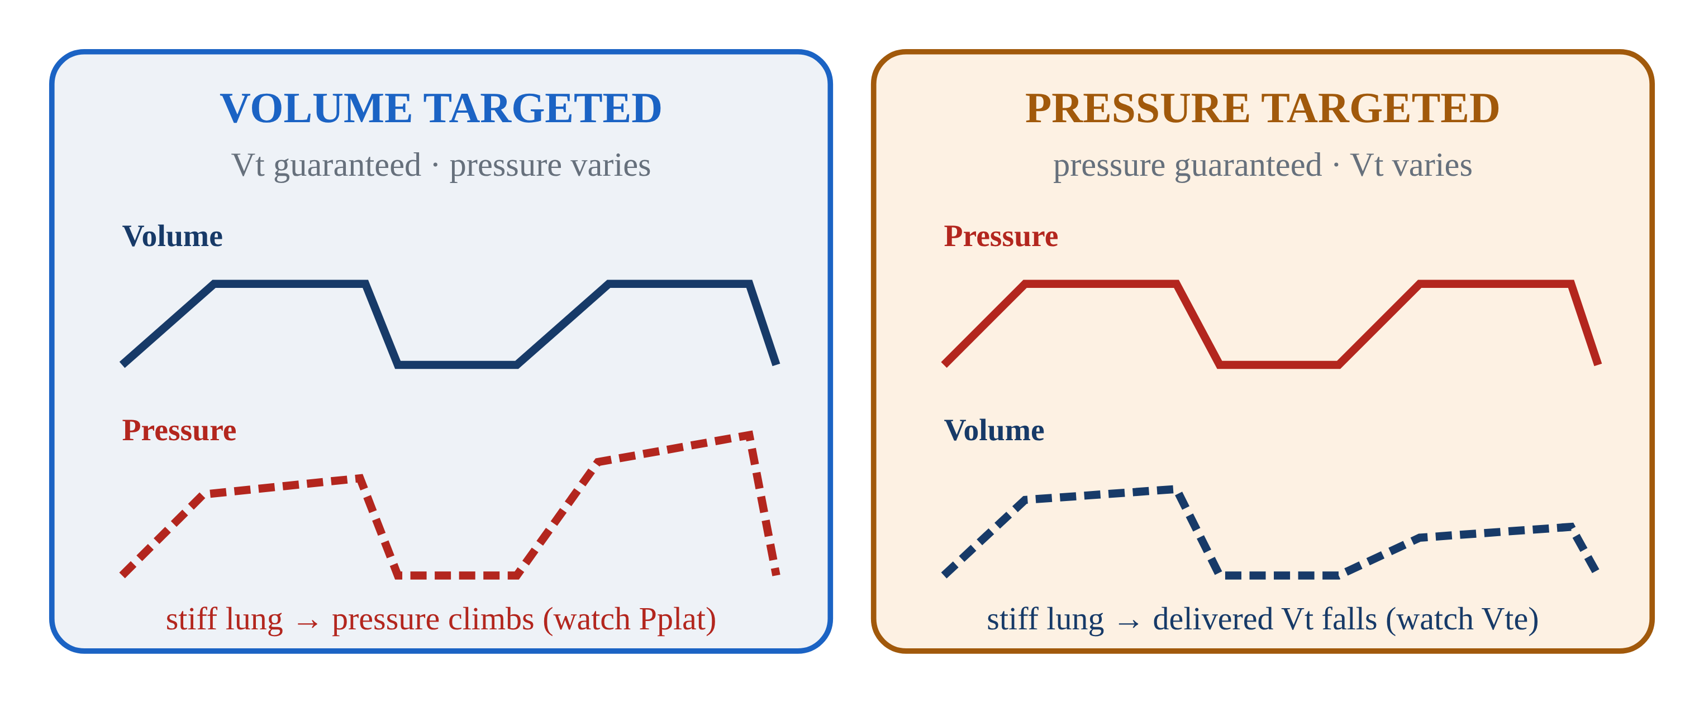
5.1 · Targeting
5.1
Volume vs Pressure Targeting
Every vent breath guarantees one thing and lets the other float — like inflating a tire: pump to a set volume of air and the pressure lands where it lands, or pump to a set pressure and the volume lands where it lands.
Volume-targeted (AC/VC): you set Vt — vent delivers it. PRESSURE varies with lung compliance. Most EMS default. Watch PIP / Pplat.
Pressure-targeted (AC/PC): you set inspiratory pressure — vent delivers it. VOLUME varies. Pressure capped, so barotrauma risk lower. Watch delivered Vt.
Trade-off: AC/VC gives predictable minute ventilation but variable pressure. AC/PC caps pressure but volume floats with stiffness.
Notes:
Every vent breath guarantees one thing and lets the other float — like inflating a tire: pump to a set volume of air and the pressure lands where it lands, or pump to a set pressure and the volume lands where it lands. You never get to fix both at once. Volume-targeted (AC/VC): you set Vt — vent delivers it. PRESSURE varies with lung compliance. Most EMS default. Watch PIP / Pplat. Pressure-targeted (AC/PC): you set inspiratory pressure — vent delivers it. VOLUME varies. Pressure capped, so barotrauma risk lower. Watch delivered Vt. Trade-off: AC/VC gives predictable minute ventilation but variable pressure. AC/PC caps pressure but volume floats with stiffness.

Slide 4
5.2 · Assist-Control
5.2
What "Control" Really Means
"Control" does NOT mean the patient is locked out. In AC mode, the patient can trigger their own breaths above the set rate.
AC guarantees a MINIMUM number of breaths per minute (set by RR). Patient-triggered breaths receive the full set Vt (or pressure) too. No "small supportive" breaths in pure AC.
Historical note: the original mode was CMV (Continuous Mandatory Ventilation) — patient locked out completely. AC came along to allow triggering, dramatically improving comfort.
Tachypneic patient on AC can stack breaths and develop auto-PEEP. Fix the cause of tachypnea (sedation, pain, hypoxia) — don't just lower the set rate.
CLINICAL PEARL
Pure AC = full breath every time
There are no small supportive breaths in AC. Every triggered breath gets the full set Vt.
Notes:
"Control" does NOT mean the patient is locked out. In AC mode, the patient can trigger their own breaths above the set rate. AC guarantees a MINIMUM number of breaths per minute (set by RR). Patient-triggered breaths receive the full set Vt (or pressure) too. No "small supportive" breaths in pure AC. Historical note: the original mode was CMV (Continuous Mandatory Ventilation) — patient locked out completely. AC came along to allow triggering, dramatically improving comfort. Tachypneic patient on AC can stack breaths and develop auto-PEEP. Fix the cause of tachypnea (sedation, pain, hypoxia) — don't just lower the set rate. PEARL — Pure AC = full breath every time: There are no small supportive breaths in AC. Every triggered breath gets the full set Vt.

Slide 5
5.3 · SIMV & Pressure Support
5.3
SIMV and Why It Fell Out of Favor
Synchronized Intermittent Mandatory Ventilation: vent delivers a SET rate of mandatory breaths. Between mandatory breaths, the patient breathes spontaneously at any volume.
Originally designed as a weaning mode — set rate decreased as the patient improved. Intuitive but not supported by evidence.
Esteban et al. (NEJM 1995) randomized weaning strategies. SIMV was the SLOWEST of four methods. Once-daily T-piece trials and PSV alone produced faster extubation. Most modern ICUs no longer use SIMV.
Pressure Support (PSV): vent senses spontaneous effort and adds a fixed pressure (5–15 cmH₂O). Compensates for ETT/circuit resistance (~5) or actively unloads the diaphragm (10–15).
EVIDENCE
Esteban 1995
T-piece and PSV both produced faster weaning than SIMV. Modern ICUs use spontaneous breathing trials, not SIMV gradual taper.
Notes:
Synchronized Intermittent Mandatory Ventilation: vent delivers a SET rate of mandatory breaths. Between mandatory breaths, the patient breathes spontaneously at any volume. Often paired with Pressure Support for the spontaneous breaths. Originally designed as a weaning mode — set rate decreased as the patient improved. Intuitive but not supported by evidence. Esteban et al. (NEJM 1995) randomized weaning strategies. SIMV was the SLOWEST of four methods. Once-daily T-piece trials and PSV alone produced faster extubation. Most modern ICUs no longer use SIMV. Pressure Support (PSV): vent senses spontaneous effort and adds a fixed pressure (5–15 cmH₂O). Compensates for ETT/circuit resistance (~5) or actively unloads the diaphragm (10–15). Inspiration cycles when flow drops to ~25% of peak. EVIDENCE — Esteban 1995: T-piece and PSV both produced faster weaning than SIMV. Modern ICUs use spontaneous breathing trials, not SIMV gradual taper.

Slide 6
5.4 · NIV Modes
5.4
CPAP vs BiPAP
CPAP: ONE pressure throughout the breath. Patient does all the work. Best for OXYGENATION problems (CHF, acute pulmonary edema).
Bersten et al. (NEJM 1991): in cardiogenic pulmonary edema, CPAP eliminated intubation in the treated arm. Cochrane: NNT 4–7 to prevent intubation.
BiPAP: TWO pressures (IPAP / EPAP). IPAP − EPAP = pressure support per breath. Best for VENTILATION problems (COPD with hypercapnia). Mechanism: EPAP overcomes auto-PEEP; IPAP unloads tired diaphragm.
Brochard et al. (NEJM 1995): in COPD exacerbation with hypercapnia, BiPAP reduced intubation from 74% to 26% and mortality from 29% to 9%.
Notes:
CPAP: ONE pressure throughout the breath. Patient does all the work. Best for OXYGENATION problems (CHF, acute pulmonary edema). Mechanism: pushes alveolar fluid into capillaries, reduces preload + LV afterload. Start 5–10 cmH₂O / FiO₂ 100%. Bersten et al. (NEJM 1991): in cardiogenic pulmonary edema, CPAP eliminated intubation in the treated arm. Cochrane: NNT 4–7 to prevent intubation. BiPAP: TWO pressures (IPAP / EPAP). IPAP − EPAP = pressure support per breath. Best for VENTILATION problems (COPD with hypercapnia). Mechanism: EPAP overcomes auto-PEEP; IPAP unloads tired diaphragm. Start IPAP 10 / EPAP 5. Brochard et al. (NEJM 1995): in COPD exacerbation with hypercapnia, BiPAP reduced intubation from 74% to 26% and mortality from 29% to 9%.

Slide 7
5.5 · PRVC
5.5
PRVC and Newer Modes
Pressure-Regulated Volume Control: a HYBRID. You set a Vt target; the vent delivers it using the LOWEST pressure required, measuring compliance breath-by-breath.
Vendor names differ: Drager AutoFlow, Servo PRVC, Hamilton ASV-like — all variations on the same idea.
The LTV 1200 does NOT natively offer PRVC. If you inherit a patient on PRVC from a sending facility, coordinate with the team, then switch to AC/VC (matching Vt and RR) or AC/PC.
APRV (Airway Pressure Release Ventilation) — used in refractory ARDS. NAVA (Neurally Adjusted Ventilatory Assist) — ICU-level synchrony. HFOV — once a rescue, OSCILLATE (NEJM 2013) showed harm.
Notes:
Pressure-Regulated Volume Control: a HYBRID. You set a Vt target; the vent delivers it using the LOWEST pressure required, measuring compliance breath-by-breath. Best of both worlds — volume guaranteed, pressure capped. Vendor names differ: Drager AutoFlow, Servo PRVC, Hamilton ASV-like — all variations on the same idea. The LTV 1200 does NOT natively offer PRVC. If you inherit a patient on PRVC from a sending facility, coordinate with the team, then switch to AC/VC (matching Vt and RR) or AC/PC. Watch PIP closely after the change. APRV (Airway Pressure Release Ventilation) — used in refractory ARDS. NAVA (Neurally Adjusted Ventilatory Assist) — ICU-level synchrony. HFOV — once a rescue, OSCILLATE (NEJM 2013) showed harm. All beyond EMS scope but worth recognizing.

Slide 8
5.6 · Synchrony
5.6
Trigger Sensitivity & Inspiratory Rise Time
Patient-vent dyssynchrony is the patient and the machine fighting over who leads the breath — pushing and pulling at different moments, like two people trying to row out of step.
Trigger sensitivity controls how easily the patient initiates a breath. Pressure trigger (−1 to −2 cmH₂O) is the common default. Flow trigger (1–3 L/min) is more responsive.
Inspiratory rise time: how fast the pressure ramps up at the start of inspiration (pressure-targeted modes). Faster rise (0.1–0.2 sec) feels powerful but can jolt awake patients.
EMS bedside fix for most dyssynchrony: deepen sedation, ensure analgesia, check trigger settings.
Notes:
Patient-vent dyssynchrony is the patient and the machine fighting over who leads the breath — pushing and pulling at different moments, like two people trying to row out of step. It affects ~25% of vented patients (Blanch, Intensive Care Med 2015) and raises work of breathing, sedation needs, and mortality. Trigger sensitivity controls how easily the patient initiates a breath. Pressure trigger (−1 to −2 cmH₂O) is the common default. Flow trigger (1–3 L/min) is more responsive. Too sensitive → auto-cycling from circuit motion. Not sensitive enough → patient struggles. Inspiratory rise time: how fast the pressure ramps up at the start of inspiration (pressure-targeted modes). Faster rise (0.1–0.2 sec) feels powerful but can jolt awake patients. Slower (0.4–0.6 sec) is gentler but can feel like flow starvation in dyspneic patients. EMS bedside fix for most dyssynchrony: deepen sedation, ensure analgesia, check trigger settings.

Slide 9
Now put it to work
Hand off to learner devices — cues match your facilitator guide.
QUIZ
Knowledge Check
10 questions · pass 8/10 to unlock the next module
MATCH
Pick the Mode
6 items · CPAP · BiPAP · AC/VC · must be perfect
CASE
Inherited Patient on PRVC
4-decision branching scenario · 54-year-old female, 5'5" (IBW ~57 kg). ARDS day 1 from urosepsis. On…
SIM
LTV 1200 Simulator
vent-ltv1200.html?scenario=niv-setup — Pick and set the right mode for an awake CHF patient — non-invasive CPAP before the…
Notes:
Transition slide: send learners to the app for this module's quiz, match, scenario, then the simulator mission. Keep the cohort together; modules unlock in sequence.

Slide 10
Carry this out the door
✓
Pure AC = full breath every time There are no small supportive breaths in AC. Every triggered breath gets the full set Vt.
✓
Targeting Volume vs Pressure Targeting
✓
SIMV & Pressure Support SIMV and Why It Fell Out of Favor
✓
NIV Modes CPAP vs BiPAP
Next: Module 6
Notes:
Recap the module pearls, then transition.

