Slide 1
6
VENTILATOR TRAINING ACADEMY
Module 6
LTV 1200 — The Platform Tour
Every control, every screen, every alarm — without a patient on it. Check it every shift, every patient.
Application · 6 lessons
Jordan Hunter Jones, NRP · Course Director
Notes:
Module 6: LTV 1200 — The Platform Tour. Every control, every screen, every alarm — without a patient on it. Check it every shift, every patient.

Slide 2
In this module
6.1
Hardware Front Panel and Side Connections
6.4
Alarms The Core Alarms
6.2
Power Battery and Line Power
6.5
Checkout Startup and Pre-Use Checkout
6.3
Display Reading the Screen
6.6
Workflow Safe Changes & Common Pitfalls
Then:
Knowledge Check
Match
Scenario
Simulator
Notes:
Roadmap of the module. Teach the lessons in order, then run the four interactive components on learner devices.

Slide 3
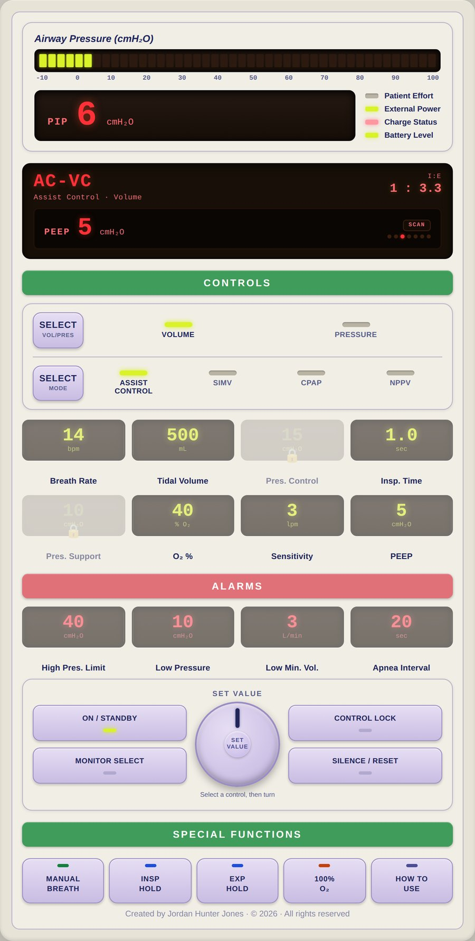
6.1 · Hardware
6.1
Front Panel and Side Connections
Front panel essentials: On/Standby power.
Side/rear connections: O₂ inlet — high-pressure DISS or a low-pressure fitting depending on configuration. Patient circuit ports including the easily-missed exhalation valve drive line.
Practice on the unit until you can find every control by feel. In a noisy ambulance bay or moving aircraft, you can't read labels.
The exhalation valve drive line is the most-missed connection. Without it, the patient cannot exhale. Verify every POST.
Notes:
Front panel essentials: On/Standby power. A bank of INDIVIDUAL control windows — one per setting (Breath Rate, Tidal Volume, Pressure Control, Inspiratory Time, Pressure Support, O₂ %, Sensitivity, PEEP) plus the alarm-limit windows. Two Select buttons (Mode and Breath Type). The Set Value knob. Manual Breath, Alarm Silence/Reset, Control Lock, and the display window. Side/rear connections: O₂ inlet — high-pressure DISS or a low-pressure fitting depending on configuration. Patient circuit ports including the easily-missed exhalation valve drive line. Battery compartment, external power input, bacterial/viral filter, and a Comm Port for service and data (it is NOT a USB port). Confirm the exact connections on YOUR unit — configurations vary. Practice on the unit until you can find every control by feel. In a noisy ambulance bay or moving aircraft, you can't read labels. The exhalation valve drive line is the most-missed connection. Without it, the patient cannot exhale. Verify every POST. PEARL — Memorize by feel: Spend ten minutes with eyes closed, locating each control by touch. Pays off the first time you have to silence an alarm at 3 a.m. in a moving truck.

Slide 4
6.2 · Power
6.2
Battery and Line Power
Internal battery: sealed lead-acid, ~45 min at nominal settings (per the LTV operator manual). Drains FASTER at high FiO₂, high PEEP, rapid rates — plan far less for a sick lung.
Battery health degrades over service life. A unit in service > 3 years and never replaced will deliver less than spec. Document unexpected battery alarms.
On the truck: confirm "line power" on the display before loading the patient.
Pre-flight rule: 100% battery + line power confirmed = ready. Test external battery packs under load — a pack that holds static charge but fails under demand is a transport hazard.
Notes:
Internal battery: sealed lead-acid, ~45 min at nominal settings (per the LTV operator manual). Drains FASTER at high FiO₂, high PEEP, rapid rates — plan far less for a sick lung. Always confirm runtime against your unit's manual. Battery health degrades over service life. A unit in service > 3 years and never replaced will deliver less than spec. Document unexpected battery alarms. On the truck: confirm "line power" on the display before loading the patient. If external power is lost, the LTV annunciates a POWER LOST alarm and transfers to the internal battery — the switch is NOT silent; acknowledge the alarm and restore AC. Pre-flight rule: 100% battery + line power confirmed = ready. Test external battery packs under load — a pack that holds static charge but fails under demand is a transport hazard.

Slide 5
6.3 · Display
6.3
Reading the Screen
The LTV does NOT split the screen into a settings half and a monitored half.
Monitored data appears in ONE display window that SCANS — cycling through the measured values one at a time: PIP, MAP, PEEP, f (total rate), Vte (exhaled tidal volume), VE (exhaled minute volume), and I:E.
Press Monitor Select once to halt the scan on a value, again to step to the next, or twice quickly to resume scanning.
Know which numbers you SET and which the vent CALCULATES. You set Inspiratory Time; the vent derives and displays I:E from that and the rate.
There is NO continuously monitored plateau pressure on this display.
CLINICAL PEARL
Set vs Exhaled
Exhaled Vt consistently < set Vt by > 10%? Check ETT cuff, walk the circuit, look at the exhalation valve drive line. Persistent leak = lost PEEP = lost oxygenation.
Notes:
The LTV does NOT split the screen into a settings half and a monitored half. Each setting lives in its OWN window and you work one at a time: press that control to select it (it brightens, the rest dim), turn the Set Value knob, then confirm. Monitored data appears in ONE display window that SCANS — cycling through the measured values one at a time: PIP, MAP, PEEP, f (total rate), Vte (exhaled tidal volume), VE (exhaled minute volume), and I:E. Alarm messages appear in this same window. Press Monitor Select once to halt the scan on a value, again to step to the next, or twice quickly to resume scanning. Know which numbers you SET and which the vent CALCULATES. You set Inspiratory Time; the vent derives and displays I:E from that and the rate. Trying to dial I:E directly is a common novice error — change Inspiratory Time or the rate instead. There is NO continuously monitored plateau pressure on this display. Pplat is obtained with an inspiratory hold maneuver where your unit and configuration support it — confirm the procedure in your operator manual. Divergence between SET Vt and EXHALED Vt (Vte) is the earliest sign of a leak or compliance change. Don't silence — investigate. PEARL — Set vs Exhaled: Exhaled Vt consistently < set Vt by > 10%? Check ETT cuff, walk the circuit, look at the exhalation valve drive line. Persistent leak = lost PEEP = lost oxygenation.

Slide 6
6.4 · Alarms
6.4
The Core Alarms
HIGH PRESSURE — PIP exceeded threshold (default ~40 cmH₂O; set to 35 in lung-protective). Most common in EMS.
LOW PRESSURE / LOW PEEP — circuit leak, disconnect, ETT cuff leak. Default 4 cmH₂O below set PEEP.
LOW MINUTE VOLUME — exhaled MV below threshold. Default is often 0 — set this to ~70% of expected MV.
APNEA — no detected breath in apnea time (default 20 sec). Triggered by complete loss of effort or sensor failure.
POWER LOST / LOW BATTERY — external power lost (transfer to internal battery) or battery depleting. Restore AC promptly.
GAS SUPPLY — O₂ source pressure low; check tank, regulator, and hose.
Notes:
HIGH PRESSURE — PIP exceeded threshold (default ~40 cmH₂O; set to 35 in lung-protective). Most common in EMS. LOW PRESSURE / LOW PEEP — circuit leak, disconnect, ETT cuff leak. Default 4 cmH₂O below set PEEP. LOW MINUTE VOLUME — exhaled MV below threshold. Default is often 0 — set this to ~70% of expected MV. APNEA — no detected breath in apnea time (default 20 sec). Triggered by complete loss of effort or sensor failure. POWER LOST / LOW BATTERY — external power lost (transfer to internal battery) or battery depleting. Restore AC promptly. GAS SUPPLY — O₂ source pressure low; check tank, regulator, and hose. Triage: READ the alarm BEFORE silencing. Silencing without identifying the cause is a sentinel-level safety event. This is the core set — the operator manual lists additional device and self-test alarms. Know your unit's full alarm list before transport.

Slide 7
6.5 · Checkout
6.5
Startup and Pre-Use Checkout
Follow the startup and operational-verification procedure in your operator manual PLUS your agency's documented equipment check. What follows is the SHAPE of that check — it replaces neither document.
Connect a complete circuit and test lung BEFORE powering on — including the exhalation valve drive line. A checkout without a circuit tests nothing that matters.
Power on and let the unit finish its self test. Any failure indication means the unit comes out of service — tag it, document it, replace it.
Answer the patient setup prompt, then load and verify settings appropriate to your patient before connecting them.
Set alarm limits for THIS patient — especially Low Minute Volume, which commonly sits at a value that will never alarm.
EVIDENCE
Why the pre-use check
Most field LTV failures are caught during pre-use checkout — the worst time to find one is mid-transport. The manufacturer's instructions and your agency policy control the exact steps and their order.
Notes:
Follow the startup and operational-verification procedure in your operator manual PLUS your agency's documented equipment check. What follows is the SHAPE of that check — it replaces neither document. Connect a complete circuit and test lung BEFORE powering on — including the exhalation valve drive line. A checkout without a circuit tests nothing that matters. Power on and let the unit finish its self test. Any failure indication means the unit comes out of service — tag it, document it, replace it. Answer the patient setup prompt, then load and verify settings appropriate to your patient before connecting them. Set alarm limits for THIS patient — especially Low Minute Volume, which commonly sits at a value that will never alarm. Verify the gas source at the required pressure, the battery state of charge, and that the display indicates external power when docked. Document the check per agency policy. EVIDENCE — Why the pre-use check: Most field LTV failures are caught during pre-use checkout — the worst time to find one is mid-transport. The manufacturer's instructions and your agency policy control the exact steps and their order.

Slide 8
6.6 · Workflow
6.6
Safe Changes & Common Pitfalls
Safe-change workflow: 1) Verbalize the change BEFORE you touch the panel. 2) Press that control's window to SELECT it — it brightens, the rest dim. 3) Turn the Set Value knob.
Common pitfalls from incident reviews: forgetting to set LOW MV alarm; setting PEEP at the dial but forgetting to attach the PEEP valve; pediatric patient on the adult circuit (dead space > Vt); missing the…
Notes:
Safe-change workflow: 1) Verbalize the change BEFORE you touch the panel. 2) Press that control's window to SELECT it — it brightens, the rest dim. 3) Turn the Set Value knob. 4) Confirm — press the control again, select another, press Control Lock, or let it time out. 5) Reassess in 30 sec. 6) Document with vitals before AND after. Common pitfalls from incident reviews: forgetting to set LOW MV alarm; setting PEEP at the dial but forgetting to attach the PEEP valve; pediatric patient on the adult circuit (dead space > Vt); missing the POWER LOST alarm when the AC plug bumps loose and the unit transfers to internal battery; POST skipped because "the next shift will do it."

Slide 9
Now put it to work
Hand off to learner devices — cues match your facilitator guide.
QUIZ
Knowledge Check
10 questions · pass 8/10 to unlock the next module
MATCH
Front-Panel Controls
6 items · Navigates / Selects · Manages Alarms · Delivers a Breath / Measures · must be perfect
CASE
Pre-Shift Walkaround
4-decision branching scenario · Pre-shift unit check. No patient yet.
SIM
LTV 1200 Simulator
vent-ltv1200.html?level=1 — Learn the controls hands-on: work the LTV 1200 tutorial on the simulator.
Notes:
Transition slide: send learners to the app for this module's quiz, match, scenario, then the simulator mission. Keep the cohort together; modules unlock in sequence.

Slide 10
Carry this out the door
✓
Memorize by feel Spend ten minutes with eyes closed, locating each control by touch. Pays off the first time you have to silence an alarm at 3 a.m. in a moving truck.
✓
Set vs Exhaled Exhaled Vt consistently < set Vt by > 10%? Check ETT cuff, walk the circuit, look at the exhalation valve drive line. Persistent leak = lost PEEP =…
✓
Power Battery and Line Power
✓
Alarms The Core Alarms
Next: Module 7
Notes:
Recap the module pearls, then transition.

