Slide 1
7
VENTILATOR TRAINING ACADEMY
Module 7
Alarms & Troubleshooting
Every alarm is information. DOPE is the universal algorithm. The 10-second rule is non-negotiable.
Application · 7 lessons
Jordan Hunter Jones, NRP · Course Director
Notes:
Module 7: Alarms & Troubleshooting. Every alarm is information. DOPE is the universal algorithm. The 10-second rule is non-negotiable.

Slide 2
In this module
7.1
Philosophy What Alarms Are For
7.5
E Equipment Failure
7.2
D Dislodgement
7.6
The 10-Second Rule When to Disconnect and Bag
7.3
O Obstruction
7.7
Dyssynchrony When the Patient and Vent Argue
7.4
P Pneumothorax
Then:
Knowledge Check
Match
Scenario
Simulator
Notes:
Roadmap of the module. Teach the lessons in order, then run the four interactive components on learner devices.

Slide 3
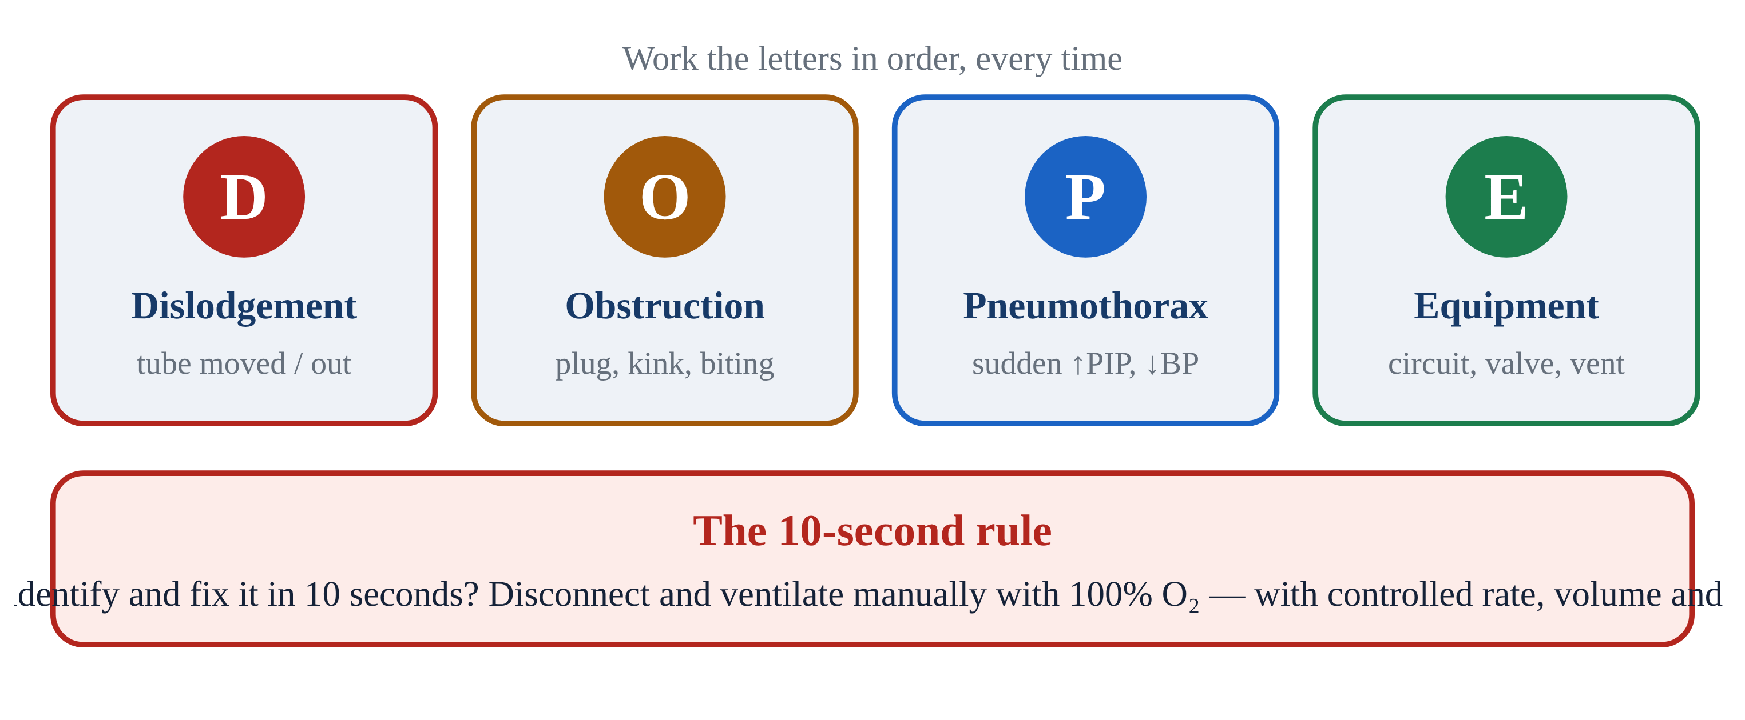
7.1 · Philosophy
7.1
What Alarms Are For
Alarms are NOT nuisances. They are information about a deteriorating system. Two kinds: equipment alarms (machine problem) and patient alarms (patient problem). Some are both.
The cardinal rule: READ the alarm before you SILENCE it. Silencing an alarm without identifying the cause is a sentinel-level safety event, documented in nearly every transport-service incident review.
Silence gives you 60 seconds of quiet to fix. Not 60 seconds to ignore. After 60 sec, if the problem persists, the alarm re-fires.
Build the habit: read first, silence second, fix third, document fourth. Train it until it's automatic.
Notes:
Alarms are NOT nuisances. They are information about a deteriorating system. Two kinds: equipment alarms (machine problem) and patient alarms (patient problem). Some are both. The cardinal rule: READ the alarm before you SILENCE it. Silencing an alarm without identifying the cause is a sentinel-level safety event, documented in nearly every transport-service incident review. Silence gives you 60 seconds of quiet to fix. Not 60 seconds to ignore. After 60 sec, if the problem persists, the alarm re-fires. Build the habit: read first, silence second, fix third, document fourth. Train it until it's automatic. PEARL — Sentinel error: Silencing without investigating is the #1 contributor to adverse vent events in transport. Don't let muscle memory take over.

Slide 4
7.2 · D
7.2
Dislodgement
Most common cause of sudden vent crisis in transport. Movement during loading, lifting, transferring between gurney and aircraft, or a road bump can dislodge an ETT.
Confirm depth: marking at the lip should match what was secured (21 cm women, 23 cm men typically).
Confirm capnography: a sudden drop to zero is dislodgement until proven otherwise.
Auscultate: equal bilateral breath sounds. Right-only = mainstem migration. Absent or epigastric = esophageal or completely out.
If the tube is out, bag with BVM + mask while preparing to re-intubate. Verify depth AGAIN after every transition.
Notes:
Most common cause of sudden vent crisis in transport. Movement during loading, lifting, transferring between gurney and aircraft, or a road bump can dislodge an ETT. Confirm depth: marking at the lip should match what was secured (21 cm women, 23 cm men typically). Confirm capnography: a sudden drop to zero is dislodgement until proven otherwise. Auscultate: equal bilateral breath sounds. Right-only = mainstem migration. Absent or epigastric = esophageal or completely out. If the tube is out, bag with BVM + mask while preparing to re-intubate. Verify depth AGAIN after every transition.

Slide 5
7.3 · O
7.3
Obstruction
Tube patent in position but blocked.
Pass a suction catheter. This is BOTH diagnostic AND therapeutic. If it passes easily and brings back secretions, you've solved the problem.
If suction passes but doesn't clear secretions, consider bronchodilator or repositioning.
If suction doesn't pass — you have a fixed obstruction or dislodgement. Disconnect and bag while investigating.
Notes:
Tube patent in position but blocked. Causes: mucus plug (most common in post-arrest, post-aspiration, COPD), biting on the tube, condensation pooled in dependent loop, kinked tube, over-inflated cuff herniating into lumen. Pass a suction catheter. This is BOTH diagnostic AND therapeutic. If it passes easily and brings back secretions, you've solved the problem. If suction passes but doesn't clear secretions, consider bronchodilator or repositioning. If suction doesn't pass — you have a fixed obstruction or dislodgement. Disconnect and bag while investigating.

Slide 6
7.4 · P
7.4
Pneumothorax
Sudden rise in PIP, often with falling SpO₂ and BP. Decreased or absent breath sounds on the affected side. Tracheal deviation away from the affected side (LATE).
Hyperresonance to percussion of the affected side. JVD + hemodynamic compromise = TENSION pneumothorax. Clinical diagnosis at the bedside, not waiting for imaging.
Decompress per protocol: needle thoracostomy at the 2nd ICS midclavicular OR 4th–5th ICS midaxillary.
High-risk populations: asthma/COPD on positive pressure, trauma, recent central line placement. Suspect early.
Notes:
Sudden rise in PIP, often with falling SpO₂ and BP. Decreased or absent breath sounds on the affected side. Tracheal deviation away from the affected side (LATE). Hyperresonance to percussion of the affected side. JVD + hemodynamic compromise = TENSION pneumothorax. Clinical diagnosis at the bedside, not waiting for imaging. Decompress per protocol: needle thoracostomy at the 2nd ICS midclavicular OR 4th–5th ICS midaxillary. Then secure and monitor the catheter/device per protocol, reassess for re-tensioning, and arrange definitive thoracostomy at the receiving facility. (A chest seal treats an OPEN chest wound — it does not stop an internal air leak.) High-risk populations: asthma/COPD on positive pressure, trauma, recent central line placement. Suspect early.

Slide 7
7.5 · E
7.5
Equipment Failure
Machine is the problem. Causes: disconnected circuit (most often exhalation valve drive line), failed sensor or transducer, silent battery switch, O₂ source disconnect, software hang, loose ETT cuff.
Universal answer: DISCONNECT FROM THE VENT AND BAG WITH 100% O₂. The bag tells you whether the problem is patient or machine.
Easy bag + sat rises = vent problem. Troubleshoot vent off-patient. Hard bag = patient problem — apply DOPE (D, O, or P).
Bagging is rarely the wrong answer. It is diagnostic AND therapeutic at the same time.
Notes:
Machine is the problem. Causes: disconnected circuit (most often exhalation valve drive line), failed sensor or transducer, silent battery switch, O₂ source disconnect, software hang, loose ETT cuff. Universal answer: DISCONNECT FROM THE VENT AND BAG WITH 100% O₂. The bag tells you whether the problem is patient or machine. Easy bag + sat rises = vent problem. Troubleshoot vent off-patient. Hard bag = patient problem — apply DOPE (D, O, or P). Bagging is rarely the wrong answer. It is diagnostic AND therapeutic at the same time.

Slide 8
7.6 · The 10-Second Rule
7.6
When to Disconnect and Bag
If you cannot identify and fix an alarm in 10 seconds, disconnect from the ventilator and bag with 100% oxygen. Then troubleshoot.
Vented patients deteriorate fast — sats can drop 20 points in two minutes of failed ventilation. Bagging buys time.
The bag gives you something the vent cannot: direct hands-on feedback. You feel resistance. You see chest rise. You CONFIRM gas exchange.
If bagging is easy and sat comes up, the problem is the machine. If bagging is hard, the problem is the patient — DOPE. Bagging is rarely the wrong answer.
CLINICAL PEARL
10 seconds, then bag
If you're hesitating past 10 seconds, you're losing time. Disconnect and bag. Troubleshoot with confidence that the patient is being ventilated.
Notes:
If you cannot identify and fix an alarm in 10 seconds, disconnect from the ventilator and bag with 100% oxygen. Then troubleshoot. Vented patients deteriorate fast — sats can drop 20 points in two minutes of failed ventilation. Bagging buys time. The bag gives you something the vent cannot: direct hands-on feedback. You feel resistance. You see chest rise. You CONFIRM gas exchange. If bagging is easy and sat comes up, the problem is the machine. If bagging is hard, the problem is the patient — DOPE. Bagging is rarely the wrong answer. PEARL — 10 seconds, then bag: If you're hesitating past 10 seconds, you're losing time. Disconnect and bag. Troubleshoot with confidence that the patient is being ventilated.

Slide 9
7.7 · Dyssynchrony
7.7
When the Patient and Vent Argue
Patient-vent dyssynchrony affects ~25% of vented patients (Blanch, ICM 2015). Four patterns:
Trigger asynchrony: patient effort doesn't initiate a breath. Fix: increase trigger sensitivity (flow trigger if available).
Flow asynchrony: vent flow doesn't match patient demand. Fix: increase peak flow or shorten inspiratory time.
Double triggering: patient effort outlasts inspiration; second breath stacks immediately. Fix: lengthen inspiratory time, deepen sedation, treat air hunger.
EMS bedside fix for most dyssynchrony: deepen sedation, ensure adequate analgesia, check trigger settings.
Notes:
Patient-vent dyssynchrony affects ~25% of vented patients (Blanch, ICM 2015). Four patterns: Trigger asynchrony: patient effort doesn't initiate a breath. Fix: increase trigger sensitivity (flow trigger if available). Flow asynchrony: vent flow doesn't match patient demand. Fix: increase peak flow or shorten inspiratory time. Double triggering: patient effort outlasts inspiration; second breath stacks immediately. Fix: lengthen inspiratory time, deepen sedation, treat air hunger. EMS bedside fix for most dyssynchrony: deepen sedation, ensure adequate analgesia, check trigger settings.

Slide 10
Now put it to work
Hand off to learner devices — cues match your facilitator guide.
QUIZ
Knowledge Check
10 questions · pass 8/10 to unlock the next module
MATCH
Sort the Signs by DOPE Letter
8 items · D — Dislodgement · O — Obstruction · P — Pneumothorax · E — Equipment · must be perfect
CASE
Run DOPE in 60 Seconds
4-decision branching scenario · 27-year-old female, 65 kg IBW, status asthmaticus, intubated 30 min…
SIM
LTV 1200 Simulator
vent-ltv1200.html?level=2 — Test yourself on the simulator's clinical scenarios — set alarm limits and correct the…
Notes:
Transition slide: send learners to the app for this module's quiz, match, scenario, then the simulator mission. Keep the cohort together; modules unlock in sequence.

Slide 11
Carry this out the door
✓
Sentinel error Silencing without investigating is the #1 contributor to adverse vent events in transport. Don't let muscle memory take over.
✓
10 seconds, then bag If you're hesitating past 10 seconds, you're losing time. Disconnect and bag. Troubleshoot with confidence that the patient is being ventilated.
✓
D Dislodgement
✓
O Obstruction
Next: Module 8
Notes:
Recap the module pearls, then transition.

