Slide 1
9
VENTILATOR TRAINING ACADEMY
Module 9
Special Populations
Same vent. Different goals. Asthma/COPD, ARDS, TBI, pediatrics. Pick the goal first; the settings follow.
Application · 6 lessons
Jordan Hunter Jones, NRP · Course Director
Notes:
Module 9: Special Populations. Same vent. Different goals. Asthma/COPD, ARDS, TBI, pediatrics. Pick the goal first; the settings follow.

Slide 2
In this module
9.1
Asthma & COPD Let Them Exhale
9.4
ARDS Rescue When Lung-Protective Isn't Enough
9.2
Auto-PEEP When the Lung Doesn't Empty
9.5
TBI Strict Normocapnia
9.3
ARDS Lung-Protective Ventilation
9.6
Pediatrics Smaller Everything, Bigger Margins
Then:
Knowledge Check
Match
Scenario
Simulator
Notes:
Roadmap of the module. Teach the lessons in order, then run the four interactive components on learner devices.

Slide 3
9.1 · Asthma & COPD
9.1
Let Them Exhale
Obstructive disease is fundamentally an EXHALATION problem. Air goes in easily; getting it out takes time.
Strategy: low rate (RR 8–10), long expiratory time (I:E 1:4 or 1:5), Vt 6–8 mL/kg IBW, FiO₂ to SpO₂ ≥ 88% (COPD) or ≥ 92% (asthma), PEEP 0–5 cmH₂O. Permissive hypercapnia is acceptable; pH ≥ 7.20 typical floor.
Don't chase a normal CO₂ at the cost of barotrauma. Forcing the rate up stacks breaths and drops BP via auto-PEEP.
Notes:
Obstructive disease is fundamentally an EXHALATION problem. Air goes in easily; getting it out takes time. Strategy: low rate (RR 8–10), long expiratory time (I:E 1:4 or 1:5), Vt 6–8 mL/kg IBW, FiO₂ to SpO₂ ≥ 88% (COPD) or ≥ 92% (asthma), PEEP 0–5 cmH₂O. Permissive hypercapnia is acceptable; pH ≥ 7.20 typical floor. Don't chase a normal CO₂ at the cost of barotrauma. Forcing the rate up stacks breaths and drops BP via auto-PEEP.

Slide 4
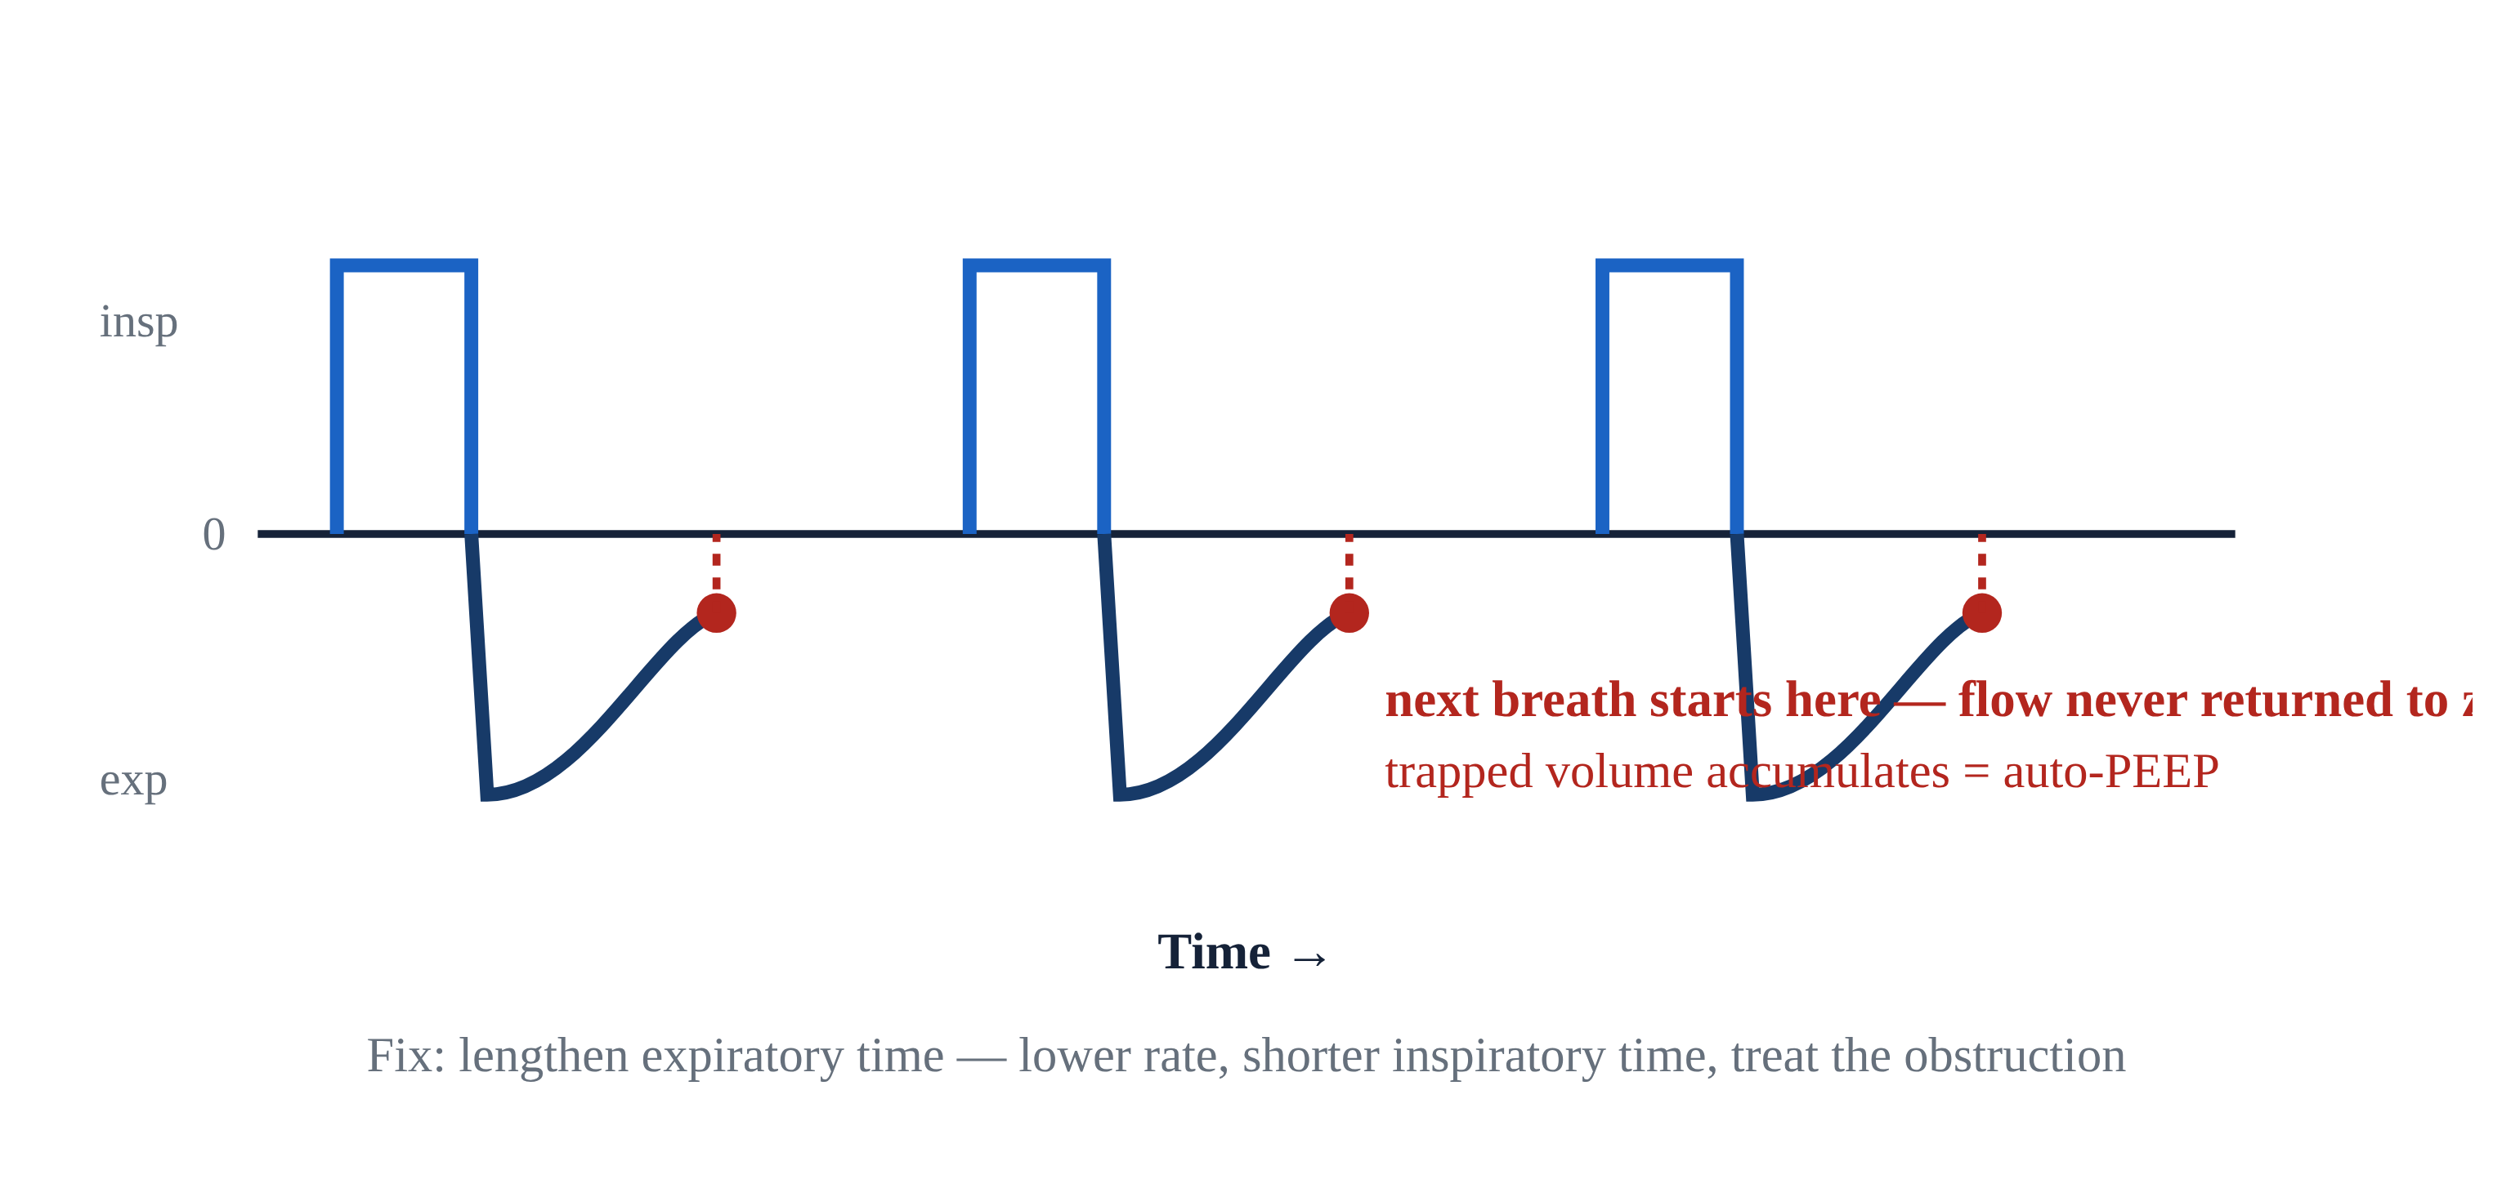
9.2 · Auto-PEEP
9.2
When the Lung Doesn't Empty
Picture pouring into a glass that drains slowly: send the next splash before it empties and the level climbs until it overflows.
Clinical signs: rising PIP without rising Pplat; falling BP; patient "fights" the vent; expiratory flow waveform doesn't return to zero before next breath.
Management: slow RR (often dramatically — to 8 or even 6). Lengthen exp time (I:E 1:4 or 1:5).
If hemodynamically compromised: BRIEFLY DISCONNECT FROM THE VENT for 5–10 seconds. Trapped gas releases. BP often improves immediately. Reconnect on slower settings.
Notes:
Picture pouring into a glass that drains slowly: send the next splash before it empties and the level climbs until it overflows. Auto-PEEP is the same — in an obstructed lung that exhales slowly, the next breath starts before the last one finishes, so air stacks, the chest over-fills, intrathoracic pressure rises, venous return drops, and BP falls. Clinical signs: rising PIP without rising Pplat; falling BP; patient "fights" the vent; expiratory flow waveform doesn't return to zero before next breath. Management: slow RR (often dramatically — to 8 or even 6). Lengthen exp time (I:E 1:4 or 1:5). If hemodynamically compromised: BRIEFLY DISCONNECT FROM THE VENT for 5–10 seconds. Trapped gas releases. BP often improves immediately. Reconnect on slower settings. Vented status asthmaticus has ~30% incidence of post-intubation hypotension — anticipate it. PEARL — Brief disconnect: Hypotensive asthmatic on the vent? Disconnect from the circuit for 5–10 sec. Release the trapped gas. BP often recovers in under a minute. Reconnect on slower settings.

Slide 5
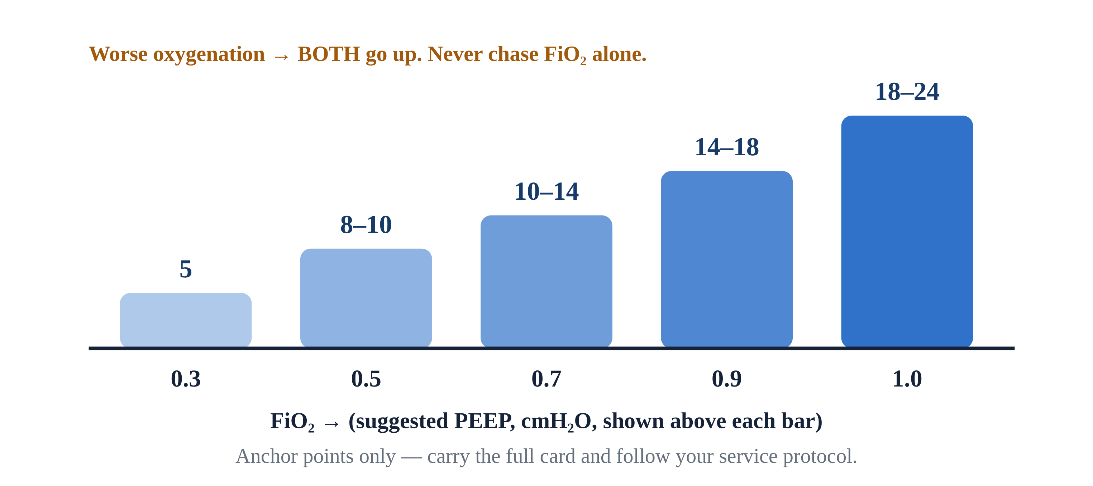
9.3 · ARDS
9.3
Lung-Protective Ventilation
Acute Respiratory Distress Syndrome: diffuse alveolar damage, refractory hypoxia. Berlin definition (2012): bilateral infiltrates, not cardiac, within 1 week.
Goal: protect the alveoli you have left. The mental model is the 'baby lung' — in ARDS so much lung is flooded or collapsed that only a small, child-sized portion is still open to ventilate.
Settings: AC/VC or AC/PC; Vt 4–6 mL/kg IBW (LOWER than usual); RR 18–22 to maintain MV; PEEP 10–15 per ARDSNet table; Pplat < 30; driving pressure (Pplat − PEEP) < 14 cmH₂O.
ARDSNet ARMA (NEJM 2000): mortality 31% vs 40% comparing 6 vs 12 mL/kg IBW. NNT 11. The most evidence-based ARDS intervention.
Notes:
Acute Respiratory Distress Syndrome: diffuse alveolar damage, refractory hypoxia. Berlin definition (2012): bilateral infiltrates, not cardiac, within 1 week. Severity by P/F ratio: mild 200–300, moderate 100–200, severe < 100. A 2023/2024 Global Definition of ARDS now also allows diagnosis by SpO₂/FiO₂ and includes patients on HFNO ≥ 30 L/min or CPAP/NIV ≥ 5 cmH₂O — but the Berlin P/F severity bands remain in everyday bedside use. Goal: protect the alveoli you have left. The mental model is the 'baby lung' — in ARDS so much lung is flooded or collapsed that only a small, child-sized portion is still open to ventilate. You are not filling an adult lung; you are filling what survives. So: small breaths, modest pressure, generous PEEP — a normal-sized Vt would over-stretch those few survivors and injure them. Settings: AC/VC or AC/PC; Vt 4–6 mL/kg IBW (LOWER than usual); RR 18–22 to maintain MV; PEEP 10–15 per ARDSNet table; Pplat < 30; driving pressure (Pplat − PEEP) < 14 cmH₂O. ARDSNet ARMA (NEJM 2000): mortality 31% vs 40% comparing 6 vs 12 mL/kg IBW. NNT 11. The most evidence-based ARDS intervention. EVIDENCE — ARDSNet PEEP/FiO₂ Lower-PEEP Table: FiO₂ 0.3 → PEEP 5. FiO₂ 0.5 → PEEP 8–10. FiO₂ 0.7 → PEEP 10–14. FiO₂ 1.0 → PEEP 18–24. Carry the card.

Slide 6
9.4 · ARDS Rescue
9.4
When Lung-Protective Isn't Enough
When lung-protective settings (6 mL/kg, Pplat < 30, ΔP < 14) aren't enough, these are the rescue options — roughly in order of evidence:
Prone positioning — PROSEVA (Guérin, NEJM 2013): 16 hr/day in severe ARDS (P/F < 150). Mortality 33% → 16%, NNT 6. The strongest single rescue.
Neuromuscular blockade — ACURASYS (NEJM 2010) showed a mortality benefit with 48-hr cisatracurium; ROSE (NEJM 2019) didn't replicate it. Now…
HFOV — OSCILLATE / OSCAR (NEJM 2013): no benefit; OSCILLATE was stopped for harm. Not first-line.
ECMO — ICU-level. Transport teams may move ECMO patients but don't initiate. Notify the receiving facility early when standard care is failing.
Notes:
When lung-protective settings (6 mL/kg, Pplat < 30, ΔP < 14) aren't enough, these are the rescue options — roughly in order of evidence:

Slide 7
9.5 · TBI
9.5
Strict Normocapnia
Two enemies of the injured brain: hypoxia and hypotension. A single SpO₂ < 90 or SBP < 90 doubles mortality in moderate-severe TBI (Brain Trauma Foundation 4th ed., 2017).
Strict normocapnia: target EtCO₂ 35–40 mmHg. Avoid prophylactic hyperventilation (BTF Level IIB recommendation) — drops cerebral blood flow and worsens secondary injury.
Standard TBI settings: AC/VC, Vt 6–8 mL/kg IBW, RR 12–16 titrated to EtCO₂ 35–40, PEEP 5, FiO₂ to SpO₂ ≥ 94%, pressors ready.
Hyperventilation rescue (transient, for impending herniation only): increase RR to target EtCO₂ 30–35 mmHg (NEVER below 30). Return to normocapnia once the exam improves (typically 2–5 min).
CLINICAL PEARL
Hyperventilation past the rescue window is harmful
Use brief hyperventilation only for signs of impending herniation (Cushing's triad, blown pupil, posturing). Return EtCO₂ to 35–40 as soon as exam improves. EtCO₂ < 30 worsens ischemia.
Notes:
Two enemies of the injured brain: hypoxia and hypotension. A single SpO₂ < 90 or SBP < 90 doubles mortality in moderate-severe TBI (Brain Trauma Foundation 4th ed., 2017). Strict normocapnia: target EtCO₂ 35–40 mmHg. Avoid prophylactic hyperventilation (BTF Level IIB recommendation) — drops cerebral blood flow and worsens secondary injury. Standard TBI settings: AC/VC, Vt 6–8 mL/kg IBW, RR 12–16 titrated to EtCO₂ 35–40, PEEP 5, FiO₂ to SpO₂ ≥ 94%, pressors ready. BTF age-stratified BP target: SBP ≥ 100 (ages 50–69), SBP ≥ 110 (other ages); for simplicity, target SBP > 100 in all adult TBI. Hyperventilation rescue (transient, for impending herniation only): increase RR to target EtCO₂ 30–35 mmHg (NEVER below 30). Return to normocapnia once the exam improves (typically 2–5 min). PEARL — Hyperventilation past the rescue window is harmful: Use brief hyperventilation only for signs of impending herniation (Cushing's triad, blown pupil, posturing). Return EtCO₂ to 35–40 as soon as exam improves. EtCO₂ < 30 worsens ischemia.

Slide 8
9.6 · Pediatrics
9.6
Smaller Everything, Bigger Margins
Use length-based weight (Broselow / Handtevy) — don't guess. Vt 6–8 mL/kg of ACTUAL body weight in peds (different from adults).
Age-based RR: infant 25–30, child 15–20, adolescent 12–16. PEEP starts 5; can go higher in severe parenchymal disease.
PALS 2020: cuffed endotracheal tubes are preferred in most pediatric patients, including infants. Pay attention to cuff pressure to avoid tracheal injury.
Most common pediatric error: adult circuit on a pediatric patient. Adult circuit dead space can exceed pediatric Vt — you're ventilating the circuit, not the lungs. Use the pediatric circuit.
Notes:
Use length-based weight (Broselow / Handtevy) — don't guess. Vt 6–8 mL/kg of ACTUAL body weight in peds (different from adults). Age-based RR: infant 25–30, child 15–20, adolescent 12–16. PEEP starts 5; can go higher in severe parenchymal disease. PALS 2020: cuffed endotracheal tubes are preferred in most pediatric patients, including infants. Pay attention to cuff pressure to avoid tracheal injury. Most common pediatric error: adult circuit on a pediatric patient. Adult circuit dead space can exceed pediatric Vt — you're ventilating the circuit, not the lungs. Use the pediatric circuit. Verify visually.

Slide 9
Now put it to work
Hand off to learner devices — cues match your facilitator guide.
QUIZ
Knowledge Check
10 questions · pass 8/10 to unlock the next module
MATCH
Population-Specific Strategy
6 items · Obstructive (low rate, long I:E) · Lung-Protective (low Vt) · Strict Normocapnia (EtCO₂ 35–40) · must be perfect
CASE
TBI with Impending Herniation
4-decision branching scenario · 22-year-old male, 80 kg, severe TBI from MVC. Intubated 30 min ago…
SIM
LTV 1200 Simulator
vent-ltv1200.html?level=3 — Take on the simulator's advanced cases — ARDS, COPD, TBI and more, no hand-holding.
Notes:
Transition slide: send learners to the app for this module's quiz, match, scenario, then the simulator mission. Keep the cohort together; modules unlock in sequence.

Slide 10
Carry this out the door
✓
Brief disconnect Hypotensive asthmatic on the vent? Disconnect from the circuit for 5–10 sec. Release the trapped gas. BP often recovers in under a minute. Reconnect…
✓
Hyperventilation past the rescue window is harmful Use brief hyperventilation only for signs of impending herniation (Cushing's triad, blown pupil, posturing). Return EtCO₂ to 35–40 as soon as exam…
✓
Asthma & COPD Let Them Exhale
✓
ARDS Lung-Protective Ventilation
Next: Final Certification Exam
Notes:
Recap the module pearls, then transition.

