Slide 1
🫁
VENTILATOR TRAINING ACADEMY
Ventilator Training Academy
AEMT & Paramedic Edition — nine modules from pulmonary physiology to transport of the mechanically ventilated patient, built around the Pulmonetic LTV 1200.
9 modules · 56 lessons · single-day course
Jordan Hunter Jones, NRP · Course Director
Notes:
Course cover. Welcome the cohort, cover objectives and device setup, then begin Module 1.

Slide 2
Course agenda
Foundations before lunch, Application after — then the certification exam.
1
Pulmonary Anatomy & Physiology ~45 min · 7 lessons
6
LTV 1200 — The Platform Tour ~50 min · 6 lessons
2
Recognizing Respiratory Failure ~45 min · 7 lessons
7
Alarms & Troubleshooting ~55 min · 7 lessons
3
Indications for Ventilatory Support ~40 min · 6 lessons
8
Sedation & Analgesia ~40 min · 5 lessons
4
Vent Vocabulary & Initial Settings ~50 min · 6 lessons
9
Special Populations ~60 min · 6 lessons
5
Modes of Ventilation ~60 min · 6 lessons
■ Foundations (1–5) ■ Application (6–9)
Capstone: Final Certification Exam — 25 questions, 80% to pass, then certificate.
Notes:
Walk the cohort through the day. Keep everyone moving together — modules unlock in sequence.

Slide 3
1
VENTILATOR TRAINING ACADEMY
Module 1
Pulmonary Anatomy & Physiology
The foundational hour. Learn how a healthy breath works — then use that to read every vent for the rest of the course.
Foundations · 7 lessons
Jordan Hunter Jones, NRP · Course Director
Notes:
Module 1: Pulmonary Anatomy & Physiology. The foundational hour. Learn how a healthy breath works — then use that to read every vent for the rest of the course.

Slide 4
In this module
1.1
Anatomy The Path of a Breath
1.5
V/Q Matching Shunt vs Dead Space
1.2
Function Two Functional Zones
1.6
Compliance vs Resistance How the Lung Pushes Back
1.3
The Mental Model Ventilation vs Oxygenation — Two Knobs Each
1.7
The Bedside Test PIP vs Pplat
1.4
Dead Space Air That Doesn't Help You
Then:
Knowledge Check
Match
Scenario
Simulator
Notes:
Roadmap of the module. Teach the lessons in order, then run the four interactive components on learner devices.

Slide 5
1.1 · Anatomy
1.1
The Path of a Breath
A breath begins at the nose or mouth and travels through the pharynx, larynx, and trachea.
From the carina, air enters the right and left mainstem bronchi — but the fork is lopsided, like a highway splitting into two ramps.
Confirm ETT depth at the lip — approximately 21 cm in women, 23 cm in men — and verify with equal bilateral breath sounds and a normal capnography waveform.
Beyond the mainstem bronchi, the airway branches through approximately 23 generations to reach the alveoli.
CLINICAL PEARL
ETT depth at the lip
21 cm in women, 23 cm in men. Confirm with capnography and equal breath sounds after every patient transition — loading, lifting, elevator, gurney bump.
Notes:
A breath begins at the nose or mouth and travels through the pharynx, larynx, and trachea. The adult trachea is approximately 12 centimeters long and ends at the carina, the bifurcation roughly at the level of the fourth thoracic vertebra. From the carina, air enters the right and left mainstem bronchi — but the fork is lopsided, like a highway splitting into two ramps. The right ramp barely curves (about 25° from vertical), almost a straight continuation of the road; the left banks hard (about 45°). Push an ETT too deep and it takes the path of least resistance straight down the right ramp, leaving the left lung dark and silent. That asymmetry is exactly why an over-deep tube is almost always a right-mainstem tube — and why you listen over the LEFT chest first when breath sounds go one-sided. Confirm ETT depth at the lip — approximately 21 cm in women, 23 cm in men — and verify with equal bilateral breath sounds and a normal capnography waveform. Beyond the mainstem bronchi, the airway branches through approximately 23 generations to reach the alveoli. There are approximately 300 million alveoli per adult, with a combined surface area of roughly 70 square meters — about the size of a tennis court. PEARL — ETT depth at the lip: 21 cm in women, 23 cm in men. Confirm with capnography and equal breath sounds after every patient transition — loading, lifting, elevator, gurney bump.

Slide 6
1.2 · Function
1.2
Two Functional Zones
The pulmonary system has two zones. The conducting zone is everything from the mouth to the terminal bronchioles. It moves air. No gas exchange occurs here.
The respiratory zone is where gas exchange happens. Type I pneumocytes form the thin alveolar wall (0.2–0.5 µm thick — about 1/100 the diameter of a red blood cell). Type II pneumocytes produce surfactant.
Picture two soap bubbles tied to the ends of a straw, one small and one large. By Laplace's law the small bubble has the higher pressure, so it empties itself into the big one and collapses.
When the soap is gone, PEEP is NOT a substitute for surfactant — but it buys time: it is the doorstop you wedge under each alveolus, mechanically splinting it open until surfactant function returns.
EVIDENCE
Surfactant and PEEP
Conditions that damage Type II pneumocytes produce a stiff lung with refractory hypoxia. The bedside fix is PEEP — not more FiO₂.
Notes:
The pulmonary system has two zones. The conducting zone is everything from the mouth to the terminal bronchioles. It moves air. No gas exchange occurs here. The volume that fills it on each breath is anatomic dead space — approximately 2 mL per kilogram of body weight, or about 150 mL in a 70 kg adult. The respiratory zone is where gas exchange happens. Type I pneumocytes form the thin alveolar wall (0.2–0.5 µm thick — about 1/100 the diameter of a red blood cell). Type II pneumocytes produce surfactant. Picture two soap bubbles tied to the ends of a straw, one small and one large. By Laplace's law the small bubble has the higher pressure, so it empties itself into the big one and collapses. Alveoli would do the same to each other on every exhale — except for surfactant, the dish soap Type II cells make to lower that surface tension so the smallest alveoli survive instead of caving into their neighbors. ARDS, smoke inhalation, drowning, and gastric aspiration all damage Type II cells or wash the soap out. When the soap is gone, PEEP is NOT a substitute for surfactant — but it buys time: it is the doorstop you wedge under each alveolus, mechanically splinting it open until surfactant function returns. EVIDENCE — Surfactant and PEEP: Conditions that damage Type II pneumocytes produce a stiff lung with refractory hypoxia. The bedside fix is PEEP — not more FiO₂.

Slide 7
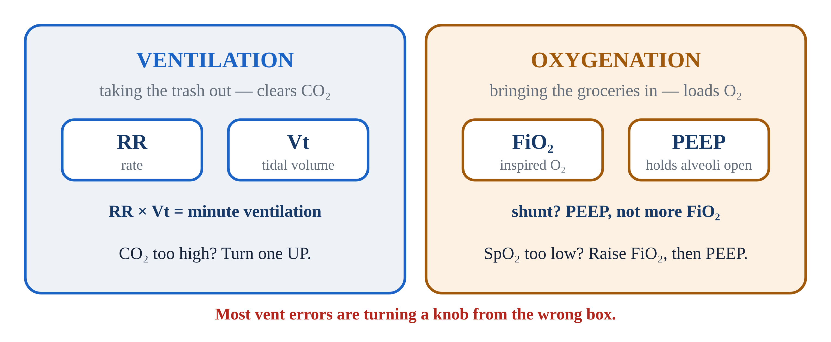
1.3 · The Mental Model
1.3
Ventilation vs Oxygenation — Two Knobs Each
This is the single most useful mental model in mechanical ventilation — memorize it now. Picture the lung as a house with two completely separate chores, each with its own set of controls.
Ventilation is taking out the trash — clearing CO₂. You run it with two knobs: Respiratory Rate (RR) and Tidal Volume (Vt) — how often the trash goes out and how big each load is.
Oxygenation is bringing in the groceries — loading O₂ across the alveolar membrane into the blood.
Most ventilator errors are turning the wrong knob — bumping FiO₂ to fix a rising CO₂, or cranking the rate to fix a low saturation. Pair them in your head: RR + Vt for ventilation, FiO₂ + PEEP for oxygenation.
Notes:
This is the single most useful mental model in mechanical ventilation — memorize it now. Picture the lung as a house with two completely separate chores, each with its own set of controls. Confusing the two is the most common ventilator mistake there is. Ventilation is taking out the trash — clearing CO₂. You run it with two knobs: Respiratory Rate (RR) and Tidal Volume (Vt) — how often the trash goes out and how big each load is. Their product is Minute Ventilation. PaCO₂ too high? Turn one up. Too low? Turn one down. Oxygenation is bringing in the groceries — loading O₂ across the alveolar membrane into the blood. It runs on two different knobs: FiO₂ (how oxygen-rich the incoming air is) and PEEP (the pressure that holds alveoli open at end-expiration). SpO₂ too low? Raise FiO₂ first, then PEEP if you suspect shunt physiology. Running the trash out more often will never restock the fridge. Most ventilator errors are turning the wrong knob — bumping FiO₂ to fix a rising CO₂, or cranking the rate to fix a low saturation. Pair them in your head: RR + Vt for ventilation, FiO₂ + PEEP for oxygenation. Trash and groceries — two chores, two sets of knobs. PEARL — Two knobs each: Ventilation = RR + Vt. Oxygenation = FiO₂ + PEEP. On the final exam. At every bedside for the rest of your career.

Slide 8
1.4 · Dead Space
1.4
Air That Doesn't Help You
Every breath is like mailing a package down a long hallway to a room at the far end. The hallway holds air but does no gas exchange — anything that never reaches the room is wasted effort.
Anatomic dead space is the volume of the conducting airways: approximately 2 mL per kilogram of body weight.
Total physiologic dead space is normally about 30% of tidal volume in a healthy adult. A study by Nuckton and colleagues (NEJM 2002) showed that VD/VT greater than 0.6 in ARDS strongly predicts mortality.
The practical bedside implication: tidal volume must be large enough to overcome dead space. Set Vt too low and the whole breath gets stuck in the hallway — dead space eats it before any reaches the room.
Notes:
Every breath is like mailing a package down a long hallway to a room at the far end. The hallway holds air but does no gas exchange — anything that never reaches the room is wasted effort. That wasted volume is dead space: the part of every breath that does not participate in gas exchange. It comes in three kinds. Anatomic dead space is the volume of the conducting airways: approximately 2 mL per kilogram of body weight. Alveolar dead space is the volume of alveoli that are ventilated but not perfused — for example, downstream of a pulmonary embolism. Equipment dead space is the volume of the vent circuit between the ETT tip and the Y-piece — up to 80 to 90 mL on an adult circuit. Total physiologic dead space is normally about 30% of tidal volume in a healthy adult. A study by Nuckton and colleagues (NEJM 2002) showed that VD/VT greater than 0.6 in ARDS strongly predicts mortality. The practical bedside implication: tidal volume must be large enough to overcome dead space. Set Vt too low and the whole breath gets stuck in the hallway — dead space eats it before any reaches the room. Aim for 6–8 mL per kg of ideal body weight in most adults; 4–6 mL/kg IBW in ARDS.

Slide 9
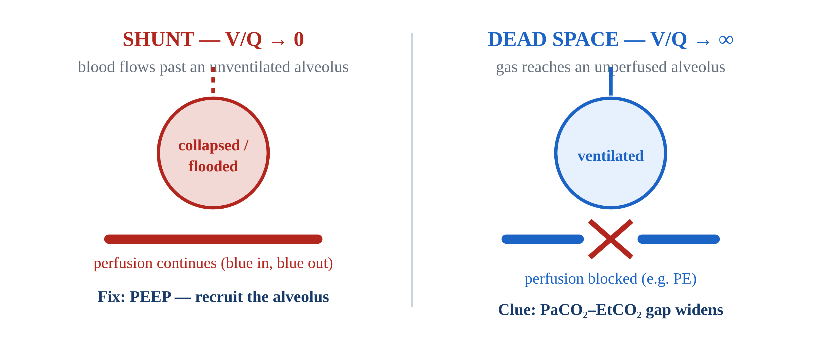
1.5 · V/Q Matching
1.5
Shunt vs Dead Space
Picture a bus line where the buses are air and the passengers are blood. Gas exchange only happens where a bus and its passengers actually meet.
Shunt is passengers crowding a stop the bus skips entirely — perfusion with no ventilation, V/Q approaching zero. Pneumonia, pulmonary edema, ARDS, and atelectasis all produce shunt.
Dead space is the mirror image: a bus running its full route past empty stops — ventilation with no perfusion. Pulmonary embolism, low cardiac output, and severe hypovolemia produce dead-space physiology.
Hypoxic Pulmonary Vasoconstriction (HPV) is a partial auto-correction: the lung constricts arterioles in poorly ventilated regions, diverting blood toward better-ventilated alveoli.
Notes:
Picture a bus line where the buses are air and the passengers are blood. Gas exchange only happens where a bus and its passengers actually meet. That match-up is V/Q, and disease breaks it in one of two opposite directions. Shunt is passengers crowding a stop the bus skips entirely — perfusion with no ventilation, V/Q approaching zero. Pneumonia, pulmonary edema, ARDS, and atelectasis all produce shunt. The hallmark is refractory hypoxia: you can send more buses (crank FiO₂ to 100%) but they keep driving past the skipped stop, so saturation barely moves. The bedside fix is PEEP, which re-opens the stop — recruiting collapsed alveoli so the bus can finally pick those passengers up. Dead space is the mirror image: a bus running its full route past empty stops — ventilation with no perfusion. Pulmonary embolism, low cardiac output, and severe hypovolemia produce dead-space physiology. The hallmark is a widening gap between PaCO₂ and EtCO₂: those empty-stop alveoli exhale air carrying almost no CO₂. The fix is getting passengers back to the stops — improving perfusion with fluids, pressors, or treating the embolism. Hypoxic Pulmonary Vasoconstriction (HPV) is a partial auto-correction: the lung constricts arterioles in poorly ventilated regions, diverting blood toward better-ventilated alveoli. HPV is incomplete; in significant disease, it is not enough. PEARL — FiO₂ alone won't fix shunt: If a patient on a non-rebreather at flush rate is still hypoxic, suspect shunt. The bedside fix is PEEP, often via CPAP.

Slide 10
1.6 · Compliance vs Resistance
1.6
How the Lung Pushes Back
Imagine blowing up a balloon through a straw — two completely separate things can make it hard. The first is the balloon's stiffness. That is compliance: how much volume the lung accepts for a given pressure.
The second is the straw's narrowness. That is resistance: how hard the airway pushes back against airflow.
Both can raise PIP on the ventilator — but only reduced compliance raises Pplat. That distinction is the foundation of bedside troubleshooting and the subject of the next lesson.
Notes:
Imagine blowing up a balloon through a straw — two completely separate things can make it hard. The first is the balloon's stiffness. That is compliance: how much volume the lung accepts for a given pressure. A brand-new, stiff balloon (the ARDS lung) fights every breath; a worn-in one gives easily. Normal adult static compliance is 60–100 mL per cmH₂O; ARDS can drop it to 20–30 — a very stiff balloon. The second is the straw's narrowness. That is resistance: how hard the airway pushes back against airflow. Pinch the straw — bronchospasm, a mucus plug, a kinked tube — and you must push far harder for the same airflow. Normal airway resistance is 1–2 cmH₂O per liter per second; severe asthma can push it to 15–20. Both can raise PIP on the ventilator — but only reduced compliance raises Pplat. That distinction is the foundation of bedside troubleshooting and the subject of the next lesson.

Slide 11
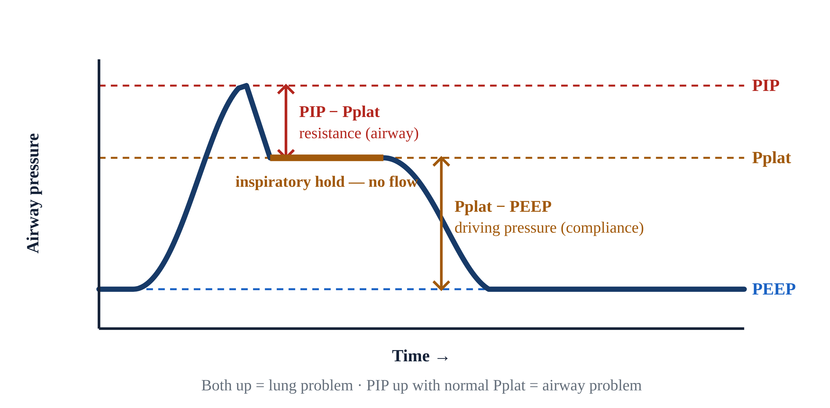
1.7 · The Bedside Test
1.7
PIP vs Pplat
Picture pushing water through a hose that has a narrow nozzle (the airways) and a balloon on the end (the alveoli).
The relationship is mechanical: PIP is approximately Pplat plus (Resistance × Flow). Clog the nozzle and resistance rises — PIP climbs but Pplat does not. Stiffen the balloon and both rise together.
Bedside interpretation: High PIP + normal Pplat means an AIRWAY problem (resistance) — mucus plug, biting on the tube, bronchospasm, kinked tube.
Driving pressure (Pplat minus PEEP) has emerged as a strong mortality predictor in ARDS (Amato 2015, NEJM). Aim for ΔP less than 14 cmH₂O. You'll use this rule in Module 4 and again in Module 9.
Notes:
Picture pushing water through a hose that has a narrow nozzle (the airways) and a balloon on the end (the alveoli). Peak Inspiratory Pressure (PIP) is the pressure while water is still flowing — it includes the squeeze through the nozzle. Hit the inspiratory hold (about 0.5 seconds, no flow) and you feel only the balloon's stretch: that is Plateau Pressure (Pplat), which reflects alveolar pressure — a measure of compliance. The relationship is mechanical: PIP is approximately Pplat plus (Resistance × Flow). Clog the nozzle and resistance rises — PIP climbs but Pplat does not. Stiffen the balloon and both rise together. Bedside interpretation: High PIP + normal Pplat means an AIRWAY problem (resistance) — mucus plug, biting on the tube, bronchospasm, kinked tube. High PIP + high Pplat means a LUNG problem (compliance) — pneumothorax, mainstem migration, worsening ARDS, pulmonary edema. Driving pressure (Pplat minus PEEP) has emerged as a strong mortality predictor in ARDS (Amato 2015, NEJM). Aim for ΔP less than 14 cmH₂O. You'll use this rule in Module 4 and again in Module 9. PEARL — PIP up, Pplat up?: Both up = lung problem. PIP up but Pplat normal = airway problem. The bedside test takes 3 seconds — press the inspiratory hold button.

Slide 12
Now put it to work
Hand off to learner devices — cues match your facilitator guide.
QUIZ
Knowledge Check
10 questions · pass 8/10 to unlock the next module
MATCH
Match the Knobs
4 items · Ventilation knobs · Oxygenation knobs · must be perfect
CASE
He's still breathing — but he's getting tired
4-decision branching scenario · 65-year-old male, 80 kg, long-standing COPD on home O₂
SIM
LTV 1200 Simulator
vent-ltv1200.html?level=1 — Meet the LTV 1200 hands-on — the Level 1 tutorial builds every control from scratch…
Notes:
Transition slide: send learners to the app for this module's quiz, match, scenario, then the simulator mission. Keep the cohort together; modules unlock in sequence.

Slide 13
Carry this out the door
✓
ETT depth at the lip 21 cm in women, 23 cm in men. Confirm with capnography and equal breath sounds after every patient transition — loading, lifting, elevator, gurney…
✓
Two knobs each Ventilation = RR + Vt. Oxygenation = FiO₂ + PEEP. On the final exam. At every bedside for the rest of your career.
✓
FiO₂ alone won't fix shunt If a patient on a non-rebreather at flush rate is still hypoxic, suspect shunt. The bedside fix is PEEP, often via CPAP.
✓
PIP up, Pplat up? Both up = lung problem. PIP up but Pplat normal = airway problem. The bedside test takes 3 seconds — press the inspiratory hold button.
Next: Module 2
Notes:
Recap the module pearls, then transition.

Slide 14
2
VENTILATOR TRAINING ACADEMY
Module 2
Recognizing Respiratory Failure
Call it before the patient calls it. Type I vs Type II, the SpO₂/PaO₂ cliff, capnography waveforms, and the pre-arrest signs everyone misses.
Foundations · 7 lessons
Jordan Hunter Jones, NRP · Course Director
Notes:
Module 2: Recognizing Respiratory Failure. Call it before the patient calls it. Type I vs Type II, the SpO₂/PaO₂ cliff, capnography waveforms, and the pre-arrest signs everyone misses.

Slide 15
In this module
2.1
Definitions What Respiratory Failure Means
2.5
Recognition Early Signs, Late Signs, and the False Calm
2.2
The Oxyhemoglobin Curve Why SpO₂ Lies — Until It Doesn't
2.6
Capnography EtCO₂ — The Earliest Number You Have
2.3
Type I Hypoxic Failure at the Bedside
2.7
Waveforms Four Capnography Patterns Every EMS Provider Must Recognize
2.4
Type II Hypercapnic Failure at the Bedside
Then:
Knowledge Check
Match
Scenario
Simulator
Notes:
Roadmap of the module. Teach the lessons in order, then run the four interactive components on learner devices.

Slide 16
2.1 · Definitions
2.1
What Respiratory Failure Means
Acute respiratory failure is defined by gas-exchange criteria. Type I, hypoxic respiratory failure, is PaO₂ less than 60 mmHg on room air.
Type II, hypercapnic respiratory failure, is PaCO₂ greater than 50 mmHg accompanied by a pH less than 7.35.
Mixed failure (Type I + Type II) is common: pneumonia in a COPD patient, ARDS with respiratory fatigue. Treat what you see.
CLINICAL PEARL
ABGs in EMS
We rarely have an arterial blood gas prehospital. Clinical signs + EtCO₂ + SpO₂ support recognition and let you act early — but they do NOT replace an ABG. The PaCO₂–EtCO₂ gap widens with shock and V/Q mismatch, so EtCO₂ can under-read a rising PaCO₂. Treat on the clinical picture; confirm gas…
Notes:
Acute respiratory failure is defined by gas-exchange criteria. Type I, hypoxic respiratory failure, is PaO₂ less than 60 mmHg on room air. The CO₂ is typically normal or low because the patient is hyperventilating in compensation. Common causes: pneumonia, acute pulmonary edema, ARDS, pulmonary embolism, pulmonary contusion. Type II, hypercapnic respiratory failure, is PaCO₂ greater than 50 mmHg accompanied by a pH less than 7.35. The pH requirement matters because chronic CO₂ retainers (stable COPD, for example) live with PaCO₂ in the 60s while their kidneys retain bicarbonate, keeping pH near normal. An acute rise in CO₂ has no time to compensate — pH crashes, and that acidosis defines the failure. Mixed failure (Type I + Type II) is common: pneumonia in a COPD patient, ARDS with respiratory fatigue. Treat what you see. PEARL — ABGs in EMS: We rarely have an arterial blood gas prehospital. Clinical signs + EtCO₂ + SpO₂ support recognition and let you act early — but they do NOT replace an ABG. The PaCO₂–EtCO₂ gap widens with shock and V/Q mismatch, so EtCO₂ can under-read a rising PaCO₂. Treat on the clinical picture; confirm gas exchange with an ABG when available.

Slide 17
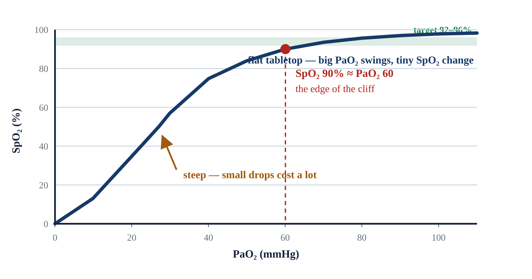
2.2 · The Oxyhemoglobin Curve
2.2
Why SpO₂ Lies — Until It Doesn't
Pulse oximetry is not linear — the SpO₂/PaO₂ relationship is an S-shaped curve, and that shape is a flat tabletop that ends at a cliff.
SpO₂ 100% → PaO₂ ≥ 100 mmHg (the curve is flat on top — very different PaO₂ values produce the same saturation).
SpO₂ 95% → PaO₂ ≈ 80 mmHg. SpO₂ 90% → PaO₂ ≈ 60 mmHg — the edge of the cliff and the threshold for Type I respiratory failure.
SpO₂ 80% → PaO₂ ≈ 45 mmHg. SpO₂ 70% → PaO₂ ≈ 38 mmHg — minutes from arrest in most adults.
Practical implication: aim for SpO₂ 92–96%. High enough to be off the cliff, low enough to detect deterioration. Targeting 100% does the patient no good and wastes oxygen reserves.
Notes:
Pulse oximetry is not linear — the SpO₂/PaO₂ relationship is an S-shaped curve, and that shape is a flat tabletop that ends at a cliff. Stroll along the top and big swings in PaO₂ barely move the saturation; step off the edge near 90% and you drop fast. SpO₂ 100% → PaO₂ ≥ 100 mmHg (the curve is flat on top — very different PaO₂ values produce the same saturation). SpO₂ 95% → PaO₂ ≈ 80 mmHg. SpO₂ 90% → PaO₂ ≈ 60 mmHg — the edge of the cliff and the threshold for Type I respiratory failure. SpO₂ 80% → PaO₂ ≈ 45 mmHg. SpO₂ 70% → PaO₂ ≈ 38 mmHg — minutes from arrest in most adults. Practical implication: aim for SpO₂ 92–96%. High enough to be off the cliff, low enough to detect deterioration. Targeting 100% does the patient no good and wastes oxygen reserves. EVIDENCE — Hyperoxia after ROSC: Multiple observational studies show worse neurologic outcomes in cardiac arrest survivors maintained at PaO₂ > 300 mmHg post-arrest. AHA recommends titrating FiO₂ to SpO₂ 90–98% post-ROSC (2025 AHA update; the prior target was 92–98%).

Slide 18
2.3 · Type I
2.3
Hypoxic Failure at the Bedside
Hypoxic failure presents first as work-of-breathing changes. Tachypnea. Accessory muscle use — sternocleidomastoid, retractions, nasal flaring, tripoding (sitting up with hands braced on knees).
Mental status is often well-preserved in early Type I failure. Hypoxia stimulates ventilation through peripheral chemoreceptors but produces less mental status change than rising CO₂.
Bedside test for shunt physiology: apply 100% FiO₂ via non-rebreather at flush rate and watch what happens to the saturation. A patient with diffusion-mediated hypoxia improves quickly.
Notes:
Hypoxic failure presents first as work-of-breathing changes. Tachypnea. Accessory muscle use — sternocleidomastoid, retractions, nasal flaring, tripoding (sitting up with hands braced on knees). Speech becomes broken into short phrases or single words. Skin: pale, mottled, or diaphoretic. Central cyanosis (blue lips and tongue) requires at least 5 g/dL of deoxygenated hemoglobin to be visible — a LATE sign. Mental status is often well-preserved in early Type I failure. Hypoxia stimulates ventilation through peripheral chemoreceptors but produces less mental status change than rising CO₂. A patient with a sat in the low 80s who is alert and oriented is not unusual in early pneumonia or pulmonary edema. Bedside test for shunt physiology: apply 100% FiO₂ via non-rebreather at flush rate and watch what happens to the saturation. A patient with diffusion-mediated hypoxia improves quickly. A patient with significant shunt does not — they need PEEP, not just more O₂. In an awake cooperative patient, that means CPAP.

Slide 19
2.4 · Type II
2.4
Hypercapnic Failure at the Bedside
Hypercapnic failure is more deceptive, because a tiring pump goes quiet, not loud. A patient retaining CO₂ may look comfortable while the partial pressure climbs — respiratory rate normal or even slowing.
Mental status correlates with the RATE of CO₂ rise rather than the absolute number. A chronic retainer at PaCO₂ 70 may be cognitively intact; an acute climb to the same value produces somnolence.
Common scenarios: the COPD patient who tires after a week of escalating bronchospasm; the severe asthmatic whose minute ventilation drops to the point of quiet chest; the opioid-overdosed patient with…
CLINICAL PEARL
Quiet chest in asthma
Wheeze means air is moving. A severe asthmatic who stops wheezing has stopped moving air. Silent chest in a previously wheezy patient is a pre-arrest sign. Bag immediately and prepare to intubate.
Notes:
Hypercapnic failure is more deceptive, because a tiring pump goes quiet, not loud. A patient retaining CO₂ may look comfortable while the partial pressure climbs — respiratory rate normal or even slowing. By the time CO₂ is high enough to affect mental status, the patient is already in trouble. Mental status correlates with the RATE of CO₂ rise rather than the absolute number. A chronic retainer at PaCO₂ 70 may be cognitively intact; an acute climb to the same value produces somnolence. As PaCO₂ rises into the 80s and 90s, the patient becomes increasingly difficult to arouse — CO₂ narcosis. Common scenarios: the COPD patient who tires after a week of escalating bronchospasm; the severe asthmatic whose minute ventilation drops to the point of quiet chest; the opioid-overdosed patient with bradypnea and miosis; the neuromuscular patient whose respiratory muscles can no longer keep pace. PEARL — Quiet chest in asthma: Wheeze means air is moving. A severe asthmatic who stops wheezing has stopped moving air. Silent chest in a previously wheezy patient is a pre-arrest sign. Bag immediately and prepare to intubate.

Slide 20
2.5 · Recognition
2.5
Early Signs, Late Signs, and the False Calm
Early signs of respiratory failure are predictable. Tachypnea is the earliest. Speech shortens. Patients tripod. Accessory muscles recruit. Skin becomes diaphoretic. The patient is often anxious or restless.
Late signs are subtle and dangerous. The previously tachypneic patient becomes quiet. RR drops. HR, which had been elevated, begins to fall.
Some call this the calm before the storm. It is pre-arrest. The patient has run out of compensatory reserve.
Notes:
Early signs of respiratory failure are predictable. Tachypnea is the earliest. Speech shortens. Patients tripod. Accessory muscles recruit. Skin becomes diaphoretic. The patient is often anxious or restless. Recognize these and you have time for non-invasive support. Late signs are subtle and dangerous. The previously tachypneic patient becomes quiet. RR drops. HR, which had been elevated, begins to fall. Accessory muscle use disappears — not because the patient is better but because they are exhausted. Cyanosis becomes obvious. Mental status declines. Some call this the calm before the storm. It is pre-arrest. The patient has run out of compensatory reserve. Capnography is your most reliable warning: a steadily climbing EtCO₂ over five minutes is a fatigue alarm. A waveform that suddenly disappears tells you the tube is out, the patient is in arrest, or perfusion has collapsed.

Slide 21
2.6 · Capnography
2.6
EtCO₂ — The Earliest Number You Have
EtCO₂ is the partial pressure of CO₂ measured at the end of exhalation. In a healthy patient, EtCO₂ runs 2 to 5 mmHg lower than PaCO₂.
Normal adult EtCO₂ is 35 to 45 mmHg. A rising trend over several minutes in a non-intubated patient suggests fatigue.
Capnography has an underappreciated role in CPR. AHA recommends continuous waveform capnography during resuscitation.
Notes:
EtCO₂ is the partial pressure of CO₂ measured at the end of exhalation. In a healthy patient, EtCO₂ runs 2 to 5 mmHg lower than PaCO₂. The gradient widens whenever V/Q mismatch increases — for example, pulmonary embolism, low cardiac output, significant pulmonary disease. A widening EtCO₂–PaCO₂ gradient in a vented patient suggests rising physiologic dead space. Normal adult EtCO₂ is 35 to 45 mmHg. A rising trend over several minutes in a non-intubated patient suggests fatigue. A sudden drop to zero or near-zero in an intubated patient is one of four things: tube dislodgement, complete tube obstruction, cardiac arrest, or massive PE. All four require immediate action. Capnography has an underappreciated role in CPR. AHA recommends continuous waveform capnography during resuscitation. EtCO₂ persistently below 10 mmHg during compressions suggests inadequate compressions or that ROSC is unlikely. A sudden rise in EtCO₂ from 10 to 40+ during ongoing compressions is the most specific sign of ROSC — often before any palpable pulse change.

Slide 22
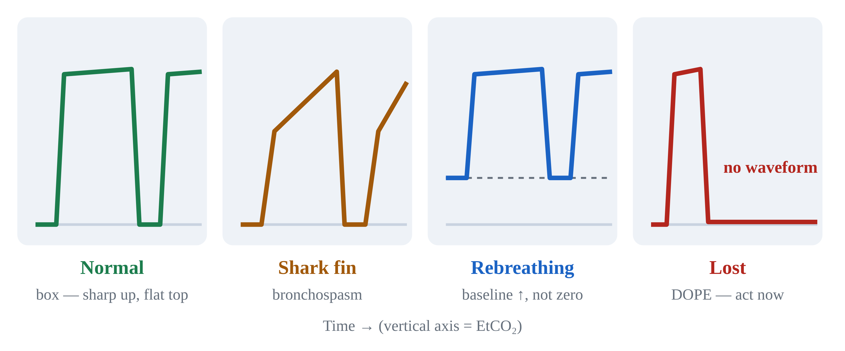
2.7 · Waveforms
2.7
Four Capnography Patterns Every EMS Provider Must Recognize
Normal: a box-like waveform. Sharp upstroke, flat plateau at the EtCO₂ value, sharp drop as the next inspiration begins.
Shark fin: the upstroke is sloped rather than sharp. This is the most specific bedside sign of bronchospasm — asthma, COPD exacerbation, anaphylaxis.
Rebreathing: the baseline is elevated rather than returning to zero between breaths. Common causes: a non-fitted NIV mask seal, an exhausted CO₂ absorber, or a kinked one-way valve.
Lost waveform: sudden drop to near zero. DOPE algorithm time — dislodgement, obstruction, pneumothorax, equipment. We cover this in Module 7.
Notes:
Normal: a box-like waveform. Sharp upstroke, flat plateau at the EtCO₂ value, sharp drop as the next inspiration begins. Shark fin: the upstroke is sloped rather than sharp. This is the most specific bedside sign of bronchospasm — asthma, COPD exacerbation, anaphylaxis. The slope correlates with severity; the steeper the slope, the more obstruction. Rebreathing: the baseline is elevated rather than returning to zero between breaths. Common causes: a non-fitted NIV mask seal, an exhausted CO₂ absorber, or a kinked one-way valve. Patient is re-inhaling exhaled CO₂. Lost waveform: sudden drop to near zero. DOPE algorithm time — dislodgement, obstruction, pneumothorax, equipment. We cover this in Module 7. PEARL — Shark fin = bronchospasm: If a vented patient's waveform turns shark-fin, treat the obstruction (bronchodilator, extended exhalation time). Don't chase the EtCO₂ number.

Slide 23
Now put it to work
Hand off to learner devices — cues match your facilitator guide.
QUIZ
Knowledge Check
10 questions · pass 8/10 to unlock the next module
MATCH
Type I or Type II?
6 items · Type I — Hypoxic · Type II — Hypercapnic · must be perfect
CASE
She was talking to me a minute ago
4-decision branching scenario · 42-year-old female, 70 kg, severe asthma, multiple prior intubations
SIM
LTV 1200 Simulator
vent-ltv1200.html?scenario=failure-type — Name the failure type from the monitor, then treat it — oxygenation vs ventilation.
Notes:
Transition slide: send learners to the app for this module's quiz, match, scenario, then the simulator mission. Keep the cohort together; modules unlock in sequence.

Slide 24
Carry this out the door
✓
ABGs in EMS We rarely have an arterial blood gas prehospital. Clinical signs + EtCO₂ + SpO₂ support recognition and let you act early — but they do NOT replace…
✓
Quiet chest in asthma Wheeze means air is moving. A severe asthmatic who stops wheezing has stopped moving air. Silent chest in a previously wheezy patient is a…
✓
Shark fin = bronchospasm If a vented patient's waveform turns shark-fin, treat the obstruction (bronchodilator, extended exhalation time). Don't chase the EtCO₂ number.
Next: Module 3
Notes:
Recap the module pearls, then transition.

Slide 25
3
VENTILATOR TRAINING ACADEMY
Module 3
Indications for Ventilatory Support
Pick the right level of support — first time. CPAP for CHF. BiPAP for COPD. Invasive for failure. The evidence behind each and the contraindications that must not be missed.
Foundations · 6 lessons
Jordan Hunter Jones, NRP · Course Director
Notes:
Module 3: Indications for Ventilatory Support. Pick the right level of support — first time. CPAP for CHF. BiPAP for COPD. Invasive for failure. The evidence behind each and the contraindications that must not be missed.

Slide 26
In this module
3.1
NIV Indications When Non-Invasive Ventilation Is the Right Tool
3.4
Contraindications When NIV Is the WRONG Tool
3.2
The Two Flavors CPAP vs BiPAP
3.5
Invasive Indications for Endotracheal Intubation
3.3
Titration How to Make NIV Work — and Recognize When It Doesn't
3.6
Pre-Oxygenation Buying Yourself Eight Minutes
Then:
Knowledge Check
Match
Scenario
Simulator
Notes:
Roadmap of the module. Teach the lessons in order, then run the four interactive components on learner devices.

Slide 27
3.1 · NIV Indications
3.1
When Non-Invasive Ventilation Is the Right Tool
Non-invasive ventilation (NIV) delivers positive-pressure ventilation through a tightly-fitting mask rather than an endotracheal tube.
For acute pulmonary edema, the foundational evidence is Bersten et al. (NEJM 1991): 39 patients randomized to CPAP vs standard oxygen. Intubation rate dropped from 35% to 0% in the CPAP arm.
For COPD exacerbation with hypercapnia, Brochard et al. (NEJM 1995) randomized 85 patients to BiPAP vs standard care. Intubation: 26% vs 74%. Mortality: 9% vs 29%.
EVIDENCE
Strong evidence
CPAP for CHF and BiPAP for COPD-with-hypercapnia are among the most evidence-based EMS interventions. Level I evidence. If your service doesn't carry NIV, advocate for it.
Notes:
Non-invasive ventilation (NIV) delivers positive-pressure ventilation through a tightly-fitting mask rather than an endotracheal tube. In EMS, two indications dominate: acute cardiogenic pulmonary edema (treated with CPAP) and acute COPD exacerbation with hypercapnia (treated with BiPAP). For acute pulmonary edema, the foundational evidence is Bersten et al. (NEJM 1991): 39 patients randomized to CPAP vs standard oxygen. Intubation rate dropped from 35% to 0% in the CPAP arm. A 2013 Cochrane review pooling more than 30 trials confirmed NIV reduces hospital mortality and intubation in cardiogenic pulmonary edema, with NNT roughly 4 to 7 to prevent one intubation. For COPD exacerbation with hypercapnia, Brochard et al. (NEJM 1995) randomized 85 patients to BiPAP vs standard care. Intubation: 26% vs 74%. Mortality: 9% vs 29%. Cochrane meta-analyses confirm approximately a 50% relative reduction in both intubation and mortality. EVIDENCE — Strong evidence: CPAP for CHF and BiPAP for COPD-with-hypercapnia are among the most evidence-based EMS interventions. Level I evidence. If your service doesn't carry NIV, advocate for it.

Slide 28
3.2 · The Two Flavors
3.2
CPAP vs BiPAP
Continuous Positive Airway Pressure (CPAP) is one steady pressure the whole cycle long — a doorstop wedged under the airway, holding it open the same amount whether the patient breathes in or out.
Bilevel Positive Airway Pressure (BiPAP) adds a second, higher pressure on inspiration — like a spotter at the bench press who shoves the bar up each time you push and eases off as you lower it.
Typical starting settings: CPAP at 5 to 10 cmH₂O with FiO₂ 100% initially, weaned. BiPAP at IPAP 10 / EPAP 5, FiO₂ titrated. Both require a good mask seal. Sit the patient up.
Notes:
Continuous Positive Airway Pressure (CPAP) is one steady pressure the whole cycle long — a doorstop wedged under the airway, holding it open the same amount whether the patient breathes in or out. The patient does all the breathing work; the machine just holds the baseline. In CHF, that baseline pushes alveolar fluid back into the capillaries, drops preload (by raising intrathoracic pressure), and reduces LV afterload. The combined effect is often dramatic. Bilevel Positive Airway Pressure (BiPAP) adds a second, higher pressure on inspiration — like a spotter at the bench press who shoves the bar up each time you push and eases off as you lower it. The two pressures are IPAP (inspiratory) and EPAP (expiratory); their difference is the pressure support delivered with each breath. EPAP is the doorstop (it behaves like PEEP — holding alveoli open and overcoming auto-PEEP); IPAP is the spotter's shove, unloading the tired diaphragm. In COPD with hypercapnia, EPAP overcomes auto-PEEP while IPAP supports the diaphragm long enough for the patient to catch up. Typical starting settings: CPAP at 5 to 10 cmH₂O with FiO₂ 100% initially, weaned. BiPAP at IPAP 10 / EPAP 5, FiO₂ titrated. Both require a good mask seal. Sit the patient up. Coach them to breathe with the machine.

Slide 29
3.3 · Titration
3.3
How to Make NIV Work — and Recognize When It Doesn't
NIV that is going to work shows signs of working within minutes. Improvement: falling respiratory rate, rising saturation, lengthening of speech, softening accessory muscle use, normalizing EtCO₂ trend.
NIV that is not going to work also declares itself early. Persistent or rising RR, no change in saturation, declining mental status, vomiting, inability to tolerate the mask are all signs of failure.
Apply the 1-hour rule. If the patient has been on NIV for 60 minutes without clear improvement, escalate to invasive ventilation.
CLINICAL PEARL
Sit them up
Upright posture (head of bed 30°+) improves functional residual capacity and reduces work of breathing. Always sit your NIV and your pre-RSI patients up.
Notes:
NIV that is going to work shows signs of working within minutes. Improvement: falling respiratory rate, rising saturation, lengthening of speech, softening accessory muscle use, normalizing EtCO₂ trend. Vital signs should improve in 5 to 15 minutes. Mental status improves in parallel. NIV that is not going to work also declares itself early. Persistent or rising RR, no change in saturation, declining mental status, vomiting, inability to tolerate the mask are all signs of failure. Apply the 1-hour rule. If the patient has been on NIV for 60 minutes without clear improvement, escalate to invasive ventilation. Continuing in a non-improving patient delays intubation under increasingly poor conditions — by the time the team gives up, the patient is often hypoxic, hypotensive, and exhausted. PEARL — Sit them up: Upright posture (head of bed 30°+) improves functional residual capacity and reduces work of breathing. Always sit your NIV and your pre-RSI patients up.

Slide 30
3.4 · Contraindications
3.4
When NIV Is the WRONG Tool
ABSOLUTE contraindications must be respected.
Inability to protect the airway — GCS ≤ 8, no gag, active vomiting, copious secretions. NIV in such a patient is a comfortable way to deliver gastric contents into the lung.
Facial trauma or severe deformity preventing mask seal.
Hemodynamic instability or peri-arrest state. The time required to set up NIV is wasted on a patient who needs definitive airway control.
Pneumothorax (until decompressed). Positive pressure can tension a small PTX into a fatal one.
CLINICAL PEARL
Vomiting on NIV
If a patient on NIV begins to vomit, remove the mask immediately, suction aggressively, and prepare to secure the airway. Most protocols treat any vomiting episode as an absolute contraindication going forward.
Notes:
ABSOLUTE contraindications must be respected. 1. Inability to protect the airway — GCS ≤ 8, no gag, active vomiting, copious secretions. NIV in such a patient is a comfortable way to deliver gastric contents into the lung. 2. Facial trauma or severe deformity preventing mask seal. 3. Hemodynamic instability or peri-arrest state. The time required to set up NIV is wasted on a patient who needs definitive airway control. 4. Pneumothorax (until decompressed). Positive pressure can tension a small PTX into a fatal one. 5. Cardiac or respiratory arrest. Bag-mask ventilation and intubation are the only acceptable options. When in doubt: secure the airway. PEARL — Vomiting on NIV: If a patient on NIV begins to vomit, remove the mask immediately, suction aggressively, and prepare to secure the airway. Most protocols treat any vomiting episode as an absolute contraindication going forward.

Slide 31
3.5 · Invasive
3.5
Indications for Endotracheal Intubation
Move to invasive mechanical ventilation when:
NIV is failing after a fair trial (typically 30 to 60 minutes; maximum 2 hours).
GCS ≤ 8 or unable to protect airway.
Apnea or agonal respirations.
Refractory hypoxia despite high-FiO₂ NIV.
Hemodynamic instability requiring control of work of breathing.
Notes:
Move to invasive mechanical ventilation when: 1. NIV is failing after a fair trial (typically 30 to 60 minutes; maximum 2 hours). 2. GCS ≤ 8 or unable to protect airway. 3. Apnea or agonal respirations. 4. Refractory hypoxia despite high-FiO₂ NIV. 5. Hemodynamic instability requiring control of work of breathing. 6. Anticipated clinical course will deteriorate — severe burn with airway involvement, anaphylaxis with airway swelling. Prehospital RSI windows are short. Once you have paralyzed a patient, you are committed to managing the airway and the ventilator for the duration of the transport. Set up deliberately and pre-oxygenate aggressively.

Slide 32
3.6 · Pre-Oxygenation
3.6
Buying Yourself Eight Minutes
Pre-oxygenation before RSI is topping off the tank before a free-dive: you flush the nitrogen out of the lung's reservoir — the functional residual capacity (FRC) — and fill it with oxygen, so the patient can…
Standard technique: 3 minutes of tidal-volume breathing on a tight-sealed NRB at flush rate (15 L/min or higher). Alternative: 8 vital-capacity breaths.
Apneic oxygenation extends safe apnea further. A nasal cannula at 15 L/min applied during the laryngoscopy itself continues to deliver oxygen during the apneic interval.
CLINICAL PEARL
NoDESAT
Place a nasal cannula at 15 L/min on the patient during pre-oxygenation and leave it in place during laryngoscopy. The continued oxygen delivery extends safe apnea time. It is the cheapest and most effective single airway technique.
Notes:
Pre-oxygenation before RSI is topping off the tank before a free-dive: you flush the nitrogen out of the lung's reservoir — the functional residual capacity (FRC) — and fill it with oxygen, so the patient can hold that breath through the apnea of intubation far longer before desaturating. In a healthy adult with a good seal and high FiO₂, safe apnea time (before SpO₂ falls below 90%) stretches to approximately 8 minutes. With moderate disease, 3 to 5 minutes. With severe ARDS or obesity, sometimes less than 60 seconds. Standard technique: 3 minutes of tidal-volume breathing on a tight-sealed NRB at flush rate (15 L/min or higher). Alternative: 8 vital-capacity breaths. In a hypoxic patient who cannot achieve adequate pre-oxygenation by these methods, NIV (CPAP or BiPAP) for 3 to 5 minutes prior to the paralytic is the best option. Apneic oxygenation extends safe apnea further. A nasal cannula at 15 L/min applied during the laryngoscopy itself continues to deliver oxygen during the apneic interval. This technique — NoDESAT — adds several minutes of safe apnea time, particularly in obese and pediatric patients. Position the patient with the head elevated 20 to 30 degrees for both pre-oxygenation and laryngoscopy. PEARL — NoDESAT: Place a nasal cannula at 15 L/min on the patient during pre-oxygenation and leave it in place during laryngoscopy. The continued oxygen delivery extends safe apnea time. It is the cheapest and most effective single airway technique.

Slide 33
Now put it to work
Hand off to learner devices — cues match your facilitator guide.
QUIZ
Knowledge Check
10 questions · pass 8/10 to unlock the next module
MATCH
Pick the Right Support
6 items · CPAP · BiPAP · Invasive Ventilation · must be perfect
CASE
Just put a non-rebreather on her
4-decision branching scenario · 68-year-old female, 80 kg, 5'4". HFrEF, atrial fibrillation, type 2…
SIM
LTV 1200 Simulator
vent-ltv1200.html?scenario=niv-vs-tube — Make the indication call on an awake COPD patient — BiPAP trial vs the tube — then set…
Notes:
Transition slide: send learners to the app for this module's quiz, match, scenario, then the simulator mission. Keep the cohort together; modules unlock in sequence.

Slide 34
Carry this out the door
✓
Sit them up Upright posture (head of bed 30°+) improves functional residual capacity and reduces work of breathing. Always sit your NIV and your pre-RSI…
✓
Vomiting on NIV If a patient on NIV begins to vomit, remove the mask immediately, suction aggressively, and prepare to secure the airway. Most protocols treat any…
✓
NoDESAT Place a nasal cannula at 15 L/min on the patient during pre-oxygenation and leave it in place during laryngoscopy. The continued oxygen delivery…
Next: Module 4
Notes:
Recap the module pearls, then transition.

Slide 35
4
VENTILATOR TRAINING ACADEMY
Module 4
Vent Vocabulary & Initial Settings
The eight numbers every vented patient has. IBW math, the ARDSNet history, and how to defend any setting you turn.
Foundations · 6 lessons
Jordan Hunter Jones, NRP · Course Director
Notes:
Module 4: Vent Vocabulary & Initial Settings. The eight numbers every vented patient has. IBW math, the ARDSNet history, and how to defend any setting you turn.

Slide 36
In this module
4.1
Tidal Volume Vt — How Much Air Per Breath
4.4
Timing I:E Ratio
4.2
Rate Respiratory Rate & Minute Ventilation
4.5
Pressures PIP, Pplat, and Driving Pressure
4.3
Oxygenation Knobs FiO₂ and PEEP
4.6
Defaults IBW Math and Safe Initial Settings
Then:
Knowledge Check
Match
Scenario
Simulator
Notes:
Roadmap of the module. Teach the lessons in order, then run the four interactive components on learner devices.

Slide 37
4.1 · Tidal Volume
4.1
Vt — How Much Air Per Breath
Tidal volume is the volume the ventilator delivers with each mandatory breath, measured in milliliters.
Modern adult target: 6 to 8 mL per kilogram of IDEAL body weight. Lower (4 to 6 mL/kg IBW) for ARDS. Pediatric: 6 to 8 mL/kg of ACTUAL body weight.
History matters. The 1990s standard was 10 to 12 mL/kg. ARDSNet ARMA (NEJM 2000) randomized 861 ARDS patients to 12 vs 6 mL/kg IBW. Mortality dropped from 39.8% to 31.0% (NNT 11).
Too low: dead space eats the breath; CO₂ rises despite normal-looking MV. Too high: alveolar over-distention, volutrauma. Always use IBW, not actual.
EVIDENCE
ARDSNet ARMA, NEJM 2000
Randomized 861 ARDS patients to 12 mL/kg vs 6 mL/kg IBW. Mortality 39.8% vs 31.0%. NNT 11. The trial also kept Pplat < 30 and paired PEEP with FiO₂.
Notes:
Tidal volume is the volume the ventilator delivers with each mandatory breath, measured in milliliters. Modern adult target: 6 to 8 mL per kilogram of IDEAL body weight. Lower (4 to 6 mL/kg IBW) for ARDS. Pediatric: 6 to 8 mL/kg of ACTUAL body weight. History matters. The 1990s standard was 10 to 12 mL/kg. ARDSNet ARMA (NEJM 2000) randomized 861 ARDS patients to 12 vs 6 mL/kg IBW. Mortality dropped from 39.8% to 31.0% (NNT 11). One of the most evidence-based interventions in critical care. Too low: dead space eats the breath; CO₂ rises despite normal-looking MV. Too high: alveolar over-distention, volutrauma. Always use IBW, not actual. EVIDENCE — ARDSNet ARMA, NEJM 2000: Randomized 861 ARDS patients to 12 mL/kg vs 6 mL/kg IBW. Mortality 39.8% vs 31.0%. NNT 11. The trial also kept Pplat < 30 and paired PEEP with FiO₂.

Slide 38
4.2 · Rate
4.2
Respiratory Rate & Minute Ventilation
Respiratory rate is the number of mandatory breaths per minute the vent delivers. Adult initial: 12 to 16, titrated to EtCO₂ 35 to 45.
Lower (8 to 10) for asthma/COPD — let them exhale. Higher (18 to 22) in ARDS where Vt is reduced.
Minute ventilation (MV) = RR × Vt. Adult target 6 to 8 L/min. For a 70 kg IBW adult: Vt 480 mL × RR 14 = 6.7 L/min, right in range.
Set the LOW MV alarm at ~70% of expected MV. The apnea alarm fires after 20 seconds of no breath — by then the patient has been failing for a while.
Notes:
Respiratory rate is the number of mandatory breaths per minute the vent delivers. Adult initial: 12 to 16, titrated to EtCO₂ 35 to 45. Lower (8 to 10) for asthma/COPD — let them exhale. Higher (18 to 22) in ARDS where Vt is reduced. Minute ventilation (MV) = RR × Vt. Adult target 6 to 8 L/min. For a 70 kg IBW adult: Vt 480 mL × RR 14 = 6.7 L/min, right in range. Set the LOW MV alarm at ~70% of expected MV. The apnea alarm fires after 20 seconds of no breath — by then the patient has been failing for a while.

Slide 39
4.3 · Oxygenation Knobs
4.3
FiO₂ and PEEP
FiO₂ is the fraction of oxygen in the inspired gas. Range 0.21 (room air) to 1.00 (100%). Start at 100% on every fresh intubation; wean.
Target SpO₂ ≥ 92% (adult), ≥ 88% (COPD per GOLD), ≥ 94% (TBI per BTF). Hyperoxia post-ROSC worsens neurologic outcome — AHA recommends SpO₂ 90–98% after cardiac arrest (2025 update; previously 92–98%).
PEEP is the pressure remaining in airways at end-exhalation. Adult default 5 cmH₂O. ARDS uses 10–15 cmH₂O paired with FiO₂ per the ARDSNet table.
PEEP recruits collapsed alveoli — the fix for shunt physiology. It also reduces preload, which can drop BP in volume-depleted patients. Pair PEEP with FiO₂ together, not separately.
CLINICAL PEARL
FiO₂ alone won't fix shunt
Patient on 100% FiO₂ and saturation barely moves? It's a shunt. The bedside fix is PEEP — usually via CPAP in awake patients.
Notes:
FiO₂ is the fraction of oxygen in the inspired gas. Range 0.21 (room air) to 1.00 (100%). Start at 100% on every fresh intubation; wean. Target SpO₂ ≥ 92% (adult), ≥ 88% (COPD per GOLD), ≥ 94% (TBI per BTF). Hyperoxia post-ROSC worsens neurologic outcome — AHA recommends SpO₂ 90–98% after cardiac arrest (2025 update; previously 92–98%). Oxygen is a drug, not a vital sign. PEEP is the pressure remaining in airways at end-exhalation. Adult default 5 cmH₂O. ARDS uses 10–15 cmH₂O paired with FiO₂ per the ARDSNet table. PEEP recruits collapsed alveoli — the fix for shunt physiology. It also reduces preload, which can drop BP in volume-depleted patients. Pair PEEP with FiO₂ together, not separately. PEARL — FiO₂ alone won't fix shunt: Patient on 100% FiO₂ and saturation barely moves? It's a shunt. The bedside fix is PEEP — usually via CPAP in awake patients.

Slide 40
4.4 · Timing
4.4
I:E Ratio
I:E is the ratio of inspiratory time to expiratory time. Adult default is 1:2 — inspiration takes half as long as exhalation.
In obstructive disease (asthma, COPD), set 1:4 or 1:5. Let the patient exhale. Forcing the rate up traps gas (auto-PEEP), drops blood pressure, and risks barotrauma.
On the LTV: you set inspiratory TIME in seconds (typically 1.0 to 1.2 in adults). The screen calculates the I:E.
Watch the expiratory flow waveform. If it doesn't return to zero before the next breath starts, you have auto-PEEP. Slow the rate and lengthen exhalation.
Notes:
I:E is the ratio of inspiratory time to expiratory time. Adult default is 1:2 — inspiration takes half as long as exhalation. In obstructive disease (asthma, COPD), set 1:4 or 1:5. Let the patient exhale. Forcing the rate up traps gas (auto-PEEP), drops blood pressure, and risks barotrauma. On the LTV: you set inspiratory TIME in seconds (typically 1.0 to 1.2 in adults). The screen calculates the I:E. Watch the expiratory flow waveform. If it doesn't return to zero before the next breath starts, you have auto-PEEP. Slow the rate and lengthen exhalation.

Slide 41
4.5 · Pressures
4.5
PIP, Pplat, and Driving Pressure
Peak Inspiratory Pressure (PIP): highest airway pressure during inspiration. Displayed continuously. Keep < 35 cmH₂O.
Plateau Pressure (Pplat): airway pressure during a 0.5-second inspiratory hold (no flow). Reflects alveolar pressure / compliance. Keep < 30 cmH₂O — ARDSNet protocol.
Math: PIP ≈ Pplat + (Resistance × Flow). High PIP + normal Pplat = AIRWAY problem (resistance). Both high = LUNG problem (compliance).
Driving pressure (ΔP) = Pplat − PEEP. Amato et al. (NEJM 2015) reanalyzed nine ARDS RCTs and showed ΔP was the strongest mortality predictor. Each 7 cmH₂O rise increased mortality ~40%.
Notes:
Peak Inspiratory Pressure (PIP): highest airway pressure during inspiration. Displayed continuously. Keep < 35 cmH₂O. Plateau Pressure (Pplat): airway pressure during a 0.5-second inspiratory hold (no flow). Reflects alveolar pressure / compliance. Keep < 30 cmH₂O — ARDSNet protocol. Press and hold the inspiratory hold button on the LTV to measure. Math: PIP ≈ Pplat + (Resistance × Flow). High PIP + normal Pplat = AIRWAY problem (resistance). Both high = LUNG problem (compliance). Driving pressure (ΔP) = Pplat − PEEP. Amato et al. (NEJM 2015) reanalyzed nine ARDS RCTs and showed ΔP was the strongest mortality predictor. Each 7 cmH₂O rise increased mortality ~40%. Target ΔP < 14 cmH₂O in ARDS. EVIDENCE — Amato 2015 driving pressure: Pplat − PEEP < 14 cmH₂O is the modern ARDS target. Stronger mortality predictor than Vt, Pplat, or PEEP individually.

Slide 42
4.6 · Defaults
4.6
IBW Math and Safe Initial Settings
Devine IBW formulas. Men: 50 + 2.3 × (inches over 60). Women: 45.5 + 2.3 × (inches over 60).
Examples. 5'6" man: 50 + 2.3 × 6 = 63.8 kg → safe Vt 380–510 mL. 5'10" woman: 45.5 + 2.3 × 10 = 68.5 kg → safe Vt 410–548 mL.
Safe adult defaults to defend: AC/VC mode; Vt 6–8 mL/kg IBW; RR 14, titrated to EtCO₂ 35–45; FiO₂ 100% then wean; PEEP 5; I:E 1:2; alarms PIP 35, low MV 4, low PEEP 3, apnea 20 sec.
When in doubt, return to defaults. Change ONE thing at a time, reassess in 30 seconds, and document with vitals before and after.
CLINICAL PEARL
5'10" rule of thumb
IBW is sex-specific — one number won't do. By the Devine formulas a 5'10" man ≈ 73 kg (Vt 440–580 mL) and a 5'10" woman ≈ 68.5 kg (Vt 410–548 mL). Anchor to the patient's sex and height, never actual weight.
Notes:
Devine IBW formulas. Men: 50 + 2.3 × (inches over 60). Women: 45.5 + 2.3 × (inches over 60). Examples. 5'6" man: 50 + 2.3 × 6 = 63.8 kg → safe Vt 380–510 mL. 5'10" woman: 45.5 + 2.3 × 10 = 68.5 kg → safe Vt 410–548 mL. Safe adult defaults to defend: AC/VC mode; Vt 6–8 mL/kg IBW; RR 14, titrated to EtCO₂ 35–45; FiO₂ 100% then wean; PEEP 5; I:E 1:2; alarms PIP 35, low MV 4, low PEEP 3, apnea 20 sec. When in doubt, return to defaults. Change ONE thing at a time, reassess in 30 seconds, and document with vitals before and after. PEARL — 5'10" rule of thumb: IBW is sex-specific — one number won't do. By the Devine formulas a 5'10" man ≈ 73 kg (Vt 440–580 mL) and a 5'10" woman ≈ 68.5 kg (Vt 410–548 mL). Anchor to the patient's sex and height, never actual weight.

Slide 43
Now put it to work
Hand off to learner devices — cues match your facilitator guide.
QUIZ
Knowledge Check
10 questions · pass 8/10 to unlock the next module
MATCH
Set or Monitored?
8 items · Operator-Set Settings · Monitored Values · must be perfect
CASE
Just took the vent. Settings look weird.
4-decision branching scenario · 5'6" male, 250 lb actual. Just intubated for hypoxic respiratory…
SIM
LTV 1200 Simulator
vent-ltv1200.html?scenario=initial-settings — Build safe initial settings on a freshly intubated patient — Vt by IBW, PEEP, and…
Notes:
Transition slide: send learners to the app for this module's quiz, match, scenario, then the simulator mission. Keep the cohort together; modules unlock in sequence.

Slide 44
Carry this out the door
✓
FiO₂ alone won't fix shunt Patient on 100% FiO₂ and saturation barely moves? It's a shunt. The bedside fix is PEEP — usually via CPAP in awake patients.
✓
5'10" rule of thumb IBW is sex-specific — one number won't do. By the Devine formulas a 5'10" man ≈ 73 kg (Vt 440–580 mL) and a 5'10" woman ≈ 68.5 kg (Vt 410–548 mL).…
✓
Tidal Volume Vt — How Much Air Per Breath
✓
Rate Respiratory Rate & Minute Ventilation
Next: Module 5
Notes:
Recap the module pearls, then transition.

Slide 45
5
VENTILATOR TRAINING ACADEMY
Module 5
Modes of Ventilation
Volume targeted, pressure targeted, and the partnerships in between. Pick the mode the patient needs — not the mode you remember.
Foundations · 6 lessons
Jordan Hunter Jones, NRP · Course Director
Notes:
Module 5: Modes of Ventilation. Volume targeted, pressure targeted, and the partnerships in between. Pick the mode the patient needs — not the mode you remember.

Slide 46
In this module
5.1
Targeting Volume vs Pressure Targeting
5.4
NIV Modes CPAP vs BiPAP
5.2
Assist-Control What "Control" Really Means
5.5
PRVC PRVC and Newer Modes
5.3
SIMV & Pressure Support SIMV and Why It Fell Out of Favor
5.6
Synchrony Trigger Sensitivity & Inspiratory Rise Time
Then:
Knowledge Check
Match
Scenario
Simulator
Notes:
Roadmap of the module. Teach the lessons in order, then run the four interactive components on learner devices.

Slide 47
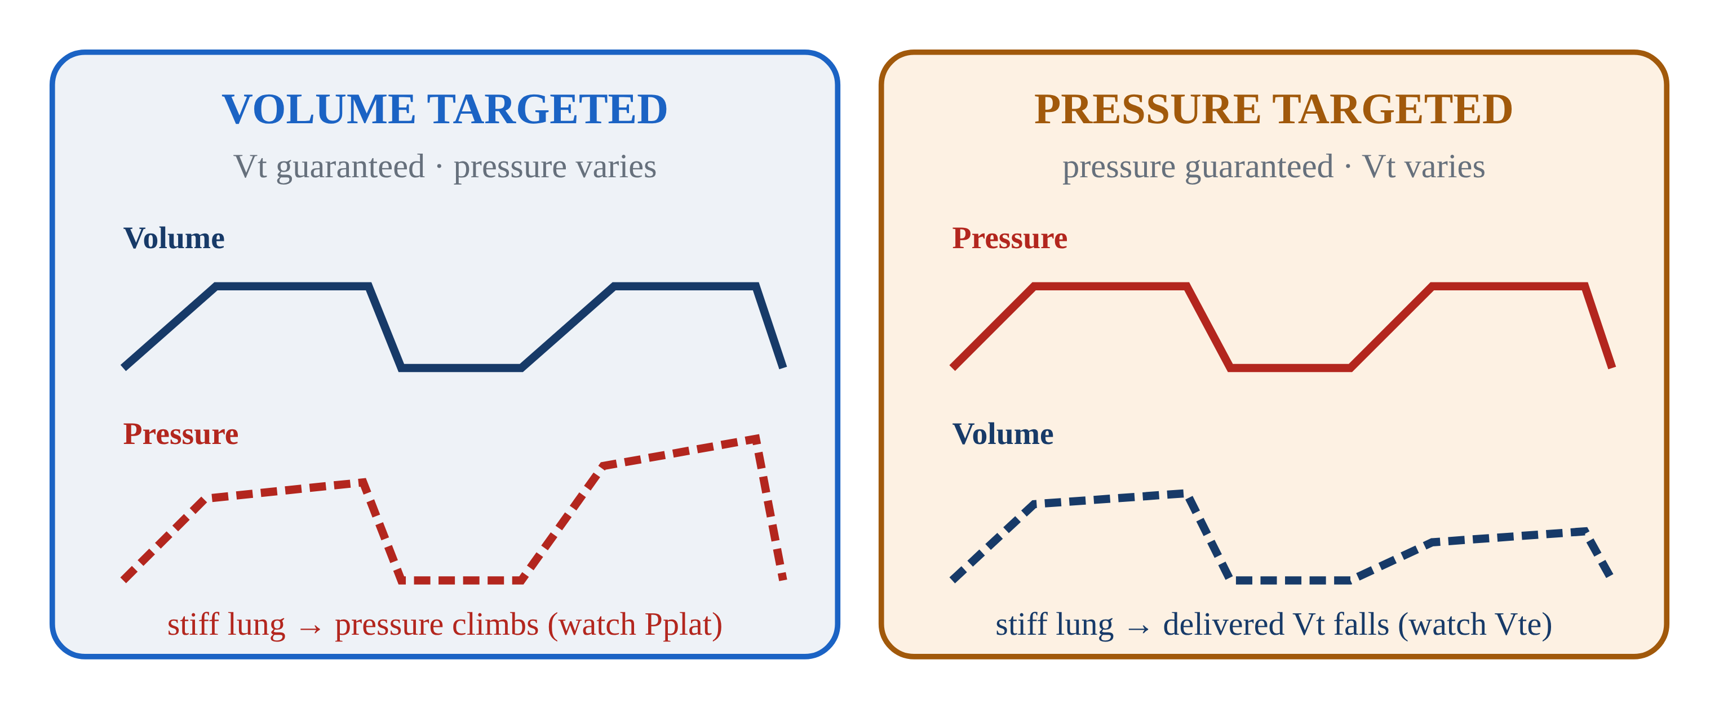
5.1 · Targeting
5.1
Volume vs Pressure Targeting
Every vent breath guarantees one thing and lets the other float — like inflating a tire: pump to a set volume of air and the pressure lands where it lands, or pump to a set pressure and the volume lands where it lands.
Volume-targeted (AC/VC): you set Vt — vent delivers it. PRESSURE varies with lung compliance. Most EMS default. Watch PIP / Pplat.
Pressure-targeted (AC/PC): you set inspiratory pressure — vent delivers it. VOLUME varies. Pressure capped, so barotrauma risk lower. Watch delivered Vt.
Trade-off: AC/VC gives predictable minute ventilation but variable pressure. AC/PC caps pressure but volume floats with stiffness.
Notes:
Every vent breath guarantees one thing and lets the other float — like inflating a tire: pump to a set volume of air and the pressure lands where it lands, or pump to a set pressure and the volume lands where it lands. You never get to fix both at once. Volume-targeted (AC/VC): you set Vt — vent delivers it. PRESSURE varies with lung compliance. Most EMS default. Watch PIP / Pplat. Pressure-targeted (AC/PC): you set inspiratory pressure — vent delivers it. VOLUME varies. Pressure capped, so barotrauma risk lower. Watch delivered Vt. Trade-off: AC/VC gives predictable minute ventilation but variable pressure. AC/PC caps pressure but volume floats with stiffness.

Slide 48
5.2 · Assist-Control
5.2
What "Control" Really Means
"Control" does NOT mean the patient is locked out. In AC mode, the patient can trigger their own breaths above the set rate.
AC guarantees a MINIMUM number of breaths per minute (set by RR). Patient-triggered breaths receive the full set Vt (or pressure) too. No "small supportive" breaths in pure AC.
Historical note: the original mode was CMV (Continuous Mandatory Ventilation) — patient locked out completely. AC came along to allow triggering, dramatically improving comfort.
Tachypneic patient on AC can stack breaths and develop auto-PEEP. Fix the cause of tachypnea (sedation, pain, hypoxia) — don't just lower the set rate.
CLINICAL PEARL
Pure AC = full breath every time
There are no small supportive breaths in AC. Every triggered breath gets the full set Vt.
Notes:
"Control" does NOT mean the patient is locked out. In AC mode, the patient can trigger their own breaths above the set rate. AC guarantees a MINIMUM number of breaths per minute (set by RR). Patient-triggered breaths receive the full set Vt (or pressure) too. No "small supportive" breaths in pure AC. Historical note: the original mode was CMV (Continuous Mandatory Ventilation) — patient locked out completely. AC came along to allow triggering, dramatically improving comfort. Tachypneic patient on AC can stack breaths and develop auto-PEEP. Fix the cause of tachypnea (sedation, pain, hypoxia) — don't just lower the set rate. PEARL — Pure AC = full breath every time: There are no small supportive breaths in AC. Every triggered breath gets the full set Vt.

Slide 49
5.3 · SIMV & Pressure Support
5.3
SIMV and Why It Fell Out of Favor
Synchronized Intermittent Mandatory Ventilation: vent delivers a SET rate of mandatory breaths. Between mandatory breaths, the patient breathes spontaneously at any volume.
Originally designed as a weaning mode — set rate decreased as the patient improved. Intuitive but not supported by evidence.
Esteban et al. (NEJM 1995) randomized weaning strategies. SIMV was the SLOWEST of four methods. Once-daily T-piece trials and PSV alone produced faster extubation. Most modern ICUs no longer use SIMV.
Pressure Support (PSV): vent senses spontaneous effort and adds a fixed pressure (5–15 cmH₂O). Compensates for ETT/circuit resistance (~5) or actively unloads the diaphragm (10–15).
EVIDENCE
Esteban 1995
T-piece and PSV both produced faster weaning than SIMV. Modern ICUs use spontaneous breathing trials, not SIMV gradual taper.
Notes:
Synchronized Intermittent Mandatory Ventilation: vent delivers a SET rate of mandatory breaths. Between mandatory breaths, the patient breathes spontaneously at any volume. Often paired with Pressure Support for the spontaneous breaths. Originally designed as a weaning mode — set rate decreased as the patient improved. Intuitive but not supported by evidence. Esteban et al. (NEJM 1995) randomized weaning strategies. SIMV was the SLOWEST of four methods. Once-daily T-piece trials and PSV alone produced faster extubation. Most modern ICUs no longer use SIMV. Pressure Support (PSV): vent senses spontaneous effort and adds a fixed pressure (5–15 cmH₂O). Compensates for ETT/circuit resistance (~5) or actively unloads the diaphragm (10–15). Inspiration cycles when flow drops to ~25% of peak. EVIDENCE — Esteban 1995: T-piece and PSV both produced faster weaning than SIMV. Modern ICUs use spontaneous breathing trials, not SIMV gradual taper.

Slide 50
5.4 · NIV Modes
5.4
CPAP vs BiPAP
CPAP: ONE pressure throughout the breath. Patient does all the work. Best for OXYGENATION problems (CHF, acute pulmonary edema).
Bersten et al. (NEJM 1991): in cardiogenic pulmonary edema, CPAP eliminated intubation in the treated arm. Cochrane: NNT 4–7 to prevent intubation.
BiPAP: TWO pressures (IPAP / EPAP). IPAP − EPAP = pressure support per breath. Best for VENTILATION problems (COPD with hypercapnia). Mechanism: EPAP overcomes auto-PEEP; IPAP unloads tired diaphragm.
Brochard et al. (NEJM 1995): in COPD exacerbation with hypercapnia, BiPAP reduced intubation from 74% to 26% and mortality from 29% to 9%.
Notes:
CPAP: ONE pressure throughout the breath. Patient does all the work. Best for OXYGENATION problems (CHF, acute pulmonary edema). Mechanism: pushes alveolar fluid into capillaries, reduces preload + LV afterload. Start 5–10 cmH₂O / FiO₂ 100%. Bersten et al. (NEJM 1991): in cardiogenic pulmonary edema, CPAP eliminated intubation in the treated arm. Cochrane: NNT 4–7 to prevent intubation. BiPAP: TWO pressures (IPAP / EPAP). IPAP − EPAP = pressure support per breath. Best for VENTILATION problems (COPD with hypercapnia). Mechanism: EPAP overcomes auto-PEEP; IPAP unloads tired diaphragm. Start IPAP 10 / EPAP 5. Brochard et al. (NEJM 1995): in COPD exacerbation with hypercapnia, BiPAP reduced intubation from 74% to 26% and mortality from 29% to 9%.

Slide 51
5.5 · PRVC
5.5
PRVC and Newer Modes
Pressure-Regulated Volume Control: a HYBRID. You set a Vt target; the vent delivers it using the LOWEST pressure required, measuring compliance breath-by-breath.
Vendor names differ: Drager AutoFlow, Servo PRVC, Hamilton ASV-like — all variations on the same idea.
The LTV 1200 does NOT natively offer PRVC. If you inherit a patient on PRVC from a sending facility, coordinate with the team, then switch to AC/VC (matching Vt and RR) or AC/PC.
APRV (Airway Pressure Release Ventilation) — used in refractory ARDS. NAVA (Neurally Adjusted Ventilatory Assist) — ICU-level synchrony. HFOV — once a rescue, OSCILLATE (NEJM 2013) showed harm.
Notes:
Pressure-Regulated Volume Control: a HYBRID. You set a Vt target; the vent delivers it using the LOWEST pressure required, measuring compliance breath-by-breath. Best of both worlds — volume guaranteed, pressure capped. Vendor names differ: Drager AutoFlow, Servo PRVC, Hamilton ASV-like — all variations on the same idea. The LTV 1200 does NOT natively offer PRVC. If you inherit a patient on PRVC from a sending facility, coordinate with the team, then switch to AC/VC (matching Vt and RR) or AC/PC. Watch PIP closely after the change. APRV (Airway Pressure Release Ventilation) — used in refractory ARDS. NAVA (Neurally Adjusted Ventilatory Assist) — ICU-level synchrony. HFOV — once a rescue, OSCILLATE (NEJM 2013) showed harm. All beyond EMS scope but worth recognizing.

Slide 52
5.6 · Synchrony
5.6
Trigger Sensitivity & Inspiratory Rise Time
Patient-vent dyssynchrony is the patient and the machine fighting over who leads the breath — pushing and pulling at different moments, like two people trying to row out of step.
Trigger sensitivity controls how easily the patient initiates a breath. Pressure trigger (−1 to −2 cmH₂O) is the common default. Flow trigger (1–3 L/min) is more responsive.
Inspiratory rise time: how fast the pressure ramps up at the start of inspiration (pressure-targeted modes). Faster rise (0.1–0.2 sec) feels powerful but can jolt awake patients.
EMS bedside fix for most dyssynchrony: deepen sedation, ensure analgesia, check trigger settings.
Notes:
Patient-vent dyssynchrony is the patient and the machine fighting over who leads the breath — pushing and pulling at different moments, like two people trying to row out of step. It affects ~25% of vented patients (Blanch, Intensive Care Med 2015) and raises work of breathing, sedation needs, and mortality. Trigger sensitivity controls how easily the patient initiates a breath. Pressure trigger (−1 to −2 cmH₂O) is the common default. Flow trigger (1–3 L/min) is more responsive. Too sensitive → auto-cycling from circuit motion. Not sensitive enough → patient struggles. Inspiratory rise time: how fast the pressure ramps up at the start of inspiration (pressure-targeted modes). Faster rise (0.1–0.2 sec) feels powerful but can jolt awake patients. Slower (0.4–0.6 sec) is gentler but can feel like flow starvation in dyspneic patients. EMS bedside fix for most dyssynchrony: deepen sedation, ensure analgesia, check trigger settings.

Slide 53
Now put it to work
Hand off to learner devices — cues match your facilitator guide.
QUIZ
Knowledge Check
10 questions · pass 8/10 to unlock the next module
MATCH
Pick the Mode
6 items · CPAP · BiPAP · AC/VC · must be perfect
CASE
Inherited Patient on PRVC
4-decision branching scenario · 54-year-old female, 5'5" (IBW ~57 kg). ARDS day 1 from urosepsis. On…
SIM
LTV 1200 Simulator
vent-ltv1200.html?scenario=niv-setup — Pick and set the right mode for an awake CHF patient — non-invasive CPAP before the…
Notes:
Transition slide: send learners to the app for this module's quiz, match, scenario, then the simulator mission. Keep the cohort together; modules unlock in sequence.

Slide 54
Carry this out the door
✓
Pure AC = full breath every time There are no small supportive breaths in AC. Every triggered breath gets the full set Vt.
✓
Targeting Volume vs Pressure Targeting
✓
SIMV & Pressure Support SIMV and Why It Fell Out of Favor
✓
NIV Modes CPAP vs BiPAP
Next: Module 6
Notes:
Recap the module pearls, then transition.

Slide 55
6
VENTILATOR TRAINING ACADEMY
Module 6
LTV 1200 — The Platform Tour
Every control, every screen, every alarm — without a patient on it. Check it every shift, every patient.
Application · 6 lessons
Jordan Hunter Jones, NRP · Course Director
Notes:
Module 6: LTV 1200 — The Platform Tour. Every control, every screen, every alarm — without a patient on it. Check it every shift, every patient.

Slide 56
In this module
6.1
Hardware Front Panel and Side Connections
6.4
Alarms The Core Alarms
6.2
Power Battery and Line Power
6.5
Checkout Startup and Pre-Use Checkout
6.3
Display Reading the Screen
6.6
Workflow Safe Changes & Common Pitfalls
Then:
Knowledge Check
Match
Scenario
Simulator
Notes:
Roadmap of the module. Teach the lessons in order, then run the four interactive components on learner devices.

Slide 57
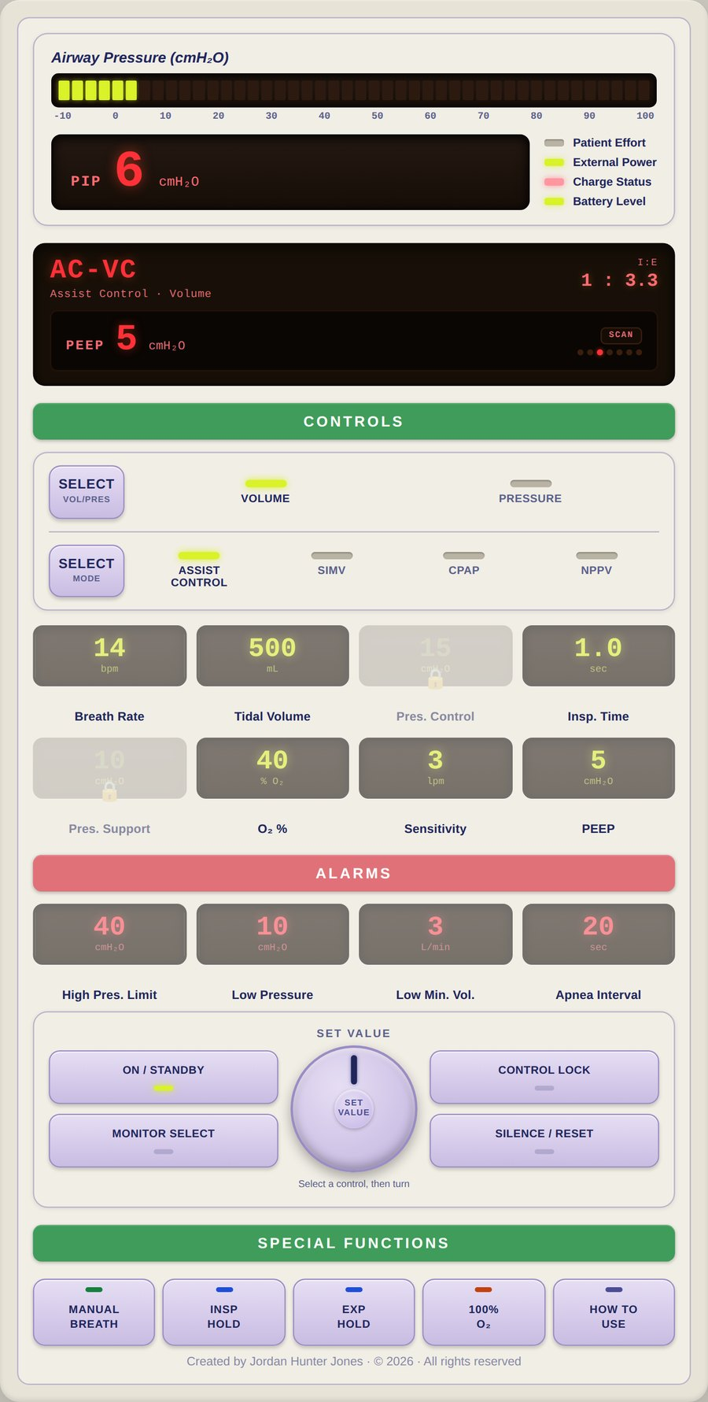
6.1 · Hardware
6.1
Front Panel and Side Connections
Front panel essentials: On/Standby power.
Side/rear connections: O₂ inlet — high-pressure DISS or a low-pressure fitting depending on configuration. Patient circuit ports including the easily-missed exhalation valve drive line.
Practice on the unit until you can find every control by feel. In a noisy ambulance bay or moving aircraft, you can't read labels.
The exhalation valve drive line is the most-missed connection. Without it, the patient cannot exhale. Verify every POST.
Notes:
Front panel essentials: On/Standby power. A bank of INDIVIDUAL control windows — one per setting (Breath Rate, Tidal Volume, Pressure Control, Inspiratory Time, Pressure Support, O₂ %, Sensitivity, PEEP) plus the alarm-limit windows. Two Select buttons (Mode and Breath Type). The Set Value knob. Manual Breath, Alarm Silence/Reset, Control Lock, and the display window. Side/rear connections: O₂ inlet — high-pressure DISS or a low-pressure fitting depending on configuration. Patient circuit ports including the easily-missed exhalation valve drive line. Battery compartment, external power input, bacterial/viral filter, and a Comm Port for service and data (it is NOT a USB port). Confirm the exact connections on YOUR unit — configurations vary. Practice on the unit until you can find every control by feel. In a noisy ambulance bay or moving aircraft, you can't read labels. The exhalation valve drive line is the most-missed connection. Without it, the patient cannot exhale. Verify every POST. PEARL — Memorize by feel: Spend ten minutes with eyes closed, locating each control by touch. Pays off the first time you have to silence an alarm at 3 a.m. in a moving truck.

Slide 58
6.2 · Power
6.2
Battery and Line Power
Internal battery: sealed lead-acid, ~45 min at nominal settings (per the LTV operator manual). Drains FASTER at high FiO₂, high PEEP, rapid rates — plan far less for a sick lung.
Battery health degrades over service life. A unit in service > 3 years and never replaced will deliver less than spec. Document unexpected battery alarms.
On the truck: confirm "line power" on the display before loading the patient.
Pre-flight rule: 100% battery + line power confirmed = ready. Test external battery packs under load — a pack that holds static charge but fails under demand is a transport hazard.
Notes:
Internal battery: sealed lead-acid, ~45 min at nominal settings (per the LTV operator manual). Drains FASTER at high FiO₂, high PEEP, rapid rates — plan far less for a sick lung. Always confirm runtime against your unit's manual. Battery health degrades over service life. A unit in service > 3 years and never replaced will deliver less than spec. Document unexpected battery alarms. On the truck: confirm "line power" on the display before loading the patient. If external power is lost, the LTV annunciates a POWER LOST alarm and transfers to the internal battery — the switch is NOT silent; acknowledge the alarm and restore AC. Pre-flight rule: 100% battery + line power confirmed = ready. Test external battery packs under load — a pack that holds static charge but fails under demand is a transport hazard.

Slide 59
6.3 · Display
6.3
Reading the Screen
The LTV does NOT split the screen into a settings half and a monitored half.
Monitored data appears in ONE display window that SCANS — cycling through the measured values one at a time: PIP, MAP, PEEP, f (total rate), Vte (exhaled tidal volume), VE (exhaled minute volume), and I:E.
Press Monitor Select once to halt the scan on a value, again to step to the next, or twice quickly to resume scanning.
Know which numbers you SET and which the vent CALCULATES. You set Inspiratory Time; the vent derives and displays I:E from that and the rate.
There is NO continuously monitored plateau pressure on this display.
CLINICAL PEARL
Set vs Exhaled
Exhaled Vt consistently < set Vt by > 10%? Check ETT cuff, walk the circuit, look at the exhalation valve drive line. Persistent leak = lost PEEP = lost oxygenation.
Notes:
The LTV does NOT split the screen into a settings half and a monitored half. Each setting lives in its OWN window and you work one at a time: press that control to select it (it brightens, the rest dim), turn the Set Value knob, then confirm. Monitored data appears in ONE display window that SCANS — cycling through the measured values one at a time: PIP, MAP, PEEP, f (total rate), Vte (exhaled tidal volume), VE (exhaled minute volume), and I:E. Alarm messages appear in this same window. Press Monitor Select once to halt the scan on a value, again to step to the next, or twice quickly to resume scanning. Know which numbers you SET and which the vent CALCULATES. You set Inspiratory Time; the vent derives and displays I:E from that and the rate. Trying to dial I:E directly is a common novice error — change Inspiratory Time or the rate instead. There is NO continuously monitored plateau pressure on this display. Pplat is obtained with an inspiratory hold maneuver where your unit and configuration support it — confirm the procedure in your operator manual. Divergence between SET Vt and EXHALED Vt (Vte) is the earliest sign of a leak or compliance change. Don't silence — investigate. PEARL — Set vs Exhaled: Exhaled Vt consistently < set Vt by > 10%? Check ETT cuff, walk the circuit, look at the exhalation valve drive line. Persistent leak = lost PEEP = lost oxygenation.

Slide 60
6.4 · Alarms
6.4
The Core Alarms
HIGH PRESSURE — PIP exceeded threshold (default ~40 cmH₂O; set to 35 in lung-protective). Most common in EMS.
LOW PRESSURE / LOW PEEP — circuit leak, disconnect, ETT cuff leak. Default 4 cmH₂O below set PEEP.
LOW MINUTE VOLUME — exhaled MV below threshold. Default is often 0 — set this to ~70% of expected MV.
APNEA — no detected breath in apnea time (default 20 sec). Triggered by complete loss of effort or sensor failure.
POWER LOST / LOW BATTERY — external power lost (transfer to internal battery) or battery depleting. Restore AC promptly.
GAS SUPPLY — O₂ source pressure low; check tank, regulator, and hose.
Notes:
HIGH PRESSURE — PIP exceeded threshold (default ~40 cmH₂O; set to 35 in lung-protective). Most common in EMS. LOW PRESSURE / LOW PEEP — circuit leak, disconnect, ETT cuff leak. Default 4 cmH₂O below set PEEP. LOW MINUTE VOLUME — exhaled MV below threshold. Default is often 0 — set this to ~70% of expected MV. APNEA — no detected breath in apnea time (default 20 sec). Triggered by complete loss of effort or sensor failure. POWER LOST / LOW BATTERY — external power lost (transfer to internal battery) or battery depleting. Restore AC promptly. GAS SUPPLY — O₂ source pressure low; check tank, regulator, and hose. Triage: READ the alarm BEFORE silencing. Silencing without identifying the cause is a sentinel-level safety event. This is the core set — the operator manual lists additional device and self-test alarms. Know your unit's full alarm list before transport.

Slide 61
6.5 · Checkout
6.5
Startup and Pre-Use Checkout
Follow the startup and operational-verification procedure in your operator manual PLUS your agency's documented equipment check. What follows is the SHAPE of that check — it replaces neither document.
Connect a complete circuit and test lung BEFORE powering on — including the exhalation valve drive line. A checkout without a circuit tests nothing that matters.
Power on and let the unit finish its self test. Any failure indication means the unit comes out of service — tag it, document it, replace it.
Answer the patient setup prompt, then load and verify settings appropriate to your patient before connecting them.
Set alarm limits for THIS patient — especially Low Minute Volume, which commonly sits at a value that will never alarm.
EVIDENCE
Why the pre-use check
Most field LTV failures are caught during pre-use checkout — the worst time to find one is mid-transport. The manufacturer's instructions and your agency policy control the exact steps and their order.
Notes:
Follow the startup and operational-verification procedure in your operator manual PLUS your agency's documented equipment check. What follows is the SHAPE of that check — it replaces neither document. Connect a complete circuit and test lung BEFORE powering on — including the exhalation valve drive line. A checkout without a circuit tests nothing that matters. Power on and let the unit finish its self test. Any failure indication means the unit comes out of service — tag it, document it, replace it. Answer the patient setup prompt, then load and verify settings appropriate to your patient before connecting them. Set alarm limits for THIS patient — especially Low Minute Volume, which commonly sits at a value that will never alarm. Verify the gas source at the required pressure, the battery state of charge, and that the display indicates external power when docked. Document the check per agency policy. EVIDENCE — Why the pre-use check: Most field LTV failures are caught during pre-use checkout — the worst time to find one is mid-transport. The manufacturer's instructions and your agency policy control the exact steps and their order.

Slide 62
6.6 · Workflow
6.6
Safe Changes & Common Pitfalls
Safe-change workflow: 1) Verbalize the change BEFORE you touch the panel. 2) Press that control's window to SELECT it — it brightens, the rest dim. 3) Turn the Set Value knob.
Common pitfalls from incident reviews: forgetting to set LOW MV alarm; setting PEEP at the dial but forgetting to attach the PEEP valve; pediatric patient on the adult circuit (dead space > Vt); missing the…
Notes:
Safe-change workflow: 1) Verbalize the change BEFORE you touch the panel. 2) Press that control's window to SELECT it — it brightens, the rest dim. 3) Turn the Set Value knob. 4) Confirm — press the control again, select another, press Control Lock, or let it time out. 5) Reassess in 30 sec. 6) Document with vitals before AND after. Common pitfalls from incident reviews: forgetting to set LOW MV alarm; setting PEEP at the dial but forgetting to attach the PEEP valve; pediatric patient on the adult circuit (dead space > Vt); missing the POWER LOST alarm when the AC plug bumps loose and the unit transfers to internal battery; POST skipped because "the next shift will do it."

Slide 63
Now put it to work
Hand off to learner devices — cues match your facilitator guide.
QUIZ
Knowledge Check
10 questions · pass 8/10 to unlock the next module
MATCH
Front-Panel Controls
6 items · Navigates / Selects · Manages Alarms · Delivers a Breath / Measures · must be perfect
CASE
Pre-Shift Walkaround
4-decision branching scenario · Pre-shift unit check. No patient yet.
SIM
LTV 1200 Simulator
vent-ltv1200.html?level=1 — Learn the controls hands-on: work the LTV 1200 tutorial on the simulator.
Notes:
Transition slide: send learners to the app for this module's quiz, match, scenario, then the simulator mission. Keep the cohort together; modules unlock in sequence.

Slide 64
Carry this out the door
✓
Memorize by feel Spend ten minutes with eyes closed, locating each control by touch. Pays off the first time you have to silence an alarm at 3 a.m. in a moving truck.
✓
Set vs Exhaled Exhaled Vt consistently < set Vt by > 10%? Check ETT cuff, walk the circuit, look at the exhalation valve drive line. Persistent leak = lost PEEP =…
✓
Power Battery and Line Power
✓
Alarms The Core Alarms
Next: Module 7
Notes:
Recap the module pearls, then transition.

Slide 65
7
VENTILATOR TRAINING ACADEMY
Module 7
Alarms & Troubleshooting
Every alarm is information. DOPE is the universal algorithm. The 10-second rule is non-negotiable.
Application · 7 lessons
Jordan Hunter Jones, NRP · Course Director
Notes:
Module 7: Alarms & Troubleshooting. Every alarm is information. DOPE is the universal algorithm. The 10-second rule is non-negotiable.

Slide 66
In this module
7.1
Philosophy What Alarms Are For
7.5
E Equipment Failure
7.2
D Dislodgement
7.6
The 10-Second Rule When to Disconnect and Bag
7.3
O Obstruction
7.7
Dyssynchrony When the Patient and Vent Argue
7.4
P Pneumothorax
Then:
Knowledge Check
Match
Scenario
Simulator
Notes:
Roadmap of the module. Teach the lessons in order, then run the four interactive components on learner devices.

Slide 67
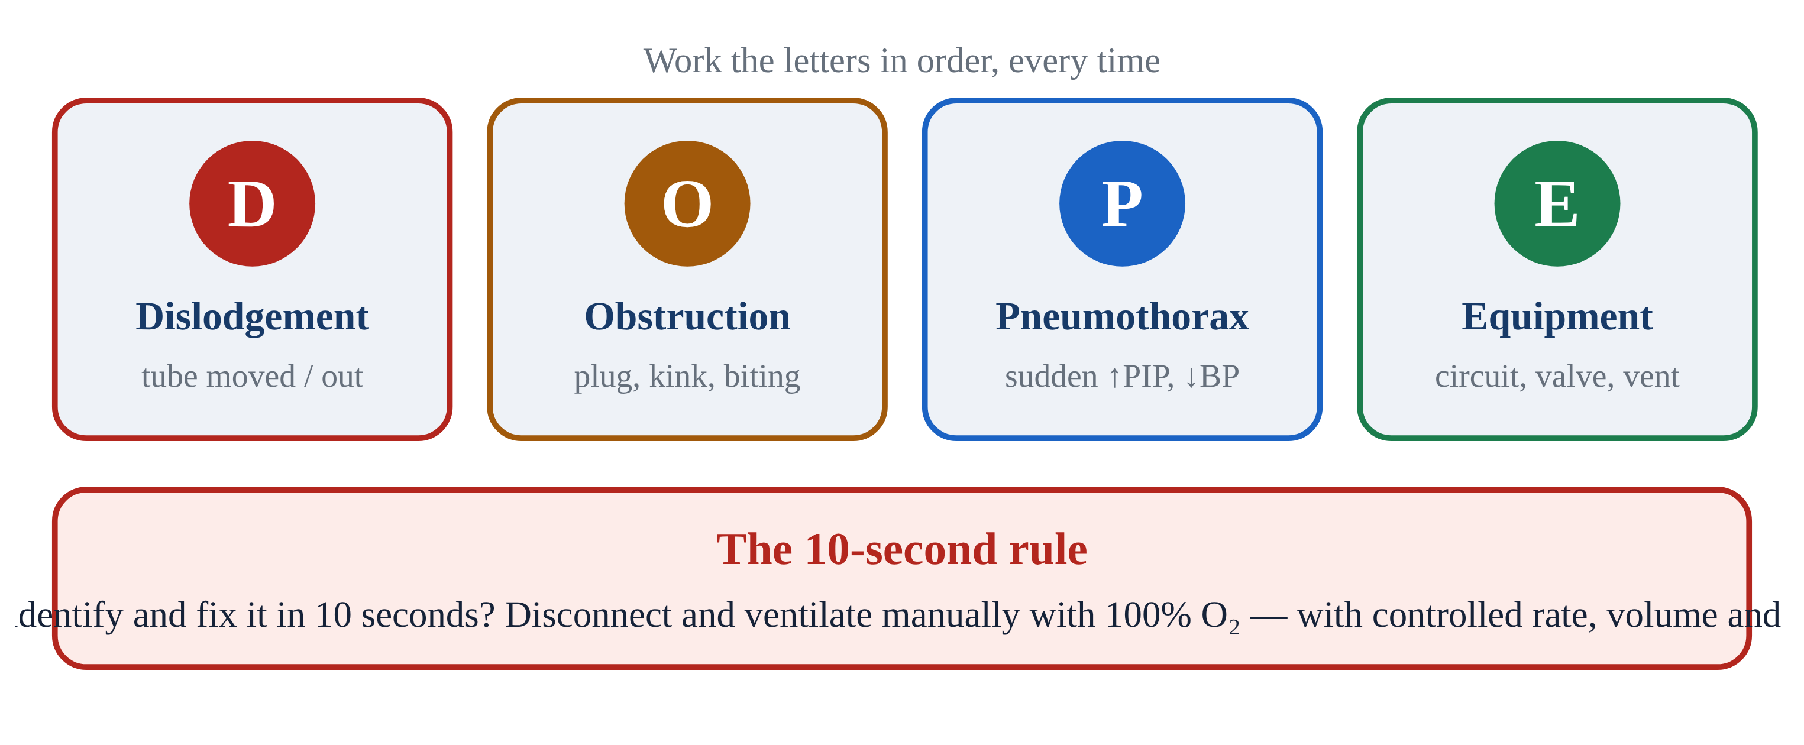
7.1 · Philosophy
7.1
What Alarms Are For
Alarms are NOT nuisances. They are information about a deteriorating system. Two kinds: equipment alarms (machine problem) and patient alarms (patient problem). Some are both.
The cardinal rule: READ the alarm before you SILENCE it. Silencing an alarm without identifying the cause is a sentinel-level safety event, documented in nearly every transport-service incident review.
Silence gives you 60 seconds of quiet to fix. Not 60 seconds to ignore. After 60 sec, if the problem persists, the alarm re-fires.
Build the habit: read first, silence second, fix third, document fourth. Train it until it's automatic.
Notes:
Alarms are NOT nuisances. They are information about a deteriorating system. Two kinds: equipment alarms (machine problem) and patient alarms (patient problem). Some are both. The cardinal rule: READ the alarm before you SILENCE it. Silencing an alarm without identifying the cause is a sentinel-level safety event, documented in nearly every transport-service incident review. Silence gives you 60 seconds of quiet to fix. Not 60 seconds to ignore. After 60 sec, if the problem persists, the alarm re-fires. Build the habit: read first, silence second, fix third, document fourth. Train it until it's automatic. PEARL — Sentinel error: Silencing without investigating is the #1 contributor to adverse vent events in transport. Don't let muscle memory take over.

Slide 68
7.2 · D
7.2
Dislodgement
Most common cause of sudden vent crisis in transport. Movement during loading, lifting, transferring between gurney and aircraft, or a road bump can dislodge an ETT.
Confirm depth: marking at the lip should match what was secured (21 cm women, 23 cm men typically).
Confirm capnography: a sudden drop to zero is dislodgement until proven otherwise.
Auscultate: equal bilateral breath sounds. Right-only = mainstem migration. Absent or epigastric = esophageal or completely out.
If the tube is out, bag with BVM + mask while preparing to re-intubate. Verify depth AGAIN after every transition.
Notes:
Most common cause of sudden vent crisis in transport. Movement during loading, lifting, transferring between gurney and aircraft, or a road bump can dislodge an ETT. Confirm depth: marking at the lip should match what was secured (21 cm women, 23 cm men typically). Confirm capnography: a sudden drop to zero is dislodgement until proven otherwise. Auscultate: equal bilateral breath sounds. Right-only = mainstem migration. Absent or epigastric = esophageal or completely out. If the tube is out, bag with BVM + mask while preparing to re-intubate. Verify depth AGAIN after every transition.

Slide 69
7.3 · O
7.3
Obstruction
Tube patent in position but blocked.
Pass a suction catheter. This is BOTH diagnostic AND therapeutic. If it passes easily and brings back secretions, you've solved the problem.
If suction passes but doesn't clear secretions, consider bronchodilator or repositioning.
If suction doesn't pass — you have a fixed obstruction or dislodgement. Disconnect and bag while investigating.
Notes:
Tube patent in position but blocked. Causes: mucus plug (most common in post-arrest, post-aspiration, COPD), biting on the tube, condensation pooled in dependent loop, kinked tube, over-inflated cuff herniating into lumen. Pass a suction catheter. This is BOTH diagnostic AND therapeutic. If it passes easily and brings back secretions, you've solved the problem. If suction passes but doesn't clear secretions, consider bronchodilator or repositioning. If suction doesn't pass — you have a fixed obstruction or dislodgement. Disconnect and bag while investigating.

Slide 70
7.4 · P
7.4
Pneumothorax
Sudden rise in PIP, often with falling SpO₂ and BP. Decreased or absent breath sounds on the affected side. Tracheal deviation away from the affected side (LATE).
Hyperresonance to percussion of the affected side. JVD + hemodynamic compromise = TENSION pneumothorax. Clinical diagnosis at the bedside, not waiting for imaging.
Decompress per protocol: needle thoracostomy at the 2nd ICS midclavicular OR 4th–5th ICS midaxillary.
High-risk populations: asthma/COPD on positive pressure, trauma, recent central line placement. Suspect early.
Notes:
Sudden rise in PIP, often with falling SpO₂ and BP. Decreased or absent breath sounds on the affected side. Tracheal deviation away from the affected side (LATE). Hyperresonance to percussion of the affected side. JVD + hemodynamic compromise = TENSION pneumothorax. Clinical diagnosis at the bedside, not waiting for imaging. Decompress per protocol: needle thoracostomy at the 2nd ICS midclavicular OR 4th–5th ICS midaxillary. Then secure and monitor the catheter/device per protocol, reassess for re-tensioning, and arrange definitive thoracostomy at the receiving facility. (A chest seal treats an OPEN chest wound — it does not stop an internal air leak.) High-risk populations: asthma/COPD on positive pressure, trauma, recent central line placement. Suspect early.

Slide 71
7.5 · E
7.5
Equipment Failure
Machine is the problem. Causes: disconnected circuit (most often exhalation valve drive line), failed sensor or transducer, silent battery switch, O₂ source disconnect, software hang, loose ETT cuff.
Universal answer: DISCONNECT FROM THE VENT AND BAG WITH 100% O₂. The bag tells you whether the problem is patient or machine.
Easy bag + sat rises = vent problem. Troubleshoot vent off-patient. Hard bag = patient problem — apply DOPE (D, O, or P).
Bagging is rarely the wrong answer. It is diagnostic AND therapeutic at the same time.
Notes:
Machine is the problem. Causes: disconnected circuit (most often exhalation valve drive line), failed sensor or transducer, silent battery switch, O₂ source disconnect, software hang, loose ETT cuff. Universal answer: DISCONNECT FROM THE VENT AND BAG WITH 100% O₂. The bag tells you whether the problem is patient or machine. Easy bag + sat rises = vent problem. Troubleshoot vent off-patient. Hard bag = patient problem — apply DOPE (D, O, or P). Bagging is rarely the wrong answer. It is diagnostic AND therapeutic at the same time.

Slide 72
7.6 · The 10-Second Rule
7.6
When to Disconnect and Bag
If you cannot identify and fix an alarm in 10 seconds, disconnect from the ventilator and bag with 100% oxygen. Then troubleshoot.
Vented patients deteriorate fast — sats can drop 20 points in two minutes of failed ventilation. Bagging buys time.
The bag gives you something the vent cannot: direct hands-on feedback. You feel resistance. You see chest rise. You CONFIRM gas exchange.
If bagging is easy and sat comes up, the problem is the machine. If bagging is hard, the problem is the patient — DOPE. Bagging is rarely the wrong answer.
CLINICAL PEARL
10 seconds, then bag
If you're hesitating past 10 seconds, you're losing time. Disconnect and bag. Troubleshoot with confidence that the patient is being ventilated.
Notes:
If you cannot identify and fix an alarm in 10 seconds, disconnect from the ventilator and bag with 100% oxygen. Then troubleshoot. Vented patients deteriorate fast — sats can drop 20 points in two minutes of failed ventilation. Bagging buys time. The bag gives you something the vent cannot: direct hands-on feedback. You feel resistance. You see chest rise. You CONFIRM gas exchange. If bagging is easy and sat comes up, the problem is the machine. If bagging is hard, the problem is the patient — DOPE. Bagging is rarely the wrong answer. PEARL — 10 seconds, then bag: If you're hesitating past 10 seconds, you're losing time. Disconnect and bag. Troubleshoot with confidence that the patient is being ventilated.

Slide 73
7.7 · Dyssynchrony
7.7
When the Patient and Vent Argue
Patient-vent dyssynchrony affects ~25% of vented patients (Blanch, ICM 2015). Four patterns:
Trigger asynchrony: patient effort doesn't initiate a breath. Fix: increase trigger sensitivity (flow trigger if available).
Flow asynchrony: vent flow doesn't match patient demand. Fix: increase peak flow or shorten inspiratory time.
Double triggering: patient effort outlasts inspiration; second breath stacks immediately. Fix: lengthen inspiratory time, deepen sedation, treat air hunger.
EMS bedside fix for most dyssynchrony: deepen sedation, ensure adequate analgesia, check trigger settings.
Notes:
Patient-vent dyssynchrony affects ~25% of vented patients (Blanch, ICM 2015). Four patterns: Trigger asynchrony: patient effort doesn't initiate a breath. Fix: increase trigger sensitivity (flow trigger if available). Flow asynchrony: vent flow doesn't match patient demand. Fix: increase peak flow or shorten inspiratory time. Double triggering: patient effort outlasts inspiration; second breath stacks immediately. Fix: lengthen inspiratory time, deepen sedation, treat air hunger. EMS bedside fix for most dyssynchrony: deepen sedation, ensure adequate analgesia, check trigger settings.

Slide 74
Now put it to work
Hand off to learner devices — cues match your facilitator guide.
QUIZ
Knowledge Check
10 questions · pass 8/10 to unlock the next module
MATCH
Sort the Signs by DOPE Letter
8 items · D — Dislodgement · O — Obstruction · P — Pneumothorax · E — Equipment · must be perfect
CASE
Run DOPE in 60 Seconds
4-decision branching scenario · 27-year-old female, 65 kg IBW, status asthmaticus, intubated 30 min…
SIM
LTV 1200 Simulator
vent-ltv1200.html?level=2 — Test yourself on the simulator's clinical scenarios — set alarm limits and correct the…
Notes:
Transition slide: send learners to the app for this module's quiz, match, scenario, then the simulator mission. Keep the cohort together; modules unlock in sequence.

Slide 75
Carry this out the door
✓
Sentinel error Silencing without investigating is the #1 contributor to adverse vent events in transport. Don't let muscle memory take over.
✓
10 seconds, then bag If you're hesitating past 10 seconds, you're losing time. Disconnect and bag. Troubleshoot with confidence that the patient is being ventilated.
✓
D Dislodgement
✓
O Obstruction
Next: Module 8
Notes:
Recap the module pearls, then transition.

Slide 76
8
VENTILATOR TRAINING ACADEMY
Module 8
Sedation & Analgesia
If the patient can fight the vent, the vent will lose. Analgesia first. Push-dose pressors ready before you push the induction agent.
Application · 5 lessons
Jordan Hunter Jones, NRP · Course Director
Notes:
Module 8: Sedation & Analgesia. If the patient can fight the vent, the vent will lose. Analgesia first. Push-dose pressors ready before you push the induction agent.

Slide 77
In this module
8.1
Why Sedate Five Reasons
8.4
Push-Dose Pressors Ready BEFORE You Push Induction
8.2
RASS The Sedation Scale
8.5
Pitfalls What Goes Wrong
8.3
Agents EMS Sedation/Analgesia Toolbox
Then:
Knowledge Check
Match
Scenario
Simulator
Notes:
Roadmap of the module. Teach the lessons in order, then run the four interactive components on learner devices.

Slide 78
8.1 · Why Sedate
8.1
Five Reasons
Comfort: an ETT is uncomfortable; bucking the vent is exhausting.
Synchrony: a patient fighting the vent generates dangerously high airway pressures (barotrauma).
Safety: awake fighting patients pull tubes and lines — self-extubation is a sentinel event.
Oxygenation: lower work of breathing = lower O₂ demand = easier oxygenation.
Hemodynamics: well-sedated patients have less sympathetic drive and more predictable response to vasopressors.
CLINICAL PEARL
Iron rule
Paralyze ONLY a patient who is also analgesed AND sedated. Bolt-and-paralyze without sedation = awareness with paralysis. Sentinel safety event.
Notes:
Comfort: an ETT is uncomfortable; bucking the vent is exhausting. Synchrony: a patient fighting the vent generates dangerously high airway pressures (barotrauma). Safety: awake fighting patients pull tubes and lines — self-extubation is a sentinel event. Oxygenation: lower work of breathing = lower O₂ demand = easier oxygenation. Hemodynamics: well-sedated patients have less sympathetic drive and more predictable response to vasopressors. Modern ICU evidence (ABCDE bundle, SAT/SBT): LIGHTER sedation with daily wake-ups reduces vent days and mortality. EMS target: RASS −1 to −2 — calm but arousable. PEARL — Iron rule: Paralyze ONLY a patient who is also analgesed AND sedated. Bolt-and-paralyze without sedation = awareness with paralysis. Sentinel safety event.

Slide 79
8.2 · RASS
8.2
The Sedation Scale
Richmond Agitation-Sedation Scale runs +4 (combative) to −5 (unarousable).
+4 combative danger to staff. +3 very agitated, pulls at tubes. +2 agitated, fights vent. +1 restless but cooperative.
0 alert and calm.
−1 drowsy, sustained eye contact > 10 sec to voice. −2 light sedation, briefly opens eyes to voice. −3 moderate, movement to voice no eye contact. −4 deep, movement to physical stimulus only.
Transport target is RASS −1 to −2. Deeper than −2 makes handoff assessment hard. Lighter than −1 risks self-extubation.
Critical caveat: RASS CANNOT be scored during neuromuscular blockade — a paralyzed patient always looks calm regardless of awareness.
Notes:
Richmond Agitation-Sedation Scale runs +4 (combative) to −5 (unarousable). +4 combative danger to staff. +3 very agitated, pulls at tubes. +2 agitated, fights vent. +1 restless but cooperative. 0 alert and calm. −1 drowsy, sustained eye contact > 10 sec to voice. −2 light sedation, briefly opens eyes to voice. −3 moderate, movement to voice no eye contact. −4 deep, movement to physical stimulus only. −5 unarousable. Transport target is RASS −1 to −2. Deeper than −2 makes handoff assessment hard. Lighter than −1 risks self-extubation. Critical caveat: RASS CANNOT be scored during neuromuscular blockade — a paralyzed patient always looks calm regardless of awareness. Until paralysis resolves, judge adequacy of analgesia/sedation by autonomic signs (heart rate, blood pressure, lacrimation, diaphoresis), not by RASS.

Slide 80
8.3 · Agents
8.3
EMS Sedation/Analgesia Toolbox
Fentanyl 1–2 mcg/kg IV, redose 0.5–1 mcg/kg q15–20 min. Analgesia first. Watch chest wall rigidity at high doses pushed rapidly.
Ketamine 1–2 mg/kg IV induction; 0.5–1 mg/kg redose. PREFERRED in shock — sympathetic effect supports BP. KETASED (Jabre 2009): equivalent to etomidate, safer in shock. Modern evidence: acceptable in TBI.
Midazolam 0.05–0.1 mg/kg IV q5–10 min. Sedation + amnesia. Synergistic respiratory depression with opioids. Reversible with flumazenil.
Propofol 5–50 mcg/kg/min infusion (per service formulary). Drops BP. PRIS (propofol-related infusion syndrome): metabolic acidosis, rhabdomyolysis, cardiac arrhythmia at > 4 mg/kg/hr or > 48 hr infusions.
Etomidate 0.3 mg/kg IV induction. Clean hemodynamics but causes adrenal suppression — many EMS prefer ketamine in shock RSI. Not carried by many EMS services.
Notes:
Fentanyl 1–2 mcg/kg IV, redose 0.5–1 mcg/kg q15–20 min. Analgesia first. Watch chest wall rigidity at high doses pushed rapidly. Ketamine 1–2 mg/kg IV induction; 0.5–1 mg/kg redose. PREFERRED in shock — sympathetic effect supports BP. KETASED (Jabre 2009): equivalent to etomidate, safer in shock. Modern evidence: acceptable in TBI. Scope varies by service — some carry it only for ongoing sedation of already-intubated patients rather than as a field induction agent; know your local protocol. Midazolam 0.05–0.1 mg/kg IV q5–10 min. Sedation + amnesia. Synergistic respiratory depression with opioids. Reversible with flumazenil. Propofol 5–50 mcg/kg/min infusion (per service formulary). Drops BP. PRIS (propofol-related infusion syndrome): metabolic acidosis, rhabdomyolysis, cardiac arrhythmia at > 4 mg/kg/hr or > 48 hr infusions. Often not carried on EMS units — typically a hospital-supplied infusion you may monitor, not initiate. Etomidate 0.3 mg/kg IV induction. Clean hemodynamics but causes adrenal suppression — many EMS prefer ketamine in shock RSI. Not carried by many EMS services.

Slide 81
8.4 · Push-Dose Pressors
8.4
Ready BEFORE You Push Induction
Post-intubation hypotension is common after emergency intubation — about 25% in Heffner's 2012 emergency-department cohort (an ED, not prehospital, study; anticipate it in the field too).
Push-dose epinephrine — a rapid bridge for peri-intubation hypotension. Mix 1 mg (1:10,000) into 100 mL NS = 10 mcg/mL. Dose 5–20 mcg IV (typically 10 mcg) every 1–5 min.
Push-dose phenylephrine — alternative when avoiding tachycardia. Mix 10 mg into 100 mL NS = 100 mcg/mL. Dose 50–200 mcg IV q1–5 min. Pure α-agonist; reflex bradycardia possible.
Label every syringe clearly. Document every push.
EVIDENCE
Post-intubation hypotension
Heffner 2012: ~25% incidence in an emergency-department intubation cohort (not a prehospital study). Higher in shock states. Always have push-dose pressors prepared before pushing the induction agent.
Notes:
Post-intubation hypotension is common after emergency intubation — about 25% in Heffner's 2012 emergency-department cohort (an ED, not prehospital, study; anticipate it in the field too). The fix is anticipation. Push-dose epinephrine — a rapid bridge for peri-intubation hypotension. Mix 1 mg (1:10,000) into 100 mL NS = 10 mcg/mL. Dose 5–20 mcg IV (typically 10 mcg) every 1–5 min. Onset 1 min, duration 5–10 min. Inotropy + vasoconstriction. It buys time until a continuous infusion is running — it is not the definitive pressor. Push-dose phenylephrine — alternative when avoiding tachycardia. Mix 10 mg into 100 mL NS = 100 mcg/mL. Dose 50–200 mcg IV q1–5 min. Pure α-agonist; reflex bradycardia possible. Label every syringe clearly. Document every push. Move to a continuous infusion as soon as practical — norepinephrine is the first-line infused vasopressor for most shock states (Surviving Sepsis 2021), started at 0.05–0.1 mcg/kg/min and titrated to MAP ≥ 65, and it can run peripherally through a good IV for transport. Push-dose pressors are a bridge to that infusion. EVIDENCE — Post-intubation hypotension: Heffner 2012: ~25% incidence in an emergency-department intubation cohort (not a prehospital study). Higher in shock states. Always have push-dose pressors prepared before pushing the induction agent.

Slide 82
8.5 · Pitfalls
8.5
What Goes Wrong
Under-sedation in the first 10 minutes after intubation. Long-acting paralytics outlast a single induction dose. Bolt → sedate → redose sedation BEFORE paralysis wears off.
Over-sedation pre-arrival. RASS −5 patients can't help with hand-off and are at higher risk of hemodynamic instability. Target RASS −1 to −2 by handoff.
Paralytic without analgesia/sedation. Awareness with paralysis — sentinel safety event. Always pair long-acting paralytics with BOTH.
Post-intubation hypotension. ~25% incidence. Push-dose pressors should be in your hand before induction.
Mixing too many agents. Stick with one analgesic + one sedative for transport.
Notes:
Under-sedation in the first 10 minutes after intubation. Long-acting paralytics outlast a single induction dose. Bolt → sedate → redose sedation BEFORE paralysis wears off. Over-sedation pre-arrival. RASS −5 patients can't help with hand-off and are at higher risk of hemodynamic instability. Target RASS −1 to −2 by handoff. Paralytic without analgesia/sedation. Awareness with paralysis — sentinel safety event. Always pair long-acting paralytics with BOTH. Post-intubation hypotension. ~25% incidence. Push-dose pressors should be in your hand before induction. Mixing too many agents. Stick with one analgesic + one sedative for transport.

Slide 83
Now put it to work
Hand off to learner devices — cues match your facilitator guide.
QUIZ
Knowledge Check
10 questions · pass 8/10 to unlock the next module
MATCH
Pick the Sedation/Pressor Agent
6 items · Ketamine · Fentanyl · Push-Dose Epi · must be perfect
CASE
Septic Shock RSI
4-decision branching scenario · 76-year-old female, 60 kg, urosepsis, on norepinephrine 8 mcg/min…
SIM
LTV 1200 Simulator
vent-ltv1200.html?scenario=agitation — A patient fighting the vent with normal mechanics — recognize when the fix is a drug,…
Notes:
Transition slide: send learners to the app for this module's quiz, match, scenario, then the simulator mission. Keep the cohort together; modules unlock in sequence.

Slide 84
Carry this out the door
✓
Iron rule Paralyze ONLY a patient who is also analgesed AND sedated. Bolt-and-paralyze without sedation = awareness with paralysis. Sentinel safety event.
✓
RASS The Sedation Scale
✓
Agents EMS Sedation/Analgesia Toolbox
✓
Push-Dose Pressors Ready BEFORE You Push Induction
Next: Module 9
Notes:
Recap the module pearls, then transition.

Slide 85
9
VENTILATOR TRAINING ACADEMY
Module 9
Special Populations
Same vent. Different goals. Asthma/COPD, ARDS, TBI, pediatrics. Pick the goal first; the settings follow.
Application · 6 lessons
Jordan Hunter Jones, NRP · Course Director
Notes:
Module 9: Special Populations. Same vent. Different goals. Asthma/COPD, ARDS, TBI, pediatrics. Pick the goal first; the settings follow.

Slide 86
In this module
9.1
Asthma & COPD Let Them Exhale
9.4
ARDS Rescue When Lung-Protective Isn't Enough
9.2
Auto-PEEP When the Lung Doesn't Empty
9.5
TBI Strict Normocapnia
9.3
ARDS Lung-Protective Ventilation
9.6
Pediatrics Smaller Everything, Bigger Margins
Then:
Knowledge Check
Match
Scenario
Simulator
Notes:
Roadmap of the module. Teach the lessons in order, then run the four interactive components on learner devices.

Slide 87
9.1 · Asthma & COPD
9.1
Let Them Exhale
Obstructive disease is fundamentally an EXHALATION problem. Air goes in easily; getting it out takes time.
Strategy: low rate (RR 8–10), long expiratory time (I:E 1:4 or 1:5), Vt 6–8 mL/kg IBW, FiO₂ to SpO₂ ≥ 88% (COPD) or ≥ 92% (asthma), PEEP 0–5 cmH₂O. Permissive hypercapnia is acceptable; pH ≥ 7.20 typical floor.
Don't chase a normal CO₂ at the cost of barotrauma. Forcing the rate up stacks breaths and drops BP via auto-PEEP.
Notes:
Obstructive disease is fundamentally an EXHALATION problem. Air goes in easily; getting it out takes time. Strategy: low rate (RR 8–10), long expiratory time (I:E 1:4 or 1:5), Vt 6–8 mL/kg IBW, FiO₂ to SpO₂ ≥ 88% (COPD) or ≥ 92% (asthma), PEEP 0–5 cmH₂O. Permissive hypercapnia is acceptable; pH ≥ 7.20 typical floor. Don't chase a normal CO₂ at the cost of barotrauma. Forcing the rate up stacks breaths and drops BP via auto-PEEP.

Slide 88
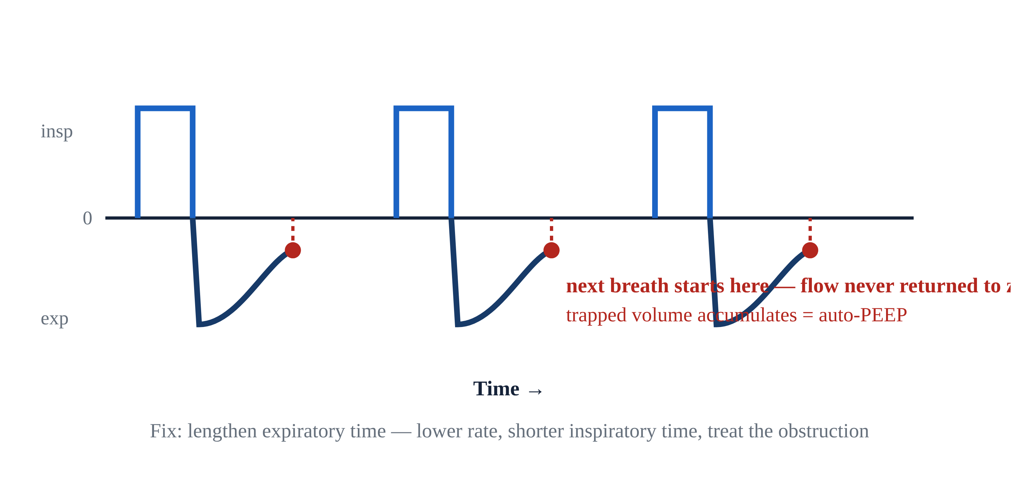
9.2 · Auto-PEEP
9.2
When the Lung Doesn't Empty
Picture pouring into a glass that drains slowly: send the next splash before it empties and the level climbs until it overflows.
Clinical signs: rising PIP without rising Pplat; falling BP; patient "fights" the vent; expiratory flow waveform doesn't return to zero before next breath.
Management: slow RR (often dramatically — to 8 or even 6). Lengthen exp time (I:E 1:4 or 1:5).
If hemodynamically compromised: BRIEFLY DISCONNECT FROM THE VENT for 5–10 seconds. Trapped gas releases. BP often improves immediately. Reconnect on slower settings.
Notes:
Picture pouring into a glass that drains slowly: send the next splash before it empties and the level climbs until it overflows. Auto-PEEP is the same — in an obstructed lung that exhales slowly, the next breath starts before the last one finishes, so air stacks, the chest over-fills, intrathoracic pressure rises, venous return drops, and BP falls. Clinical signs: rising PIP without rising Pplat; falling BP; patient "fights" the vent; expiratory flow waveform doesn't return to zero before next breath. Management: slow RR (often dramatically — to 8 or even 6). Lengthen exp time (I:E 1:4 or 1:5). If hemodynamically compromised: BRIEFLY DISCONNECT FROM THE VENT for 5–10 seconds. Trapped gas releases. BP often improves immediately. Reconnect on slower settings. Vented status asthmaticus has ~30% incidence of post-intubation hypotension — anticipate it. PEARL — Brief disconnect: Hypotensive asthmatic on the vent? Disconnect from the circuit for 5–10 sec. Release the trapped gas. BP often recovers in under a minute. Reconnect on slower settings.

Slide 89
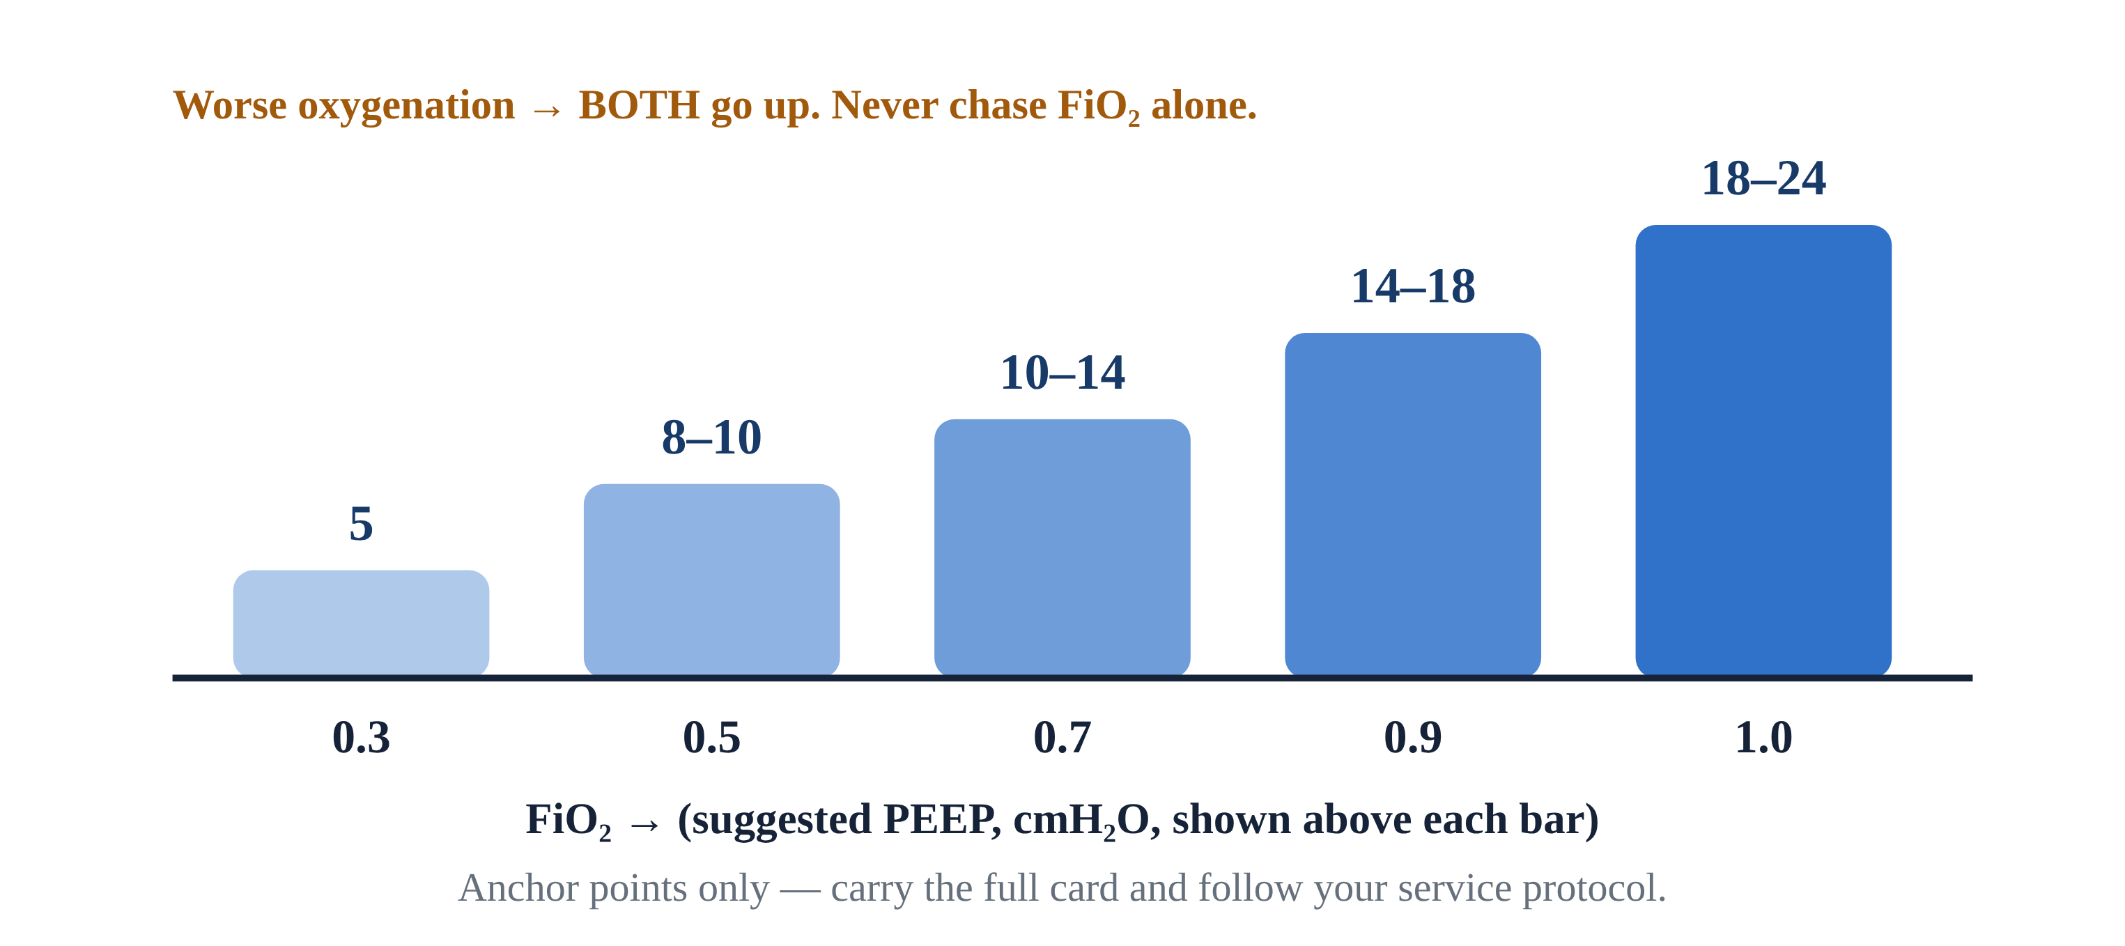
9.3 · ARDS
9.3
Lung-Protective Ventilation
Acute Respiratory Distress Syndrome: diffuse alveolar damage, refractory hypoxia. Berlin definition (2012): bilateral infiltrates, not cardiac, within 1 week.
Goal: protect the alveoli you have left. The mental model is the 'baby lung' — in ARDS so much lung is flooded or collapsed that only a small, child-sized portion is still open to ventilate.
Settings: AC/VC or AC/PC; Vt 4–6 mL/kg IBW (LOWER than usual); RR 18–22 to maintain MV; PEEP 10–15 per ARDSNet table; Pplat < 30; driving pressure (Pplat − PEEP) < 14 cmH₂O.
ARDSNet ARMA (NEJM 2000): mortality 31% vs 40% comparing 6 vs 12 mL/kg IBW. NNT 11. The most evidence-based ARDS intervention.
Notes:
Acute Respiratory Distress Syndrome: diffuse alveolar damage, refractory hypoxia. Berlin definition (2012): bilateral infiltrates, not cardiac, within 1 week. Severity by P/F ratio: mild 200–300, moderate 100–200, severe < 100. A 2023/2024 Global Definition of ARDS now also allows diagnosis by SpO₂/FiO₂ and includes patients on HFNO ≥ 30 L/min or CPAP/NIV ≥ 5 cmH₂O — but the Berlin P/F severity bands remain in everyday bedside use. Goal: protect the alveoli you have left. The mental model is the 'baby lung' — in ARDS so much lung is flooded or collapsed that only a small, child-sized portion is still open to ventilate. You are not filling an adult lung; you are filling what survives. So: small breaths, modest pressure, generous PEEP — a normal-sized Vt would over-stretch those few survivors and injure them. Settings: AC/VC or AC/PC; Vt 4–6 mL/kg IBW (LOWER than usual); RR 18–22 to maintain MV; PEEP 10–15 per ARDSNet table; Pplat < 30; driving pressure (Pplat − PEEP) < 14 cmH₂O. ARDSNet ARMA (NEJM 2000): mortality 31% vs 40% comparing 6 vs 12 mL/kg IBW. NNT 11. The most evidence-based ARDS intervention. EVIDENCE — ARDSNet PEEP/FiO₂ Lower-PEEP Table: FiO₂ 0.3 → PEEP 5. FiO₂ 0.5 → PEEP 8–10. FiO₂ 0.7 → PEEP 10–14. FiO₂ 1.0 → PEEP 18–24. Carry the card.

Slide 90
9.4 · ARDS Rescue
9.4
When Lung-Protective Isn't Enough
When lung-protective settings (6 mL/kg, Pplat < 30, ΔP < 14) aren't enough, these are the rescue options — roughly in order of evidence:
Prone positioning — PROSEVA (Guérin, NEJM 2013): 16 hr/day in severe ARDS (P/F < 150). Mortality 33% → 16%, NNT 6. The strongest single rescue.
Neuromuscular blockade — ACURASYS (NEJM 2010) showed a mortality benefit with 48-hr cisatracurium; ROSE (NEJM 2019) didn't replicate it. Now…
HFOV — OSCILLATE / OSCAR (NEJM 2013): no benefit; OSCILLATE was stopped for harm. Not first-line.
ECMO — ICU-level. Transport teams may move ECMO patients but don't initiate. Notify the receiving facility early when standard care is failing.
Notes:
When lung-protective settings (6 mL/kg, Pplat < 30, ΔP < 14) aren't enough, these are the rescue options — roughly in order of evidence:

Slide 91
9.5 · TBI
9.5
Strict Normocapnia
Two enemies of the injured brain: hypoxia and hypotension. A single SpO₂ < 90 or SBP < 90 doubles mortality in moderate-severe TBI (Brain Trauma Foundation 4th ed., 2017).
Strict normocapnia: target EtCO₂ 35–40 mmHg. Avoid prophylactic hyperventilation (BTF Level IIB recommendation) — drops cerebral blood flow and worsens secondary injury.
Standard TBI settings: AC/VC, Vt 6–8 mL/kg IBW, RR 12–16 titrated to EtCO₂ 35–40, PEEP 5, FiO₂ to SpO₂ ≥ 94%, pressors ready.
Hyperventilation rescue (transient, for impending herniation only): increase RR to target EtCO₂ 30–35 mmHg (NEVER below 30). Return to normocapnia once the exam improves (typically 2–5 min).
CLINICAL PEARL
Hyperventilation past the rescue window is harmful
Use brief hyperventilation only for signs of impending herniation (Cushing's triad, blown pupil, posturing). Return EtCO₂ to 35–40 as soon as exam improves. EtCO₂ < 30 worsens ischemia.
Notes:
Two enemies of the injured brain: hypoxia and hypotension. A single SpO₂ < 90 or SBP < 90 doubles mortality in moderate-severe TBI (Brain Trauma Foundation 4th ed., 2017). Strict normocapnia: target EtCO₂ 35–40 mmHg. Avoid prophylactic hyperventilation (BTF Level IIB recommendation) — drops cerebral blood flow and worsens secondary injury. Standard TBI settings: AC/VC, Vt 6–8 mL/kg IBW, RR 12–16 titrated to EtCO₂ 35–40, PEEP 5, FiO₂ to SpO₂ ≥ 94%, pressors ready. BTF age-stratified BP target: SBP ≥ 100 (ages 50–69), SBP ≥ 110 (other ages); for simplicity, target SBP > 100 in all adult TBI. Hyperventilation rescue (transient, for impending herniation only): increase RR to target EtCO₂ 30–35 mmHg (NEVER below 30). Return to normocapnia once the exam improves (typically 2–5 min). PEARL — Hyperventilation past the rescue window is harmful: Use brief hyperventilation only for signs of impending herniation (Cushing's triad, blown pupil, posturing). Return EtCO₂ to 35–40 as soon as exam improves. EtCO₂ < 30 worsens ischemia.

Slide 92
9.6 · Pediatrics
9.6
Smaller Everything, Bigger Margins
Use length-based weight (Broselow / Handtevy) — don't guess. Vt 6–8 mL/kg of ACTUAL body weight in peds (different from adults).
Age-based RR: infant 25–30, child 15–20, adolescent 12–16. PEEP starts 5; can go higher in severe parenchymal disease.
PALS 2020: cuffed endotracheal tubes are preferred in most pediatric patients, including infants. Pay attention to cuff pressure to avoid tracheal injury.
Most common pediatric error: adult circuit on a pediatric patient. Adult circuit dead space can exceed pediatric Vt — you're ventilating the circuit, not the lungs. Use the pediatric circuit.
Notes:
Use length-based weight (Broselow / Handtevy) — don't guess. Vt 6–8 mL/kg of ACTUAL body weight in peds (different from adults). Age-based RR: infant 25–30, child 15–20, adolescent 12–16. PEEP starts 5; can go higher in severe parenchymal disease. PALS 2020: cuffed endotracheal tubes are preferred in most pediatric patients, including infants. Pay attention to cuff pressure to avoid tracheal injury. Most common pediatric error: adult circuit on a pediatric patient. Adult circuit dead space can exceed pediatric Vt — you're ventilating the circuit, not the lungs. Use the pediatric circuit. Verify visually.

Slide 93
Now put it to work
Hand off to learner devices — cues match your facilitator guide.
QUIZ
Knowledge Check
10 questions · pass 8/10 to unlock the next module
MATCH
Population-Specific Strategy
6 items · Obstructive (low rate, long I:E) · Lung-Protective (low Vt) · Strict Normocapnia (EtCO₂ 35–40) · must be perfect
CASE
TBI with Impending Herniation
4-decision branching scenario · 22-year-old male, 80 kg, severe TBI from MVC. Intubated 30 min ago…
SIM
LTV 1200 Simulator
vent-ltv1200.html?level=3 — Take on the simulator's advanced cases — ARDS, COPD, TBI and more, no hand-holding.
Notes:
Transition slide: send learners to the app for this module's quiz, match, scenario, then the simulator mission. Keep the cohort together; modules unlock in sequence.

Slide 94
Carry this out the door
✓
Brief disconnect Hypotensive asthmatic on the vent? Disconnect from the circuit for 5–10 sec. Release the trapped gas. BP often recovers in under a minute. Reconnect…
✓
Hyperventilation past the rescue window is harmful Use brief hyperventilation only for signs of impending herniation (Cushing's triad, blown pupil, posturing). Return EtCO₂ to 35–40 as soon as exam…
✓
Asthma & COPD Let Them Exhale
✓
ARDS Lung-Protective Ventilation
Next: Final Certification Exam
Notes:
Recap the module pearls, then transition.

