Slide 1

ADVANCED MULTIVARIATE STATISTICS PROJECT
FIFA 22 DATASET
First Name: Amr Mohamed Nazih Mohamed
Last Name: Rashad
ID: 991043

Slide 2

Dataset Description
The dataset is obtained from Kaggle, and it contains the football players data from FIFA 22.
Originally the dataset contained 110 columns, however only the columns that are relevant to this analysis have been selected.
Goalkeepers have been filtered out.
Only players playing in the top 5 European leagues have been selected.
Players’ data can be described into two categories:
General information
Football attributes

Slide 3
Introduction
The purpose of utilizing this dataset is to provide a straightforward and relatable dataset suitable for conducting multivariate statistical analyses.
The types of analysis that are going to be conducted are the following:
Exploratory data analysis
Principal Component Analysis
Multivariate Analysis of Variance
Canonical Correlation Analysis

Slide 4
Exploratory data analysis

Slide 5
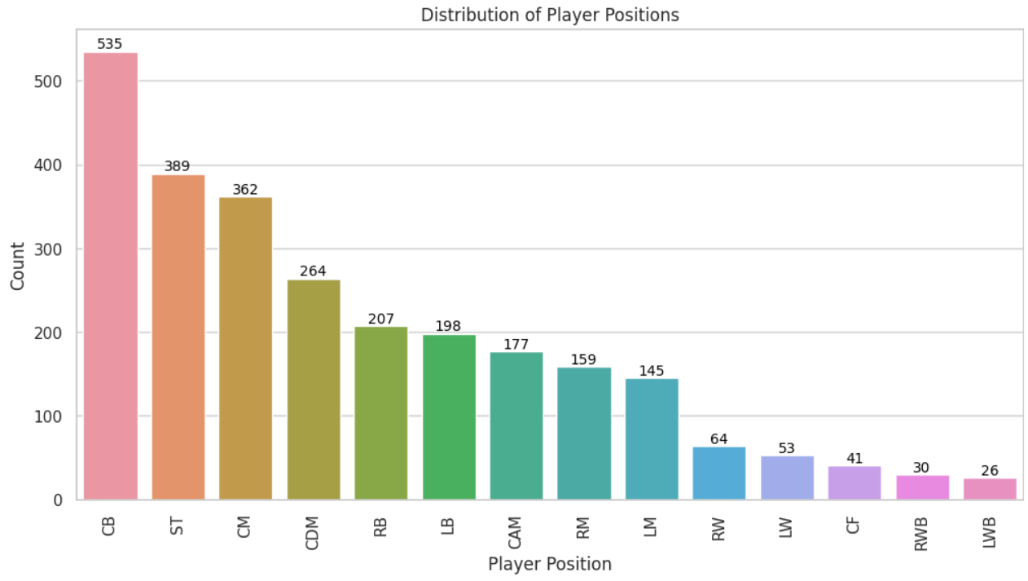
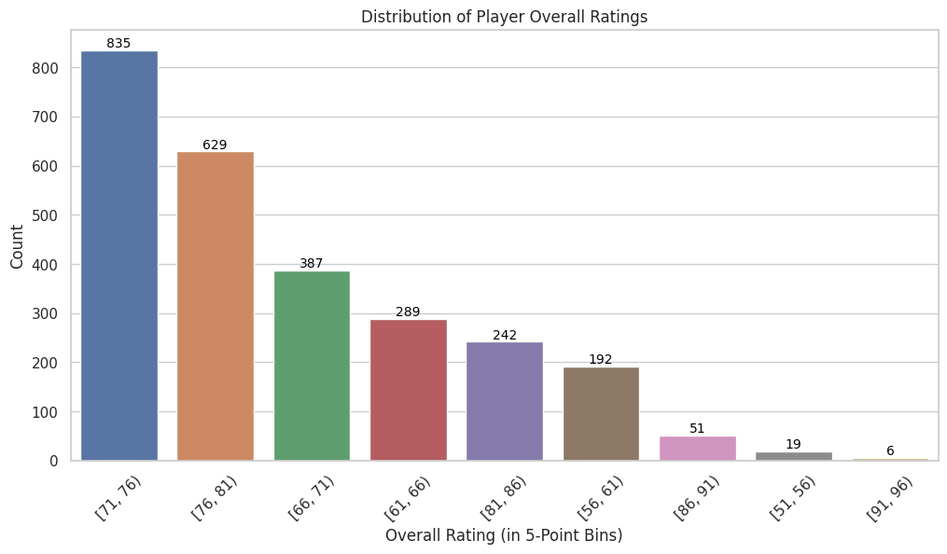
Exploratory Data Analysis

Slide 6
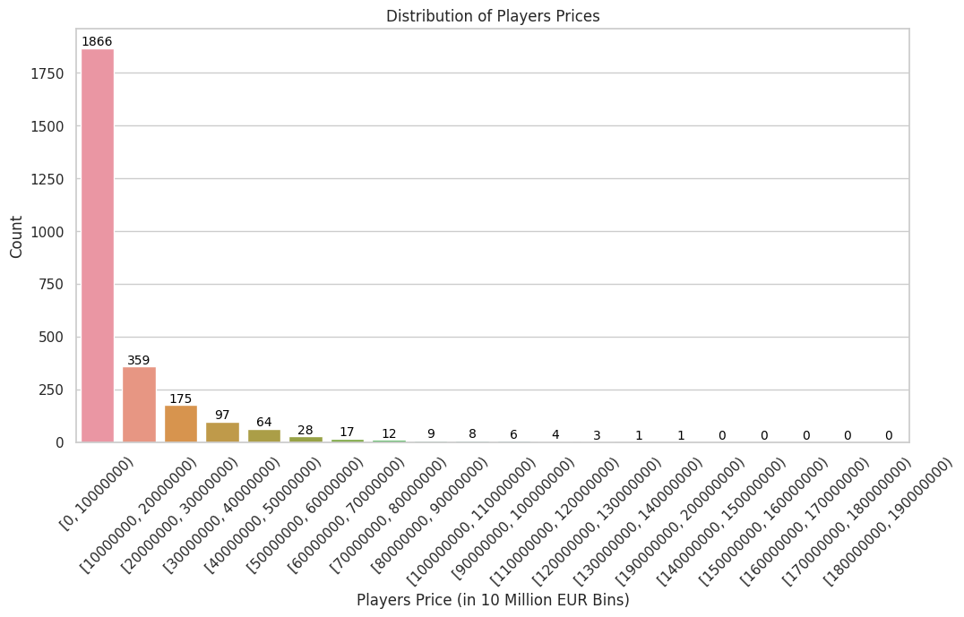
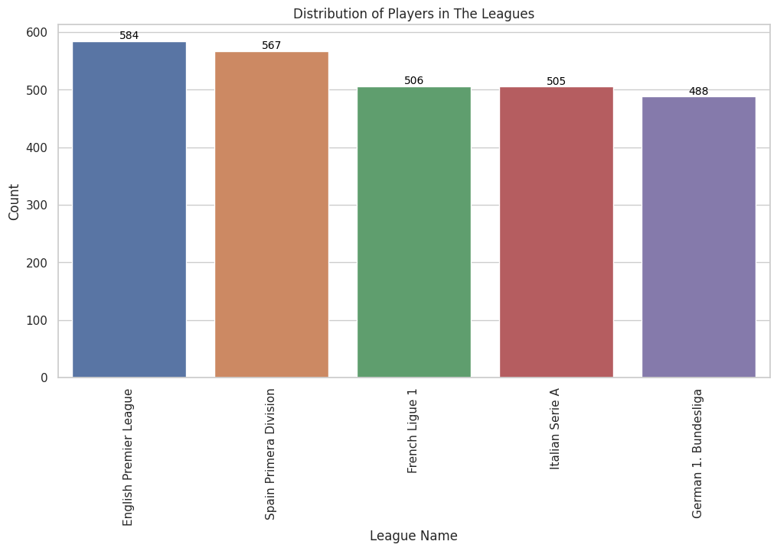
Exploratory Data Analysis

Slide 7
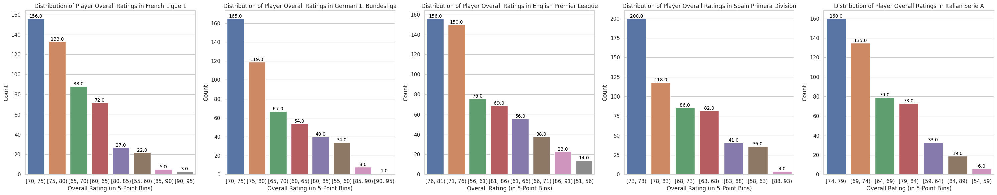
Exploratory Data Analysis

Slide 8
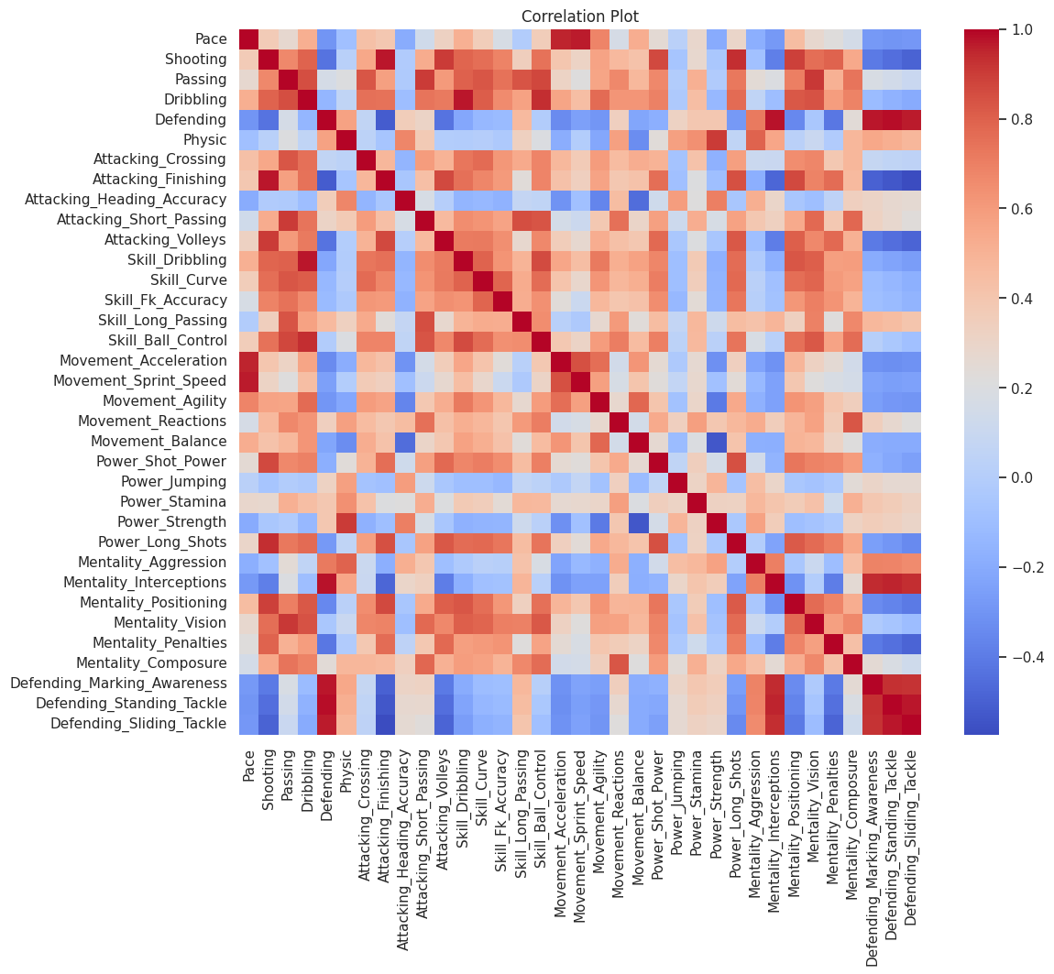
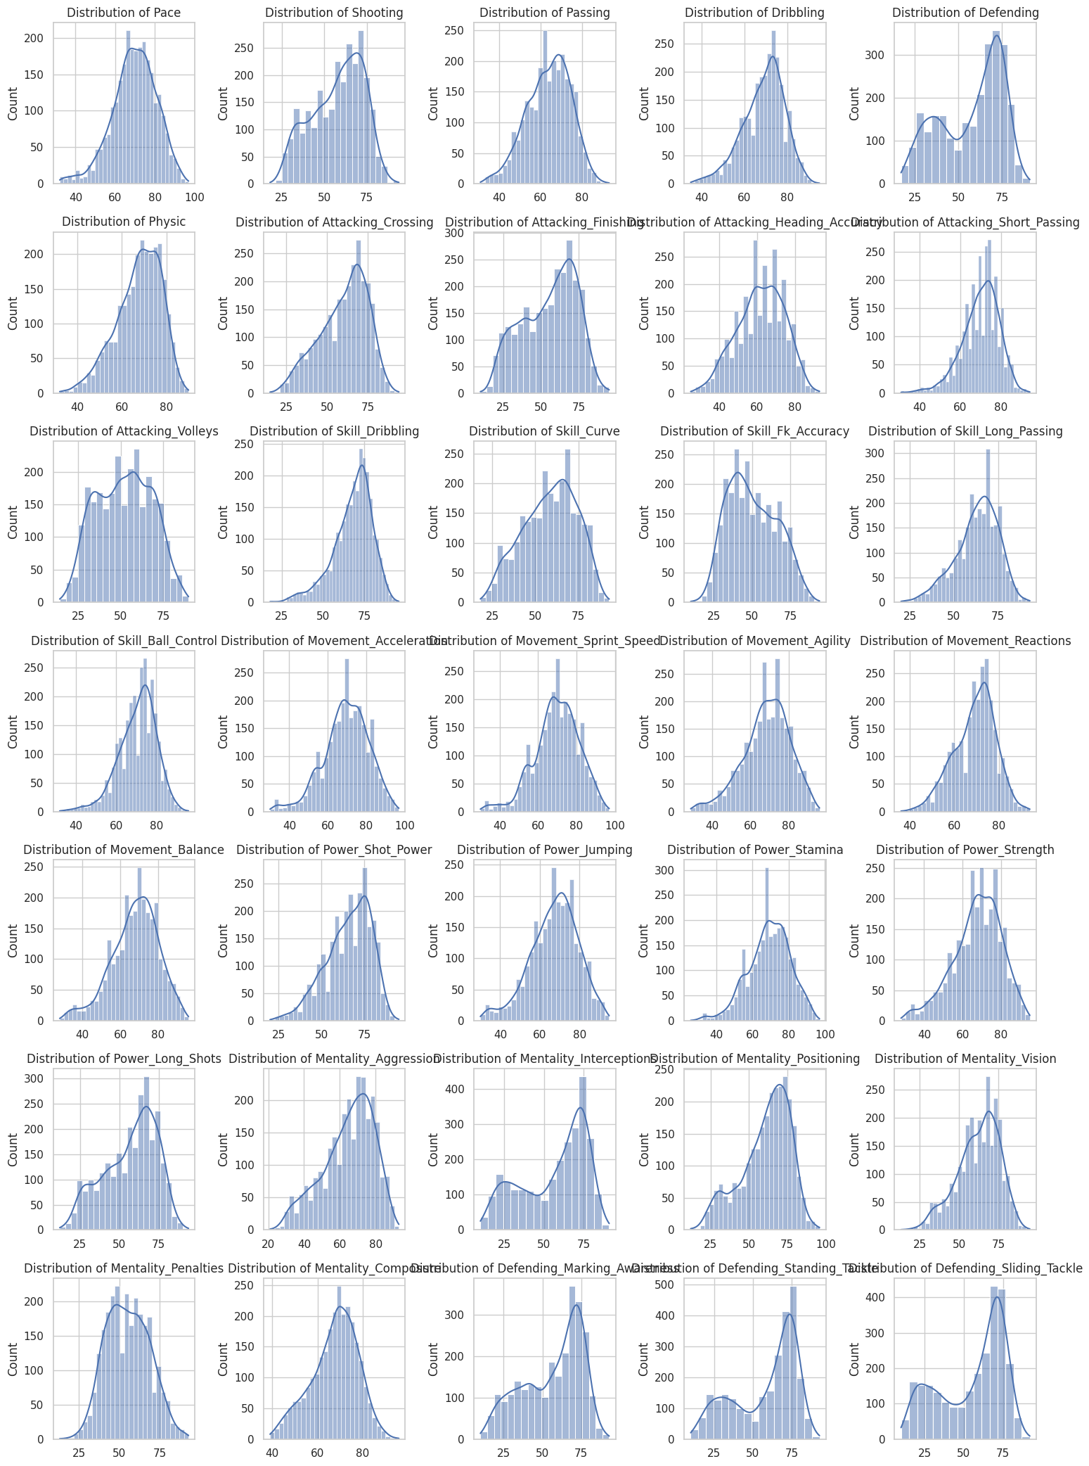
Exploratory Data Analysis

Slide 9
PRINCIPAL COMPONENT analysis

Slide 10
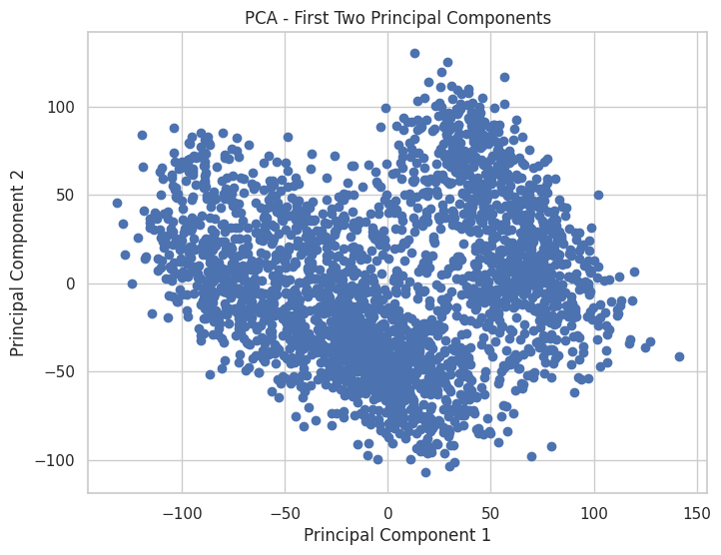
Principal Component Analysis
An initial plot was created with the aim of visualizing the data in a reduced two-dimensional space.
An assumption that can be reasonably made is that offensive and defensive players may exhibit some degree of separation or clustering in the PCA plot.
A more graphical representation of the percentages of variation that each PC accounts for is required to determine the optimal number of dimensions that would best explain our dataset

Slide 11
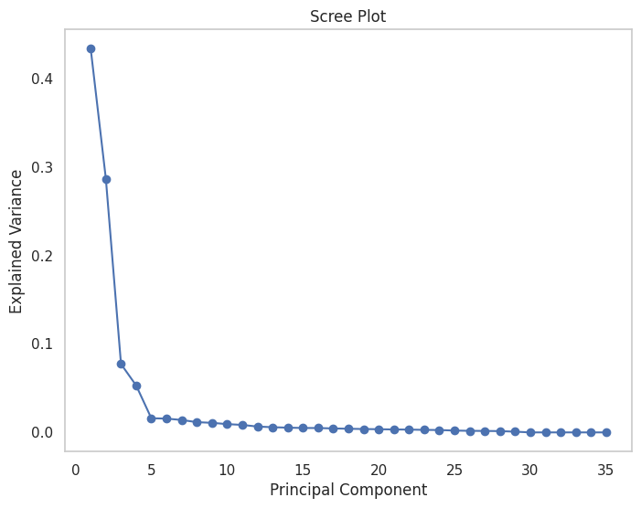
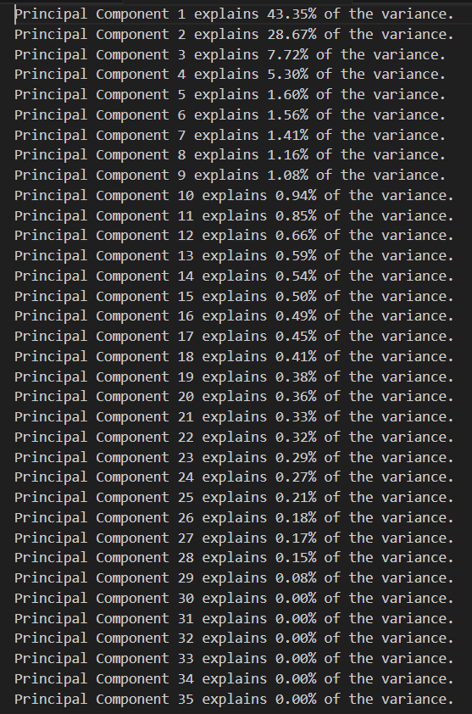
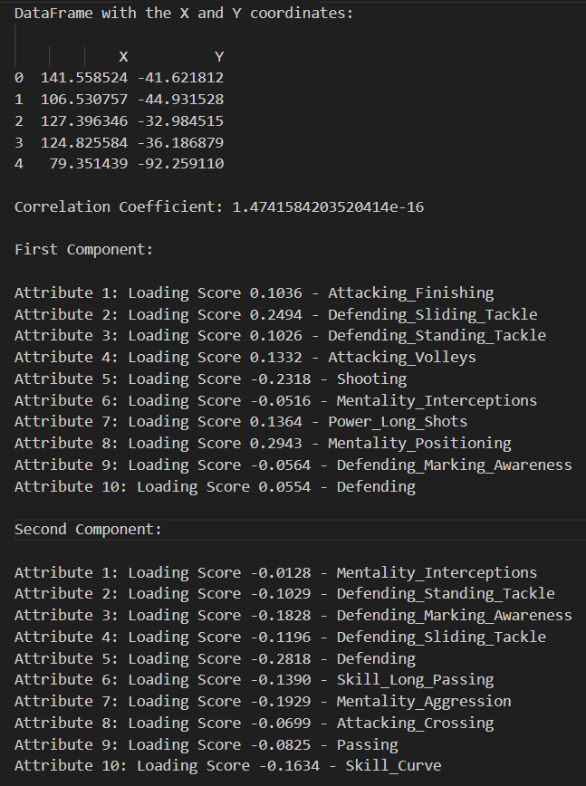
Principal Component Analysis
The scree plot reveals that the first two components account for 72.02% of the variance in the original data.
Confirming that the first two components are not correlated with each other.
Displaying the loading scores of the top 10 attributes of each component.

Slide 12
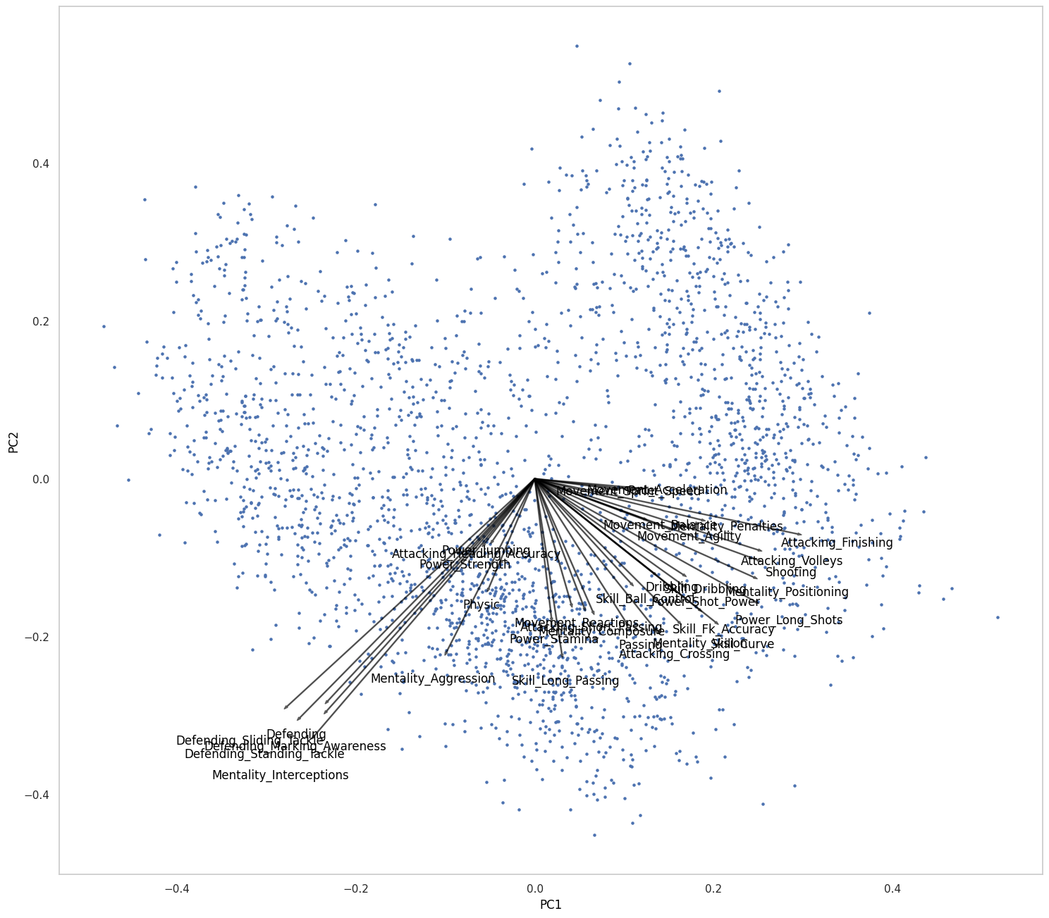
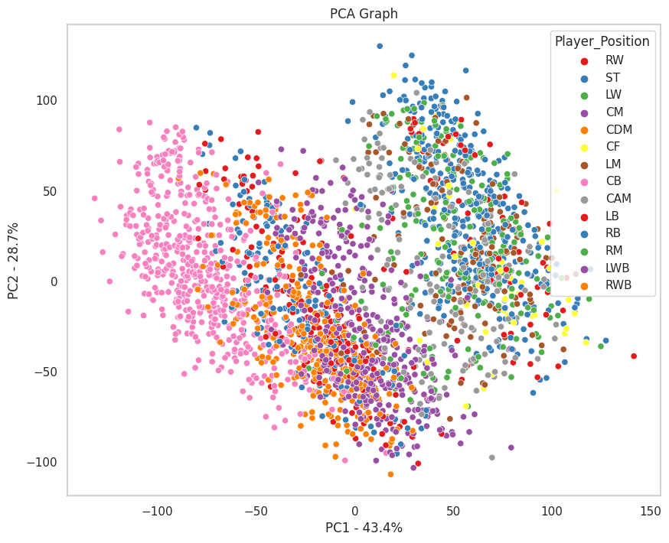
Principal Component Analysis
The arrows in the plot serve as a visual representation of the eigenvectors and their relationship to the original variables.
There are two main directions of these arrows, lower left, and lower right. We can see that the arrows are separated into two categories, defensive attributes (lower left) and offensive attributes (lower right).
From the scatterplot, We can clearly see that the offensive players are on the right side while the defensive players are on the left side

Slide 13
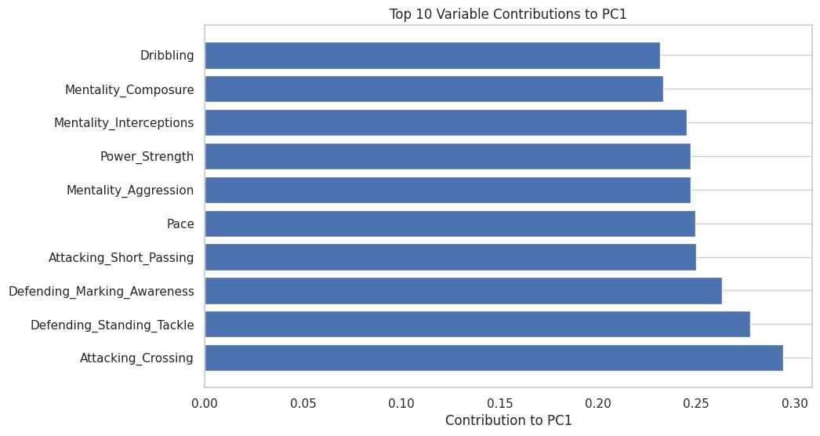
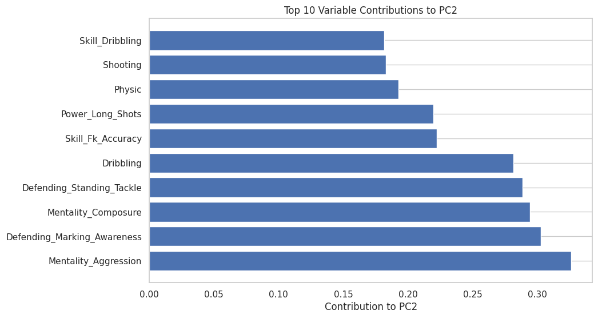
Principal Component Analysis

Slide 14
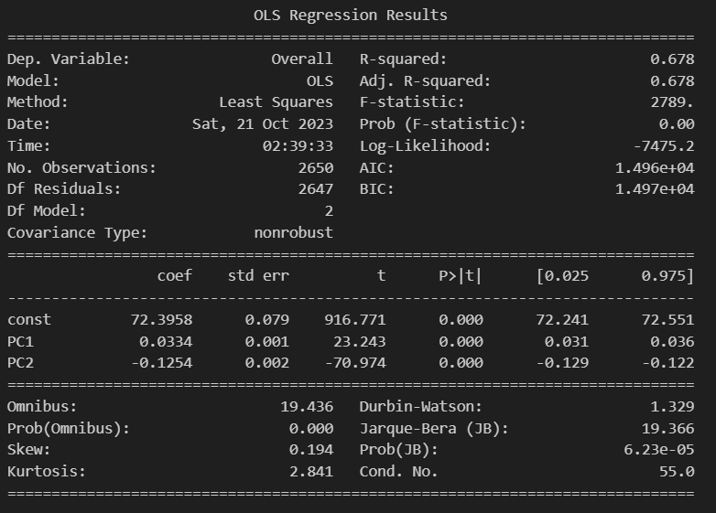
Principal Component Analysis
It appears that the two principal components (PC1 and PC2) are significant for determining the overall rating.
The R-squared value of 0.678 indicates that approximately 67.8% of the variance in the overall rating can be explained by the two principal components in the model.
This suggests that PC1 and PC2 collectively have a substantial influence on the overall rating.

Slide 15
Multivariate Analysis of VARIANCE

Slide 16
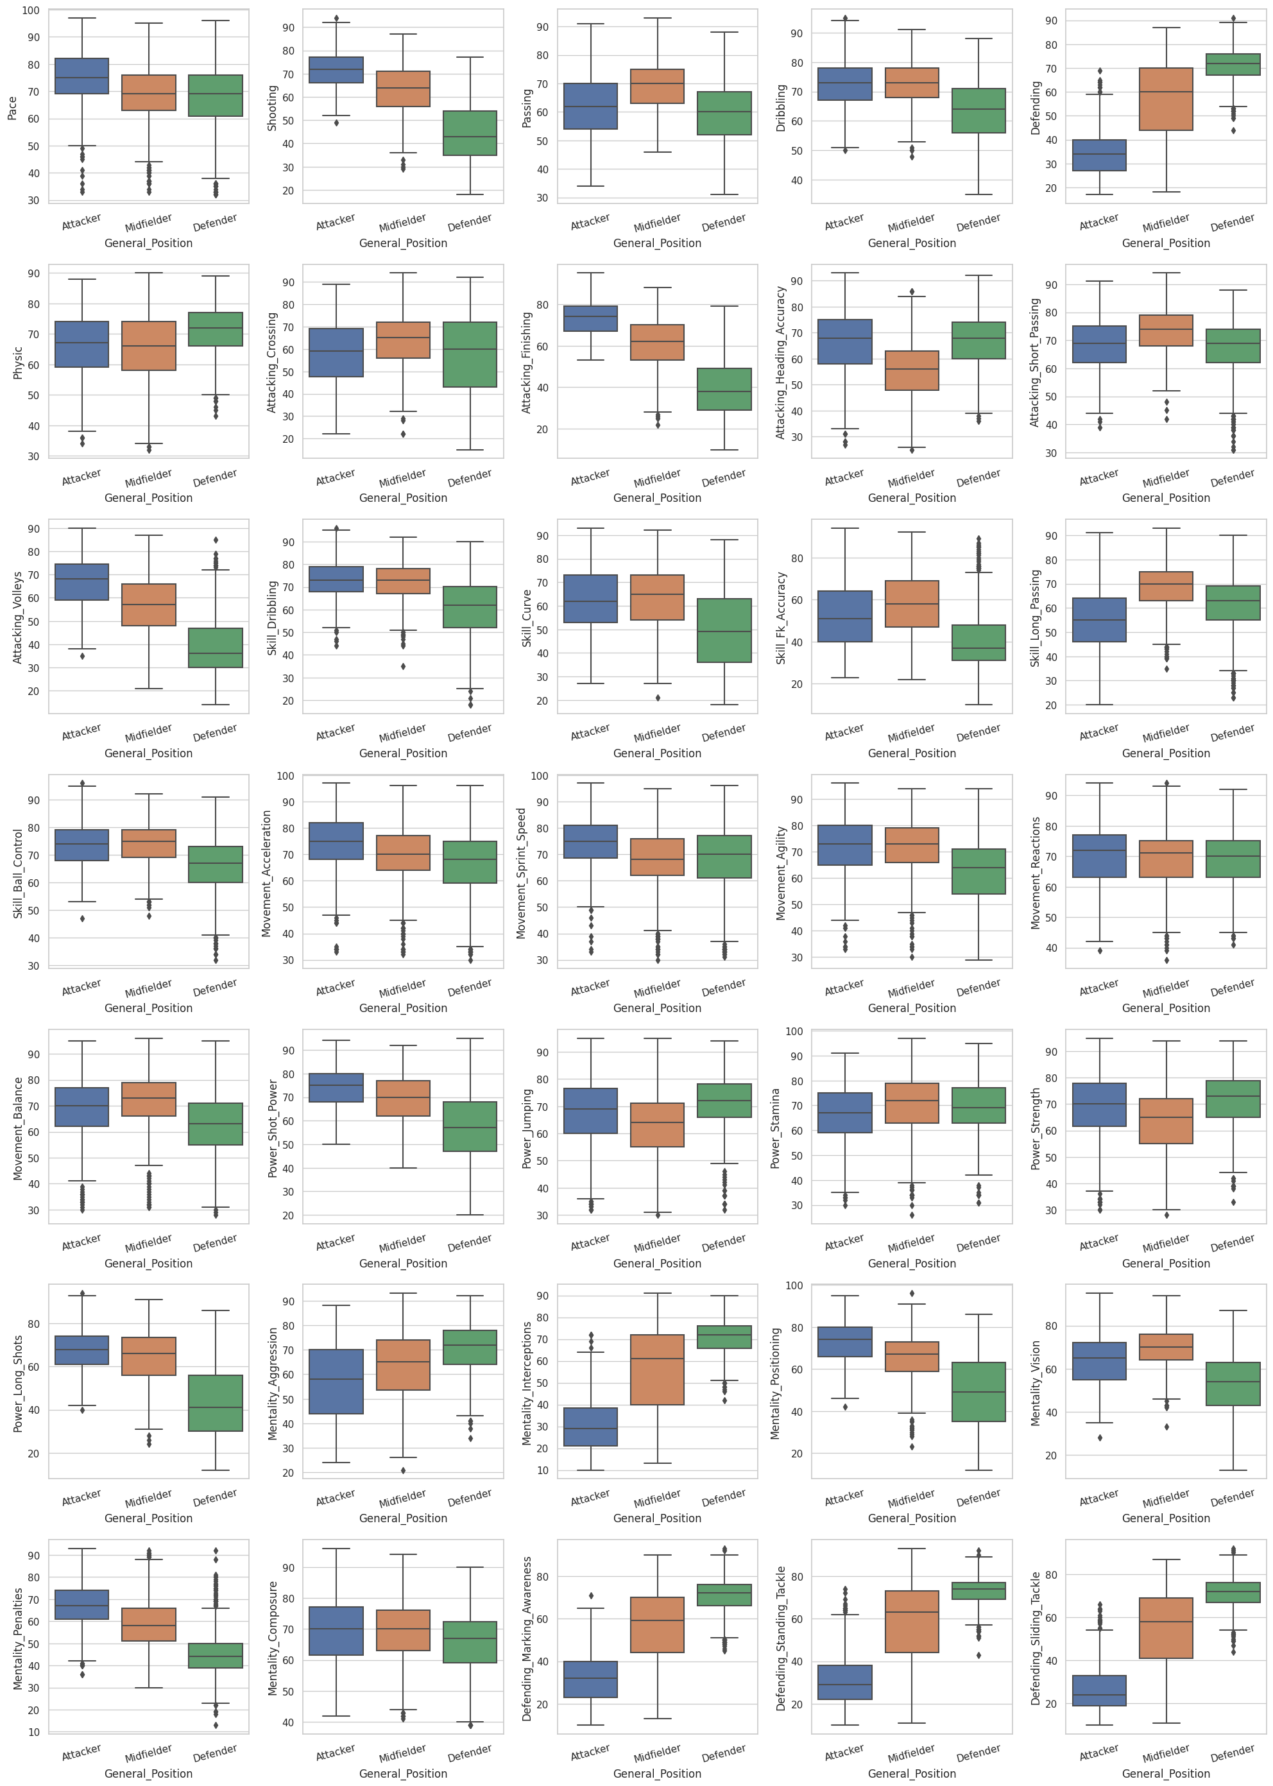
Multivariate Analysis of Variance
Testing whether player attributes vary significantly among players from different positions.
Generalize the players’ positions into three categories: Attacker, Midfielder and Defender.
Create a set of boxplots that visualize the distribution of players’ attributes based on their general positions.

Slide 17
Multivariate Analysis of Variance
The MANOVA assumptions are the following:
Groups that are compared should be independent
Having multivariate normality
Homogeneity of the covariance matrices
No multicollinearity, meaning there should not be a too strong correlation between the dependent variables.
Existence of linear relationship between the dependent variables for each group.

Slide 18
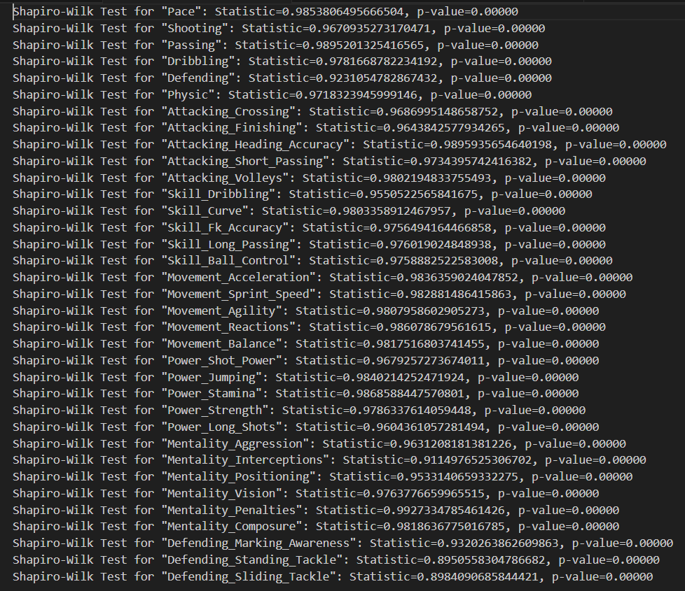
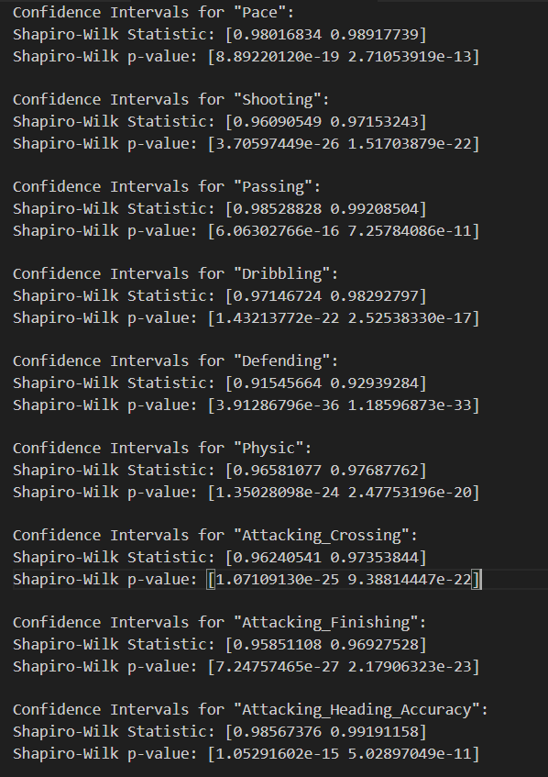
Multivariate Analysis of Variance
The Shapiro-Wilk test indicates that the data in these players’ football attributes is significantly deviating from a normal distribution.
A more robust assessment of the normality of the data by taking into account the variability is introduced by bootstrapping.

Slide 19
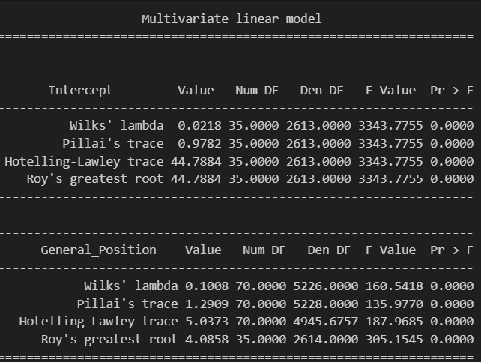
Multivariate Analysis of Variance
One of the tests that can be implemented that is the most robust against violations of the assumptions behind MANOVA is Pillai’s Trace test.
Null hypothesis: There are no group differences in the multivariate outcome variable(s).
Pillai’s trace value is 0.978, i.e., close to 1 & p-value is near 0 → There is a highly significant relationship between the "General Position" variable and the set of dependent variables.
We REJECT the null hypothesis.

Slide 20
CANONICAL CORRELATION ANALYSIS

Slide 21
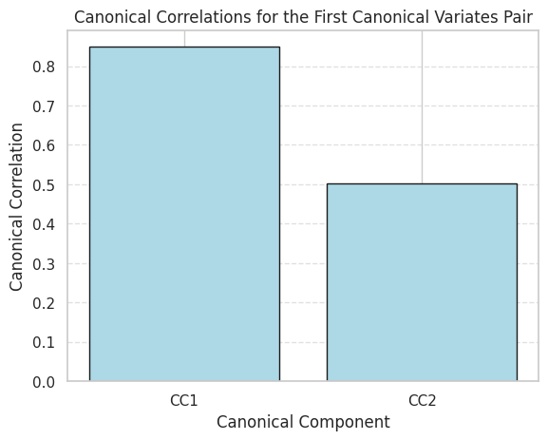
CANONICAL CORRELATION ANALYSIS
Observe the correlation between two separate categories of data: player general information and player football attributes.
Investigate how they collectively impact a player’s overall rating.
Generalize the players’ overall rating into three categories: High, Average, Low.
Visualizing the correlation for the first two canonical variates (CC1 and CC2).

Slide 22
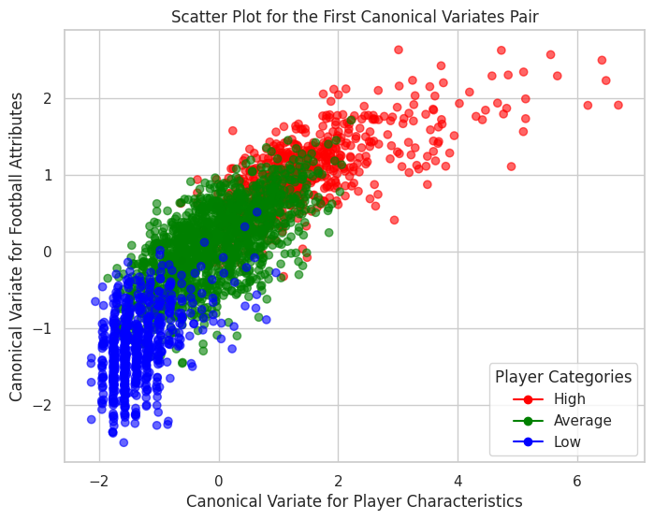
CANONICAL CORRELATION ANALYSIS

Slide 23
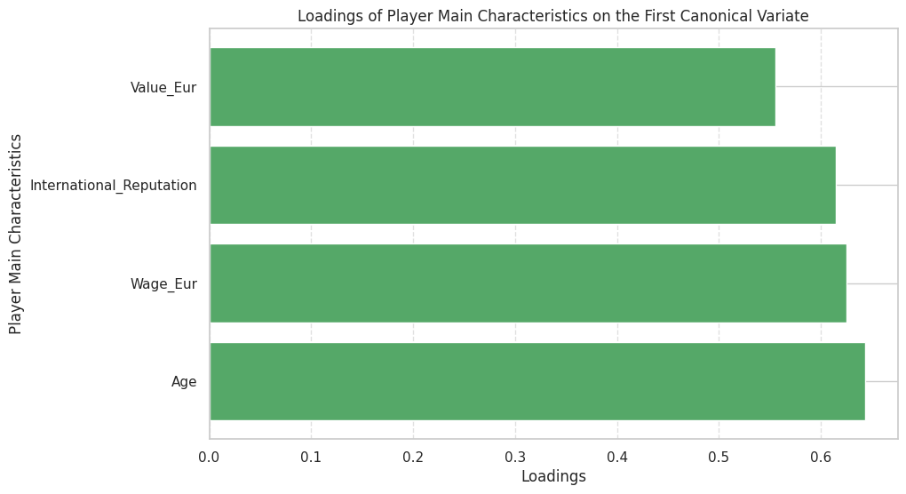
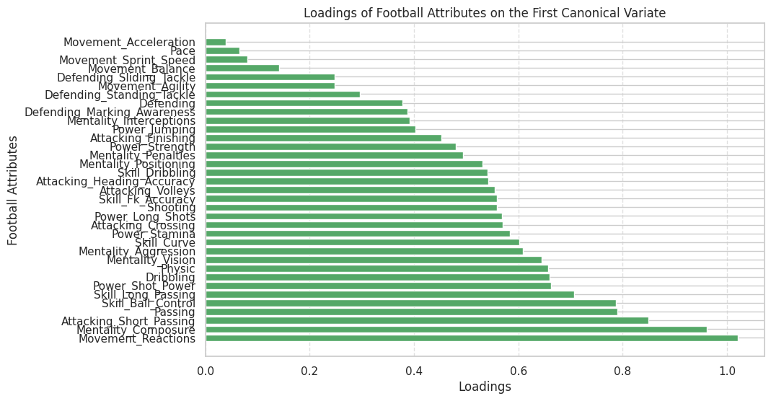
CANONICAL CORRELATION ANALYSIS
We do not have negative loadings.
Magnitude of the loadings for the player's general information (left plot)
Magnitude of the loadings for the player's football attributes (right plot)
These loadings indicate the strength of the positive relationship of each variable with the player's overall level.

Slide 24
Conclusion
This project provided valuable insights into FIFA 22 player statistics.
It identified the key attributes influencing overall player ratings
It examined variations in attributes across different positions
It revealed the correlation between general player information and football attributes in determining a player's overall rating.

Slide 25
THANK YOU

