Slide 1
Introduction to HTML
Amr Mohamed Eissa

Slide 2
Title and Content Layout with List
What is HTML
HTML TAGS
HTML ATTRIBUTES
HTML FORM AND INPUTS
HTML LAYOUT

Slide 3
Introduction
What is HTML ?
HTML Is Hyper Text Markup Language , Standard for writing web pages .
HTML History?
HTML Tags – 1991
HTML 2.0 – 1995
HTML 3.2 – 1997
HTML 4.0 – 1999
HTML 5.0 – 2014

Slide 4
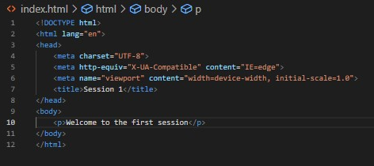
Introduction
HTML ?
WEB PAGES that run in a web browser (client side)

Slide 5
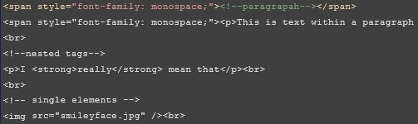
HTML Tags
TAGS .
<tag>content</tag>

Slide 6

HTML Tags
ATTRIBUTES .
<tag attributeName="attributeValue">content</tag>

Slide 7
HTML Tags
Head
<head>
<meta name="keywords" content="HTML, CSS, JavaScript">
<meta name="description" content="Intro to web dev">
<meta name="author" content="Alberto Romeu">
<meta http-equiv="refresh" content="30">
<title>Title of the document</title>
<br>
</head>

Slide 8
BODY
<body>
Write here the content of your web page
</body>

Slide 9
HEADING
<h1>I'm a very big heading</h1>
<br>
<span | style="font-family: | monospace; | font-size: | 19.662282943725586px; | fo
<span | style="font-family: | monospace; | font-size: | 19.662282943725586px; | fo
<span | style="font-family: | monospace; | font-size: | 19.662282943725586px; | fo
<span | style="font-family: | monospace; | font-size: | 19.662282943725586px; | fo
<span | style="font-family: | monospace; | font-size: | 19.662282943725586px; | fo
<span | style="font-family: | monospace; | font-size: | 19.662282943725586px; | fo
<span | style="font-family: | monospace; | font-size: | 19.662282943725586px; | fo

Slide 10
PARAGRAPH
<p>
Here’s a paragraph.
</p>
<p>
And here’s a different one. It’s as simple as that.
</p>

Slide 11
BREAK
I’d like to write some text<br>and then have the next bit on the line b

Slide 12
SPAN
<p>Here’s a paragraph of text. What I want to happen is to make <span> text </span> abc </p>

Slide 13
LINK
<a href="http://www.prodevelop.es" target="blank">This is a link</a>

Slide 14
IMAGE
<img src="picture.jpg" width="104" height="142" />
<br>
<a href="http://www.prodevelop.es" target="blank">
<span style="font-family: monospace;"> <img src="picture.jpg" width="10
</a>

Slide 15
DIV
Here’s some content…
<div>This is a div.</div>
<div>And this is another one. Works pretty much like a new paragraph for Here’s some more content…

Slide 16
TABLE
<table border="1">
<tr>
<th>Header 1</th>
<th>Header 2</th>
</tr>
<tr>
<td>row
<td>row
</tr>
<tr>
<td>row
<td>row
</tr>
</table>
1, cell 1</td>
1, cell 2</td>
2, cell 1</td>
2, cell 2</td>

Slide 17
list
<ul>
<li>Coffee</li>
<li>Milk</li>
</ul>
<br>
<ol>
<li>Coffee</li>
<li>Milk</li>
</ol><br>

Slide 18
FORM
<form>
First name: <input type="text" name="firstname"><br> Last name: <input type="text" name="lastname">
</form>
<br>
<form name="input" action="html_form_action.php" method="get"> Username: <input type="text" name="user">
<input type="submit" value="Submit">
</form><br>

Slide 19
LAYOUT
<!DOCTYPE html>
<html>
<body>
<div id="container" style="width:500px">
<div id="header" style="background-color:#FFA500;">
<h1 style="margin-bottom:0;">Main Title of Web Page</h1></div>
<div id="menu" style="background-color:#FFD700;height:200px;width:100px;
<b>Menu</b><br> HTML<br> CSS<br>
JavaScript</div>
<div id="content" style="background-color:#EEEEEE;height:200px;width:400 Content goes here</div>

Slide 20
Thank You
Amr Mohamed Eissa

