Slide 1
Air and Traffic Data ETL Design Air and Traffic Data Pipeline
Transform
Air Data Transposed From Column to Rows in Stage Schema
WGS 26917
Tables are Projected to WGS:26917 in Production Public Schema
02
04
01
03
05
Extraction
Web Scraping Data and Saving to Stage Schema
Load
3:1 Duplicates-to-Unique Records Eliminated and Stored in Public Schema
Aggregation
Weekly, Daily, and Lifetime Calculated Avg in Public Schema

Slide 2




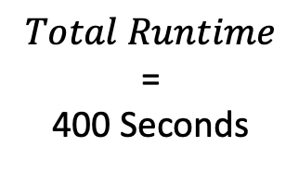
Pipeline Process Execution Time
1
2
3
4
Web Scraping
Staging Tables
Transform
Load
$$Total Runtime$$ = 400 Seconds
279.1 Seconds
69.7%
64 Seconds
16%
1.9 Seconds
0.48%
55 Seconds
13.8%
Notes:
© Copyright PresentationGO.com – The free PowerPoint and Google Slides template library

Slide 3
Autonomous Machine Learning and Web Maps
H₂O AutoML
INLA
GeoPandas
Shapely
Training and Predictive Data
Pipeline
Data
Lake
Turf
Mapbox
Folium
Load Testing
Optimal Map
Notes:
© Copyright PresentationGO.com – The free PowerPoint and Google Slides template library

