Slide 1

Toronto Weather, Pedestrians,
Vehicles, and Air Quality
Web Maps
Amr Shalaby

Slide 2
Air and Traffic Data ETL Design Data Sources
1. Canada Environment Air Quality and Weather Data
1: Best to 11: Worst from February 1, 2023 – Today
2. City of Toronto Open Data Portal
Traffic Volume January 18 , 1984 – December 19, 2023
3. ArcGIS Data Portal
Pedestrians and Vehicles Counts Dec 1, 2003 – September 7, 2016
4. Canada Natural Resources
Geo Stations Meta Data from Jan 1, 1850 – March 5, 2024

Slide 3


Air and Traffic Data ETL Design Code Structure
Data Ingestion
Configuration Object
Config.ini
Data Frames Object
Extremely Efficient
(DB Connections Bypassed)
User Requirements DB Credentials, Auto ML Duration, Forecast Horizon

Slide 4
Air and Traffic Data ETL Design Air and Traffic Data Pipeline
Transform
Air Data Transposed From Column to Rows in Stage Schema
WGS 26917
Tables are Projected to WGS:26917 in Production Public Schema
02
04
01
03
05
Extraction
Web Scraping Data and Saving to Stage Schema
Load
3:1 Duplicates-to-Unique Records Eliminated and Stored in Public Schema
Aggregation
Weekly, Daily, and Lifetime Calculated Avg in Public Schema

Slide 5
Air and Traffic Data ETL Design Auto ML Layer and Load Testing
H₂O
GeoPandas
Shapely
Database
Turf
Folium
Mapbox
Load Testing
Optimal Map
Historical and Forecasted Data
Locust
Data Frames Object
selenium
Historical and Predictive Data
Notes:
© Copyright PresentationGO.com – The free PowerPoint and Google Slides template library

Slide 6
Air and Traffic Data ETL Design Execution Phases
Main.py Executes All Steps
Config.ini
DB Credentials
Auto ML Duration
Extractor
Web Scraping
Ingesting Scraped Data into Stage Schema
Transformer
Create Projection Tables PostGIS
Transpose Air Data (Station ID were Columns)
Save Locally Flag
Skip DB Ingestion
Skip Prediction
Insert Timestamp of Inserted Records
Loader
Pushes Staging Table into Public Schema
Tracks Performance
Data Frames Creator
Pandas
GeoPands
H2O
Data Frames
Maps Creator
Creates Web Maps from Data Frames
Maps Tester
Performance Testing of Each Map Type
Configs Object & Data Frames Object
Notes:
© Copyright PresentationGO.com – The free PowerPoint and Google Slides template library

Slide 7






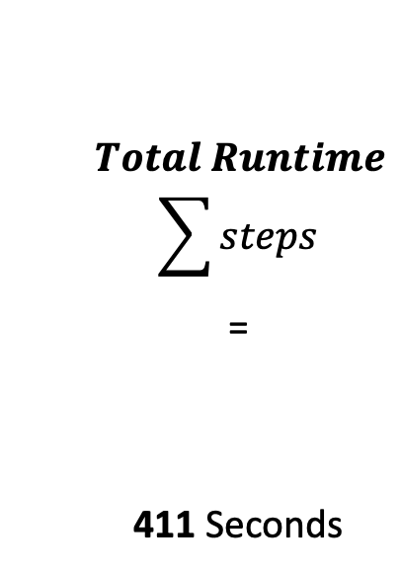
Air and Traffic Data ETL Design Pipeline Execution Time
1
2
3
4
5
6
$$Total Runtime$$
$$\sum{steps}$$
=
411 Seconds
Web Scraping
Staging Tables
Transform
Load
Dataframes
Web Maps
279.1 Seconds
68%
64 Seconds
16%
1.9 Seconds
0.48%
55 Seconds
13.4%
7.1 Seconds
1.7%
3.8 Seconds
0.9%
Notes:
© Copyright PresentationGO.com – The free PowerPoint and Google Slides template library

Slide 8
Air and Traffic Data ETL Design Maps Efficient Implementation
Map
Control Layer
Feature Group
Markers
Marker Cluster
. add to
. add Child
No Bugs
Bugs

Slide 9
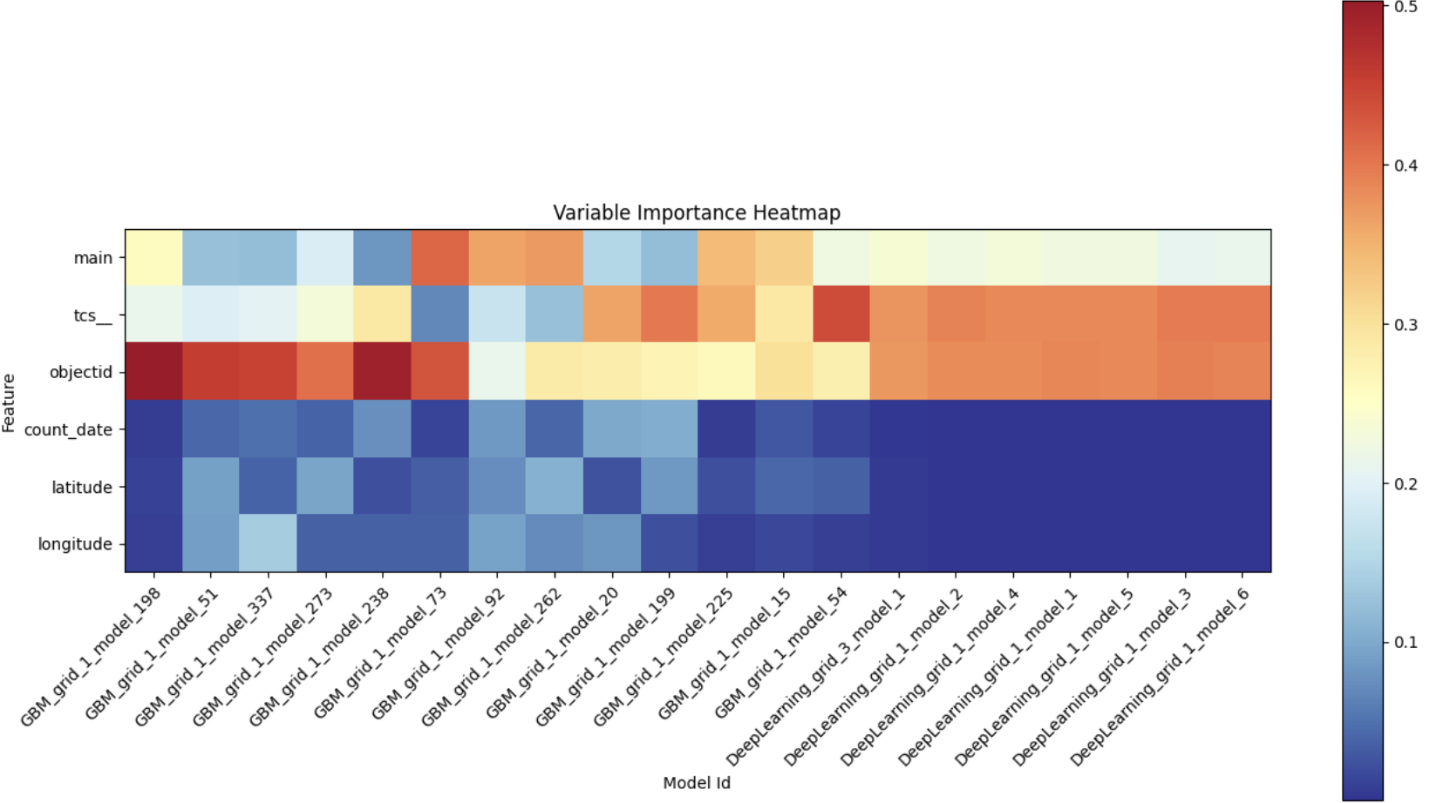
Air and Traffic: H₂O Traffic More Spatial Less Temporal

Slide 10
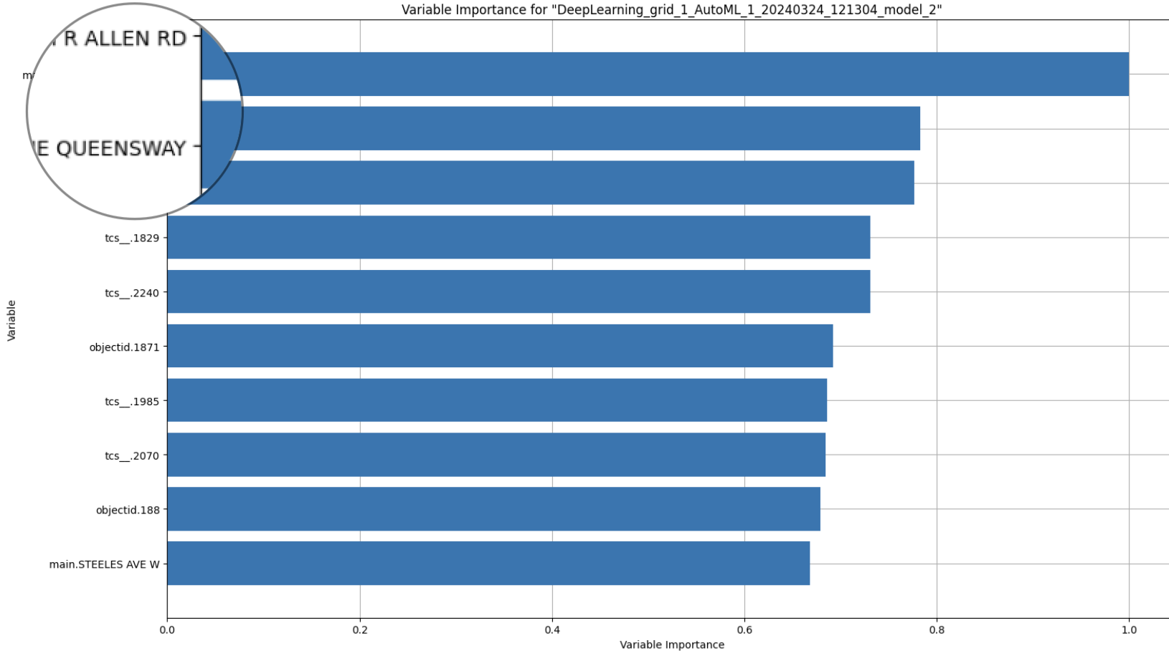
Where is: H₂O Traffic More Spatial Less Temporal

Slide 11
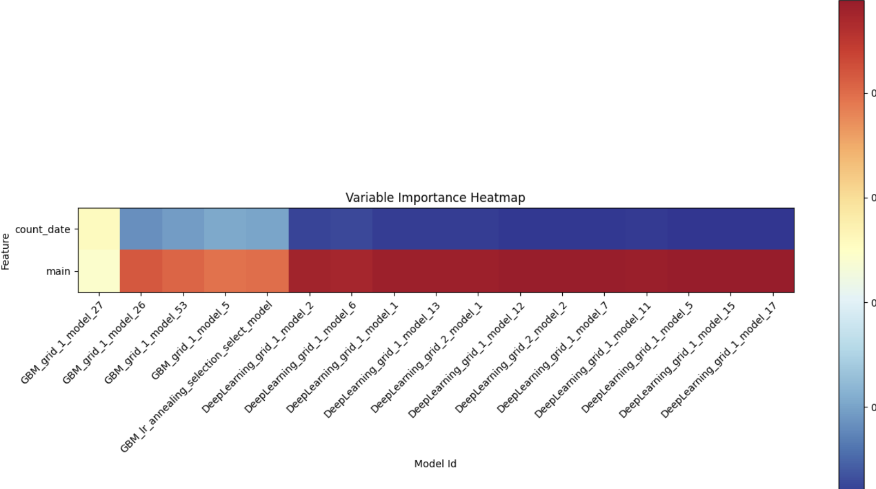
Air and Traffic : H₂O Pedestrains More Spatial Less Temporal

Slide 12
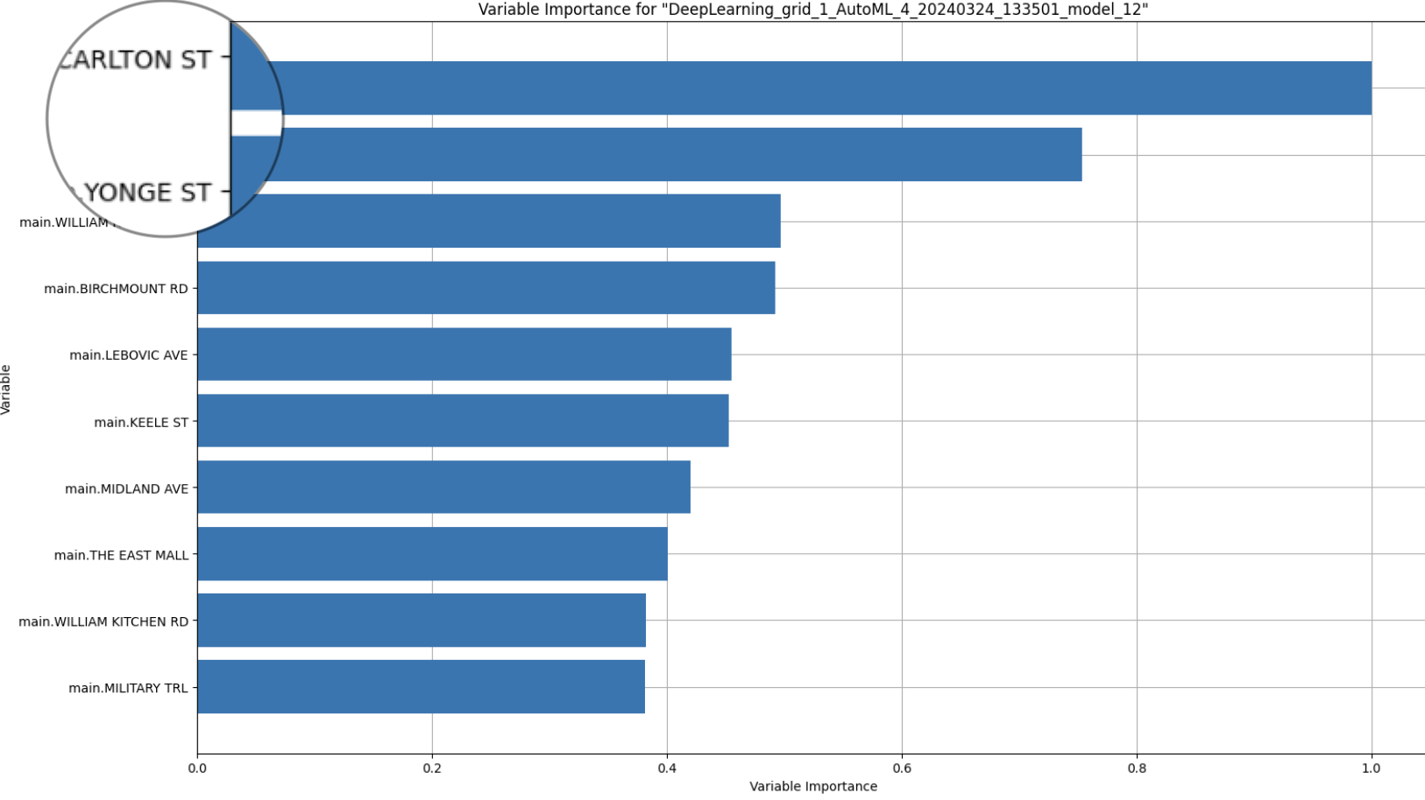
Where is: H₂O Pedestrains More Spatial Less Temporal

Slide 13
Where is: H₂O Pedestrains More Spatial Less Temporal

Slide 14
Air and Traffic: Optimal Maps (Loading Time)

Slide 15
Finally: The Map
https://amr-y-shalaby.github.io/ggr_472_project/
https://github.com/amr-y-shalaby/ggr_472_project

