Slide 1
بسم الله الرحمن الرحيم
Name : Amr Gamal Abbas
Group: 1.9

Slide 2
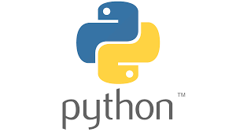
Python Basics

Slide 3
Data type :
1- int >>> integer >> ex: 1 ,2 ,3 ,20 ,100
2- float >> ex: 1.5 , 0.5
3-str>>> string >> ex: “hello world”
4-bool>>> True , False
-------------------------------------
Any thing in python is {Object}
To get the type of any object use function :
type ()

Slide 4
Print → hello world
If we want to print any thing in python we can use function print to do that :
print (“hello world”)
Out :
hello world

Slide 5
if condition
if condition :
code will run if condition True
elif condition:
code will run if condition True
else:
code that will run when all conditions are False

Slide 6
For loop
EX:
for i in range(4):
print(i)
Out:
0
1
2
3

Slide 7
While loop
Ex:
i=0
While i<5:
print(i)
i=i+1
Out:
0
1
2
3
4

Slide 8
Input
To get an input from user you can do this with function :
input()
Be carful the type of data in this function is string

Slide 9
Functions
To do any function in python do the steps in this example:
def say_hello(name):
print(f”hello{name}”)
say_hello(“amr”)
Out:
hello amr

Slide 10

Github

Slide 11
I LEARNED IN GITHUB :
1-git clone
2- git status
3-git add
4- git reset head ( file name)
5- git commit –m
6- git branch
7-git remote –v
8- git push (remote name )(branch name)

