Slide 1


Assiut University
Faculty of Computers & Information
Faculty and Students Scheduling Information System (FSSIS)

Slide 2
Project Team
Amr Abdo Saber Shaaban
Omar Nasr Mohamed Salama
Ali Ossama Ali Mohamed
Abd-El Monem Khamis Ishmail Hassan
Fatma Mahmoud Wadia Sheref
Fatma Mahmoud Abd-El-Tawab Gad El-Rab
Ghada Helal Zakaria El-Said Salama
Supervisor
Dr. Naglaa
Eng. Omnia
2023/2024

Slide 3

Problem definition

Slide 4

The Faculty and Students Scheduling and Information System (FSSIS) benefits both students, professors, and teaching assistants by providing them with detailed schedules and information related to the college, including lectures, sessions, and their respective locations and times. It helps students to be aware of all the professors available in their academic year, as well as the academic subjects and the individuals responsible for teaching them, whether professors or teaching assistants.

Slide 5
Also, it helps the scheduling committee to organize schedules for students, professors, and teaching assistants and to view their schedules systematically, avoiding schedule conflicts.

Slide 6
It also aids IT technicians in understanding the status of all devices in the college, enabling them to perform necessary repairs. Additionally, it supports student affairs personnel in obtaining details about the facilities, such as available equipment and chairs suitable for use during exams. This information proves valuable for organizing students into examination committees.

Slide 7

Motivation

Slide 8
The existence of numerous schedules for students, professors, and teaching assistants has led to the problem of schedule conflicts and overlapping appointments. Therefore, the idea solves this issue by providing a single schedule containing all the appointments for students, professors, and teaching assistants.

Slide 9
Another problem arises for professors and teaching assistants when a lecture or section is canceled. Therefore, one of them wants to compensate for the lecture or section at a suitable time and place for the students. This is achieved by providing the scheduling committee with a schedule that includes both available and occupied time slots for laboratories and lectures. This facilitates the selection of suitable locations by professors and teaching assistants from the available slots.

Slide 10
Another problem arises specifically for IT technicians, which is the negligent management of laboratories and lecture halls, and the lack of awareness of their status, including the equipment in each lab and lecture hall. Therefore, the idea solves this problem by providing a dedicated schedule for laboratories and lecture halls containing the status of each device and the specifications of each lab and hall as well.

Slide 11

Objective

Slide 12
The Faculty and Students Scheduling and Information System (FSSIS) aims to facilitate the process of knowing the schedules and locations of lectures and sessions for both students, professors, and teaching assistants without the need to consult multiple schedules. This provides them with schedule stability and prevents conflicts in timings. In the event of any schedule changes, everyone can be informed of such changes and can act accordingly without having to refer to student affairs.

Slide 13
Moreover, the project enables individuals to know the detailed locations of professors' and teaching assistants' offices, along with their office hours. It also allows administrators to have a comprehensive overview of all schedules for students, professors, and teaching assistants.
It also aims to improve the quality of facilities and equipment by allowing IT technicians to identify devices that have malfunctions and require maintenance. This includes computers, air conditioning units, chairs, and projectors found in laboratories and lecture halls.

Slide 14

ERD
Use case diagram
Use case scenario
Activity diagram
Function requirement

Slide 15
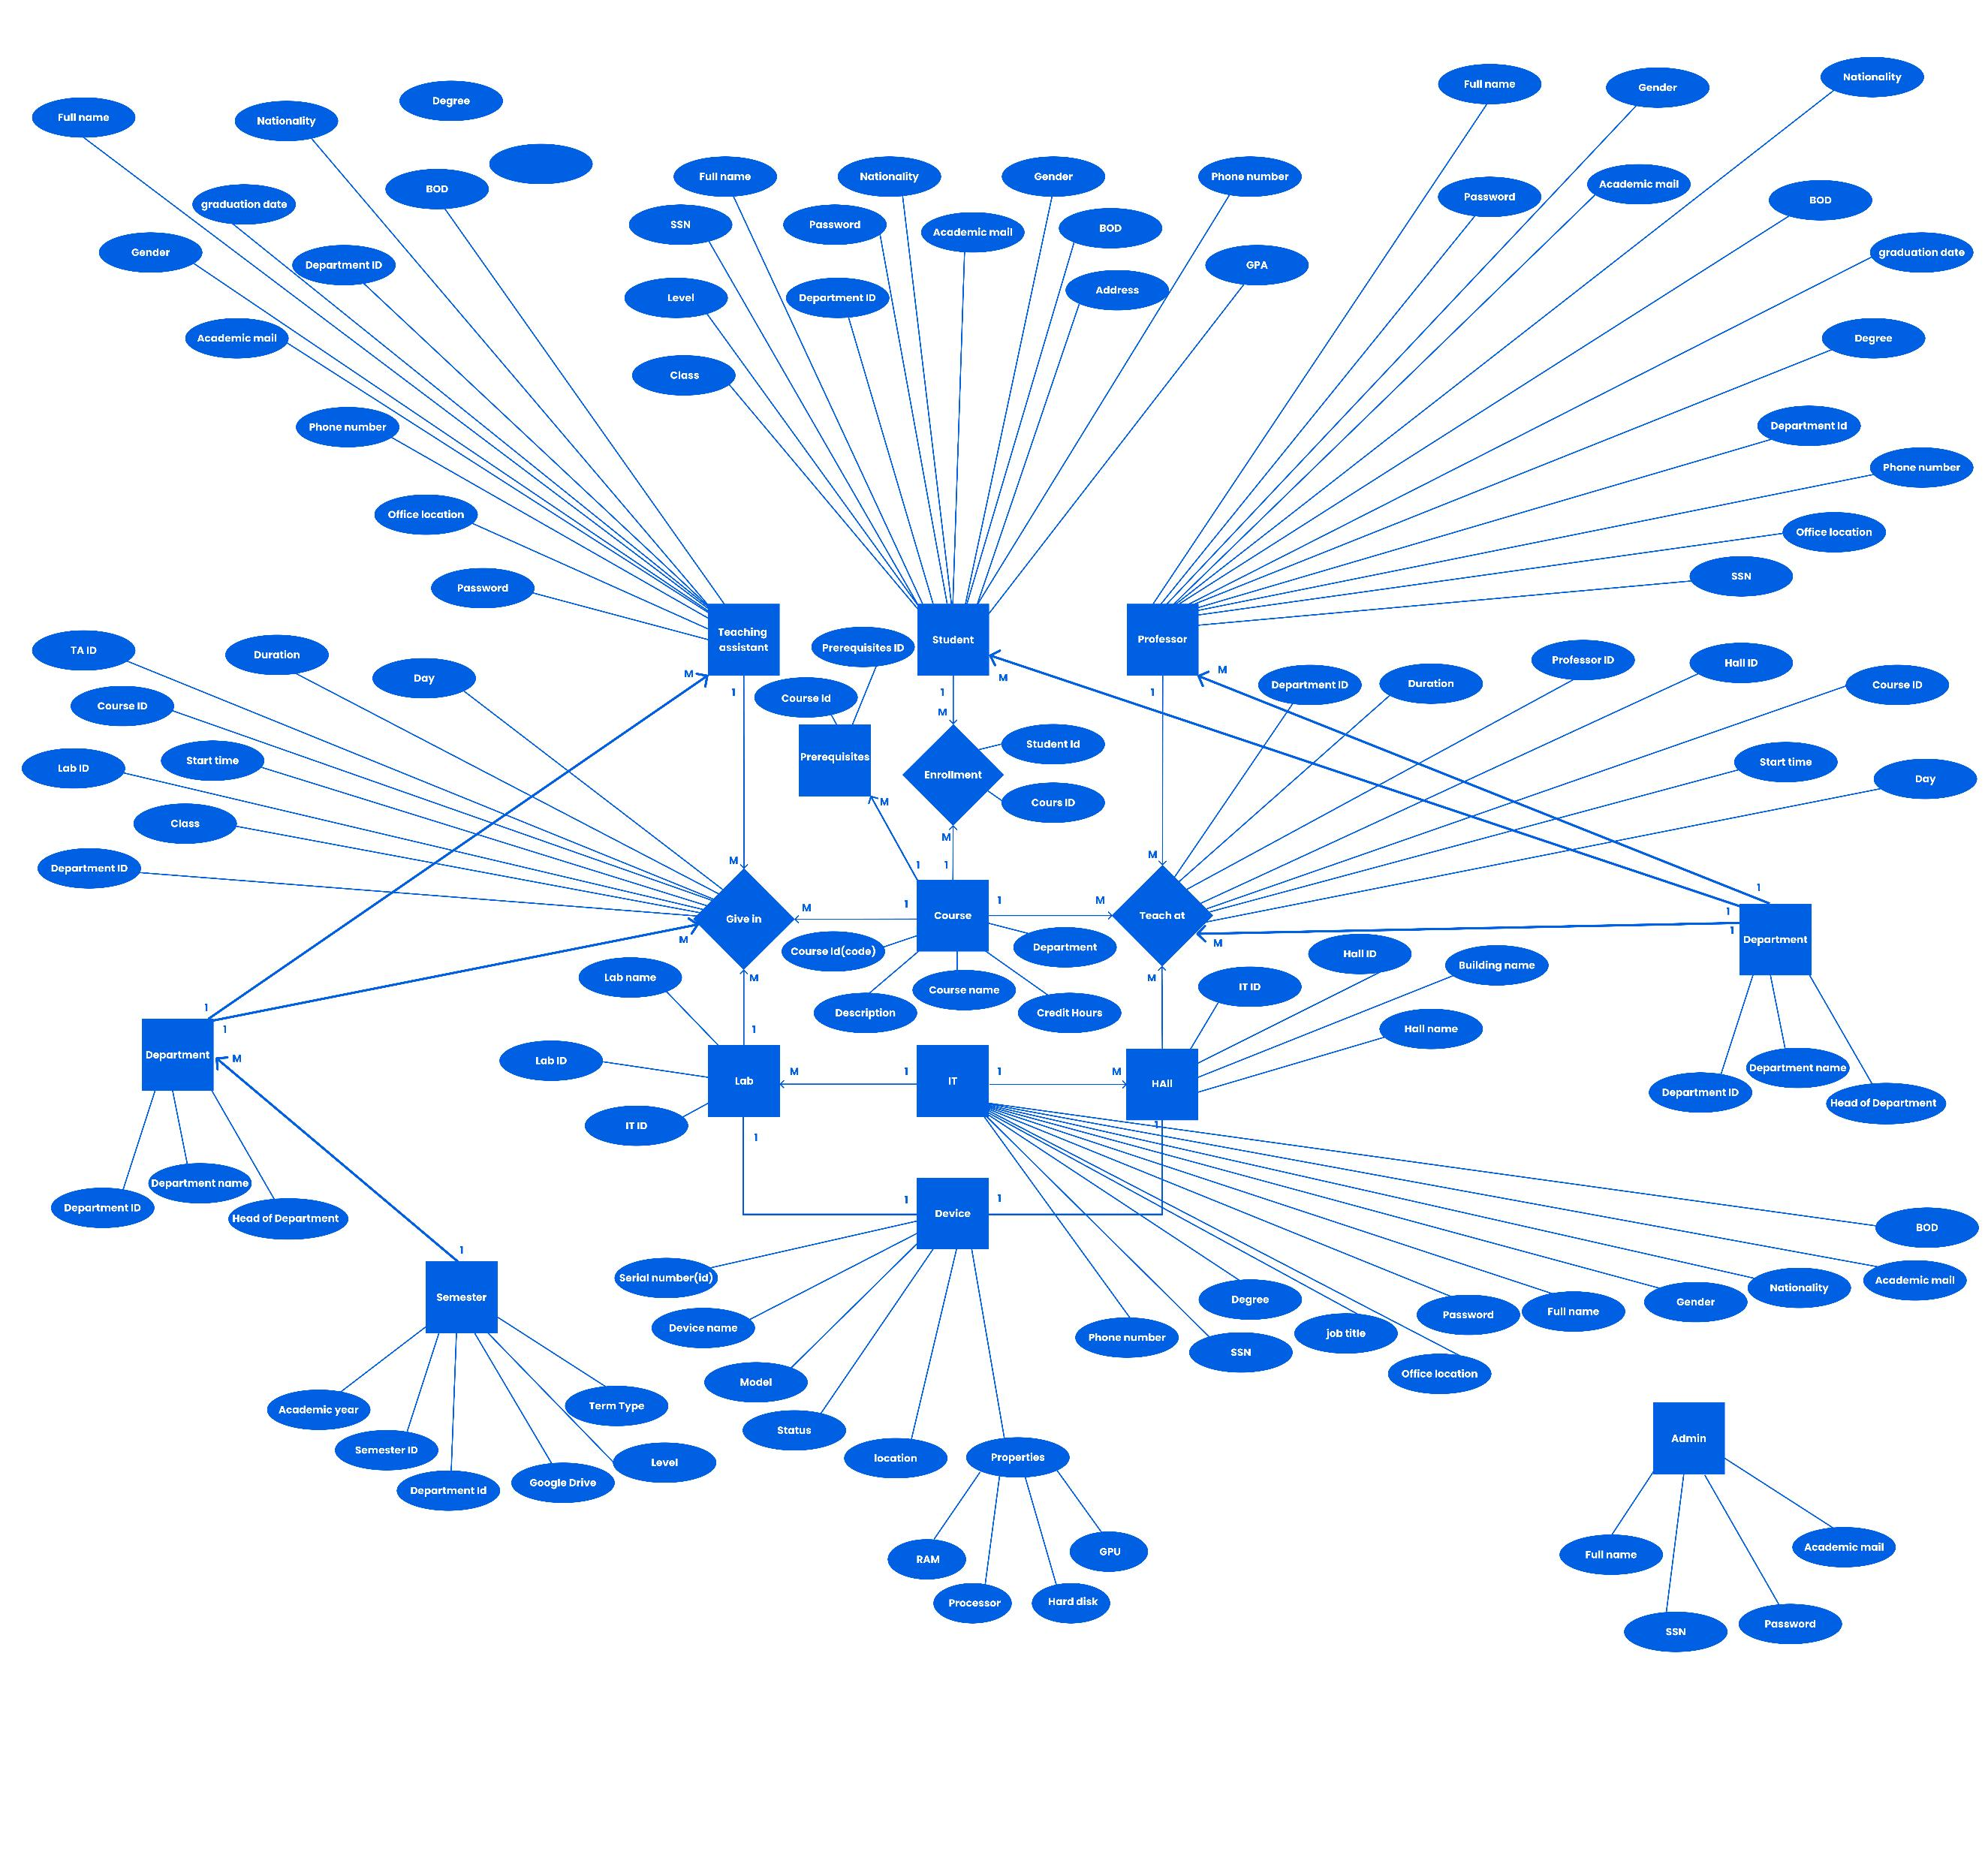

Slide 16
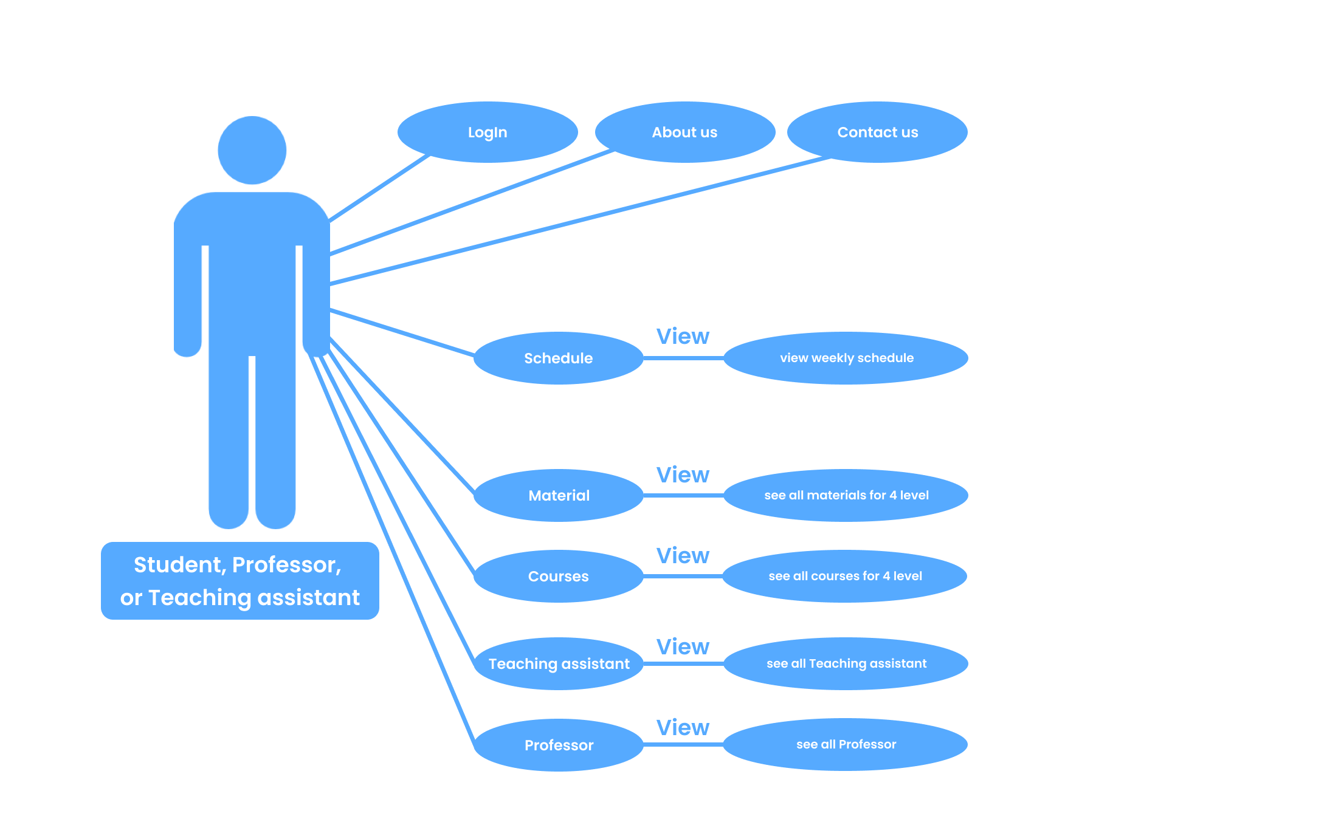

Slide 17
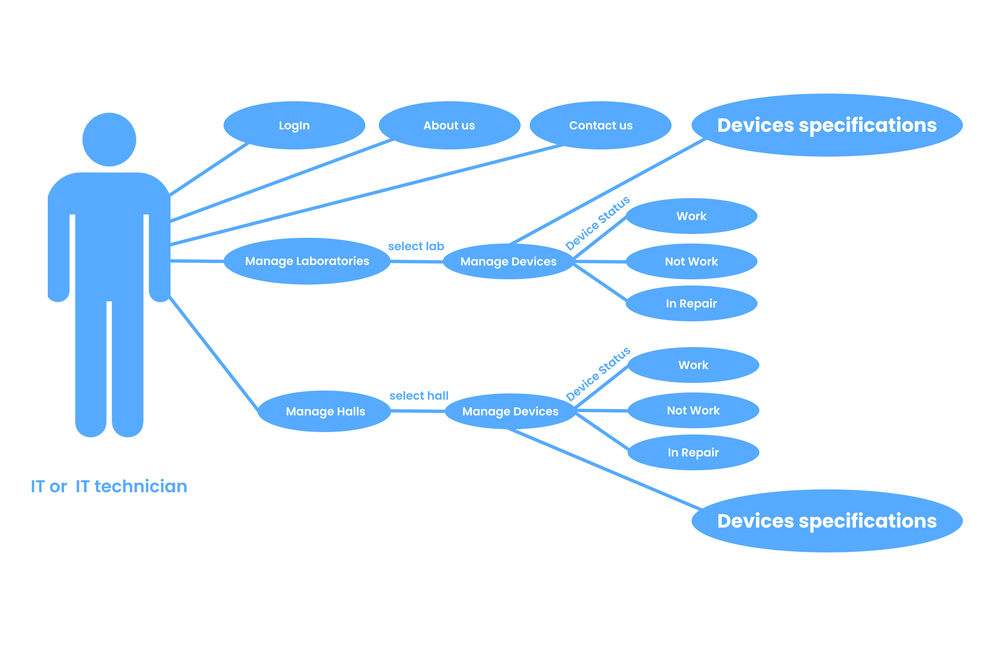

Slide 18
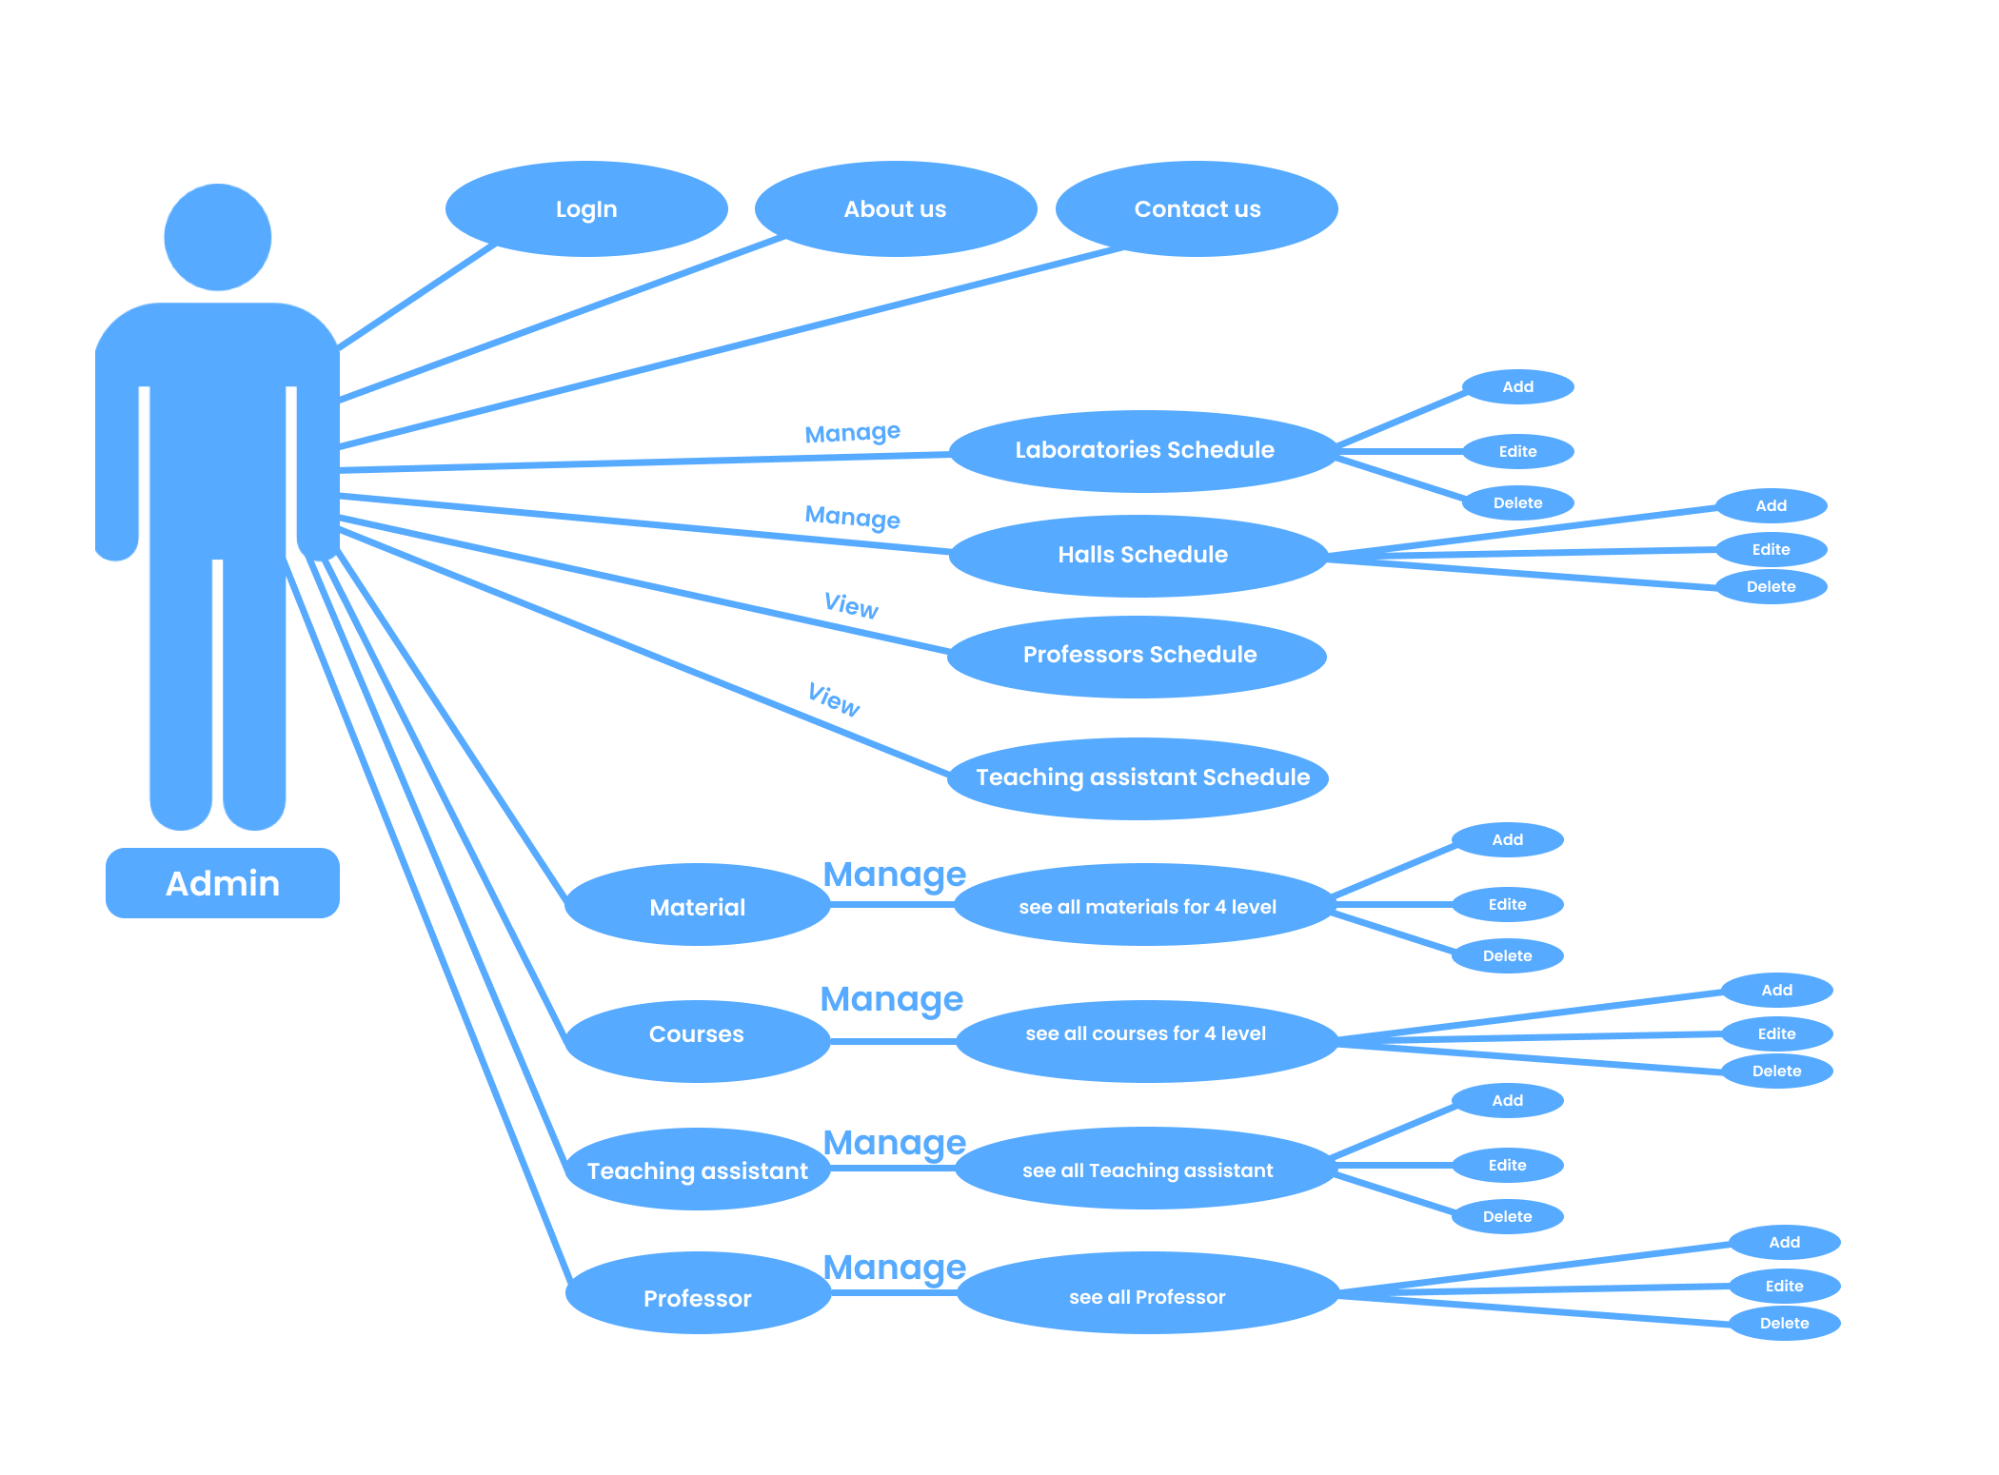

Slide 19
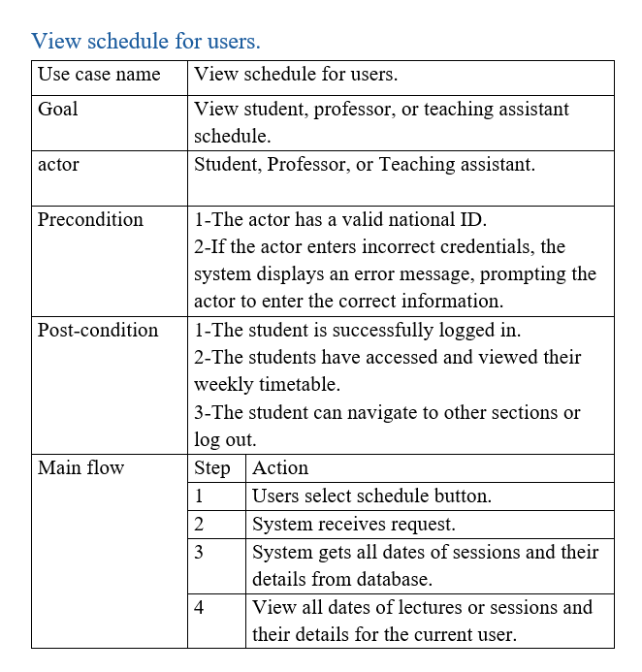

Slide 20
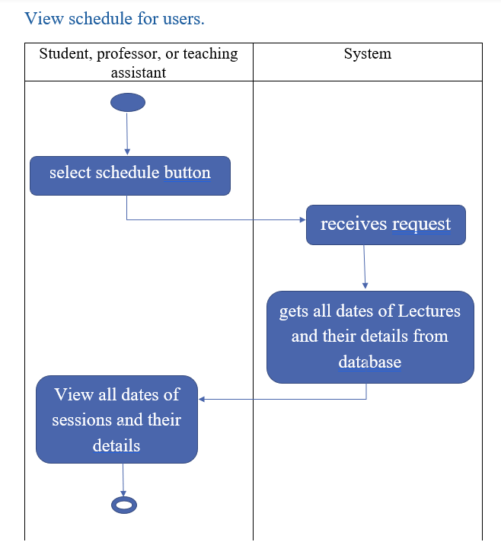

Slide 21
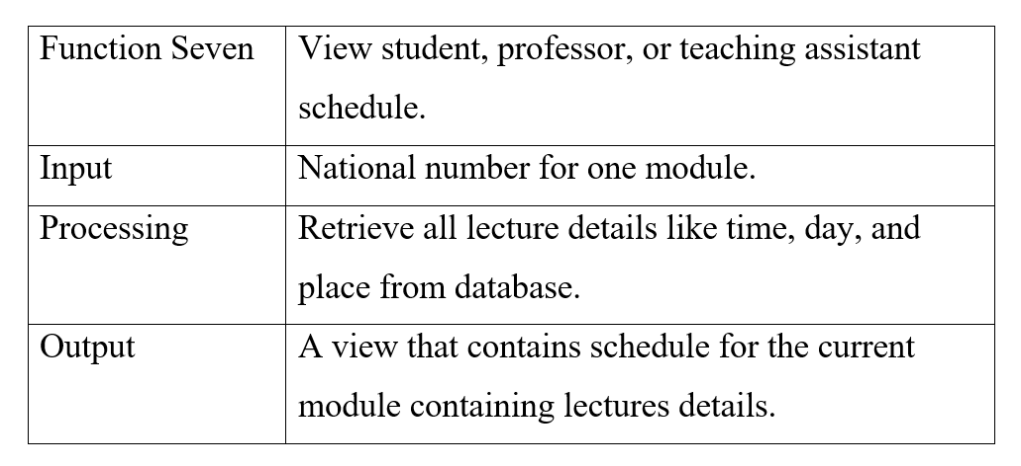

Slide 22
Product Functions
- Log In - About us
- Contact us - New Student Enrollment Application
- Material - Courses
- Student/professor/teaching assistant table
- Professors - Teaching assistant
- Laboratories - Halls
- Table for Laboratories schedule - Table for Halls schedules
- Table for Professor schedules
- Table for Teaching assistant schedules

Slide 23
User Classes and Characteristics
Students
Professors
Teaching Assistants
IT Technicians
Administrators

Slide 24


Thank you

