Slide 1
VAE
Danu
By Amr Mohamed

Slide 2
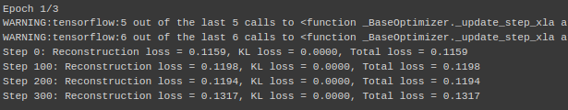
problems
The data is only 5000 photos.
The decoder always reconstructed different images into gray images.
KL loss is always zero.
Reconstruction loss is always small.

Slide 3
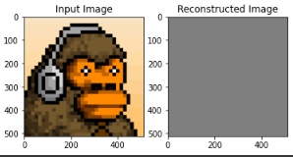
Debugging
Use more complex models for both encoder and decoder
Add regularization term to the loss function
Use dropout technique to regularize network
Add data augmentation to the data
The decoder still have a problems and
Couldn’t reconstruct images correctly.

Slide 4
CycleGans
It solves the problem of sticking to the trivial solution, like what happened with VAE.

Slide 5
Architecture
The CycleGAN consists of two generators (G_AB and G_BA) and two discriminators (D_A and D_B)
Each generator takes an image from one domain (e.g., domain A) and generates a corresponding image in the other domain (e.g., domain B)
Each discriminator takes an image and predicts whether it comes from the real domain or the generated domain
convolutional neural networks (CNNs) are used as the building blocks for our generators and discriminators
The generator loss consists of two parts: the adversarial loss and the cycle-consistency loss

Slide 6
The adversarial loss encourages the generator to generate realistic images in the target domain
The cycle-consistency loss ensures that the generated images can be mapped back to the original domain without loss of information
The discriminator loss penalizes the discriminator for incorrectly classifying real and fake images

Slide 7

results

Slide 8

results

Slide 9
Limitations
5000 photos are small number for vae to generalize well, but the cyclegan solved this using data Augmentation.
The photos are pixelated, so it may deceive the model most of the time.

Slide 10
Modifications
Downsampling photos to 64*64 photos
Use super resolution network simultaneously that outputs 128*128 photos with Cylegans
Augment the colors of photos before training

Slide 11
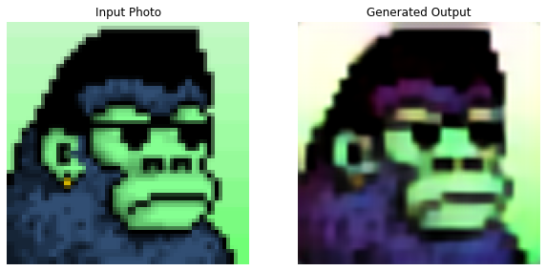
results

Slide 12


Slide 13
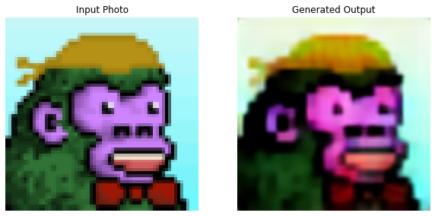

Slide 14
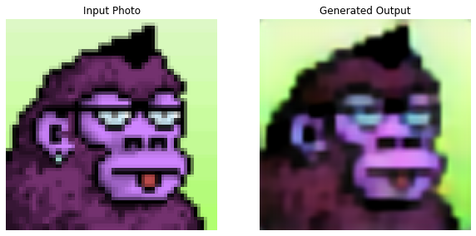

Slide 15

Results on Cool cats Collection

Slide 16
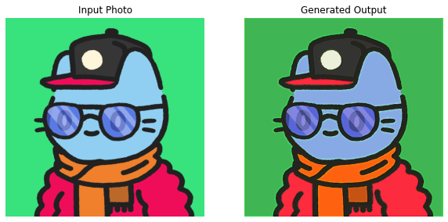

Slide 17
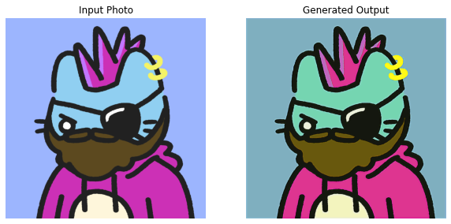

Slide 18
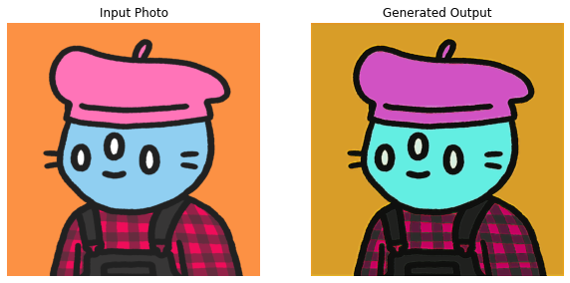

Slide 19
