Slide 1

DRIVING SUCCESS FOR 28+ YEARS
Partner with us to raise the bar.
Defining, designing and implementing software products that drive desired business outcomes.
Product Centric Agile Delivery
Deliver Predictably with Speed & Quality
Outcome Measurement
Set Up Delivery
for Success
Business Outcome
Deliver the Right Product
Product Discovery
AI and
Automation
Leverage AI for Productivity and Business Transformation
Product Plan and Initiation Workshop
Governance
CONFIDENTIAL
1

Slide 2
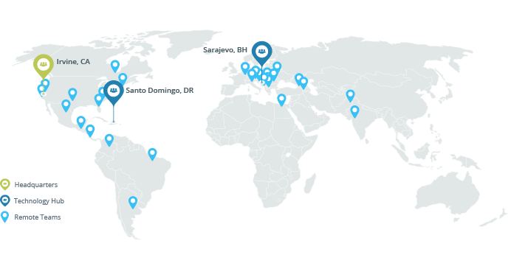
IDEAL GLOBAL PARTNER
With our geographically distributed teams operating in over 13 time zones, we position ourselves to pick the best talent in the world, delivering impact and transformation to our client-partners around the clock.
5
30
13
Continents
Countries
Time Zones
PUBLIC
2

Slide 3
WHAT WE DO FOR OUR CLIENT-PARTNERS
Technology Strategy and Software Engineering
Innovate
Refresh
Accelerate
Rapid AI Product Delivery
Cloud-Native Migration
Staff Augmentation
Product Workshop and Discovery
Codebase Refresh
Dedicated Nearshore Team (Client-Managed)
Agentic AI Assessment
Microservices Transformation
Managed Delivery Pod (AP-Managed)
AI Academy
Encompass EPC Migration
Client-Aligned Delivery Center (No-Transfer)
AI-Native Delivery Transformation
CONFIDENTIAL
3

Slide 4
PROVEN SOFTWARE ENGINEERING METHOD
A proven engagement method to deliver your desired outcomes with quality, in the shortest time possible.
Lean-Agile Product Delivery
Measure Outcomes
Velocity Quality Product Impact
Product Vision
Product Plan
MVP
R2
R3
Discover
Plan
Deliver/Measure/Maintain
Product Ideation
Customer Research
User Personas
User Experience Blueprint
User Journey Mapping
Epic Backlog Creation
High-Level Architecture Design
Sizing and Estimation
Team Modeling
MVP Definition
Release Roadmap
Initial Design (as needed)
UX Design/Rapid Prototyping
Solution Architecture and Technical Design
Agile Delivery
Quality Engineering
Lean-Agile Product Delivery
CONFIDENTIAL
4

Slide 5


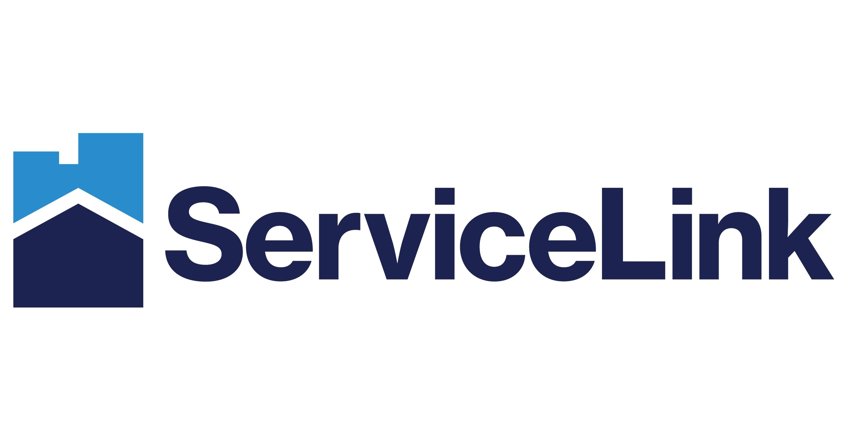


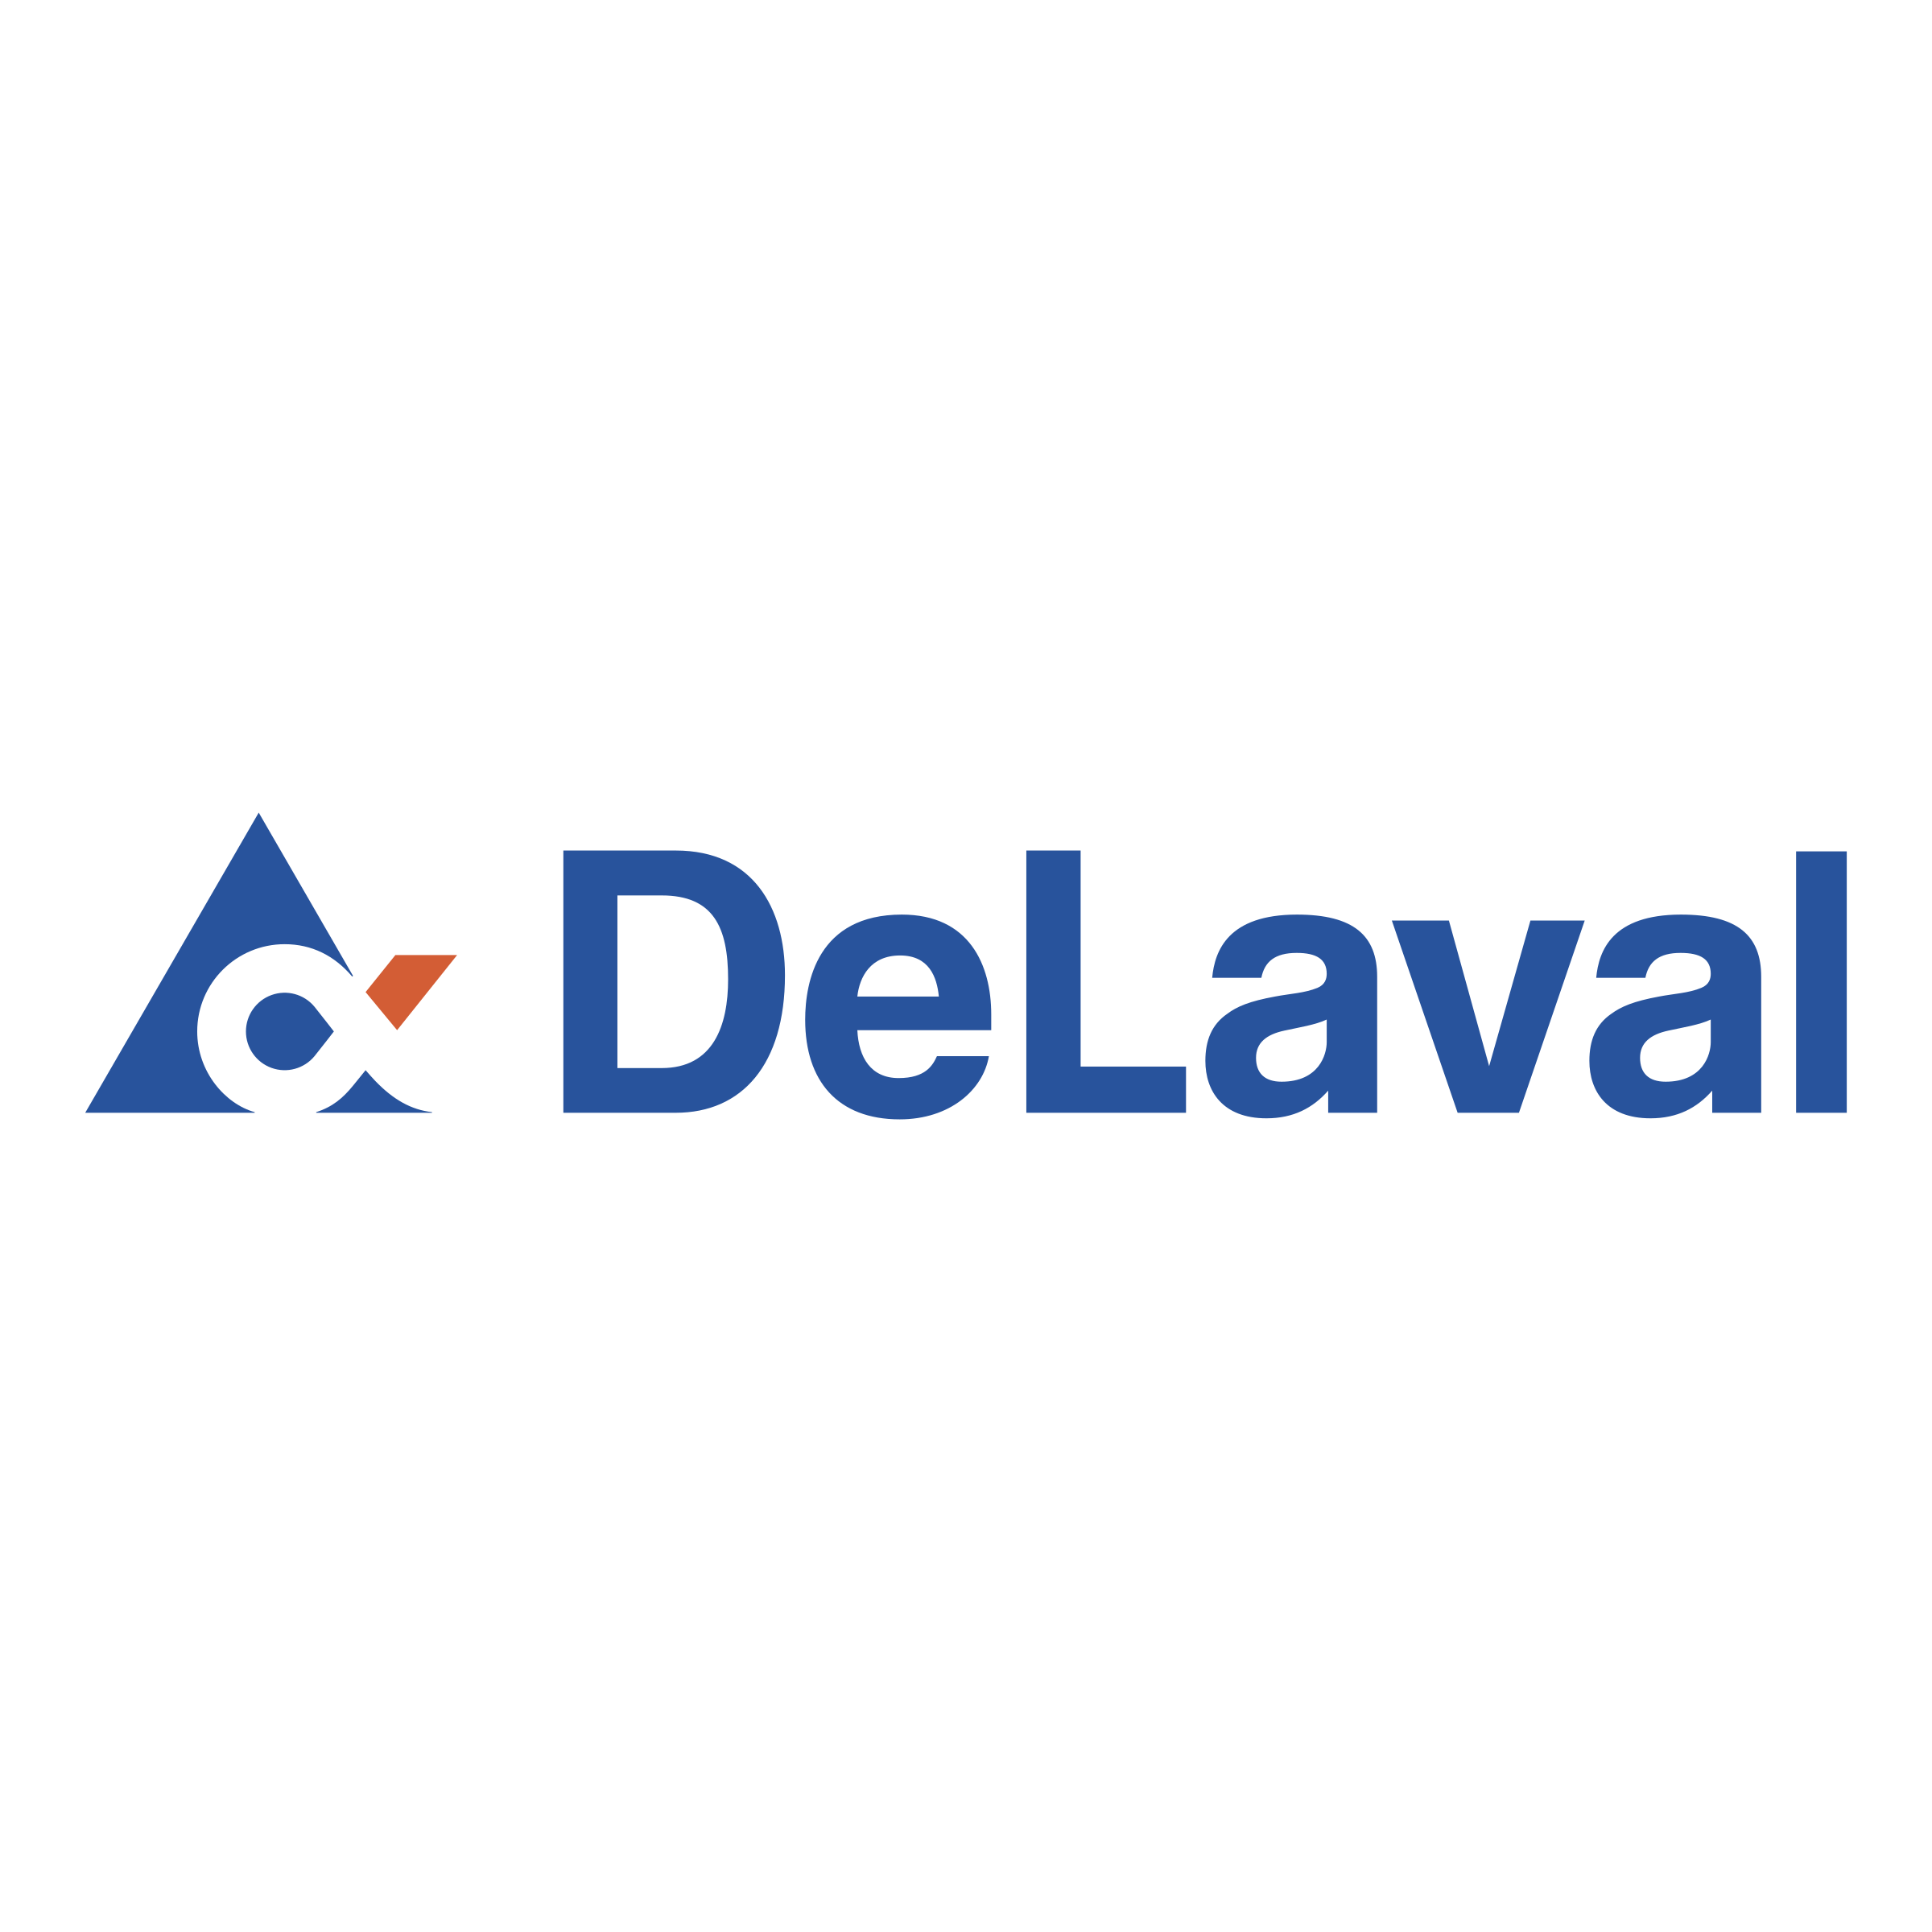

















100+ CLIENT PARTNERS OVER 28 YEARS
CONFIDENTIAL
5

Slide 6


WHY OUR CLIENTS CHOOSE, RENEW
& GROW WITH AUTHORITY PARTNERS
WE HELP OUR CLIENTS:
Build great software products
Increase quality and speed-to-market
Reduce risk by working with a 28+ year proven model
Leverage the right mix of capabilities, credentials and capacity
Access an untapped / under-leveraged talent pool
DELIVERING BETTER EXPERIENCE & BETTER OUTCOMES WITH A LOWER TOTAL COST OF ENGAGEMENT.
70
7.6
4.4yr
40%
Net Promoter
Score
Top 10 Client Tenure
Employee
Tenure
SDLC
Acceleration
Strong Value Alternative
to National & Boutique Firms
CONFIDENTIAL
6

Slide 7
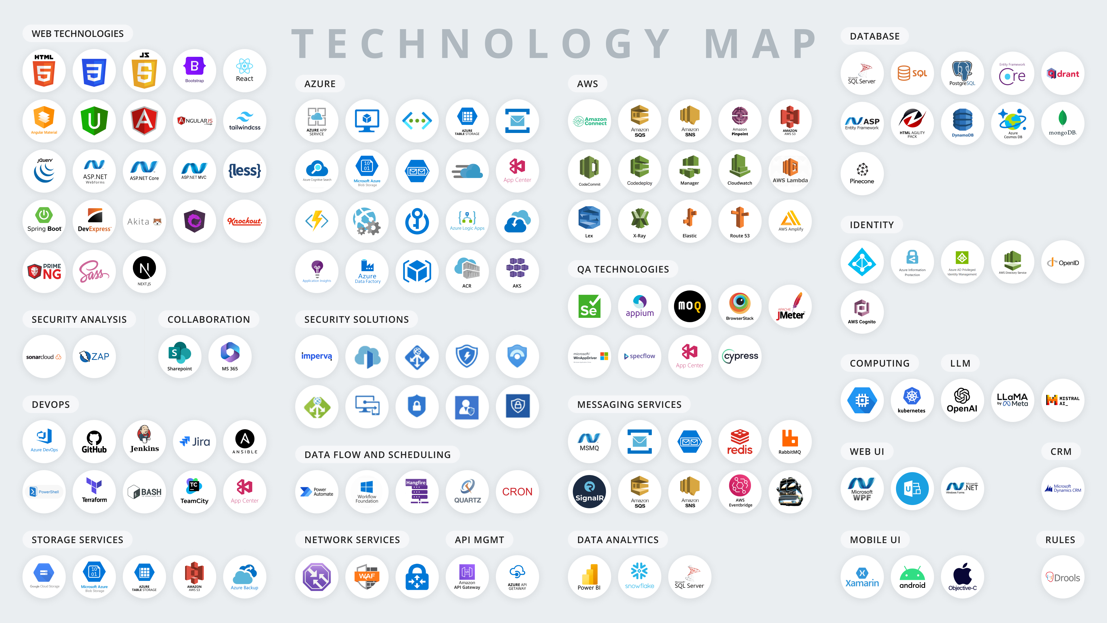

Slide 8
DELIVERING THE RIGHT PRODUCT
Using KPIs to assess product team output and business outcomes.
Velocity
Quality
Product Impact
Team’s productivity & predictability
Degree of excellence
Business impact and value
Story points delivered
Feature release velocity
Predict future velocity and visibility into release roadmap
Bug reduction trend
Increase in Test Coverage and Automation
Reduction in errors and downtime
Revenue stream
Customer ratings
Usage & adoption
Business process cycle time
Cost savings
Digital experience
CONFIDENTIAL
8

Slide 9


LEVERAGING AI FOR PRODUCTIVITY
AND DIGITAL TRANSFORMATION
Transform Business Operations
Rewire enterprise via automation.
Revolutionize Customer Engagement
Providing tailored experiences.
Accelerate Solution Delivery
Engineering productivity acceleration.
CONFIDENTIAL
9

Slide 10
PRODUCT-CENTRIC AGILE DELIVERY
Business outcomes become a common focus of delivery teams.
Project Based Engineering
Software Product Engineering
Prioritizing Features & Roadmap Progress
Prioritizing Business Outcomes
Business KPIs
User Experience
Scope
Scalability
Quality
Budget
Iterability
Impact
Release Speed
Reliability
Scope
Quality
Release Speed
Budget
Teams are assembled and dis-assembled on a project-by-project basis with loss of momentum in between projects and having to ramp up teams for each project.
Product teams are assembled and live throughout the journey of the product lifecycle with focus on business outcomes and customer delight.
CONFIDENTIAL
10

Slide 11
GOVERNANCE FOR STRATEGIC PARTNERSHIP
Delivery Excellence Framework governance model ensures deep client engagement and reliable & repeatable delivery.
AUTHORITY PARTNERS
PROCESS
CLIENT-PARTNER
Daily
Program Manager, Program Architect, Pod
Scrum
Weekly
Program Manager, Program Architect
Delivery KPI Review
Product Owner
1-3 Weeks
Program Manager, Program Architect
Sprint Demo Review
Product Owner, Stakeholders
Monthly
Client Executive, Engagement Lead, Delivery Solution Lead
Engagement Status Review
Product Owner
Quarterly
CRO, Client Executive, Engagement Lead, Delivery Solution Lead
Business Review
VP of Engineering, Product Sponsor
6-12 Months
Delivery Solution Lead
Process Compliance Audit
1-2 Years
VP of Operations
ISO 9001, ISO 27001, SOC/SSAE 16 Audit
Pod Level
Engagement Level
Relationship Level
AP Business-Unit Level
AP Company Level
CONFIDENTIAL
11

Slide 12



AP LAB
32
Shaping Innovators. Building the Future.
We make change.
Training Sessions
AP Lab is a 12-week intensive program led by experienced Authority Partners consultants, designed for aspiring software developers with a foundational understanding of object-oriented programming and C#.
The program focuses on full-stack development and the complete SDLC through hands-on, real-world practice. The curriculum also incorporates AI-powered tools and concepts to enhance development workflows and code quality.
400+
Trainees
~50%
Alumni Hired
PUBLIC
12

