Slide 1
ALGORITHM FOR MATHEMATICAL SIMPLICATION
BATCH NO:10
Satyam Sharma (160717733061)
L. Sai Prakash(160717733062)
K. Dhanush Reddy (160717733106)
Under the guidance of
Dr R Ch A Naidu
Professor, CSE
Project coordinators:
Dr B Jayalakshmi
Associate Professor, CSE
K Uday Kumar
Assistant Professor, CSE

Slide 2
Introduction
“Algorithm For Mathematical Simplification” is a algorithm designed for helping the user to solve complex mathematical equations without doing them manually .
The algorithm mainly build with the vision of providing an easy mathematical simplification approach with peak accuracy.
The algorithm also provides the user the flexibility to apply multiple methods at the same time , thus giving an user the smart way to choose the best method for the given equation.

Slide 3
System analysis
Existing System
Proposed system
Software and hardware requirements

Slide 4
Existing system
In existing system, solving mathematical equations are done manually.
Solving the mathematical equations are complex and time consuming
Solving a number of Mathematical methods becomes complex , inaccurate.
Selecting an appropriate method for an mathematical simplification of a particular equation consumes a lot of time and energy of an user with no guarranted accurate outcome resulting in false predictions.

Slide 5
Proposed system
User friendly interface
Less error
Peak accuracy
Fast access to methods
Quick simplification
More storage capacity

Slide 6
System Requirements
Hardware Requirements
Disk space: 1TB
Memory: 4 GB RAM
Processor: 2.4 GHZ processor speed
Software Requirements
Compiler’s : notepad++ , cpp.sh , onlinegdb.com
Operating System: Windows 7,8,9,10,XP.

Slide 7
BLOCK DIAGRAM:
Start
Menu
(list of Methods)
Instructions
(for the methods)
Execute Time
Run time
stop

Slide 8
ARCHITECTURE DIAGRAM
Start
Menu:
1:Newton Raphson
2:Bisection
3.Newton Interpolation
Bisection method:
Code ,execution , Result
Newton interpolation method:
Code ,execution , Result
Newton Raphson method:
Code ,execution , Result
stop

Slide 9
MAIN FLOW CHART:
Start
1:Newton Raphson
2:Bisection
3.Newton Interpolation
Case 1
Case 2
Case 3
Case 4
Newton Raphson Method
Newton interpolation
Message
(want to continue)
Bisection method
No
yes
exit()
Stop

Slide 10
OVERVIEW
1) Newton Raphson Method
2)Bisection Method
3)Newton Interpolation Method

Slide 11
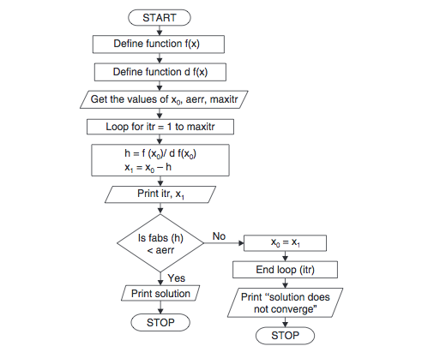
Newton Raphson Method flow chart :

Slide 12
Newton Raphson Method algorithm:
1.Start
2.Read x0, e, n, d
*x0 is the initial guess
e is the absolute error i.e the desired degree of accuracy
n is for operating loop
d is for checking slope*
3.Do for i =1 to n in step of 2f = f(x0)
4.f1 = f'(x0)
5.If ( [f1] < d), then display too small slope and go to 11.
[ ] is used as modulus sign
6.x1 = x0 – f/f1
7.If ( [(x1 – x0)/x1] < e ), the display the root as x1 and go to 11.
8.[ ] is used as modulus sign
9.x0 = x1 and end loop
10.Display method does not converge due to oscillation.
11.Stop

Slide 13
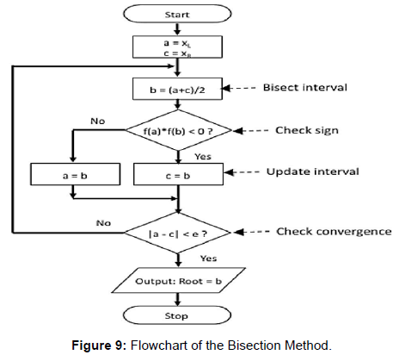
Bisection Method flow chart

Slide 14
Bisection Method algorithm:
Start
1.Decide initial values for x1 and x2 and stopping criterion, E.
2.Compute f1 = f(x1) and f2 = f(x2).
If f1 * f2>0, x1 and x2 do not bracket any root and go to step 7; Otherwise continue.
3.Compute x0 = (x1+x2)/2 and compute f0 = f(x0)
4.If f1*f0 < 0 then set x2 = x0 else set x1 = x0 set f1 = f0
5.If absolute value of (x2 – x1)/x2 is less than error E, then root = (x1 + x2)/2 6.write the value of root go to step 7 else go to step 4
7.Stop.

Slide 15
Newton Interpolation Flow chat:
Start
Enter the no of data points:
Enter the y data points:
Enter value of x for interpolated y(x):
The interpolated value is :
End

Slide 16
Newton Interpolation algorithm :
Start
1.Enter the no of data points you want to take
2.Enter the y data points
3.Enter the x data points for interpolated y(x)
4.Display the interpolated value of y(x)
5.Stop.

Slide 17
REFERENCES
1) C++: The Complete Reference, 4th Edition - The Complete Reference(for concepts of C++)
2) Object oriented programming with c++ by robert lafore

Slide 18

ANY QUERIES…..??

Slide 19
Thank You

