Slide 1
PROJECT 2: SEQUENCE LABELING & TOXIC SPANS DETECTION
Toxic Spans Detection
Domain Continuity: Extending Project 1 (Toxic Text Classification) to Fine-Grained Token Span Attribution
01. BIO Engineering
7,939 Train / 2,000 Test
Offset → BIO Alignment
02. Baseline HMM
Generative + Viterbi
03. Advanced CRF
±2 Context + L-BFGS
04. BiLSTM-CRF (Best)
SpatialDrop + LayerNorm
RESEARCH TEAM MEMBERS & STUDENT IDs
Amr Alsayed
ID: 2309115638
Abdulrahman Alabar
ID: 220903363
Adham Mostafa
ID: 2309115774
Omar Elgamal
ID: 2309116447
Yahia Alhamwi
ID: 2309115151

Slide 2
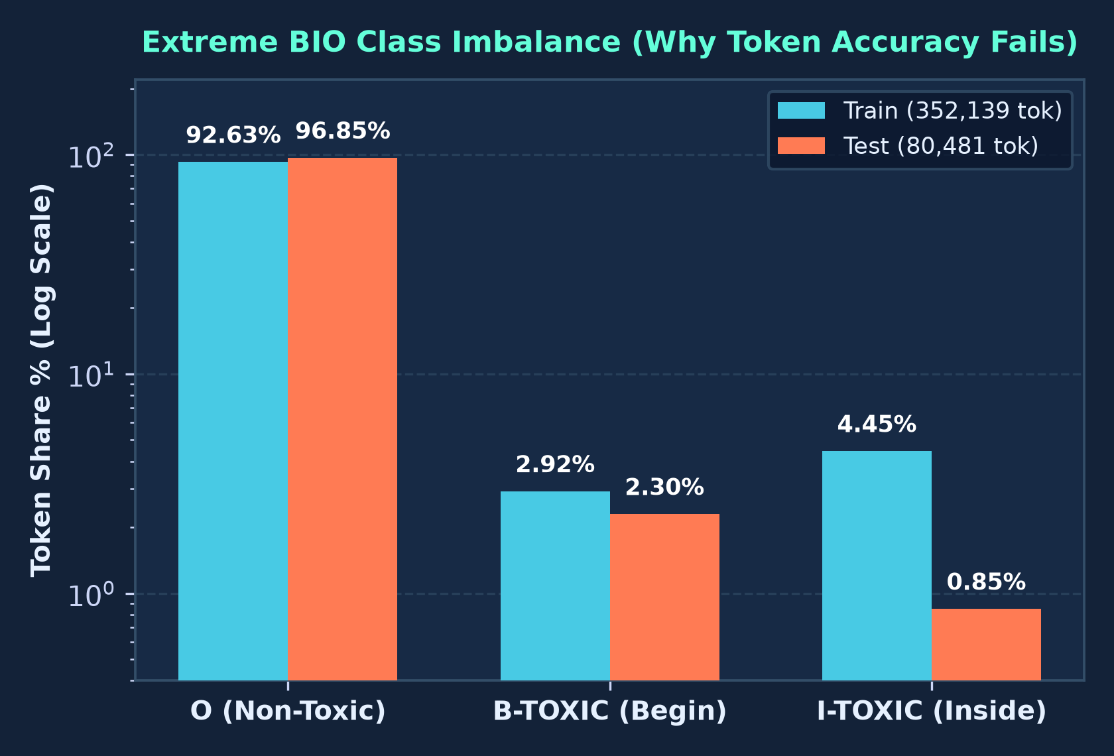
Problem Statement & Dataset Challenges
Continuing the Toxicity Domain from Project 1 into Token-Level Sequence Labeling
1. Continuing Project 1 into Span Detection
• Same Domain, Deeper Granularity: Moves from Project 1 comment toxicity to pinpointing exact toxic word spans.
• Input / Output: Character offsets S ⊆ {0..L-1} mapped to BIO token tags {O, B-TOXIC, I-TOXIC}.
• Goal: Precisely localize multi-word toxic phrases for explainable moderation.
2. The 96.85% 'O' Imbalance & Accuracy Trap
• Severe Sparsity: 96.85% of test tokens are 'O'; only 2.30% are 'B-TOXIC' and 0.85% 'I-TOXIC'.
• Why Accuracy Fails: Predicting 'O' everywhere yields 96.85% accuracy but 0.0000 F1.
• Strict Metric: Exact Span Match F1 (100% start & end boundary match required).
Toxic Spans Detection | HMM • CRF • BiLSTM-CRF | Slide 2 / 10

Slide 3
Phase 1: Data Engineering & BIO Tagging Pipeline
Notebook 01 (01_Data_Engineering_BIO.ipynb): Character Offsets to Word-Level BIO Tags
1. AST Offset Parsing
• 7,939 Train & 2,000 Test rows.
• Parses '[8, 9, 10...]' safely via ast.literal_eval.
2. Contiguous Intervals
• Groups adjacent indices into closed intervals [a_k, b_k].
• Preserves multi-word phrases.
3. Regex Tokenization
• Pattern: \w+|[^\w\s]
• Tracks exact token coordinates [s_i, e_i).
4. BIO Tag Assignment
• ≥50% char overlap = Toxic.
• First token → B-TOXIC; continuation → I-TOXIC.
BIO Alignment Verification (Sample #0) & Exported Corpus
• Raw Text : "Another violent and aggressive immigrant killing a innocent..."
• Character Span : [8..39] → Contiguous Interval k=0 ("violent and aggressive immigrant")
• BIO Sequence : Another[O] violent[B-TOXIC] and[I-TOXIC] aggressive[I-TOXIC] immigrant[I-TOXIC] killing[O]
• Exported Datasets : tsd_train_bio.csv (352,139 tokens) & tsd_test_bio.csv (80,481 tokens) — 0 invalid transitions.
Toxic Spans Detection | HMM • CRF • BiLSTM-CRF | Slide 3 / 10

Slide 4
Phase 2: Generative Baseline — Hidden Markov Model
Notebook 02 (02_Baseline_HMM.ipynb): First-Order Markov Transitions & Log-Space Viterbi
Baseline HMM Metric (Test Split) | Score
Exact Span Micro Precision | 0.5937
Exact Span Micro Recall | 0.6746
Exact Span Micro F1-Score | 0.6316
Exact Span Macro F1-Score | 0.5948
True Positives / FP / FN | 1,248 / 854 / 602
Invalid BIO Transitions (O → I) | 0
Generative Formulation & Decoding
• Joint Model: P(x, y) = ∏ P(y_t | y_{t-1}) · P(x_t | y_t).
• Transition Smoothing: α_trans = 1e-6 blocks unseen O → I-TOXIC transitions.
• OOV Handling: Singleton words (freq ≤ 1) mapped to <UNK> with Laplace smoothing (α_emit = 1e-3).
• Log-Space Viterbi: Dynamic programming prevents underflow and recovers exact global BIO paths.
• Key Limitation: Context-free emissions ignore surrounding words and subword morphology.
Baseline Takeaway
• Strong Single-Word Recall (0.6746): Captures frequent explicit profanity effectively.
• Boundary Merging Error: Over-extends spans across commas ('racist , bigot , sexist rubbish').
Toxic Spans Detection | HMM • CRF • BiLSTM-CRF | Slide 4 / 10

Slide 5
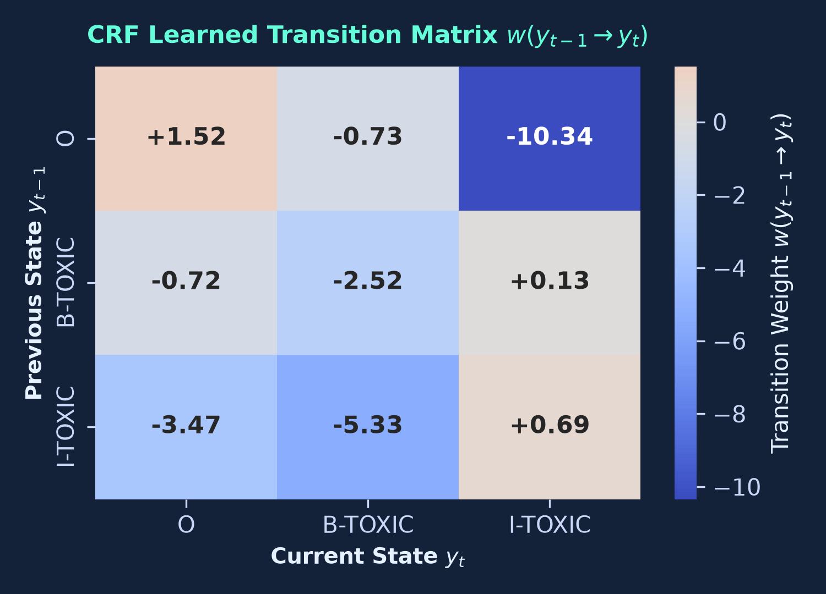
Phase 3: Discriminative Linear-Chain CRF (±2 Context)
Notebook 03 (03_Advanced_CRF.ipynb): Contextual Features & Global Transition Weights
Discriminative Model & Feature Engineering
• Global Conditional Model: Directly optimizes P(y | x; w) over entire label sequences.
• Morphological Features: 2/3/4-char prefixes & suffixes, word shapes ('Xx+'), capitalization, and obfuscation flags.
• Contextual Window (±2): Includes surrounding words [t-2, t+2] and adjacent lexical bigrams.
• L-BFGS + Elastic-Net (c1=0.1, c2=0.1): Prunes noisy features while regularizing weights.
• Test Results: 0.6859 Micro-Recall (1,269 TPs, +21 over HMM) and 0.6207 Micro-F1.
Learned Transition Constraints
• Illegal BIO Blocked: w(O → I-TOXIC) = -10.34 yields 0 invalid transitions.
• Phrase Continuation: Positive w(I-TOXIC → I-TOXIC) = +0.69 preserves multi-word spans.
Toxic Spans Detection | HMM • CRF • BiLSTM-CRF | Slide 5 / 10

Slide 6
Phase 4: Deep Learning Architecture — BiLSTM-CRF
Notebook 04 (04_DeepLearning_BiLSTM_CRF.ipynb): SpatialDropout1D, LayerNorm & Masked CRF
1. Hybrid Embeddings
• Word Emb: 18,221 × 128d.
• 3-Char Suffix: 2,041 × 32d.
• 160d vector captures semantics + morphology.
2. SpatialDropout1D
• nn.Dropout2d (p = 0.30).
• Drops entire channels across all timesteps t.
3. 2-Layer BiLSTM + LN
• 256d bidirectional state.
• LayerNorm stabilizes emission logits.
4. Masked CRF Layer
• Hard -10000 mask on O → I-TOXIC.
• Batched Forward NLL + Viterbi decode.
Training Strategy & Recall Breakthrough
• Toxic-Sequence Upweighting (1.8×): Boosts NLL gradient on toxic comments, lifting Test Recall to 73.51% (1,360 TPs).
• Optimization: AdamW (lr = 3e-3, wd = 1e-4), Gradient Clipping (5.0), ReduceLROnPlateau, Early Stopping (patience = 3).
• Best Performance: 0.6578 Exact Span Micro-F1 (+2.62% over HMM, +3.71% over CRF) and 0.6137 Macro-F1.
Toxic Spans Detection | HMM • CRF • BiLSTM-CRF | Slide 6 / 10

Slide 7
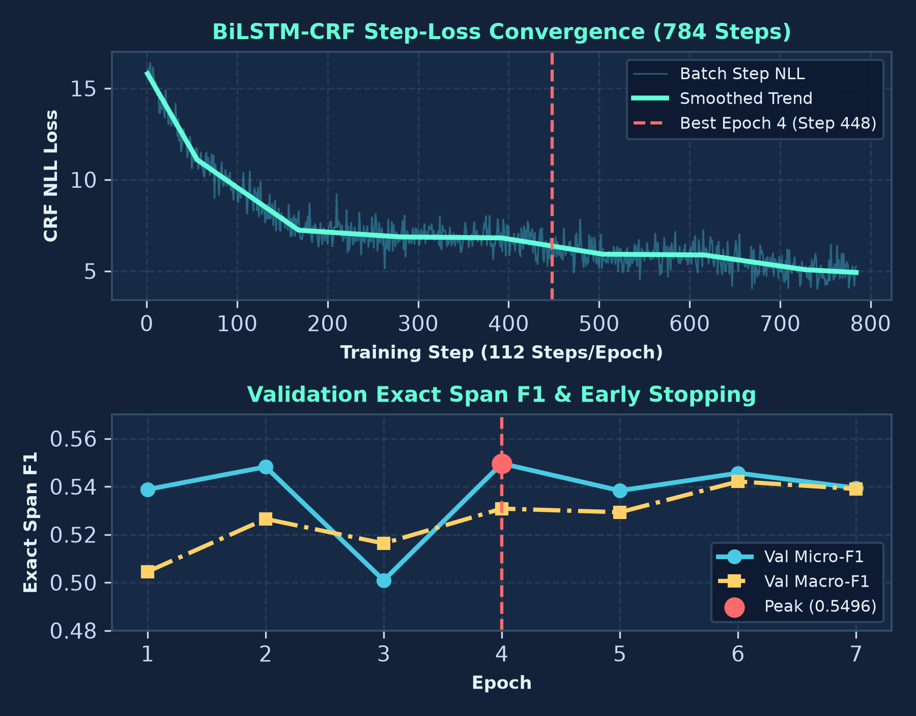
Training Dynamics & Convergence (BiLSTM-CRF)
Step-Loss Curve & Epoch Validation Table (Project 1 Visual Standard)
Epoch | Train NLL | Val P | Val R | Val Micro-F1 | Val Macro-F1
Epoch 01 | 11.0850 | 0.6090 | 0.4832 | 0.5388 | 0.5045
Epoch 02 | 7.2335 | 0.6024 | 0.5030 | 0.5482 | 0.5265
Epoch 03 | 6.8636 | 0.4484 | 0.5672 | 0.5009 | 0.5163
Epoch 04* | 6.8134 | 0.5974 | 0.5089 | 0.5496 (Best) | 0.5308
Epoch 05 | 5.9192 | 0.5829 | 0.5000 | 0.5383 | 0.5293
Epoch 06 | 5.8775 | 0.5742 | 0.5198 | 0.5456 | 0.5421
Epoch 07 | 5.0697 | 0.5485 | 0.5306 | 0.5394 (Stop) | 0.5390
Test Eval | Held-Out | 0.5952 | 0.7351 | 0.6578 | 0.6137
Key Convergence Insights
• Fast Convergence: NLL drops from 11.09 → 6.81 by Epoch 4 (Step 448).
• Early Stopping at Epoch 7: Restores Epoch 4 weights, achieving 0.6578 Test Micro-F1.
Toxic Spans Detection | HMM • CRF • BiLSTM-CRF | Slide 7 / 10

Slide 8
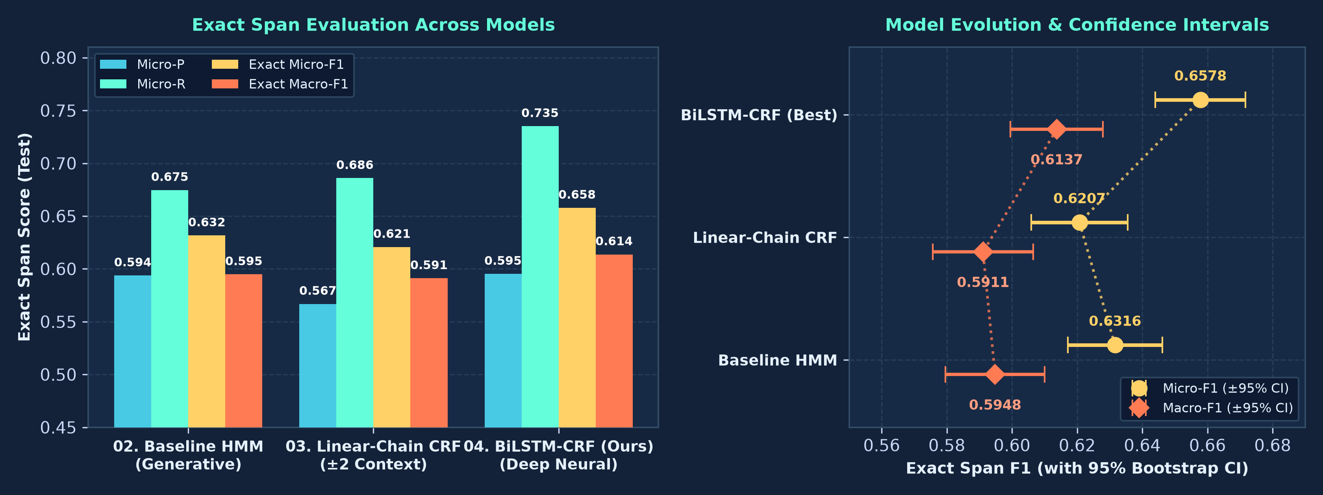
Comprehensive Model Comparison & Evolution
Exact Span Precision, Recall & F1 Progression Across HMM, CRF & BiLSTM-CRF
Sequence Labeling Model | Micro-P | Micro-R | Exact Micro-F1 | Exact Macro-F1 | TP / FP / FN | Invalid BIO | Net Gain
02. Baseline HMM | 0.5937 | 0.6746 | 0.6316 | 0.5948 | 1248 / 854 / 602 | 0 | Baseline
03. Linear-Chain CRF | 0.5668 | 0.6859 | 0.6207 | 0.5911 | 1269 / 970 / 581 | 0 | +21 Exact TPs
04. BiLSTM-CRF (Ours) | 0.5952 | 0.7351 | 0.6578 | 0.6137 | 1360 / 925 / 490 | 0 | +2.62% F1
Toxic Spans Detection | HMM • CRF • BiLSTM-CRF | Slide 8 / 10

Slide 9
Project Synergy & Methodological Bridge (Project 1 → Project 2)
Shared Toxicity Domain: From Document Classification to Token-Level BIO Sequence Labeling
Project 1: Coarse Toxic Text Classification
• Task: Single binary/multi-label prediction per comment.
• Key Insight: Subword morphology & n-grams capture obfuscated profanity.
• Discipline: Class-weighted loss & F1 evaluation over raw accuracy.
Project 2: Fine-Grained Toxic Span Labeling
• Task: Token-level BIO path y = (y_1..y_T) localizing exact spans.
• Feature Transfer: Project 1 n-gram insights → CRF ±2 features & 3-char suffix embeddings.
• Structured Output: CRF transition matrix + Viterbi guarantee valid BIO boundaries.
Dimension | Project 1 (Text Classification) | Project 2 (Toxic Spans Sequence Labeling)
Output Granularity | Comment-level label P(y | x) | Token-level BIO path P(y_1..T | x) via Viterbi
Subword Representation | TF-IDF char/word n-grams | Word (128d) + 3-Char Suffix (32d) & ±2 shapes
Regularization | Standard Dropout & L2 decay | SpatialDropout1D (Dropout2d), LayerNorm & Elastic-Net
Evaluation Metric | Macro / Weighted F1 & ROC-AUC | Strict Exact Span Micro-F1 (0.6578) & 0 Invalid BIO
Toxic Spans Detection | HMM • CRF • BiLSTM-CRF | Slide 9 / 10

Slide 10
Conclusion, Key Takeaways & Future Enhancements
Summary of Experimental Achievements & Next-Generation Roadmap
Key Takeaways
• Complete 4-Notebook Pipeline: Offset-to-BIO engineering, generative HMM, discriminative CRF, and deep BiLSTM-CRF.
• BiLSTM-CRF Achieves Best F1 (0.6578): Outperforms HMM (0.6316) by +2.62% and CRF (0.6207) by +3.71%, reaching 73.51% recall.
• Zero Structural BIO Violations: 0 invalid O → I-TOXIC transitions across all 80,481 test tokens.
• Rigorous Evaluation: Strict Exact Span Match F1 avoids the 96.85% token accuracy trap.
Future Enhancements
• Transformer-CRF Backbones: Pair DeBERTa-v3 / RoBERTa with a Linear-Chain CRF head for contextualized subword spans.
• Character CNN Encoders: Capture adversarial leetspeak and symbol-obfuscated profanity.
• Biaffine Span Pointer Networks: Directly score (start, end) span matrices for nested toxic expressions.
• Active Learning Moderation: Use CRF marginal probabilities to route uncertain spans to human reviewers.
Toxic Spans Detection | HMM • CRF • BiLSTM-CRF | Slide 10 / 10

