Slide 1
Term Deposit Prediction & Marketing Analysis
Targeting Customers that are likely to opt into a Term Deposit service Business Science

Slide 2
Executive Summary
Duration since last contact and success of prior enrollments are correlated to success of Term Deposit opt-in
A strategy targeting customers that haven’t been contacted in 319 days and have those with prior enrollments yield 32% positive outcomes (enrollments) vs 4.3% otherwise.

Slide 3
Analysis
Correlation of various features to Term Deposit enrollment. Duration since last contact and success of prior enrollments are correlated to success of Term Deposit opt-in.

Slide 4
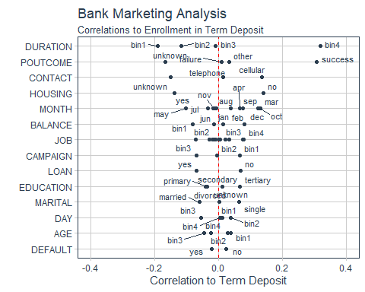

Slide 5
Strategy
A strategy targeting customers that haven’t been contacted in 319 days and have those with prior enrollments yields 32% positive outcomes (enrollments) vs 4.3% otherwise.

Slide 6
