Slide 1

Industrial and Organizational Psychology
Introduction to the World of Work
Business Psychology Topic 1

Slide 2
Business Definition
Is a primary social institute of our society
Business has three dimensions of a meaning
  A commerce
  An occupation
  An organization

Slide 3
Business Defined As….
Business as a commerce is the process that people produce, exchange and trade goods and services
Business as an occupation is the acquired set of specialized skills and abilities that allows people to create valuable goods and services
Business as an organization is the system of task and authority relationship that coordinates and controls the interactions between people so that they work toward a common goal

Slide 4
Business Definition
Business as a system is a combination of business commerce, occupations, and organizations that produces and distributes the goods and services that create value for people in a society

Slide 5
Organizations
No universally accepted definition
Organizations are a consciously coordinated social entity, with a relatively identifiable boundary, that functions on a relatively continuous basis to achieve a common goal or a set of goals.
  Robbins.89

Slide 6
Forms of Business Organizations
Sole proprietorship
Partnership
Corporation
Cooperative

Slide 7
Business Psychology
Is the study of the effectiveness of interpersonal relations in the workplace

Slide 8
WHAT IS I/O PSYCHOLOGY?
Psychology is the science of human behavior
I/O psychology is the science of human behavior at work
Dual focus
  Efficiency/productivity of organizations
  Health/well-being of employees
Dual nature
  Application of the science of psychology to the workplace
  Development/discovery of scientific psychological principles at work

Slide 9
SPECIFIC AREAS OF CONCERN
Recruiting and selecting employees for jobs
Training employees
Assessing performance
Defining and analyzing jobs
Determining people feel about work
Determining why people act as they do at work
Effects work has on people
Effects people have on one another
How organizations are structured and function
Designing work
Designing tools and equipment
Employee Health and Safety

Slide 10
When can business psychology is useful?
When you want more (self) understanding
When you behave in ways that are self defeating
When you need to deal with (difficult) colleagues or employees

Slide 11
I/O AS A PROFESSION
Graduate degree necessary (MA or Ph.D.)
Content of graduate training
Basic psychology
Research methods (heavy emphasis)
I/O content
Thesis, Dissertation
Qualifying exam
Internship, practica
Entry requirements very competitive
SIOP website for most US programs (www.siop.org)
Employment
Little or no unemployment
Academic and nonacademic market strong
Field expanding and becoming popular

Slide 12
I/O PSYCHOLOGY AROUND THE WORLD
At one time I/O was almost entirely American
I/O interest has exploded over the past 10-15 years and accelerating
American consulting firms have become international, reflected in names
  DDI--Developmental Decisions Inc. to International
  PDI--Personnel Decisions Inc. to International
Number of graduate programs increasing rapidly around the world

Slide 13
The Most Popular I/O Research Topics in Eight Countries
Country
Topics
Canada
Career development, Employee selection, job stress, leadership
England
Employee selection, gender, job stress, leadership, turnover
Germany
Job Stress, motivation, training, work environment
India
Job satisfaction, job stress, motivation, organizational level
Israel
Career development, job satisfaction, motivation, performance appraisal, values
Japan
Career development, job stress, leadership, motivation
Scandinavia
Gender, job stress, shift work, unemployment
United States
Career development, employee selection, leadership, performance appraisal
Note: From Erez, M. (1994). Tow

Slide 14
History of I/O
Began early 1900s
World War I first mass testing
Between wars psychology helping business: I side
Hawthorne studies impact of social aspects: O side
World War II: Psychology and the war effort
Civil rights movement: Job relevance
Technological change

Slide 15
Leading Historical Figures
Hugo Münsterberg: Psychology and Industrial Efficiency
Walter Dill Scott: The Theory of Advertising
Frederick Winslow Taylor: Scientific Management
Robert Yerkes: Army Alpha and Beta tests
Lillian Gilbreth: Time and motion; Human factors
Bruce V. Moore: First I/O PhD?
Roethlisberger & Dickson: Hawthorne Studies

Slide 16
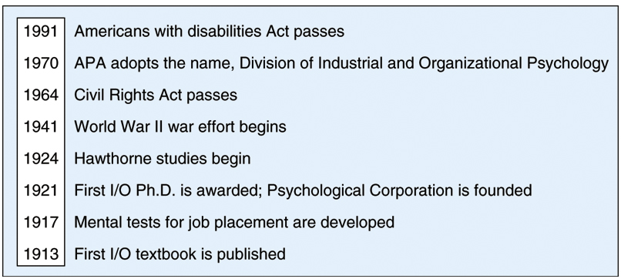
Timeline of Major Events

Slide 17
Prospects for I/O Field
Rapidly growing
  New areas/topics
  Attracting more graduate students
  More graduate programs
  More psychologists in the world
Job market strong: Academic and applied
Area of psychology making an impact on the world
  Relevant to anyone who works
Interdisciplinary connections
  Business, engineering, health fields, other areas of psychology

