Slide 1

Industrial and Organizational Psychology
Productive and Counterproductive Behavior
Copyright Paul E. Spector, All rights reserved, March 15, 2005

Slide 2
Productive Behavior
Ability and performance
Motivation and performance
Personal characteristics and performance
  Big Five: Small correlations, largest with conscientiousness
  Locus of Control: Opposite results depending on criterion
    Internals better on tasks requiring initiative
    Externals better on routine tasks
  Age and performance: No relation
Job characteristics: Very small relationship
Incentive systems: Effective
Design of technology: Effective

Slide 3
Technology: Human Factors
Person‑technology interface (tools, machines, computers)
Physical interaction: Movement, manipulation and control
Communication: Exchange of information
Design of tools and equipment for people
  Level of individual tool (screwdriver) vs. system (airplane)
Human capabilities
  Perceptions (What can people sense and process?)
  Sensory capabilities (thresholds)
    Is it there vs. what is it?
  Accuracies of sense modalities
  Motions (What can people manipulate and reach?)
  Strength
  Sizes of objects (chairs, consoles, cockpits)

Slide 4
Technology 2
Design of controls
  Shape, location, resistance
  Recognition (visual, touch)
  Standardization (clockwise for left)
  Natural motions (overlearning)
  Cultural tendencies (Americans pass on right)
Judgments (What judgments can people make?)
  What information is necessary for a decision?
  Accuracy of decisions
  Ways of presenting information
  Decision aids
Design of information systems
  Computer hardware
  Computer software
  Telecommunications

Slide 5
Organizational Citizenship Behavior, OCB
Behavior that goes beyond job requirements
Another way to contribute to the organization
Dimensions
  Altruism – helping others
  Compliance – following rules
  Individual vs. Organization beneficiary
OCB related to job satisfaction
Found in many diverse countries
  Nigeria and Taiwan
Different factors related to different beneficiaries
  Individual: Concern for others and empathy
  Organization: Desire for recognition and equity
More likely in people who are collectivistic, e.g., Chinese

Slide 6
Counterproductive Work Behavior, CWB:
Withdrawal
Absence
  Absence culture
  Absence policies
Lateness
  Job dissatisfaction
  Long commutes
  Work-family conflict, e.g., having young children
Turnover
  Job dissatisfaction
  Availability of alternative employment

Slide 7
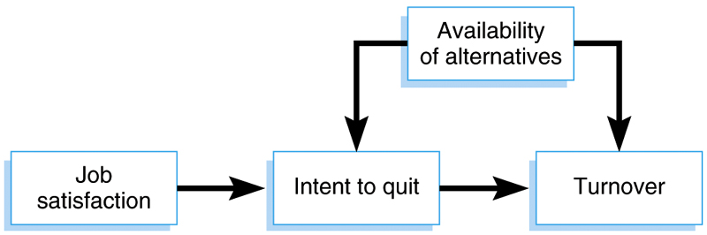
Model of Turnover

Slide 8
Counterproductive Work Behavior: Aggression, Mistreatment, Sabotage & Theft
Intentional behavior that harms the organization or organization members
  Aggression (physical and verbal)
  Sabotage
  Theft
  Withdrawal
Directed at organization vs. people
  Coworkers
  Subordinates
  Supervisors
  Clients/Customers

Slide 9
Impact of CWB
Extreme forms of direct violence are rare
  1993 American B.L.S.: 1,063 workplace homicides, 59 by employees
Employee theft accounts for more loss than shoplifting
Employee theft estimated at $200 billion/year
  Hollinger (1986) stealing varied with industry
    6.6% retail (merchandise)
    27.3% hospital (supplies like linens)
    14.3% manufacturing (raw materials)
Geddes (1994) manager national survey, response by employees
to negative feedback.
  Pushed or shoved 3%, damaged my property 4%
  Refused to perform assignment 19%, Absence 18%

Slide 10
Causes of CWB
Person
  Certain types of people more likely to engage in these behaviors.
  Delinquent(অপরাধী) personality:
    Alienated(জনবিচ্ছিন্ন)
    Hostility to rules
    Poor impulse(উদ্‌বদ্ধ করা) control
    Social insensitivity
  Integrity tests used to screen them.
Situation
  Situations that are stressful
  Situations that induce negative emotions such as anger
  Situations that allow for little employee control
  Culture that encourages CWB
  Injustice: CWB to even the score

Slide 11
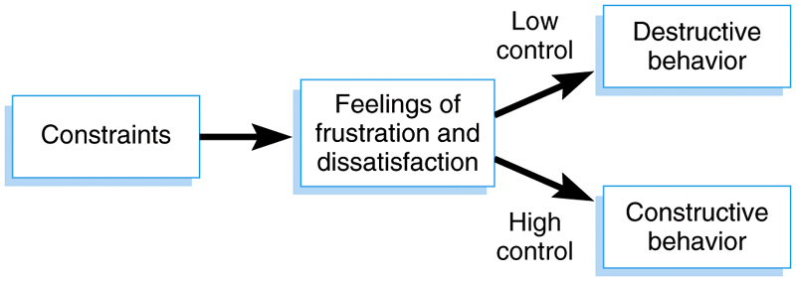
Model of CWB

Slide 12
Mistreatment
Form of psychological aggression aimed at an individual
Can involve single individual (bullying) or group (mobbing)
Causes
  General anxiety disorder in victim
  Poor leadership and problems in the workplace
  Bullies—individuals who like to mistreat
Effects
  Anxiety & Depression
  Physical symptoms
  Posttraumatic stress disorder
Examples of Mistreatment
  Ignoring the person
  Insulting a person
  Spreading false rumors
  Not allowing the person to speak
  Physical threats
  Sexual harassment

