Slide 1

Industrial and Organizational Psychology
Occupational Health Psychology, OHP
Copyright Paul E. Spector, All rights reserved, March 15, 2005

Slide 2
Occupational Health Psychology
Concerned with employee health, safety, and well-being
Interdisciplinary scientific and applied field
  I/O psychology
  Clinical psychology
  Ergonomics
  Public health
New emerging field of study
Development
  American Psychological Association (APA)
  National Institute for Occupational Safety and Health (NIOSH)
  Founding of Journal of Occupational Health Psychology
  Awarding training grants to universities for graduate education

Slide 3
Occupational Health and Safety: Accidents
Leading cause of death in US for under 38 years old
1999 5.7 million workplace injuries in the U.S.
Estimated cost of work accidents: $131.2 billion in U.S.
2002 4424 workplace fatalities
Relatively few fatalities at work compared to nonwork
Motor vehicle most common (43% of all accidents)
Agriculture and mining most dangerous in U.S.
Manufacturing safest in US, due to regulation by OSHA
  Occupational Safety and Health Administration

Slide 4
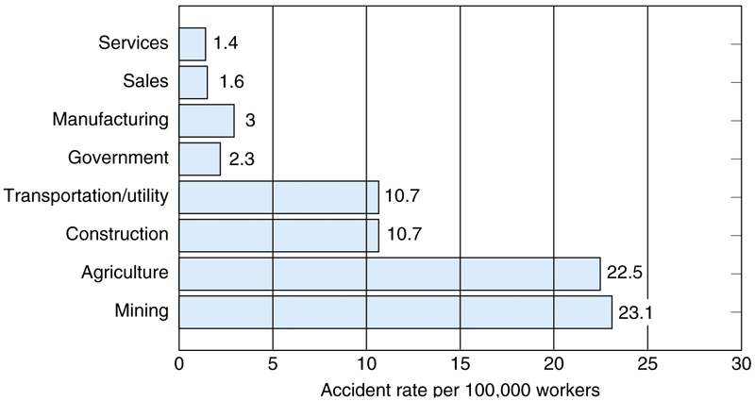
U.S. Accidents Rates By Job Category

Slide 5
Accident Causes and Prevention
Causes
  Employee stress
  Employee personality
  Inadequate safety training
  Poor safety climate
Prevention
  Human factors approach: design of equipment
  Goal setting (pizza deliverers, Ludwig & Geller, 1997)
  Incentive systems for safe behavior
  Management support for safe behavior
  Training in safe procedures

Slide 6
Occupational Health and Safety: Physical Conditions
Infectious disease
  AIDS
  Hepatitis B
  Universal precautions
Loud noise
  Hearing loss
Repetitive actions
  Carpal tunnel
Toxic substances
  Allergy
  Sick building phenomenon

Slide 7
Workplace Violence
Violence and aggression common at work
Fatalities relatively rare
  709 U.S. 1998
    About 6% of total U.S. homicides
    About 15% committed by coworkers
    Most due to crime such as robbery
  Cab drivers and liquor store clerks most common
Nonfatal
  Very common
  No weapons
  Client, customer, or patient
  Healthcare workers, e.g., nurses

Slide 8
Work Schedules
Night shifts
  Health consequences
    Upsets circadian rhythm of the body
    Sleep problems
    Stomach distress
  Long breaks of several days helpful, Barton 1995
  Permanent night shift—let people choose it
Long shifts
  More than 8 hours
  Can cause fatigue and health problems
  Allows more days off

Slide 9
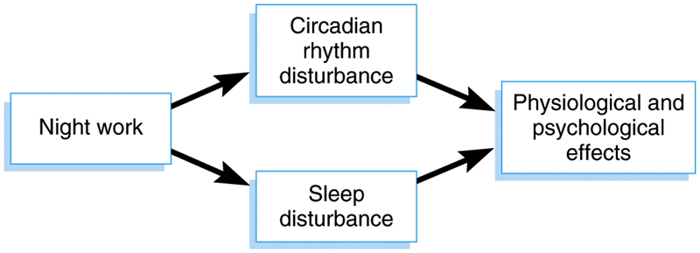
Physiological Effects of Night Shifts

Slide 10
Work Shifts 2
Long work weeks
  48 hours per week magic number
  Leads to heart disease if nonvoluntary
  (Sparks & Cooper, 1997)
  European Council rule on hours
    11 hours off every 24
    48 total per week
Flexible schedules
  Employees choose some or all of own hours
  Reduces absence
  Sometimes increased productivity
  Small increase in job satisfaction

Slide 11
Occupational Stress
Job stressor: Condition at work requiring adaptive response
  Objective
  Perceived
Job strain: Negative response to stressor
  Psychological: Anger
  Physical: Increased blood pressure
  Behavioral: Absence

Slide 12
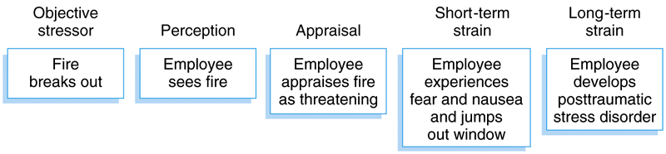
Model of Job Stress Process

Slide 13
Job Stressors
Role ambiguity: Uncertainty about what you should do
Role conflict: Incompatible demands
Workload: Too much to do or too difficult
Social Stressors: Stressors arising from interpersonal contact
  Interpersonal conflict
  Mistreatment
Organizational politics: Self-serving behaviors and favoritism

Slide 14
Control
Extent to which employees make decisions about work
Autonomy: Control over how, when, where work is done
Relates to many strains
  Job satisfaction
  Organizational commitment
  Health symptoms
  Negative emotions
  Absence
Machine pacing: Machine determines how fast one works
Leads to strains
  Anxiety
  Health Symptoms

Slide 15
Demand/Control Model
Control buffers negative effects of stressors
Low control and high demand leads to strain
High control and high demand doesn’t lead to strain
Widely believed but research support inconclusive
  Control in studies not linked to demands
Other variables might buffer stress
  Self-efficacy
    High self-efficacy buffered effects of demands

Slide 16
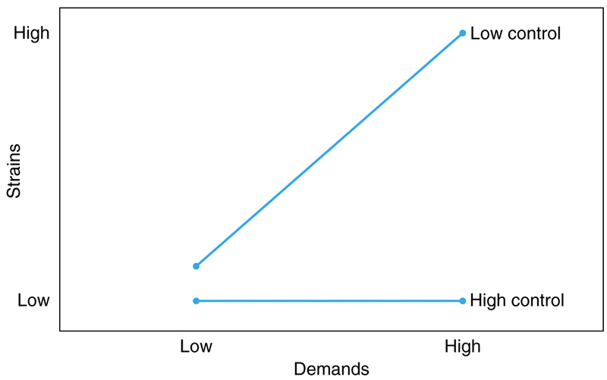
Demand/Control Model

Slide 17
Work-Family Conflict, WFC
Incompatible demands between work and family
Gallup poll found 34% of Americans experience WFC
Causes
  Work hours
  Inflexible work schedules
  Negative affectivity
Effects
  Absence and Lateness
  Depression
  Health Symptoms
  Job dissatisfaction
Interventions
  Flexible work schedules
  On-site child care

Slide 18
Burnout
Distressed psychological state in response to occupational stressors
  Emotional exhaustion
  Depersonalization
  Reduced personal accomplishment
Effects
  Absence
  Fatigue
  Low motivation
  Poor performance

