Slide 1

Industrial and Organizational Psychology
Leadership and Power In Organizations
Copyright Paul E. Spector, All rights reserved, March 15, 2005

Slide 2
What Is Leadership?
Social influence or power
Ability to control and influence others
Directed toward specific goals and objectives

Slide 3
Social Power
Five types of social power or influence (French & Raven)
Informational or expert: Persuasion through expertise
  Target must believe
  Information must have importance for target
Referent: Desire for identification & interpersonal attraction
Legitimate: Power in formal role
  Must be accepted by target
Reward: Contingent rewards for compliance
Coercive: Punishment
  Causes poor relationships with subordinates

Slide 4
Political Power
Process by which people gain and protect power
Yukl
Control over decision processes
Forming coalitions
Co-optation

Slide 5
Abuse of Power
Supervisors who abuse/harass subordinates
Sexual harassment: Behavior of a sexual nature that
  Is unwanted
  Interferes with a person’s job performance
  Creates a hostile and intimidating work environment
Often in eye of beholder
Ethnic harassment
Mistreatment
  Bullying and mobbing by supervisors

Slide 6
Trait Approach
Good leaders possess certain traits
Born not made
Good supervision a selection problem
Good leaders good in all situations
General approach much like test validation
  Identify sample of good & bad leaders
  Measure traits
  Analyze relations of traits & effectiveness
  Mean r of leader effectiveness with I.Q.= .30, Personality = .28
Problems and limitations
  Some inconsistency of results
  Lack of insight into process
  Ignores situational specificity
  Counter to zeitgeist, i.e., fell out of favor when I/O abandoned personality in favor of situational influences

Slide 7
Behavior Approach
Good leaders do certain things
Leaders made not born
Good supervision as training problem
Styles universal
Ohio State Leadership Studies (1950's)
  1. Analysis of supervisory behavior (critical incidents)
  2. 1800 incidents distilled to 150 items
  3. Administered to employees to rate supervisors
  4. Factor analyzed to two dimensions
  Consideration
  Initiating structure
Problems and limitations
  Ignores situational differences
  Ignores individual differences

Slide 8
Fiedler’s Contingency Theory
Considers situational and leader variables
Situational control has three components
  Task structure
  Position power
  Leader‑group relations
Leader characteristic assessed with a Least Preferred Coworker (LPC)
Hypotheses (moderately supported)
  High LPC leaders most effective in middle favorable
  Low LPC leaders best at extremes
Implications
  Fiedler argues that person should be chosen to fit the job or job can be changed to fit the person
  He does not recommend trying to change the leader

Slide 9
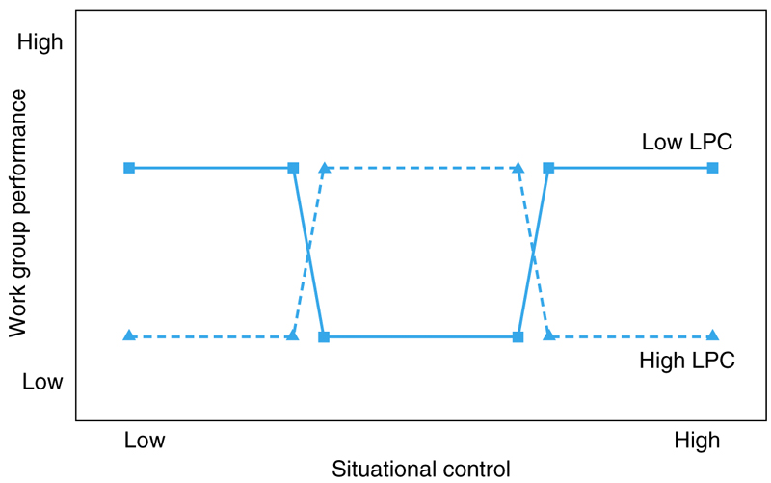
Fiedler’s Contingency Theory

Slide 10
Path-Goal Theory
A more complex contingency theory than Fiedler’s
Supervisors motivate employees by
  Increasing value of rewards and clarifying paths to rewards
Four styles
  Achievement oriented
  Directive
  Participative
  Supportive
Contingency factors
  Subordinate personality such as locus of control
  Perceived ability
  Environment
  Nature of task (aversiveness)
Theory has a series of hypotheses
  When tasks are frustrating, consideration will increase social support and reduce negative valence of tasks
Support for the theory mixed with only some hypotheses upheld

Slide 11
Leader-Member Exchange Theory, LMX
Leadership as interaction of supervisor and subordinate
Supervisors treat different employees differently
  In-group are those in the supervisor’s inner circle
  Out-group are everyone else
  In-group treated better
  Competence of subordinate an important determinant of group membership
Laboratory study: Lowin and Craig (1968)
  Subjects asked to act as supervisors for confederates who acted either competent or incompetent
  Competents received high consideration and low structure
  Incompetents received low consideration and high structure
Field studies
  Similar results in organizations Danseueau et al. (1975)
  Performance related to subordinate autonomy Spector, Dwyer, Jex (1988)

Slide 12
Transformational Leadership Theory
Leaders with considerable and unusual influence
  Can convince followers to do things they would never do alone
  Both good and evil
Represents a return to focus on personality of leaders
Charisma of supervisor relates to subordinate
  Job performance
  Job satisfaction
  OCB
  Organizational commitment
Might be trainable
  Actors were trained to be charismatic in a lab study (Kirkpatrick & Locke, 1996)
  Bank managers trained in charisma (Barling et al., 1996)

Slide 13
Vroom-Yetton Model
Prescriptive model of how decisions should be made
Decision aid
Based on established principles
Focus on decision making
Five decision styles, based on problem attributes
  From make decision yourself to allow group to decide
Model indicates which approach should be taken, depending upon the situation

Slide 14
Women and Leadership
In U.S. 46% of management jobs held by women
Women under-represented at top levels
  Glass ceiling
Subtle bias against women because they don’t fit stereotype of top manager
Women more democratic than men
No differences in consideration or initiating structure
Little difference in transformational leadership, with women being slightly higher (Bass et al., 1996)

Slide 15
Cross-Cultural Issues In Leadership
Good leadership practice culturally determined
Project GLOBE 62-country study
  Intelligence and trustworthiness universal
  Risk taking only positive in some countries
Comparison of Middle East and U.S. (Scandura et al., 1999)
  Initiating structure more important to effectiveness in Middle East
  Consideration more important to effectiveness in U.S.
Comparison of India and U.S. (Narayanan et al., 1999).
  Americans preferred democratic style
  Indians preferred directive style

