Slide 1

Industrial and Organizational Psychology
Selecting Employees
Copyright Paul E. Spector, All rights reserved, March 15, 2005

Slide 2
Selection Problem: Choose the Best Person For the Job
1. Best performer
2. Best social fit (team player)
3. Best person‑job fit (worker adjustment/well-being)
Empirical process: Data based and objective
Legal process: Government regulation and law
Utility: Benefit of using a selection procedure

Slide 3
Hiring Process

Slide 4
Planning and Recruitment
Planning: Anticipating needs for human resources
  Expansion vs. replacements
  Labor markets
Recruitment
  Advertising
  Employee referral
  Employment agencies
  School recruiters
  Walk-ins
  Web (Monster website)

Slide 5
Preliminary Concepts
Reliability
  Test‑retest
  Internal consistency: Multiple items required
Validity
  Criterion related
    Concurrent vs. predictive
  Content
  Face
  Convergent vs. Discriminant
  Construct: Overall case necessary for legal defense

Slide 6
Making Selection Decisions
Human judgment: Hire whoever seems best
I/O approach: Use empirically (research-based) proven assessment methods
Steps involved in I/O method
  1. Analyze job
  2. Define criteria
  3. Define abilities needed
  4. Choose potential predictors
  5. Validate (determine equation)
  6. Cross‑validate
Multiple cutoff option: Must meet each selection requirement
Multiple regression: Must achieve a certain total score regardless of performance on each requirement
Validity generalization: Effective selection devices work in all settings

Slide 7
Utility
Value of selection system to the organization
Cost/benefit ratio
Utility is maximized by
  1. Validity of selection device—should be high
  2. Selection ratio (hired/applicants)—should be low
  3. Baseline for success—should be 50%
  4. Cost of selection program—should be low
  5. Cost of bad selection (recruitment, training, low productivity)—should be high
Hunter‑Schmidt programmer aptitude test for federal government
  Cost: $6000/year
  Estimated gain: $5.6 million to 97.2 million
  If universally adopted could save $1.5 billion in U.S.
  However, this assumes unlimited supply of applicants and no constraints on performance in organizations

Slide 8
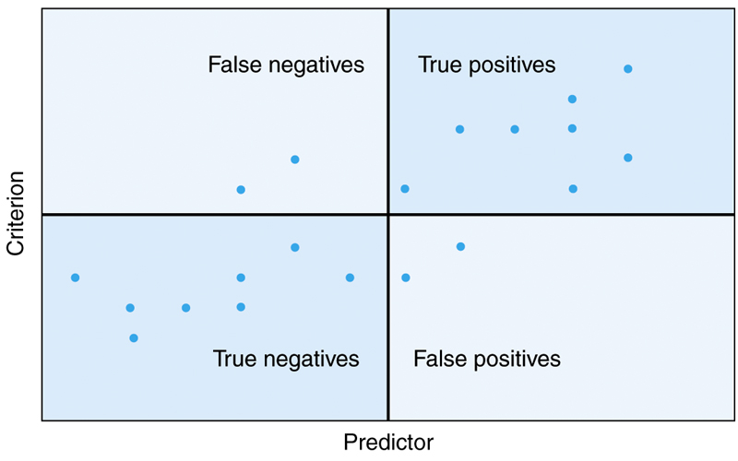
Utility Example

Slide 9
Legal Issues
Civil Rights Act (1964) prohibited discrimination
Equal Employment Opportunity Commission, EEOC charged with overseeing compliance
Uniform Guidelines for Employee Selection (1978).
Adverse impact (80% rule based on selection ratios)
Discrimination Case based on
  Adverse impact
  Invalid selection/placement procedures
  Job irrelevance
  Lack of business necessity

Slide 10
Affirmative Action
Required of all organizations with > 50 employees or government contracts > $50,000
Includes universities with grants
Requires a plan to increase female and minority representation
Hiring unqualified forbidden by Supreme Court
Preferential Treatment
  Not required except under unusual circumstances
  E.g., organization unwilling to practice fair selection
  Can have negative effects
  Beneficiaries--poor self-image
  Nonbeneficiaries--negative attitudes and resistance

Slide 11
Americans With Disabilities Act of 1990
Extends civil rights protection to disabled
Similar to Civil Rights Act in how it works
Reasonable accommodation
  What is reasonable?
Essential functions

Slide 12
Solutions To Problems of Discrimination
Objectivity in selection procedures
Focus on job relevant characteristics
Panel interview with diverse membership (Prewett-Livingston et al., 1996)
Training of people who make selection decisions

