Slide 1

Industrial and Organizational Psychology
Training and Development

Slide 2
What is Training?
Training - a planned effort by a company to facilitate employees’ learning of job-related competencies.
  Competencies include knowledge, skills or behavior critical for successful job performance.
The goal of training is for employees to master the competencies and apply them to their day-to-day activities.

Slide 3
What is Training? (cont.)
High-leverage training
  Is linked to strategic business goals and objectives.
  Uses an instructional design process to ensure that training is effective.
  Compares or benchmarks the company's training programs against training programs in other companies.
  Creates working conditions that encourage continuous learning.

Slide 4
What is Training? (cont.)
Continuous learning - requires employees to understand the entire work system, including the relationships among their jobs, their work units, and the company.

Slide 5
What is Training? (cont.)
Managers take an active role in:
  Identifying training needs.
  Ensuring that employees use training in their work.
  Facilitating the sharing of knowledge, by using informational maps.

Slide 6
What is Training? (cont.)
Today, training is being evaluated on how training addresses business needs related to learning, behavior change, and performance improvement.

Slide 7
What is Training? (cont.)
There is a greater emphasis on:
  Providing educational opportunities for all employees.
  Performance improvement as an ongoing process than a one-time training event.
  Demonstrating to executives, managers, and trainees the benefits of training.
  Learning as a lifelong event.
  Training being used to help attain strategic business objectives.

Slide 8
Differences between Training, Education & Development
Training is short term, task oriented and targeted on achieving a change of attitude, skills and knowledge in a specific area. It is usually job related.
Education is a lifetime investment. It tends to be initiated by a person in the area of his/her interest
Development is a long term investment in human resources.

Slide 9
Designing Effective Training
Training design process
  A systematic approach for developing training programs.
  Is based on the principles of Instructional System Design (ISD).
  Is sometimes referred to as the ADDIE model because it includes analysis, design, development, implementation, and evaluation.
  Should be systematic yet flexible enough to adapt to business needs.

Slide 10
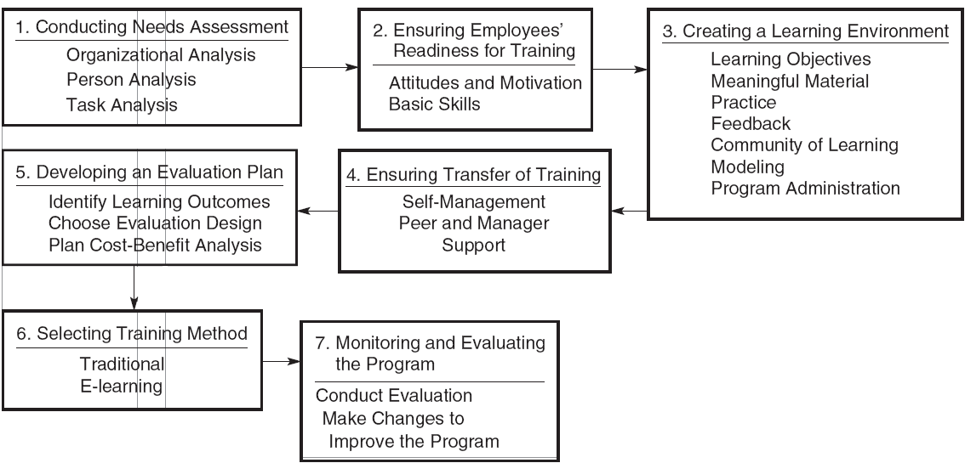
Figure 1.1 - Training Design Process

Slide 11
Designing Effective Training (cont.)
Regardless of the specific ISD approach used, all the steps share the following assumptions:
  Training design is effective only if it helps employees reach their training objectives.
  Measurable learning objectives should be identified before the training program begins.
  Evaluation plays an important part in planning and choosing a training method, monitoring the training program, and suggesting changes to the training design process.

Slide 12
Designing Effective Training (cont.)
Flaws of the ISD model:
  In organizations, the training design process rarely follows the step by-step approach of the activities.
  Organizations require trainers to provide detailed documents of each activity found in the model; this adds time and cost to developing a training program.
  It implies an end point: evaluation.

Slide 13
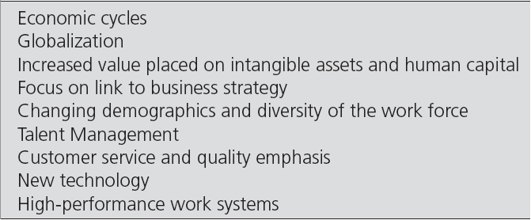
Table - Forces Influencing Working and Learning

Slide 14
Forces Influencing Working and Learning
Economic cycles
  Provide an opportunity for companies to take a closer look at training and development to identify those activities that are critical for supporting the business strategy as well as those mandated by law.

Slide 15
Forces Influencing Working and Learning (cont.)
Globalization
  Provide training and development opportunities for global employees.
  Provide cross-cultural training to prepare employees and their families to understand the culture and norms of the country to which they are being relocated and assists in their return to their home country after the assignment.

Slide 16
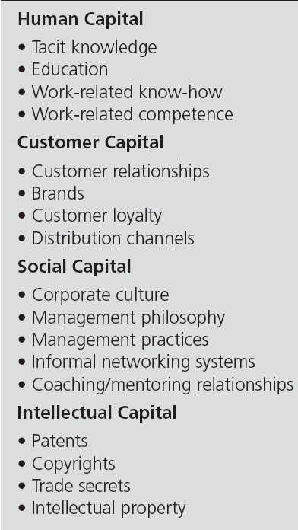
Table - Examples of
Intangible Assets

Slide 17
Forces Influencing Working and Learning (cont.)
The value of intangible assets and human capital has the following implication:
  Focus on knowledge worker - employees who contribute to the company not through manual labor but through what they know, perhaps about customers or a specialized body of knowledge.

Slide 18
Forces Influencing Working and Learning (cont.)
The value of intangible assets and human capital has the following implication:
  Employee engagement - the degree to which employees are fully involved in their work and the strength of their commitment to their job and the company.
  Companies measure employees' engagement levels with attitude or opinion surveys.

Slide 19
Forces Influencing Working and Learning (cont.)
The value of intangible assets and human capital has the following implication:
  Change - the adoption of a new idea or behavior by a company.
  Learning organization - embraces a culture of lifelong learning, enabling all employees to continually acquire and share knowledge.

Slide 20
Forces Influencing Working and Learning (cont.)
Talent management - attracting, retaining, developing, and motivating highly skilled employees and managers.
It is becoming increasingly more important because of:
  occupational and job changes.
  retirement of baby boomers.
  skill requirements.
  the need to develop leadership skills.

Slide 21
Forces Influencing Working and Learning (cont.)
New technology
  Is changing the delivery of training and makes training more realistic.
  Allows training to occur at any time and any place.
  Reduces travel costs.
  Provides greater accessibility to training and consistent delivery.

Slide 22
Forces Influencing Working and Learning (cont.)
  Provides the ability to access experts and share learning with others.
  Provides the possibility of creating a learning environment with many positive features such as feedback, self-pacing, and practice exercises.
  Allows companies greater use of alternative work arrangements.

Slide 23
Forces Influencing Working and Learning (cont.)
High performance models of work systems
  Work teams - involve employees with various skills who interact to assemble a product or provide a service.
  Cross training - training employees in a wide range of skills so they can fill any of the roles needed to be performed on the team.

Slide 24
Forces Influencing Working and Learning (cont.)
High performance models of work systems
  Virtual teams - teams that are separated by time, geographic distance, culture, and/or organizational boundaries and that rely almost exclusively on technology to interact and complete their projects.
Use of new technology and work designs are supported by human resource management practices.

Slide 25
Snapshot of Training Practices
Key trends in learning initiative investments:
  Direct expenditures, as a percentage of payroll and learning hours, have remained stable over the last several years.
  There is an increased demand for specialized learning that includes professional or industry-specific content.
  The use of technology-based learning delivery has increased from 11 percent in 2001 to 33 percent in 2007.

Slide 26
Snapshot of Training Practices (cont.)
  Self-paced online learning is the most frequently used type of technology-based learning.
  Technology-based learning has helped improve learning efficiency, and has resulted in a larger employee–learning staff member ratio.
  The percentage of services distributed by external providers dropped from 29 percent in 2004 to 25 percent in 2007.

Slide 27
Snapshot of Training Practices (cont.)
In most companies training and development activities are provided by trainers, managers, in-house consultants, and employee experts.
They can also be outsourced.
Training and development can be the responsibility of professionals in human resources, human resource development, or organizational development.

Slide 28
Snapshot of Training Practices (cont.)
As companies grow and/or recognize the important role of training for business success, they form an entire training function, which may include instructional designers, instructors, technical training, and experts in instructional technology.
To be a successful training professional requires staying up-to-date on current research and training practices.

Slide 29
Purpose of Orientation
Orientation Helps New Employees
Feel welcome and at ease
Understand the organization
Know what is expected in work and behavior
Begin the socialization process
Copyright © 2011 Pearson Education
8–<number>
Notes:
Human Resources Management 12e
Gary Dessler
Copyright © 2011 Pearson Education
8–<number>
Employee orientation (often called “onboarding” today) provides new employees with the information they need to function; ideally, though, it should also help new employees start getting emotionally attached to the firm.

Slide 30
The Orientation Process
Employee benefit information
Company organization and operations
Employee Orientation
Personnel
policies
Safety measures
and regulations
Daily
routine
Facilities
tour
Copyright © 2011 Pearson Education
8–<number>
Notes:
Human Resources Management 12e
Gary Dessler
Copyright © 2011 Pearson Education
8–<number>
An orientation typically includes information on employee benefits, personnel policies, the daily routine, company organization and operations, safety measures and regulations, and a facilities tour.

Slide 31

FIGURE
New Employee
Departmental
Orientation Checklist
Copyright © 2011 Pearson Education
8–<number>
Notes:
Human Resources Management 12e
Gary Dessler
Copyright © 2011 Pearson Education
8–<number>
A supervisor could use an orientation checklist such as Figure 8-1 to explain to a new employee the organization and workings of the department.

Slide 32
The Training Process
Training
  Is the process of teaching new employees
  the basic skills they need to perform their jobs
  Is a hallmark of good management
  Reduces an employer’s exposure to negligent training liability
Training’s Strategic Context
  The aims of firm’s training programs must make sense in terms of the company’s strategic goals.
  Training fosters employee learning, which results in enhanced organizational performance.
Copyright © 2011 Pearson Education
8–<number>
Notes:
Human Resources Management 12e
Gary Dessler
Copyright © 2011 Pearson Education
8–<number>
Training means giving new or current employees the skills they need to perform their jobs. Training is a hallmark of good management. Employers today must make sure that their training programs are supporting their firms’ strategic goals.

Slide 33

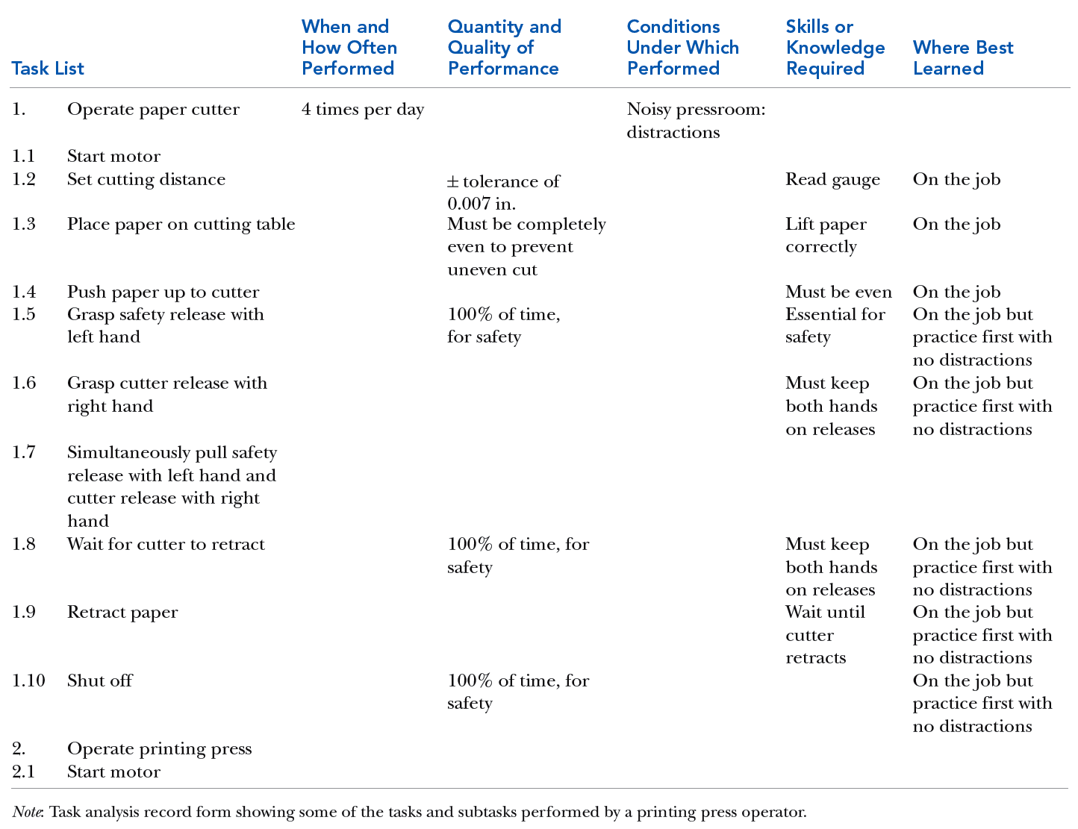
TABLE Sample Task Analysis Record Form
Copyright © 2011 Pearson Education
8–<number>
Notes:
Human Resources Management 12e
Gary Dessler
Copyright © 2011 Pearson Education
8–<number>
As Table 8-1 illustrates, the task analysis record form consolidates six types of information regarding required tasks and skills that is helpful for determining training requirements.

Slide 34
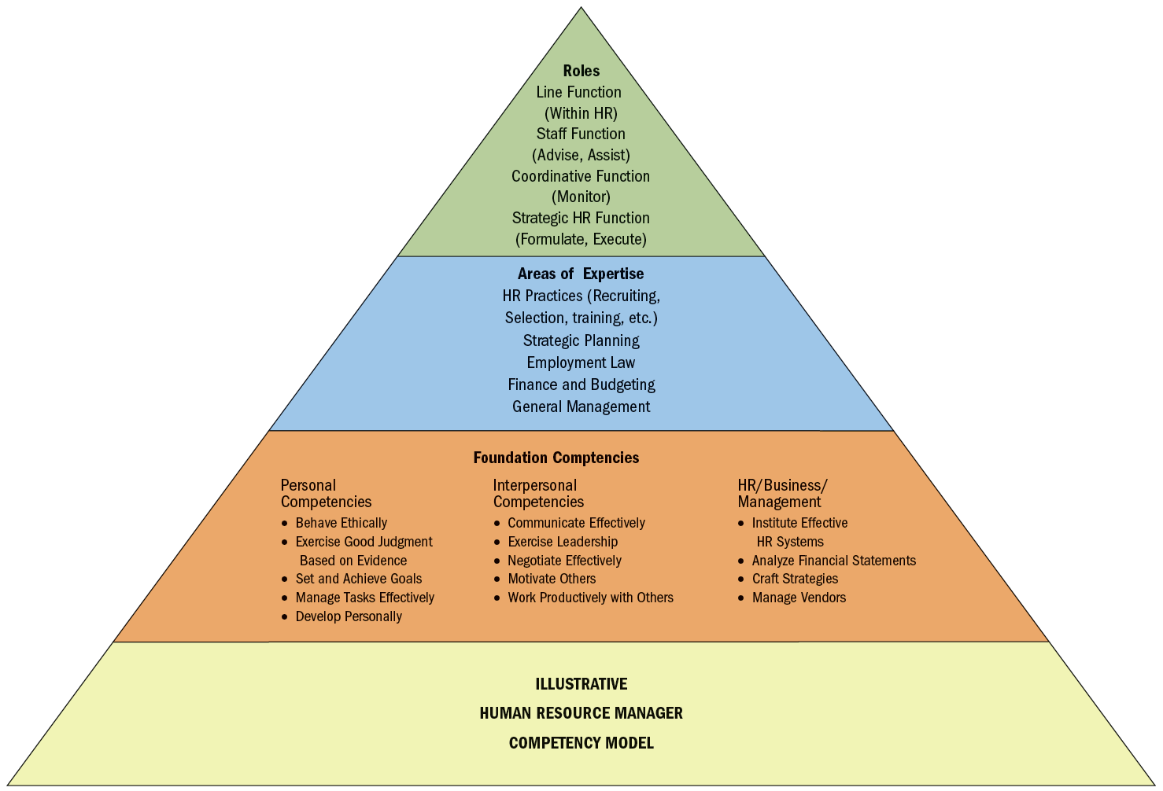
FIGURE Example of Competency Model for Human Resource Manager
Copyright © 2011 Pearson Education
8–<number>
Notes:
Human Resources Management 12e
Gary Dessler
Copyright © 2011 Pearson Education
8–<number>
The competency model consolidates, usually in one diagram, a precise overview of the competencies (knowledge, skills, and behaviors) someone would need to do a job well. As an example, Figure 8-2 shows an illustrative competency model for a human resource manager.
In this case, the model shows three things: At the top of the pyramid, it shows four roles we would expect the human resource manager to fill—line, staff, coordinative, and strategic. Beneath that, it shows the areas of expertise in which he or she must be expert to fill these roles, such as an expertise in HR practices and strategic planning. Next step down are basic competencies one would need to exhibit the required expertise and to fill the HR manager’s roles.

Slide 35
Performance Analysis:
Assessing Current Employees’ Training Needs
Specialized Software
Assessment Center Results
Performance Appraisals
Methods
for Identifying Training Needs
Individual Diaries
Job-Related Performance Data
Attitude Surveys
Observations
Tests
Interviews
Can’t-do or Won’t-do?
Copyright © 2011 Pearson Education
8–<number>
Notes:
Human Resources Management 12e
Gary Dessler
Copyright © 2011 Pearson Education
8–<number>
Performance analysis is the process of verifying that there is a performance deficiency and determining whether the employer should correct such deficiencies through training or other means (motivation).
The heart of performance analysis is determining why performance is down. It is futile to train an employee whose work actually is deficient because of insufficient motivation. Distinguishing between can’t-do and won’t-do problems is therefore crucial.

Slide 36

Training Methods
On-the-Job Training
Apprenticeship Training
Informal Learning
Job Instruction Training
Lectures
Programmed Learning
Audiovisual-Based Training
Vestibule Training
Teletraining and Videoconferencing
Electronic Performance Support Systems (EPSS)
Computer-Based Training (CBT)
Simulated Learning
Internet-Based Training
Learning Portals
Copyright © 2011 Pearson Education
8–<number>
Notes:
Human Resources Management 12e
Gary Dessler
Copyright © 2011 Pearson Education
8–<number>
With the program designed and budgeted and objectives set, you can turn to implementing the training program. This means actually doing the training, choosing and using one or more of the simpler, low-tech methods and, then perhaps, proceeding on to computer-based ones.

Slide 37
The OJT Training Method
On-the-Job Training (OJT)
  Having a person learn a job
  by actually doing the job.
Types of On-the-Job Training
  Coaching or understudy
  Job rotation
  Special assignments
Advantages
  Inexpensive
  Learn by doing
  Immediate feedback
Copyright © 2011 Pearson Education
8–<number>
Notes:
Human Resources Management 12e
Gary Dessler
Copyright © 2011 Pearson Education
8–<number>
On-the-job training (OJT) means having a person learn a job by actually doing it. Every employee, from mailroom clerk to CEO, gets on-the-job training when he or she joins a firm. In many firms, OJT is the only training available.

Slide 38
On-the-Job Training
Steps to Help Ensure OJT Success
1
Prepare the learner
2
Present the operation
3
Do a tryout
4
Follow up
Copyright © 2011 Pearson Education
8–<number>
Notes:
Human Resources Management 12e
Gary Dessler
Copyright © 2011 Pearson Education
8–<number>
Don’t take the success of an on-the-job training effort for granted. Train the trainers themselves (often the employees’ supervisors), and provide the training materials. Trainers should know, for instance, the principles of motivating learners.
Because low expectations on the trainer’s part may translate into poor trainee performance, supervisors/trainers should emphasize the high expectations they have for their trainees’ success.

Slide 39
FIGURE Some Popular Apprenticeships
The U.S. Department of Labor’s Registered Apprenticeship program offers access to 1,000 career areas, including the following top occupations:
  Able seaman
  Carpenter
  Chef
  Child care development specialist
  Construction craft laborer
  Dental assistant
  Electrician
  Elevator constructor
  Fire medic
  Law enforcement agent
  Over-the-road truck driver
  Pipefitter
Copyright © 2011 Pearson Education
8–<number>
Notes:
Human Resources Management 12e
Gary Dessler
Copyright © 2011 Pearson Education
8–<number>
Figure 8-3 lists popular recent apprenticeships. Apprenticeship training is a process by which people become skilled workers, usually through a combination of formal learning and long-term on-the-job training. It traditionally involves having the learner/apprentice study under the tutelage of a master craftsperson.

Slide 40
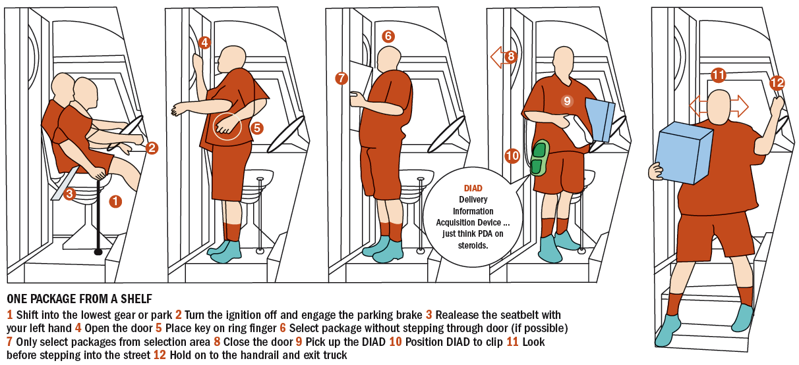
FIGURE Job Instruction Training at UPS
Copyright © 2011 Pearson Education
8–<number>
Notes:
Human Resources Management 12e
Gary Dessler
Copyright © 2011 Pearson Education
8–<number>
Many jobs (or parts of jobs) consist of a logical sequence of steps that one best learns step-by-step. This step-by-step training is called job instruction training (JIT). Figure 8-4 shows the step-by-step graphical instructions UPS uses to train new drivers in how to park their trucks and disembark.

Slide 41
Delivering Effective Lectures
Don’t start out on the wrong foot.
Give your listeners signals.
Be alert to your audience.
Maintain eye contact with audience.
Make sure everyone in the room can hear.
Control your hands.
Talk from notes rather than from a script.
Break a long talk into a series of five-minute talks.
Practice and rehearse your presentation.
Copyright © 2011 Pearson Education
8–<number>
Notes:
Human Resources Management 12e
Gary Dessler
Copyright © 2011 Pearson Education
8–<number>
Lecturing is a quick and simple way to present knowledge to large groups of trainees, as when the sales force needs to learn a new product’s features. Here are some guidelines for presenting a lecture.

Slide 42
Programmed Learning
Presenting questions, facts, or problems to the learner
Allowing the person to respond
Providing feedback on
the accuracy
of answers
Advantages
  Reduced training time
  Self-paced learning
  Immediate feedback
  Reduced risk of error for learner
Copyright © 2011 Pearson Education
8–<number>
Notes:
Human Resources Management 12e
Gary Dessler
Copyright © 2011 Pearson Education
8–<number>
Programmed learning (or programmed instruction) is a step-by-step, self-learning method that consists of three parts.

Slide 43

Intelligent Tutoring Systems
Advantages
  Reduced learning time
  Cost effectiveness
  Instructional consistency
Types of Programmed Learning
  Interactive multimedia training
  Virtual reality training
  Virtual classroom
Copyright © 2011 Pearson Education
8–<number>
Notes:
Human Resources Management 12e
Gary Dessler
Copyright © 2011 Pearson Education
8–<number>
Intelligent tutoring systems are computerized, supercharged, programmed instruction programs. In addition to the usual programmed learning, intelligent tutoring systems learn what questions and approaches worked and did not work for the learner, and therefore adjust the suggested instructional sequence to the trainee’s unique needs.

Slide 44
TABLE Names of Various Computer-Based Training Techniques
PI Computer-based programmed instruction
CBT Computer-based training
CMI Computer-managed instruction
ICAI Intelligent computer-assisted instruction
ITS Intelligent tutoring systems
Simulation Computer simulation
Virtual Reality Advanced form of computer simulation
Copyright © 2011 Pearson Education
8–<number>
Notes:
Human Resources Management 12e
Gary Dessler
Copyright © 2011 Pearson Education
8–<number>
Table 8-2 summarizes the main terminology of computer-based training.

Slide 45
Internet-Based Training
Teletraining and Videoconferencing
Distance Learning Methods
Electronic Performance Support
Systems (EPSS)
Computer-Based Training
E-learning and learning portals
Copyright © 2011 Pearson Education
8–<number>
Notes:
Human Resources Management 12e
Gary Dessler
Copyright © 2011 Pearson Education
8–<number>
Learning management systems (LMS) play an important role in Internet training. They are special software packages that support Internet training by helping employers identify training needs, and in scheduling, delivering, assessing, and managing the online training itself.

Slide 46

FIGURE Partial List of E-Learning Vendors
Copyright © 2011 Pearson Education
8–<number>
Notes:
Human Resources Management 12e
Gary Dessler
Copyright © 2011 Pearson Education
8–<number>
When an employer contracts with applications service providers (ASP) like those listed in Figure 8-5, employees can go to their firm’s learning portal to access a menu of training courses that the ASP company contracted with the employer to offer.

Slide 47
Lifelong Learning and
Literacy Training Techniques
Employer Responses to Employee Learning Needs
Provide employees with lifelong educational and learning opportunities
Instituting basic skills
and literacy programs
Copyright © 2011 Pearson Education
8–<number>
Notes:
Human Resources Management 12e
Gary Dessler
Copyright © 2011 Pearson Education
8–<number>
Lifelong learning means providing employees with continuing learning experiences over their tenure with the firm, with the aims of ensuring they have the opportunity to learn the skills they need to do their jobs and to expand their horizons.
Many employees have learning disabilities that make it challenging to read, write, or do arithmetic. The current emphasis on teamwork and quality requires that employees read, write, and understand numbers. Employers use both public and private sources to provide literacy training for their workers.

Slide 48
Implementing Management Development Programs
Long-Term Focus of Management Development
Assessing the company’s strategic needs
Appraising managers’ current performance
Developing the managers and future managers
Copyright © 2011 Pearson Education
8–<number>
Notes:
Human Resources Management 12e
Gary Dessler
Copyright © 2011 Pearson Education
8–<number>
Management development is any attempt to improve managerial performance by imparting knowledge, changing attitudes, or increasing skills. The management development process consists of (1) assessing the company’s strategic needs (for instance, to fill future executive openings or to boost competitiveness), (2) appraising managers’ current performance, and then (3) developing the managers (and future managers).

Slide 49
Succession Planning
Steps in the Succession Planning Process
1
Anticipate management needs
2
Review firm’s management skills inventory
3
Create replacement charts
4
Begin management development
Copyright © 2011 Pearson Education
8–<number>
Notes:
Human Resources Management 12e
Gary Dessler
Copyright © 2011 Pearson Education
8–<number>
Development is usually part of the employer’s succession planning. Succession planning refers to the process through which a company plans for and fills senior-level openings.

Slide 50
Management Development Techniques
Managerial On-the-Job Training
Job
rotation
Coaching and understudy
Action
learning
Copyright © 2011 Pearson Education
8–<number>
Notes:
Human Resources Management 12e
Gary Dessler
Copyright © 2011 Pearson Education
8–<number>
Managerial on-the-job training methods include job rotation, the coaching/understudy approach, and action learning.

Slide 51
Other Management Training Techniques
Off-the-Job Management Training
and Development Techniques
The case study method
Role playing
Management games
Behavior modeling
Outside seminars
Corporate universities
University-related programs
Executive coaches
Copyright © 2011 Pearson Education
8–<number>
Notes:
Human Resources Management 12e
Gary Dessler
Copyright © 2011 Pearson Education
8–<number>
There are also many other off-the-job techniques for training and developing managers.

Slide 52
FIGURE Typical Role in a Role-Playing Exercise
Walt Marshall—Supervisor of Repair Crew
You are the head of a crew of telephone maintenance workers, each of whom drives a small service truck to and from the various jobs. Every so often you get a new truck to exchange for an old one, and you have the problem of deciding which of your crew members you should give the new truck. Often there are hard feelings, since each seems to feel entitled to the new truck, so you have a tough time being fair. As a matter of fact, it usually turns out that whatever you decide is considered wrong by most of the crew. You now have to face the issue again because a new truck has just been allocated to you for assignment.
In order to handle this problem you have decided to put the decision up to the crew. You will tell them about the new truck and will put the problem in terms of what would be the fairest way to assign the truck. Do not take a position yourself, because you want to do what they think is most fair.
Copyright © 2011 Pearson Education
8–<number>
Notes:
Human Resources Management 12e
Gary Dessler
Copyright © 2011 Pearson Education
8–<number>
The aim of role playing is to create a realistic situation and then have the trainees assume the parts (or roles) of specific persons in that situation. Figure 8-6 presents a role from a classic role-playing exercise called the New Truck Dilemma.

Slide 53
Behavior Modeling
Behavior Modeling Training
1
Model the effective behaviors
2
Have trainees role play using behaviors
3
Provide social reinforcement and feedback
4
Encourage transfer of training to job
Copyright © 2011 Pearson Education
8–<number>
Notes:
Human Resources Management 12e
Gary Dessler
Copyright © 2011 Pearson Education
8–<number>
Behavior modeling involves (1) showing trainees the right (or “model”) way of doing something, (2) letting trainees practice that way, and then (3) giving feedback on the trainees’ performance.

Slide 54
Managing Organizational
Change Programs
What to Change
Strategy
Culture
Structure
Technologies
Employees
Copyright © 2011 Pearson Education
8–<number>
Notes:
Human Resources Management 12e
Gary Dessler
Copyright © 2011 Pearson Education
8–<number>
Faced with the need to change, managers can change one or more of five aspects of their companies—their strategy, culture, structure, technologies, or the attitudes and skills of the employees.

Slide 55
Managing Organizational Change and Development
The Human Resource Manager’s Role
Overcoming resistance to change
Organizing
and leading organizational change
Effectively using organizational development practices
Copyright © 2011 Pearson Education
8–<number>
Notes:
Human Resources Management 12e
Gary Dessler
Copyright © 2011 Pearson Education
8–<number>
Knowing how to deal with resistance to change is the heart of implementing an organizational change program. Implementing change can mean either reducing the forces for the status quo or building up the forces for change.

Slide 56
Managing Organizational Change and Development (cont’d)
Overcoming Resistance to Change:
Lewin’s Change Process
1
Unfreezing
2
Moving
3
Refreezing
Copyright © 2011 Pearson Education
8–<number>
Notes:
Human Resources Management 12e
Gary Dessler
Copyright © 2011 Pearson Education
8–<number>
Psychologist Kurt Lewin formulated a model of change to summarize what he believed was a three-step process for implementing a change with minimal resistance.

Slide 57
How to Lead the Change
Unfreezing Stage
  Establish a sense of urgency (need for change).
  Mobilize commitment to solving problems.
Moving Stage
  Create a guiding coalition.
  Develop and communicate a shared vision.
  Help employees to make the change.
  Consolidate gains and produce more change.
Refreezing Stage
  Reinforce new ways of doing things.
  Monitor and assess progress.
Copyright © 2011 Pearson Education
8–<number>
Notes:
Human Resources Management 12e
Gary Dessler
Copyright © 2011 Pearson Education
8–<number>
This slide details Lewin’s three-step change process.

Slide 58
Using Organizational Development
Organizational Development (OD)
1
Usually involves action research
2
Applies behavioral science knowledge
3
Changes the organization in a particular direction
Copyright © 2011 Pearson Education
8–<number>
Notes:
Human Resources Management 12e
Gary Dessler
Copyright © 2011 Pearson Education
8–<number>
Organizational development (OD) is a change process through which employees formulate the change that’s required and implement it, often with the assistance of trained consultants.

Slide 59
TABLE Examples of OD Interventions
Human Process Applications
  T-groups (Sensitivity Training)
  Process consultation
  Third-party intervention
  Team building
  Organizational confrontation meeting
  Survey research
Technostructural Interventions
  Formal structural change
  Differentiation and integration
  Cooperative union–management projects
  Quality circles
  Total quality management
  Work design
HRM Applications
  Goal setting
  Performance appraisal
  Reward systems
  Career planning and development
  Managing workforce diversity
  Employee wellness
Strategic OD Applications
  Integrated strategic management
  Culture change
  Strategic change
  Self-designing organizations
Copyright © 2011 Pearson Education
8–<number>
Notes:
Human Resources Management 12e
Gary Dessler
Copyright © 2011 Pearson Education
8–<number>
Table lists the four basic categories of OD applications: human process, technostructural, human resource management, and strategic applications.
Action research—getting the employees themselves to review the required data and to design and implement the solutions—is the basis of all four.

Slide 60
Evaluating the Training Effort
Designing the Evaluation Study
  Time series design
  Controlled experimentation
Choosing Which Training Effects to Measure
  Reaction of trainees to the program
  Learning that actually took place
  Behavior that changed on the job
  Results achieved as a result of the training
Copyright © 2011 Pearson Education
8–<number>
Notes:
Human Resources Management 12e
Gary Dessler
Copyright © 2011 Pearson Education
8–<number>
There are two basic issues to address when evaluating training programs. The first is the design of the evaluation study and, in particular, whether to use controlled experimentation. The second issue is of “What should we measure?” and involves choosing which training outcomes to assess.

Slide 61
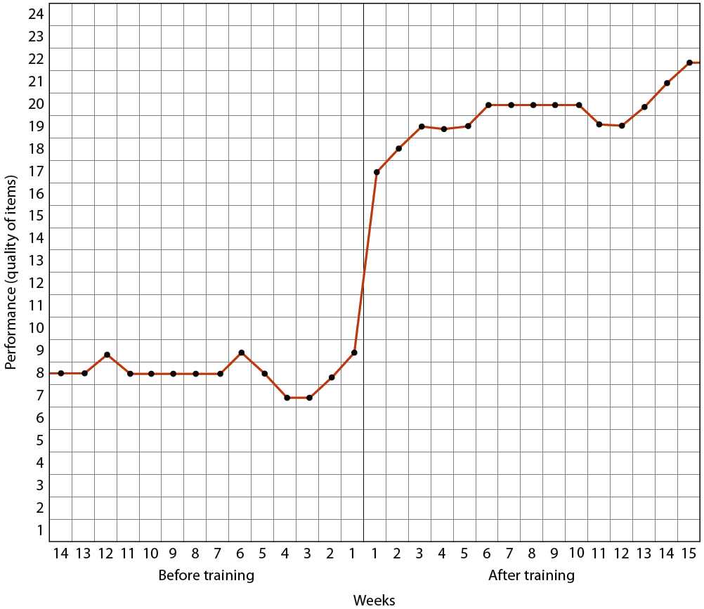
FIGURE 8–7 Using a Time Series Graph to Assess a Training Program’s Effects
Copyright © 2011 Pearson Education
8–<number>
Notes:
Human Resources Management 12e
Gary Dessler
Copyright © 2011 Pearson Education
8–<number>
Figure illustrates the assessment of a training program’s effects by a series of measures taken before and after the training program.

Slide 62

FIGURE
A Sample Training
Evaluation Form
Copyright © 2011 Pearson Education
8–<number>
Notes:
Human Resources Management 12e
Gary Dessler
Copyright © 2011 Pearson Education
8–<number>
Figure 8-8 presents one page from a sample evaluation questionnaire for assessing trainees’ reactions to training.

