Slide 1

Industrial and Organizational Psychology
Motivation
Copyright Paul E. Spector, All rights reserved, March 15, 2005

Slide 2
What Is Motivation?
Internal regulatory processes of behavior
  Direction: What should I do?
  Intensity: How hard should I try?
  Persistence: Should I keep going?
Distal
  Processes far removed from the actual behavior
  Needs—what I want but not how I will get it.
Proximal
  Processes close to the actual behavior
  Intentions—what I plan to do now

Slide 3
Need Theories
Need hierarchy
  Maslow
  Behavior determined by five needs
  Physiological, Safety, Love, Esteem, Self‑actualization
  Movement up the hierarchy
Two-Factor
  Herzberg
  Work behavior determined by two classes of needs
  Hygiene factors, rewards and social factors
  Motivator factors, nature of work
  Theory says only motivator factors can motivate work performance
  One of the few theories abandoned based on data

Slide 4
Reinforcement Theory
Operant conditioning
Skinner
Law of Effect – Thorndike 1913
  Response = f(reinforcement)
  Behavior ‑‑> Reward ‑‑‑> Greater likelihood of Behavior
Basis of incentive systems
Research results:
  High productivity with piece rates
  Successful for reducing absence
  Workers often prefer hourly (too much pressure)

Slide 5
Expectancy Theory
Cognitive reinforcement theory
Vroom
Predicts motivation not performance
Force = Exp (Sum Valence x Instrumentality)
Expectancy: Effort‑Performance
Instrumentality: Performance‑Reward
Valence: Value of rewards to the person
Multiplicative implies all must be high
Meta-analysis finds support Van Eerde, 1996
  Mean correlations of VIE formula with
    Preference: .74
    Intention: .42
    Effort: .29
    Performance: .19
  Predicts distal better than proximal

Slide 6
Self-Efficacy
Self-confidence in task performance
Bandura
Belief in self-efficacy increases motivation
Galatea Effect – personal self-fulfilling prophesy
Dov Eden
Increases job performance
Study showing effects on seasickness
  Naval cadets in Israel
  Training session during which cadets told they were unlikely to get sick at sea.
  Random assignment to training or control group
  Manipulation effective
  Less sickness
  Better performance
  (Eden & Zuk, 1995)

Slide 7
Justice Theories: Equity
Theory about fairness and justice in rewards
Adams
Balance between Inputs & Outcomes
Imbalance motivates behavior
Homeostatic approach
Overpayment → Increase effort
Underpayment → Decreased effort, turnover

Slide 8
Justice Theories: Distributive and Procedural
Modern justice theory
Distributive justice: Fairness in distribution of rewards
Procedural justice: Fairness in distribution methods
Often procedure is more important than distribution
Justice relates to many variables
  Job performance
  Job satisfaction
Procedural justice may be more important for women
Distributive justice may be more important for me

Slide 9
Goal Setting Theory
Goals direct and focus behavior
Locke
Goals must be accepted
Goal specificity: specific, difficult goals most effective
Survey of British companies: 79% use goals (Yearta et al., 1995)
Often works, but has limitations
Group goals work better with work groups
Not all jobs easy to set goals

Slide 10
Control Theory
Role of feedback in goal striving
Klein
Focuses on regulation of performance toward goal
Person compares progress toward goal to internal standard
Insufficient progress leads to
  Goal modification
  Revised strategies for goal attainment

Slide 11
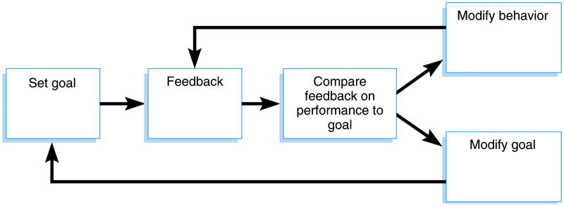
Control Theory

Slide 12
Action Theory
German comprehensive theory of work behavior
Hacker (English, Michael Frese & Dieter Zapf, 1994
Provides good contrast to US I/O approaches
Based on goal setting, but far more extensive than US theories
Major focus is on goal oriented or intentional behavior
Behaviors are called actions
Actions result from conscious intentions to accomplish something
Theory is concerned with the process linking goals to behavior, and how goals and behavior are regulated
Cognitive theory

Slide 13
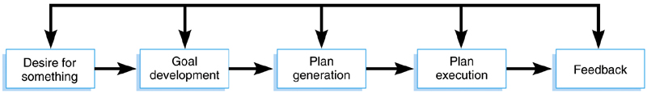
Action Sequence

Slide 14
Action Theory: Action Sequence
Task: Internal or external thing to be accomplished at work
  External assigned by supervisor
  Internal chosen by worker
  External task redefined by worker—idiosyncratic
  Potential conflict between supervisor and employee task
Desire: Thing to be accomplished—the goal
  Big or small: Develop new motor to finish piece on line
Plan generation: Decide on steps needed to accomplish goal
  Not necessarily detailed or fully developed
  Long-range vs. short-range
Execution: Carry out plans
Feedback: Information about progress toward goal
  Concurrent: Feedback as actions occur
  Terminal: Feedback about results of action

Slide 15
Summary of Motivation Theories
Theory
Theorist
Basis For Motivation
Need Hierarchy
Maslow
Five levels of unfulfilled needs
Two Factor
Herzberg
Two categories of needs
Reinforcement
Skinner
Rewards and punishments
Expectancy
Vroom
Expectations for desired outcomes and valences of those outcomes
Justice-Equity
Adams
Perceived unfairness of rewards in relation to inputs
Distributive & Procedural Justice
No one person
Fairness with which rewards are distributed and procedures for distribution.
Self-Efficacy
Bandura
Feelings of competence
Goal Setting
Locke
Individual goals if accepted
Control Theory
Klein
Feedback toward goals
Action Theory
Hacker
Goals leading to plans leading to actions, modified by feedback

