Slide 1
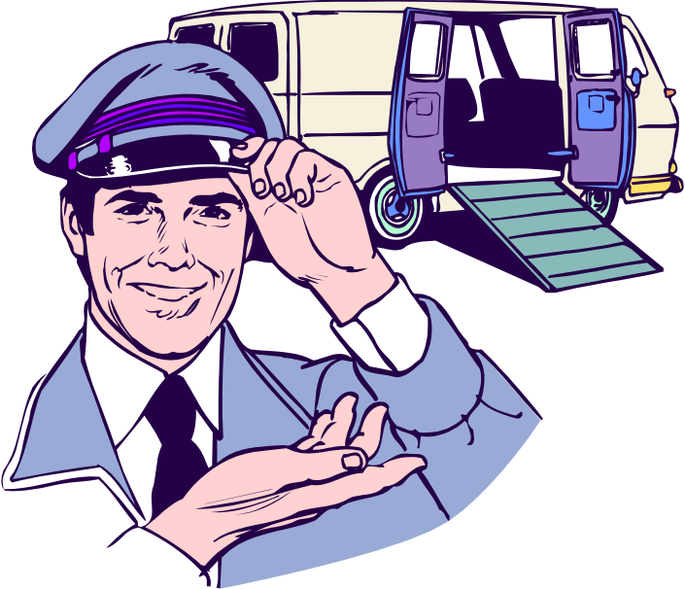
Industrial and Organizational Psychology
Feelings About Work: Job Attitudes and Emotions
Copyright Paul E. Spector, All rights reserved, March 15, 2005

Slide 2
Feelings About Work
Job satisfaction: Attitude about the job reflecting like/dislike for it and various facets.
Organizational commitment: Attachment to the job.
Emotion: Reaction to a situation that includes both physiological arousal and cognitive appraisal, e.g., anger or anxiety.

Slide 3
Nature of Job Satisfaction
Global approach: Overall satisfaction with work
Facet approach: Satisfaction with aspects of the job
  Pay
  Promotion
  Supervision
  Nature of work
Most people like the job overall
Facet satisfactions vary
  Highest: Nature of work
  Lowest: Pay and Promotion opportunities

Slide 4
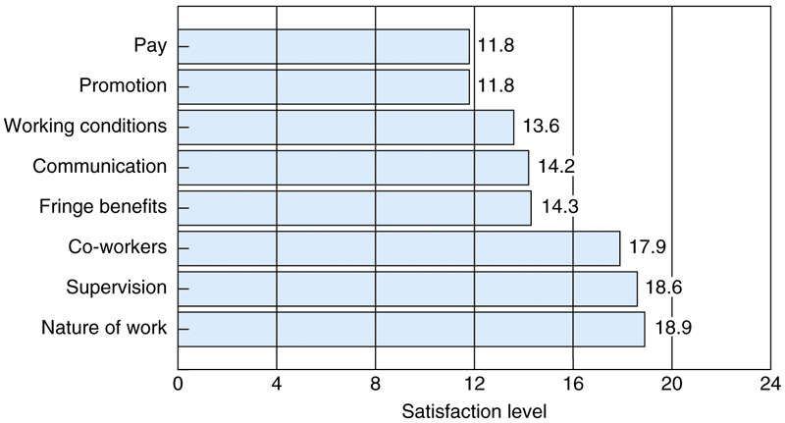
Mean levels of U.S. Satisfaction On the Job Satisfaction Survey

Slide 5
Assessment
Self-report survey
  Easy to use
  Can be anonymous
  Person best judge of own feelings
Standard scales exist
  Job Descriptive Index (JDI)
    5 facets of job satisfaction
  Job In General (JIG)
    Global job satisfaction
Scales exist for commitment and emotion

Slide 6
Antecedents of Job Satisfaction: Environmental
Job characteristics
  Hackman & Oldham
  Characteristics → Psychological States → Job satisfaction
  Strong research support linking perceptions of characteristics to job satisfaction
  Weak research support linking objective characteristics to job satisfaction
Pay
  Salary compared to people in same job more important than different jobs
Justice
  Distributive and Procedural related to global and facet satisfaction

Slide 7
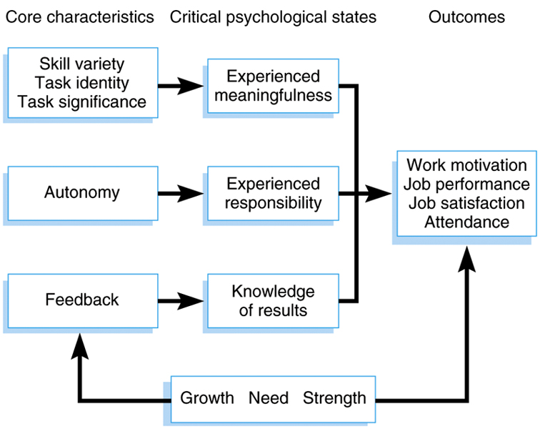
Job Characteristics Theory

Slide 8
Antecedents of Job Satisfaction: Environmental
Personality
  Negative affectivity (high NAs less satisfied)
  Locus of control (externals less satisfied)
Gender
  Few gender differences
Age
  Curvilinear—satisfaction lowest age 26 to 31
Culture and Ethnicity
  Few racial differences within the U.S.
  Western countries score higher than Asians
    Could be due to response styles rather than true feelings

Slide 9
Country Differences In Job Satisfaction Facets On JSS
Facet
Dominican Republic
Hong Kong
Jamaica
Singapore
US
Pay
17.2
15.0
5.8
14.0
11.8
Supervision
20.0
16.0
17.5
13.4
18.6
Fringe Benefits
16.8
14.4
6.1
14.2
14.3
Coworkers
20.0
15.6
17.0
13.4
17.9
Work Itself
22.2
14.9
18.3
17.1
18.9
Total
160.9
133.3
110.0
134.7
133.4

Slide 10
Person-Job Fit
Match between individual and the job
People differ in reactions to same situation
Characteristics of the person is a moderator
  Moderator: Variable that affects relationship between two other variables
Growth need strength (GNS)
  People high on GNS are more satisfied with high scope jobs
  People low on GNS are not more satisfied with high scope jobs

Slide 11
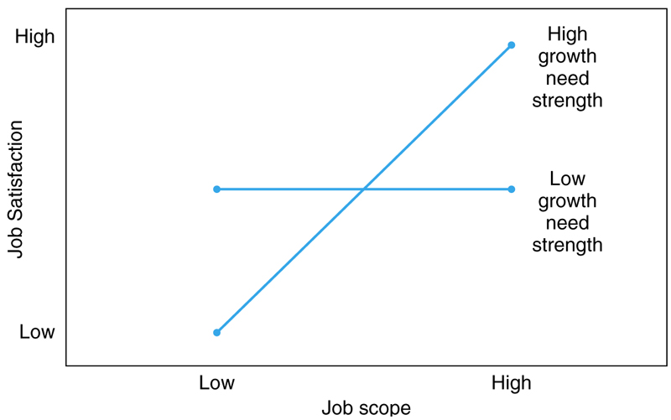
Moderating Effect of GNS On Relationship Between Job Scope and Job Satisfaction

Slide 12
Effects of Job Satisfaction
Job Performance
  Small correlation
  More evidence that performance causes satisfaction than reverse
Turnover
  Dissatisfied people more likely to quit
  Moderated by labor market—people quit when they find another job
Absence
  Very small correlation—other factors more important
Health and Well-Being
  Job satisfaction relates to health variables such as anxiety and depression
Life Satisfaction
  Job satisfaction important component of life satisfaction
  Spillover

Slide 13
Organizational Commitment
One commitment, three components
  Mowday, Steers, Porter
  Acceptance of organization goals
  Intention to stay on the job
  Willingness to work hard
Three commitments
  Meyer and Allen
  Affective: Like the job
  Continuance: Need the job
  Normative: Feel obligated to stay on the job

Slide 14
Commitment and Other Variables
Similar correlations as job satisfaction
High commitment associated with
  High job scope
  High job satisfaction
  Low job stressors
  Job Scope

Slide 15
Emotions and Work
Emotion state: How you feel now
Emotion mood: How you have been feeling lately
Positive emotions: Feeling good
  Greater creativity
  Higher job satisfaction
  More contextual performance
Negative emotions: Feeling bad
  Lower job satisfaction
  Higher absence
  More turnover

Slide 16
Emotional Labor
Requirement at work to express or inhibit emotional display
  Smiling at customers
  Not showing anger toward clients
Some studies showed that acting happy can lead to job satisfaction
Emotional dissonance: Expressing emotion you don’t feel
  Leads to dissatisfaction and stress

