Slide 1

Streams Tech Limited

Slide 2
Presented by Amran Hossain BSSE 0917 Institute of Information Technology University of Dhaka

Slide 3
Presentation outline
About StreamsTech
My Observations
My Learnings
About Team overview
About Project overview
My Contributions

Slide 4
About StreamsTech
Streams Tech Ltd. is a software development company providing full-cycle software engineering, custom application development and system integration services.
Business goal to help client meets on time within a budget
specialize in the development of .NET application, customized ArcGIS based geographic information system (GIS) software, SharePoint and data integration, processing, analysis and visualization systems.
Streams Tech Ltd. project managers plan, execute and monitor projects from initiation to closing to ensure each project is a success

Slide 5
About StreamsTech
Established on 2012.
Services
- Advanced GIS solutions.
- Native cross-platform mobile app development
- Dashboard development

Slide 6









About StreamsTech
Products

Slide 7

About StreamsTech
Clients

Slide 8
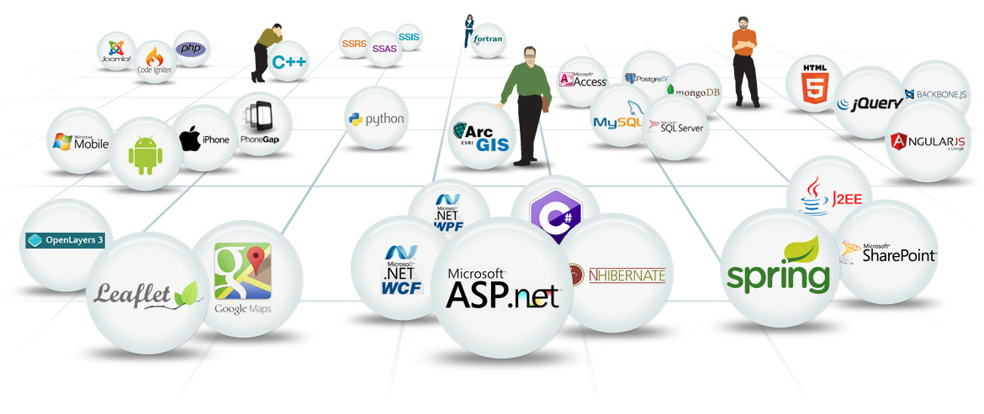
About StreamsTech
Technologies

Slide 9
About Streams Tech cultures
Friendly Environment
Lunch and snack
Gratuity
Annual Tour
Provident Fund
Pitha festive
Medical expenses

Slide 10
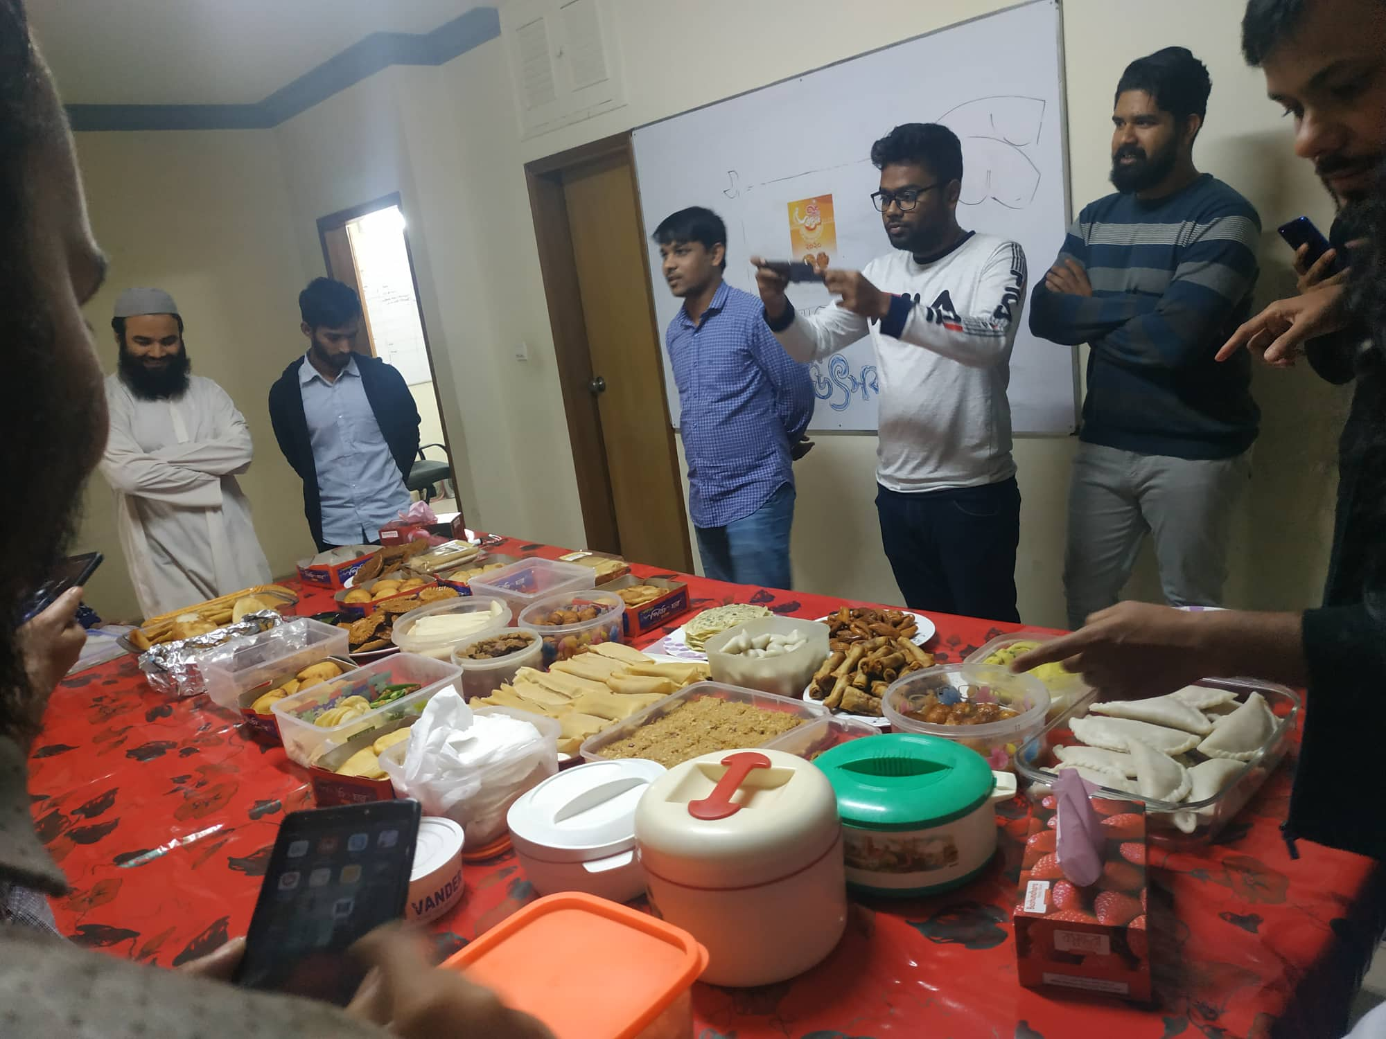
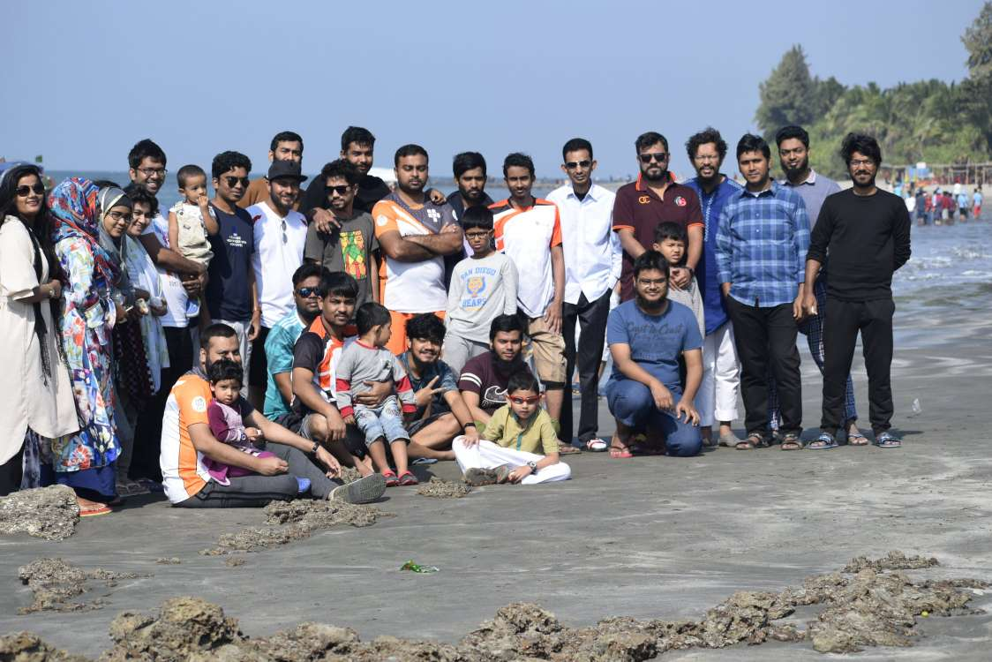
About Streams Tech cultures
Notes:
Pitha festive and Saintmartin’s tour

Slide 11
My observation
Flexible Working Hour
Friendly Environment
Goal Oriented Environment
Office time 9a.m to 6p.m(Entry flexible 9a.m-11a.m). They used hourpad for time entry
All the employees help any kind of development problem
Helps me to take the ownership of my work

Slide 12
My learnings
Angular
ASP.NET framework
Angular material
ASP.NET Core framework
PostgreSql
Sourcetree

Slide 13
My learnings
C#
Typescript
TeamCity
Postman

Slide 14
My learnings
Angular focuses on frontend development in website designing. I learned angular 8 ,is a typescript language, for web programming.

Slide 15
My learnings
.NET core is a cross-platform framework. We used .NET core for our Buet_88 projects. . I learned C# for working on this framework to connect with database.

Slide 16
My learnings
ASP.NET focuses on backend development in website designing. I learned C# for working on asp.net framework to connect with database.

Slide 17
My learnings
TeamCity is a build management and continuous integration server from JetBrains. I learned this for CI/CD purpose. I learned only how this works and how deployment works.

Slide 18
My learnings
C# (C-Sharp) is a programming language developed by Microsoft that runs on the .NET Framework.
C# is used to develop web apps, desktop apps, mobile apps, games and much more. I learned it for backend server connection.

Slide 19
My learnings
PostgreSql is a database server
Angular material and mdbBootstrap used for designing the website.

Slide 20
Team overview
Project Manger
Shafiul Parvez Akash
Maeenul Islam
Team members
1.Fazlay Rabbi
2.Musa Ali
3.Amran Hossain
4.Shariful Islam(employee)
5.Shahnewaj Rasel(employee)
6.Farhan Abdullah

Slide 21
Project overview
Project Name: Showcase
Internal project of this company where all of their projects to be showed.
Project Name: Jantrik crud
Internal framework project of this company.
Project Name: Buet88 club
This project holds buet88 batch member management.

Slide 22
My Contributions
Project Name: Showcase
I built admin panel of this project with Angular.
I have built following module such as
- GIS - BI
- M&E - TECHNOLOGY SERVICES
- WEB APP - CONSULTANCY SERVICE
- MOBILE APP
Project Name: Jantrik crud
I am converting a module angular js to angular in this project.

Slide 23
My Contributions
Project Name: Buet88 club
I built admin panel of this project with Angular. I have built following module such as
Hall
Members Management (dynamically child addition)
Events
Publications
Departments
Authentication
User

Slide 24
Thanks for listening……….

