Slide 1
DU SERVICES SYSTEM
SUPERVISED BY:
Dr.Ahmedul Kabir
Assistant professor
IIT,DU
Presented BY:
AMRAN HOSSAIN
BSSE 0917

Slide 2
Project Description
It is a web project
It is a such kind of system where students get services such as (testimonial, Course Certificate) easily.
Students apply for the services with giving personal information and pay the money through the system.
Admin manages the application (accept/reject)
System will notify the user through the mail for his current application status.
Also system will make testimonial or certificate for the application and notify the applicants.

Slide 3
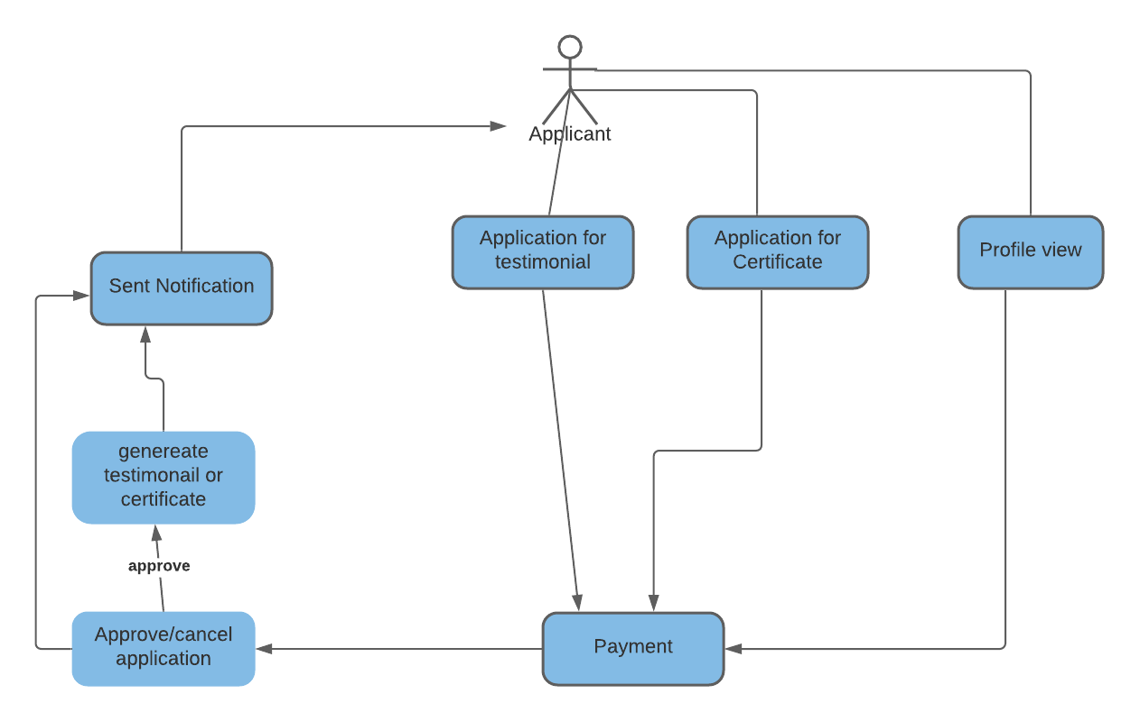

Slide 4
Module
Application for Certificate
Application for testimonial
Payment gateway
Application status and Profile
Admin Authentication
Testimonial and Certificate Process
Admin Roles
Departments

Slide 5
Github url
https://github.com/amran0917/DU_Services_System

