Slide 1
DU SERVICES SYSTEM
SUPERVISED BY:
MD.Saeed siddik
Assistant professor
IIT,DU
Presented BY:
AMRAN HOSSAIN
BSSE 0917

Slide 2
Presentation Outline
Project Description
Use Case Scenario
ER Diagram
Class Diagram
Archetype
Architectural Mapping
Work progress

Slide 3
Project Description
It is a such kind of system where students can apply and get services such as (testimonial, Language Certificate) easily.
Here, students can apply for the services with transaction and admin approve this application and system will be given completion notification .
It is a web development.
Two type of users in here: Admin and student

Slide 4
STUDENT Module:
Application
Payment
Status seen
ADMIN Module:
Approve application
Cancel application
Log in
Role creation
Edit applicant’s info
Add, edit ,delete department, services
Process testimonial, document

Slide 5
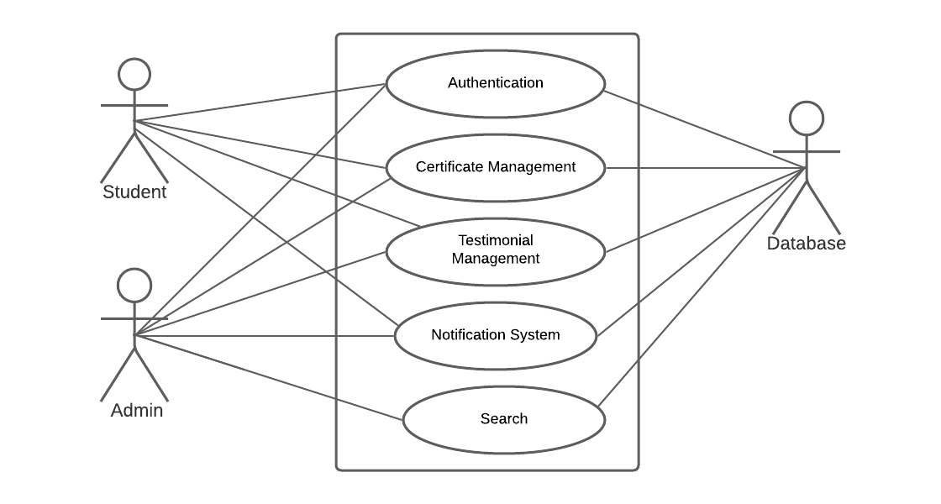
Use Case Scenario
A Use Case captures a contract that describes the system behavior under the various conditions as the system responds to a request from one of its stakeholders.

Slide 6
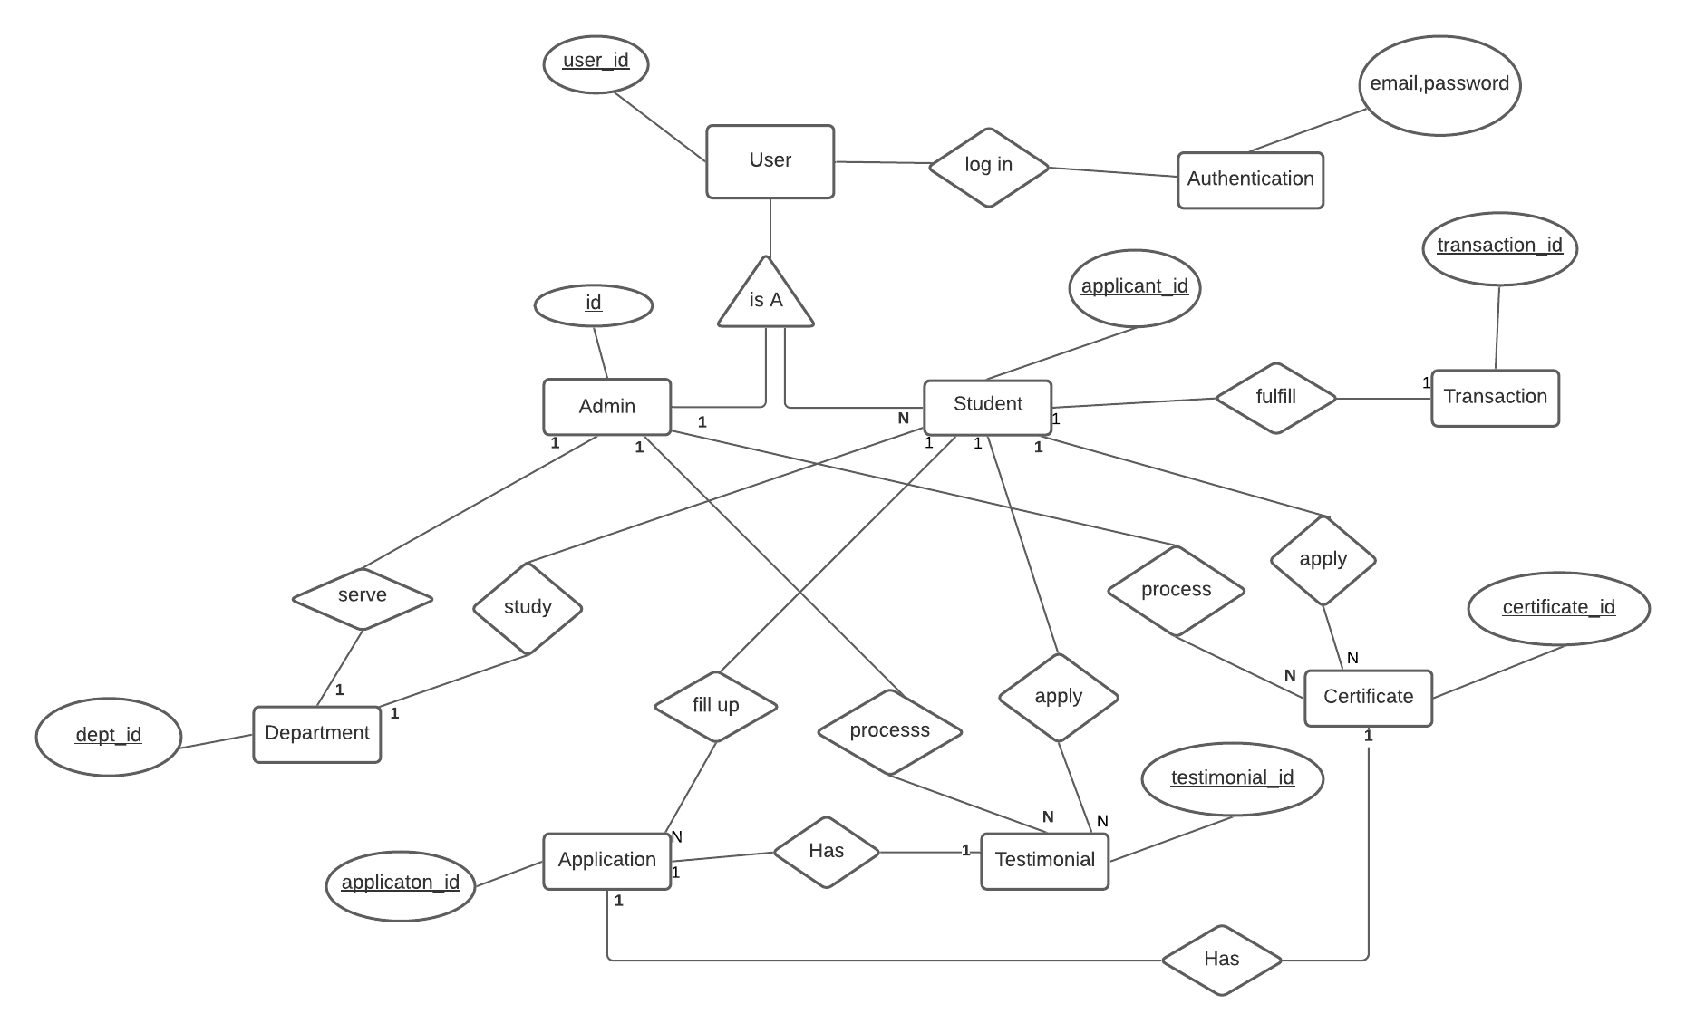
ER Diagram

Slide 7
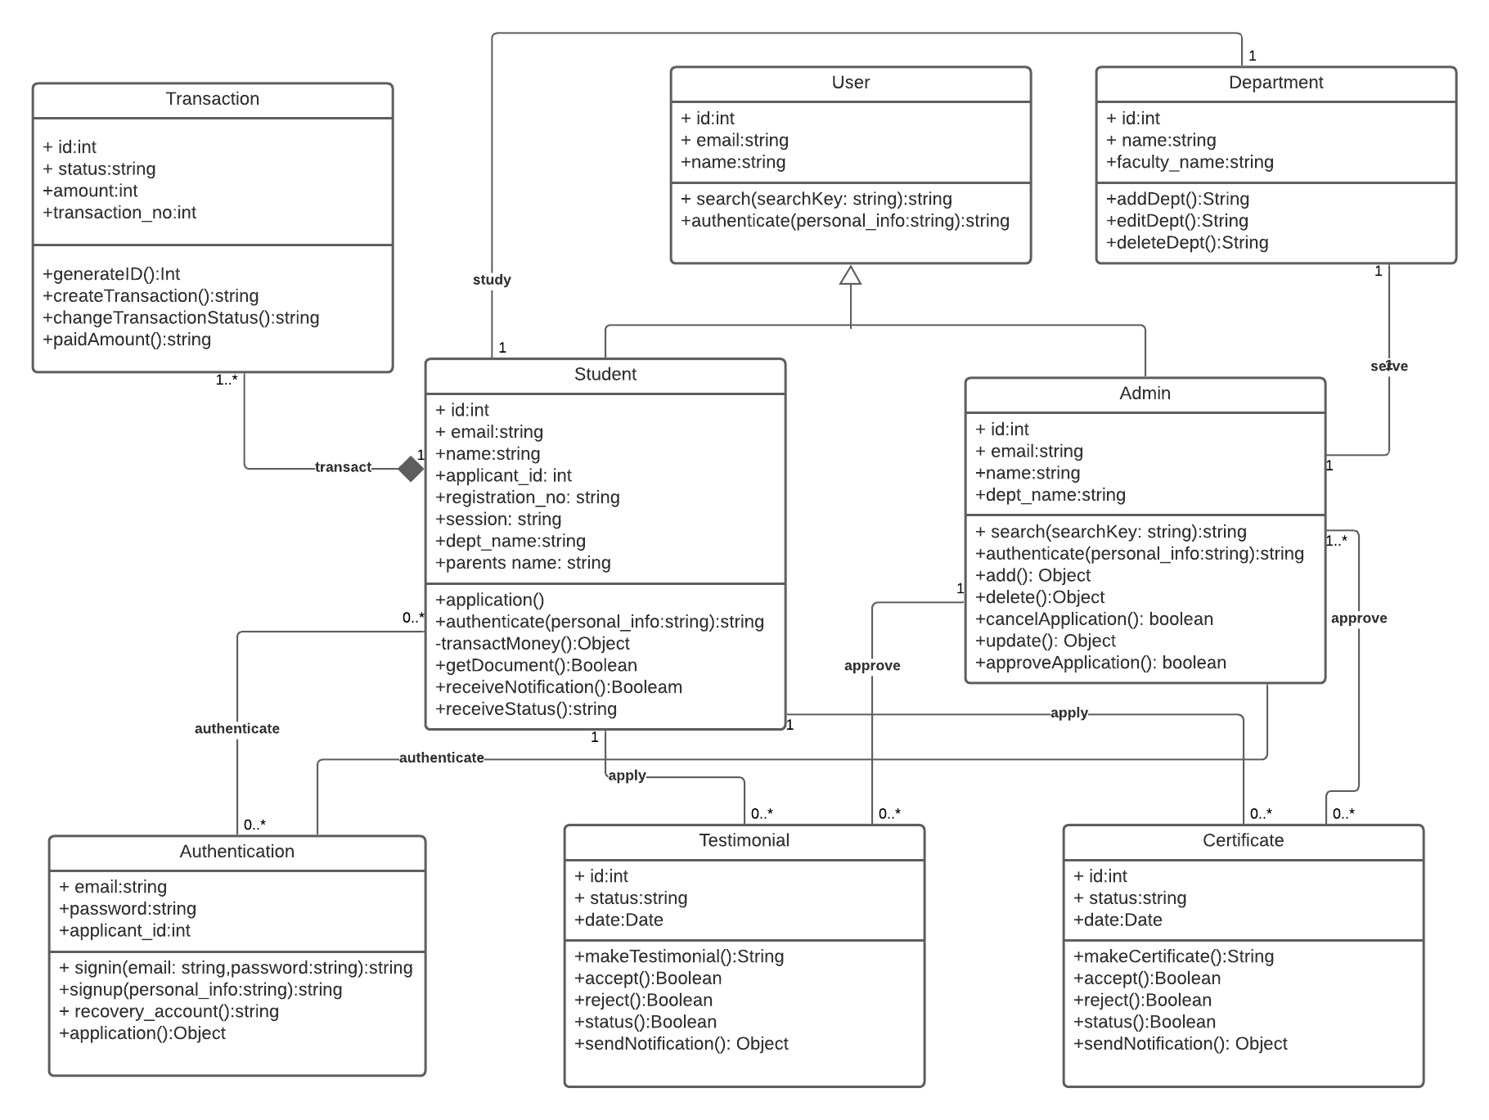
Class Diagram

Slide 8
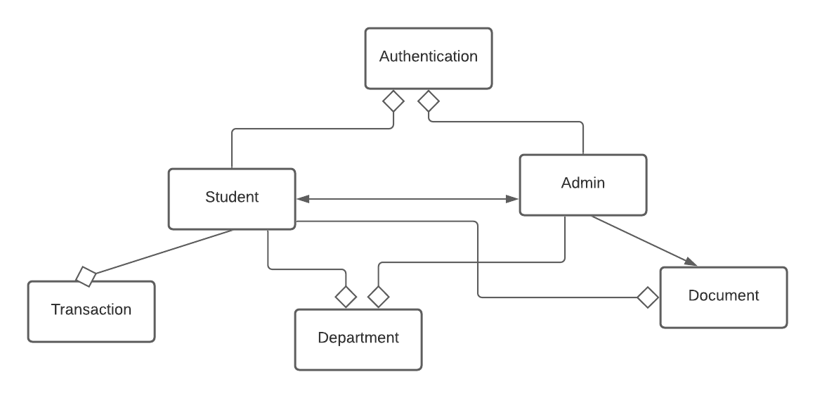
Archetype
It is a class or pattern that represents a core abstraction.

Slide 9
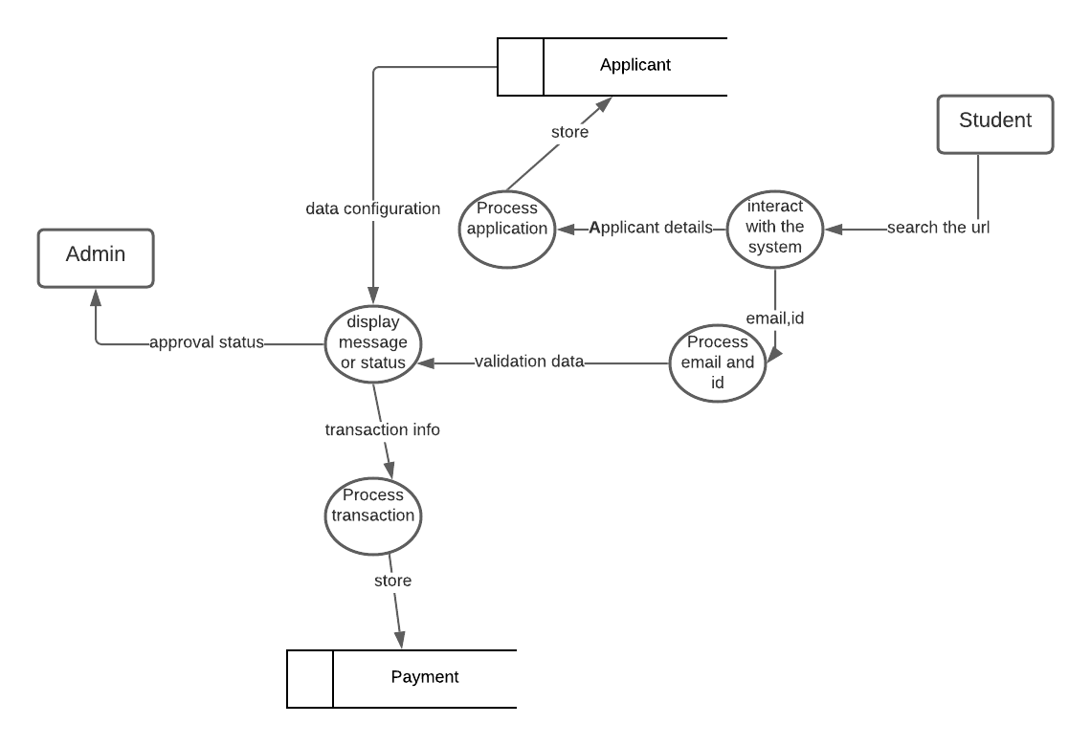
Architectural Mapping

Slide 10
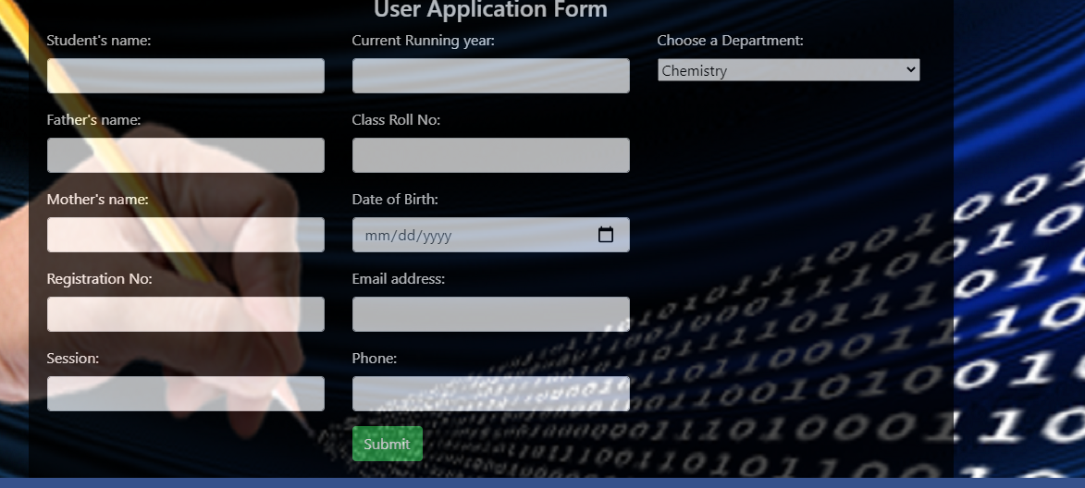
What have I done
Application page

Slide 11
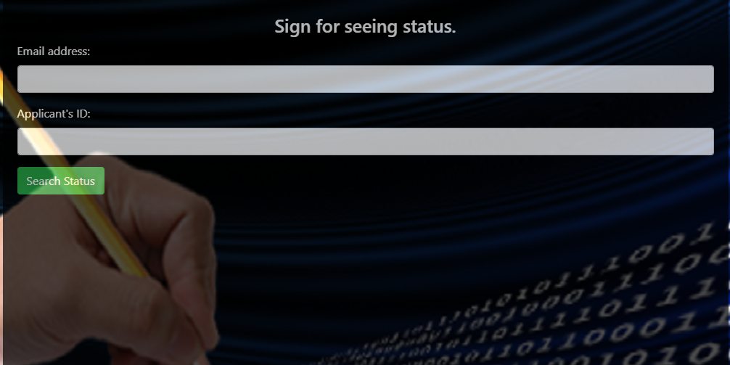
Applicant log in

Slide 12
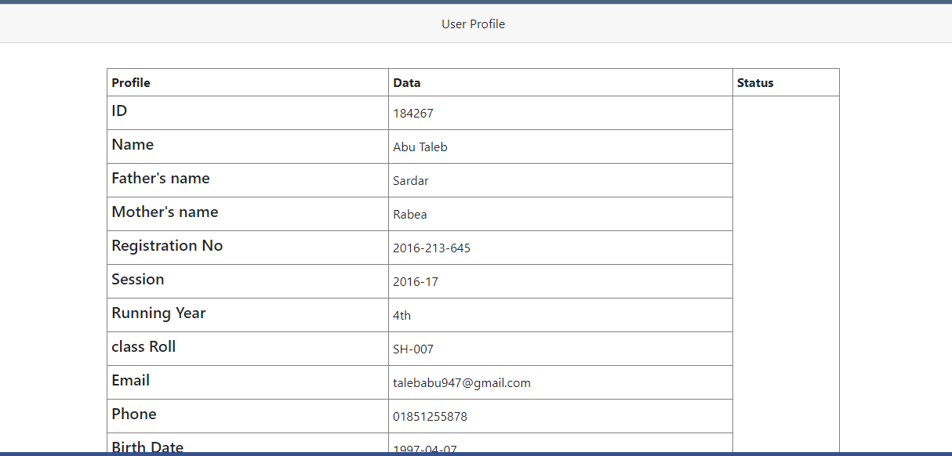
Profile section

Slide 13
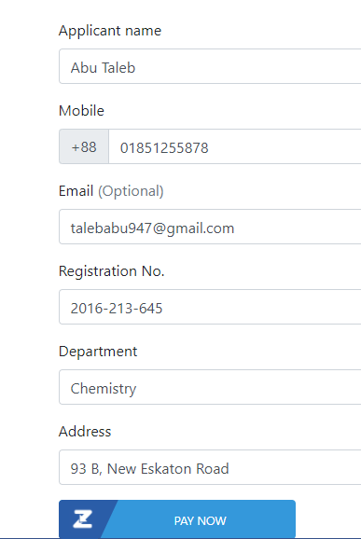
Payment page

Slide 14
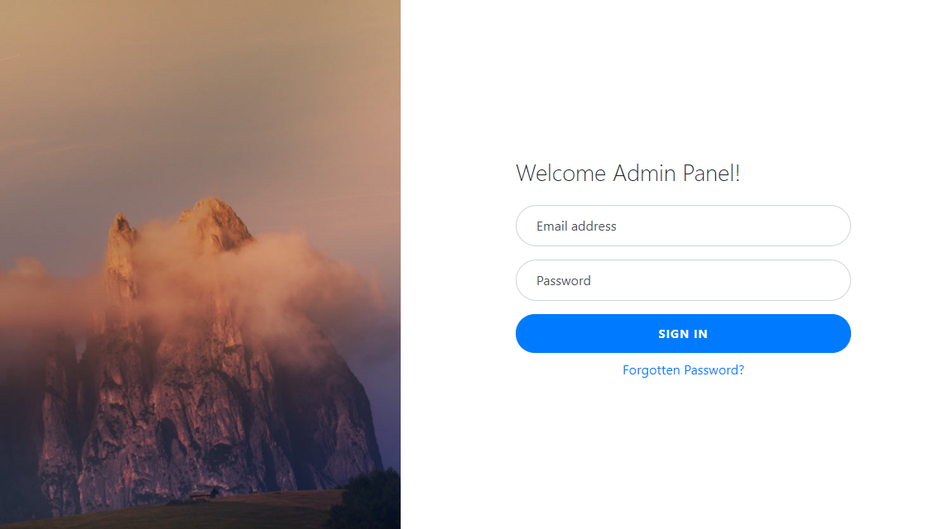
Admin log in

Slide 15
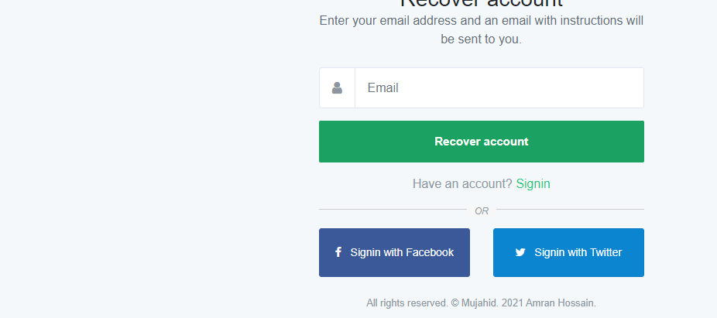
Recover account

Slide 16
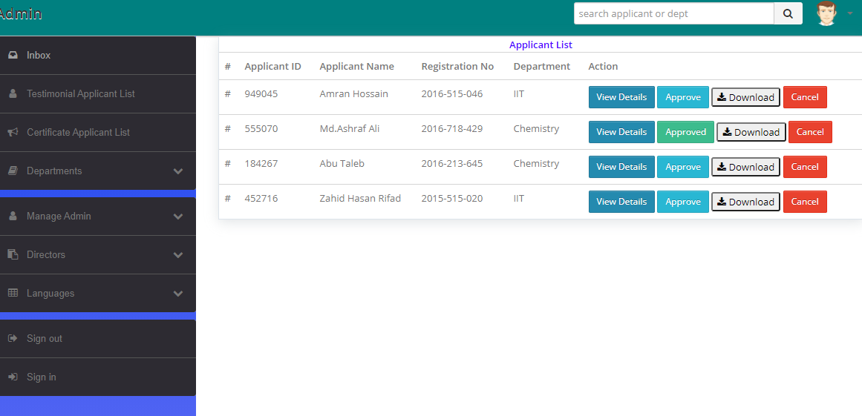
Applicant list admin panel

Slide 17
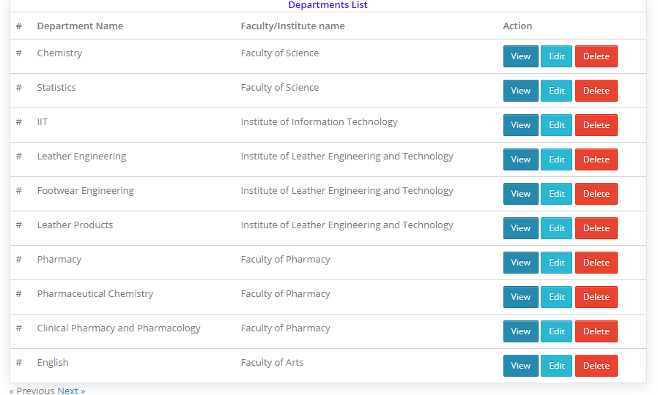
Department list

Slide 18
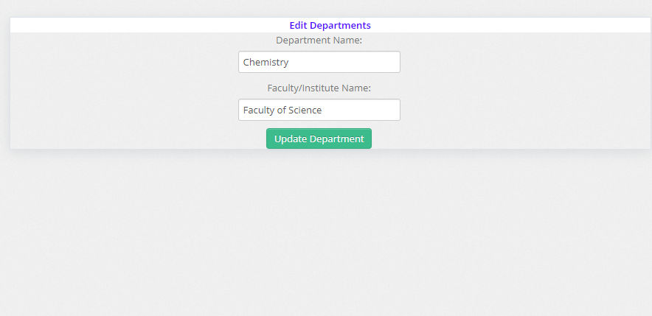
Department edit

Slide 19
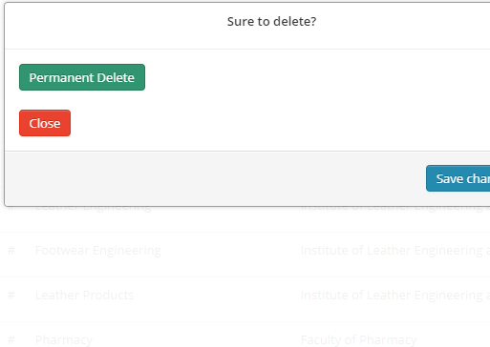
delete

Slide 20
Thanks
Any question??

