Slide 1
Presented by Amran Hossain BSSE 0917 Institute of Information Technology University of Dhaka
IIT Testimonial Management System
Supervised by Md. Saeed Siddik Assistant Professor Institute of Information Technology University of Dhaka

Slide 2
Presentation outline
Motivation
Project Overview
Quality Function Development
Tools and Technologies
Timeline

Slide 3
Motivation
Getting a testimonial is a lengthy process in our Department.
Time consuming

Slide 4
Project Overview
It is a such kind of system where student can apply for the testimonial and get it
It is a web application.
Student apply for a testimonial with giving personal details and transact money with bKash.
Admin approve the application and student are notified his status and get his testimonial.

Slide 5
Quality Function Development
Normal Requirement
Application form for applicant
Authentication system
Applicant’s and admin profile view
Admin and applicants list view and edit.
Expected Requirement
Admin can accept or reject the application
Testimonial processing and notify.
Applicant’s status.

Slide 6
Quality Function Development
Exciting Requirement
Transaction system for this application
Admin and Super admin feature for this application

Slide 7
Tools and Technologies
Environment:Website
Framework:Laravel
Database:MySQL
Tools: Visual Studio Code,Postman
Language:PHP, HTML,CSS,JavaScript

Slide 8
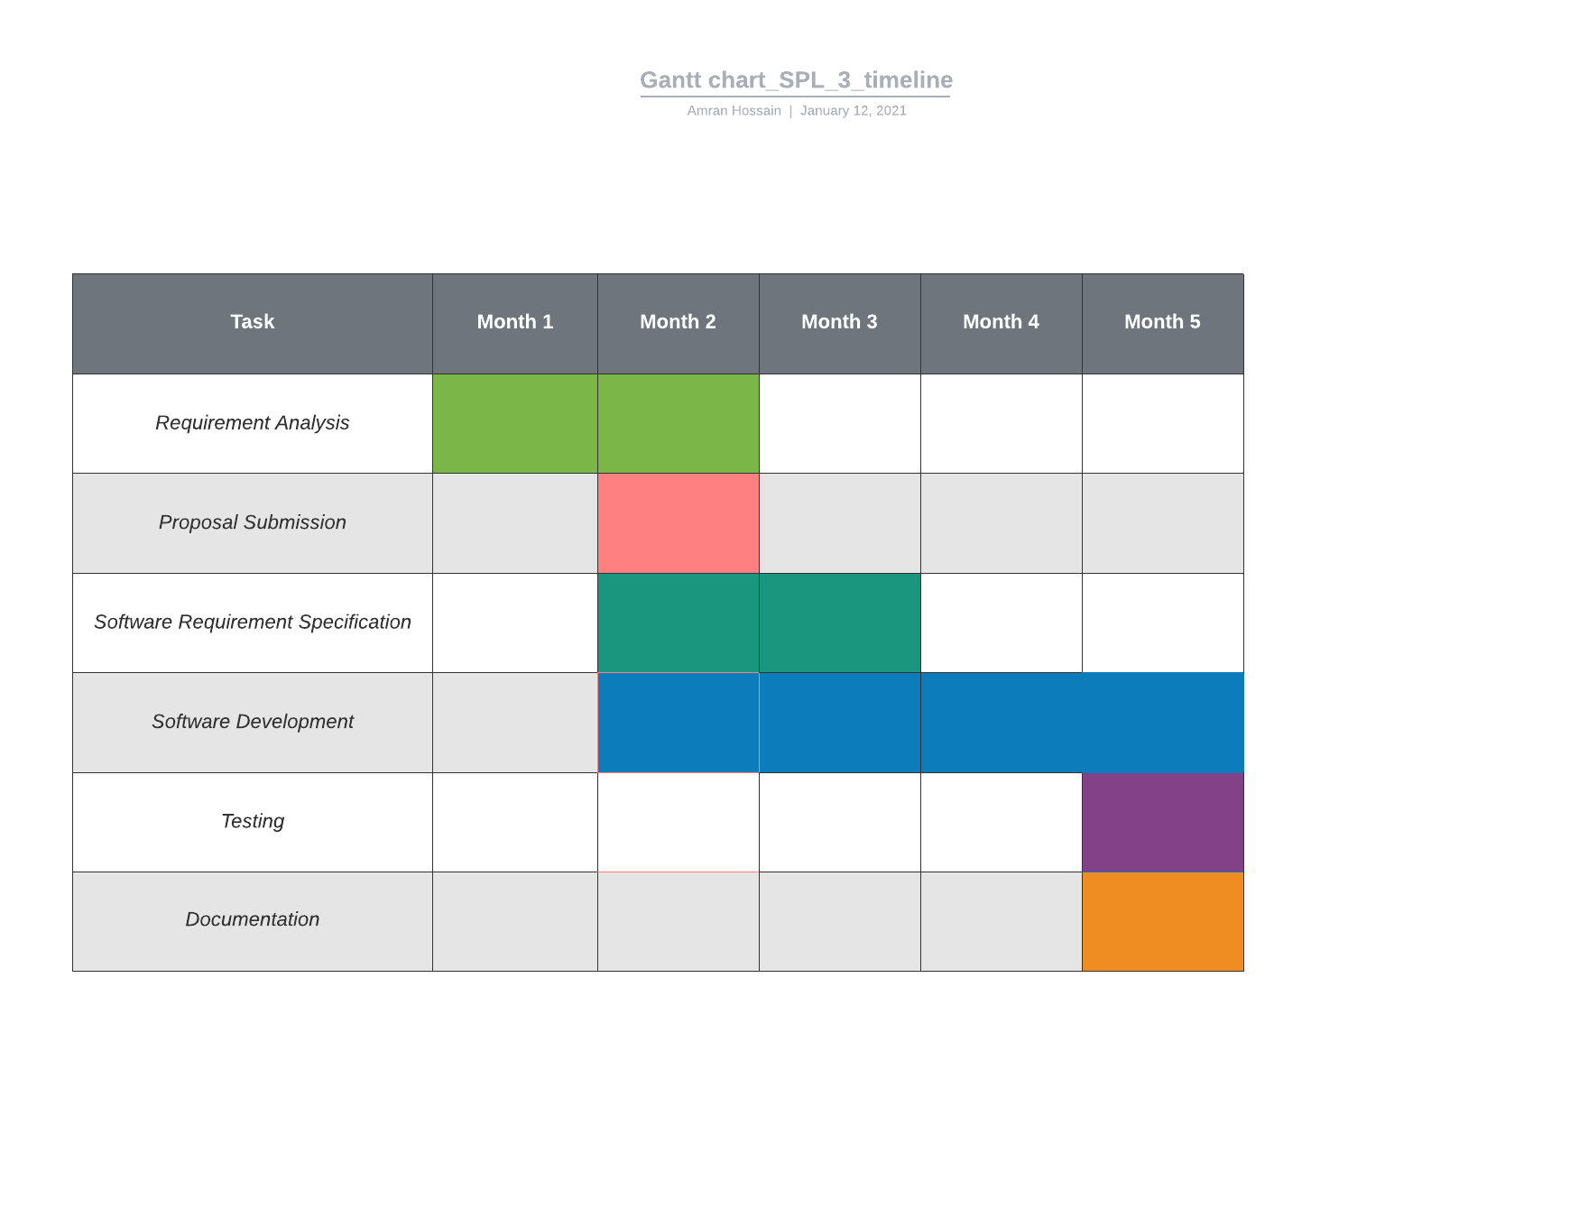
Timeline

Slide 9
😉
Thanks for listening……….

