Slide 1
CAI Classification – Surgery Tool Recognition
Nil Crespo-Peiró, Paco Rahn, Amin Ranem

Slide 2




Introduction
Input
Surgical Video
Surgery Recognition Tool
Transform video and predict present tools per frame
Output
Predicted tools are saved in .json file.
Predictions are also displayed in a listbox (GUI)

Slide 3
Dataset

Slide 4
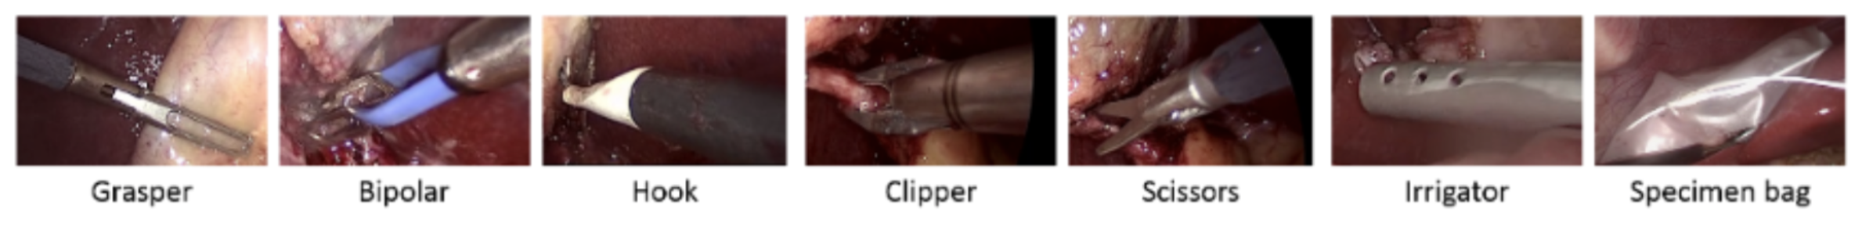
Cholec80 Dataset
Contains footage of 80 surgical operations at 25 fps each
7 different tools used (Grasper, Bipolar, Hook, Clipper, Scissors, Irrigator, Specimen Bag)

Slide 5
Cholec80 Dataset Preprocessing
Cholec80 Dataset
25 fps
different frame sizes
Cholec80 Dataset downsampled
1 fps
different frame sizes
Cholec80 Dataset resized
1 fps
frame size: 224x224x3
Cholec80 Dataset randomized
1 fps
frame size: 224x224x3
2000 random frames per video
videos in full length
videos in full length
videos in full length

Slide 6
Models

Slide 7
Models: Structure
ResNet:
Transfer learning using pre-trained ResNet50 model (PyTorch) by changing the number of output features from the last layer to 7 (number of tools).
Idea based on the Cholecystectomy Cataract lecture from the Deep Learning for Medical Imaging (DLMI) course where the ZIB-Net was introduced.
AlexNet (ToolNet):
Transfer learning using pre-trained AlexNet model (PyTorch) by changing the number of output features from the last layer to 7 (number of tools).
Idea based on official Paper (EndoNet -- ToolNet to detect tools in a surgical video)

Slide 8
Models: Configuration
ResNet:
input_shape: (224, 224, 3)
lr: 0.001
weight_decay: 0.00005
batch_size: 62
nr_epochs: 40 (stopped at 25 → bad results)
random_frames: True
nr_video: 80
nr_frames: 2000
val_ratio: 0.2
test_ratio: 0.3
AlexNet (ToolNet):
input_shape: (224, 224, 3)
lr: 0.0001
weight_decay: 0.001
batch_size: 32
nr_epochs: 40
random_frames: True
nr_video: 80
nr_frames: 2000
val_ratio: 0.2
test_ratio: 0.3

Slide 9
Models: Results
ResNet:
Training of this approach has been stopped, since the training and validation accuracies were not as promised, although model overfitted on small dataset (see reports):
Epoch 10:
train_acc = 30.37%
val_acc = 30.96%
Epoch 20:
train_acc = 30.37%
val_acc = 30.97%
AlexNet (ToolNet):
Training after 40 epochs resulted in an averaged (test) accuracy of 67%
See corresponding plots on following slide

Slide 10
Models: Results (AlexNet)

Slide 11
Graphical User interface

Slide 12
Graphical User Interface: Demo Video
Used for making predictions with our pre-trained models

Slide 13
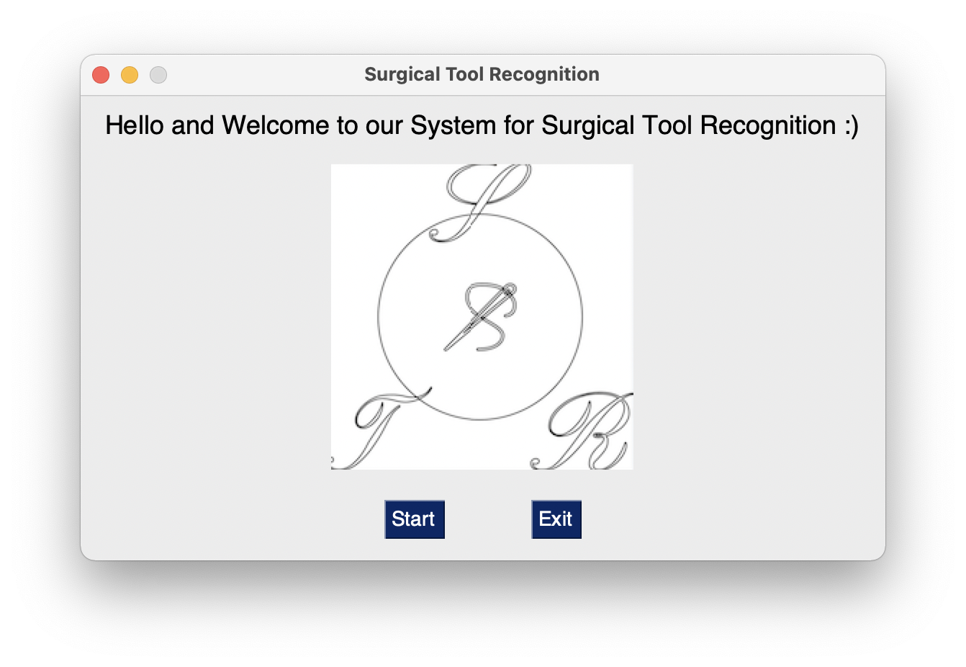
Graphical User Interface: WelcomeWindow

Slide 14
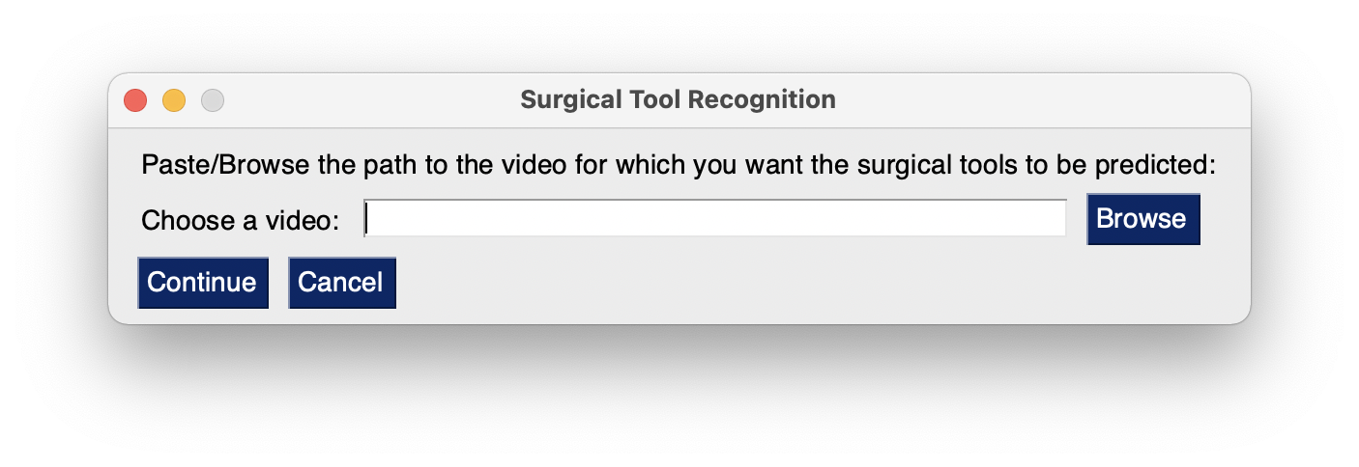
Graphical User Interface: StartWindow
User needs to specify path to desired video he/she wants to use

Slide 15
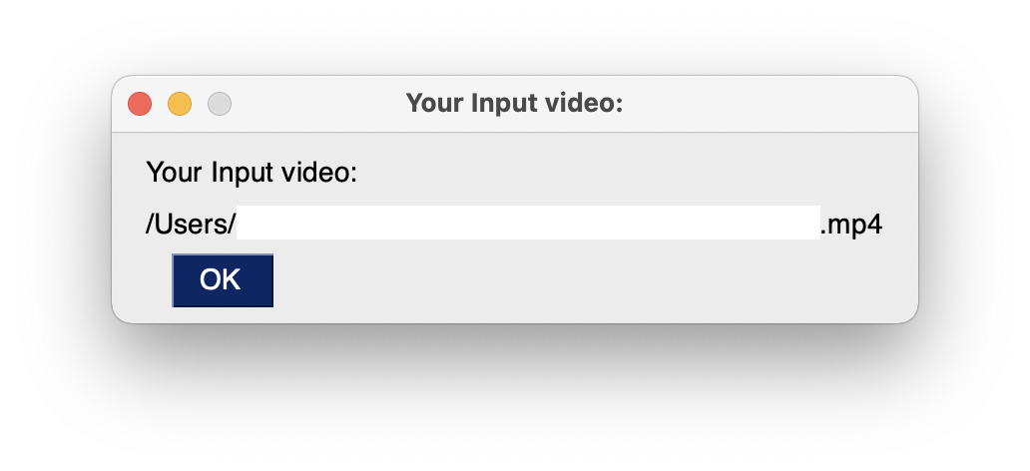
Graphical User Interface: ConfirmationPopUp

Slide 16
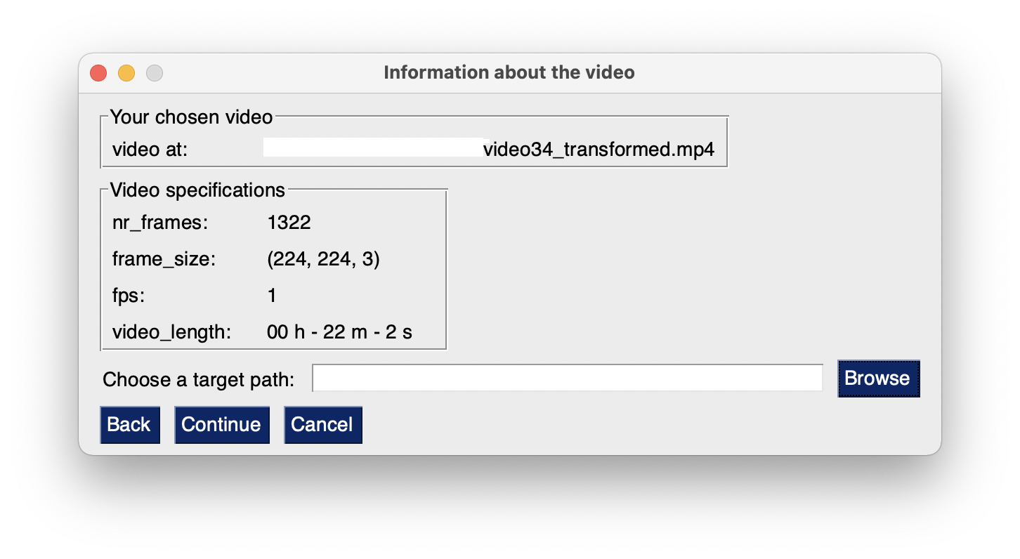
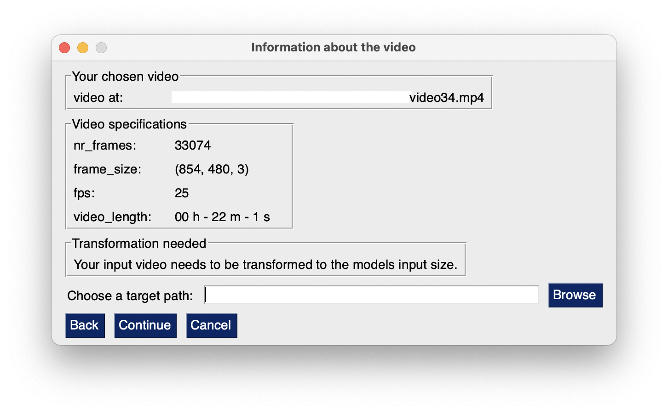
Graphical User Interface: TransformVideo
Video is in desired format
Video needs to be transformed

Slide 17
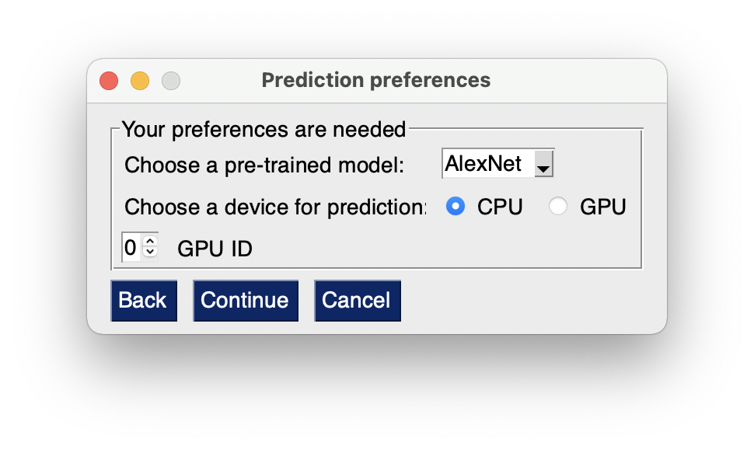
Graphical User Interface: ChooseModelAndDevice

Slide 18
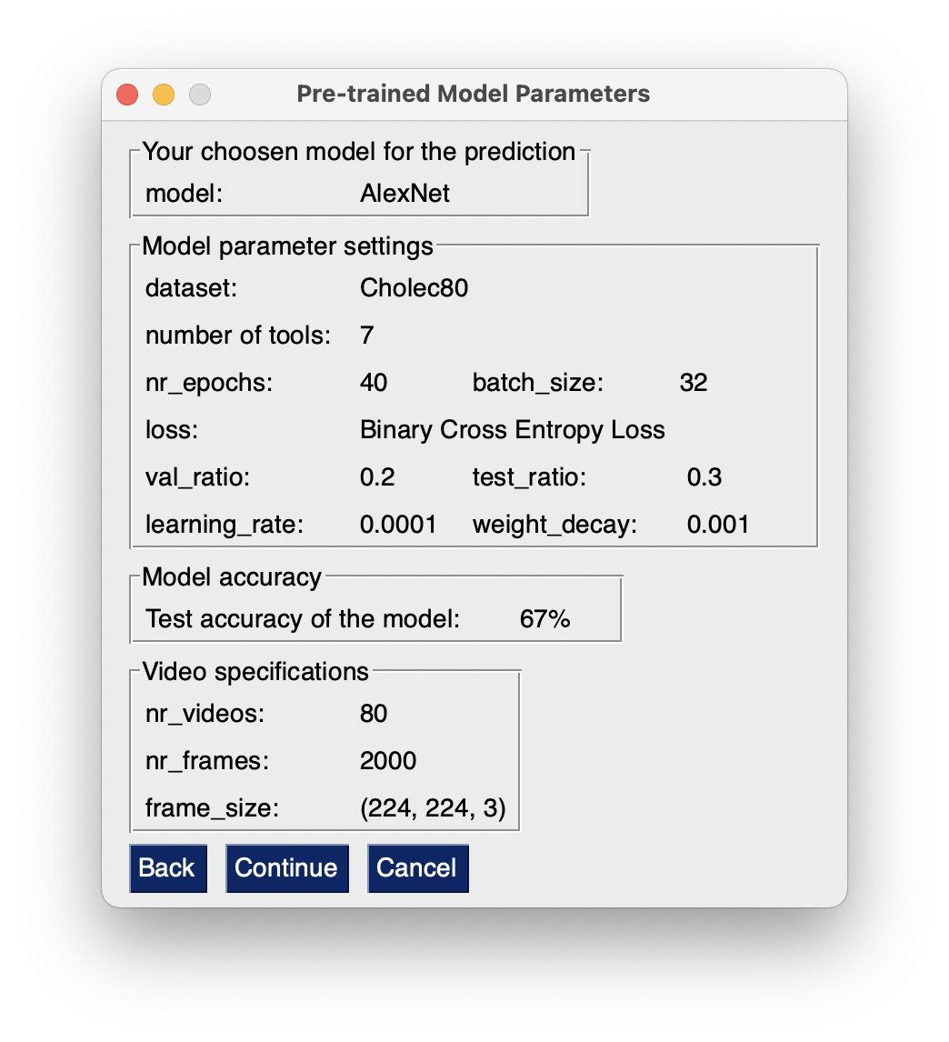
Graphical User Interface: ModelSpecs

Slide 19
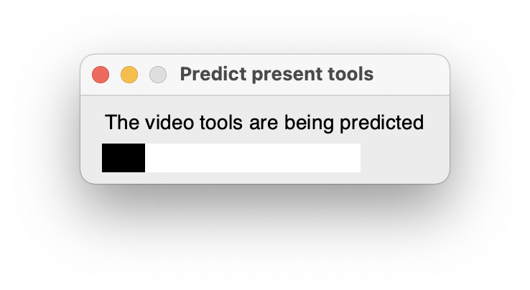
Graphical User Interface: PredictVideoTools

Slide 20
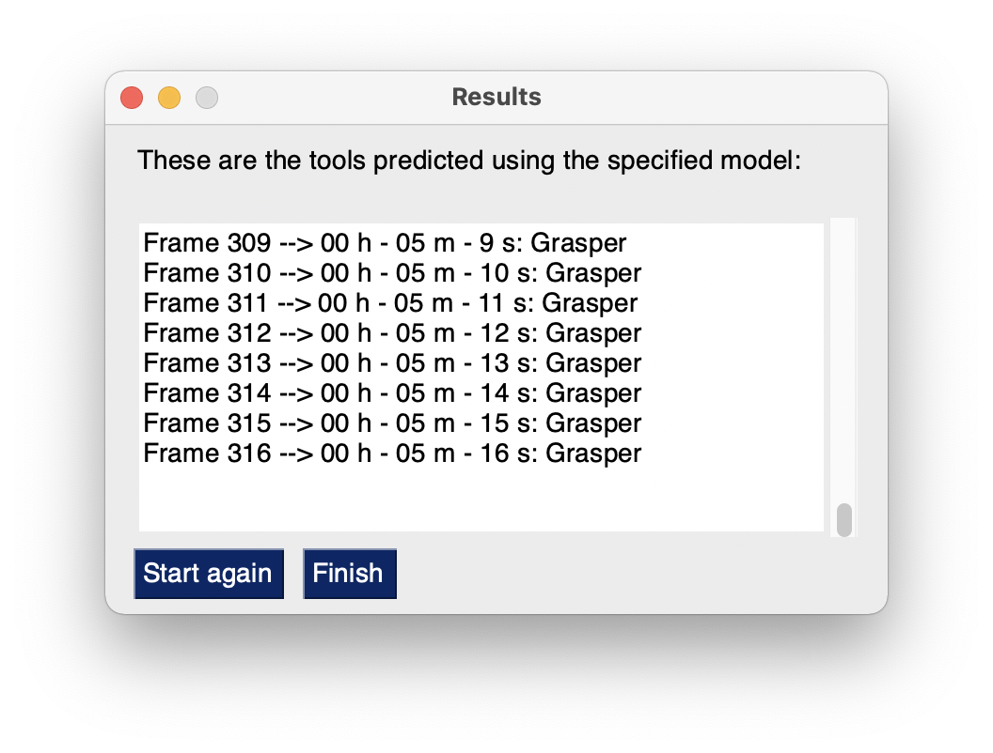
Graphical User Interface: ResultWindow
Change screenshot – Model param settingswrong

