Slide 1

Diagnosis of Parkinson's disease using machine learning
Mohammad Amran Hossain
Supervisor: Prof. Francesco Amenta
Computer Science and Mathematics
University of Camerino

Slide 2
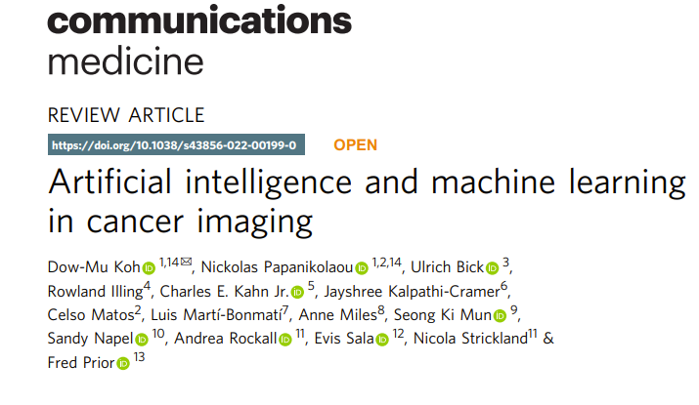
Background
What is the current diagnosis of Parkinson disease?
Which Machine learning/ Deep learning algorithms could be useful to diagnosis?
Which type of data are crucial for the diagnosis process and build the models?
What are the difficulties in diagnosing Parkinson disease?
How can machine learning models be applied to the diagnosis of Parkinson disease?
Research objective : Develop a machine-learning approach to diagnosis Parkinson's disease using biomarker sample and medical data.
Notes:
While treatments for PD diseases aim to manage symptoms and slow disease progression, there is currently no cure for most of these conditions. Treatment approaches may involve medications to manage symptoms, physical and occupational therapy to improve mobility and function, and supportive care to enhance the quality of life.

Slide 3
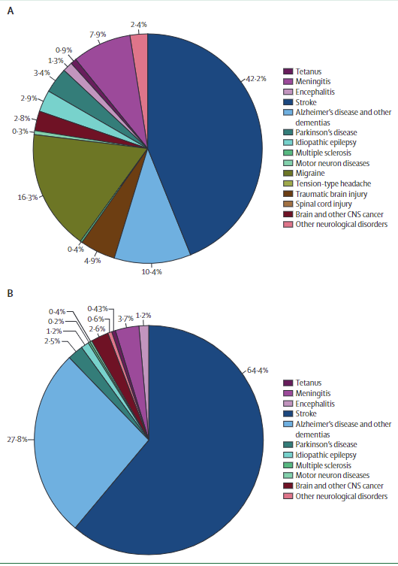
Parkinson's disease (PD)
Parkinson's disease (PD) is mostly relevant to movement disorder. The brain gradually loses some neurons as the disease progresses.
Globally, in 2019, there were nearly 10 million deaths and 349 million disability-adjusted life years (DALYs) due to neurological disorders
PD is the second most common neurodegenerative disease after Alzheimer's disease. The prevalence of PD is 1% among people over the age of 60 years and 4% among those over the age of 80 years
Led to progressive disability, impairment of daily activities, and in quality of life. Nearly all patients with PD suffer from a variety of non-motor symptoms (NMS), such as hyposmia, constipation, urinary dysfunction, orthostatic hypotension, memory loss, depression, pain, and sleep disturbances
Notes:
early symptoms such as difficulty in remembering recent events and problems with language, developed into later symptoms such as disorientation, mood swings, impaired judgment, and difficulty in speaking, swallowing, and walking
symptoms of PD are constipation, depression, Voice, and speech changes, loss of smell, low blood pressure, sleep issues, and reduced ability to show facial expressions
Proportions (%) of disability-adjusted life-years (A) and deaths (B). Based on data from Feigin and colleagues.

Slide 4

Dataset Description
The leucine-rich repeat kinase 2 (LRRK2) Funded by the Michael J. Fox Foundation (MJFF). LRRK2 has emerged as a prioritized target for the development of therapeutic approaches for Parkinson's.
the LRRK2 Cohort Consortium (LCC) objective to assemble and scrutinize individuals affected by Parkinson's disease, as well as those unaffected by it. This consortium encompasses three distinct investigations: the LRRK2 Cross-sectional Study, LRRK2 Longitudinal Study, and the 23andMe Blood Collection Study.
The LRRK2 Cohort Consortium (LCC) was a multi-site endeavours involving individuals carrying mutations in the leucine-rich repeat kinase 2 (LRRK2) gene, both with and without Parkinson's disease. As part of the comprehensive testing process, a subset of participants provided biological samples including serum, plasma, DNA, RNA from blood, whole blood, urine, and cerebrospinal fluid.
A total of 1204 individuals volunteered for the study, demonstrating their remarkable willingness to contribute their data for the benefit of the research community. Among these participants, 619 are female, and 555 are male. Within this cohort, 504 individuals have received a diagnosis of Parkinson's disease, while 671 serve as healthy control (HC) participants.
Notes:
the evaluation of Genentech's LRRK2 inhibitors has revealed alterations in lung tissue.
The LCC meticulously adhered to standardized data acquisition procedures, ensuring that clinical information and biological specimens were rigorously stored within an extensive Parkinson’s database and biorepository.
biological samples including serum, plasma, DNA, RNA from blood, whole blood, urine, and cerebrospinal fluid
These samples are continuously distributed to academic laboratories and industry groups for ongoing analysis. The resulting data is then aggregated and combined with essential clinical measures obtained through cross-sectional and routine longitudinal assessments.

Slide 5
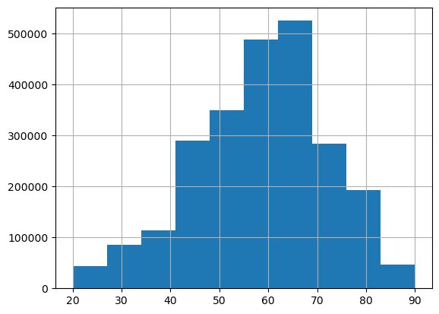
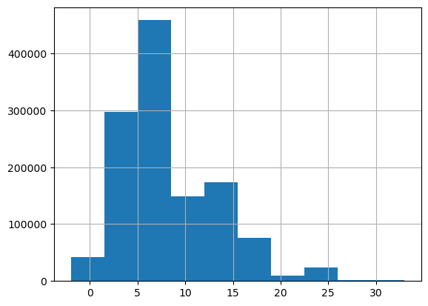
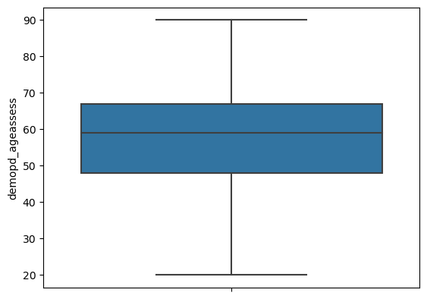
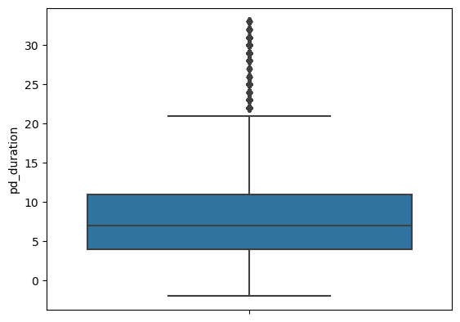
Dataset Description
Gender | PDenrl | Lrrkid
Female | 0 | 314
 | 1 | 204
Male | 0 | 210
 | 1 | 237
Gender | PDenrl | Lrrkid
female | 0 | 194
 | 1 | 95
Male | 0 | 120
 | 1 | 102
Notes:
965-518,447//241,524. 511-299,222//197-314

Slide 6
Dataset Features
MCATOT: Montreal Cognitive Assessment (MoCA)
STROKE: participant reports having has had STROKE
HETRA: participant reports having has had head trauma
RLS: participant reports having has had RLS
NARCOLEPSY: participant reports having has had NARCOLEPSY
DEPRS: participant reports having has had depression
EPILEPSY: participant reports having has had EPILEPSY
BRNINFM: has had inflammatory disease of the brain
APOE: A variable indicating Apolipoprotein E (APOE) genotype results
Hypertension

Slide 7
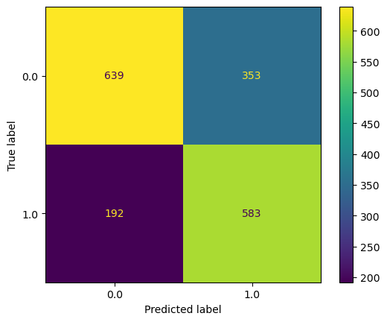
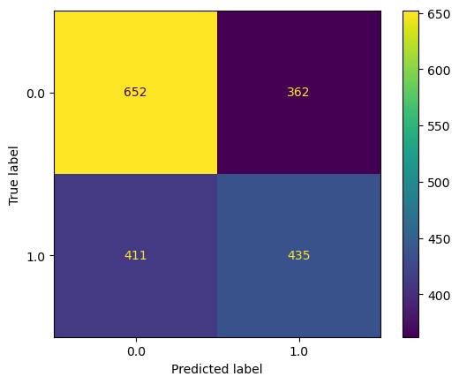
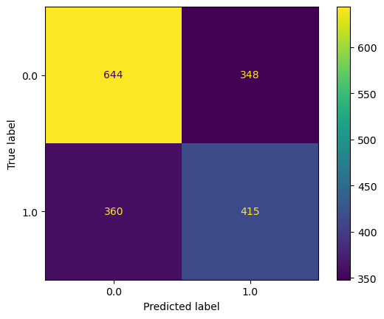
Confusion Matrix
Actual value |  | Negative | Positive
 | Negative | True Negative (TN) | False Positive (FP)
 | Positive | False Negative (FN) | True Positive (TP)
 |  | Predicted Value
a. HGB
TP = "True Positive" accurately indicates that a condition is present. TN = "True Negative" correctly suggests that a condition is absent. FP = "False Positive" incorrectly indicates that a condition is true. FN = "False Negative" incorrectly implies the absence of a condition.
b. DT
c. BC
Notes:
TP = "True Positive" accurately indicates that a condition is present. TN = "True Negative" correctly suggests that a condition is absent. FP = "False Positive" incorrectly indicates that a condition is true. FN = "False Negative" incorrectly implies the absence of a condition.

Slide 8
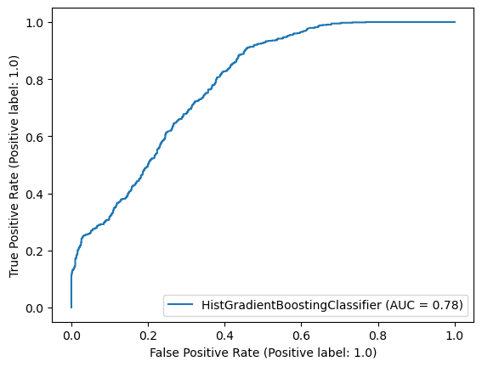
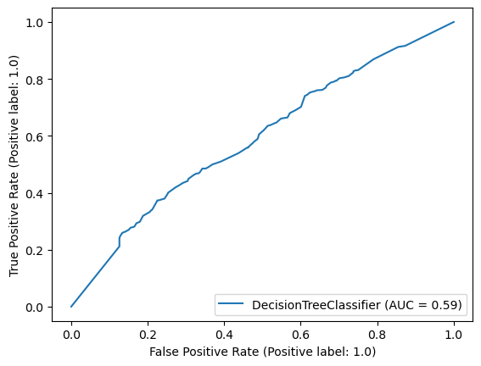
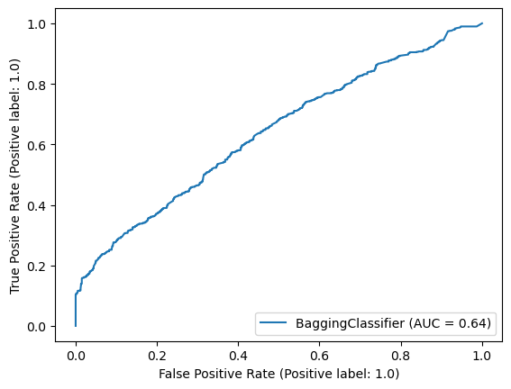
AUC-ROC curve
An area under the curve (AUC) represents the area beneath the entire Receiver operating characteristic curves (ROC). False positive rates (FPR) and true positive rates (TPR) are plotted on the ROC curve.

Slide 9
Classification Report
 |  | Precision | Recall/ Sensitivity | F1-score | Train Score | Test Accuracy | 10-CV
DecisionTree Classifier | 0 | 0.61 | 0.64 | 0.63 | 83.63 | 58.44 | 58.00
 | 1 | 0.55 | 0.51 | 0.53
HistGradient Boosting Classifier | 0 | 0.77 | 0.64 | 0.70 | 92.41 | 69.16 | 75.00
 | 1 | 0.62 | 0.75 | 0.68
Bagging Classifier | 0 | 0.64 | 0.65 | 0.65 | 92.29 | 59.94 | 56.00
 | 1 | 0.54 | 0.54 | 0.54 |  | 59.94 | 50.00

Slide 10
Future Work
Validate models Performance with medical expert.
01
Handle NaN values.
03
Find out best model
04
Improve models performance
02
05

Slide 11
Thank You

