Slide 1
Higher National School of Renewable Energy, Enviroment and Sustainable Devolopment
SVM: Support Vector Machine
students:
BOUREBBOU Fetima
ALLOUI Zineb Nedjla
2023-2024

Slide 2
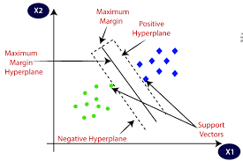
Introduction
Support Vector Machine (SVM) is a supervised machine learning algorithm used for classification tasks. In which, we try to find the best hyper plane separates the two classes. When we maximizes the margin between the classes (maximizes the distance between the nearest data points of each class).
SVM algorithm
1

Slide 3
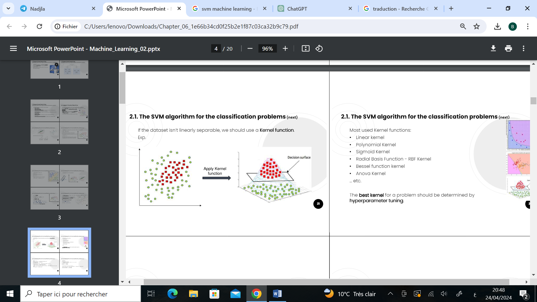
Kernel Functions
SVM can handle linear and non-linear data by using different kernel functions to map the data into a higher-dimensional space where it can be separated by a hyper plane.
SVM algorithm with kernel function
2

Slide 4
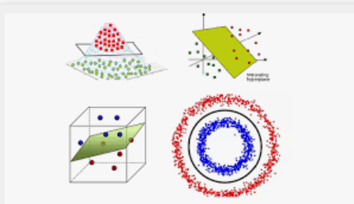
Kernel Functions
Most used Kernel functions:
• Linear kernel
• Polynomial Kernel
• Sigmoid Kernel
• Radial Basis Function - RBF Kernel
… etc.
kernel functions
3

Slide 5

DATA
Our DATA represent the Measurements of electric power consumption in one household
it contains 21996 measurements ,and 6 feutures
The target is “Global_intensety”
4

Slide 6

SVM
5

Slide 7
Data Preparation
import pandas as pd from sklearn.model_selection import train_test_split, GridSearchCV from sklearn.svm import SVC from sklearn.preprocessing import StandardScaler from sklearn.metrics import classification_report, confusion_matrix
import numpy as np import matplotlib.pyplot as plt
# Read the data from the CSV file df = pd.read_csv("SVM.csv")
# Preprocessing # Drop the rows with missing values df.dropna(inplace=True)
# Convert the 'Global_intensity' column to numeric, coerce errors df['Global_intensity'] = pd.to_numeric(df['Global_intensity'], errors='coerce')
# Drop rows where 'Global_intensity' column contains NaN values df.dropna(subset=['Global_intensity'], inplace=True)
# Defining the target variable: If Global_intensity is greater than 10, we label it as high, otherwise low df['intensity_level'] = df['Global_intensity'].apply(lambda x: 'high' if x > 10 else 'low')
6

Slide 8
Splitting the dataset
# Splitting the dataset into features and target variable X = df.drop(["Global_intensity", "intensity_level"], axis=1) y = df["intensity_level"]
# Splitting the dataset into the Training set and Test set X_train, X_test, y_train, y_test = train_test_split(X, y, test_size=0.2, random_state=42)
7

Slide 9
Feature Scaling
# Feature Scaling scaler = StandardScaler() X_train = scaler.fit_transform(X_train) X_test = scaler.transform(X_test)
8

Slide 10
Model Training
# Model Training svm = SVC(kernel='poly') svm.fit(X_train, y_train)
9

Slide 11
Model Evaluation
# Model Evaluation y_pred = svm.predict(X_test) print("Classification Report:\n", classification_report(y_test, y_pred)) print("Confusion Matrix:\n", confusion_matrix(y_test, y_pred))
10

Slide 12
Model Evaluation Result
Classification Report:
precision recall f1-score support
high 0.98 0.94 0.96 1395
low 0.97 0.99 0.98 3004
accuracy 0.97 4399
macro avg 0.97 0.96 0.97 4399
weighted avg 0.97 0.97 0.97 4399
Confusion Matrix:
[[1305 90]
[ 29 2975]]
11

Slide 13
Hyperparameter Tuning
# Hyperparameter Tuning
param_grid = {'C': [10, 100], 'gamma': [1, 0.1], 'kernel': ['rbf', 'poly', 'linear']} grid = GridSearchCV(SVC(), param_grid, refit=True, verbose=3,cv=2) grid.fit(X_train, y_train) print("Best parameters found:", grid.best_params_) print("Best estimator found:", grid.best_estimator_)
12

Slide 14
Hyperparameter Tuning Result
Fitting 2 folds for each of 12 candidates, totalling 24 fits
[CV 1/2] END .........C=10, gamma=1, kernel=rbf;, score=0.989 total time= 0.7s
[CV 2/2] END .........C=10, gamma=1, kernel=rbf;, score=0.987 total time= 0.7s
[CV 1/2] END ........C=10, gamma=1, kernel=poly;, score=0.991 total time= 0.5s
[CV 2/2] END ........C=10, gamma=1, kernel=poly;, score=0.986 total time= 0.6s
[CV 1/2] END ......C=10, gamma=1, kernel=linear;, score=0.994 total time= 0.1s
...........ect
Best parameters found: {'C': 100, 'gamma': 1, 'kernel': 'linear'}
Best estimator found: SVC(C=100, gamma=1, kernel='linear')
13

Slide 15
Hyperparameter Tuning retrain the model
# Re-train the model with the best parameters svm = grid.best_estimator_ svm.fit(X_train, y_train)
# Model Evaluation with tuned parameters y_pred = svm.predict(X_test) print("Classification Report (After Hyperparameter Tuning):\n", classification_report(y_test, y_pred)) print("Confusion Matrix (After Hyperparameter Tuning):\n", confusion_matrix(y_test, y_pred))
14

Slide 16
Hyperparameter Tuning retrain the model
Classification Report (After Hyperparameter Tuning):
precision recall f1-score support
high 1.00 0.98 0.99 1395
low 0.99 1.00 1.00 3004
accuracy 0.99 4399
macro avg 0.99 0.99 0.99 4399
weighted avg 0.99 0.99 0.99 4399
Confusion Matrix (After Hyperparameter Tuning):
[[1373 22]
[ 5 2999]]
15

Slide 17
Visualize feature importance
# Analyze the importance of different features feature_importance = np.abs(svm.coef_[0]) feature_importance = 100.0 * (feature_importance / feature_importance.max()) sorted_idx = np.argsort(feature_importance) pos = np.arange(sorted_idx.shape[0]) + .5
# Visualize feature importance
plt.figure(figsize=(10, 8)) plt.barh(pos, feature_importance[sorted_idx], align='center') plt.yticks(pos, X.columns[sorted_idx]) plt.xlabel('Relative Importance') plt.title('Variable Importance') plt.show()
16

Slide 18
Plot
We can that the most importent variable in this SVM model is
Global_active_power
17

Slide 19
Conclusion
After analyzing the SVM model trained on the dataset, we observed a significant improvement in performance following hyperparameter tuning. Feature importance analysis revealed that "Global_active_power" is the most critical features in predicting intensity levels. the tuned SVM model accurately predicts intensity levels based on input features with a decent performance .
18

Slide 20
THANK YOU
bourebbou.fetima@hns-re2sd.dz
alloui.zineb.nedjla@hns-re2sd.dz
19

