Slide 1



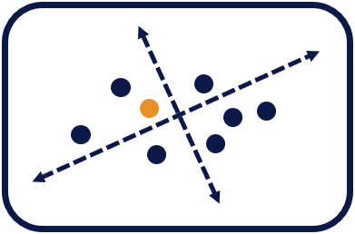
Higher National School of Renewable Energies, Environment & Sustainable Development
PCA
Principal Component Analysis
Presented by : MAHMOUDI Isra
Specialty : IRIIA
Module : Industrial Supervision and Control

Slide 2

Table of Content
Introduction
PCA Overview
Dataset Used
PCA Program
Interpretation of the Results
PCA Benefits
Conclusion

Slide 3
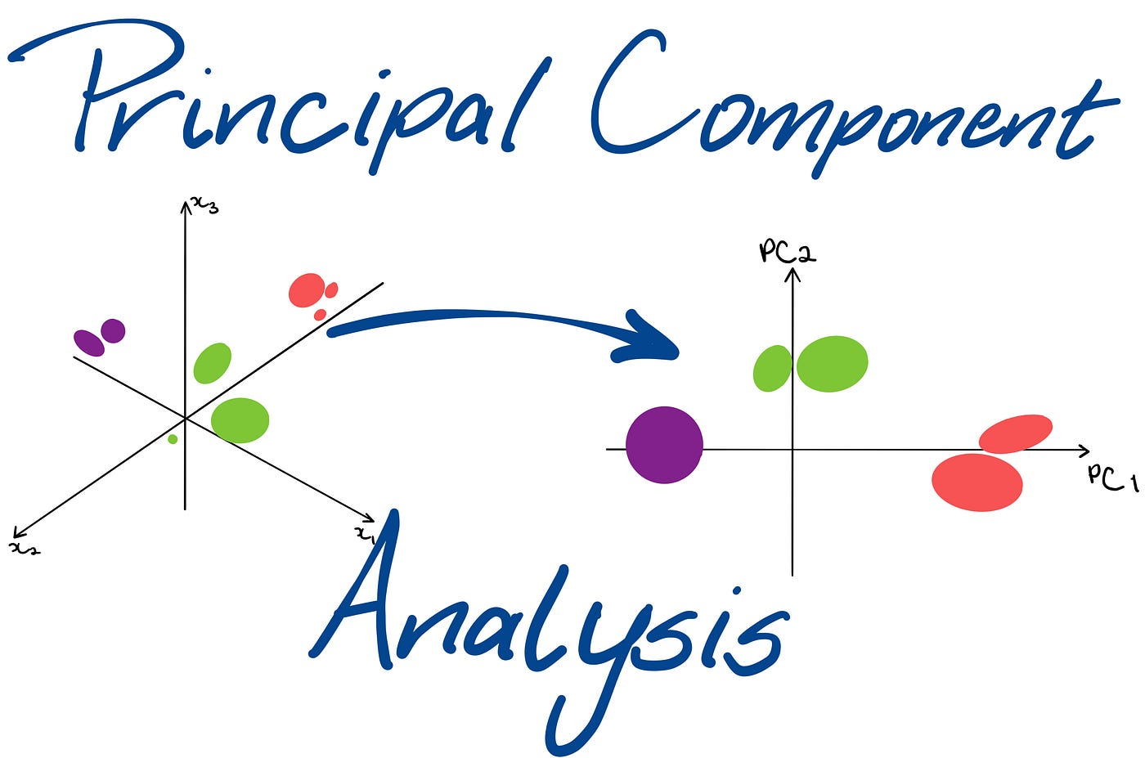
Introduction
Principal Component Analysis (PCA) is a Dimensionality reduction technique used to transform a higher-dimensional space to a lower-dimensional space while retaining important information.

Slide 4
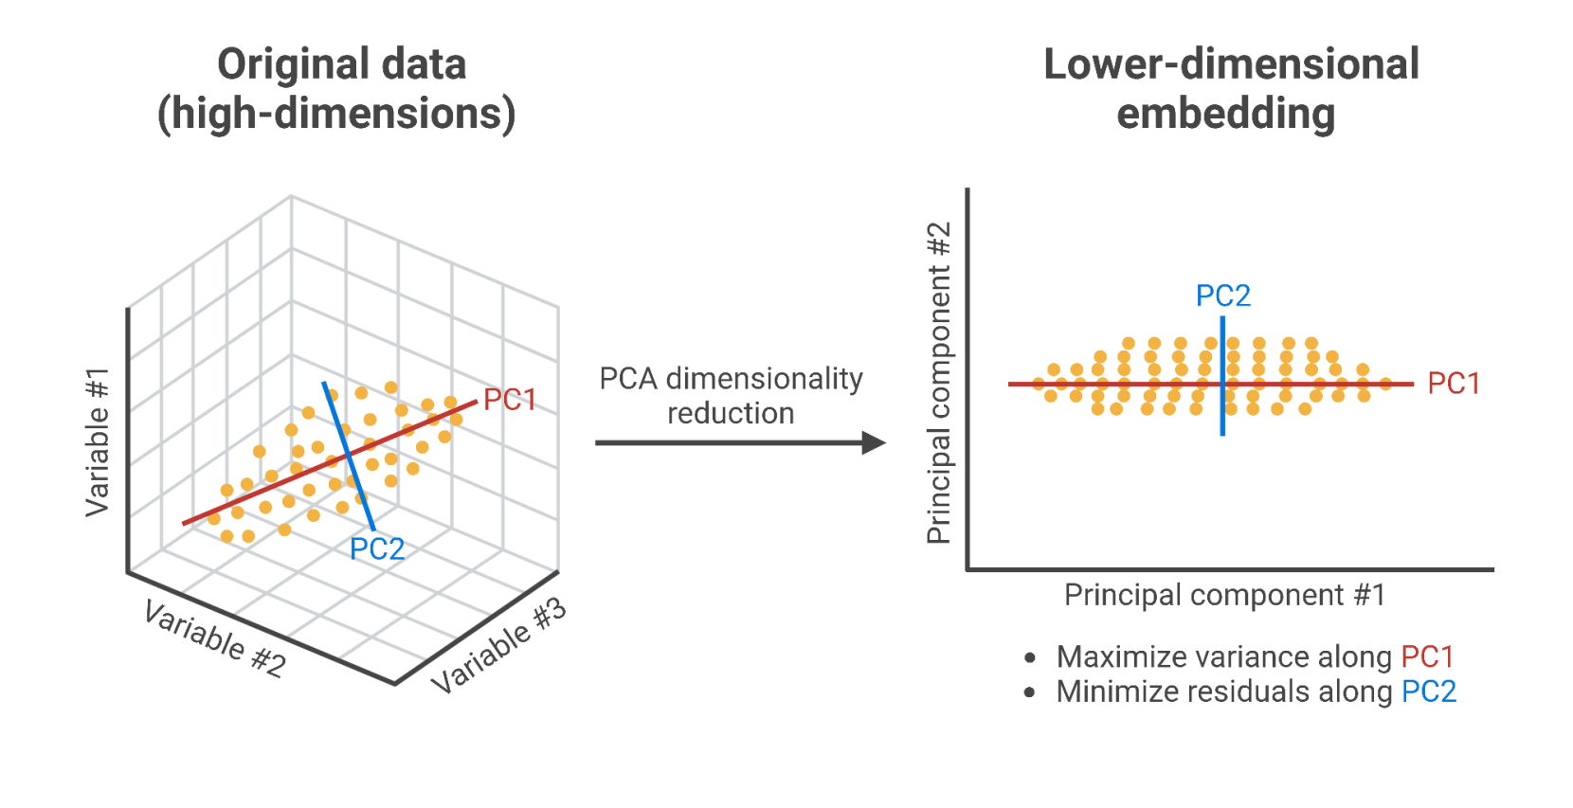
PCA Overview
How does PCA work ?
It will project the original data into a lower dimensional linear space, known as the principal subspace.
Principal Components are the orthogonal axes of the new subspace.

Slide 5
Dataset Used
The dataset used is the “Household Power Consumption" dataset comprises various features :
Features
Day
Global Reactive Power
Sub Metering 1
Month
Global Intensity
Sub Metering 2
Year
Voltage
Sub Metering 3
Hour
Target
Global Active Power

Slide 6
PCA Program
Python Code
Importing necessary libraries
import pandas as pd
import matplotlib.pyplot as plt
from sklearn.ensemble import RandomForestRegressor
from sklearn.preprocessing import StandardScaler
from sklearn.decomposition import PCA
from sklearn.model_selection import train_test_split
from sklearn.metrics import r2_score, mean_absolute_error
Load traffic data
data = pd.read_csv("household_power_consumption.csv")
# Data Preparation
Drop rows with missing values
data = data.dropna()
Select features and target
X = data.drop(columns=["Global_active_power"]) y = data["Global_active_power"]

Slide 7
PCA Program
Python Code
Normalizing features
scaler = StandardScaler()
X_scaled = scaler.fit_transform(X)
# PCA Model Creation
pca = PCA()
Train the model
pca.fit(X_scaled)
# Variance Explained
Plot explained variance ratio
plt.figure(figsize=(10, 6))
plt.plot(range(1, len(pca.explained_variance_ratio_) + 1), pca.explained_variance_ratio_, marker='o')
plt.xlabel('Number of Components')
plt.ylabel('Explained Variance Ratio')
plt.title('Scree Plot')
plt.grid(True)
plt.show()

Slide 8
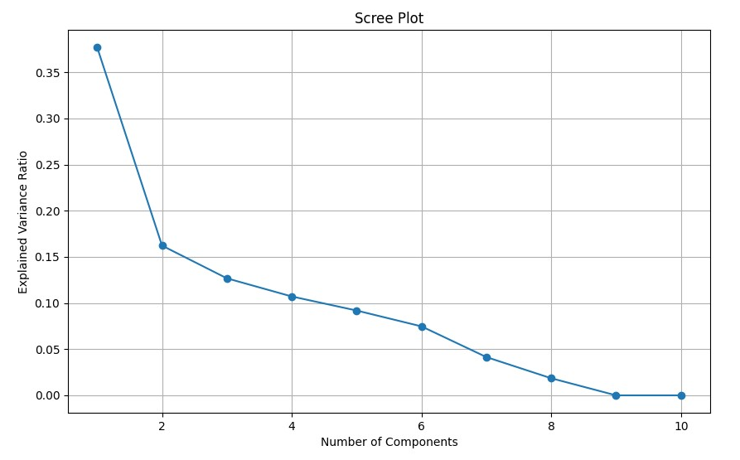
PCA Program
Python Code
Elbow Point
The best component number is : 6

Slide 9
PCA Program
Python Code
Determine the number of components to explain at least 90% of the data
explained_variance = 0.90
cumulative_variance_ratio = pca.explained_variance_ratio_.cumsum()
n_components = (cumulative_variance_ratio < explained_variance).sum() + 1
print("Number of components to retain 90% variance:", n_components)
# Dimensionality Reduction
pca = PCA(n_components=6)
X_pca = pca.fit_transform(X_scaled)
Split the original data into training and testing sets
# Model Evaluation
X_train, X_test, y_train, y_test = train_test_split(X, Y, test_size=0.2)

Slide 10
PCA Program
Python Code
Create a Random Forest model
rf_regressor_orig = RandomForestRegressor(random_state=42)
rf_regressor_orig.fit(X_train, y_train)
Train the model
Make predictions
y_pred_orig_rf = rf_regressor_orig.predict(X_test)
accuracy_orig_rf = sum(abs(y_pred_orig_rf - y_test) < 0.5) / len(y_test) * 100
print("Accuracy (Original Data):", accuracy_orig_rf)
print("R-squared (Original Data):", r2_score(y_test, y_pred_orig_rf))
Evaluate model

Slide 11
PCA Program
Python Code
Split the reduced data into training and testing sets
X_train_red, X_test_red, y_train_red, y_test_red = train_test_split(X_pca, y, test_size=0.2, random_state=42)
Create a Random Forest model
rf_regressor_red = RandomForestRegressor(random_state=42)
Train the model
rf_regressor_red.fit(X_train_red, y_train_red)
Make predictions
y_pred_red_rf = rf_regressor_red.predict(X_test_red)
Evaluate model
accuracy_red_rf = sum(abs(y_pred_red_rf - y_test_red) < 0.5) / len(y_test_red) * 100
print("Accuracy (Reduced Data):", accuracy_red_rf)
print("R-squared (Reduced Data):", r2_score(y_test_red, y_pred_red_rf))

Slide 12
Interpretation of the Results
Results :
Number of components to retain 90% variance: 6
Shape of original data: (4888, 10)
Shape of reduced data: (4888, 6)
Accuracy (Original Data): 100.0
Accuracy (Reduced Data): 96.7280163599182
R-squared (Reduced Data): 0.9809861224554342
R-squared (Original Data): 0.9989046737853734
Interpretation:
The model after reduction slightly lower accuracy than before.
It is still very high and indicates good performance.
The PCA-reduced dataset is almost as informative as the original dataset.

Slide 13

PCA Benefits
Benefits:
Reducing dimension while preserving most of the important information
Reducing storage requirements
Enabling faster model training
Reducing computation time
Enabling better model analysis

Slide 14

Conclusion
In conclusion, PCA is a powerful technique for dimensionality reduction, facilitating the extraction of essential features from high-dimensional datasets while retaining as much relevant information as possible.

Slide 15


Thank You for Your Attention !
mahmoudi.isra@hns-re2sd.dz

