Slide 1

G2M Case Study
Virtual Internship
12-Oct-2022

Slide 2
Agenda – G2M(cab industry) case study
Data Summary
Objective
Problem Statement
EDA
Data Analysis
Hypothesis Testing
Recommendation

Slide 3
Background –G2M(cab industry) case study
XYZ is a private equity firm in US. Due to remarkable growth in the Cab Industry in last few years and multiple key players in the market, it is planning for an investment in Cab industry.
Objective : Provide actionable insights to help XYZ firm in identifying the right company for making investment.
The analysis has been divided into following parts:
Data Understanding
Data Visualization
Profit Analysis and number of rides for each cab type
Finding the most profitable Cab company
Recommendations for investment

Slide 4
Data Exploration
22 Features( including 8 derived features)
Timeframe of the data: 2016-01-31 to 2018-12-31
Total data points :355,032
Assumptions:
Outliers are present in Price_Charged feature but due to
unavailability of trip duration details ,we are not treating this as outlier.
Profit of rides are calculated keeping other factors constant and only
Price_Charged and Cost_of_Trip features used to calculate profit.
Cab_Data.csv
Customer_ID.csv
Transaction_ID.csv
City.csv
Master Data

Slide 5
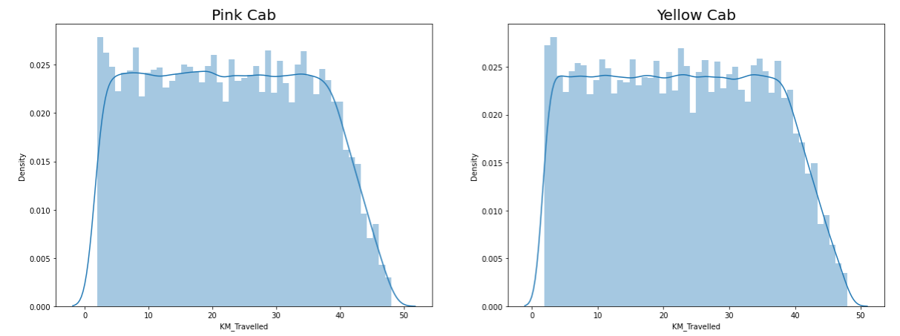
Profit Analysis
EDA
Above visualization shows that total distance travelled in KM for yellow cab as well as Pink cab is same, which is range from 2- 48 KM.

Slide 6
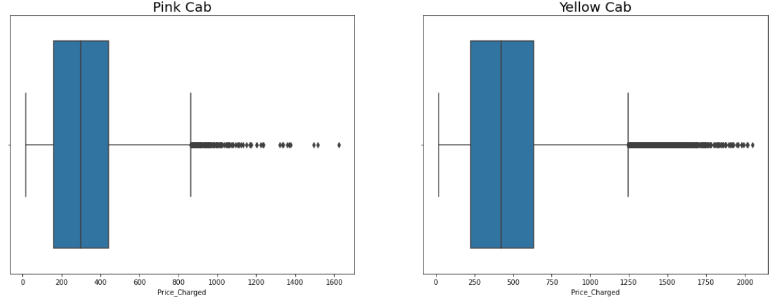
Profit Analysis
EDA
Above visualization shows that Price charged for yellow cab is greater than price charged for Pink cab.
Price charged for Box plot shows outliers. But they are not considered as outliers, as unavailability of trip duration.

Slide 7
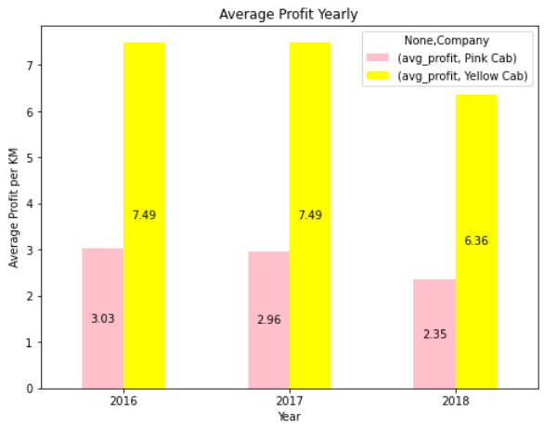
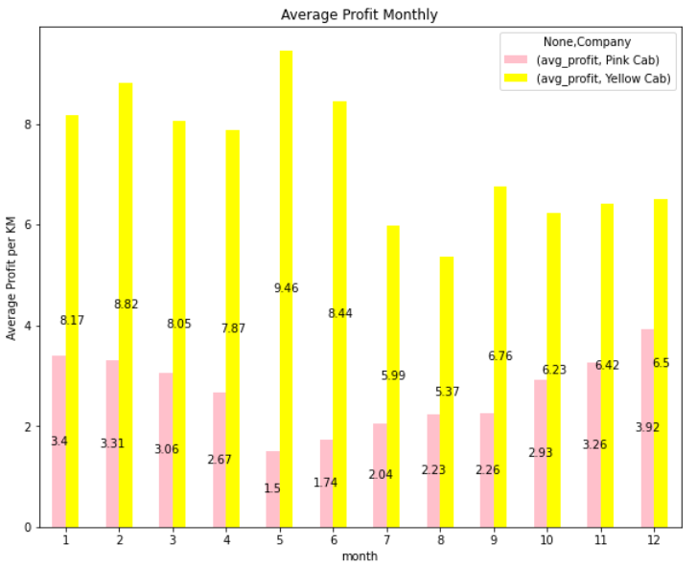
Profit Analysis
Profit Analysis
Yearly average profit for yellow cab is more by around 39% than Pink cab for all three years.
Monthly analysis of average profit shows that profit for yellow cab in month of May is higher than all months.

Slide 8
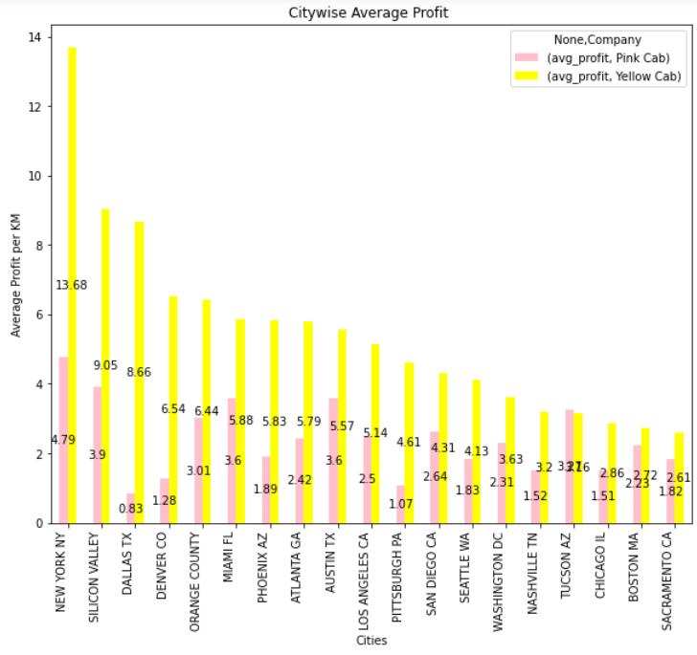
City wise Profit Analysis
City wise profit analysis was taken by considering all users for three years.

Slide 9
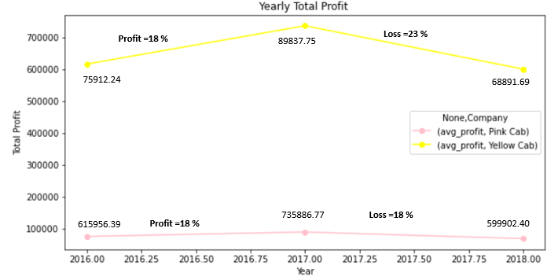
Yearly Profit Analysis

Slide 10
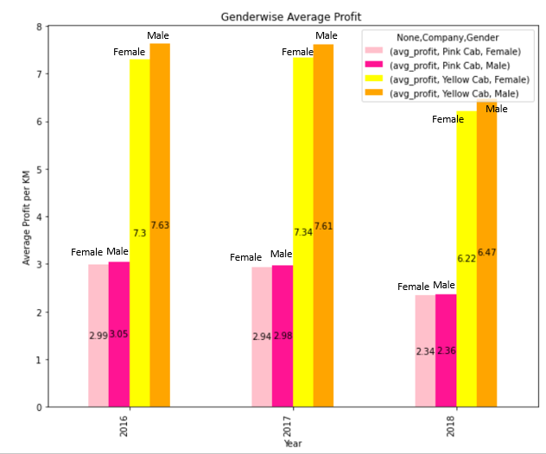
Gender wise Average Profit Analysis
Gender wise average profit shows that profit increase is negligible for male or female.
For Yellow cab profit is more for both gender.

Slide 11
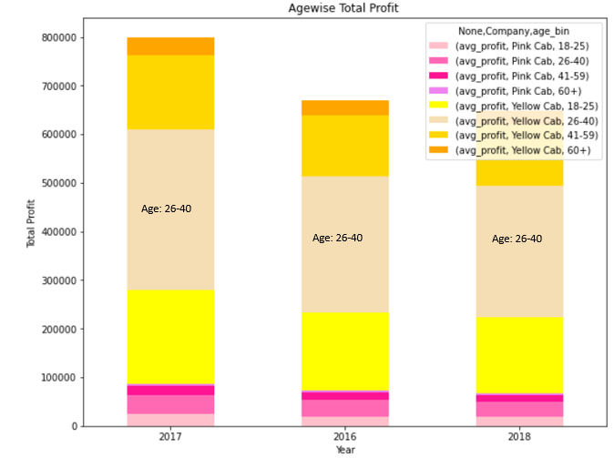
Age wise Profit Analysis
Number of users in age group of 60+ for yellow cab is approximately equal to age group of 18-25 for pink cab
Age wise distribution shows that users for yellow cab in range of age 26-40 are more than any other age

Slide 12
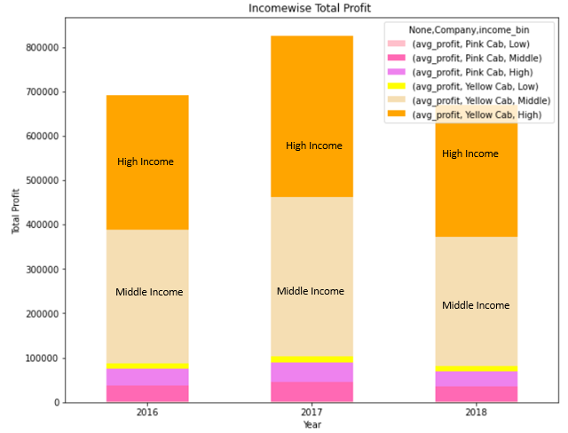
Income wise yearly total Profit Analysis
Income wise yearly total Profit Analysis shows that number of users for yellow cab are more in income range of middle and high.

Slide 13
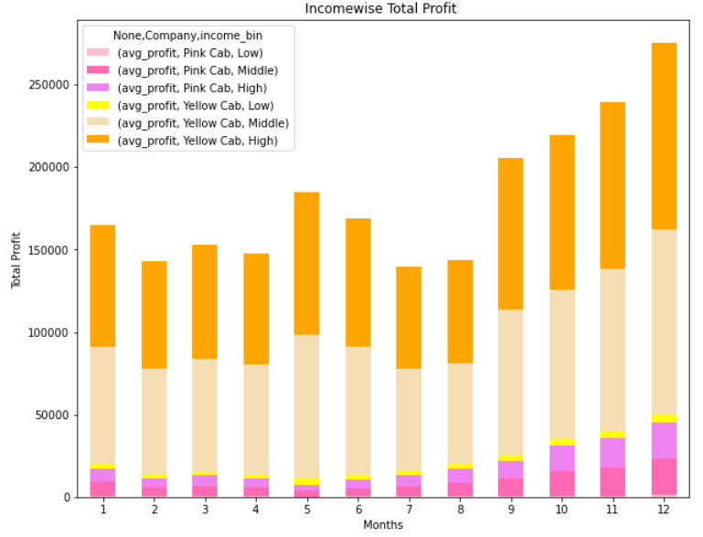
Income wise monthly Profit Analysis
Income wise monthly total Profit Analysis shows that number of users for yellow cab are more in income range of middle and high.

Slide 14
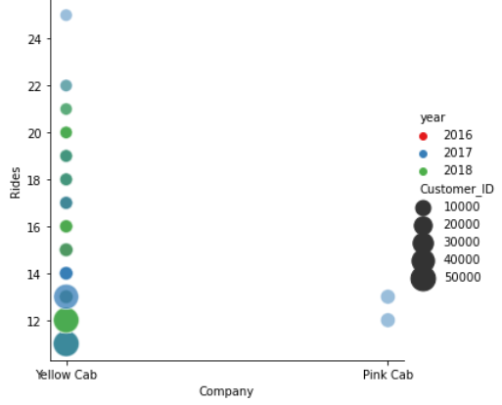
Customer Retention
For customer retention number of users are considered who have at least 10 rides.
Yellow cab is capable to retain customers as compared to pink cab.

Slide 15
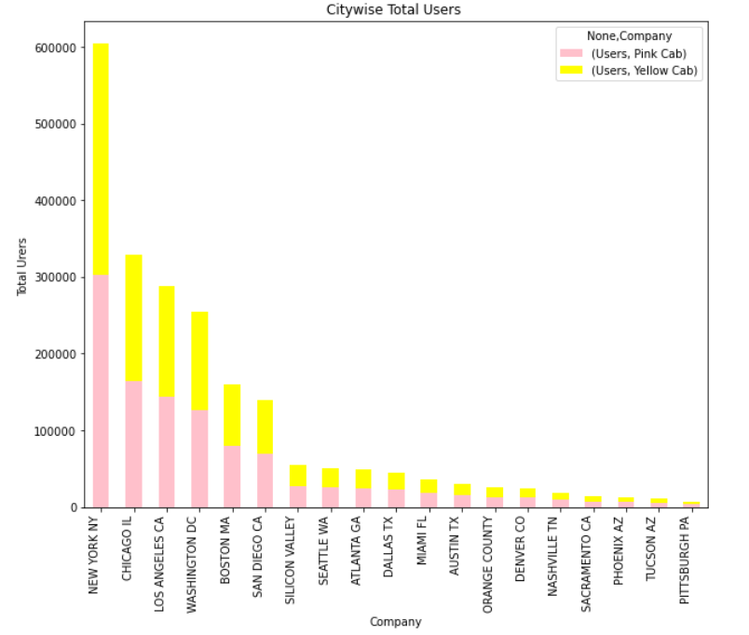
City wise total Users
Yellow cab has higher reach in different 19 cities
For yellow cab number of users are more in New York as compared to other cities of US.

Slide 16
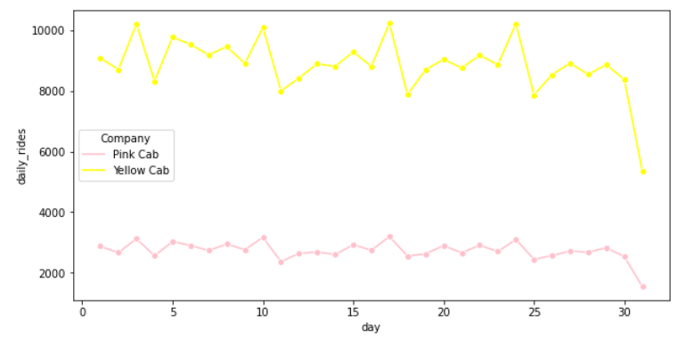
Seasonability Daily Riders
For every 3rd day of month daily users are more and the trend get repeated after 7th day for both pink and yellow cab.

Slide 17
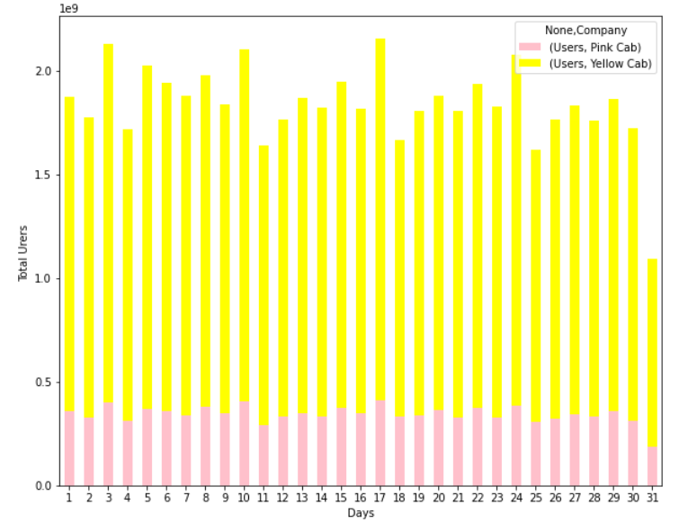
Seasonability Daily Users

Slide 18
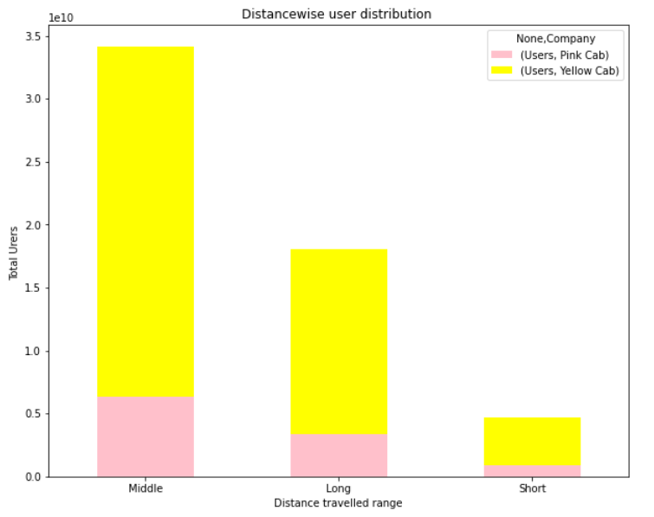
Distance wise user Distribution
Distance travelled range is considered as short, Middle and Long.
Number of Users in middle distance travelled is more for pink as well as yellow cab.

Slide 19
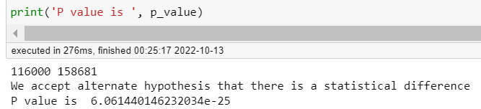
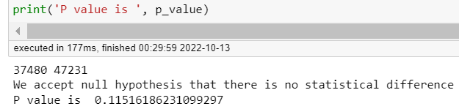
Hypothesis Testing
Hypothesis : Is there profit remains same for gender for yellow & pink cab?
Yellow Cab: There is difference in Profit between Male and Female customers
Pink Cab: There is no difference in profit between Male and Female customers

Slide 20
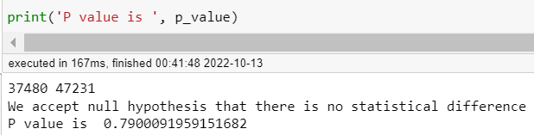
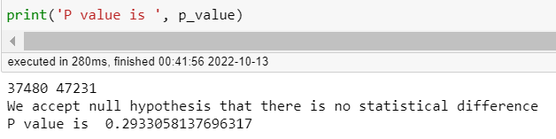
Hypothesis Testing
Hypothesis : Is there difference in profit for Card payers and Cash payers?
Pink Cab: There is no difference in profit for cash and card users
Yellow Cab: There is no difference in profit for cash and card users

Slide 21
Recommendations
I have evaluated both the cab companies on following points and found Yellow cab is better than Pink cab:
Average Profit per KM : Yearly average profit for yellow cab is more by around 39% than Pink cab
Customer Reach : Yellow cab has higher reach in different 19 cities. For yellow cab number of users are more in New York as compared to other cities of US.
Customer Retention: We have analyzed this in two segments : at least 5 drive and at least 10 drive with the same cab company. And we found that Yellow cab is doing far better than Pink cab in both these segments.
Age wise Reach : Number of users in age group of 60+ for yellow cab is approximately equal to age group of 18-25 for pink cab
Income wise Reach :Both the cabs are very popular in high and medium income class but here also Yellow cab is performing better than Pink cab in offering their services to all the three income class group (low, medium and high)
Ride count : For every 3rd day of month daily users are more and the trend get repeated after 7th day for both pink and yellow cab.
Distance wise distribution : Number of Users in middle distance travelled is more for pink as well as yellow cab.
On the basis of above points , I will recommend Yellow cab for investment.

Slide 22
Thank You

