Slide 1
Object-Oriented Programming with PHP and Go
Semester work
Amra Ramic
Concepts of programming languages

Slide 2
Agenda
1. Introduction to PHP and Go
2. Object-oriented programming
3. Demo
4. Comparison
5. Conclusion
5. Special features of object-oriented programming in PHP

Slide 3
Introduction
PHP
1995 by Rasmus Lerdorf
Latest version 8.1
Usage:
Server-side programming (Web applications)
Command-line programming
Desktop applications
Go
2009 by Google employees
Latest version 1.17.6
Usage:
System programming
Network programming
Cloud programming

Slide 4
Object-oriented programming
Representation of reality in objects to reduce the complexity of the software.
Abstraction Hiding unnecessary details from the user.
Inheritance Providing the properties of a superclass to its subclasses
Encapsulation Access rights management
Polymorphism Different expression of a behavior by different objects

Slide 5

Demo – Banking system

Slide 6
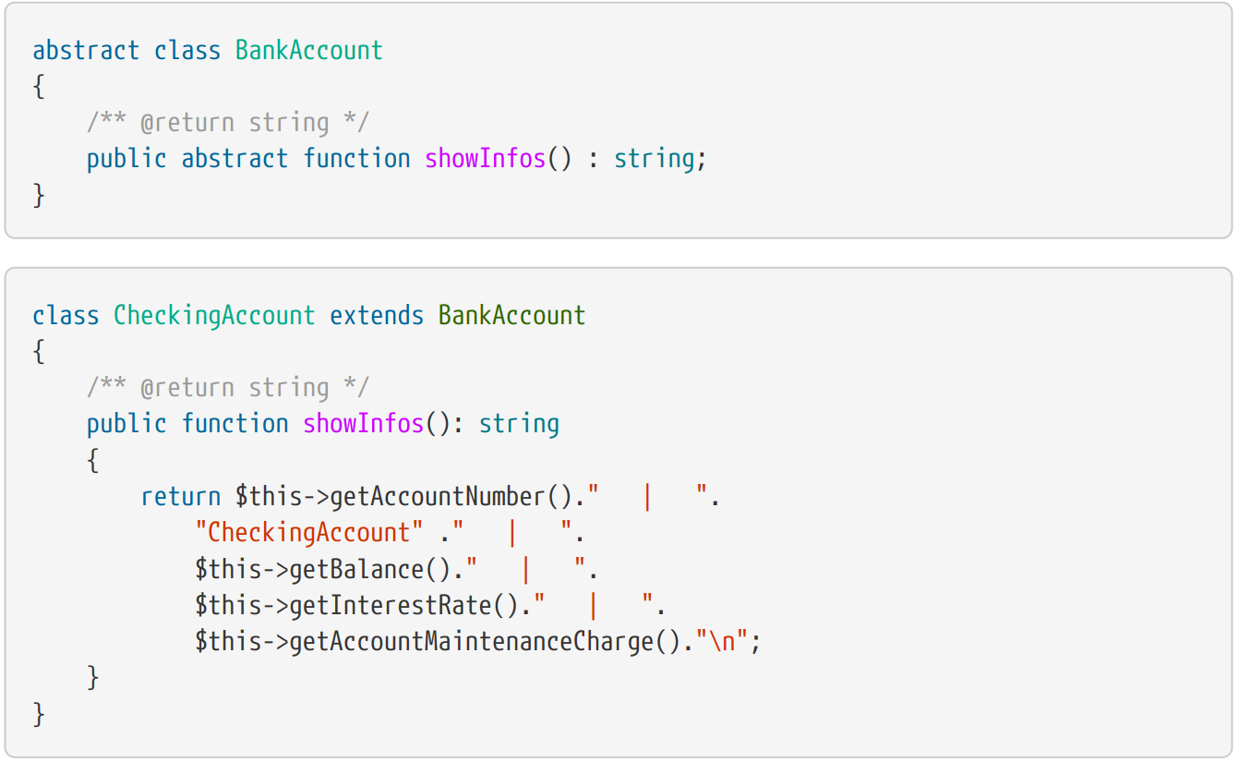
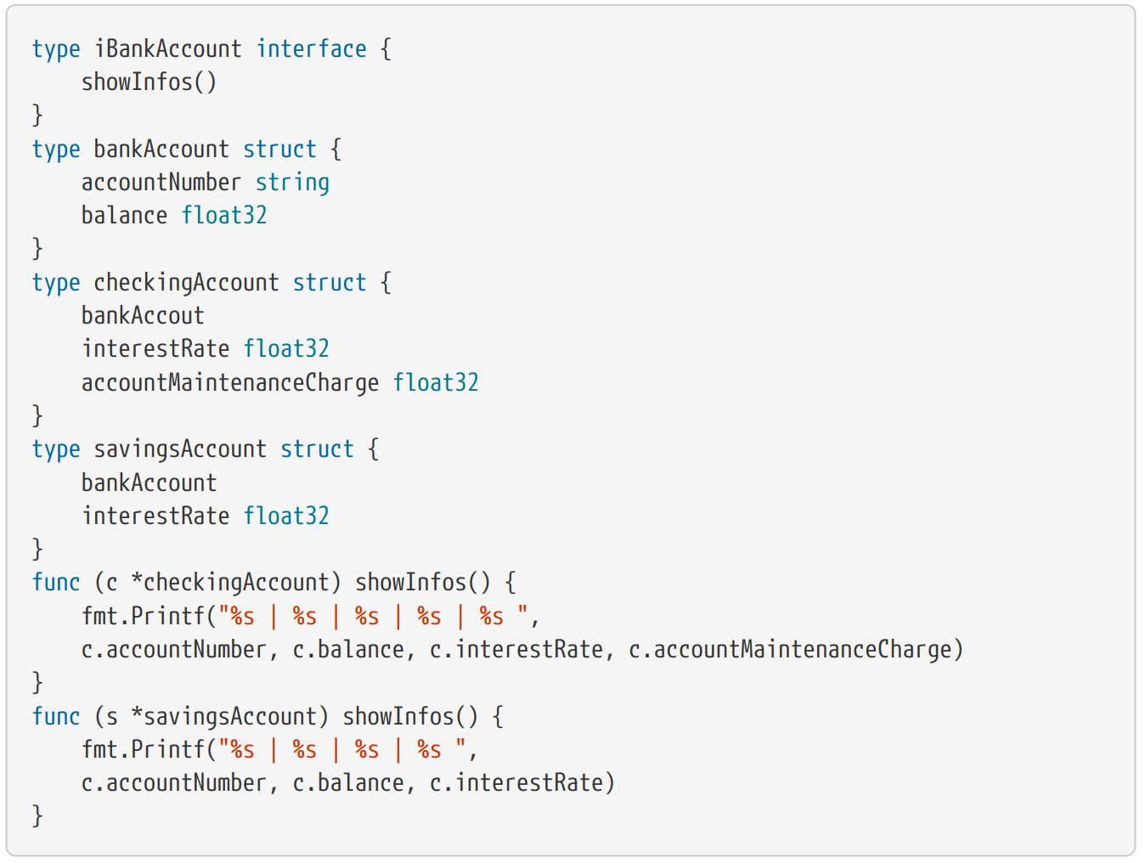
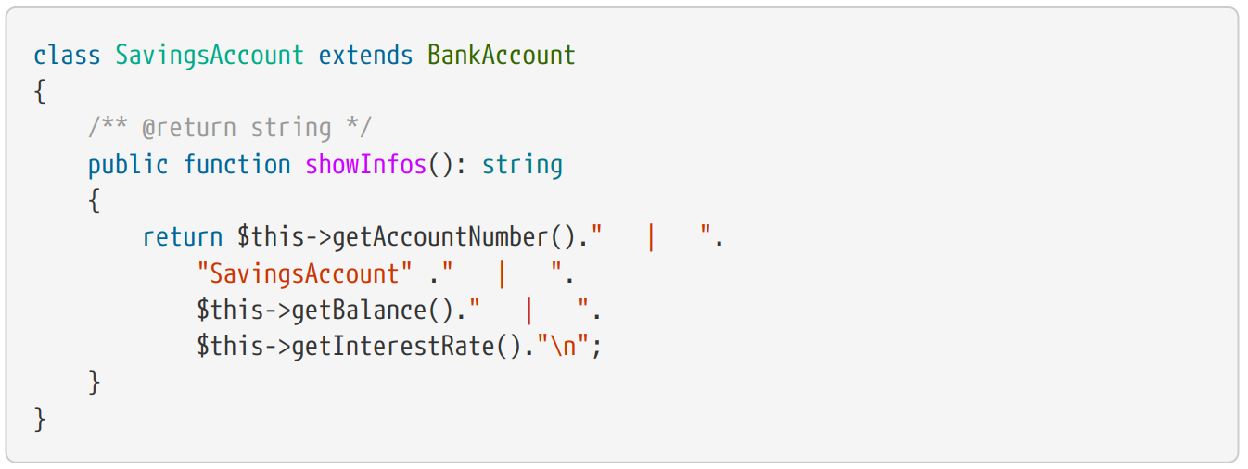
Abstraction
PHP
Abstract classes & methods
Go
Interfaces

Slide 7
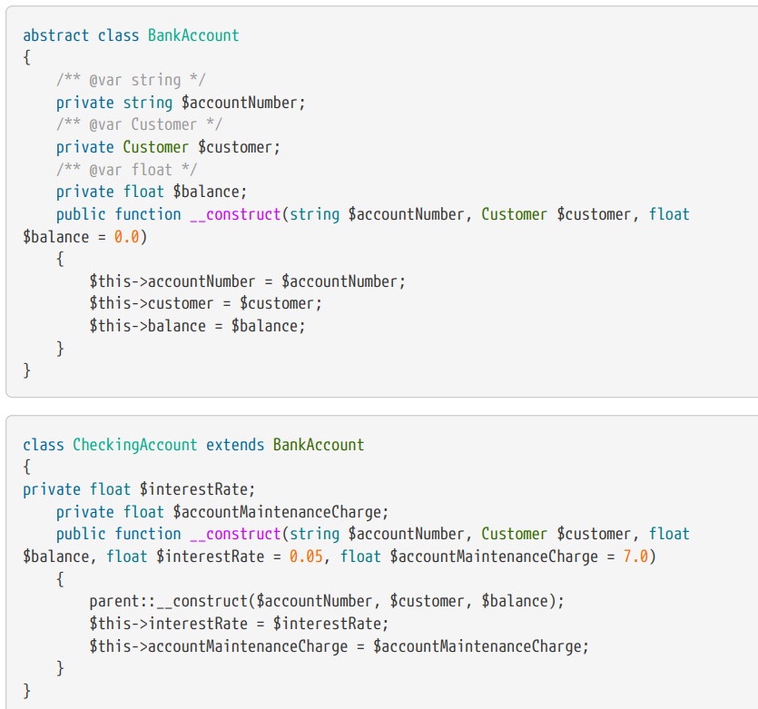
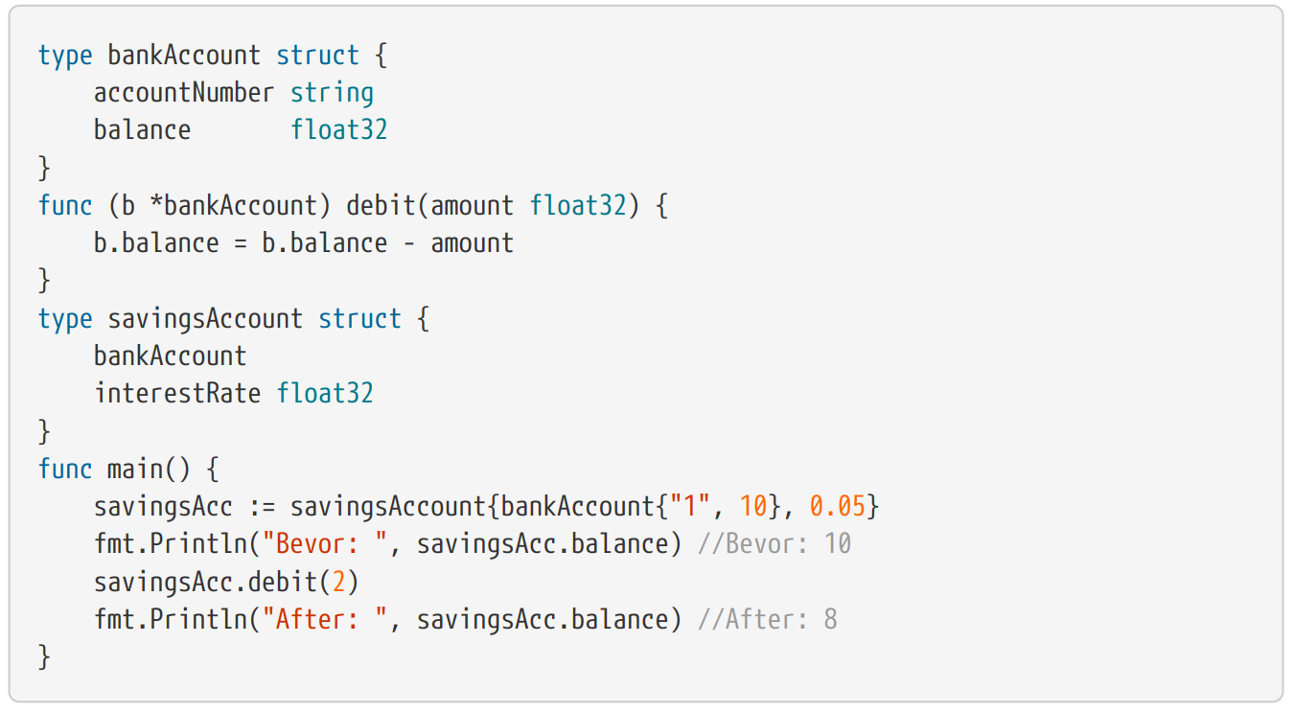
Inheritance
PHP
Key word extends
Go
Embedded structures

Slide 8
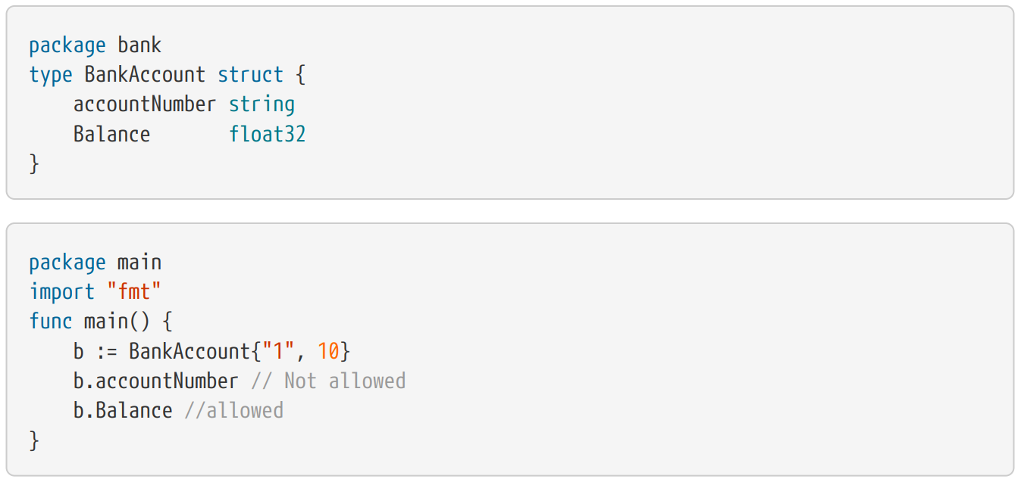
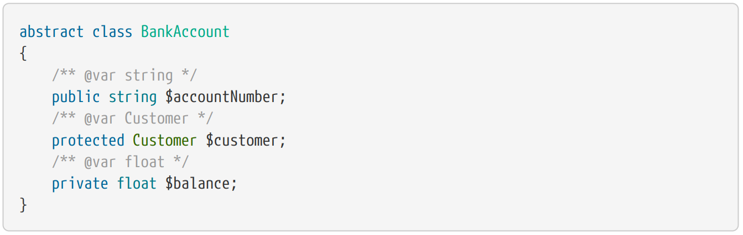
Encapsulation
PHP
public, private, protected
Go
Lower and upper case

Slide 9
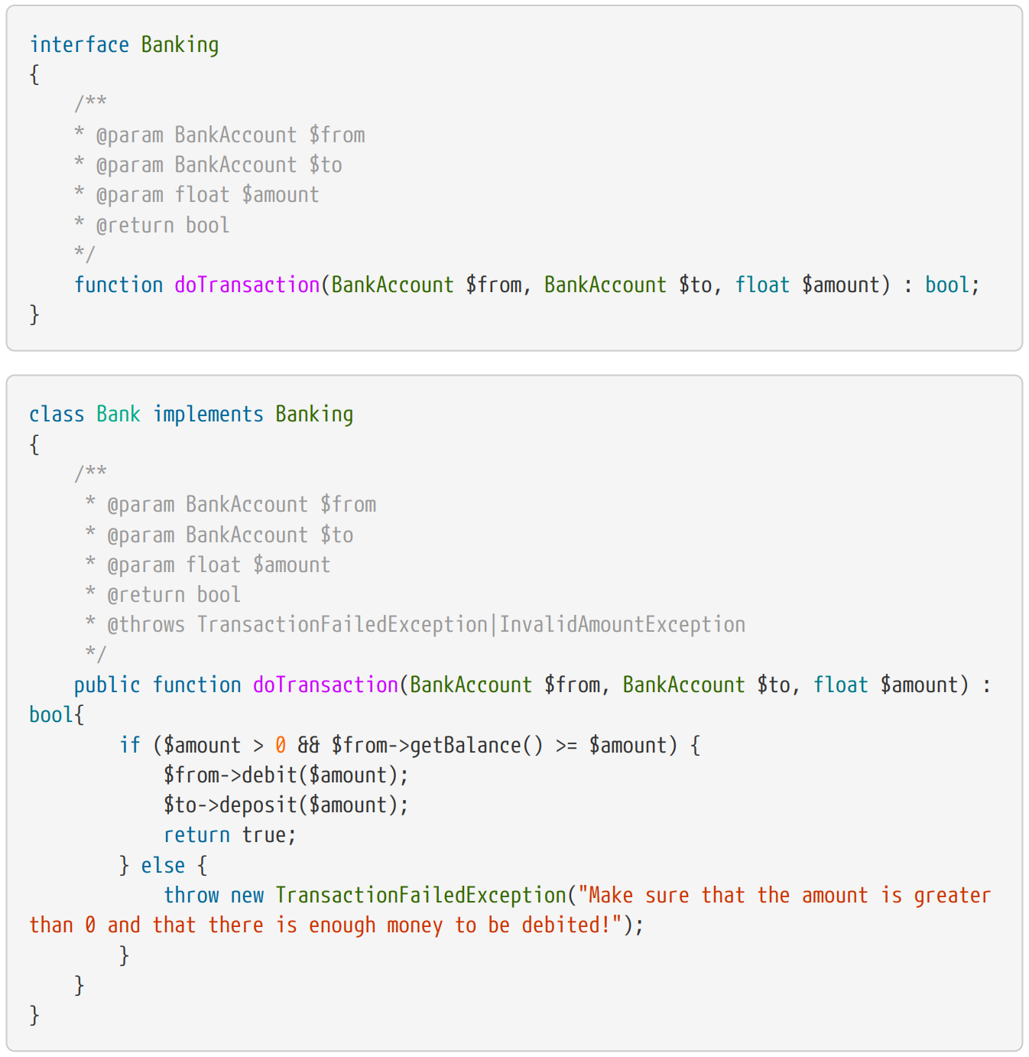
Polymorphism
PHP
Interfaces
Go
Interfaces

Slide 10
Special features of object-oriented programming in PHP
Traits
Autoloading
Exception handling
allow the free reuse of different methods in many classes that do not have to be in the same class hierarchy.
loading multiple classes/files with only one command
try/catch/finally
user defined exceptions

Slide 11
Conclusion
Go – not designed for object-oriented programming, but offers many object-oriented features
PHP – specialized for object-oriented programming
PHP – stable and embedded language, probably no revolutionary features anymore
Go – young language with many potential

