Slide 1

Containerized Deployment of Scoold Q&A Platform
Presented by: Amr Bolas
Course: Programming Networks
Instructor: (اسم الدكتور)

Slide 2
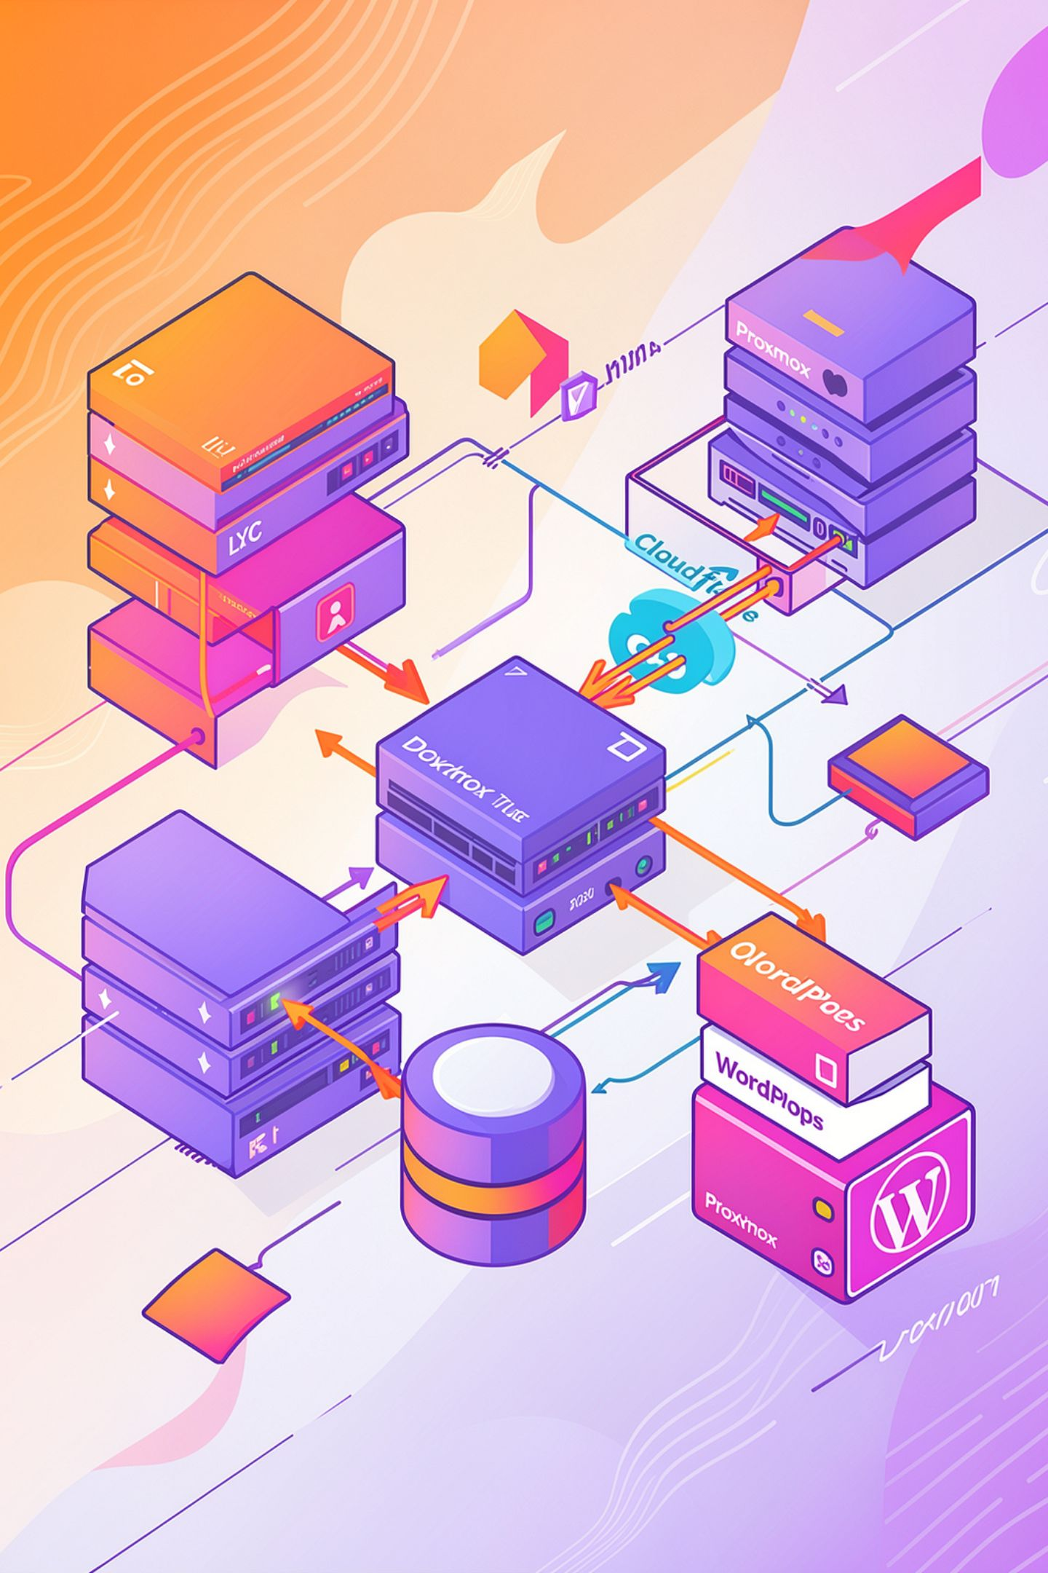
Project Overview
Deploy Scoold Q&A platform
Use Docker containers
Host the platform on Proxmox LXC
Publish it using Cloudflare Tunnel
Integrate it with a WordPress website

Slide 3
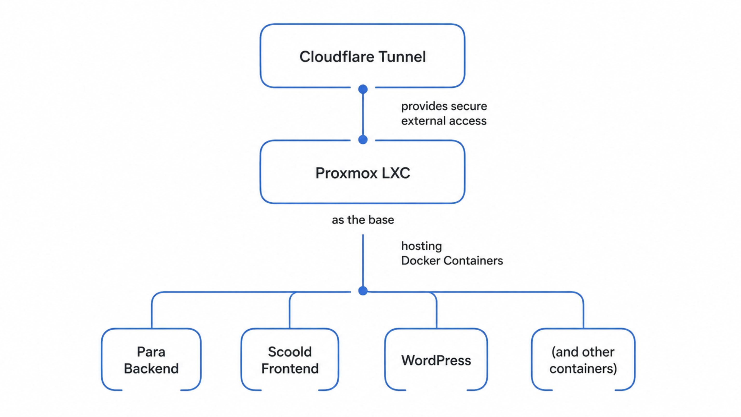
System Architecture
This slide outlines the architecture for the containerized deployment of the Scoold Q&A platform and WordPress, leveraging virtualization and modern containerization technologies for efficient resource management and secure external access.
The architecture is built on a Proxmox LXC instance, which hosts the Docker environment. Inside Docker, multiple applications including the Para Backend, Scoold Frontend, and WordPress are run as separate containers. Cloudflare Tunnel is utilized to provide a secure and efficient connection from external users to these services, bypassing traditional firewall complexities and enhancing security.

Slide 4
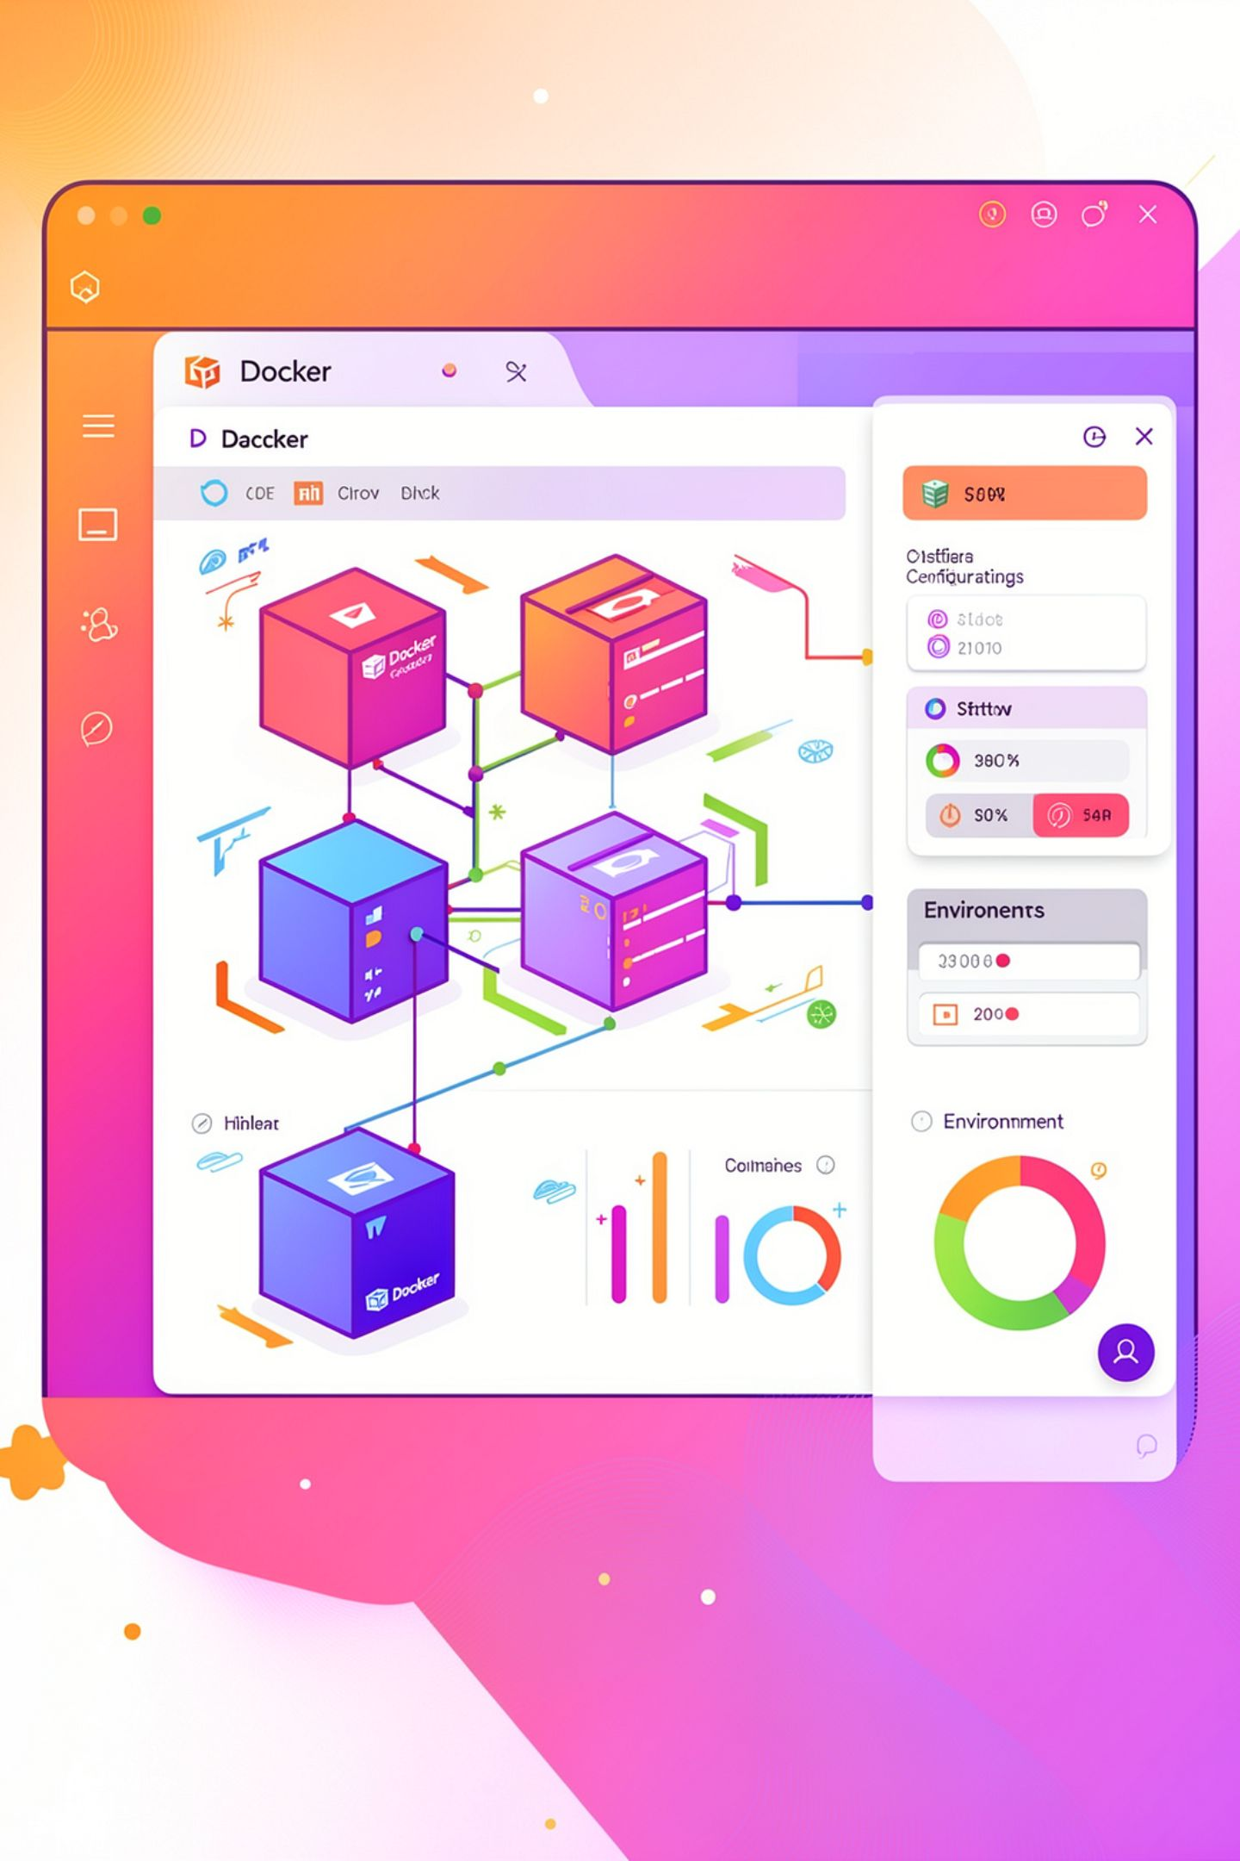
Deploying Scoold
Created Docker containers for Scoold and Para
Connected both containers using Docker Compose
Configured environment variables
Verified internal communication
Confirmed successful startup

Slide 5

Cloudflare Tunnel
Created a Cloudflare Tunnel
Connected the tunnel to Scoold
Published the application securely
HTTPS enabled
No port forwarding required

Slide 6

WordPress Deployment
Installed WordPress in Docker
Configured MySQL database
Connected WordPress to the Docker network
Published the website through Cloudflare
Created a landing page for the community portal

Slide 7

Custom Plugin
Developed a custom WordPress plugin
Displayed live community statistics
Displayed recent Scoold questions
Added quick access to the platform
Embedded Scoold information inside WordPress

Slide 8
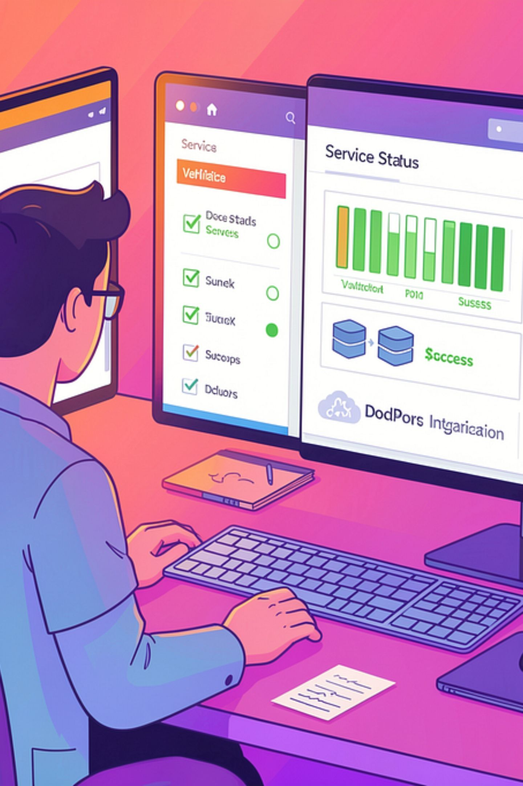
Testing
Verified Docker services
Verified Cloudflare Tunnel
Tested WordPress integration
Tested public access
Confirmed automatic container restart

Slide 9
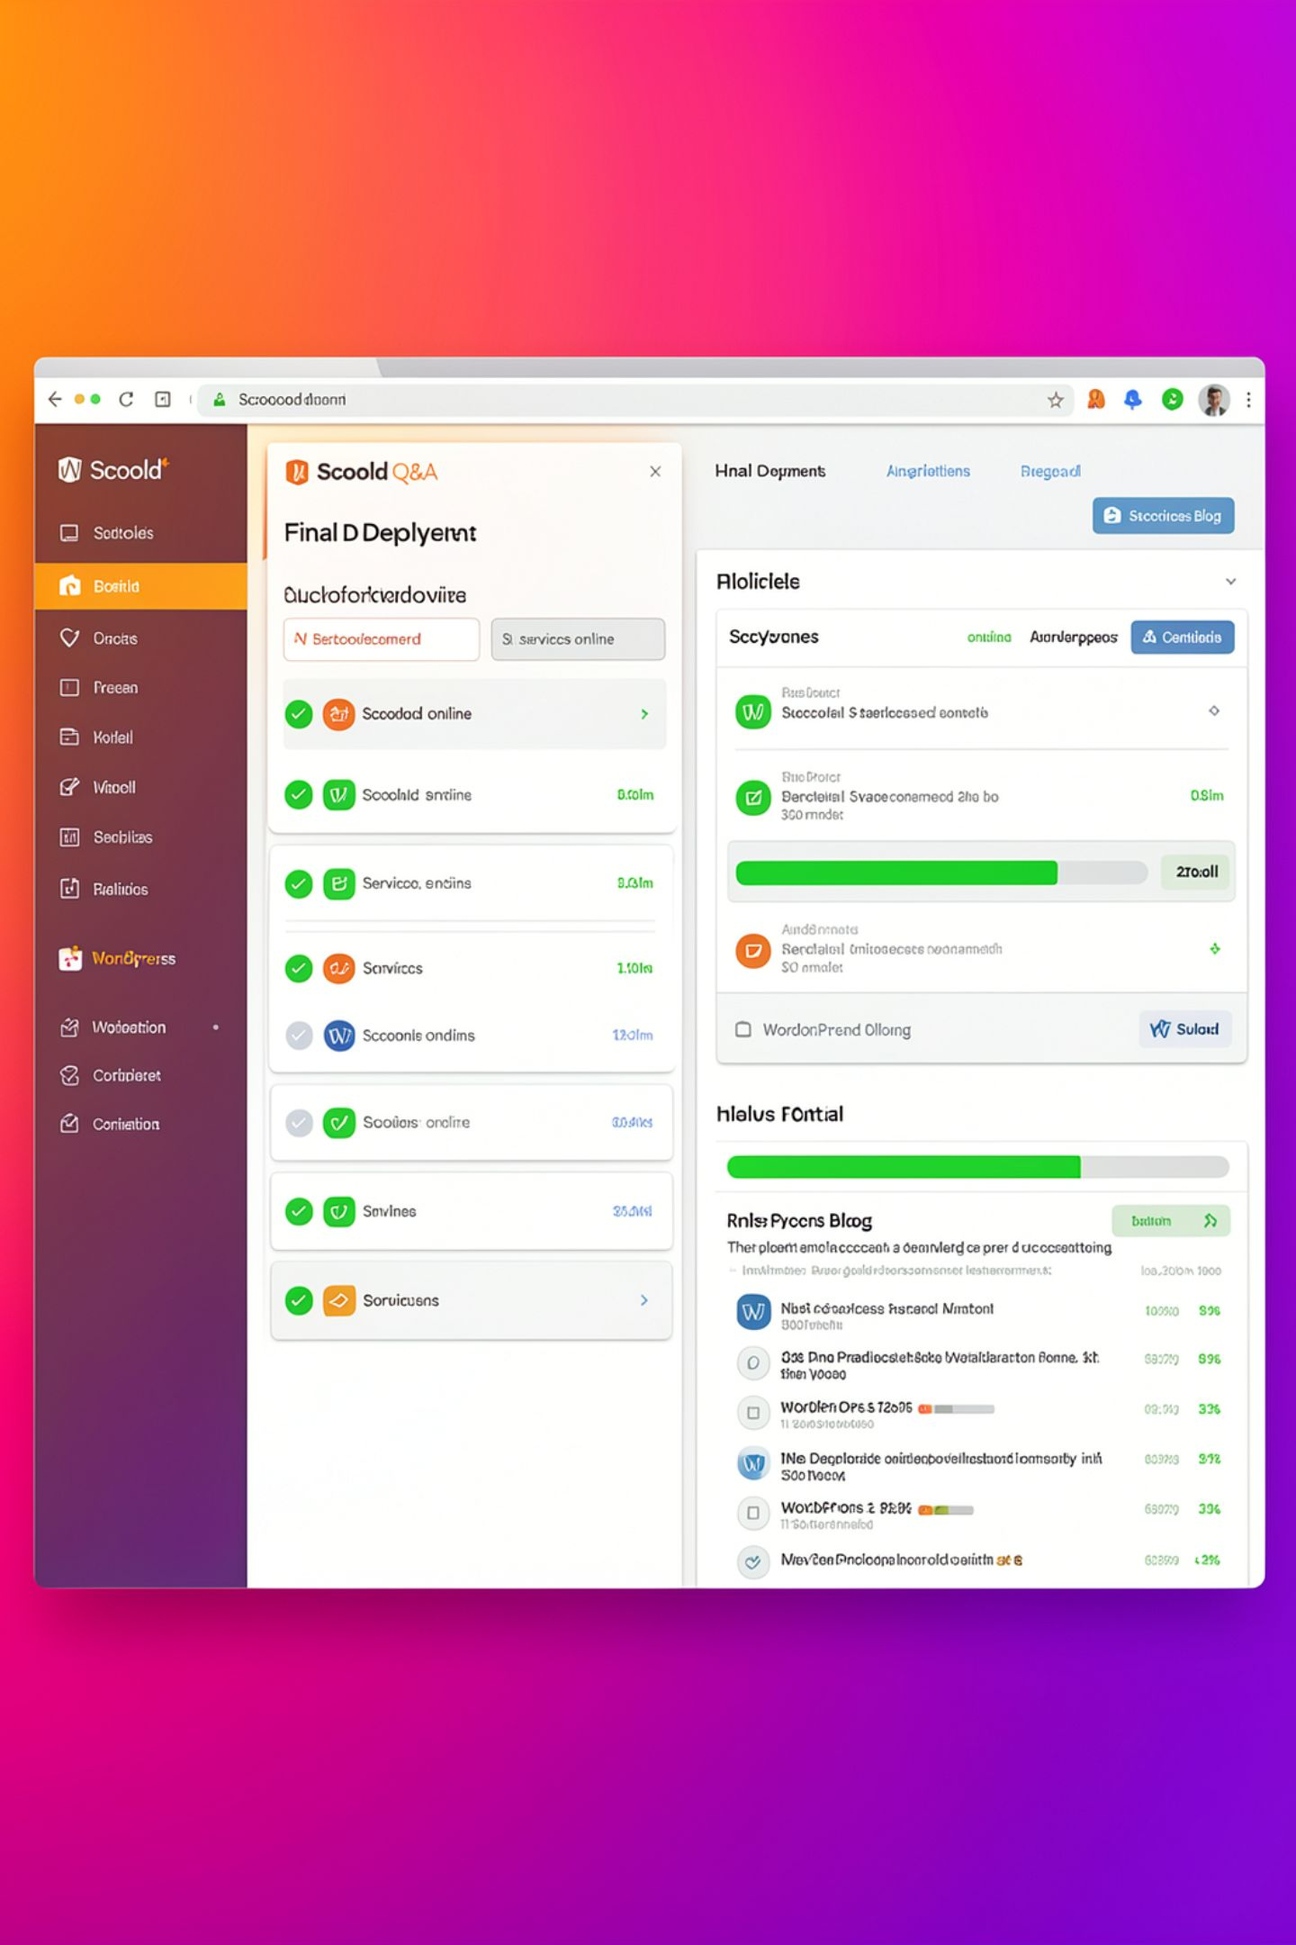
Final Deployment
Scoold running successfully
WordPress integrated successfully
Public HTTPS access available
Docker services running correctly

Slide 10
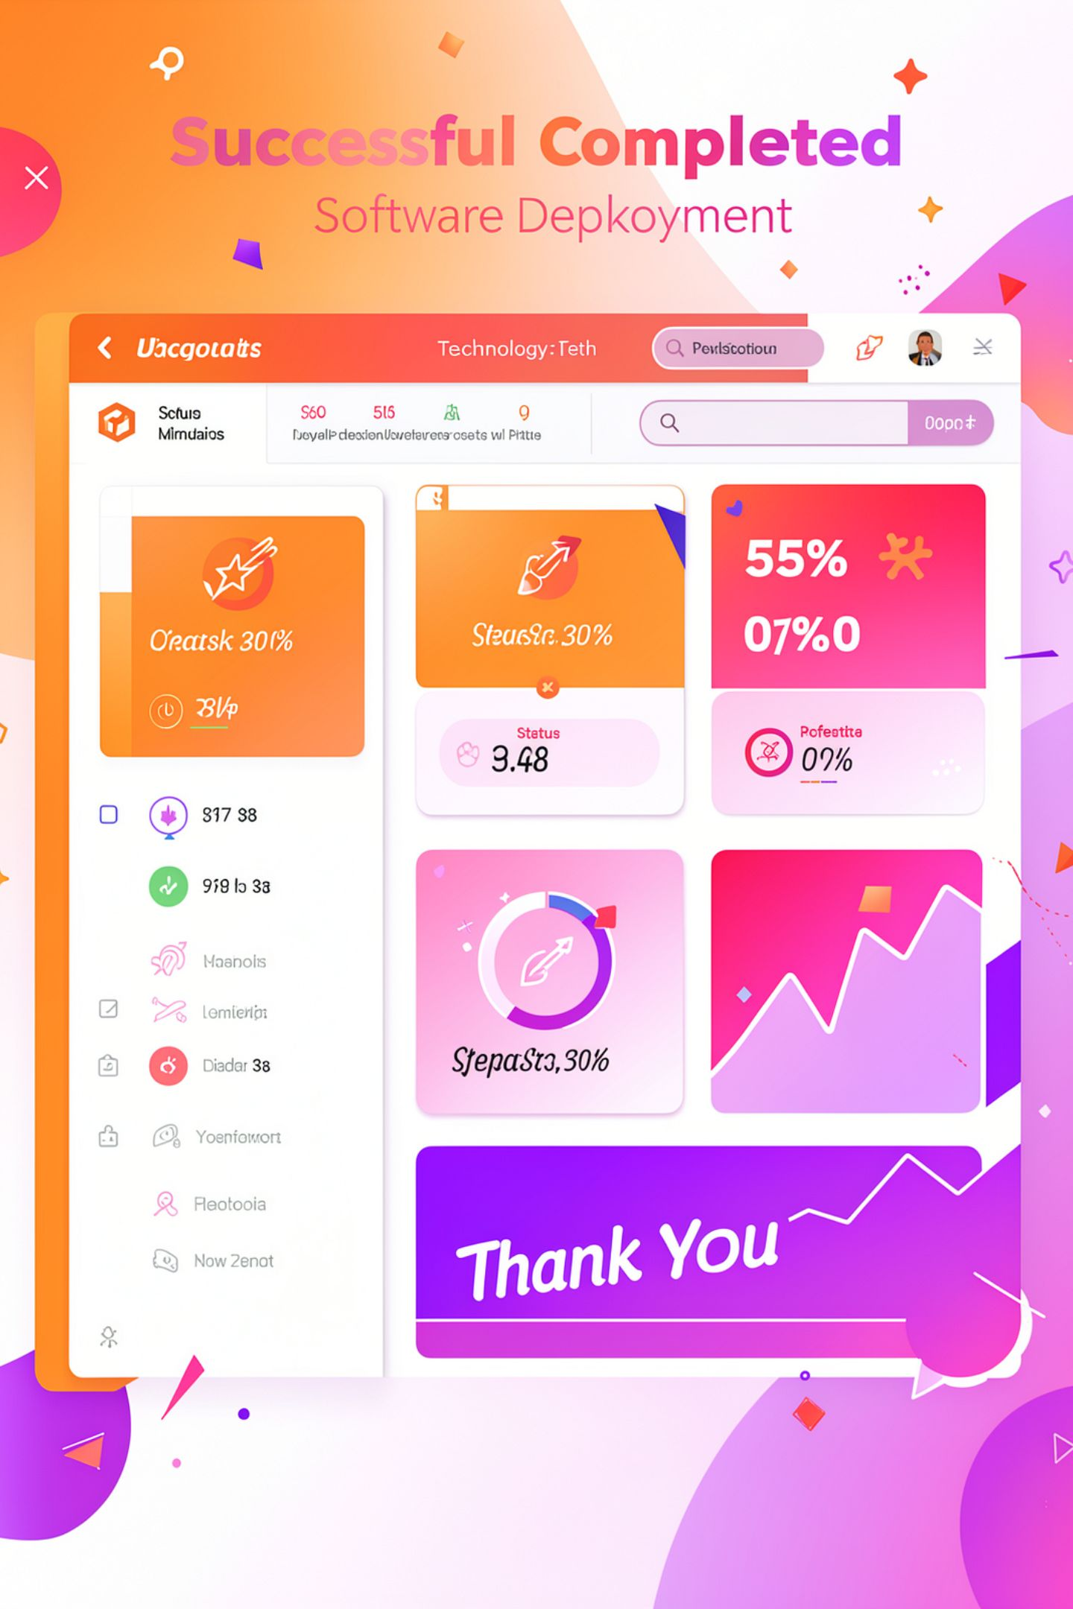
Conclusion
Successfully deployed Scoold using Docker
Published the platform securely
Integrated WordPress with Scoold
Built a complete containerized deployment environment
Thank You

