Slide 1


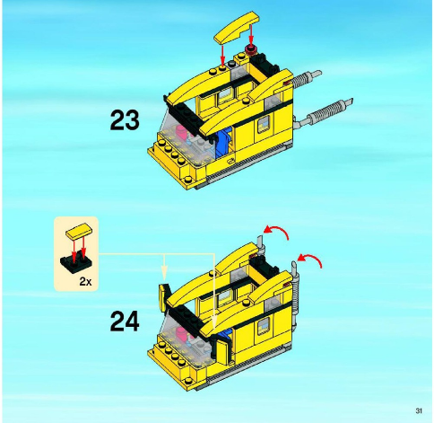
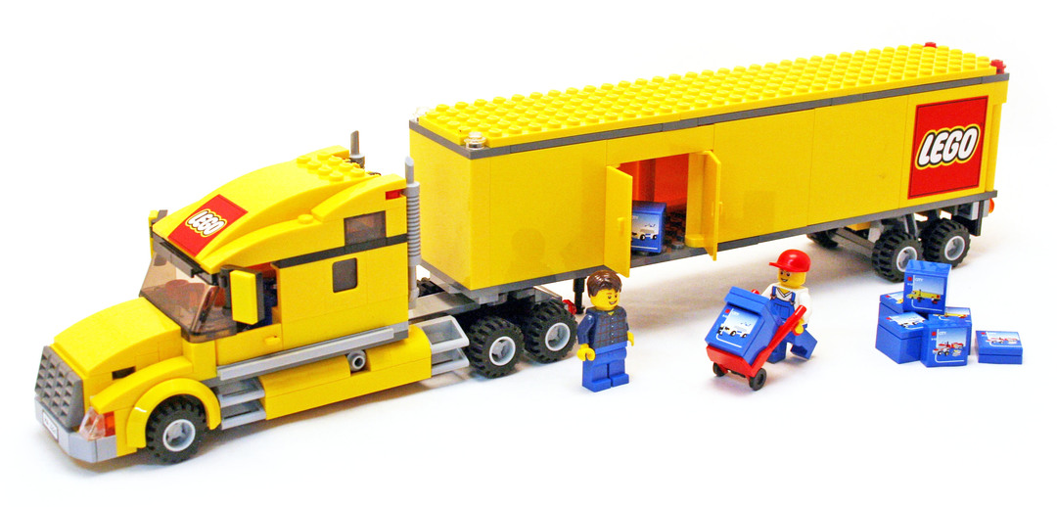
Modules
Core
Plan

Slide 2
Report
AnyPlot
plots [list]
filename [character]
obs [numeric]
rendered [logical]
plot_element [call]
evalElement()
pdfElement()
shinyElement()
logElement()
pdfElement()
shinyElement()
ScatterPlot
PlotReport
HistPlot
TableReport
TableElement

Slide 3
Report
AnyPlot
plots [list]
filename [character]
obs [numeric]
rendered [logical]
plot_element [call]
evalElement()
pdfElement()
shinyElement()
logElement()
pdfElement()
shinyElement()

Slide 4
PlotReport
PlotReport
ScatterPlot
HistPlot
TableReport
TableReport
TableElement

Slide 5
Report
obs
modules

Slide 6
PDF
Report
download
render

Slide 7
PlotReport
ScatterPlot
TableReport
HistPlot
TableElement
appCore

Slide 8

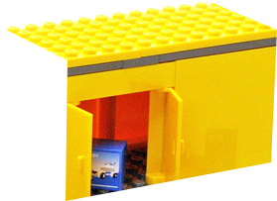
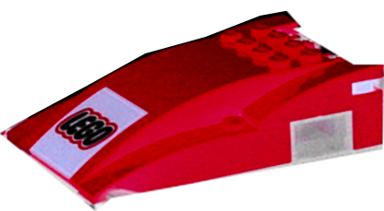
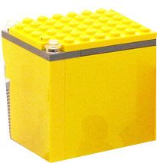

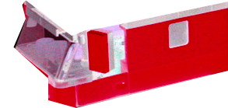

Table
TableReport
Histogram
ScatterPlot
appCore
PlotReport

