Slide 1


Team members
Alina Abu Siam
Amr Darawsheh
Jobs Ability bridges the communication gap between job seekers and recruiters, enabling people with disabilities to find the jobs they desire.

Slide 2
13%
84%
48%
80%
Population
Unemployed
Deaf and Low Vision
Deaf can’t read
are people with disabilities.
of all People with disabilities.
make up 48% of all disability types.
or write in any form.

Slide 3

4%
Of Employees
Recruiters
should be of people with disabilities according to the law
find it difficult to
communicate with people with disabilities

Slide 4


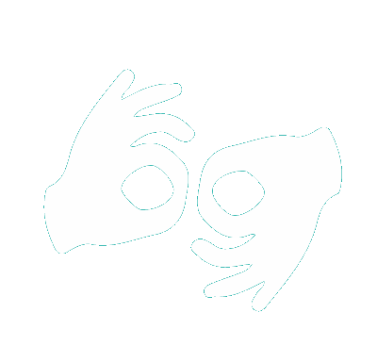
Biggest Problem? Communication
I’M BATMAN!

Slide 5


Slide 6

Our solution
JobsAbility, a double – sided website, which connects job recruiters to people with disabilities using AI & Machine Learning to build assistive technologies that provides people with disabilities easy browsing and comfort.

Slide 7


Our Goals
Bridge the Gap
Enable People
Help Companies
of communication between people with disabilities and companies, using their own languages.
with disabilities to work, involve themselves in the community and effectively reduce the unemployment rate.
find talents they require and abide by the law in and easy and efficient manner.

Slide 8




Methods
Text-to-speech
SIGN LANGUAGE INTERPRETR
Sign language interpreter
All text is read using AWS Polly, thus people with low vision can use website
TEXT TO SPEECH
Enables Hard of hearing people or deaf people to understand the text on screen
Accessible Chat
ACCESSIBLE CHAT
EASY BROWSING
Easy Browsing
Allowing people with disabilities to communicate with the recruiters using their own language easily
Allows easy navigation and selection through keyboard on the website

Slide 9
Methods
Text-to-speech
SIGN LANGUAGE INTERPRETR
Sign language interpreter
All text is read using AWS Polly, thus people with low vision can use website
TEXT TO SPEECH
Enables Hard of hearing people or deaf people to understand the text on screen
PLANNING
Accessible Chat
ACCESSIBLE CHAT
EASY BROWSING
Easy Browsing
PROMOTE
PRICING
Allowing people with disabilities to communicate with the recruiters using their own language easily
Allows easy navigation and selection through keyboard on the website

Slide 10
Methods
Text-to-speech
SIGN LANGUAGE INTERPRETR
Sign language interpreter
All text is read using AWS Polly, thus people with low vision can use website
TEXT TO SPEECH
Enables Hard of hearing people or deaf people to understand the text on screen
TEXT TO SPEECH
Accessible Chat
ACCESSIBLE CHAT
EASY BROWSING
Easy Browsing
PROMOTE
PRICING
Allowing people with disabilities to communicate with the recruiters using their own language easily
Allows easy navigation and selection through keyboard on the website

Slide 11
Methods
Text-to-speech
SIGN LANGUAGE INTERPRETR
Sign language interpreter
All text is read using AWS Polly, thus people with low vision can use website
TEXT TO SPEECH
Enables Hard of hearing people or deaf people to understand the text on screen
RESEARCH
PLANNING
Accessible Chat
ACCESSIBLE CHAT
EASY BROWSING
Easy Browsing
PRICING
Allowing people with disabilities to communicate with the recruiters using their own language easily
Allows easy navigation and selection through keyboard on the website

Slide 12
Methods
Text-to-speech
SIGN LANGUAGE INTERPRETR
Sign language interpreter
All text is read using AWS Polly, thus people with low vision can use website
TEXT TO SPEECH
Enables Hard of hearing people or deaf people to understand the text on screen
RESEARCH
PLANNING
Accessible Chat
ACCESSIBLE CHAT
EASY BROWSING
Easy Browsing
PROMOTE
Allowing people with disabilities to communicate with the recruiters using their own language easily
Allows easy navigation and selection through keyboard on the website

Slide 13
Methods
Text-to-speech
SIGN LANGUAGE INTERPRETR
Sign language interpreter
All text is read using AWS Polly, thus people with low vision can use website
TEXT TO SPEECH
Enables Hard of hearing people or deaf people to understand the text on screen
RESEARCH
PLANNING
Accessible Chat
ACCESSIBLE CHAT
EASY BROWSING
Easy Browsing
PROMOTE
PRICING
Allowing people with disabilities to communicate with the recruiters using their own language easily
Allows easy navigation and selection through keyboard on the website

Slide 14









Backend
Database
Machine Learning
Frontend
ASP.NET Core
SQL Server
Polly & MRI API
Bootstrap 4
Deployed
Deployed
using
Elastic Beanstalk
RDS

Slide 15


Slide 16
Team members
Alina Abu Siam
Amr Darawsheh
Jobs Ability bridges the communication gap between job seekers and recruiters, enabling people with disabilities to find the jobs they desire.

