Slide 1
General context

Slide 2
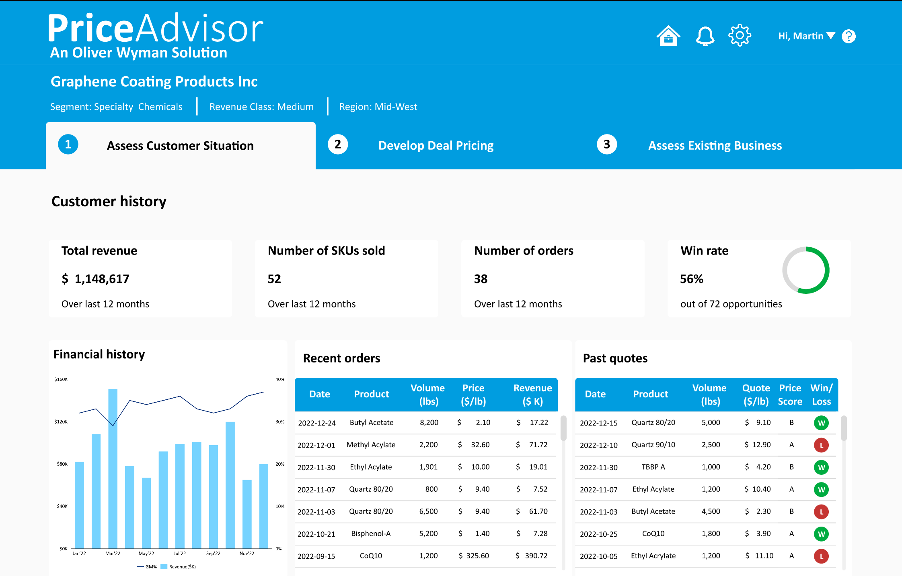
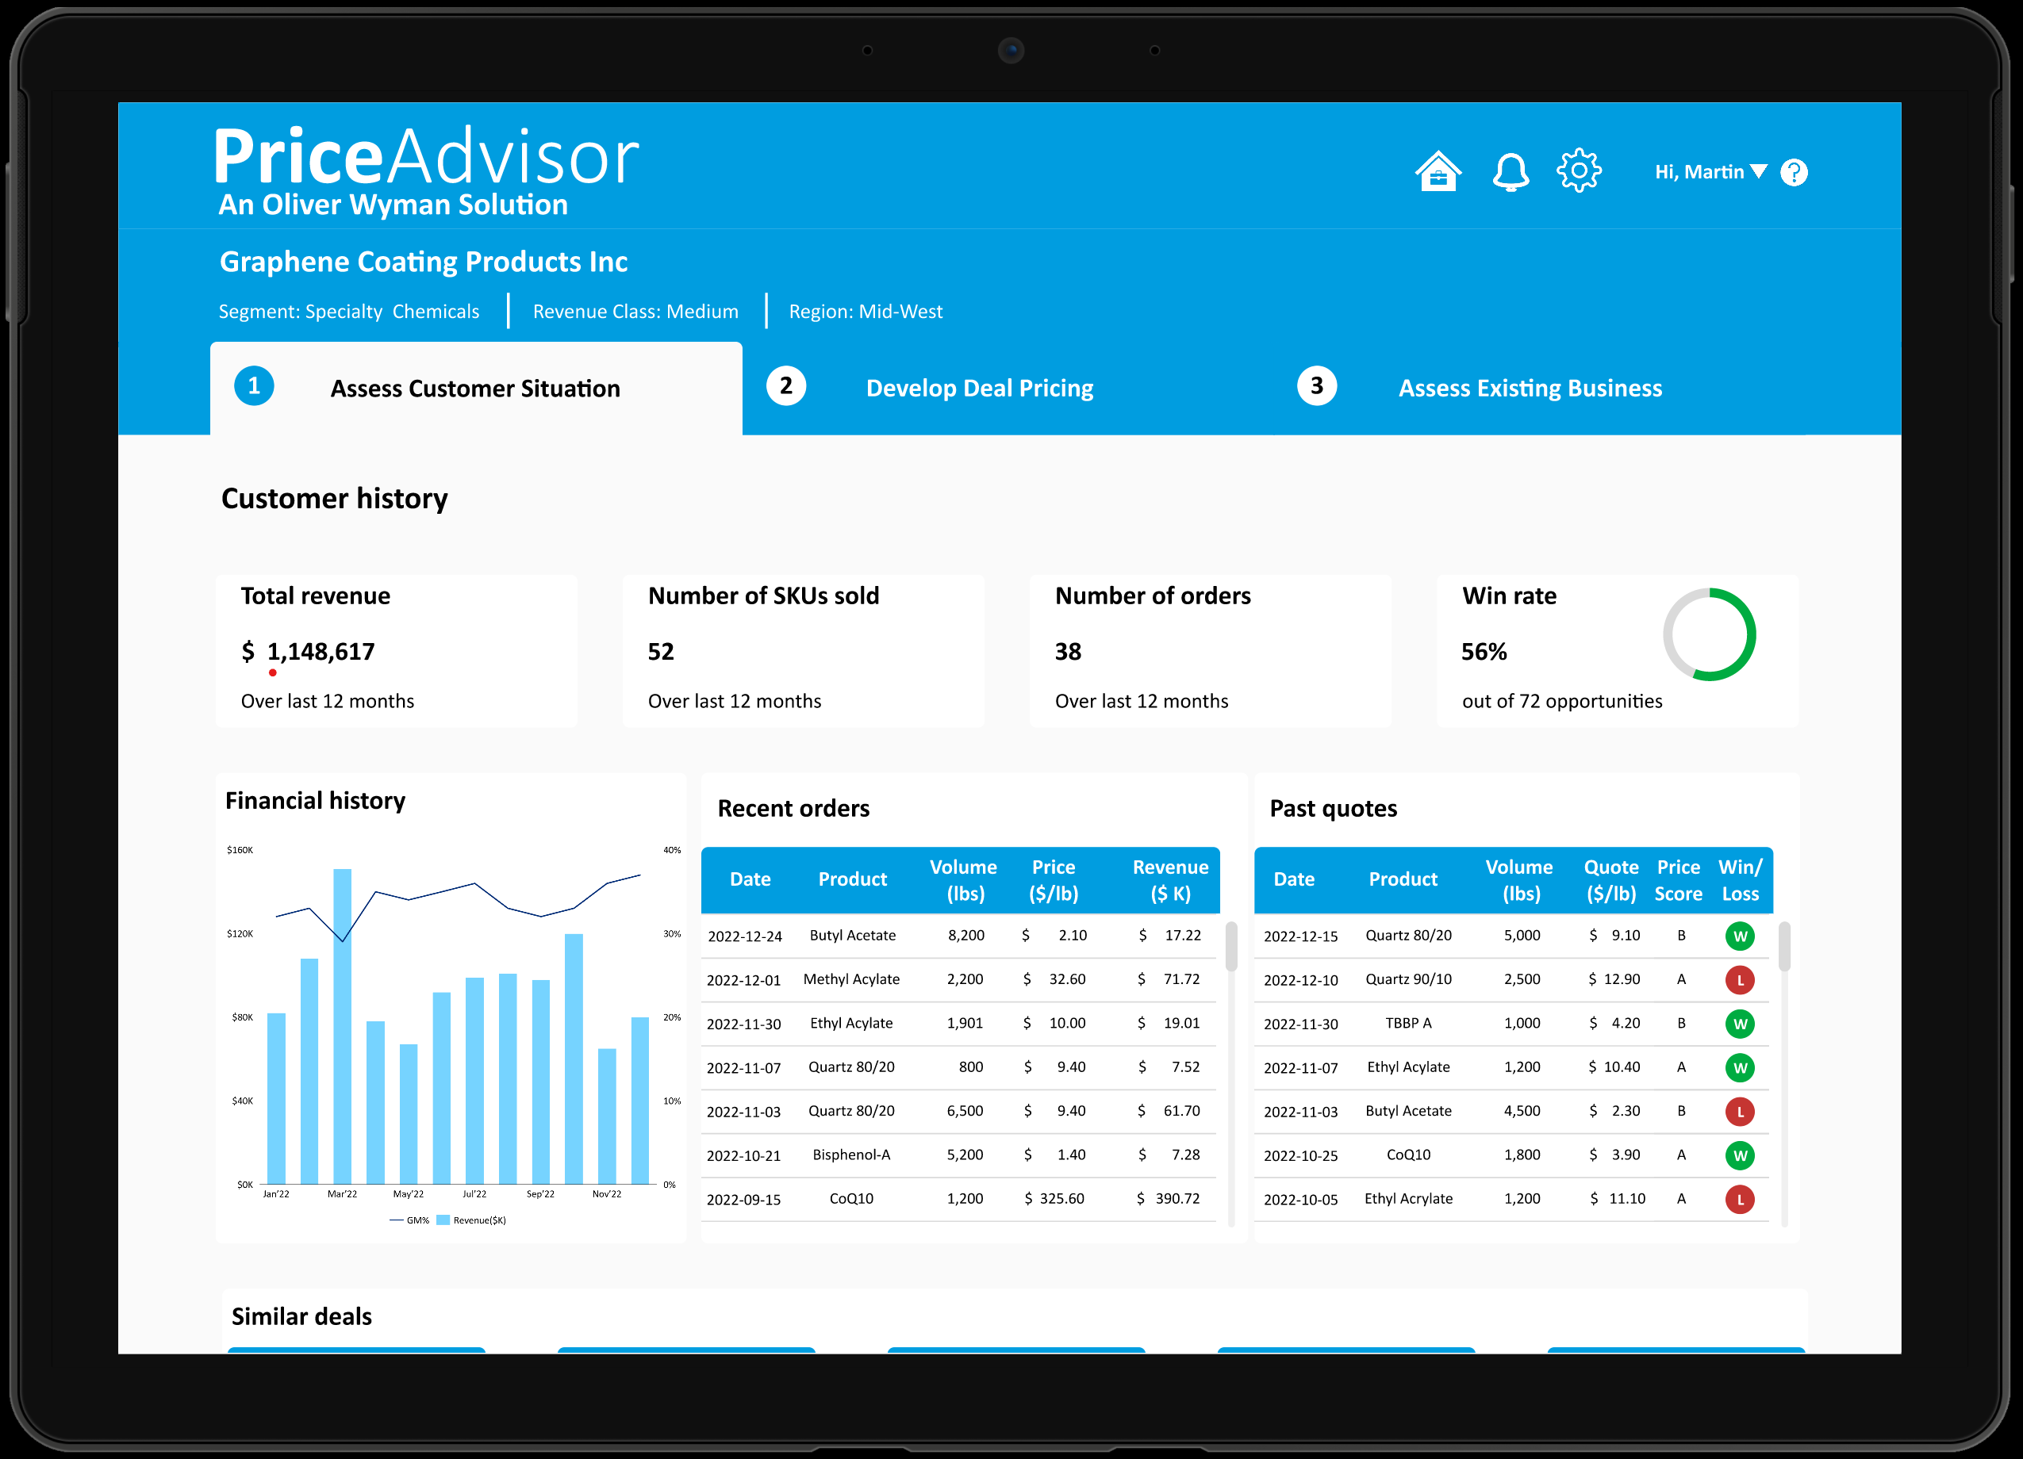
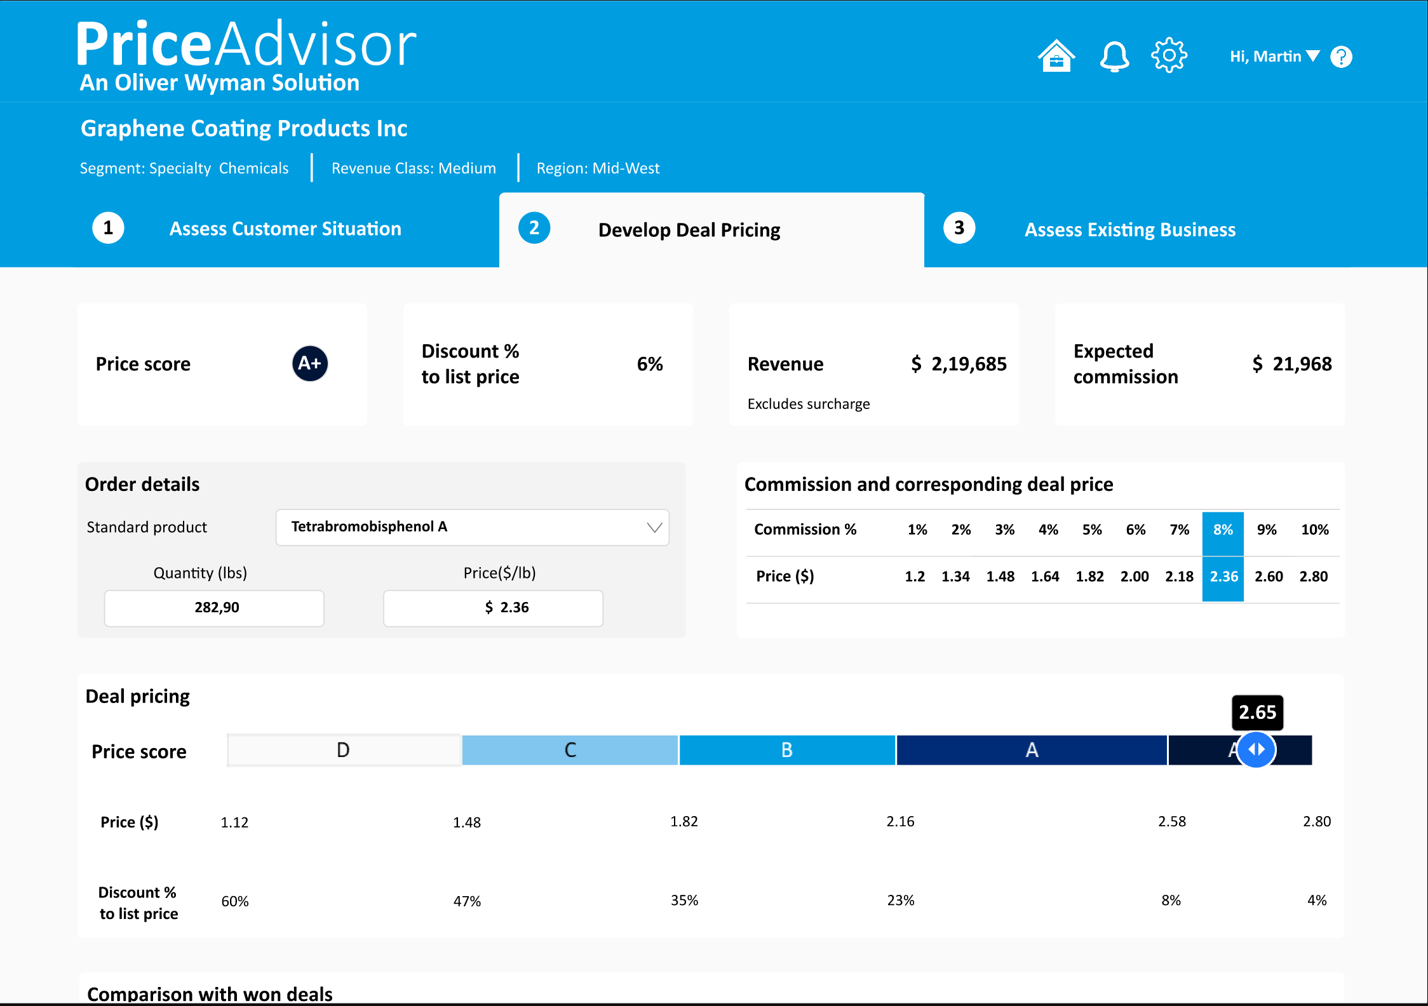
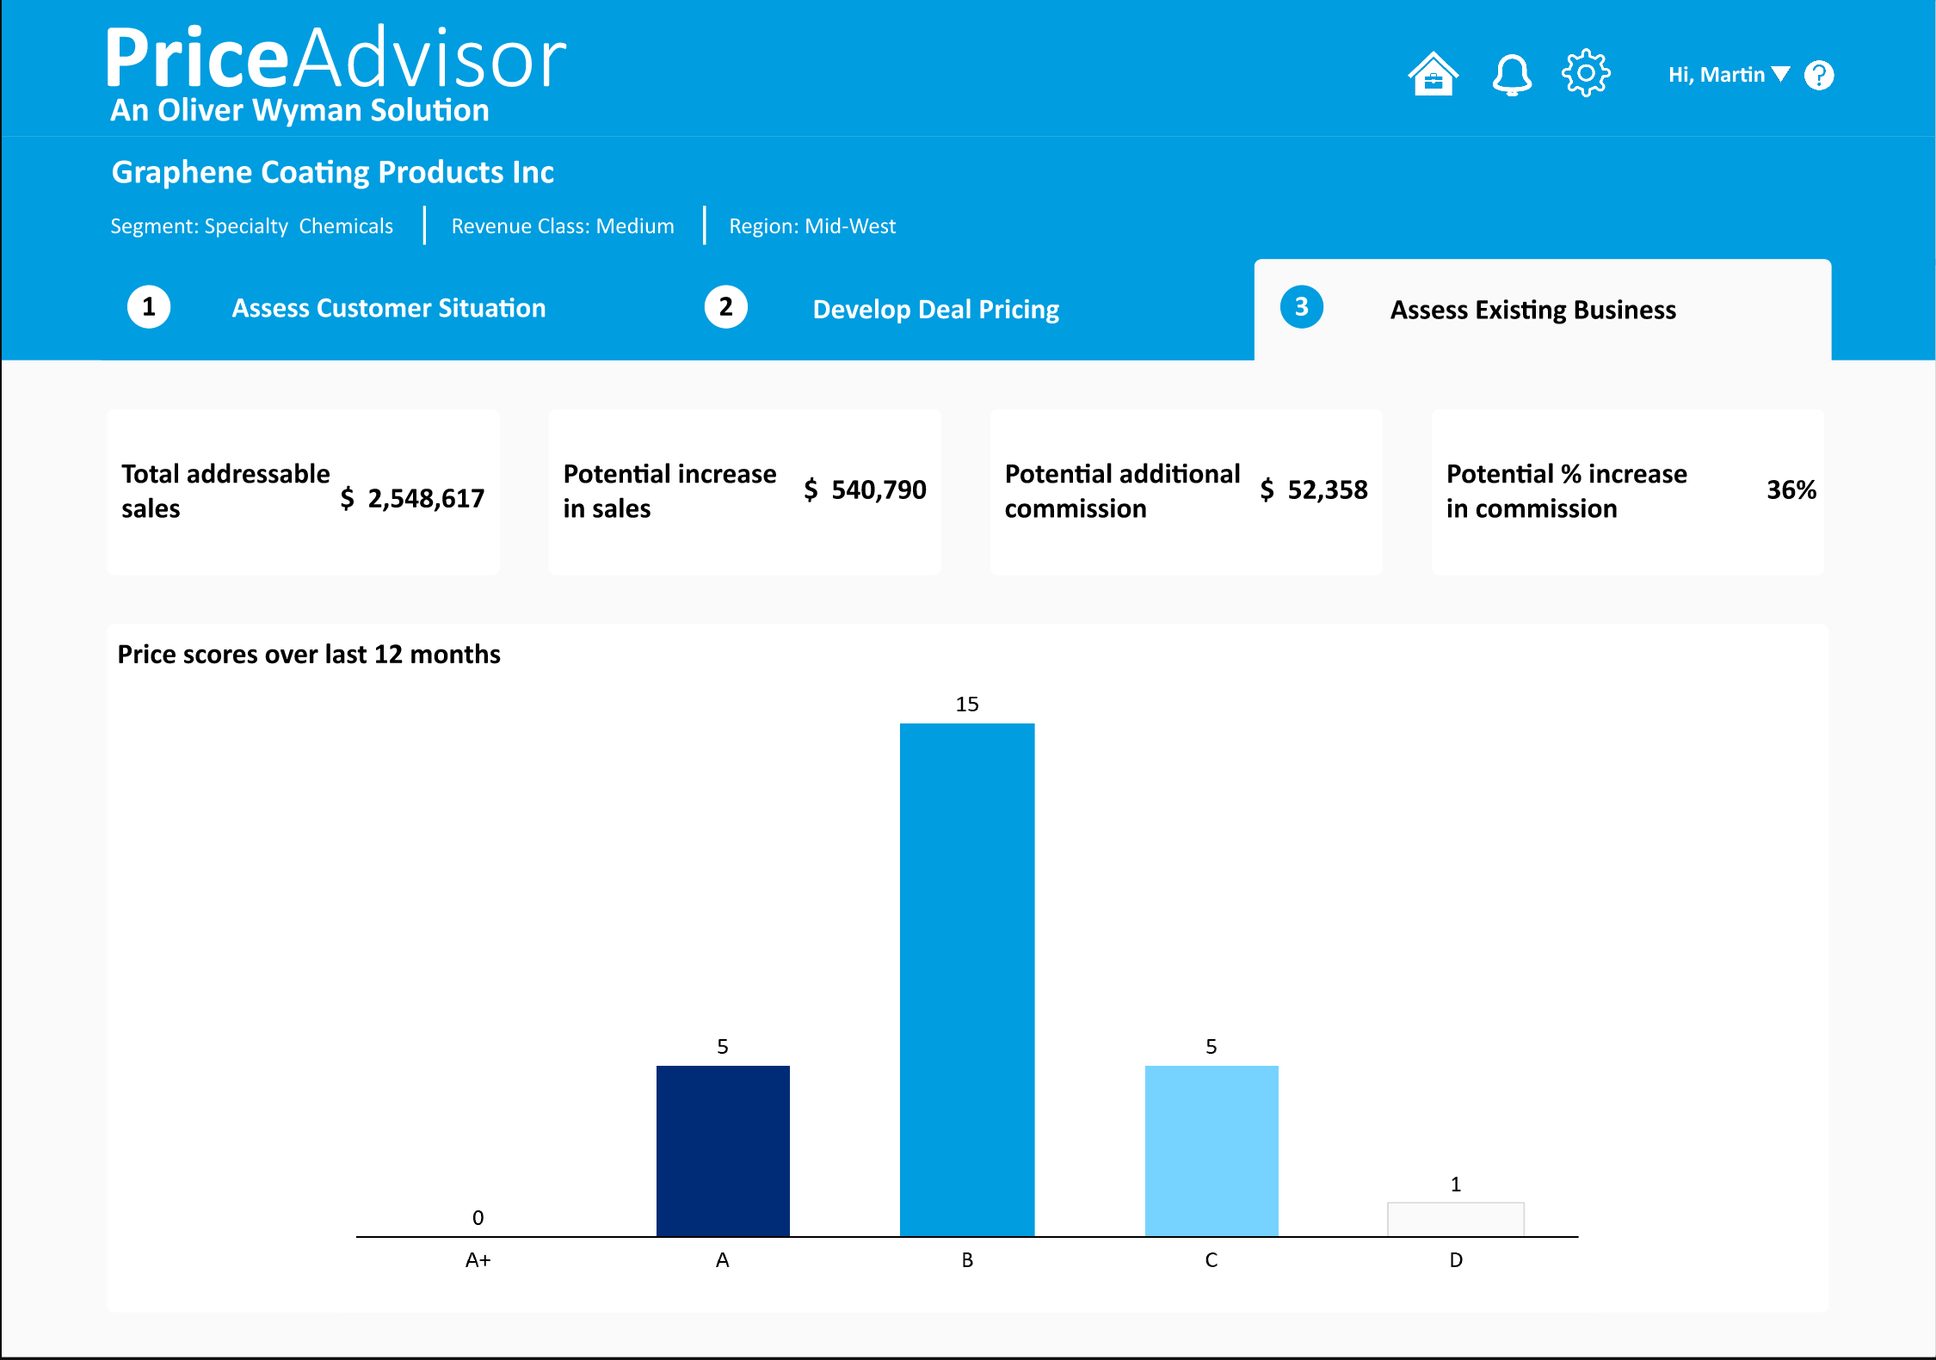
Overall vision & objectives Custom, easy-to-use pricing tool supports a structured quoting process
1A
Requirements for a pricing tool at DuBois
Based on input from commercial team
Illustrative pricing tool for DuBois
Based on Oliver Wyman PriceAdvisor for chemical industry clients
✓
Easy for user to navigate, input requirements, and create a quote
Anchors rep. on book and target pricing vs. material margins
Outlines expected commissions
Enables guardrails to control variability
Provides deal scoring
Tracks and provides data analytics on quote performances
Available on both mobile and PC (as screen in dynamics)
Integrates well with current data and systems environment
Shows the customers situation and price performance
✓
Mobile-friendly for Reps and Technicians to leverage in-field
✓
✓
✓
✓
Provides deal-specific guidance to increase margins and motivate value-selling
✓
✓
Scores the offer and benchmarks it against historical deals

Slide 3
Scope of use cases Primary initial focus on is pricing new customer deals. Additional pricing use cases could later be enabled by this platform
✓
Scope for initial build effort
?
✗
1C
Partially enabled or TBD
Potential future scope
✓
✓
✗
Price a new customer deal
Understand and monitor W/L
Set a distributor price list
Core initial use case for the tool
Provide price guidance, deal score, and approval support for new opportunities
Track outcomes to understand what drives wins and losses
Create feedback loops to refine pricing guidance over time
Potential adjacent use case, but likely needs separate logic and workflow
Could be partially enabled later once core pricing engine is established
✗
✗
✗
Assess existing customer prices
Monitor quote to consumption
Periodic price management
Not in initial scope
Future phase could support review of repricing and renewal opportunities
Not in initial scope
Valuable for understanding realization and customer follow-through
Not in initial scope
Future extension could support inflation-led increases and portfolio-wide actions

Slide 4
Process Steps: future state overview among various use cases
No or limited change to current process
Change to current process & tool
Core initial pricing tool build
Enabled fast follower capability
2A
Legend
1. Discovery & qualification
2. Quoting process and approvals
3. Ordering & tracking
Process differs 1.1 to 1.4
1.5 Trials & Samples
2.1 Develop Quote
2.2 Approve Quote
2.3 Send quote to customer
2.4 Iterate Quote Drafts
2.5 Establish Price in F&O
3.1 Place order
3.2 Fulfill order
3.3 Bill to
cash
3.4 Track Win/loss
A. New customer
1.1 Customer setup request
1.2 Segment assignment
1.3 Locate Prior Terms
1.4 Create Opportunity
New customer created in CRM, assigned customer # in F&O, and confirm commercials (e.g., delivery term, ship-to locations) | Sales Ops confirms correct customer setup in F&O, assign customer segment and check for prior customer family | N/A | Create new opportunity in CRM. Enter high-level revenue and product line expectations tab
B. Existing customer, new product¹
1.1 Customer setup request
1.2 Segment assignment
1.3 Locate Prior Terms
1.4 Create Opportunity
N/A | N/A | Rep verifies that this is a new product without prior pricing terms | Create new opportunity in CRM. Enter customer ID and revenue and product line expectations tab. Customer details are pulled automatically
C. Existing customer, price update
1.1 Customer setup request
1.2 Segment assignment
1.3 Locate Prior Terms
1.4 Create Opportunity
N/A | N/A | Rep views current product terms (contract length, price / quantity, etc.) within PriceAdvisor as a reference point for desired update | Create new opportunity in CRM. Enter customer ID and revenue and product line expectations tab. Customer details are pulled automatically
D. Existing customer, product update
1.1 Customer setup request
1.2 Segment assignment
1.3 Locate Prior Terms
1.4 Create Opportunity
N/A | N/A | Rep views current product terms (contract length, price / quantity, etc.) within PriceAdvisor as a reference point for desired update | N/A
1. Includes new customer ship-to location under current customer family

Slide 5
focus for the next 1-2 weeks

Slide 6
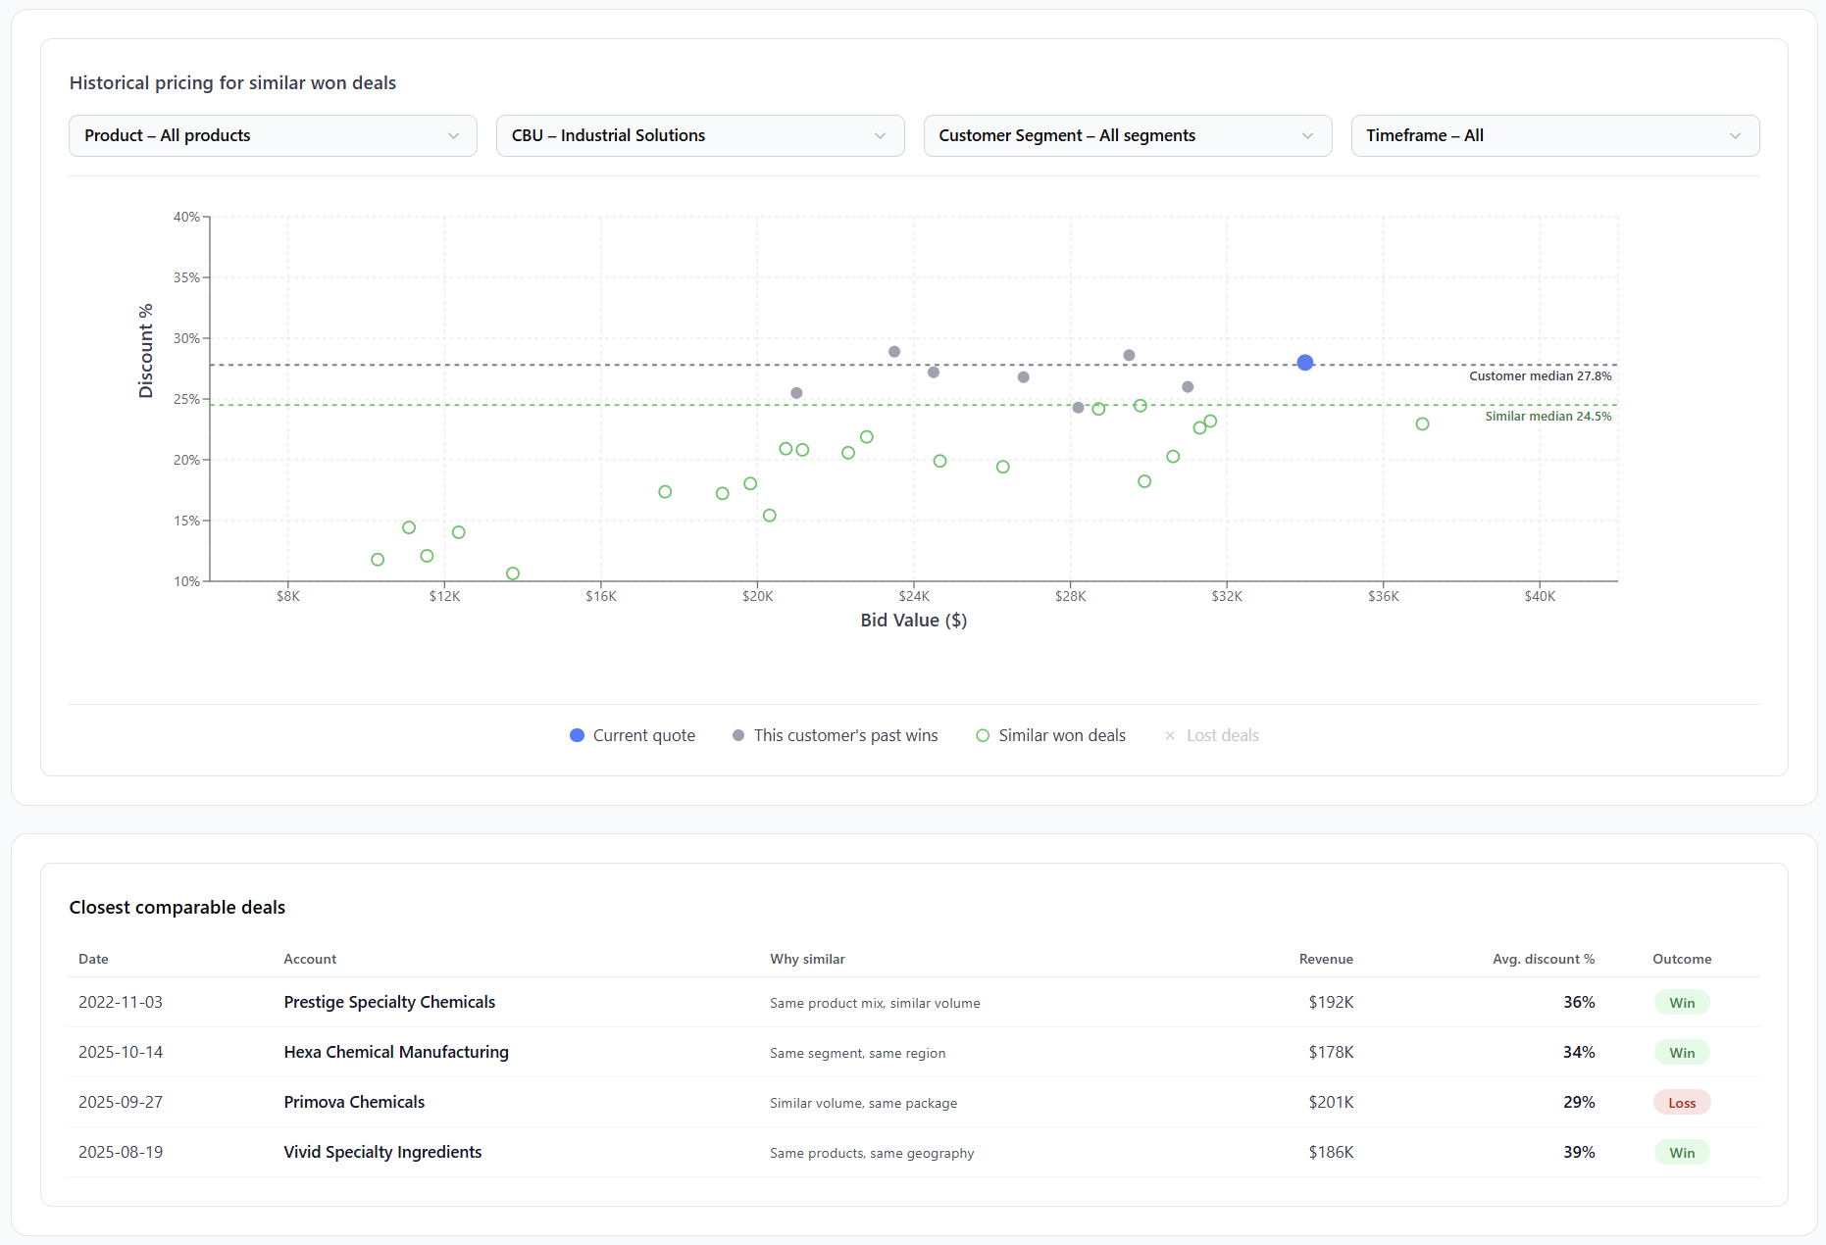
comparing to similar past deals
A
Compare vs similar deals (scatterplot)
Select product overlap
Filter by CBU
Filter by customer segment
Select relevant timeframe
Review current quote vs past customer wins and other similar won deals
Lost deals feature will be enabled by PriceAdvisor and go live at a later stage
Deep-dive closest comparable deals (table): explore the most similar past deals in detail, clicking on each row and accessing the quote
A
B
B
C
D
E
C
D
F
E
F
G
H
G
H

Slide 7
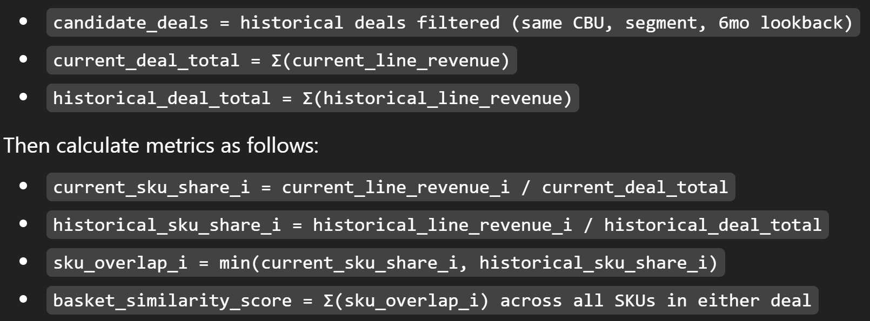
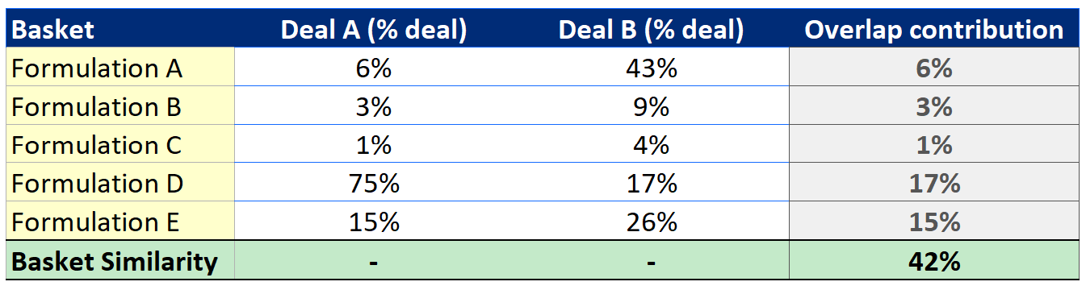
Comparable deals are identified using a simple basket similarity methodology Measures the shared portion of each basket to surface historical deals that are commercially similar and easy to explain
4D
Logic
Details
Definition: won deals in the same CBU and customer segment over the last 6 months, ranked by basket similarity score
Basket similarity score:
Compare current deal against each historical deal
Calculate each SKU as a % of total deal value in both baskets
Take the lower of the two shares for each SKU
Sum across SKUs to get total shared basket %
Fallbacks:
First relax CBU
Then extend lookback from 6 to 12 months
Then move from exact SKU to product family overlap
Assumptions:
Historical deals dataset is available and sufficiently populated, including:
Deal-level (customer ID, customer segment, CBU, deal date) and;
Line-level (SKU, product family, price, quantity)
Historical line items can be grouped: SKU and product family definitions are standardized across datasets
Exclusions: duplicate, cancelled, and obsolete transactions can be removed cleanly
Worked example

Slide 8
Comparable deals | Analytics base table
Source all Sales Orders (or live Price Exceptions as a fallback) from F&O databases
Base table to construct from F&O databases which will be used for backend/frontend calculation of similarity scores
Backend/Frontend calculation follows steps in the following slide to implement the methodology
Deal-level info
SKU-level info
Calculated fields
Deal ID | Customer ID | Customer Segment | CBU | Deal date | Product Family | SKU | Quoted price | Target price | Quoted quantity | Expected frequency | Proportion of deal | Discount % | Annualized Bid Value | wAvg Discount %
Deal_12345 | ABC | D | Ind. Solutions | 4/27/2026 | PL1: amine-based control oils | 2033-68 - NXT 717 - PREM AM-RC OIL -- 55G DRUM | 50 | 75 | 100 | Bi-yearly | 66.7% | 33% | $15.000 | 27.6%
Deal_12345 | ABC | D | Ind. Solutions | 4/27/2026 | PL1: fire resistant fluids | SEAL SAFE FRH-46-WG 208L/55G -- 55G DRUM | 2000 | 2500 | 1 | Bi-yearly | 26.7% | 20% | $15.000 | 27.6%
Deal_12345 | ABC | D | Ind. Solutions | 4/27/2026 | PL1: neutral process cleaners | BIO-TEC 225 NEUTRAL -- 5G PAIL | 250 | 250 | 2 | Bi-yearly | 6.7% | 0% | $15.000 | 27.6%
… | … | … | … | … | … | … | … | … | … | … | … |  | … | …

Slide 9
Comparable deals | Backend/frontend logic
Create live basket table: One row per live deal SKU, with each SKU’s proportion of the total live basket.
Join to historical transactions: Inner join the live basket to the historical transaction table on SKU, keeping only historical rows where the SKU exists in the live basket.
Calculate overlap contribution: Keep the lower value between live proportion and historical proportion as the SKU-level overlap contribution.
Roll up to deal level: Sum overlap contributions by historical Deal ID to calculate the basket similarity score, then rank deals highest to lowest.
Add benchmark fields: Add back deal-level fields like annualized bid value and weighted average discount %, which are used for the comparable deals output and scatterplot.
Similarity score calculation
Final output for PriceAdvisor
Deal ID | SKU | Live share | Hist. share | Overlap (min) | Similarity score
Deal_12345 | SKU A | 60% | 30% | 30% | 50%
Deal_12345 | SKU B | 40% | 20% | 20% | 50%
Deal_67890 | SKU A | 60% | 70% | 60% | 60%
Deal_99999 | SKU B | 40% | 80% | 40% | 40%
Rank | Deal ID | Similarity score | Ann. Bid Value | wAvg Discount
1 | Deal_67890 | 60% | $40k | 18.0%
2 | Deal_12345 | 50% | $15k | 27.6%
3 | Deal_99999 | 40% | $25k | 35.0%

